Slide 1

Tangerine Project

Slide 2
Table of Contents
Overview
OMS (Order Management System)
IMS (Inventory Management System)

Slide 3
Overview
S.No | CORE FLOW | DESCRIPTION | APPLICATIONS
1 | Item Data Feed | E-Comm IMS will process Item feed from Supply chain, Retail and Catalog and store them in Cosmos DB instance. | EDIS Catalog E-Comm IMS
2 | Send Item load to TakeOff MFC (Once a Day) | For each MFC store, E-Comm IMS Application will generate daily Item feed files (Item Feed at ROG level and also at each store level) to process and store. | E-Comm IMS TakeOff MFC
3 | Inventory Snapshot flow | Takeoff MFC will expose a API to provide MFC's Inventory snapshot which includes current inventory in hand, future orders and expected replenishments. E-Comm IMS will make REST call for each MFC store, fetch the inventory snapshot, process and store this data. During Item Add/ Check-out in ShopSite, they will make a call to EComm OMS to confirm if Inventory is available for all cart items or not. | E-Comm IMS TakeOff MFC ERUMS
4 | Order flow (Create/ Update/Cancel) | This process covers the End-to-End Order flow for OMS orders. | ERUMS E-Comm OMS Route Planner

Slide 4
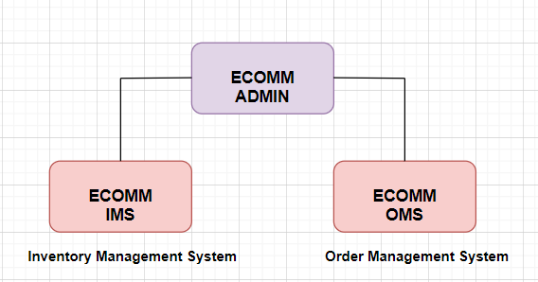
OVERVIEW

Slide 5
Types of Applications
E-Comm Admin: This web application will be used by Store Admins/ Merchants to do maintenance activities on IMS and OMS data.
E-Comm IMS (Inventory Management System): This custom solution will be used to manage and store Item details for all MFC stores.
E-Comm OMS (Order Management System): Currently the existing Order ﬂow uses Manhattan product which is vey diﬃcult to manage/ modify. We have custom needs for MFC order ﬂows.

Slide 6
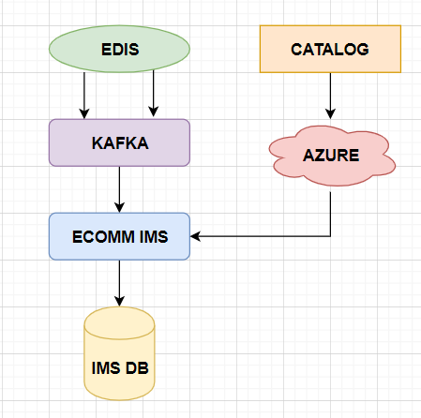
IMS:ITEM DATA FEED [ FROM EDIS ]

Slide 7
Types of Item Feeds
Supply
Retail
Catalog
IsOrderable
Store Authorizised Item

Slide 8
The ‘Supply Item Master’ data feed will be updated with the items list in the Item.
The ‘Retail Item Master’ data feed will be updated in Item and Store with all the details of the item and availability in the store.
‘Catalog’ System sends us complete feed Json (full snapshot of few attributes, for each MFC) via Azure File Store.
E-Comm IMS picks up all the Item feed ﬁles (one of each MFC) from Azure Files, parses the data and stores it into IMS DB.

Slide 9
‘IsOrderable’ finds the availability of the item in the store for confirming an order.
‘StoreAuthorization’ looks into the availability of the storeID in the list provided and ignores the message if missing.

Slide 10
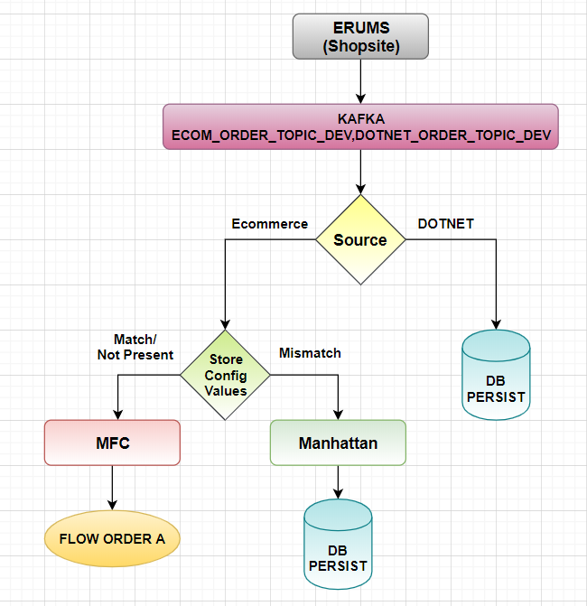
OMS:ORDER FLOW [Create/ Update/Cancel]
OMS_Flow Diagram

Slide 11
OMS : ORDER CREATE
User places an Online order for an MFC enabled store. ERUMS sends order details to Kafka topic.
For all ‘Order Events’ , E-Comm OMS will send a short JSON Message to new Kafka/MQ topic.
E-Comm OMS (E-Comm Order Management System) reads the order message from Kafka and processes it.
E-Comm OMS send the Order details to TakeOﬀ MFC via 'setCustomerOrder' REST API exposed by TakeOﬀ.

Slide 12
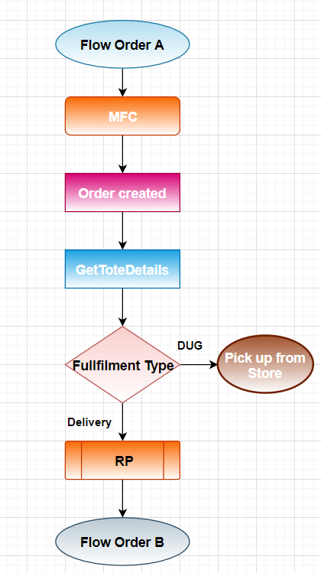
MFC_Flow Diagram
RP: Route Planner

Slide 13
MFC Flow :
An MFC order type gets created when there are no store config values placed in order or the config values matches with the order values. Ex:Store ID.
When the Store config values mismatches with the order config values ,the order is created as a Manhattan order and gets persisted in DB.
After waiting for ﬁxed timeframe (say 60 seconds), EComm OMS makes a call to Takeoﬀ REST API to fetch tote estimates.
E-Comm OMS sends Tote estimate (provided by TakeOﬀ MFC) details to Route Planner.

Slide 14
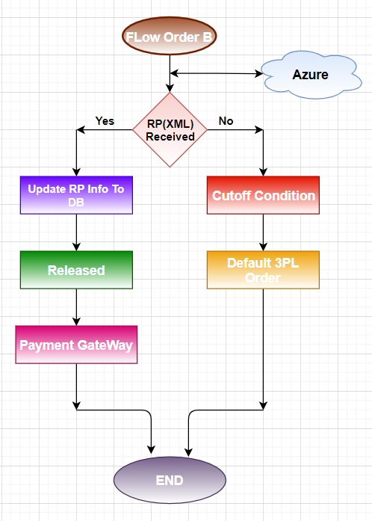
RP_Flow Diagram

Slide 15
Description
The Route planner updates OMS with all the details in the form of ‘XML’ from Azure storage.
Updated with RP information, the order is marked as ‘Released’ for Delivery.
With No updation of the RP within the ‘cut off time’, all the Delivery orders are marked to ‘Default 3PL’ order.
Cutoff job runs for every 25 minutes

Slide 16
OMS : Order Update
By Default, Creating an order will be marked as ‘IsActive’.
Any changes made to the old order will then be updated and marked
as ‘IsActive’ and the initial order goes to ‘InActive’ state.

Slide 17
Cancellation Procedure
Cancel:
Customer Cancel(By Customer)
EOD Cancel (Manhattan)
DC Cancel (MFC)
Packaged/Staged
Back Order Cancel (Shortage of item)
DELIVERY : If the cancelled order is Delivery we need to send order to RP.
DUG : Just update the status in "order" collection.

Slide 18
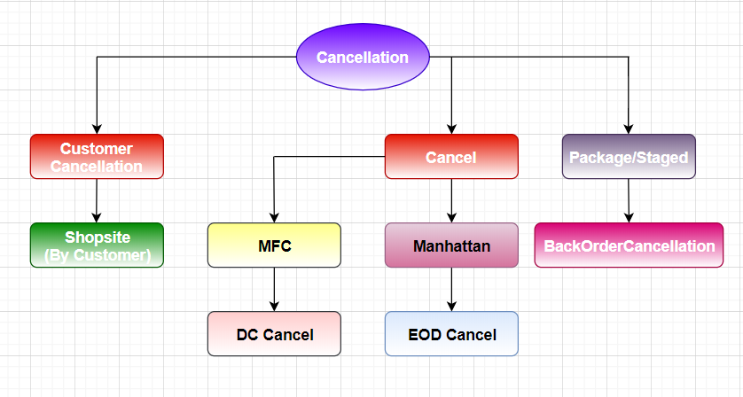
Cancellation Flow Diagram

Slide 19
Abbreviations
DB : Data Base
IMS : Inventory Management System
OMS : Order Management system
MFC : Micro Fullfilment Center
EDIS : Ecommerce Data Integration Service
ERUMS : Ecommerce Rearchitecture using Microservices
RP : Route Planner
DC : Direct Cancel
EOD : End of Day

Slide 20
Questions?
Thank you!

