Slide 1
Apache Airflow with Docker
By
Junaid Ahmed

Slide 2
Context
Introduction
Apache Airflow with Docker setup
A simple code walk-through

Slide 3
Introduction
Apache Airflow:
Airflow is a platform to programmatically author, schedule, and monitor workflows or data pipelines.
The project joined the Apache Software Foundation’s incubation program in 2016.
A workflow (data-pipeline) management system developed by Airbnb
  A framework to define task and dependencies in python
  Executing, scheduling and distributing tasks across worker nodes.
  View of present and past runs, logging feature.
  Extensible through plugins.
  Nice UI, possibility to define REST interface.
  Interact well with database.
Used by more than 200 companies: Airbnb, Yahoo, Paypal, Intel, Stripe

Slide 4
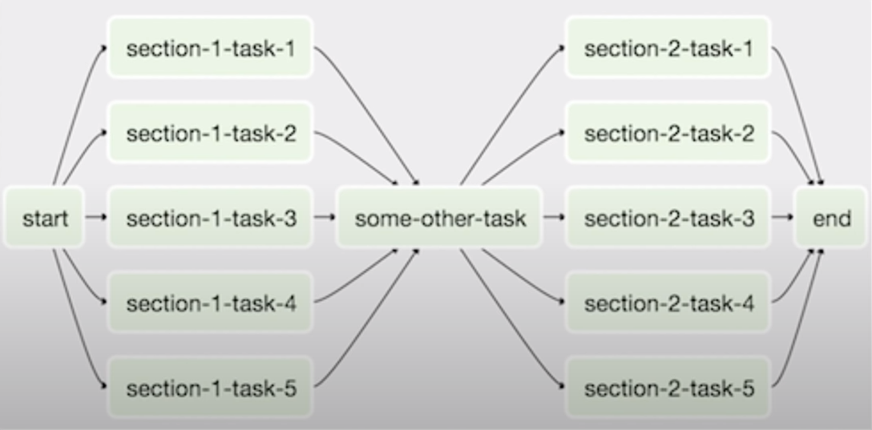
Airflow DAG
Airflow DAG:
A workflow as a Directed Acyclic Graph (DAG) with multiple tasks which can be executed independently.
Airflow DAGs are composed of Tasks.

Slide 5
Context
Advantages:
Can handle upstream/downstream dependencies gracefully (Eg: upstream missing tables)
Easy to reprocess historical jobs by date, or re-run for specific intervals.
Jobs can pass parameters to other jobs downstream.
Handle error and failures gracefully. Automatically retry when a task fails.
Ease of deployment of workflow changes (continuous integration)
Integrations with a lot of infrastructure (Hive, Presto, Druid, AWS, Google cloud etc..)
Data sensors to trigger a DAG when data arrives.
Job testing through Airflow itself.
Accessibility of log files and other meta-data through the web GUI.
Implement trigger rules for tasks.
Monitoring all jobs status in real time + Email alerts.
Community support.

Slide 6
Applications
Applications
Data Warehousing:
  Cleanse, organize, data quality check, and publish/stream data.
Machine Learning:
  Automate machine learning workflows.
Growth Analytics:
  Compute metrics around guest and host engagement as well as growth accounting.
Experimentation:
  Compute A/B testing experimentation frameworks logic and aggregates.
Email Targeting:
  Apply rules to target and engage users through email campaigns.
Sessionization:
  Compute clickstream and time spent datasets.
Search:
  Compute search ranking related metrics.
Data Infrastructure Maintenance:
  Database scrapes, folder cleanup, applying data retention policies etc.

Slide 7
Apache Airflow with Docker - setup
Initially we need to install and configure Docker in our local machine.
Docker Setup:
Step1: Create an account on docker hub
Step2: Install Docker Desktop and login with our credentials.
Apache Airflow Setup:
Step1: Create a docker compose file with all the services and configurations.
Step2: Have some sample dags to be tested.

Slide 8

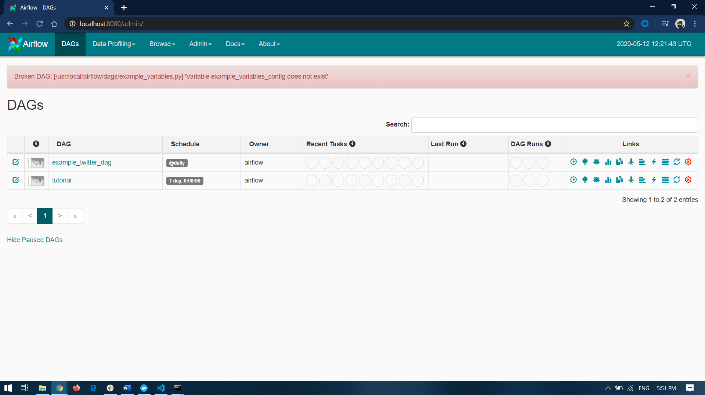
Basic Commands
Docker:
  To initiate or build the docker compose file use: $ docker-compose -f fileName up –d
  To check the logs : $ docker-compose –f filename logs
  To check the services running: $ docker-compose -f fileName ps
  To shutdown the services : $ docker-compose -f fileName down
Airflow:
To land on Airflow homepage, visit the local host with a specified port in the docker compose file. For Apache Airflow, it all comes down to the dag files.

Slide 9
Thank You
“ Code is like humor. When you explain it, it’s bad.” – Cory House

