Slide 1
Intro to git(hub)

Slide 2
Version control
Allows users to ”track changes” and preserve the history of a file
Tracks both insertions and deletions
Helpful for tracking your own work and collaborators’ work

Slide 3
Configuring git
Need to configure username, email, and default text editor.
Alternative editor options include vim, emacs, and more

Slide 4

Creating repositories
Make a new project directory and navigate to the directory.
Same as ”create new folder”

Slide 5
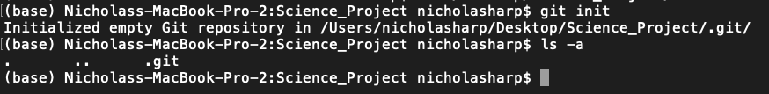
Initializing a repository
You must initialize a repository for git to work. Git will track any subdirectories that already exist or new ones that you make.
Git creates a .git file which is where it stores information about your project. If you delete this file, you will lose the entire history.

Slide 6
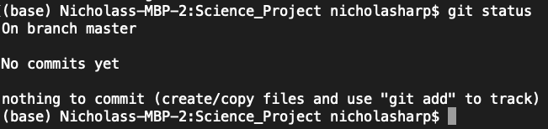
Checking your repository’s status
If your repository matches git’s last version, then you’ll see that there is nothing to commit.

Slide 7
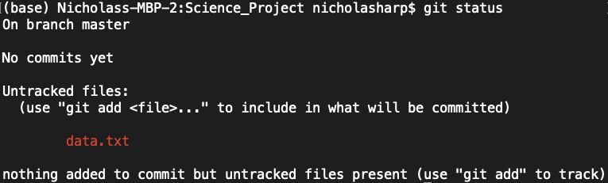
Checking your repository’s status
If your repository has a new file that git is not tracking, then you’ll see that there is an untracked file to commit.

Slide 8
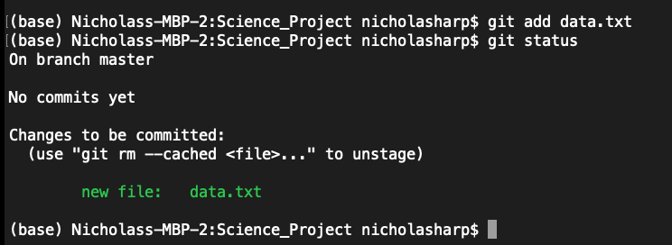
Adding
Add files for git to track them

Slide 9
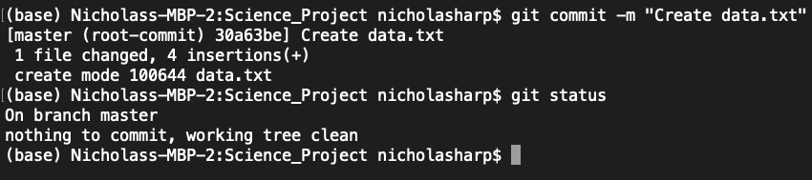
Committing changes
After adding a file, you need to commit every time you want git to created a new tracked version.
You can use the “-m” flag to add a message describing your changes.

Slide 10
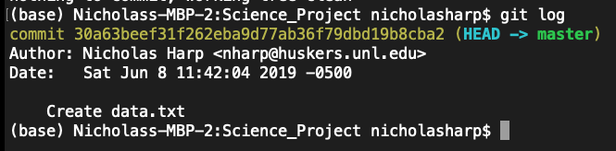
Check the log to see your previous commits

Slide 11
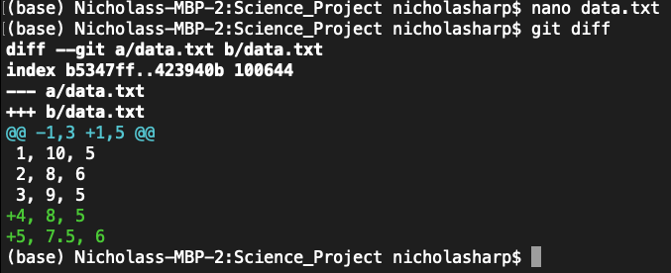

Slide 12
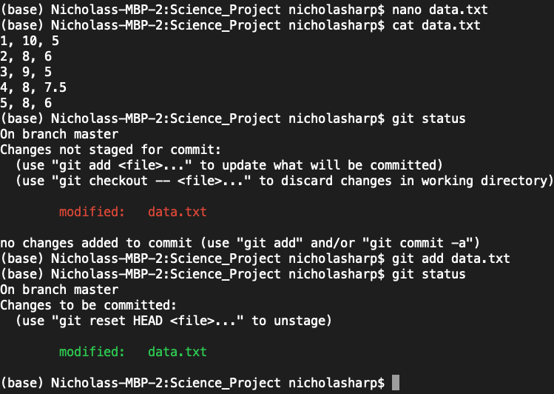

Slide 13
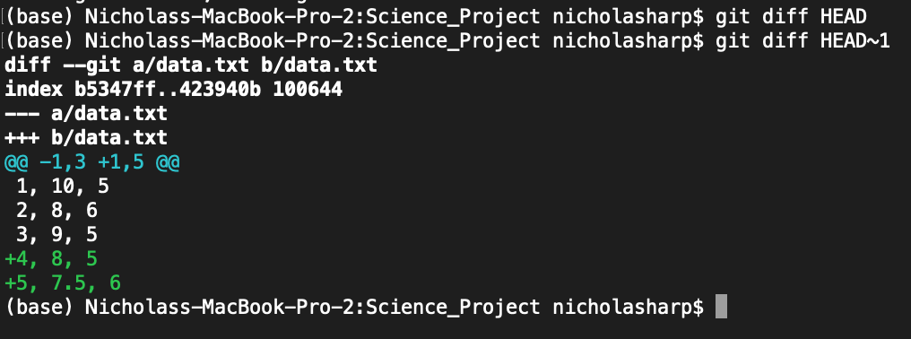
Comparing earlier versions
You can use identifiers to refer to commits, or you can refer to the most recent commit using the HEAD command. HEAD~1 = Previous commit

Slide 14
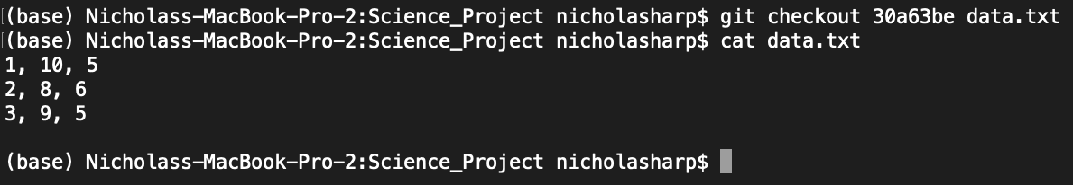
Restore earlier versions of files
Use ”checkout” to restore earlier versions of a file. Provide the commit identifier for the version you want to restore.
Use the first seven digits of the identifier

Slide 15
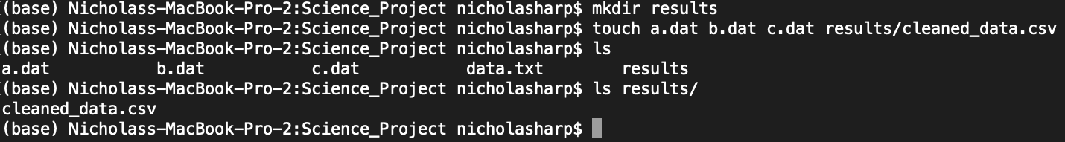
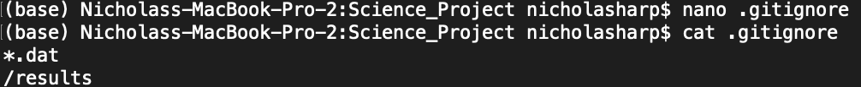
Ignoring files
Use .gitignore to ignore files
Ignore entire subdirectories or file types

Slide 16
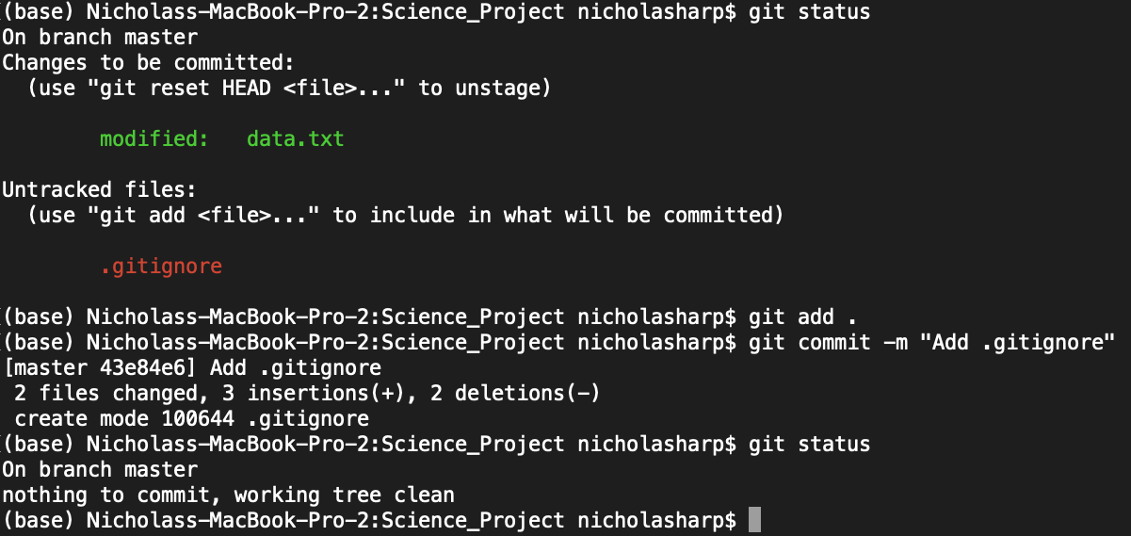
Ignoring files

Slide 17
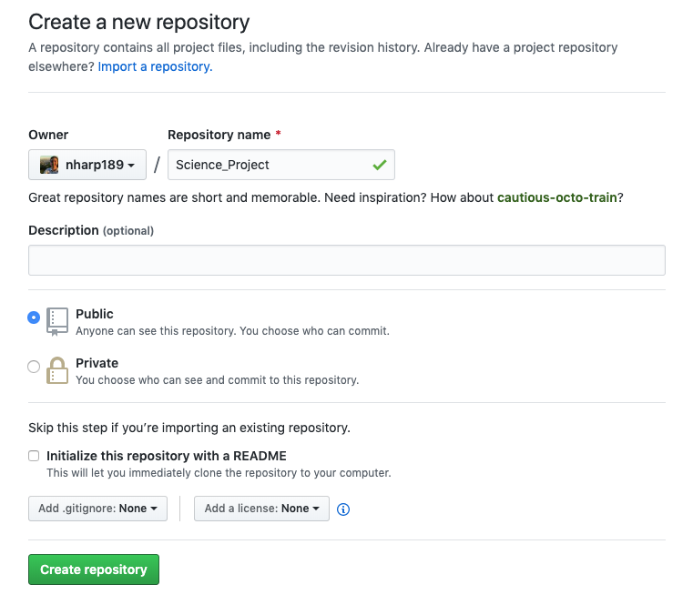
github
Create a new repository
Public vs. private
Can add README or .gitignore

Slide 18
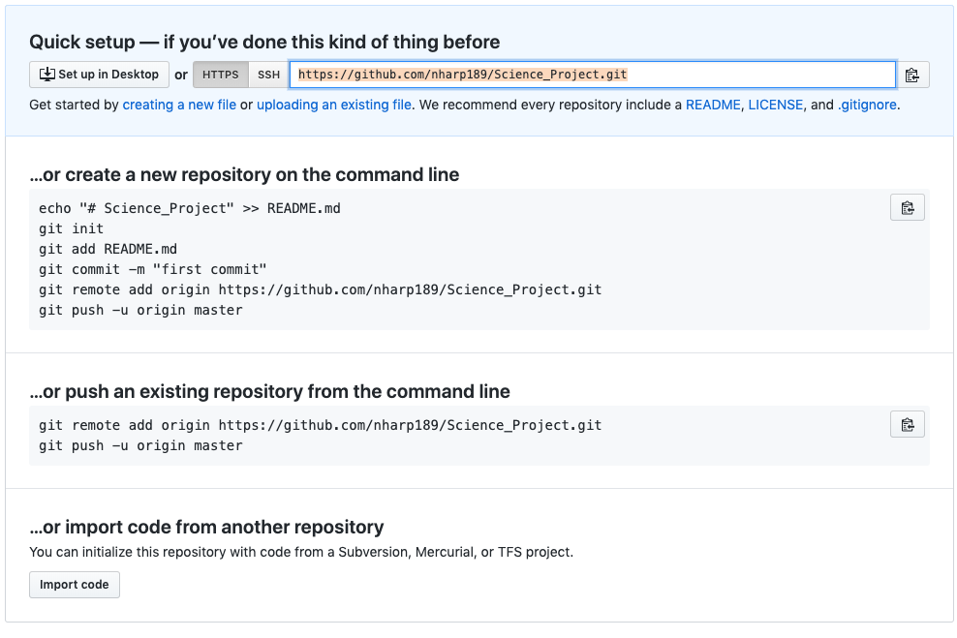
github
Copy either the https or ssh path.
ssh requires keys, but saves time with passwords

Slide 19
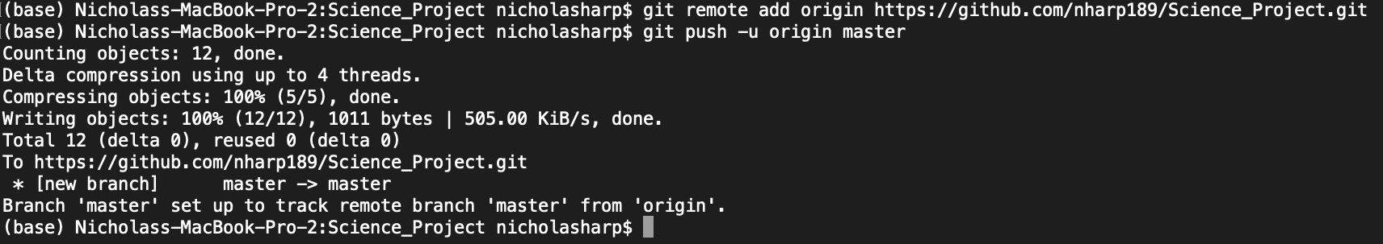
github
Use “ git remote add origin https/ssh” to setup the online repository.
“Push” to send changes to the online repository and “pull” to update your local repository.

Slide 20
