Slide 1
Domain-specific working memory loads selectively increase negative interpretations of surprised facial expressions
Nicholas R. Harp
University of Nebraska-Lincoln

Slide 2
Background overview
People differ in interpretations of emotionally ambiguous faces
Cognitive demands impair decision making but do not affect valence bias
Maybe it has to do with domain-specificity (emotion)

Slide 3

Facial expressions are social signals
Communicate emotion and lead to emotional experience in perceivers _{(Frith, 2009)}
We often make judgments about faces
Personality traits (Bar, Neta, & Linz, 2006; Todorov, Baron, & Oosterhof, 2008)
Aesthetics _{(Said & Todorov, 2011)}
Emotions _{(Carroll & Russell, 1996)}
These judgments guide downstream behavior, such as approach-avoidance decisions (Krieglmeyer, Deutsch, De Houwer, & De Raedt, 2010 )

Slide 4

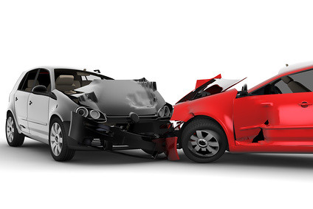


Valence bias
Individuals differ in their interpretations of some faces (Neta et al., 2009; Petro, Tong, Henley, & Neta, 2018)
Some faces are clearly positive or negative, but others (e.g., surprise) are emotionally ambiguous
This individual difference is known as valence bias (Neta, Kelley, & Whalen, 2013; Neta et al., 2009; Neta & Whalen, 2010)

Slide 5
Initial negativity hypothesis
The initial negativity hypothesis suggests that everyone perceives surprise as negative initially (Neta, Davis, & Whalen, 2011; Neta et al., 2009; Neta & Whalen, 2010; Petro et al., 2018)
Reaction times are faster on average for negative interpretations than positive interpretations _{(Neta et al., 2009)}
Low spatial frequency images of surprised faces are judged more negatively than high spatial frequency _{(Neta & Whalen, 2010)}
Surprised faces are more quickly detected amongst happy faces _{(Neta et al., 2011)}

Slide 6
Positivity requires regulation
Positive interpretations take longer and instructions to delay responding shifts biases towards positivity (Neta et al., 2009; Neta & Tong 2016)
vmPFC and amygdala are inversely related _{(Kim et al., 2003)}
More amygdala activity indicates more negative bias
vmPFC has been implicated in emotion regulation
Regulatory strategies can be costly _{(Richards & Gross, 2000)}

Slide 7
Background overview
People differ in interpretations of emotionally ambiguous faces
Cognitive demands impair decision making but do not affect valence bias
Maybe it has to do with domain-specificity (emotion)

Slide 8

Cognitive loads
Cognitive resources are limited (Baumeister & Heatherton, 1996; Kahneman, 1973; Storbeck, 2012; Scalf, Torralbo, Tapia, & Beck, 2013)
Cognitive load can hinder performance
Learning _{(Chandler & Sweller, 1991)}
Facial expression categorization _{(Ahmed, 2018)}

Slide 9
Cognitive loads and emotion
Increased working memory load and cognitive demands reduce subjective emotional experience and activation of emotion-related regions (i.e., amygdala) _{(Van Dillen et al., 2009)}
Performance on cognitively demanding tasks decreases when the demands take on emotional meaning _{(Blair et al., 2007)}
Cognitive loads reduce age-related positivity bias (Mather & Knight, 2005; Knight et al., 2007)

Slide 10
Background overview
People differ in interpretations of emotionally ambiguous faces
Cognitive demands impair decision making but do not affect valence bias
Maybe it has to do with domain-specificity (emotion)

Slide 11
Cognitive loads and valence bias
Previous work has shown that cognitive loads do not alter valence bias (Mattek, Whalen, Berkowitz, & Freeman, 2016)
Numeric strings were used to induce cognitive load via working memory maintenance.
Valence bias may be sensitive to cognitive loads that directly affect the neural systems used for regulation
Other work has shown that a given task may increase activation in different brain areas depending on the affective qualities of the task (Egner, Etkin, Gale, & Hirsch, 2008)

Slide 12
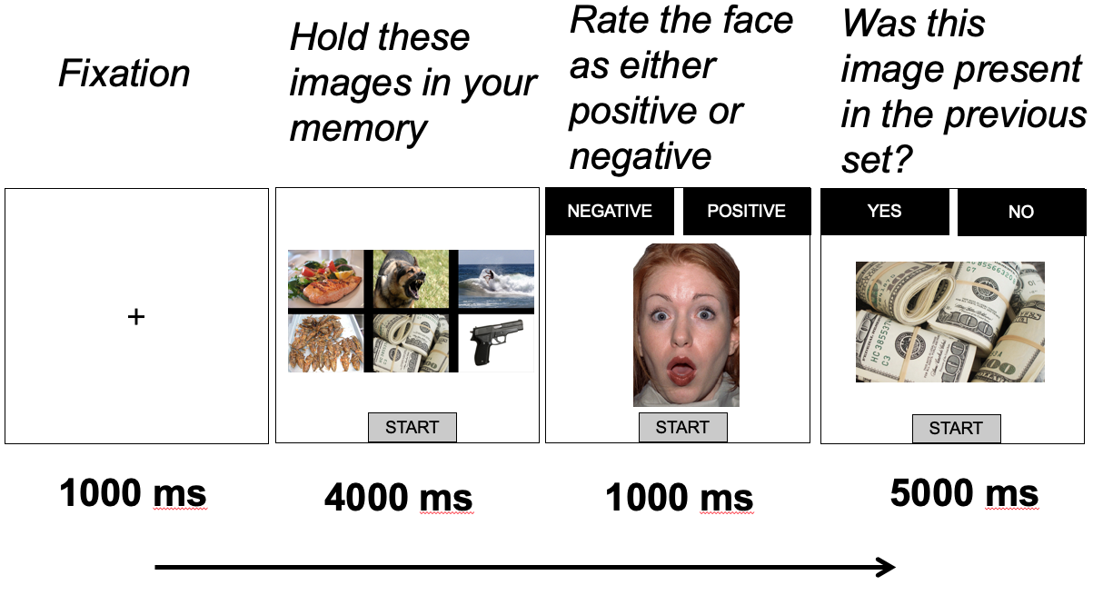
Methods - Procedure

Slide 13
Methods - Procedure

Slide 14
Methods - Procedure

Slide 15
Methods - Procedure

Slide 16
Hypotheses
No effect of load (low vs. high)
Effect of load type (emotional vs. non-emotional)
High loads with emotional information will result in more negative interpretations than similar low loads

Slide 17
Methods – Participants & Stimuli
Sample of 50 college students
Age_{M} = 18.82, Age_{SD} = 1.19
All white without Hispanic/Latnix ethnicity
41 female
Face stimuli included 34 unique identities
Angry, happy, surprised
Scene stimuli included 288 scenes (IAPS)
MouseTracker used to capture response trajectories

Slide 18
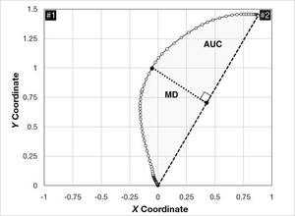
MouseTracker
Maximum deviation (MD) is the distance from a direct trajectory to the chosen response
MD is a measure of response competition
Image from mousetracker.org

Slide 19
Data analysis
Reaction time outliers removed (> 3 SDs from mean)
Removed incorrect memory probe trials (manipulation failure)
Percent negativity calculated as proportion of negative responses out of total surprise ratings
Distributions of percent negativity across conditions was non-normal (all p’s < .001); negatively skewed

Slide 20
Data analysis – multilevel modeling
Repeated measures leads to statistical dependency within subjects
Robust standard errors used to account for violations of normality
Model building approach using X² difference tests at each step to assess model fit

Slide 21
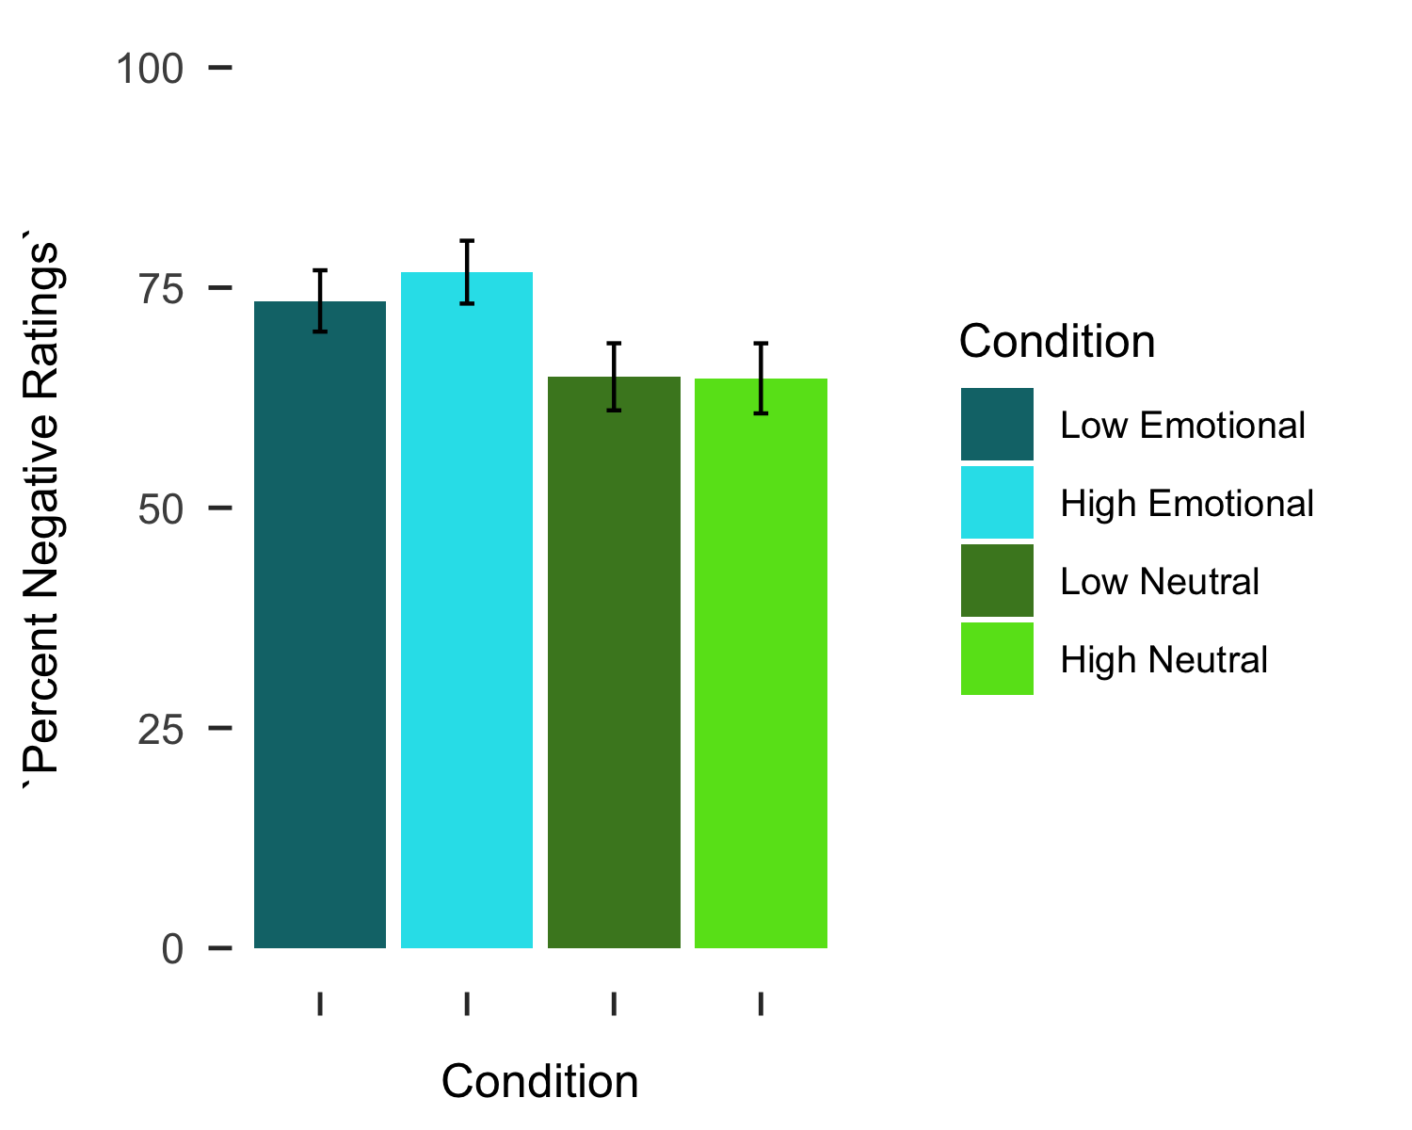
Results – ratings

Slide 22
Results – ratings
Random intercept model accounts for interindividual variability
Effect of load type: (ß₁₀ = .10, t(149) = 7.82, p < .001; emotional > neutral)
*

Slide 23
Results – ratings
Level-1 Model:
PerNeg_{ti} = π_{0i} + π_{1i}*(Load Type_{ti}) + e_{ti}
Level-2 Model:
π_{0i} = β₀₀ + r_{0i}
π_{1i} = β₁₀
Random intercept model accounts for interindividual variability
Effect of load type: (ß₁₀ = .10, t(149) = 7.82, p < .001; emotional > neutral)
No effect of load: (t(148) = .92, p = .361)
Interaction: (t(147) = .83, p = .406)

Slide 24
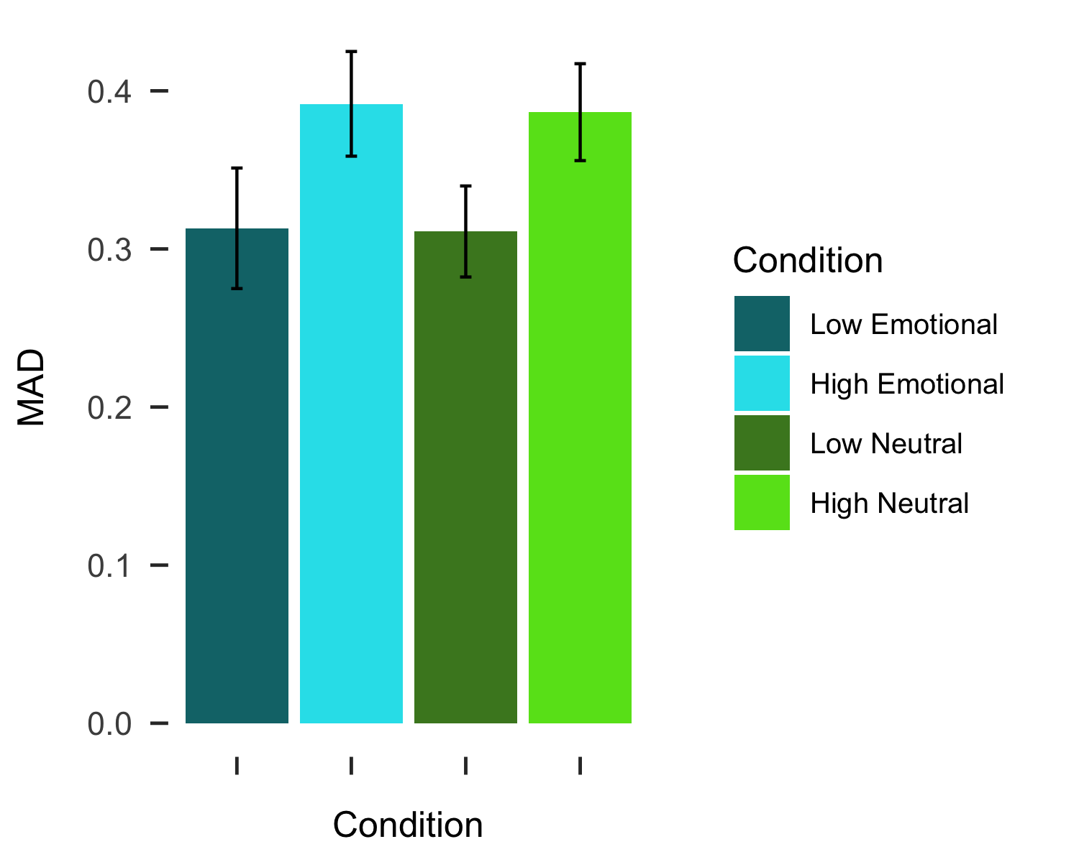
Results – MD

Slide 25
Results – MD
*
Random intercept model accounts for individual differences in average MD
No effect of load type (t(148) = .143, p = .886)
Effect of load: (ß₁₀ = .08, t(149) = 2.81, p =.006; high > low)
Interaction: (t(147) = .07, p = .994)

Slide 26
Results – MD
Level-1 Model:
MD_{ti} = π_{0i} + π_{1i}*(Load_{ti}) + e_{ti}
Level-2 Model:
π_{0i} = β₀₀ + r_{0i}
π_{1i} = β₁₀
Random intercept model accounts for individual differences in average MD
No effect of load type (t(148) = .143, p = .886)
Effect of load: (ß₁₀ = .08, t(149) = 2.81, p =.006; high > low)
Interaction: (t(147) = .07, p = .994)

Slide 27
Working Memory Load
Low load
High load

Slide 28
Discussion
Valence bias shifts towards negativity when working memory loads contain emotional information (domain-specific)
Maximum deviation (response competition) increases under high working memory loads (domain-general)

Slide 29
Discussion
Valence bias shifts towards negativity when working memory loads contain emotional information (domain-specific)
Maximum deviation (response competition) increases under high working memory loads (domain-general)

Slide 30
Domain-specific effects
In this working memory paradigm, loads with emotional properties shifted valence bias towards negativity
The initial negativity hypothesis suggests that regulatory resources are needed for positive interpretations
Working memory loads with emotional properties may tax these resources specifically

Slide 31
Domain-specific effects
Tasks with emotional properties recruit emotion-related neural resources (Etkin et al., 2006; Neta et al., 2011)
Emotional expression n-back task elicits higher levels of amygdala activity than identity task _{(Neta et al., 2011)}
Emotional Stroop task related to higher levels of ACC activity _{(Etkin et al., 2006)}
ACC-Amygdala activity is positively correlated in individuals with high anxiety _{(Kujawa} _{et} _{al.,} ₂₀₁₇₎

Slide 32
Discussion
Valence bias shifts towards negativity when working memory loads contain emotional information (domain-specific)
Maximum deviation (response competition) increases under high working memory loads (domain-general)

Slide 33
Domain-general effects
High working memory loads, regardless of emotional properties, resulted in larger MDs
MDs are conceptualized as response competition and large MDs may signal a type of distraction effect (Spivey, Grosjean, & Knoblich, 2005)
Previous work did not show this effect of load, but typical response trajectories were mitigated _{(Mattek et al., 2016)}

Slide 34
Domain-general effects
Ambiguity resolution relies on a domain-general task control network: cingulo-opercular network _{(Neta et al., 2013)}
The cingulo-opercular network is responsive to cognitively demanding tasks (requiring attention and control) (Duncan & Owen, 2000; Nee, Wager, & Jonides, 2007)
High cognitive loads, regardless of load type, may have taxed this network and resulted in larger MDs

Slide 35
Limitations
Working memory performance near ceiling which may have weakened effects
Lack of neuroimaging data to understand brain basis of effects
Future work should explore this

Slide 36
Conclusions
Conceptual replication that increasing cognitive demands through working memory load does not affect valence bias
Demonstrated a domain-specific effect of cognitive loads shifting valence bias towards negativity
Demonstrated a domain-general effect of cognitive loads altering response trajectories

Slide 37
Acknowledgments
Maital Neta
Abigail Schneff
Nathan Pettid
CAN Lab

