Slide 1
Front end development with React
Pelagia Sykdodi

Slide 2
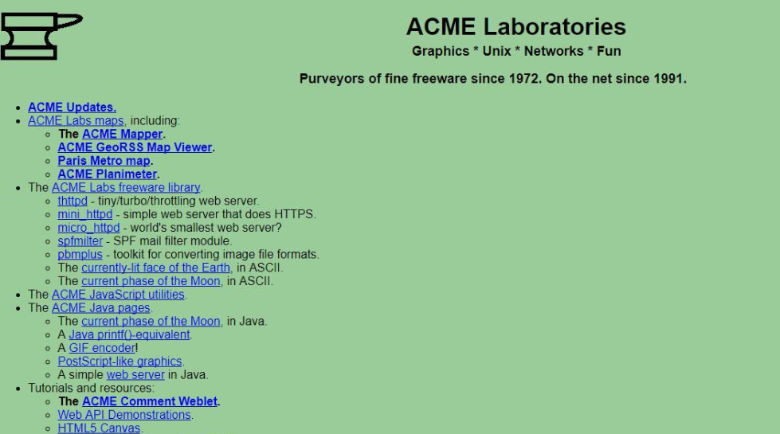


Slide 3
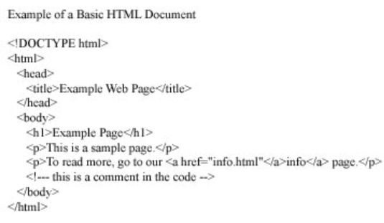
HTML
HTML stands for Hypertext Markup Language
HTML elements are the building blocks of HTML pages
HTML elements are represented by <> tags

Slide 4
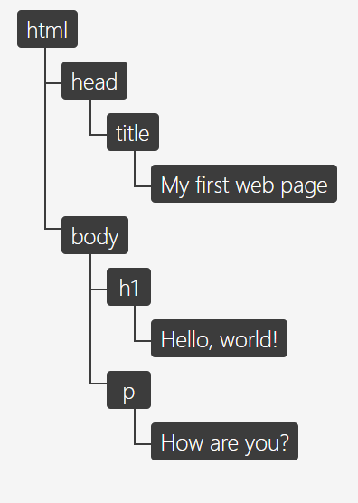
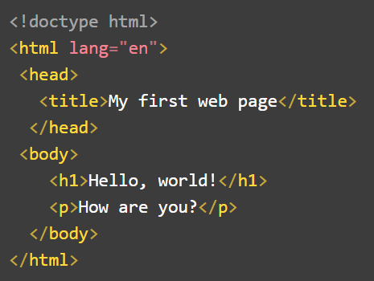
HTML - DOM
The DOM is an object-based representation of the source HTML document.
DOM model can be used by various programs

Slide 5
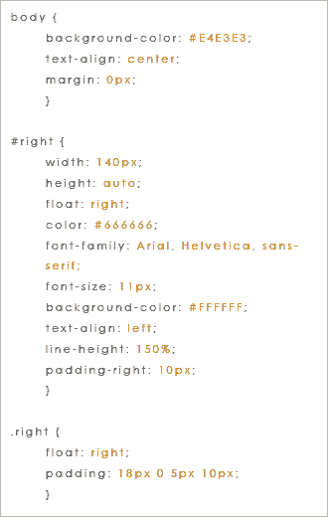
CSS
CSS stands for Cascading Style Sheets.
CSS is designed to enable the separation of presentation and content.
Layout, font, colors

Slide 6
JavaScript
1
HTML describes the page
CSS controls and customizes the look of the page
JavaScript adds behavior, makes elements programmable and dynamic
HTML
2
3
CSS
JavaScript

Slide 7
JavaScript
JavaScript was created for NetScape
JavaScript is standardized by Ecma International (ECMAScript versions).
Today we are using ES6 and ES5 in web browsers.

Slide 8
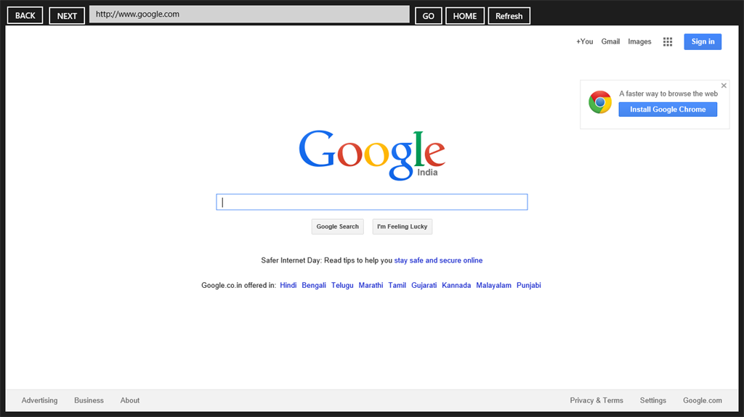

JavaScript
JavaScript runs on browsers.
HTML
CSS
engines
JavaScript

Slide 9
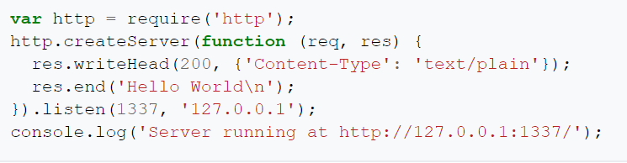
Node.js
Node.js is a run-time environment where we can run a JavaScript Program as a stand alone application.
In other languages and platforms, you can pass off I/O to separate threads or perform non-blocking I/O, but you have to go out of your way to do this.
In Node.js this is a core platform feature and should be embraced.

Slide 10
Npm packages
In 2010 a package manager was introduces for Node.js
Developers can publish their libraries as packages and make use of them.

Slide 11
Yarn
Yarn is a new package manager
https://yarnpkg.com/lang/en/docs/install/#windows-stable

Slide 12
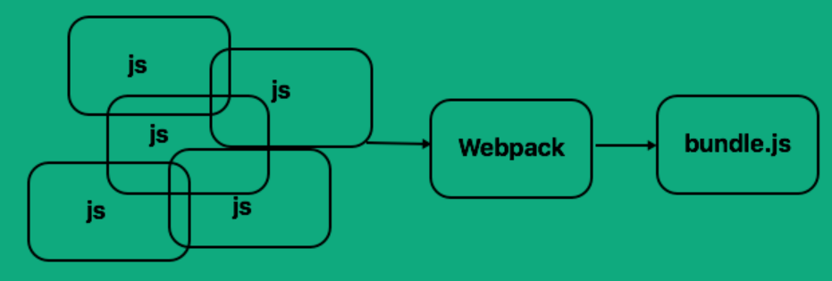
Webpack
Webpack builds everything together
Webpack is a module bundler. It takes disparate dependencies, creates modules for them and bundles the entire network up into manageable output files.

Slide 13
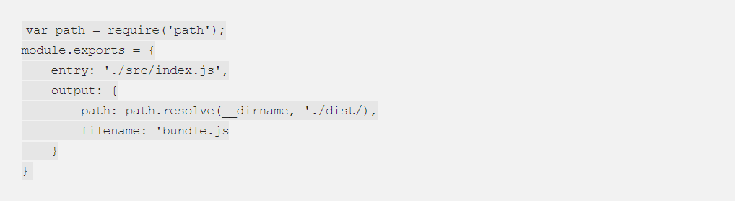
Webpack
Initial configuration

Slide 14
React can be used also with TypeScript
- Open source project with Microsoft's patronage
- Specially designed tool for small scripts
- Supports classes, interfaces & modules.
- Compiled JavaScript runs in any browser
- Allows cross-compilation
- You can extend JavaScript for writing large apps
- Adds support for classes, interfaces, and modules
- TypeScript supports JS libraries & API Documentation
- It is a superset of JavaScript
- It is optionally typed scripting language
- It can be converted into plain JavaScript Code
- Better code structuring , object-oriented programming
- Allows better development time tool support
- It can extend the language beyond the standard decorators, async/await

Slide 15
REACT
React is JavaScript language for User Interface development.
With React we can build reusable UI components.
React is supported by Facebook and the open source community for React is big and active.
With React is used a Virtual DOM which checks for updates on the real DOM and updates only the part that changes, not the entire DOM

Slide 16
REACT
JSX stands for JavaScript XML
Example:
const element = <h1> This is an element </h1>
JSX extends JavaScript with the latest features of ES6.
Babel is used in React to convert JSX to JS.
Babel is a transpiler which converts ES6 to ES5 code and resolves the cross-browser compatibility.

Slide 17
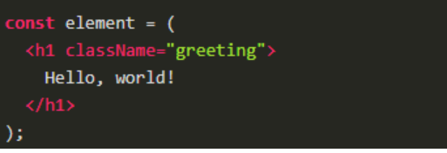
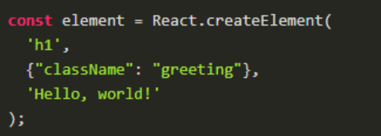
REACT
JSX stands for JavaScript XML

Slide 18
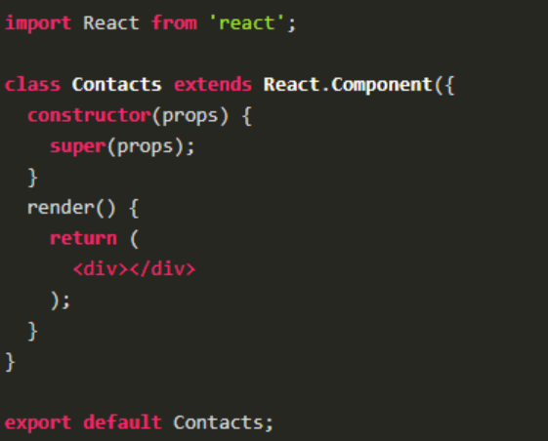
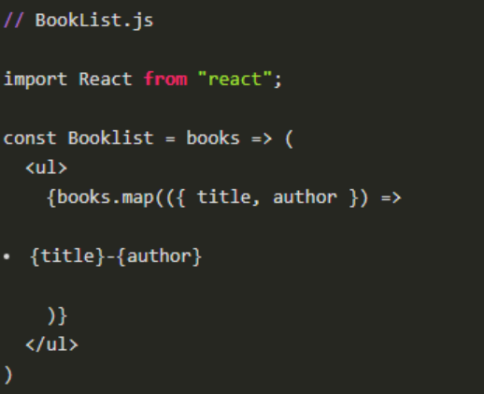
REACT
React Component vs Class

Slide 19
REACT
React props pass from one component to another

Slide 20
REACT
React component state can change the way the component is rendered

Slide 21
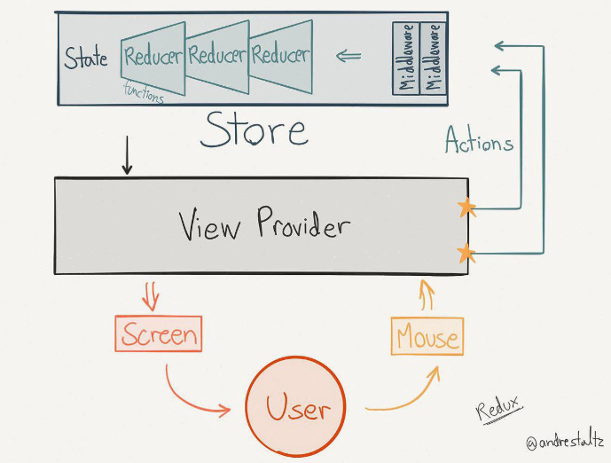
REACT

Slide 22
REACT
VS code extensions
Beautify css/sass/scss/less
CSS formatter
Debugger for Chrome
Docker
DotENV
EditorConfig for VS Code
ESLint
Git History
Git Lens
Jest
Jest Snippets
Prettier Code formatter
SCSS Formatter
SCSS-lint
Shell-format
Spell Right
Standard JS

Slide 23
Useful links
https://github.com/microsoft/TypeScript-React-Starter
https://www.makeuseof.com/tag/what-is-javascript/
https://thibaultlaurens.github.io/javascript/2013/04/29/how-the-v8-engine-works/
https://reactjs.org/docs/hello-world.html
Wes-Bos Course React for beginners
Tutorial from React page
https://reactjs.org/tutorial/tutorial.html#function-components

