Slide 1
Genomic Epidemiology
Norman Hassell
Centers for Disease Control and Prevention

Slide 2
Disclaimer
The findings and conclusions in this presentation are those of the authors and do not necessarily represent the official position of the Centers for Disease Control and Prevention.
Use of trade names and commercial sources is for identification only and does not imply endorsement by the U.S. Department of Health and Human Services.
References to non-CDC sites on the Internet do not constitute or imply endorsement of these organizations or their programs by CDC or the U.S. Department of Health and Human Services. CDC is not responsible for the content of pages found at these sites.

Slide 3
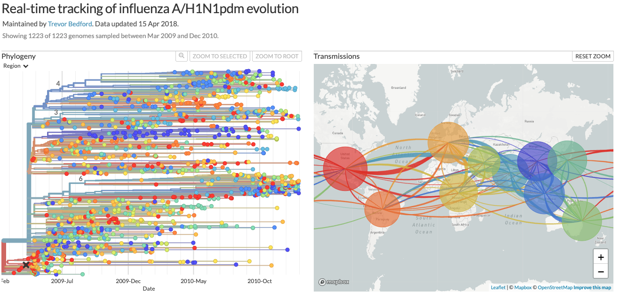
Reiterating the Points of Genomic Epidemiology
Genomic Epidemiology (aka Molecular Epidemiology):
The use of genetic sequence data to study the distribution, transmission, and evolution of diseases in populations.
Notes:
After all the work we’ve done today, we’re going to just reiterate and reinforce the concepts of genomic epidemiology (also known as molecular epidemiology). We’ve touched on all these concepts and have even been doing some direct genomic epidemiology through the exercises we’ve done today.

Slide 4
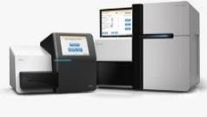

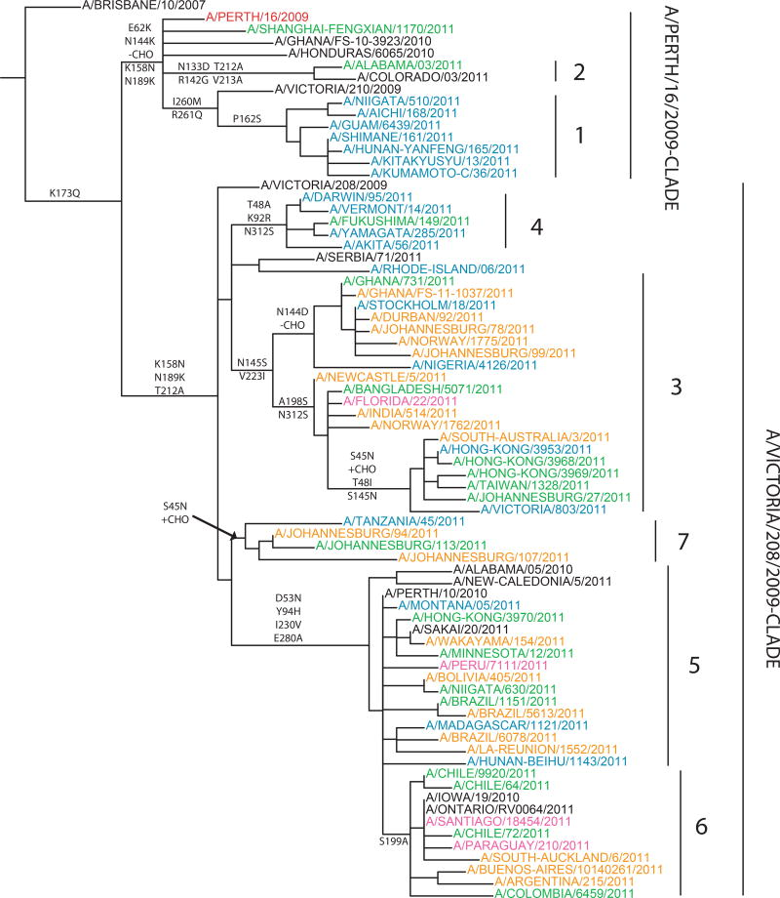
Goals of Global Influenza Genomic Surveillance: understand circulating viral diversity, where and to what extent
Create quality sequence of a virus and share data publicly
Molecular Epidemiology
Multiple sequence alignment with relevant sequences of viruses/reference virus for your question
Create phylogenetic tree(s) – Maximum-likelihood and Time-scaled
Data integration
Correlate genetic change with metadata such as phenotypic, proteomic and epidemiological data
Analysis is retrospective and a moving window by season – timeliness of data critical for situational awareness
Klimov et al, Vaccine. 2012 Oct 5;30(45):6461-71.
Notes:
Underpinning all genomic epi, is understanding viral diversity. The most important factor of this is generating high quality sequence data of viruses and sharing that data publicly. The cumulative submissions of data enable us to ask relevant questions. Generating phylogenies to understand the current patterns of evolution and correlate genetic change with other data, such as metadata, proteomic, and epidemiological data. Our analysis in this way is always retrospective, but timeliness of data is critical for situational awareness and gives us a better understanding of the current evolutionary trajectories.
When assessing seasonal virus phylogenies, we are usually contextualizing the information in terms of clades and subclades. Primarily for the purposes of communications.

Slide 5
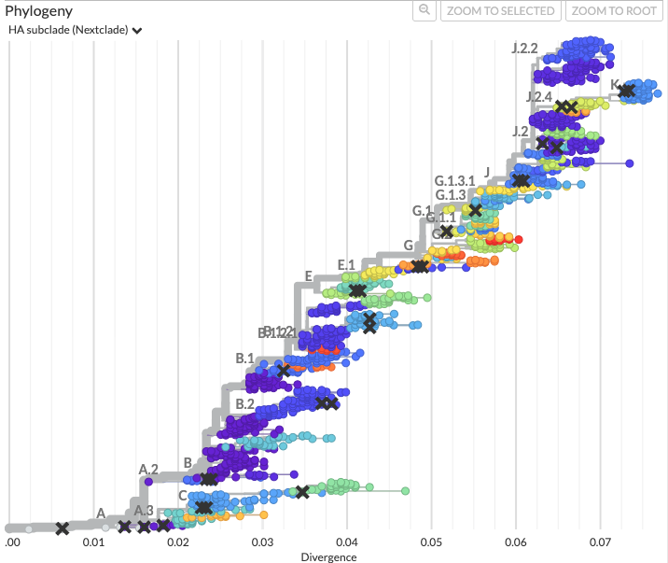
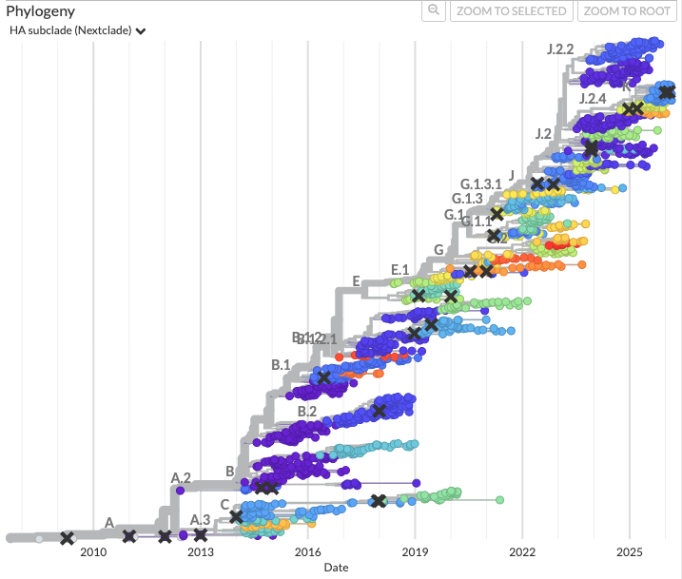
Nextstrain
Divergence
Time-scaled
https://nextstrain.org/seasonal-flu/h3n2/ha/12y
Notes:
Again, Nextstrain remains to be a powerful tool in conducting genomic epidemiology
Hopefully through the exercises we’ve gone through, you have a better understanding of how to interrogate data within the platform for your own analyses

Slide 6
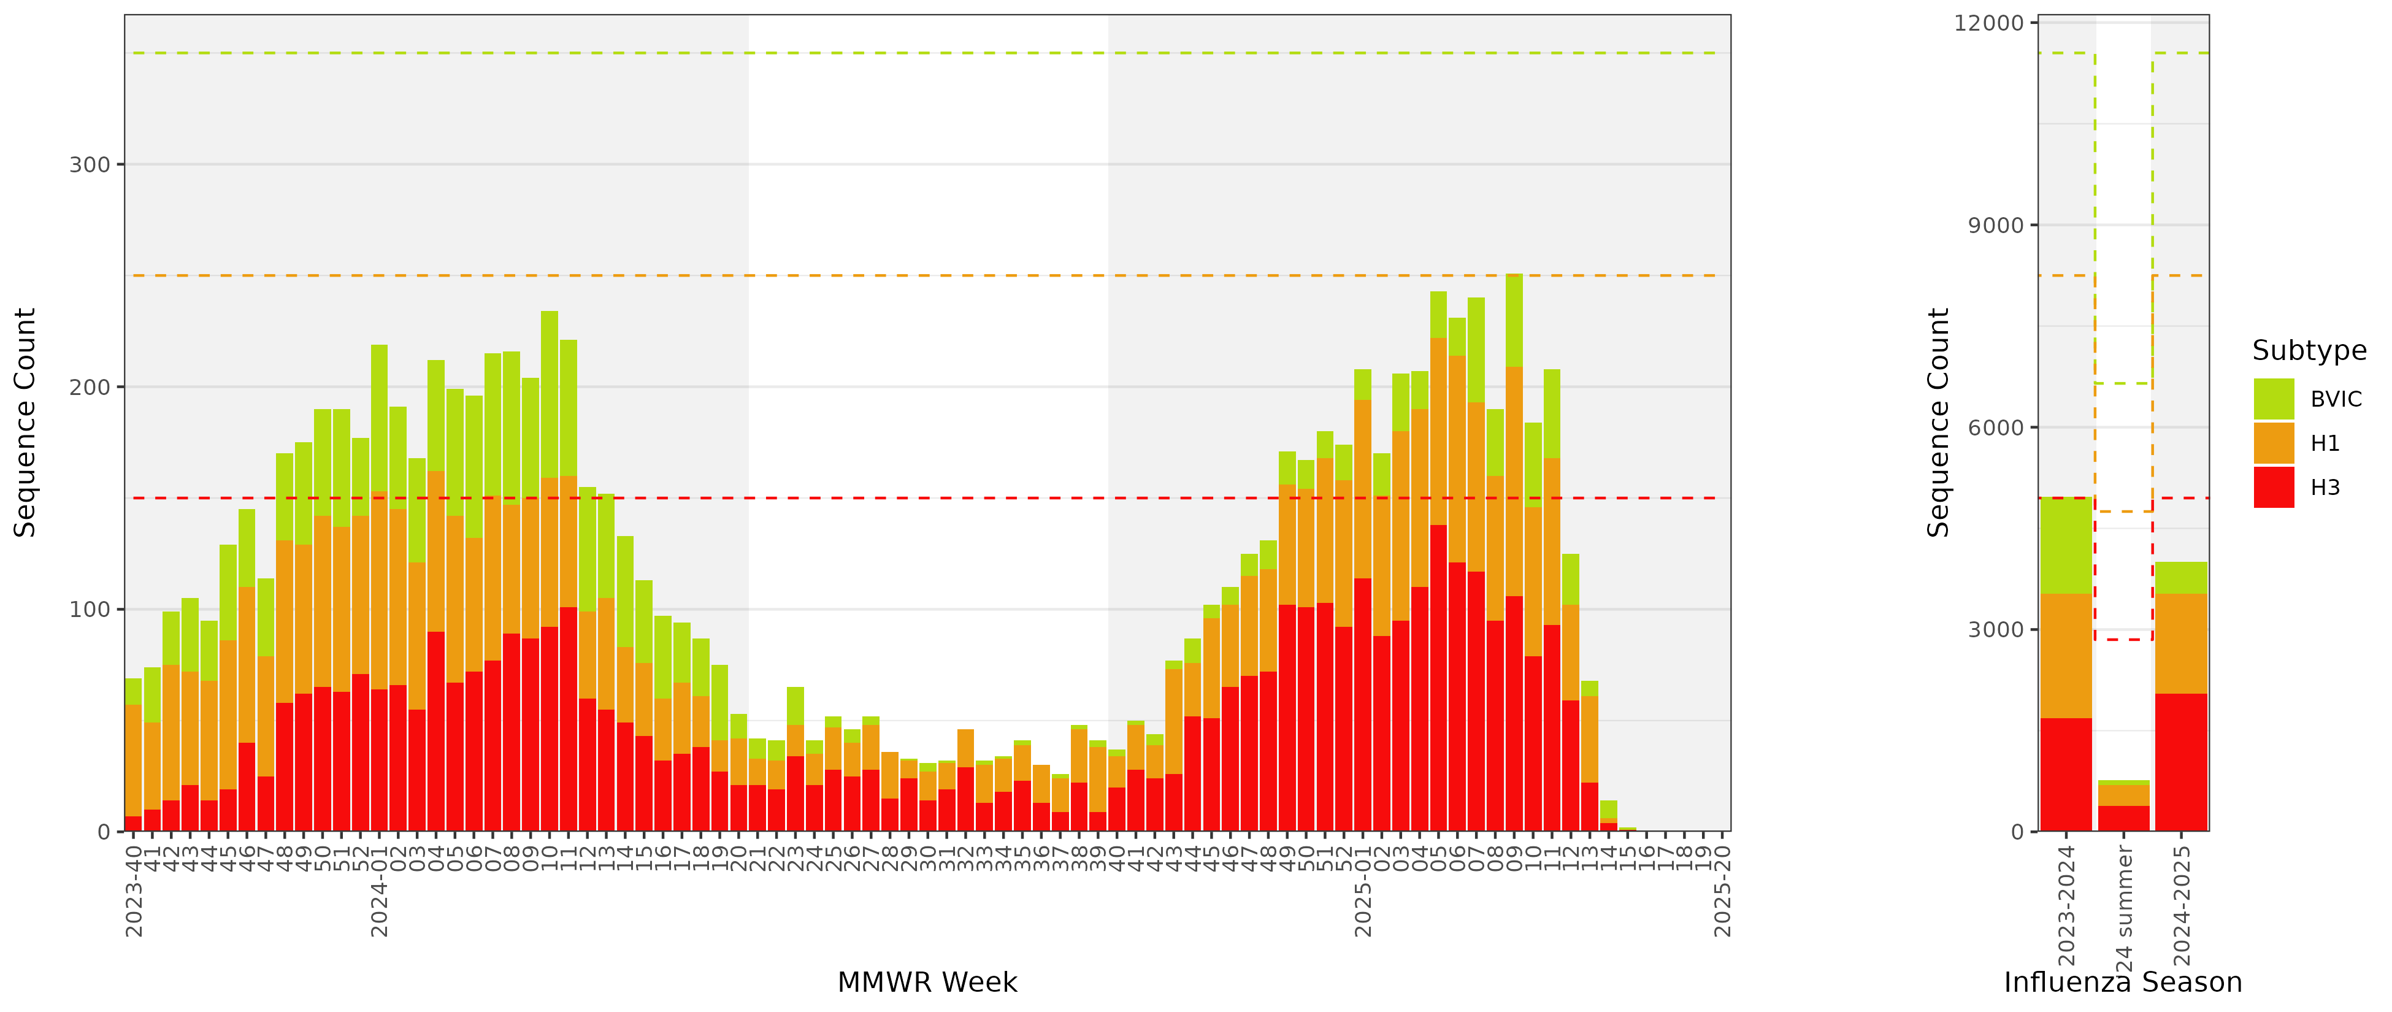
Goals of Global Influenza Genomic Surveillance: understand circulating viral diversity, where and to what extent
Determine type of analysis and confidence levels to set sampling strategies
E.g., Random sampling of specimens from ILI surveillance
US Sample Goals vs Actuals
B/Vic = 100/wk = 3300/season
H1N1 = 100/wk = 3300/season
H3N2 = 150/wk = 4950/season
Total = 350/wk = 11,550/season
Notes:
The resulting phylogenies from data are useful, but stepping back, it helps to have a sampling strategy based on analysis goals. The U.S. does this by random sampling of specimens from ILI surveillance. We set weekly goals for each subtype, which serve as a guideline (often we do not meet these numbers). However, this helps to ensure we’re getting a good representation of data.

Slide 7
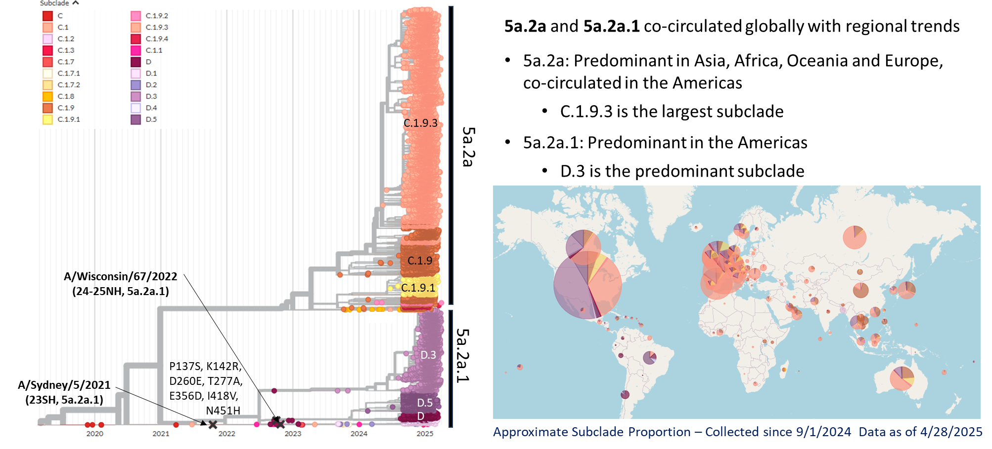
Understand the genetic diversity in epidemic
Predominant clade/subclade, HA sequence by geography
Confidence dependent on sample size
Notes:
When we have sampling of data across different countries this allows us the ability to assess regional trends. For instance, for this example of past H1 HA data, clades 5a.2a and 5a.2a.1 co-circulated globally with regional trends.
5a.2a was more predominant in Asia, Africa, Oceania, and Europe, with C.1.9.3 being the largest subclade.
Whereas 5a.2a.1 was predominant in the Americas, with D.3 being the most abundant subclade.

Slide 8
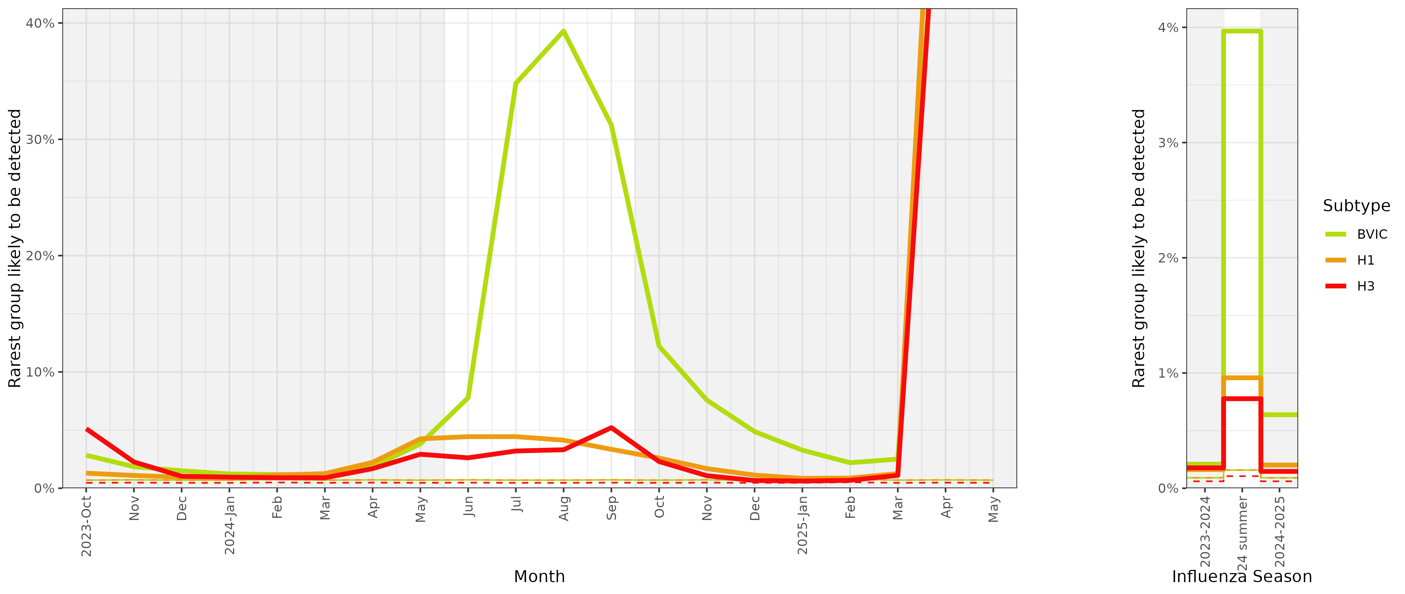
Understand the genetic diversity in epidemic
What is the minimum proportion we are likely (i.e., confidence = 95%) to detect with a given sample size?
Goal to identify emerging genetic variants early
Notes:
Country specific sampling also comes into play for what you can do with your data. This graph below shows the relative confidence we can have that a variant detected at a given percentage will be detected given the sampling across weeks. We can see the relative variability of this given the difference in the depth of our sampling over time, especially during off season times, when getting influenza specimens is much more challenging.
However, for all subtypes, during the U.S. influenza seasons we consistently had enough samples to detect variants at around 5-10% abundance weekly. And at less than 1% when assessing a given influenza season.

Slide 9
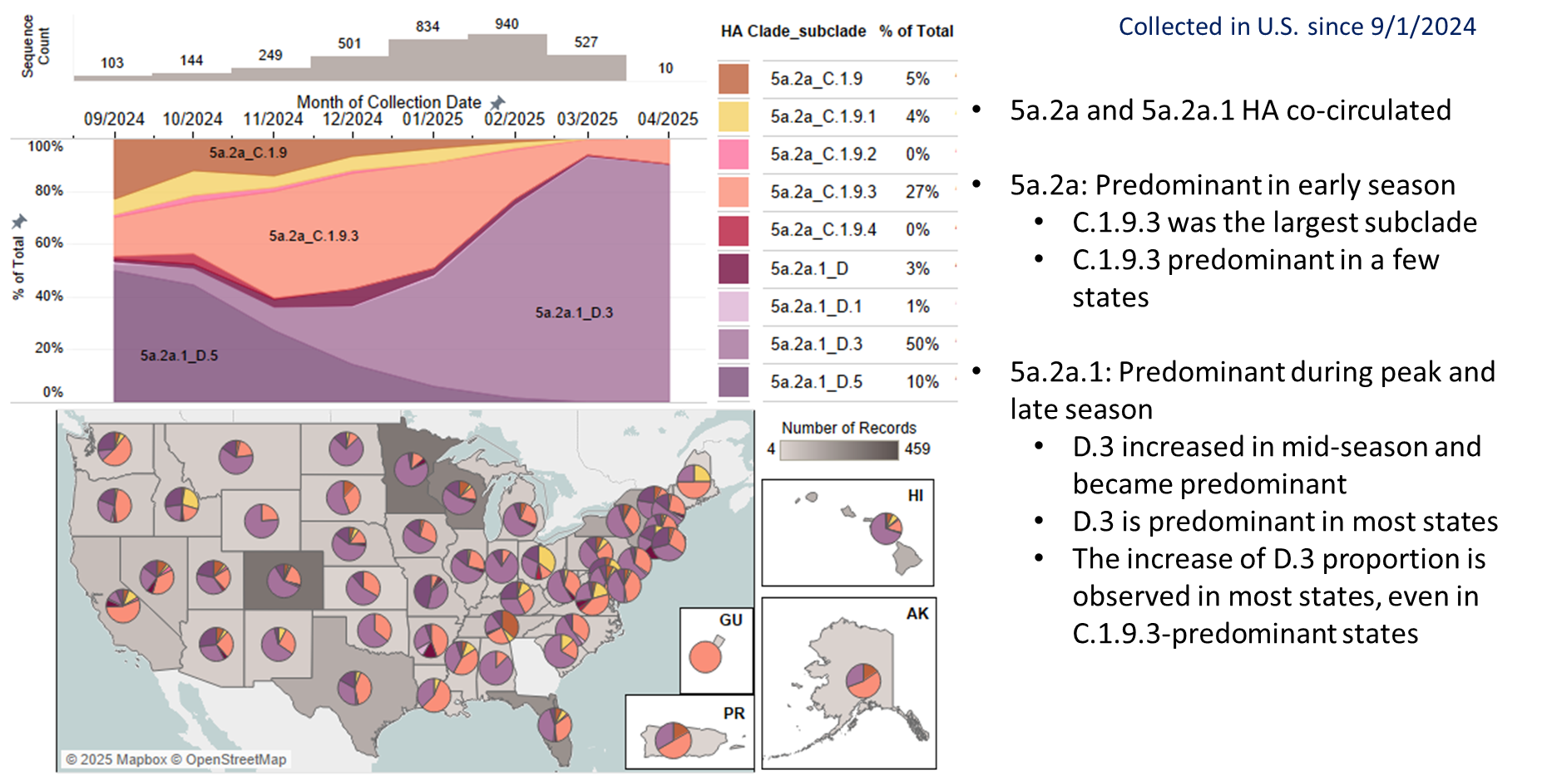
Understand the genetic diversity in epidemic
Change in clade/subclade, HA sequence over time
Notes:
Deep country specific sampling also allows the ability to accurately assess changes in clade/subclade frequency over time. In the 2024/2025 U.S. flu season, for H1N1pdm HA sequences, clades 5a.2a and 5a.2a.1 co-circulated. In clade 5a.2a subclade C.1.9.3 was more predominant early in the season, but was quickly replaced by subclade D.3 in the 5a.2a.1 clade.

Slide 10
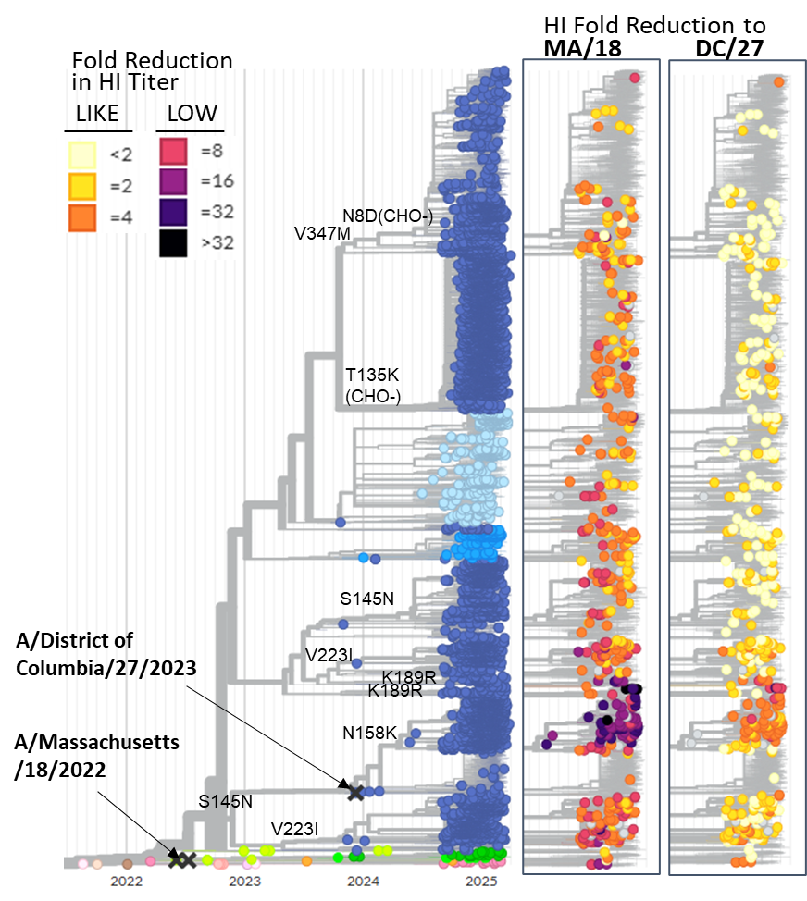
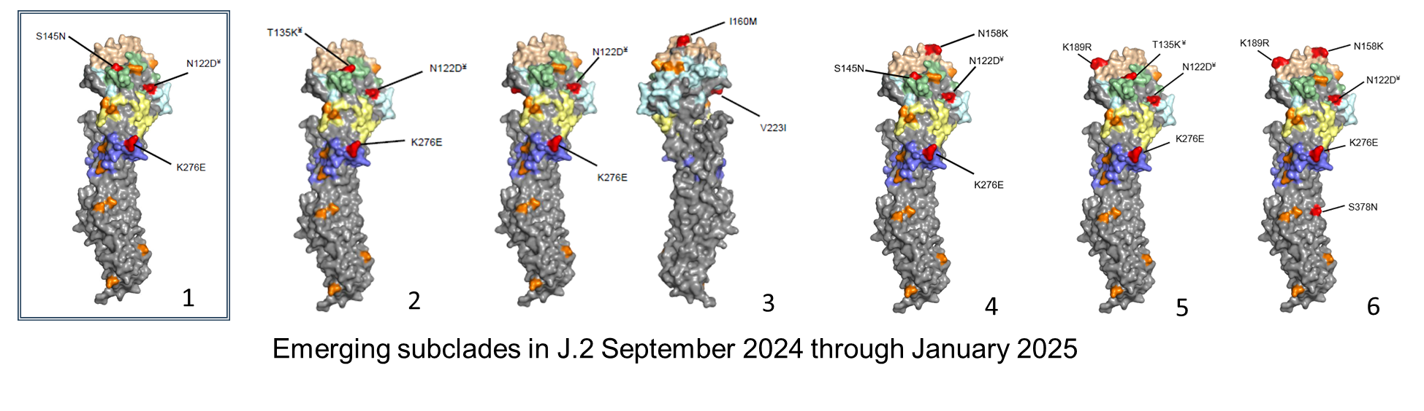
Genotype to Phenotype
Create phenotypic data representing the circulating genetic diversity
Prioritize viruses by their HA sequence and global observance
Create testing goal per HA sequence
Determine molecular determinants of antigenic change through genetic and antigenic data integration
E.g., Amino acid positions N158K and K189R associated with decreased antibody recognition using post-infection ferret antisera
Identify genetic and antigenic lineages for additional analysis using human sera
Notes:
Another point we try to understand in genomic epidemiology is the interrelation between genotype and phenotype. We create phenotypic data representing the circulating genetic diversity, by strategically testing viruses by their HA protein sequence global observance. Setting testing goals per unique HA sequence.
By generating this data, it helps us to determine the molecular determinates of antigenic change through cross-data integration. In the example to the left and below, we found that the amino acid mutations of N158K and K189R were associated with decreased antibody recognition using post-infection ferret antisera. We also identified genetic and antigenic lineages for additional analysis using human sera.

Slide 11
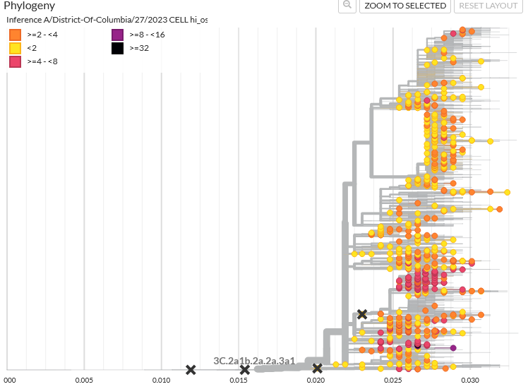
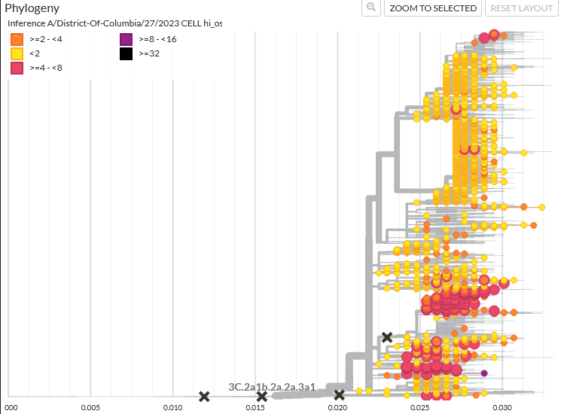
Genotype to Phenotype
Infer Antigenic Characterization for HA proteins which have met testing and result quality thresholds
more of the genetic variation seen within a season to have actional antigenic results in time for the vaccine selection meetings
Test Results
Test and Inferred Results
Notes:
By implementing our strategic antigenic testing and the statistical framework behind it, we are also able to infer antigenic characterization for HA proteins which have met testing and result quality thresholds. This allows us to “fill in” more of the genetic variation seen with actionable antigenic results in time for vaccine selection meetings.

Slide 12
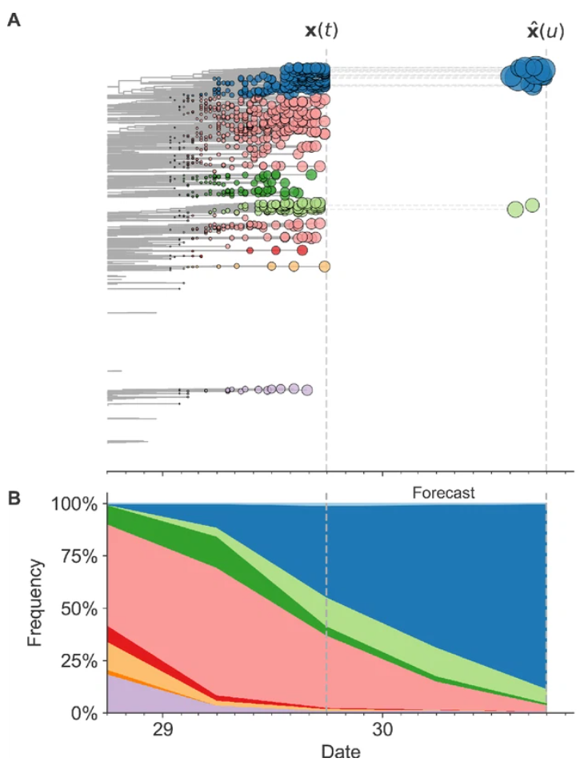
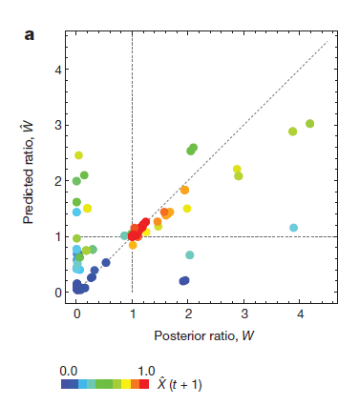
Predictive Models
Goals: predict the clade which will continue to circulate in the next 6 months/1 year
Nextstrain – Richard Neher and Trevor Bedford
Previr - Marta Luksza and Michael Lassig
Clade fitness models
Sequence data from GISAID
Clade frequency
Mutational load
Epitope sites
Antigenic data from HI or neutralization assays
Corresponding meta-data
Correlated epidemiological data
Luksza M, Lässig M. Nature. 2014 Mar 6;507(7490):57-61
Huddleston J, et al. eLife 9:e60067
Neher RA, Bedford T. Bioinformatics. 2015 Nov 1;31(21):3546-8.
Notes:
Another tool that builds upon genomic epidemiology are predictive models. Predictive model goals are lofty, and aim to predict which clade or subclade will continue to circulate in the next 6mos to 1year. Two of our collaborating groups, Nextstrain and Previr, currently implement predictive models for seasonal influenza. These are primarily clade fitness models that use sequences from GISAID in their estimations and incorporate antigenic, specimen meta-data, and correlated epidemiological data.

Slide 13
Current state of predictive modeling
Still a lot of work to do
Unable to predict which clade will predominate – but can have confidence that it will persist
Unable to predict which new clades will emerge
Unable to predict which A subtype or B lineage will predominate
Virus phenotype changes
Geographic and temporal differences in clade proportions
Clade turnover rate differences
Influenza B and A(H1N1)pdm09 – need to assess the how the models based on A(H3N2) work for other subtypes
Notes:
However, there is still a lot of work to do in the modelling space. The current models are unable to predict which clade will predominate, but do give confidence in what will persist. They are also unable to predict new clade emergence, subtype (or lineage) predominance, virus phenotypic changes, geographic or temporal differences in clade proportions, or clade turnover rate differences.
Models have also been primarily applied to H3N2, and need to be evaluated for other virus subtypes and lineages.

Slide 14
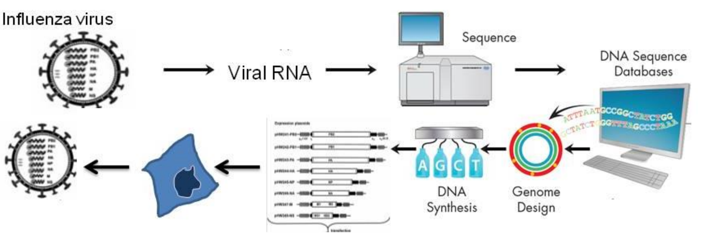
Future Landscape of Influenza Genomics
Improved lab-epi data integration
Automated electronic lab reporting
Data lake approach
Cloud computing
Synthetic genomics
Rapidly generated viruses from sequence data
New vaccine strategies may require different data analysis for recommendations
Use of genetic data to design and synthesize candidate vaccine viruses
Courtesy of Dr. Dave Wentworth
Notes:
There are however, a lot of goals and current projects to improve the future landscape of influenza genomics. We aim for improved lab-epi data integration using automated electronic lab reporting, a high throughput data lake, and further utilization of cloud computing. We are also exploring synthetic genomics for the rapid generation of viruses from sequencing data, this may be especially helpful for if there is a new emerging variant that we do not yet have any samples of.
It’s also important to consider that new vaccine strategies may require different data analysis for recommendations.

Slide 15


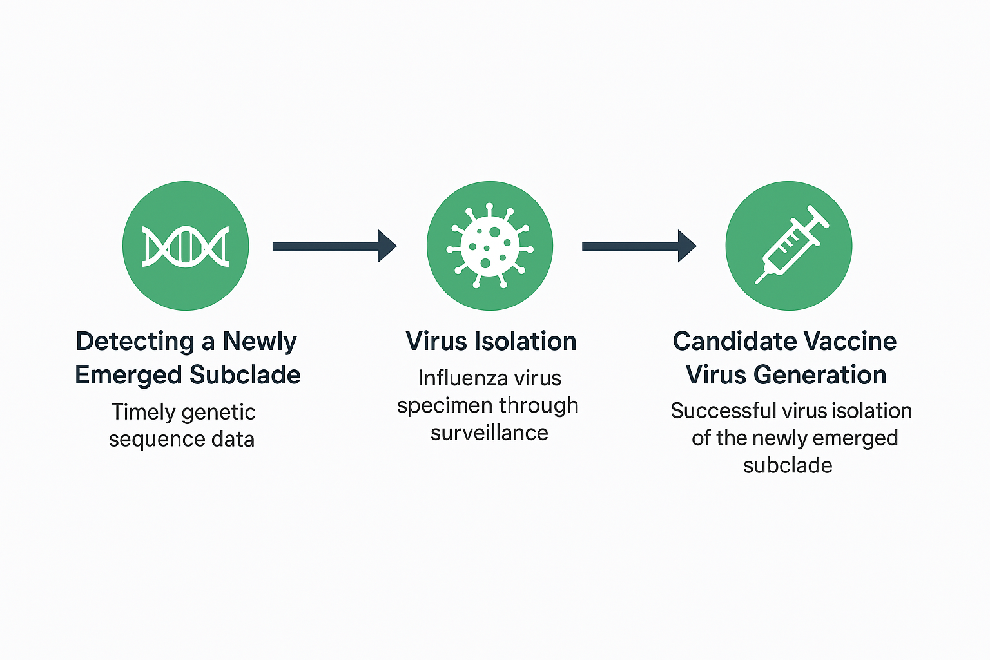


Specimen Collection
First K specimens collected through CDC National Influenza Surveillance and Traveler-Based Genomic Surveillance
Genomic Epi in Action: Subclade K CVV Generation Timeline
CVV Initiation
Initial isolation attempts via provision of respiratory specimens National Influenza Surveillance
Subclade Naming
Emerging subclade of J.2.4 viruses with specific amino acid substitutions were designated as subclade J.2.4.1 and then given alias K
CVVs Generated
Egg and cell reference viruses generated to newly emerging subclade of J.2.4 viruses
Reassortants
High growth reassortants started to arrive at CDC to subclade K
J.2.4.1
(K)
JUN to
JUL
AUG
SEP
OCT
NOV
JAN
FEB
VCM
VCM
Detection
Sequence analysis highlighted J.2.4 viruses with ten amino acid changes relative to vaccine and promptly performed antigenic characterization;
Evidence of antigenic drift
Collaborators Notified
CDC notified other GISRS collaborating centers of their findings for newly emerging subclade of J.2.4 viruses
2026 SH Vaccine Recommendation Report: J.2.4 viruses well including those with notable additional HA substitutions S144N (a potential addition of an N-glycosylation site), N158D, I160K and Q173R, which have recently emerged
Reference ferret antisera
Ferret antisera generated to K reference viruses and tested
CVV Distribution
Reference viruses for subclade K distributed to collaborators and reassorting laboratories
2026-27 NH Vaccine Recommendation:
Subclade K viruses recommended as A(H3N2) component
Pre-print Interim US 2025-26 Season SSRN
NOTE – timeline length is not to scale
Notes:
Lastly, I want to close this session with a recent example of genomic epi in action, by going through the process of the generation of a candidate vaccine virus for the emergent subclade K of H3N2.
The first subclade K specimens were collected through CDC national influenza surveillance and Traveler-Based genomic surveillance in June to July of 2025. Once this data was available for analysis in August, sequence analysis and secondary confirmation highlighted these viruses with 10 amino acid changes relative to the vaccine. These viruses were promptly antigenically characterized and results showed evidence of genetic drift. From this confirmatory data we promptly initiated the CVV process and notified other GISRIS collaborating centers of our findings. A few weeks later we had initial egg and cell reference viruses generated to this newly emergent subclade. During the 2026SH vaccine recommendation we were able to provide the information of our findings. Shortly thereafter, this emergent subclade was designated as J.2.4.1 and given the alias of K, to further highlight the group. Reference ferret antisera were then generated in late October and tested. In November, CVVs were distributed to collaborators and reassorting laboratories. By January subclade K high-growth reassortants started to arrive at CDC. And by the 2026-27NH vaccine recommendation, these viruses were able to be pushed forwards as the recommended H3N2 vaccine component. I hope this example helps to not only demonstrate the importance of genomic epi in the initial process, but also the importance of sampling strategies and fast turn around times from collection to sequence data generation.

Slide 16
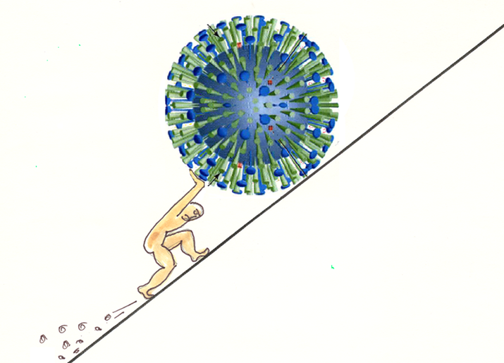
Thank you!
Notes:
I hope this has been informative and thank you for listening!

