Slide 1
Boundary-Blind World Models — Weekly Progress
Week of 2026-06-12 → 06-19
• Goal: get JEPA world models to plan contact tasks (push / pick-place), where they fail.
• This week: pinned the failure to ONE channel — the predictor can't tell actions apart at the object level.
• Encoder and factual object tracking are both fine; the apparent 'fixes' were measurement artifacts.
• Reach still beats the paper: 94% vs 44.8%.

Slide 2
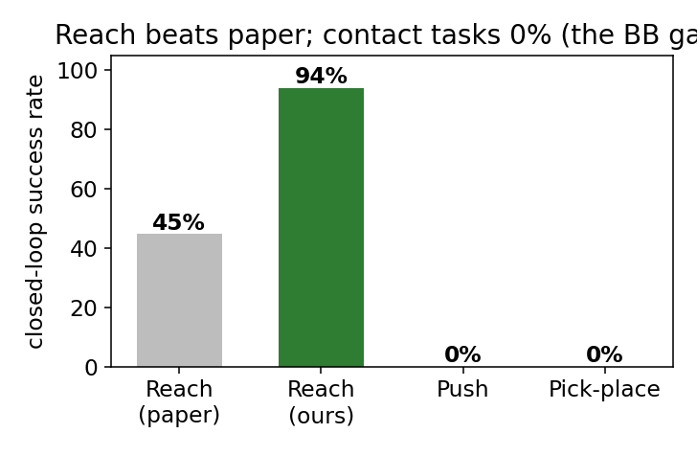
Recap & this week's question
• Boundary Blindness (BB): the predictor smears different actions into one latent near contact.
• Closed-loop: Reach works (94%); Push / Pick-place stuck at 0% — the BB gap.
• Last week: a scoring fix gave a small placement gain but zero successes.
• Question:
– Is the bottleneck the PLANNER, the ENCODER, or the PREDICTOR itself?

Slide 3
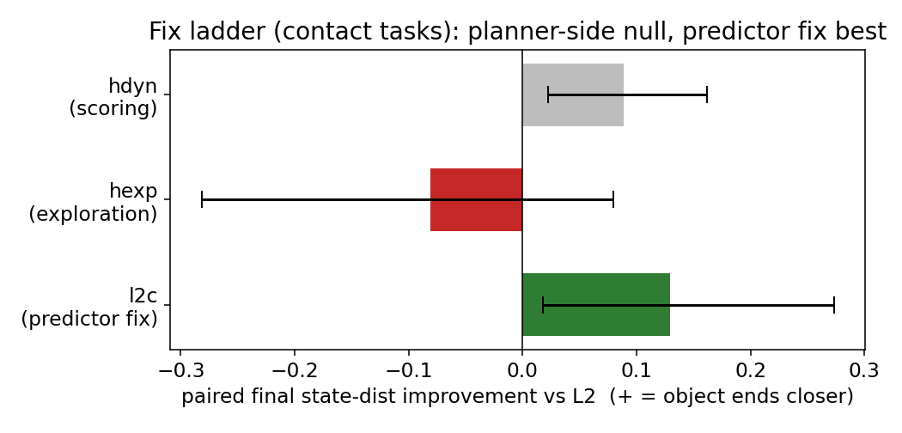
Two fix legs — and why we had to dig deeper
• hexp — grounded EXPLORATION: null, slightly worse. Not the planner's search.
• l2c — residual corrective PREDICTOR: looked like the BEST leg (+0.13).
• But every fix was read through a lossy 'pooled' object readout (6.4 cm).
– So we built a precise readout and re-measured — the l2c win did not survive (next slides).

Slide 4
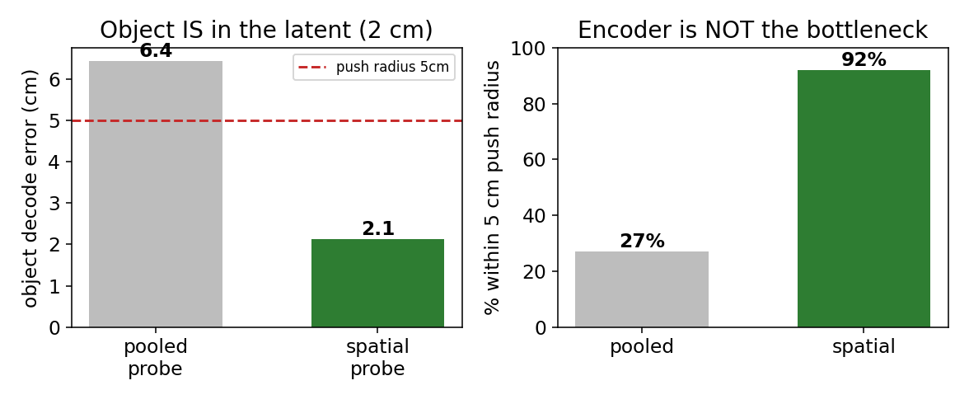
Not the encoder, not factual tracking
• A spatially-aware probe recovers the object to 2 cm from the SAME latent (pooled said 6.4 cm).
• 92% within the 5 cm push radius → the encoder clearly holds the object.
• The frozen predictor also tracks the object factually to ~3 cm over a 6-step rollout.
• And the residual 'fix' is no better than frozen under the precise probe — it gamed the old readout.

Slide 5
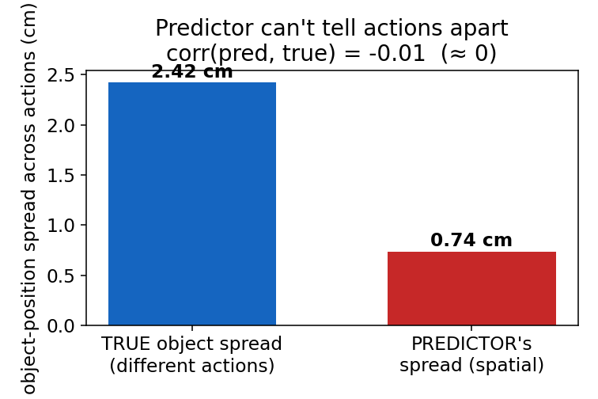
The real bottleneck: the predictor can't tell actions apart
• Planning needs different actions → different predicted object (so CEM can choose).
• From one state, different actions move the object ~2.4 cm apart (ground truth).
• But the predictor predicts ~the same object for every action: 0.74 cm spread, corr ≈ 0.
• → True Boundary Blindness, at the object level, confirmed with a 2 cm-precise readout.

Slide 6
Resolved picture & next step
• Where the contact-planning failure lives:
– Encoder (object in latent): FINE — 2 cm.
– Predictor, factual object tracking: FINE — ~3 cm / 6 steps.
– Predictor, counterfactual object response: DEAD — the locus.
• The residual fix was illusory (gamed the old readout) — an honest negative.
• Next (launching now):
– Supervise the action→object channel separately + plan against it with the 2 cm readout —
– the precisely-motivated shot at flipping contact successes beyond the paper.
• Reach 94% vs 44.8% stands.

