Slide 1
Boundary-Blind World Models — Weekly Progress
Week of 2026-06-12 → 06-19
• Goal: make these AI 'world models' plan contact tasks (push, pick-and-place) — today they fail.
• This week we found exactly why: the model predicts almost the same result no matter which action you try.
• Its 'eyes' and 'memory' are fine — the earlier 'fixes' only looked like fixes.
• On the one task it does handle (reaching), we already beat the published result: 94% vs 44.8%.

Slide 2
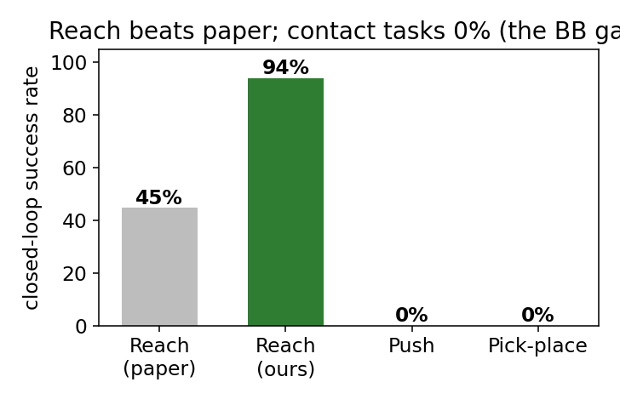
Recap & the question
In plain terms: the arm reaches the target, but the robot never actually moves the object.
• A 'world model' imagines what the robot will see after an action; the planner uses it to pick actions.
• Reaching an empty-space target works (94%). The moment the arm must move an OBJECT, it fails (0%).
• Question: is the problem the planner, the model's vision, or the model's predictions?

Slide 3
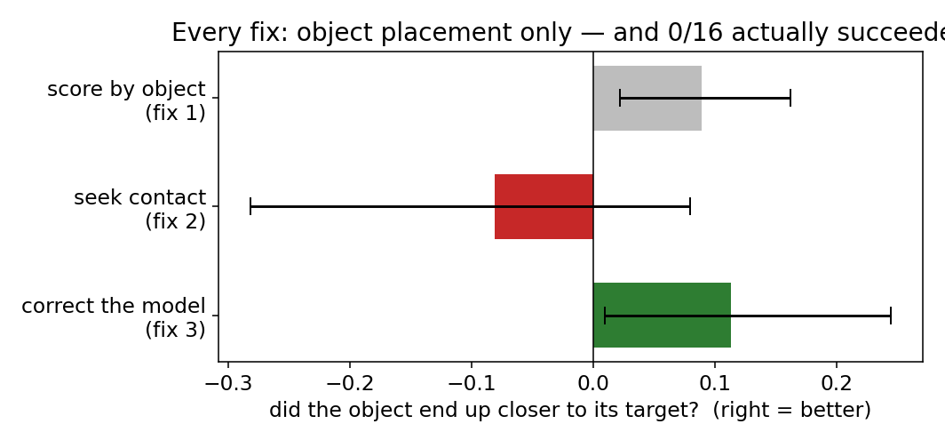
Three fixes — and why we dug deeper
In plain terms: two fixes looked promising, so we built a sharper ruler to check if they were real.
• Fix 1 — score actions by how much they move the object: tiny gain.
• Fix 2 — push the planner to seek contact: no help (slightly worse).
• Fix 3 — correct the model's predictions: looked like the best...
• ...but all three left success at 0/16. So we built a more precise way to read the object.

Slide 4
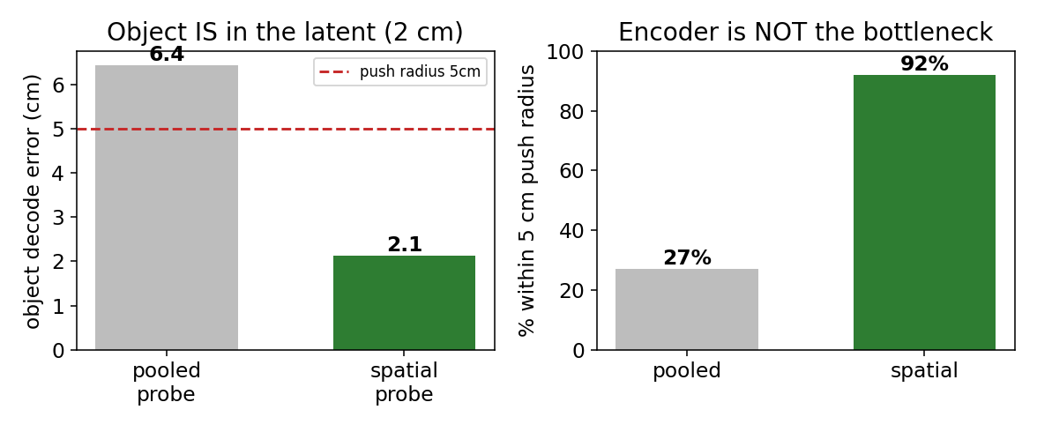
It's not the model's vision or its memory
In plain terms: the model's 'eyes' (where the object is) and 'memory' (what just happened) are both fine.
• We read the object's position out of the model two ways; the old readout was blurry (6 cm).
• A better readout pins it to 2 cm — inside the 5 cm success zone 92% of the time. The info was always there.
• The model also correctly replays what really happened (~3 cm over 6 steps).
• And Fix 3 is no better than no-fix under the precise readout — it had just gamed the blurry one.

Slide 5
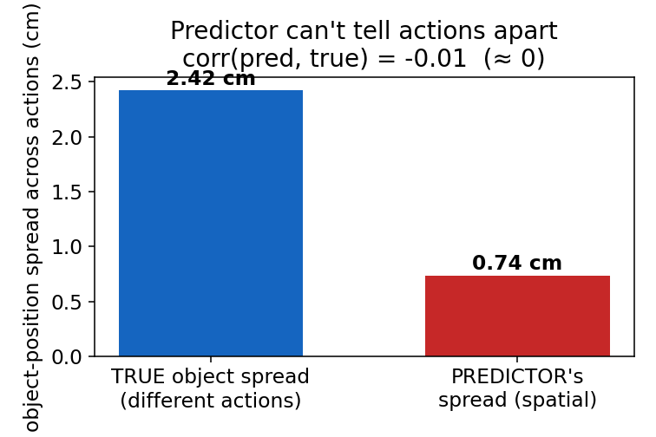
The real problem: it can't tell actions apart
In plain terms: the model imagines almost the same object outcome for every action — so the planner can't choose.
• Planning = imagine many actions, keep the one that best moves the object to the goal.
• In reality, different actions send the object ~2.4 cm apart.
• But the model imagines them all landing in nearly the same spot (0.74 cm) — unrelated to the truth.
• So every action looks equally good to the planner. That is the core failure.

Slide 6
Where it stands & what's next
In plain terms: vision ✓, memory ✓, imagining different actions ✗ — that last part is what we now fix.
• The failure, located:
– Vision (where the object is): FINE — 2 cm.
– Memory (replaying what happened): FINE — ~3 cm over 6 steps.
– Imagining different actions differently: BROKEN — the culprit.
• Fix 3 was a mirage (it gamed the blurry readout) — an honest negative.
• Running now: give the planner an accurate object target + the one part that DOES tell actions
– apart, weighted to drive the choice. Works → first contact successes; if not → strengthen that part.
• Reaching already beats the paper (94% vs 44.8%).

