Slide 1

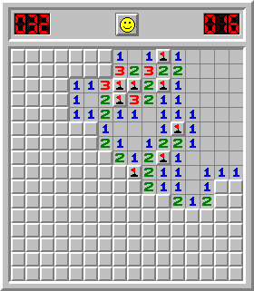
Project: Mine Sweeper Language: Java Course: Algorithms & Data Structures
VIETNAM NATIONAL UNIVERSITY INTERNATIONAL UNIVERSITY
Team Member:
Nguyễn Võ Nhật Anh – ITITIU19001
Trần Hoàng Phúc – ITITIU17017

Slide 2
Chapter 1. Introduction
GAME INTRODUCTION
- Minesweeper is a single-player puzzle video game.
- The game originates from the 1960s and has many variations and offshoots.
SCOPE
- Try to make it as original as possible
- Has some replica functions: New game, Easy, Medium, Hard, Custom,…

Slide 3
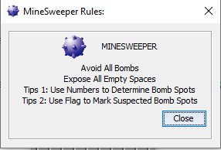
Chapter 2. Rules and How-To-Play
Rules
Open all cells
Avoid all bombs
Cell’s Number indicates nearby bombs

Slide 4
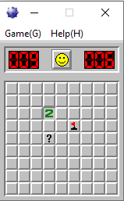
Chapter 2. Rules and How-To-Play
How-To-Play
Left-click to open cells
Right-click:
First time: Flag
Second time: Question Mark
Third time: Recover blank cells

Slide 5
Game Features
New Game
Start new game with previously selected level.
Choose Difficulty
There will be three types of game mode: Easy (9x9 and 10 mines), Medium (16x16 and 40 mines), Hard (30x16 and 99 mines).
Custom
You can customize the number of rows, columns and mines of a board.
Leaderboard
A leaderboard for player based on their finish time of each game mode.
Exit
Exit the game.
Rules and Mine Hint
A window to display the rules.
A feature to reveal all the mine spots.

Slide 6
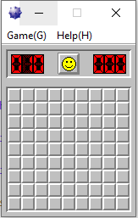
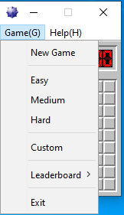
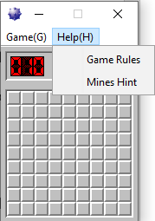
Chapter 3. Game Design
Interface

Slide 7
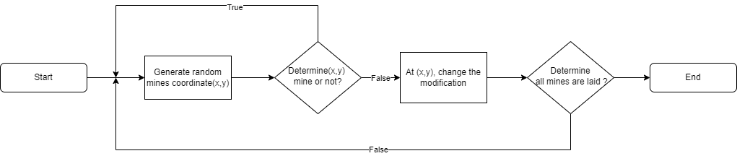
Chapter 3. Continue
Mine Laying:

Slide 8
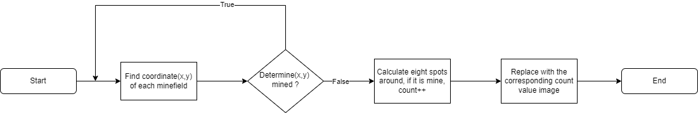
Chapter 3. Continue
Determine Mines:

Slide 9
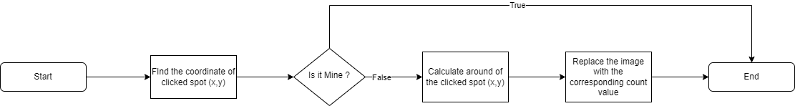
Chapter 3. Continue
Clicks Cells

Slide 10
Chapter 4. Conclusion
OUTCOME
How to apply algorithm
How to use data structures
And many more
FUTURE IMPROVEMENT
Implement more features for the game
Add more game modes to the games.
Maybe upgrade the UI so the game would look more modern.

Slide 11
References
Wikipedia.com:https://en.wikipedia.org/wiki/Minesweeper_(video_game)
Wikihow.com: https://www.wikihow.com/Play-Minesweeper
English Tutorial: Java Minesweeper - creating Minesweeper game clone in Java (zetcode.com)
Vietnamese Tutorial: Làm game MineSweeper (Dò mìn) bằng Java – Mai trời sáng ! (wordpress.com)

Slide 12
End of Presentation
THANK YOU FOR LISTENING

