Slide 1

Group 4
KNOW LEDGE DISCOVERY AND DATA MINING
Final presentation
MEMBERS
INSTRUCTOR
HOANG ANH
MEMBER
HUYNH NHAT BAO

Slide 2
Table of contents
1
Topic Introduction
2
KerasNLP
3
DistilBERT
4
Demo code

Slide 3

This is a topic taken from a competition on Kaggle about natural language processing. In this topic we will process tweets on the social network Twitter. In this competition, you’re challenged to build a machine learning model that predicts which Tweets are about real disasters and which one’s aren’t.
I.
Topic Introduction
The author explicitly uses the word “ABLAZE” but means it metaphorically. This is clear to a human right away, especially with the visual aid. But it’s less clear to a machine.

Slide 4
2.2 Overview of problem
Initial State
The research object is 10,000 tweets collected from the social network Twitter.
Goal Test
In this competition, you’re challenged to build a machine learning model that predicts which Tweets are about real disasters and which one’s aren’t.
Actions
The research topic uses the DistilBERT machine learning model to analyze and visualize data and expect results and therefore the actual results will score the model.
Transition Model
Machine learning model that predicts which Tweets are about real disasters and which one’s aren’t.
Path Cost
Per Actions is 1 steps
4

Slide 5

2. Keras NLP
5

Slide 6
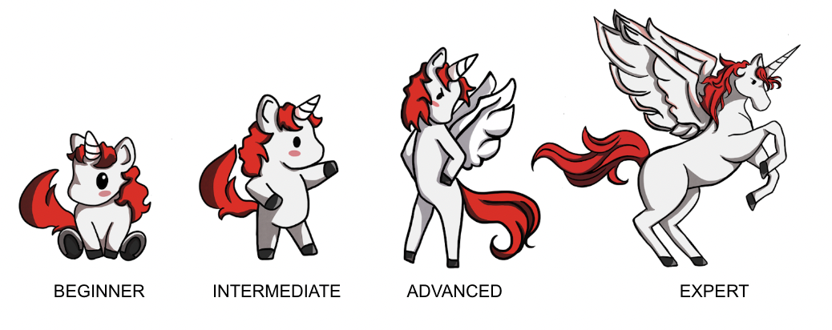
2. Keras NLP
KerasNLP is a library that natively supports language processing throughout the entire development process. This library is an extension of the core Keras API, all high-level modules are multi-layered or models.
KerasNLP uses Keras 3 to work with any TensorFlow, Pytorch or Jax. In our article we use Tensorflow backend to train our models.
7

Slide 7
2. Keras NLP
Pros
Cons
Easy Integration: KerasNLP directly integrates with frameworks like TensorFlow, JAX, and PyTorch, making it easy for users to use and combine with other tools.
Flexible Customization: KerasNLP’s models and layers can be flexibly customized to suit various NLP tasks.
Good Performance: KerasNLP retains over 95% of BERT’s performance on the GLUE benchmark while reducing parameters by 40% compared to bert-base-uncased.
Limited Customization: While it is customizable, KerasNLP has less flexibility in creating complex architectures compared to some other NLP libraries.
Handling Large Data: KerasNLP may not be the best choice for handling large or complex data due to potential memory management and processing speed challenges.

Slide 8
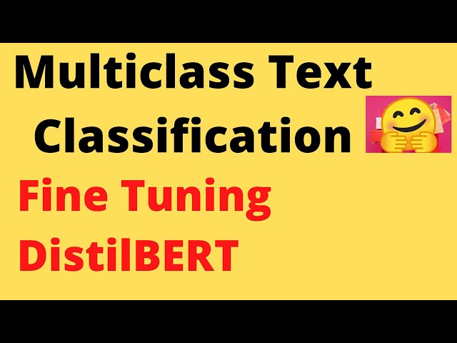
3. BERT and DistilBERT
9

Slide 9
3.1 Overview of BERT
BERT(Bidirectional Representations from Transformers) is a natural language model developed by Google and announced in 2018. This is one of the most important advances in the field of natural language processing (NLP) in recent years.
BERT is a model based on the Transformer architecture, specifically the Transformer encoder.
The goal of BERT is to create semantic representations of words in their context by learning to understand the meaning of the word in both directions (left and right) of the sentence.
Revolutionizing NLP: BERT has revolutionized the approach to NLP problems by using models that are pre-trained on big data and then fine-tuned on specific tasks.
Opening a new era for NLP research and application: After BERT, many similar models such as GPT (Generative Pre-trained Transformer), RoBERTa, and T5 have been developed, further improving and expanding the capabilities of NLP. language models.
10

Slide 10
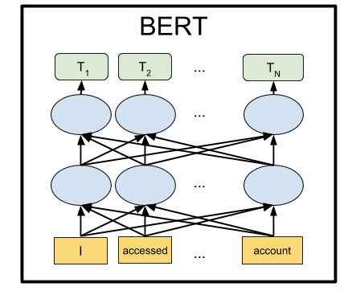
3.1 BERT architect
BERT will cut the transformer in half and only take the Encoder part on the left and remove the Decoder part on the right, leaving only the part where the text sentence is inserted and the output is the encoder output as shown:
11

Slide 11
3.1. Limitation
Pros
Cons
Comprehensive context
High performance on many NLP tasks
Flexible fine-tuning capabilities
Powerful pre-training
Requires large computational resources
Large model size
Complexity in implementation
Optimization and parameter adjustment
Performance degrades on uncommon languages

Slide 12
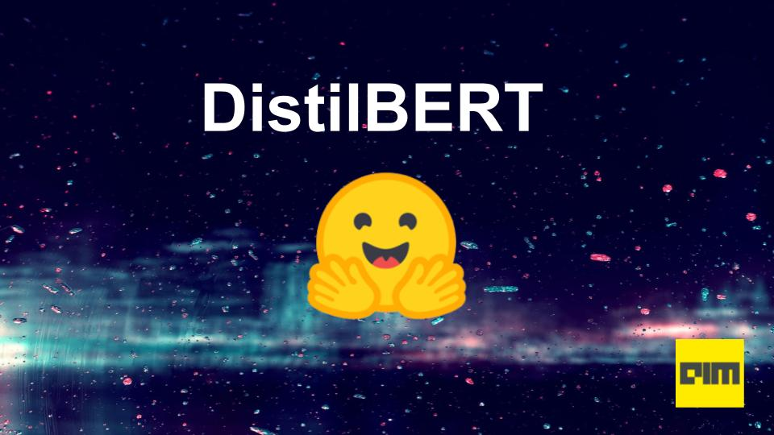
3.2 Overview of DistilBERT
DistilBERT is an advanced natural language model (NLP), announced by Hugging Face in late 2019.
The goal: use distillation to reduce model size and increase processing speed while maintaining much of BERT performance.
13

Slide 13
3.2 DistilBERT vs BERT
DistilBERT is a small, fast, cheap and light Transformer model based on the BERT architecture. Knowledge distillation is performed during the pre-training phase to
Reduce the size of a BERT model by 40%
While retaining 97% of its language understanding abilities
And being 60% faster.
DistilBERT Highlights: is an improved version of BERT. DistilBERT uses knowledge distillation to create a smaller, faster and more efficient version of the original BERT model while retaining much of its performance. With its compact size, DistilBERT is easy to deploy on resource-constrained devices that can be easily used for on-device applications.
Disadvantages of DistilBERT: Reduced accuracy compared to BERT which may affect applications requiring absolute accuracy. Depends on the quality and performance of the BERT model as a teacher. If BERT has problems or limitations, these can be passed back to DistilBERT.
14

Slide 14
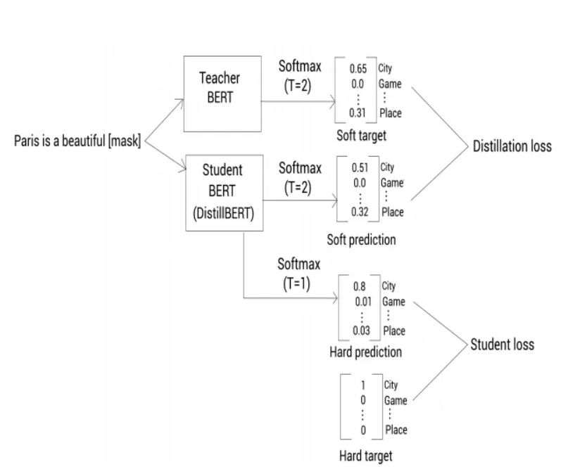
3.2 How does DistilBERT work?
15

Slide 15

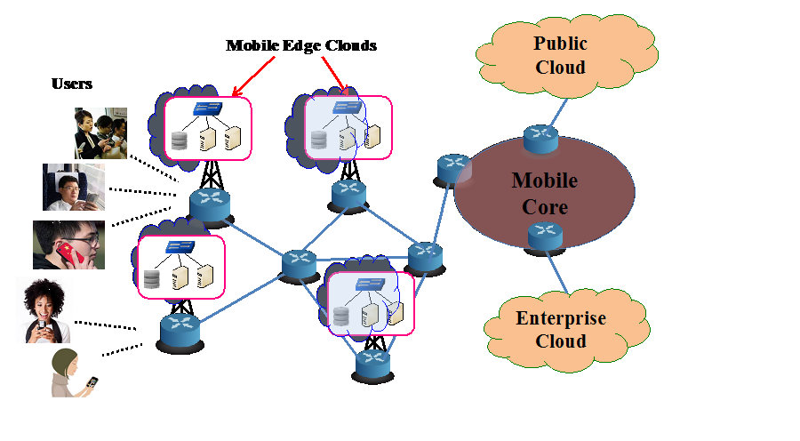
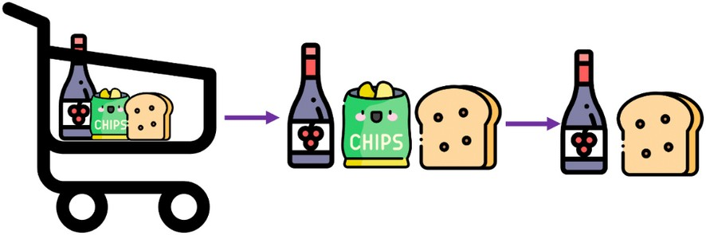

Purposes
Chatbots and Virtual Assistants: For faster response times and reduced computational costs
Mobile and Edge Computing: Deployment on devices with limited computational resources.
Web Services: Improved speed and reduced operational costs in cloud-based services
16

Slide 16
4. SOURCE CODE
17

Slide 17
Group 4
THANK YOU

