Slide 2
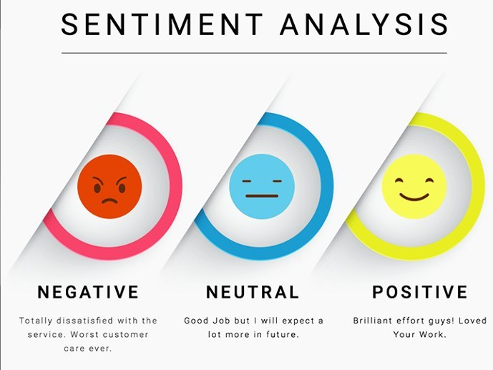

SENTIMENT ANALYSIS
NATURAL LANGUAGE PROCESSING PROJECT
GROUP 9

Slide 3
1. Introduction

Slide 4


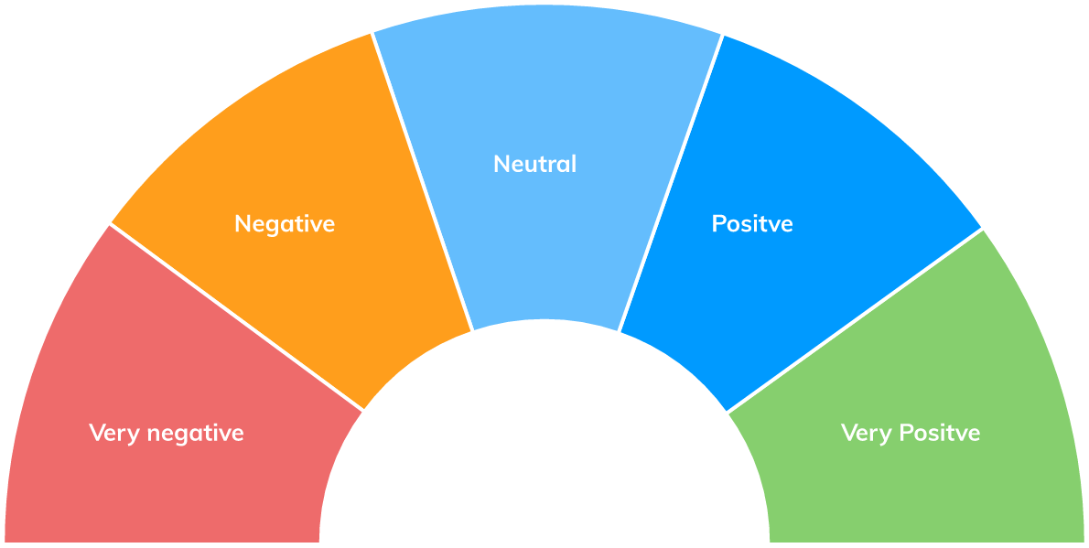

INTRODUCTION
Sentiment analysis is the automated method of examining text to determine the sentiment expressed.
By tackling sentiment analysis problems, enterprises can build a system to recognize the customer satisfaction level during text messages or calls with their consultants.
In this project, we decided to use amazon product reviews dataset to train our systems. The system will take the customer review as an input and output rating stars

Slide 5
2. Dataset

Slide 6
DATASET
Source: Amazon Product Reviews (Kaggle)
Size: 56845 records
Train: 80%
Validation: 10%
Test: 10%
Input: review text
Output: Rating star from 1 to 5
Example:
5 star: "Best BBQ Sauce out there. Pick some up today!"
1 star: "This stuff is not stuffing. It's not good at all. Save your money!"

Slide 7

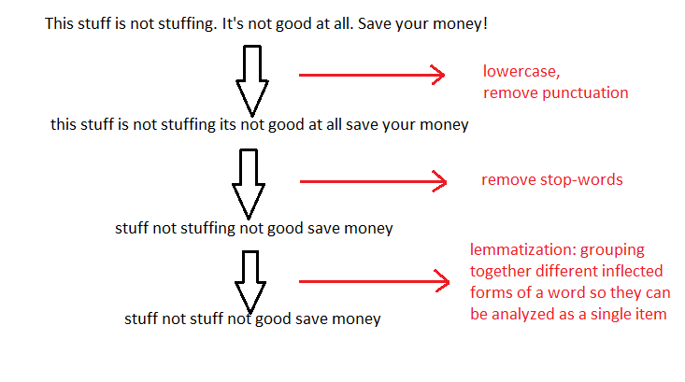
DATA CLEANING

Slide 8
Machine learning approaches

Slide 9
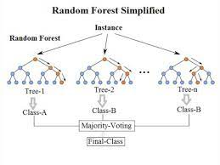
Random forest algorithm takes the decision tree concept further by producing many decision trees.
The approach first takes a random sample of the data and identifies a key set of features to grow each decision tree.
These decision trees then have their out of bag error determined (error rate of the model) and then the collection of decision trees is compared to find the joint set of variables that produce the strongest classification method.

Slide 10
N-grams
The types of grams in N-grams used depend on the problem and the complexity of the data.
1. Unigram
2. Bigram
3. Trigram
The results of data analysis based on different grams will yield different results depending on the intended use and input data.

Slide 11
N-grams​
We use 5 types of features to create the bag-of-word input: unigram, unigram_bigram, bigram, bigram_trigram, trigram.
In 5 types of features, unigram_bigram and bigram_trigram are the combination of 2 types of grams to form a feature to help your model or algorithm understand the association between single words (unigram) and consecutive word pairs (bigram) in sentences, and is able to better predict or classify data based on this feature.

Slide 12
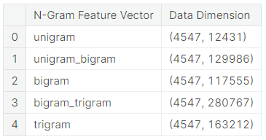
N-grams​
The data dimension for each feature as below:

Slide 13
N-grams​
Because the data dimension of each feature vector is too high so we use a method to reduce the dimension that is SelectFromModel.
Random Forest evaluates the importance scores of features based on two methods: orthogonality importance and mean decrease impurity.

Slide 14
N-grams​
Permutation importance is a way of assessing the importance of a feature by removing it from a data set and considering the impact of that removal on the accuracy of the Random Forest. In particular, a feature that is removed will significantly reduce the predictive power of the model.
The mean decrease impurity is calculated by measuring the decrease in the error value of the Random Forest when the feature is used to build a decision tree in some depth. In particular, suppose a feature allows to separate samples into two groups of different purity, then that feature is of high importance.

Slide 15
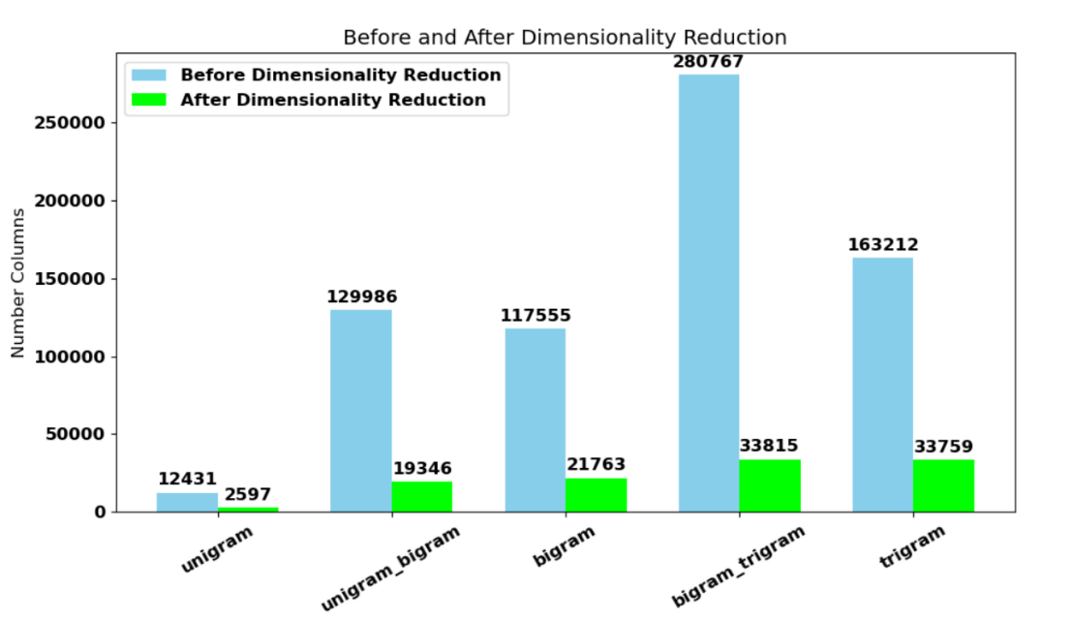
N-grams​
Finally, we train the model again with the reduced dimensional dataset.

Slide 16
Training process
Random forest will be trained with these hyperparameters:
- n-esimators = 100
- max_depth = 30
- min_samples_split = 4

Slide 17
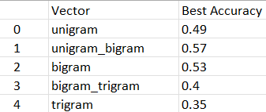
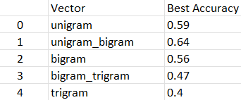
Experimental results
Each vector will be evaluated by the accuracy value on validation data to choose the vector that best affects the model
Before reduction
After reduction

Slide 18
Experimental results
We see how dimensionality reduction affects on our Machine learning model.
 | Training time | Accuracy
Before reduction | 10h 30min | 57%
After reduction | 2h 10min | 64%

Slide 19
Deep learning approaches

Slide 20

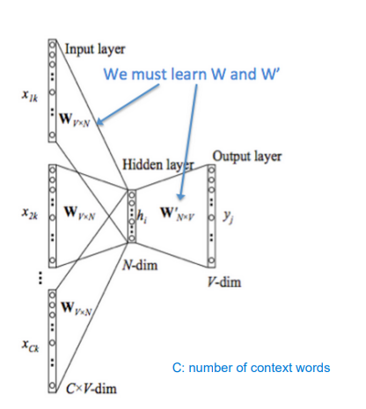
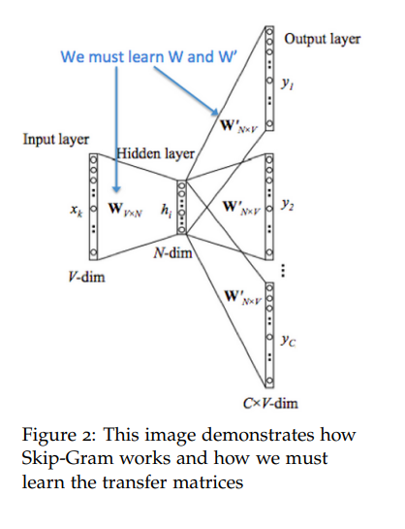
Word2vec
Word2vec is a group of simple and well-known models that are used to produce word embeddings.
Word2Vec is based on the idea that the meaning of a word can be inferred from its neighboring words. The two main architectures employed by Word2Vec are:
Continuous Bag-of-Words (CBOW): the model predicts the target word given a context of surrounding words.
Skip-gram: is the reverse of CBOW. It takes a single word as input and predicts the context words around it.
Continuous Bag-of-Words
Skip-gram

Slide 21
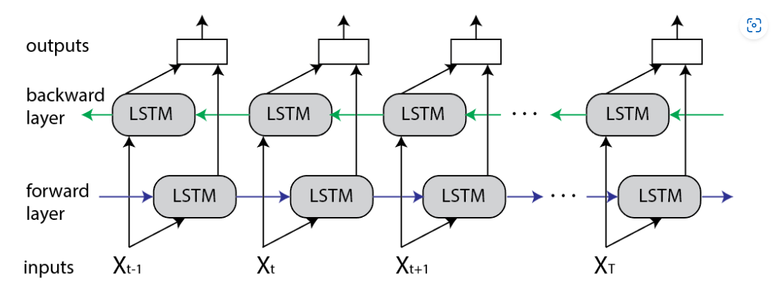
Bidirectional Long Short Term Memory(BiLSTM)
LSTM a special type of RNN is developed to solve the problem of long-term dependencies occurring in RNN by adopting the notion of cell state and hidden state
BiLSTM is simply a LSTM layer of the backward direction coupled with a LSTM layer of the forward direction
Output is the concatenation of the two layers

Slide 22
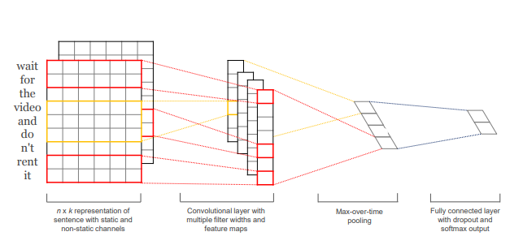
Convolutional Neural Network(CNN)
CNN has a long history of solving computer vision related tasks
In 2014, a paper named Convolutional Neural Networks for Sentence Classification showing that it turns out CNN can be very efficient in solving tasks in natural language processing(NLP) also
Convolutional operation slides along the sequence length dimension to do computation

Slide 23
Model Architechture
Embedding: learn word representation
Conv1D, BiLSTM: feature extraction
Dropout: regularization
Architecture | #params
BiLSTM | 4 124 745
CNN | 4 125 445
Layer
Embedding
Dropout
Conv1D
Conv1D
MaxPooling1D
Conv1D
Conv1D
GlobalAveragePooling1D
Dropout
Fully-connected layer
Layer
Embedding
Dropout
BiLSTM
BiLSTM
Dropout
Fully-connected layer
BiLSTM architechture
CNN architechture

Slide 24
Training process
Adam optimizer
+ learning rate = 1e-3
+ batch size = 128
+ epochs = 5
For the pretrained versions, we use GoogleNews-vectors-negative300.bin.gz (learned by Word2Vec) as the weight initialization of the embedding layer and we let the models fine-tune the embedding weights in the training process.
GoogleNews-vectors-negative300.bin.gz is produced by the model trained on part of Google News dataset (about 100 billion words) with the following details:
+ Architecture: Continuous bag-of-words (CBOW)
+ Dimensions: 300
+ Window size: 5
+ Training method: Negative sampling

Slide 25
Result
Model | Training time | Storage capacity
BiLSTM | 30min 58s | 46 092KB
CNN | 2min 30s | 45 488KB
CNN is x15 times faster
CNN and BiLSTM take up nearly the same amount of memory

Slide 26
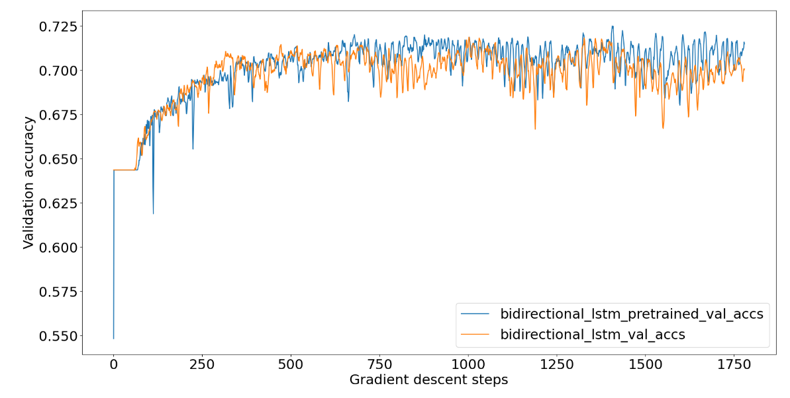
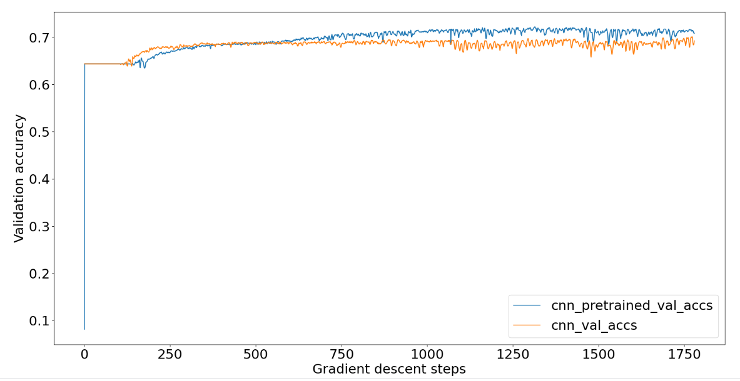
Result

Slide 27
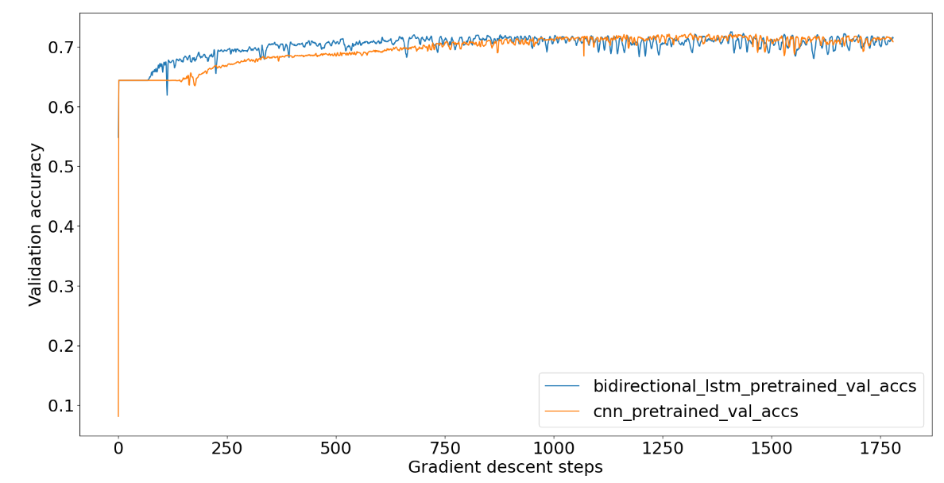
Result

Slide 28
Evaluation

Slide 29

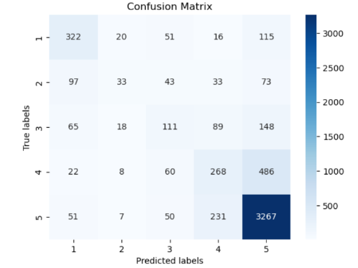
we can derive that pre-trained CNN yields the highest performance in both accuracy and training time. Therefore, we choose this model to train on both train set and validation set, then evaluate the model on test set.

Slide 30
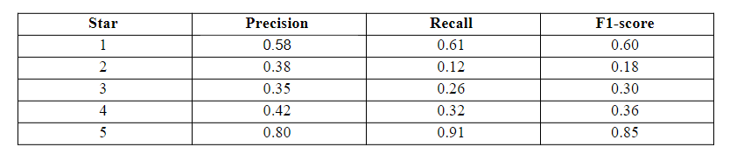
Accuracy: 0.70
Macro-average f1-score: 0.46
The model does quite a good job of predicting the instances that fall in class 5. For the hard classes such as 2, 3, and 4, the model still does not do well, we may improve this situation by training on more instances from these classes. The instances that belong to 4-star class tend to be misclassified into 5-star and vice versa.

Slide 31
Conclusion

Slide 32

Word2vec embedding matrix enhance the performances of CNN and BiLSTM
CNN gives a more stable performance
CNN is more computing efficient than BiLSTM using hardware such as GPU
Deep learning models that can take advantage from the sequence property of the text produce a better result than machine learning model
CNN with a pre-trained word2vec embedding matrix is the best model not only by its accuracy but also by its saving in computing resources. However, the model still needs to improve its performance in predicting the classes that are inherently hard. The most promising solution is using more computing resources to exploit all possible data points in the dataset.

Slide 33
THANK YOU !

