Slide 1
STM32-BASED IOT WEATHER STATION
Design and implementation using ESP32, MQTT and Node-RED
EMBEDDED SYSTEM DESIGN PROJECT
Đặng Nguyễn Nam Nhật - 22119022
Ngô Phúc Khang - 20119117
Supervisor: Huynh Hoang Ha
Ho Chi Minh City University of Technology and Engineering | October 2026

Slide 2
CHAPTER I — INTRODUCTION
Project context, motivation, objectives, scope and methodology

Slide 3
1.1 BACKGROUND AND PROJECT MOTIVATION
• Weather monitoring supports environmental awareness and automated systems, but a standalone display limits remote access.
• A network-only sensor can lose remote service when connectivity fails.
• This project combines local sensing and warnings with remote viewing: STM32 handles measurements and rain response, while ESP32 handles Wi-Fi and MQTT.
• The split architecture lets sensor and control firmware be tested separately from network and dashboard tasks.
• The prototype is intended for academic demonstration; it is not a calibrated meteorological instrument.

Slide 4
1.2 OBJECTIVES, SCOPE AND METHOD
OBJECTIVES
• Measure temperature, humidity, pressure, light and rain; show values locally and remotely.
• Classify rain as DRY, LOW or HEAVY and provide an audible warning.
• Test sensor/display operation, UART and MQTT delivery, network recovery and power-cycle restart.
SCOPE AND METHOD
• Integrate STM32F103C8T6, ESP32, four sensor modules, OLED and active buzzer.
• Configure and test modules individually, integrate firmware, then validate the sensor-to-dashboard path.
• Excludes weatherproofing, reference calibration, persistent storage, wind/rainfall-quantity sensing and battery optimization.

Slide 5
CHAPTER II — LITERATURE REVIEW
Weather-monitoring architecture, sensing components, communication interfaces and software tools

Slide 6
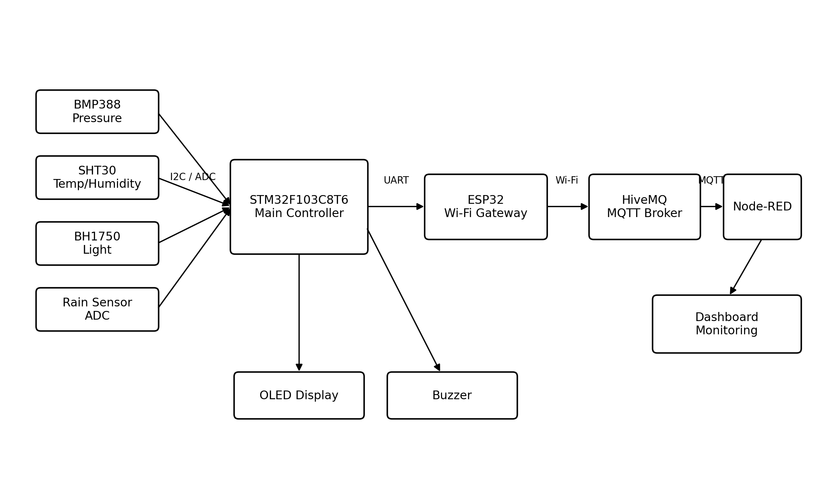
2.1 OVERVIEW OF IOT WEATHER MONITORING SYSTEMS
• An IoT weather station links sensors, local processing, wireless transport, a broker and a monitoring dashboard.
• Local processing can preserve basic measurement and warning functions when Internet access is unavailable.
• Here, STM32 performs sensing and local control while ESP32 provides the network gateway.
• HiveMQ brokers MQTT messages; Node-RED subscribes and presents the latest readings.
• The report’s block diagram summarizes this end-to-end data path.
System block diagram from the report

Slide 7
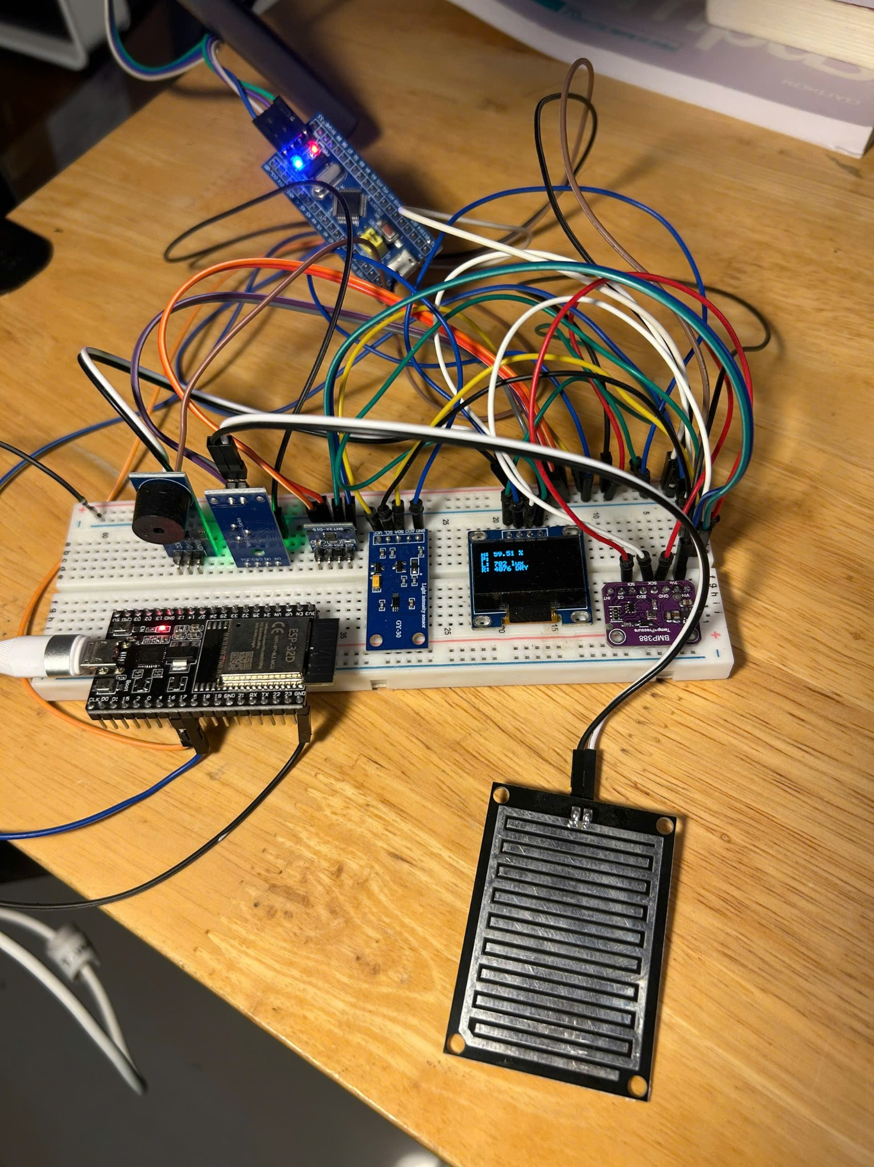
2.2 HARDWARE COMPONENTS AND ROLES
• STM32F103C8T6 is the main controller for sensor acquisition and local outputs.
• SHT30 measures temperature and humidity; BMP388 measures pressure; BH1750 measures ambient light.
• The analog rain module provides a wetness-related ADC reading.
• A 0.96-inch SSD1306 OLED displays local measurements; an active-low buzzer signals rain state.
• ESP32 DOIT DevKit V1 provides Wi-Fi connectivity; the modules were assembled on a breadboard for testing.
Final hardware prototype documented in the report

Slide 8
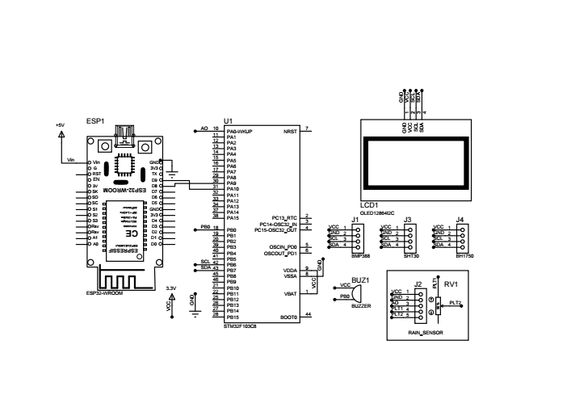
2.10 COMMUNICATION INTERFACES
• I2C1 uses PB6/SCL and PB7/SDA to connect SHT30, BMP388, BH1750 and OLED at 100 kHz.
• Rain sensor analog output connects to PA0 / ADC1 channel 0; buzzer control is PB0 (active-low).
• USART1 PA9/TX connects to ESP32 GPIO16/RX; PA10/RX connects from GPIO17/TX.
• UART is configured for 115200 bit/s, 8-N-1; STM32 and ESP32 share a common ground.
• Breadboard wiring suits the prototype; field use needs protected, secure connections.
Circuit schematic from the report

Slide 9
CHAPTER III — SYSTEM DESIGN
3.1 SYSTEM REQUIREMENTS
• Measure temperature, humidity, pressure, light and rain; show values locally and remotely.
• Keep local measurements and rain warnings available during network interruption.
3.2 OVERALL SYSTEM ARCHITECTURE
• STM32 acquires and processes sensor data; ESP32 transfers valid readings through Wi-Fi/MQTT to HiveMQ and Node-RED.
3.4–3.5 SENSOR ACQUISITION AND RAIN LOGIC
• About one-second cycle; digital sensors use I2C; rain uses ADC1 channel 0 (PA0).
• DRY ≥3000: buzzer OFF; LOW 1500–2999: 150 ms beep; HEAVY <1500: continuous ON.
• Prototype-specific thresholds; rain ADC generally falls as the plate gets wetter and should be calibrated for each installation.

Slide 10
3.6 STM32-TO-ESP32 WEATHER DATA FRAME
• STM32 sends a fixed 16-byte binary packet over UART at 115200 bit/s, 8-N-1. Bytes 0–1 contain the 0xAA 0x55 header.
• Bytes 2–3: temperature ×100 (signed int16); bytes 4–5: relative humidity ×100 (uint16).
• Bytes 6–9: pressure ×100 (uint32, little-endian); bytes 10–11: light in lux (uint16).
• Bytes 12–13: raw rain ADC (uint16); byte 14: state (0 DRY, 1 LOW, 2 HEAVY).
• Byte 15 is the XOR checksum of bytes 0–14. ESP32 checks the header and checksum before decoding and publishing.
• The checksum detects basic transmission errors; it is not cryptographic protection.

Slide 11
3.10 SYSTEM OPERATING FLOWCHART
The report flowchart follows initialization, sensing, local rain response, UART transfer, Wi-Fi/MQTT publishing, dashboard update and the next measurement cycle.

Slide 12
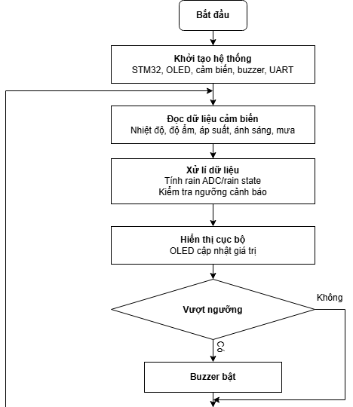
3.10 SYSTEM OPERATING FLOWCHART — PART 1
Original report flowchart, upper sequence: initialization, sensing, local display, rain warning and UART transfer.

Slide 13
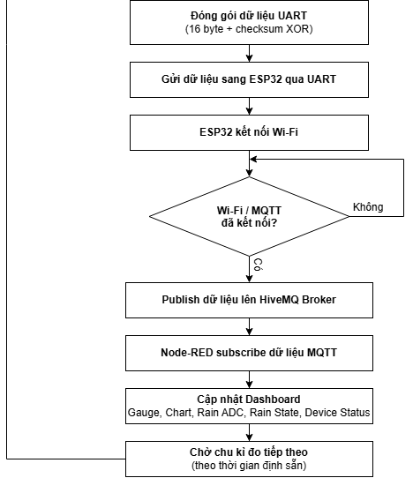
3.10 SYSTEM OPERATING FLOWCHART — PART 2
Original report flowchart, continued: ESP32 connectivity, MQTT publishing, Node-RED dashboard and cycle restart.

Slide 14
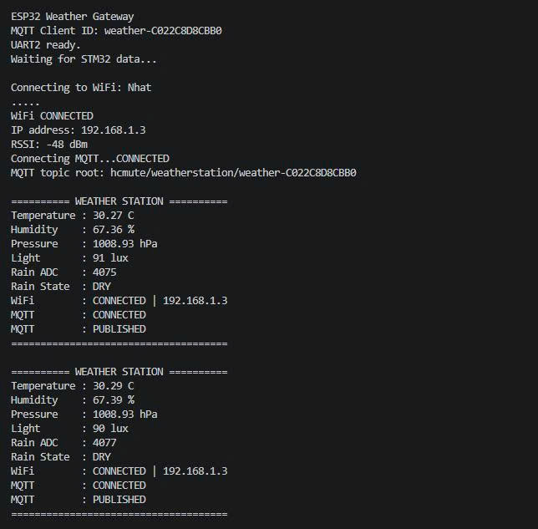
CHAPTER IV — SYSTEM IMPLEMENTATION
4.1 HARDWARE IMPLEMENTATION
• The prototype was assembled on a breadboard to support module-level testing and replacement; the wiring follows the circuit design in Chapter II.
4.2 STM32 FIRMWARE
• STM32CubeMX configures clock, GPIO, I2C, ADC and USART; Keil MDK-ARM builds and debugs the project.
• Separate modules handle SHT30, BMP388, BH1750, rain sensing, OLED updates and UART framing.
• The main loop refreshes readings and local outputs, then sends a 16-byte frame about once per second.
ESP32 serial diagnostics during normal system operation

Slide 15
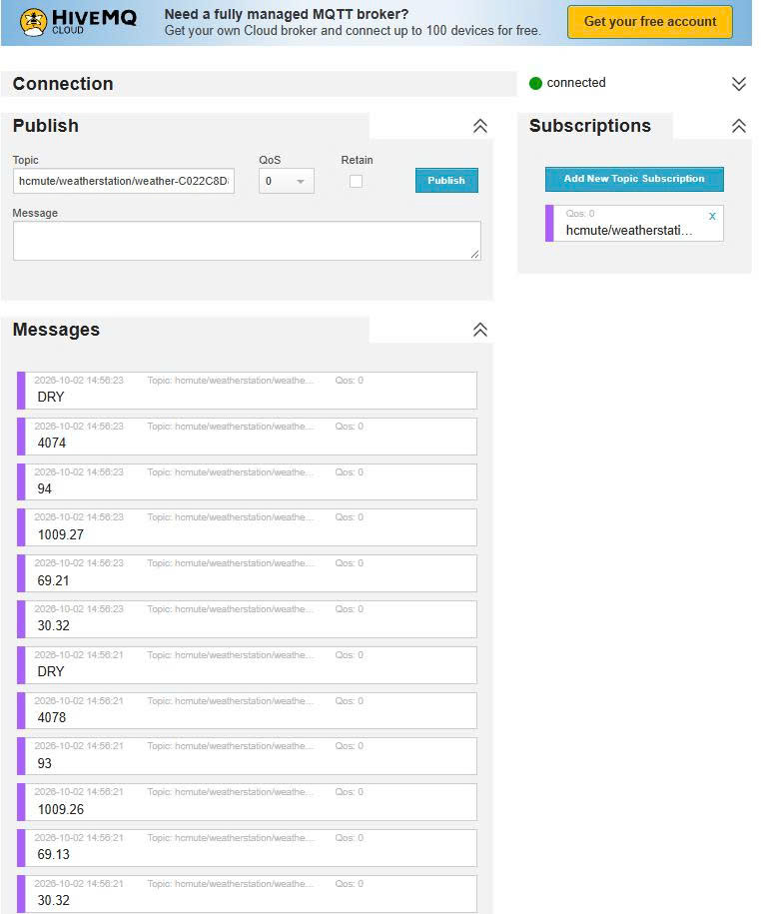
4.3 ESP32 FIRMWARE AND MQTT GATEWAY
• PlatformIO/Arduino configures UART2 (GPIO16/17, 115200); ESP32 syncs on 0xAA 0x55, verifies XOR and decodes each 16-byte frame.
• It reconnects to Wi-Fi/MQTT and publishes only valid readings to HiveMQ.
• Topics cover temperature, humidity, pressure, light, raw rain, rain state and device status.
• Serial logs show values, IP/RSSI and publish status. The public broker is for testing; production requires authentication and encryption.
Weather messages received through HiveMQ in the report

Slide 16
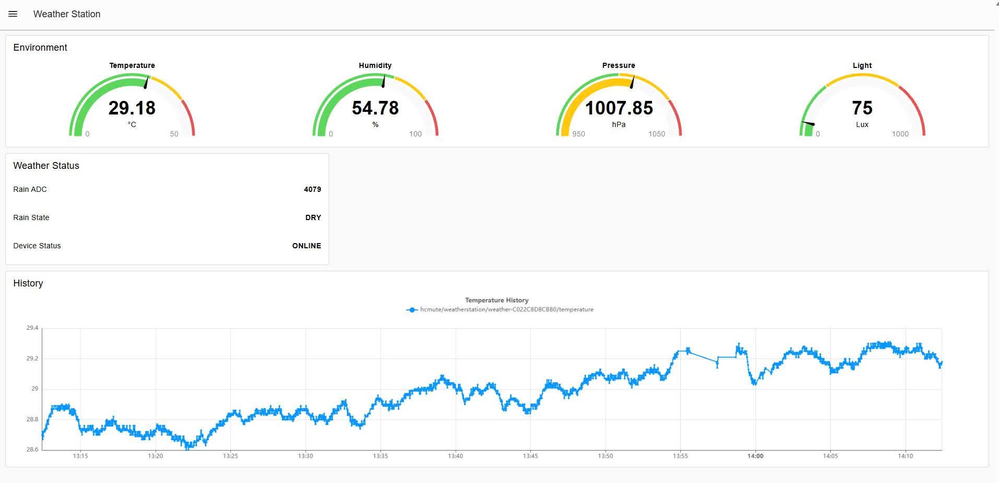
4.4–4.6 MQTT, NODE-RED FLOW AND DASHBOARD
• MQTT In subscribes to weather topics; a Switch node routes each message by topic.
• Gauges show temperature, humidity, pressure and light; status fields show rain ADC, rain state and device connectivity.
• A chart shows recent temperature history; the report does not use persistent database storage.
• The dashboard separates remote viewing from local sensing and rain warnings on STM32.
Node-RED dashboard screenshot from the report

Slide 17
CHAPTER V — RESULTS AND EVALUATION
Functional outcomes, rain-warning behavior, network recovery and prototype limitations

Slide 18
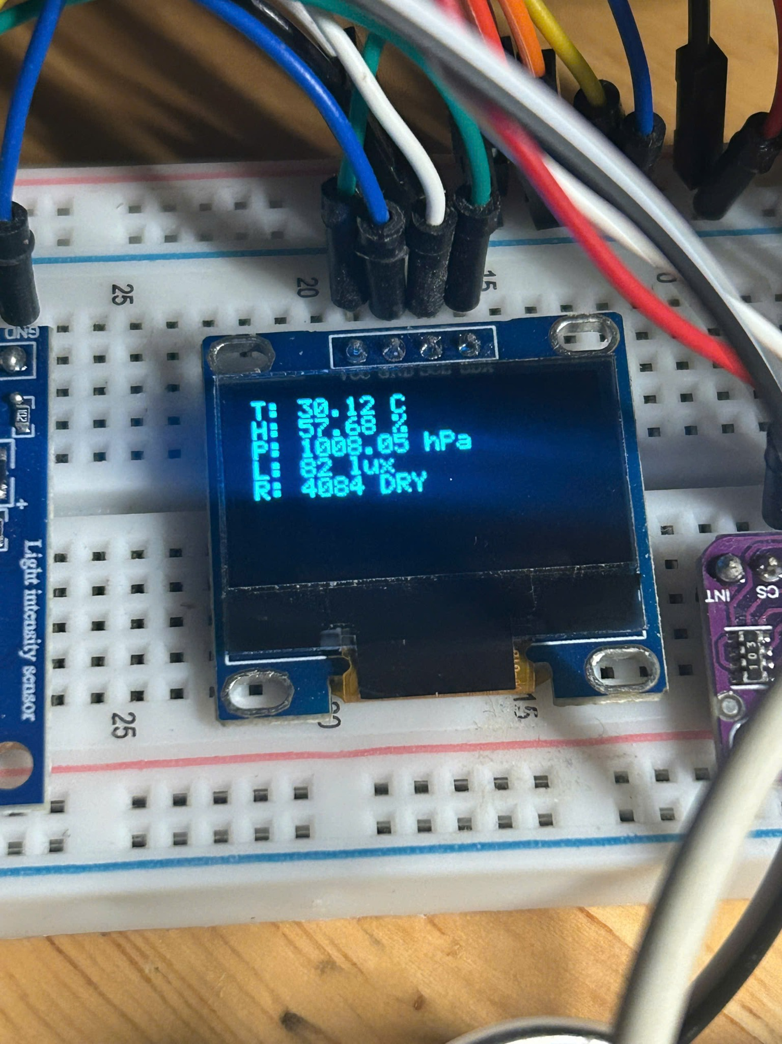
5.1 FUNCTIONAL TEST RESULTS
NORMAL OPERATION
• Temperature, humidity, pressure, light and rain readings updated during the functional checks.
• OLED displayed local values; rain-state changes triggered the expected buzzer behavior.
END-TO-END CHECKS
• UART transfer, Wi-Fi/MQTT publication, HiveMQ reception and Node-RED dashboard update were marked PASS in the report.
• DRY (≥3000): buzzer OFF; LOW (1500–2999): short beep; HEAVY (<1500): continuous ON.
• The report presents functional checks, not quantified accuracy or latency results.
OLED local display captured during testing

Slide 19
5.7–5.10 RECOVERY, EVALUATION AND LIMITATIONS
RECOVERY TESTS
• During Wi-Fi loss, STM32 continued sensor sampling, OLED refresh and rain alerts.
• After Wi-Fi returned, ESP32 reconnected to the network and MQTT broker, then resumed publishing.
• After a full power cycle, sensing, UART, MQTT and dashboard updates resumed without manual reconfiguration.
EVALUATION AND LIMITATIONS
• The prototype uses a breadboard and is not weatherproof.
• Rain thresholds need calibration for each sensor and mounting condition; no reference-instrument comparison is reported.
• The public MQTT broker, lack of persistent storage, missing wind/rainfall-quantity sensors and no battery optimization limit field deployment.

Slide 20
CHAPTER VI — CONCLUSION AND FUTURE WORK
6.1 CONCLUSION
• STM32 handles sensing, rain response and the OLED; ESP32 provides Wi-Fi/MQTT for remote monitoring.
• HiveMQ and Node-RED present weather readings, status and temperature history.
• Functional checks passed for sensors, rain warning, UART/MQTT, dashboard updates, network reconnection and power-cycle recovery.
6.2 FUTURE WORK
• Build a PCB and weather-resistant enclosure; calibrate against a reference instrument.
• Use authenticated TLS MQTT and persistent data storage.
• Add wind/rain sensors, mobile alerts and low-power battery/solar operation.

