Slide 1

Requirements Analysis and Design
FINAL PROJECT Topic: Online sales website
GROUP: 02
Ngô Đức Huy – 522H0038
Đặng Thành Nhân – 522H0006
Võ Nhật Hào – 522H0090
Nguyễn Thành Nhân – 522H0051

Slide 2
Table of contents
01
02
03
USE CASE DIAGRAM
ACTIVITY DIAGRAM
CLASS DIAGRAM
04
05
SEQUENCE DIAGRAM
DATABASE MODEL

Slide 3
Task 1:
Use case Diagram

Slide 4
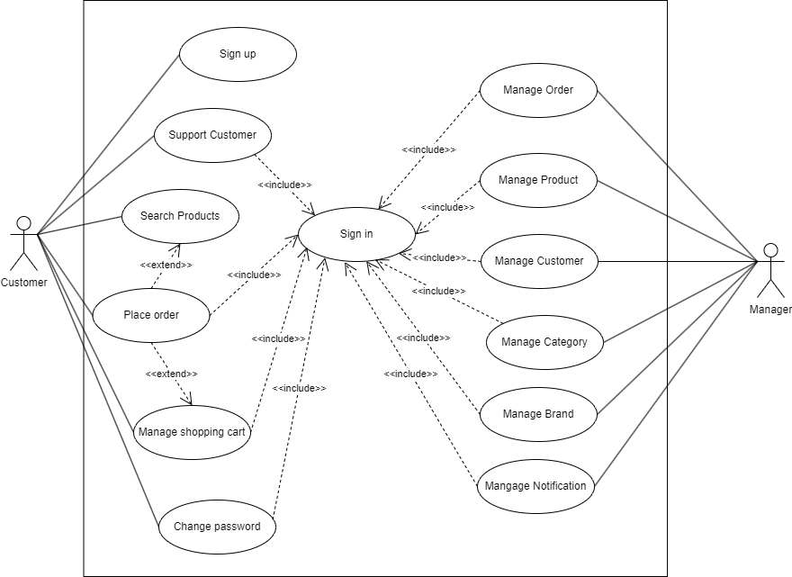
General Use case Diagram

Slide 5
2. Decomposition use case

Slide 6
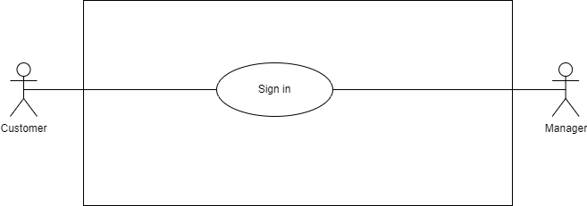
2.1 Use case of “Sign in”

Slide 7
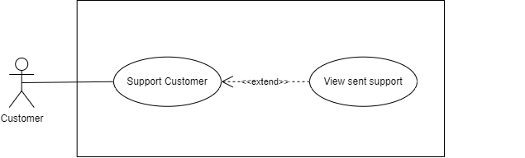
2.2 Use case of “Support customer”

Slide 8
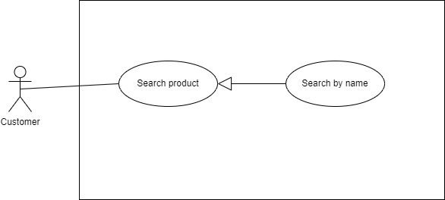
2.2 Use case of “Search Products”

Slide 9
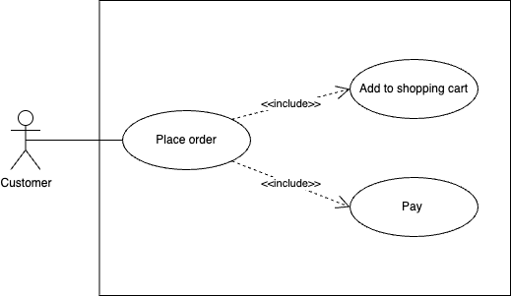
2.3 Use case of “Place Order”

Slide 10
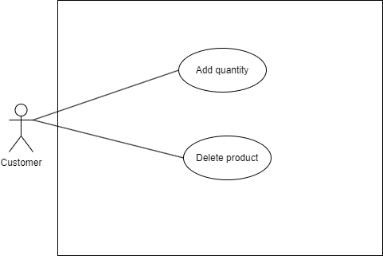
2.4 Use case of “Manage Shopping Cart”

Slide 11
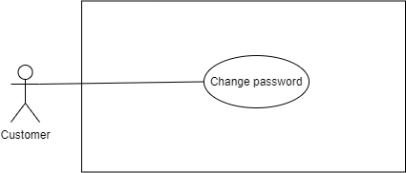
2.5 Use case of “Change Password”

Slide 12
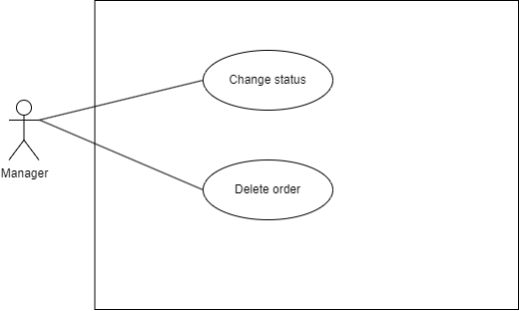
2.6 Use case of “Manage Order”

Slide 13
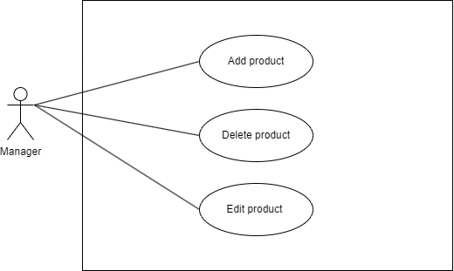
2.8 Use case of “Manage Product”

Slide 14
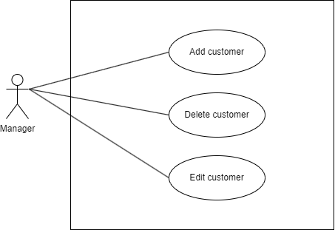
2.7 Use case of “Manage Customer”

Slide 15
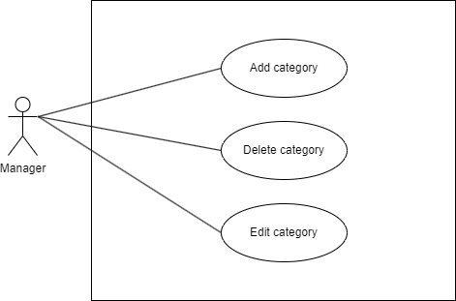
2.8 Use case of “Manage Category”

Slide 16
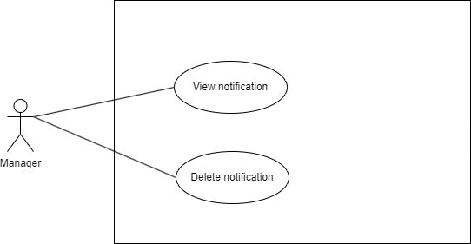
2.10 Use case of “Manage notification”

Slide 17
Task 2:
Activity Diagram

Slide 18
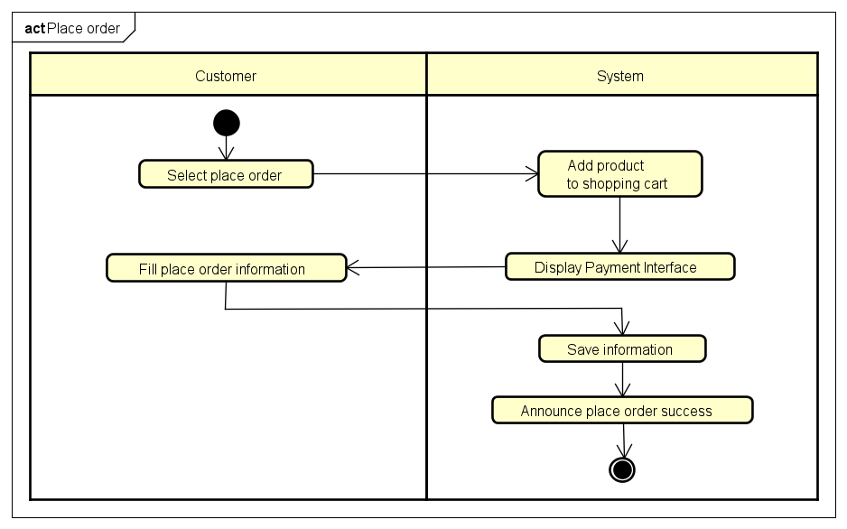
Activity Diagram of “Place Order”

Slide 19
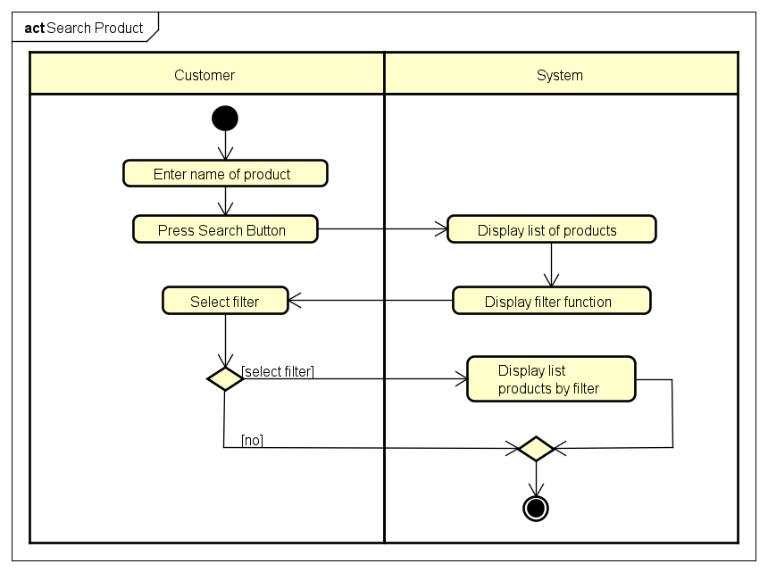
2. Activity Diagram of “Search Product”

Slide 20
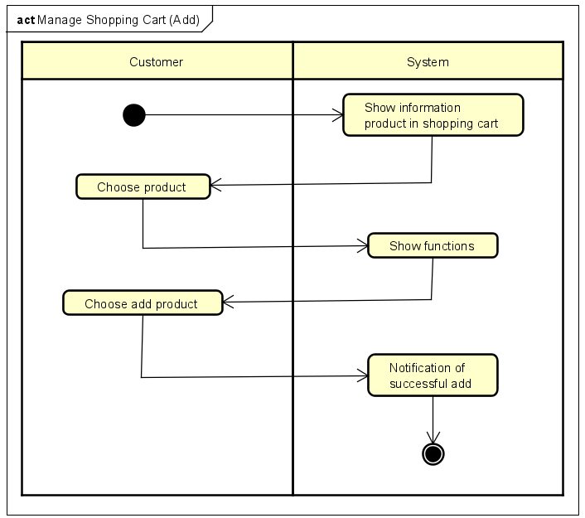
3.1 Activity Diagram of “Manage Shopping Cart (Add)”

Slide 21
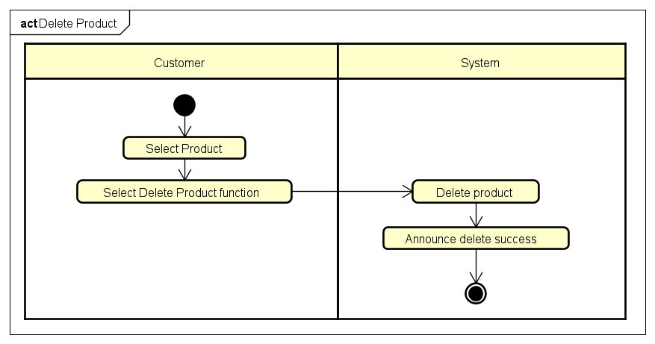
3.2 Activity Diagram of “Manage Shopping Cart (Delete)”

Slide 22
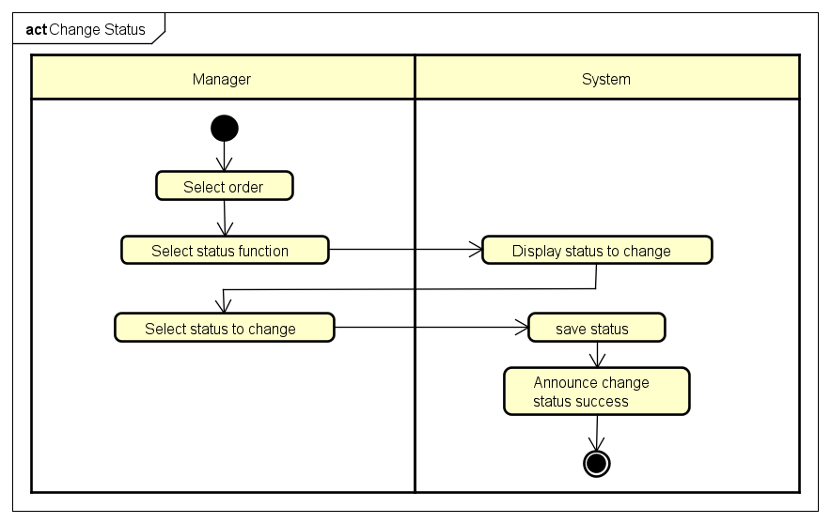
4.1 Activity Diagram of “Manage Order (Change status)”

Slide 23
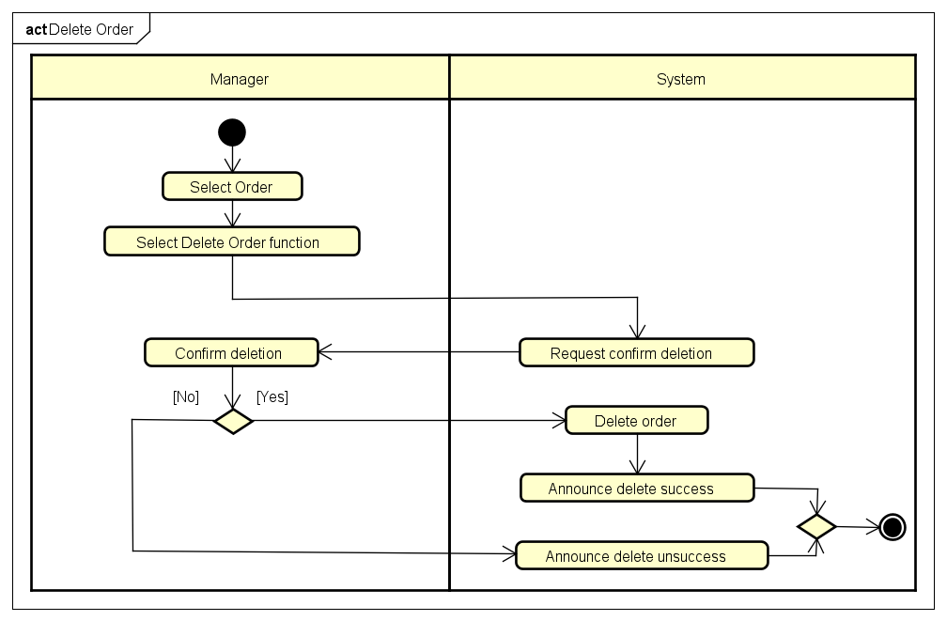
4.2 Activity Diagram of “Manage Order (Delete)”

Slide 24
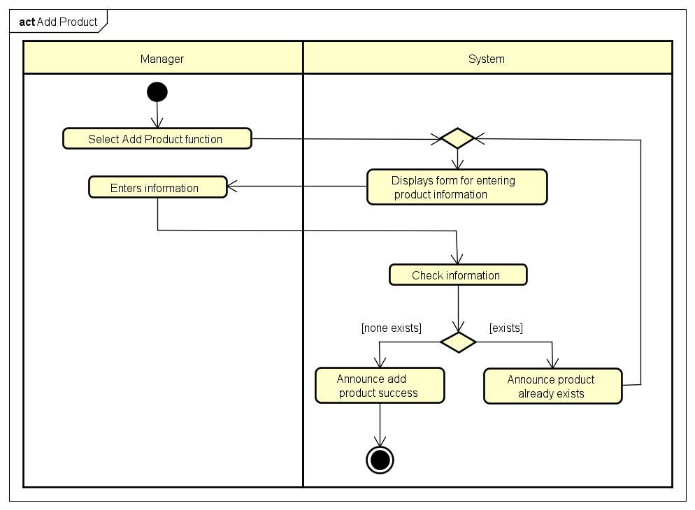
5. Activity Diagram of “Manage Product (Add)”

Slide 25
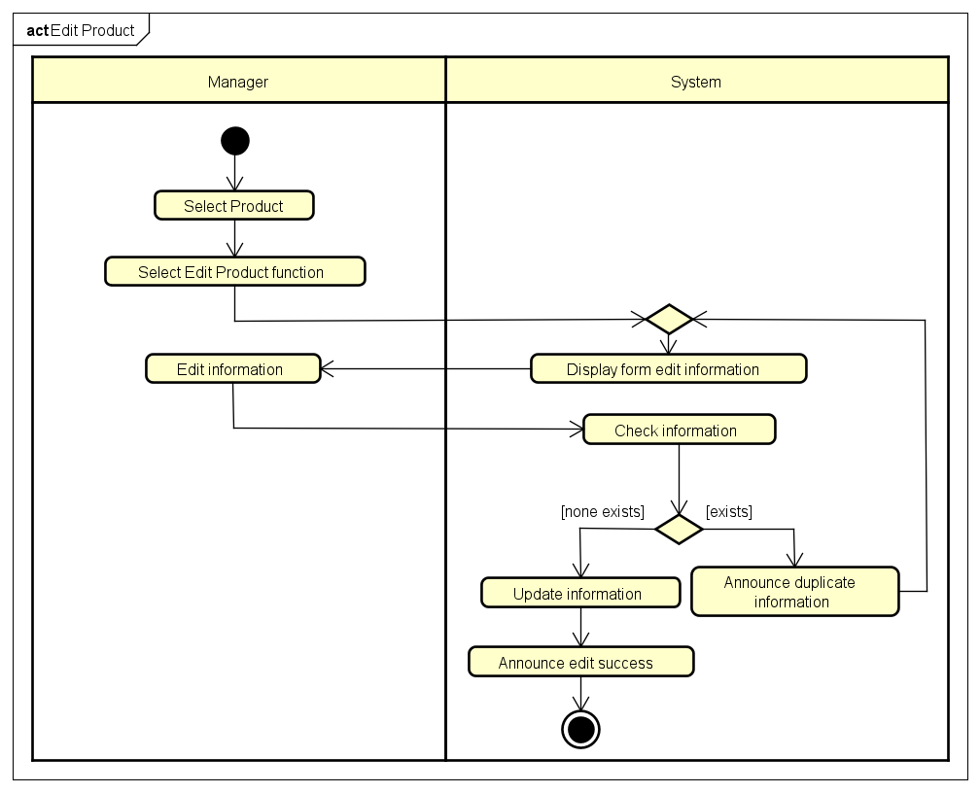
5. Activity Diagram of “Manage Product (Edit)”

Slide 26

6. Activity Diagram of “Manage Product (Delete)”

Slide 27
Task 3:
Sequence Diagram

Slide 28
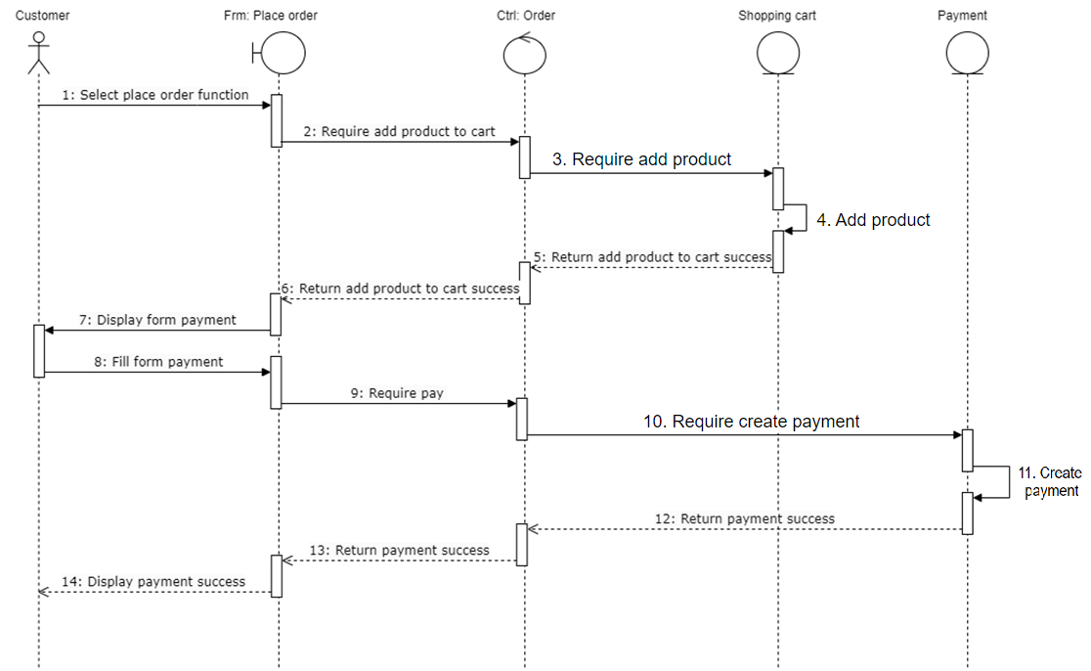
Sequence Diagram of “Place Order”

Slide 29
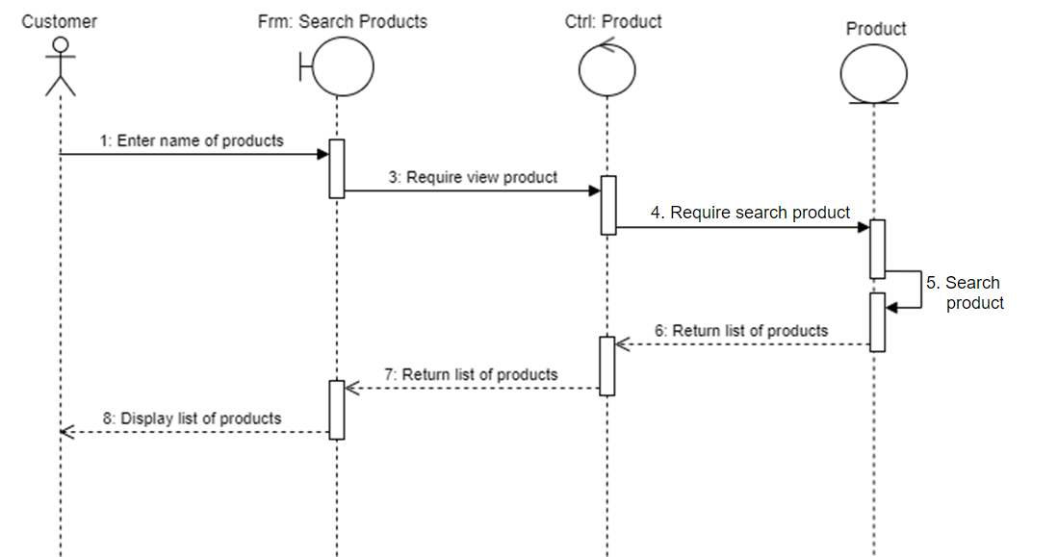
2. Sequence Diagram of “Search”

Slide 30
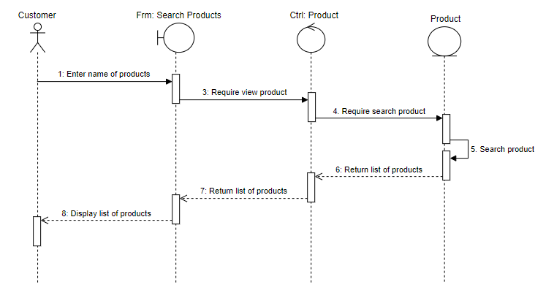
2. Sequence Diagram of “Search filter”

Slide 31
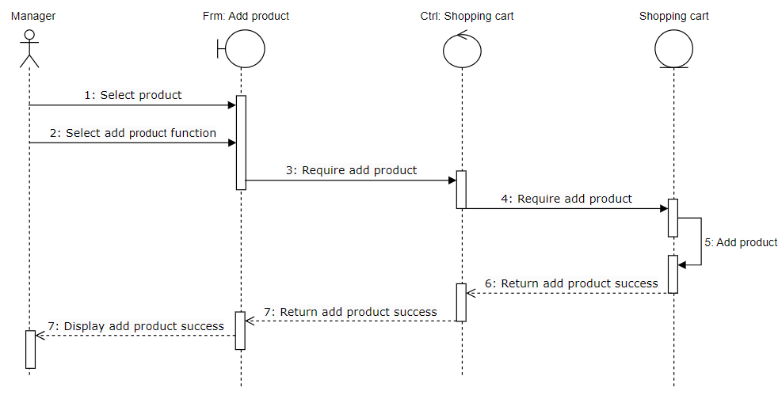
3.1 Sequence Diagram of “Manage Shopping Cart (Add)”

Slide 32
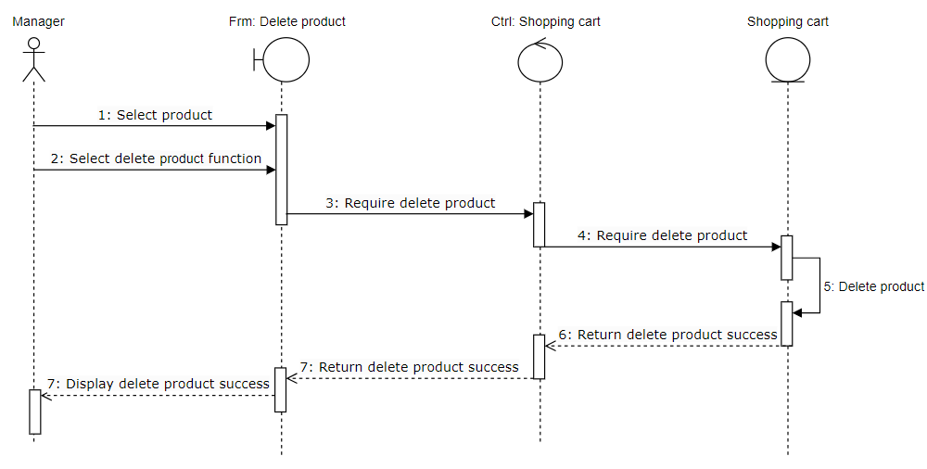
3.2 Sequence Diagram of “Manage Shopping Cart (Delete)”

Slide 33
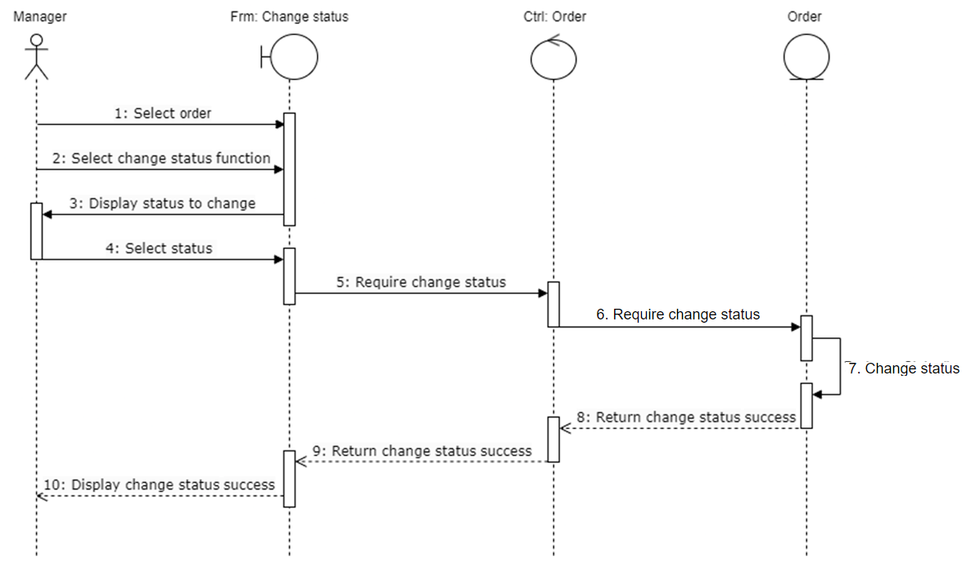
4.1 Sequence Diagram of “Manage Order (Change status)”

Slide 34
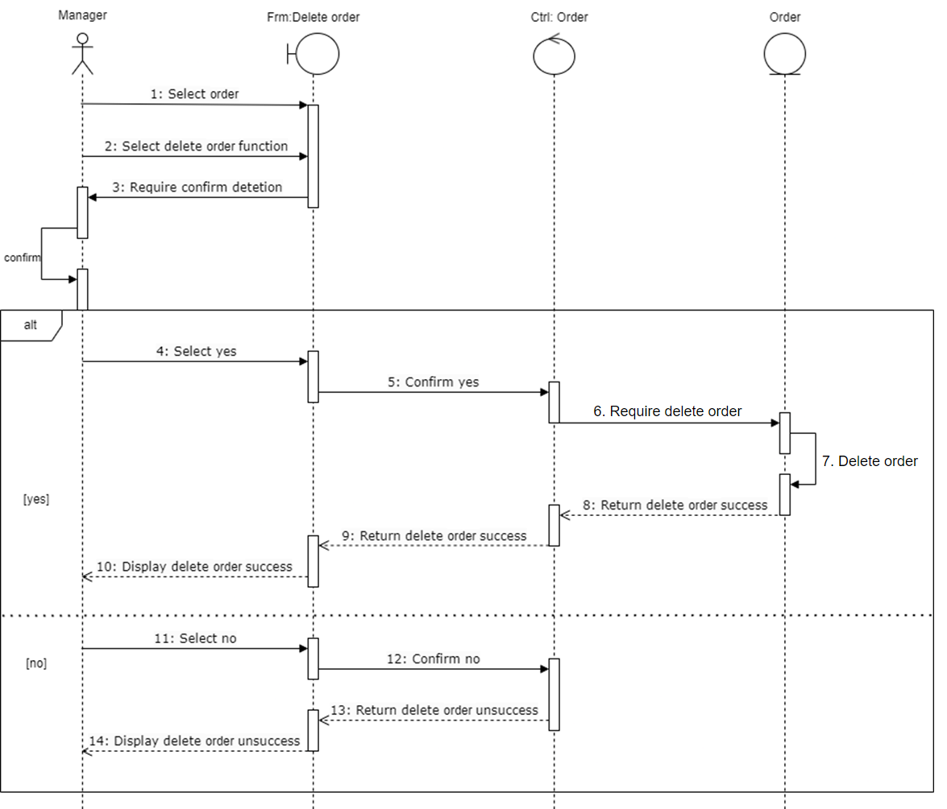
4.2 Sequence Diagram of “Manage Order (Delete)”

Slide 35
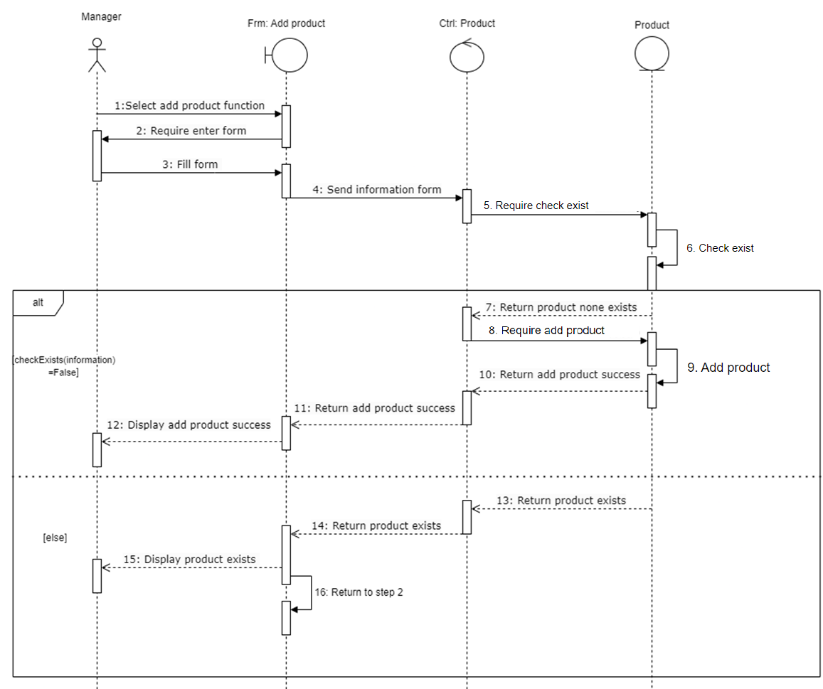
5.1 Sequence Diagram of “Manage Product (Add)”

Slide 36
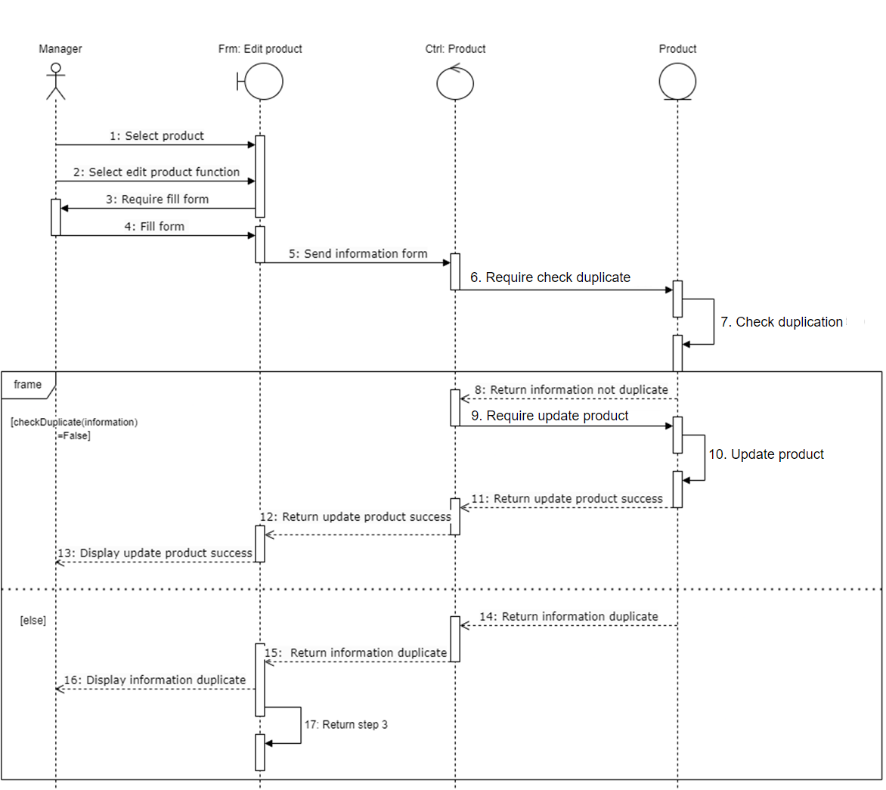
5.2 Sequence Diagram of “Manage Product (Edit)”

Slide 37
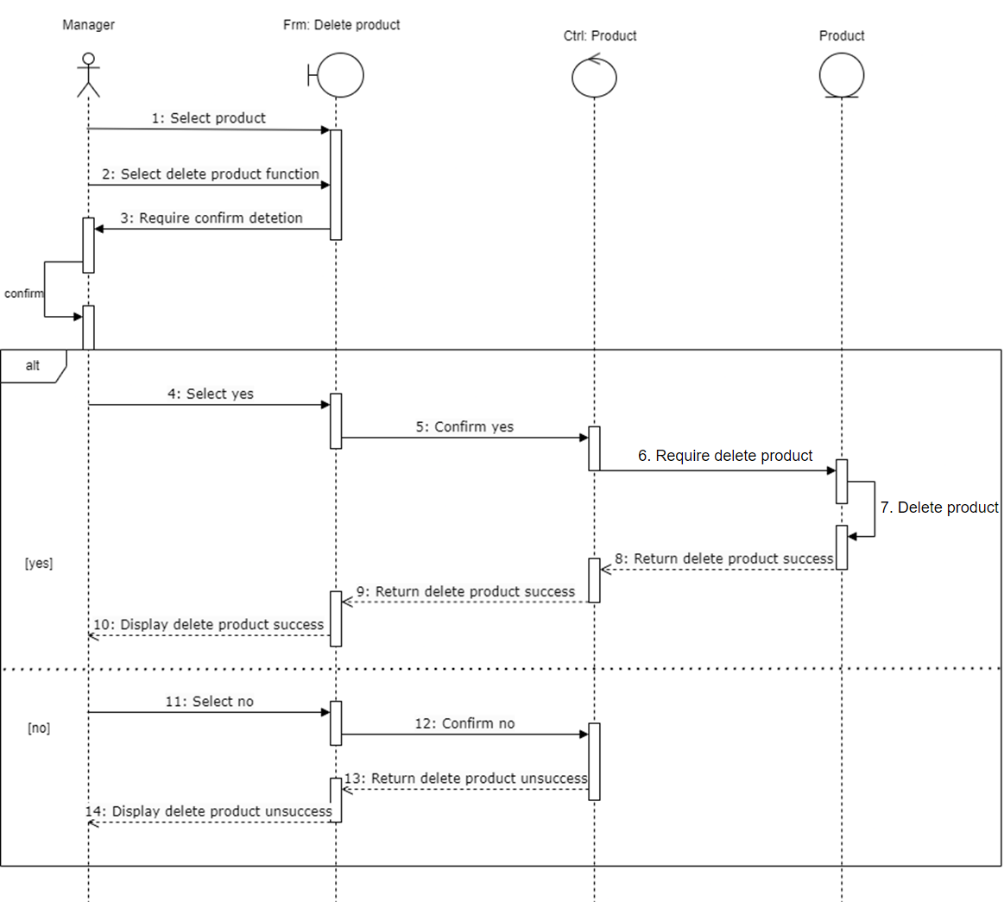
5.3 Sequence Diagram of “Manage Product (Delete)”

Slide 38
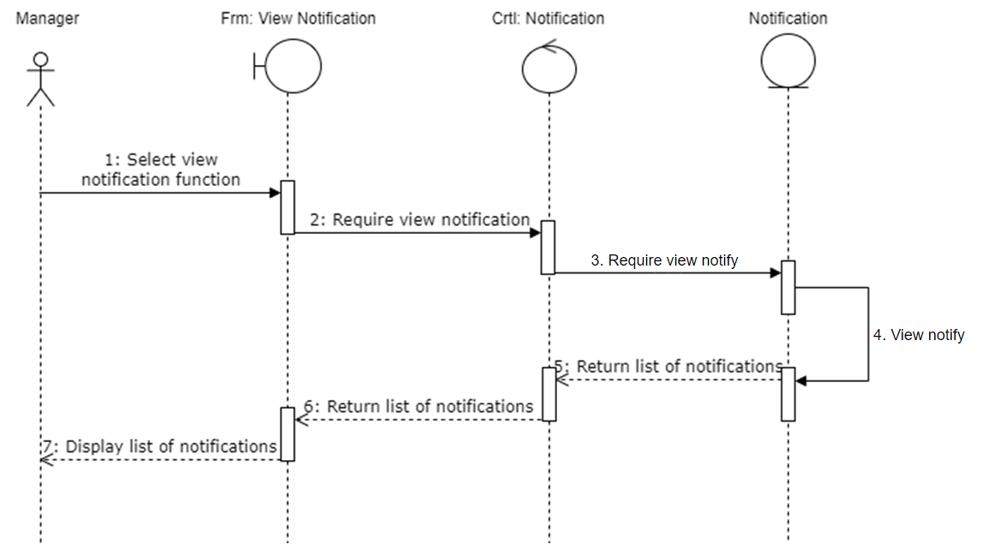
7. Sequence Diagram of “Manage notification”

Slide 39
Task 4:
Class Diagram

Slide 40
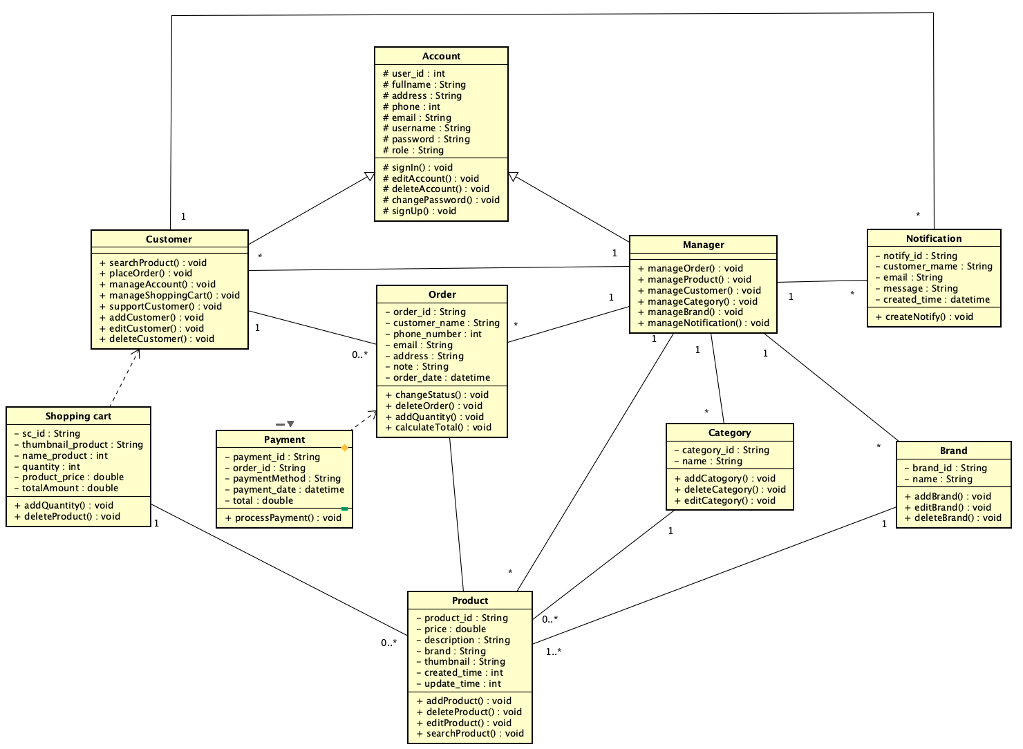
Class Diagram

Slide 41
Task 5:
Database model

Slide 42
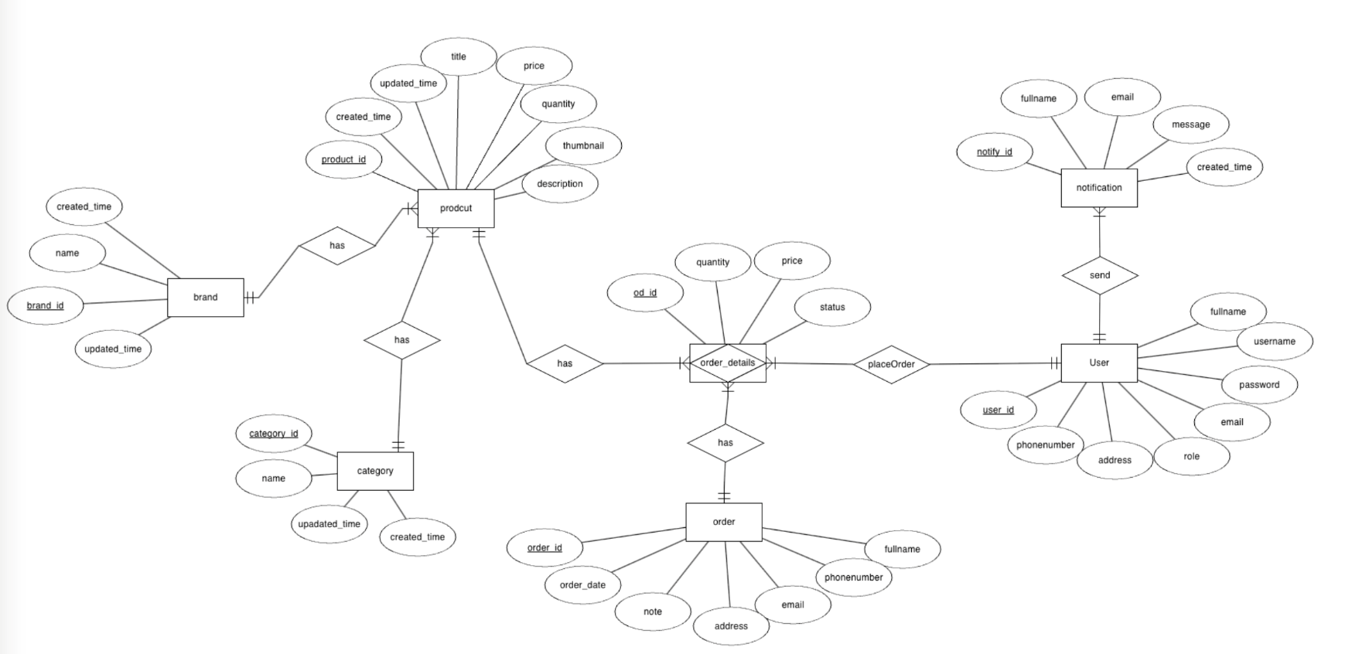
ERD

Slide 43
THANKS YOU
FOR LISTENING ❤️

