Slide 1

Linear Regression and Feature Selection
Assoc. Prof. Quan Thanh Tho

Slide 2
Learning Objectives
Regression – estimation of the relationship between variables
Linear regression
Assessing the assumptions
Non-linear regression

Slide 3
Learning Objectives
Regression – estimation of the relationship between variables
Linear regression
Assessing the assumptions
Non-linear regression
Correlation
Correlation coefficient quantifies the association strength
Sensitivity to the distribution

Slide 4
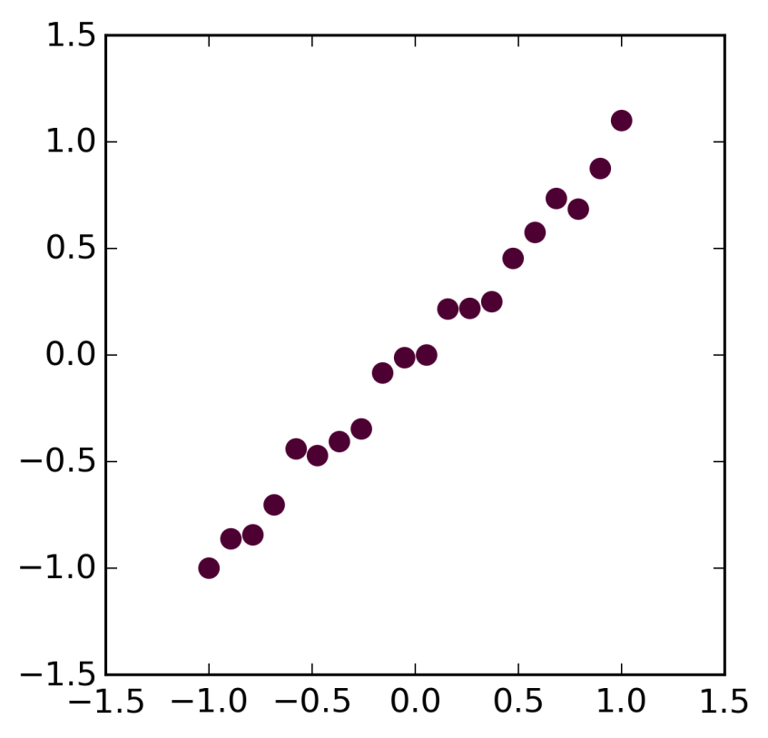
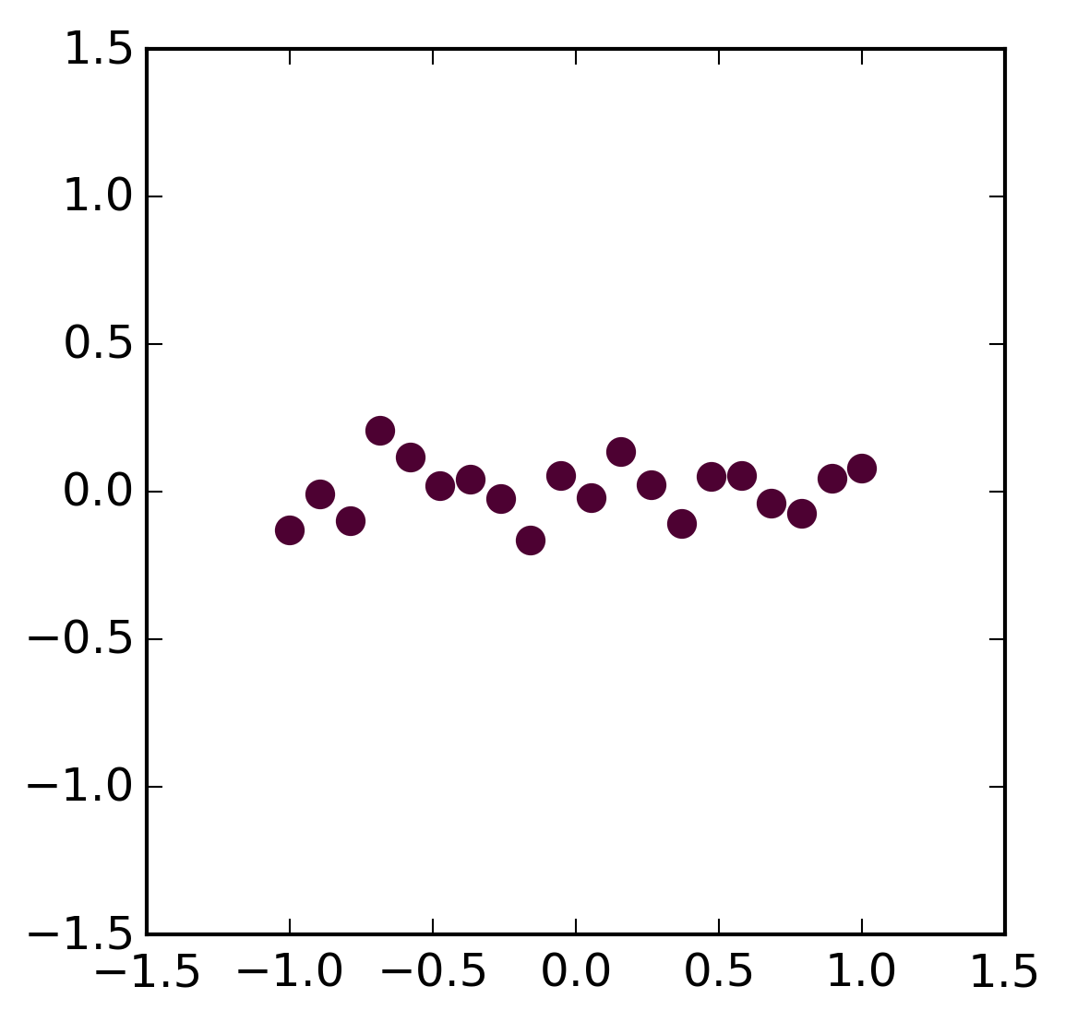
Relationships
Relationship
No Relationship

Slide 5
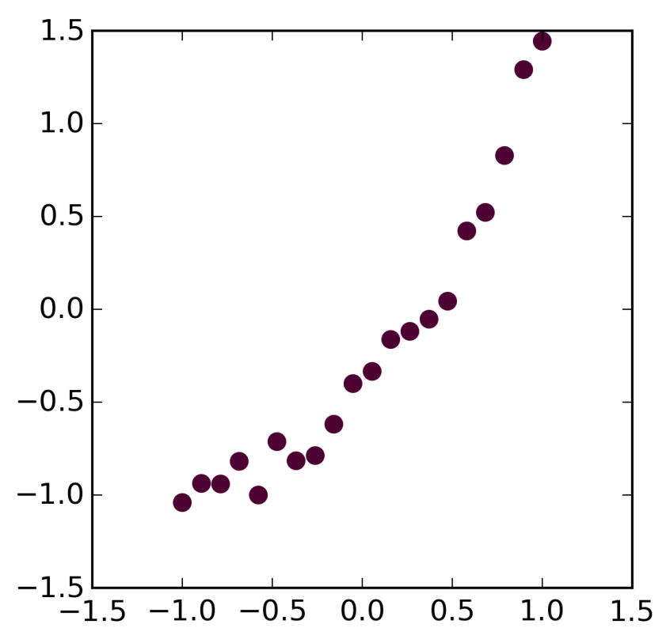
Relationships
Linear Relationships
Non-Linear Relationship

Slide 6
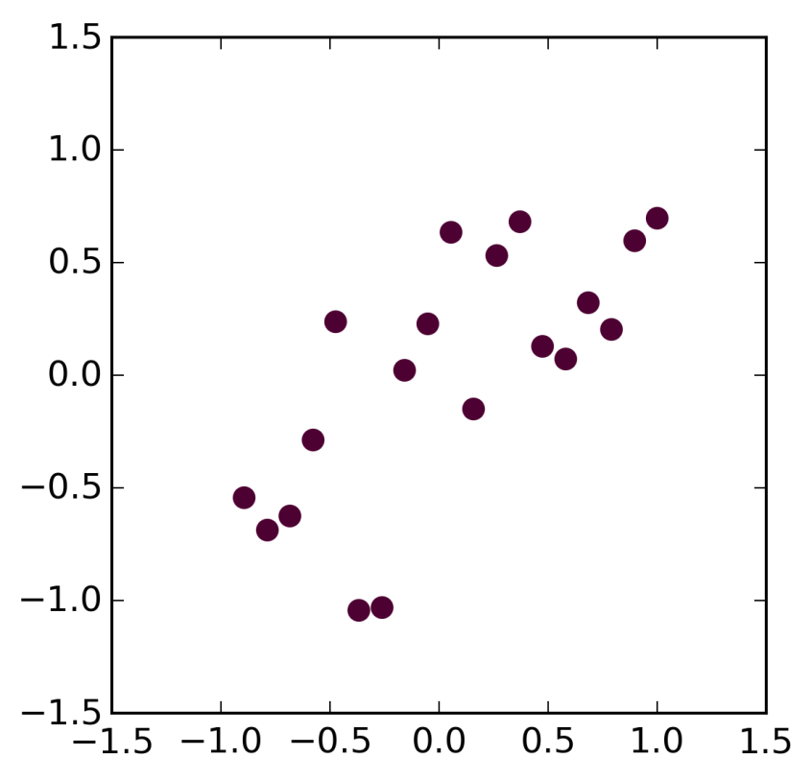
Relationships
Linear, Strong
Linear, Weak

Slide 7
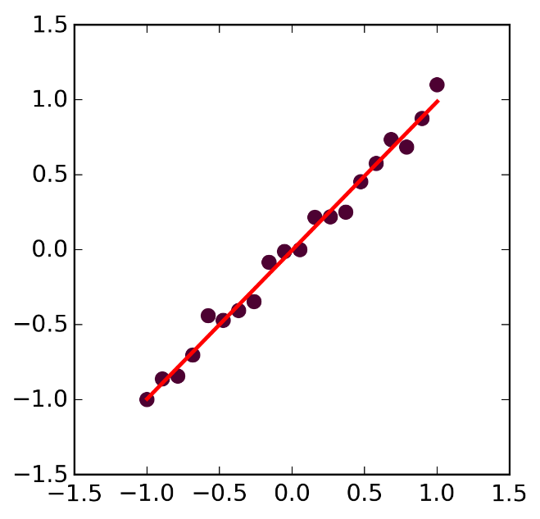
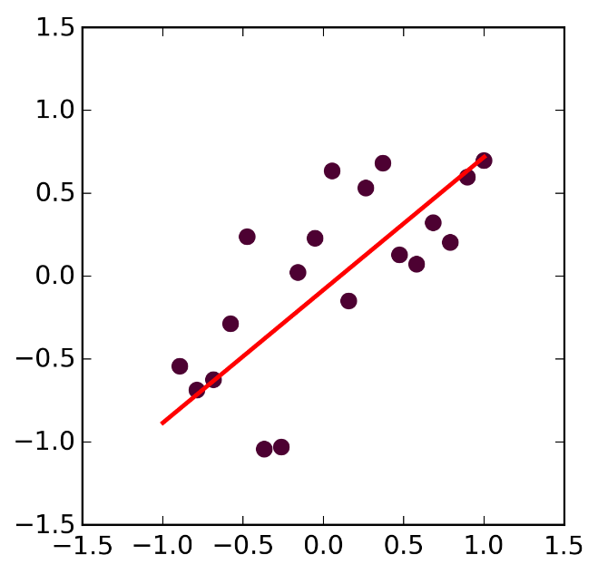
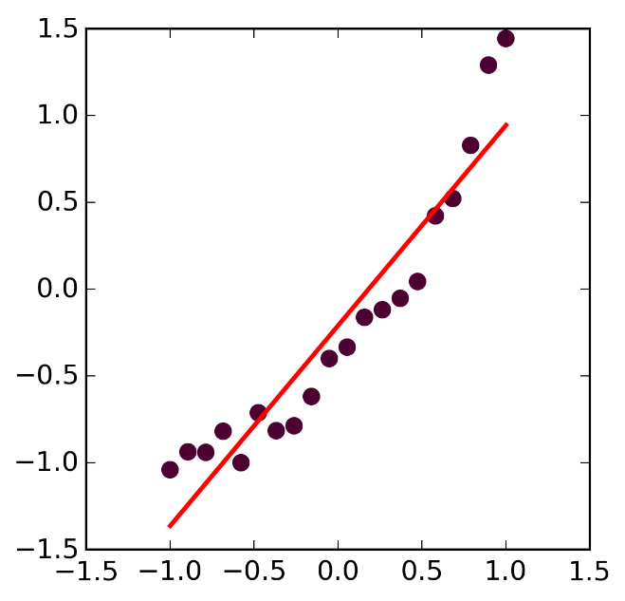
Linear Regression
Linear, Strong
Linear, Weak
Non-Linear

Slide 8
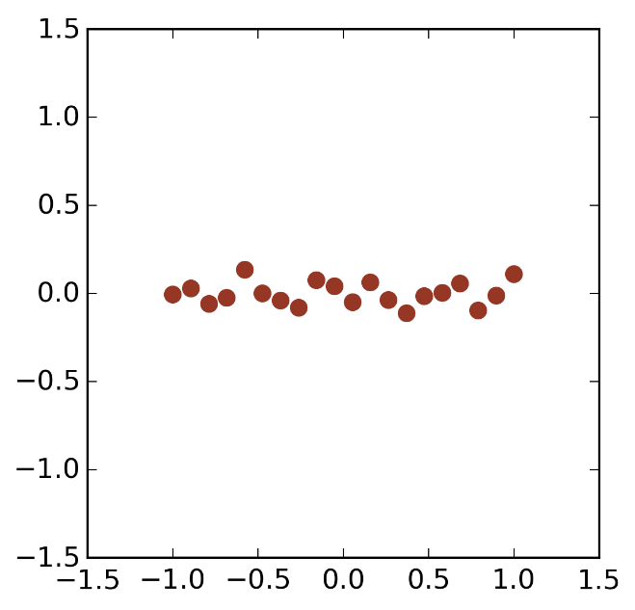
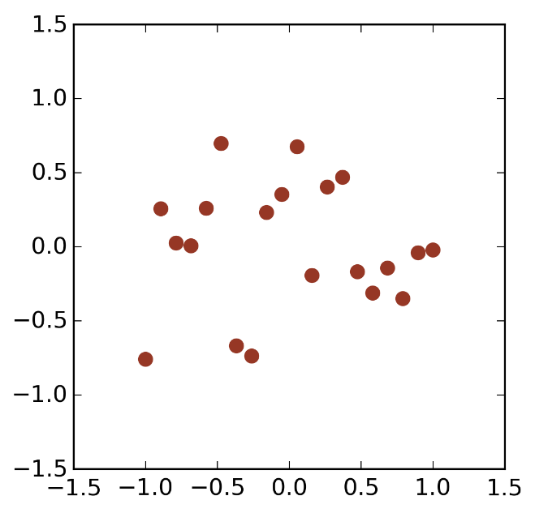
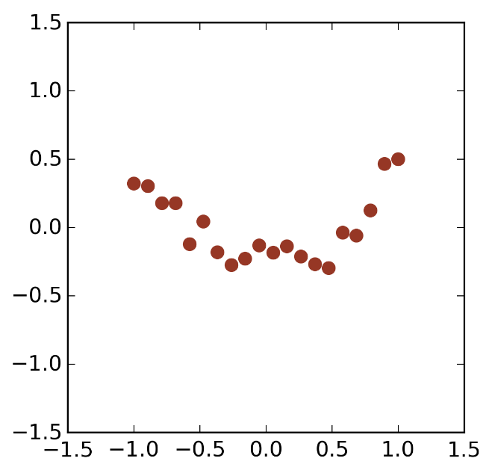
Linear Regression - Residuals
Linear, Strong
Linear, Weak
Non-Linear
Residuals
Residuals
Residuals

Slide 9
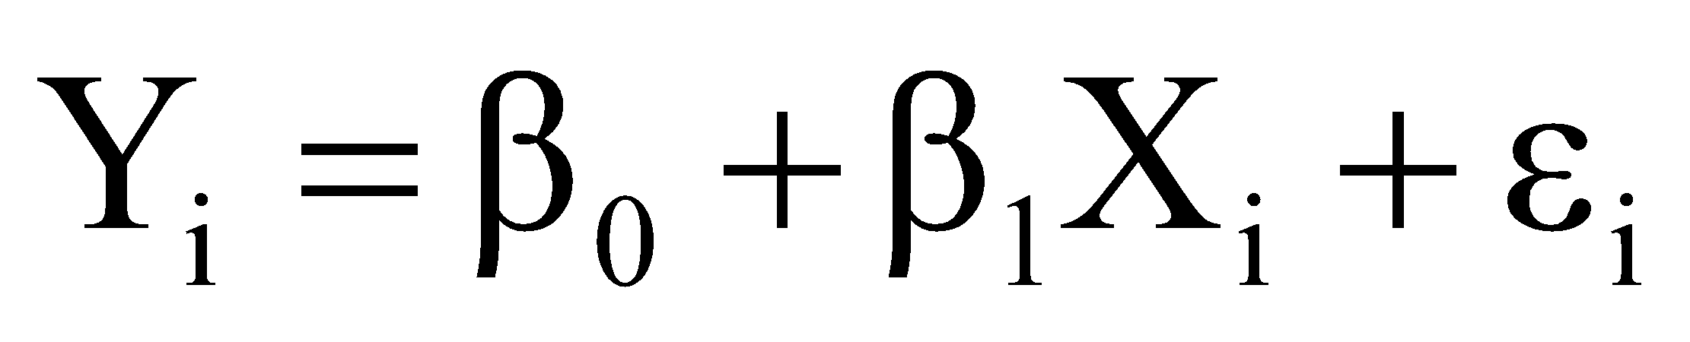
Linear Regression Model
Slope
Independent Variable
Intercept
Dependent Variable
Random Error
Linear
component
Random Error
component

Slide 10
Linear Regression Assumptions
The relationship between the variables is linear.

Slide 11
Linear Regression Assumptions
The relationship between the variables is linear.
Errors are independent, normally distributed with mean zero and constant variance.

Slide 12
Linear Regression Assumptions
Linear
Non-Linear
Residuals
Residuals

Slide 13
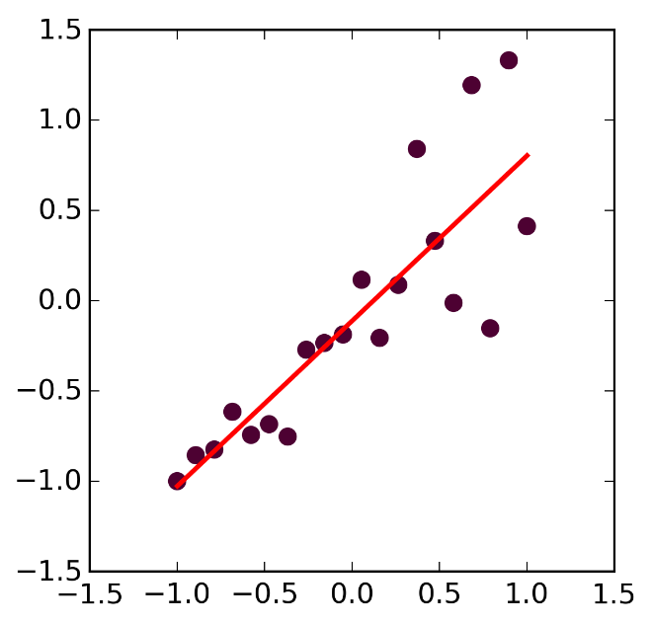
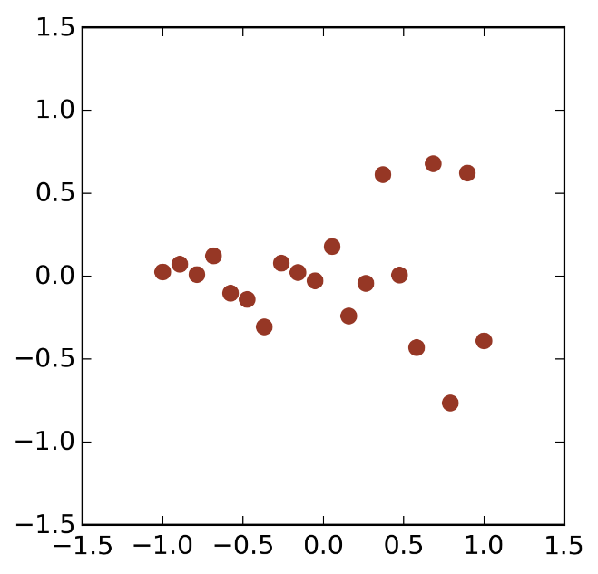
Linear Regression Assumptions
Constant Variance
Variable Variance
Residuals
Residuals

Slide 14
Linear Regression Model
Slope
Independent Variable
Intercept
Dependent Variable
Random Error
Linear
component
Random Error
component

Slide 15
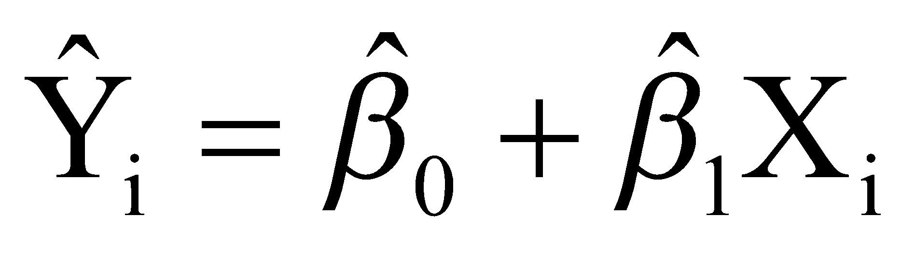
Linear Regression - Estimating the line
Estimated Intercept
Estimated Slope
Estimated Value
Independent Variable

Slide 16
Least Squares Method
Find slope and intercept given measurements X_{i},Y_{i}, i=1..N that minimizes the sum of the squares of the residuals.

Slide 17
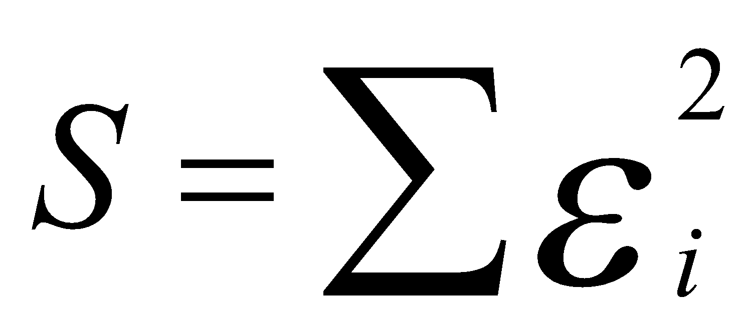
Least Squares Method
Find slope and intercept given measurements X_{i},Y_{i}, i=1..N that minimizes the sum of the squares of the residuals.

Slide 18
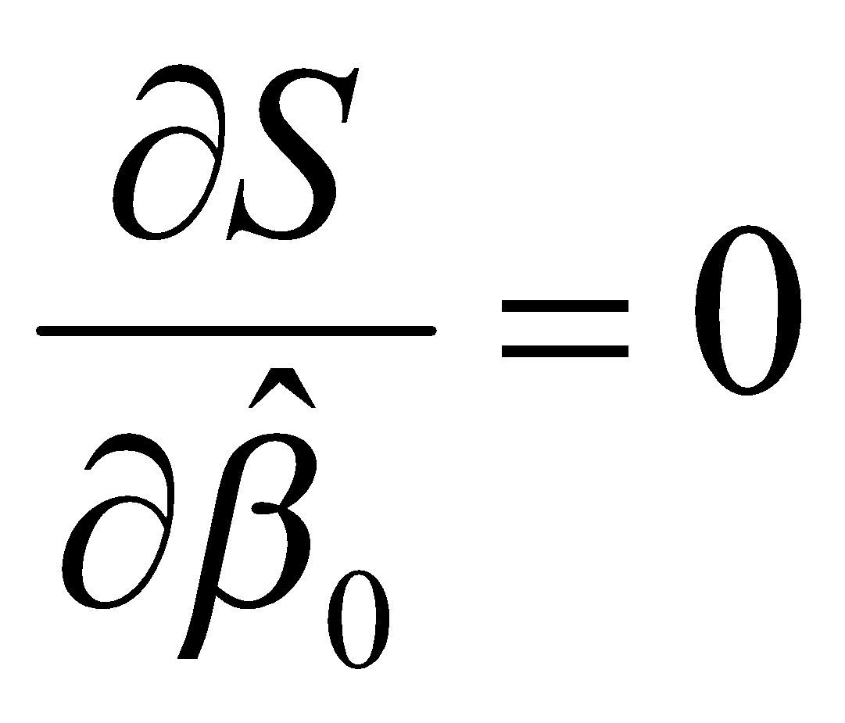
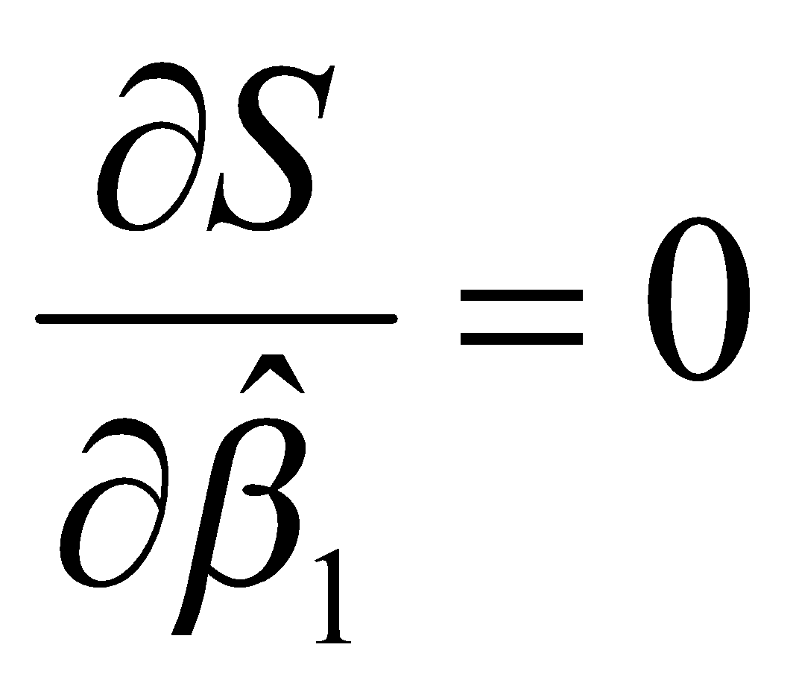
Least Squares Method
Find slope and intercept given measurements X_{i},Y_{i}, i=1..N that minimizes the sum of the squares of the residuals.

Slide 19
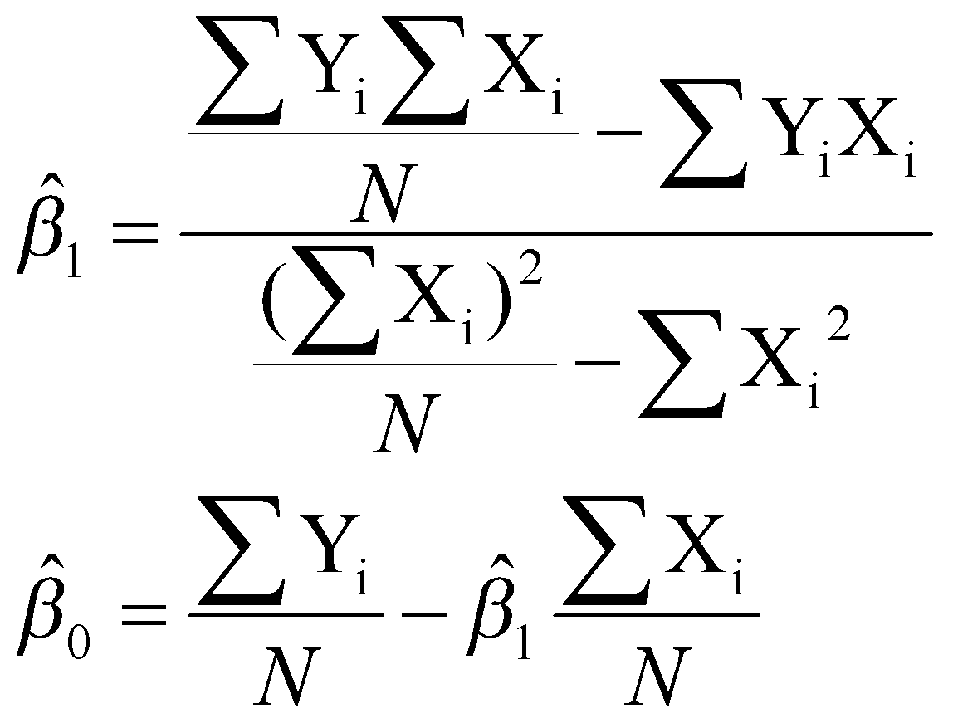
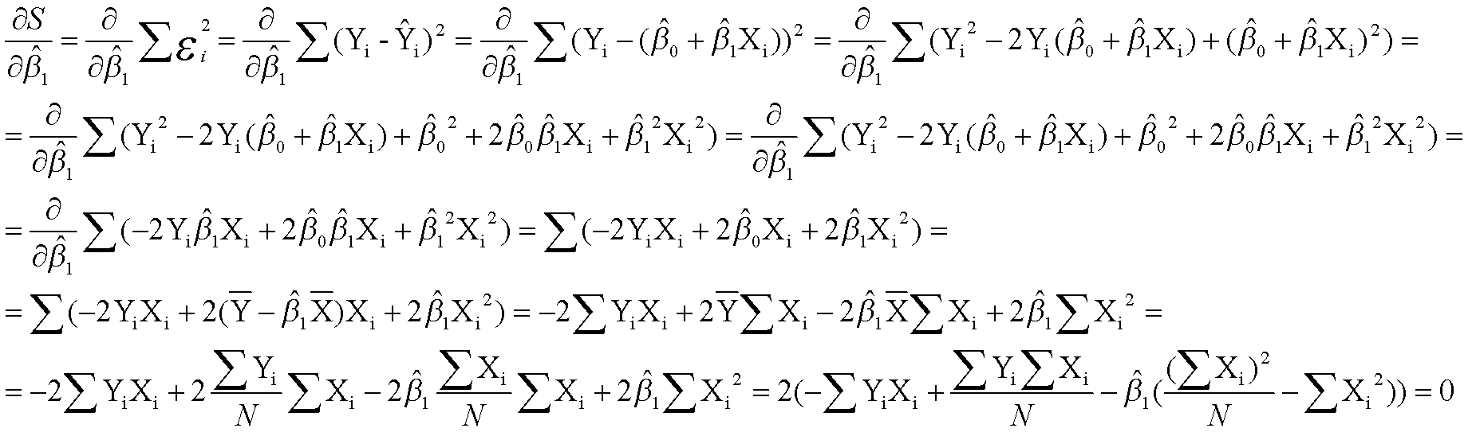
Least Squares Method
Find slope and intercept given measurements X_{i},Y_{i}, i=1..N that minimizes the sum of the squares of the residuals.

Slide 20
Linear Regression in Python
import scipy.stats as stats
slope,intercept,r_value,p_value,std_err = stats.linregress(x,y)

Slide 21
Linear Regression Example
Linear, Strong
x=np.linspace(-1,1,points)
y=x+0.1*np.random.normal(size=points)
slope,intercept,r_value,p_value,std_err = stats.linregress(x,y)
y_line=slope*x+intercept
fig, (ax1) = plt.subplots(1,figsize=(4,4))
ax1.scatter(x,y,color='#4D0132',lw=0,s=60)
ax1.set_xlim([-1.5,1.5])
ax1.set_ylim([-1.5,1.5])
ax1.plot(x,y_line,color='red',lw=2)
fig.savefig('linear.png')
fig, (ax1) = plt.subplots(1,figsize=(4,4))
ax1.scatter(x,y-y_line, color='#963725',lw=0,s=60)
ax1.set_xlim([-1.5,1.5])
ax1.set_ylim([-1.5,1.5])
fig.savefig('linear-residuals.png')
Residuals

Slide 22
Linear Regression Example
Linear, Weak
x=np.linspace(-1,1,points)
y=x+0.4*np.random.normal(size=points)
slope,intercept,r_value,p_value,std_err = stats.linregress(x,y)
y_line=slope*x+intercept
fig, (ax1) = plt.subplots(1,figsize=(4,4))
ax1.scatter(x,y,color='#4D0132',lw=0,s=60)
ax1.set_xlim([-1.5,1.5])
ax1.set_ylim([-1.5,1.5])
ax1.plot(x,y_line,color='red',lw=2)
fig.savefig('linear-weak.png')
fig, (ax1) = plt.subplots(1,figsize=(4,4))
ax1.scatter(x,y-y_line, color='#963725',lw=0,s=60)
ax1.set_xlim([-1.5,1.5])
ax1.set_ylim([-1.5,1.5])
fig.savefig('linear-weak-residuals.png')
Residuals

Slide 23
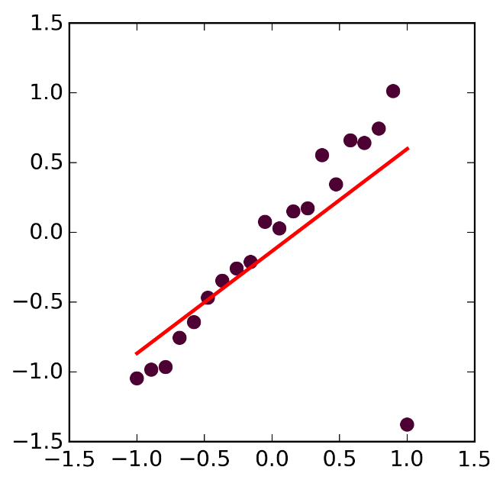
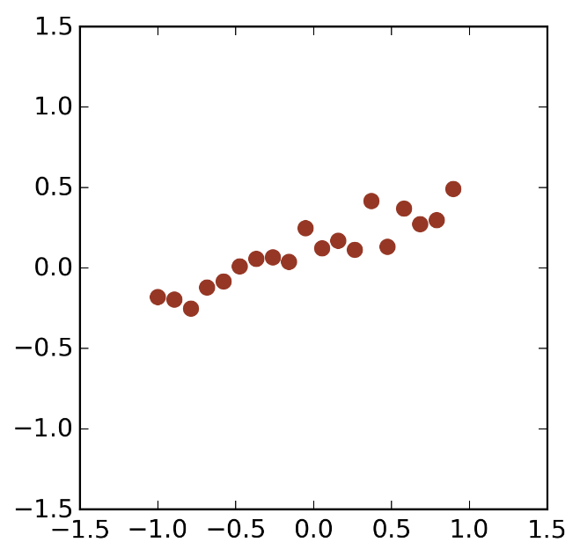
Linear Regression Example
Outlier

Slide 24
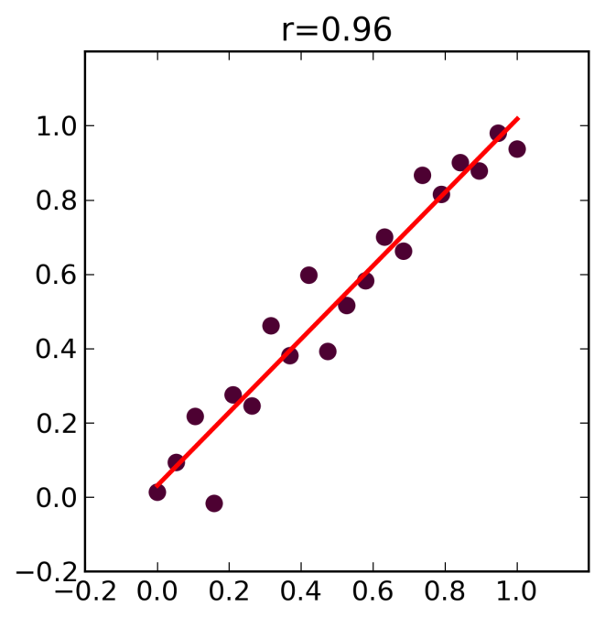
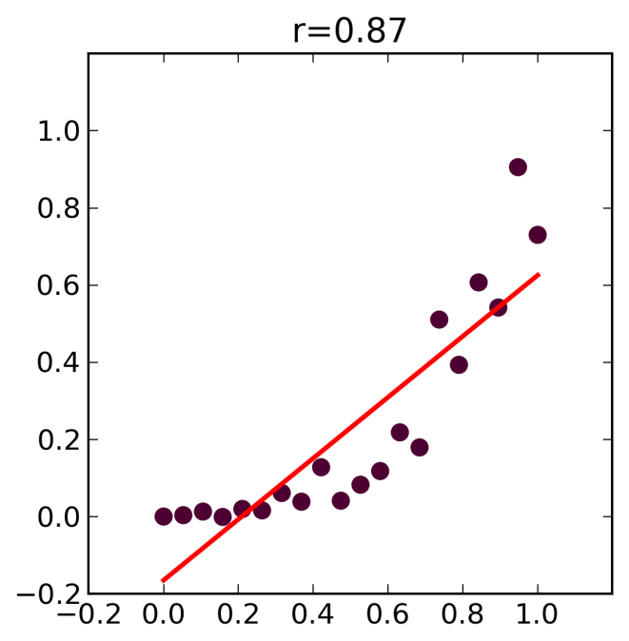
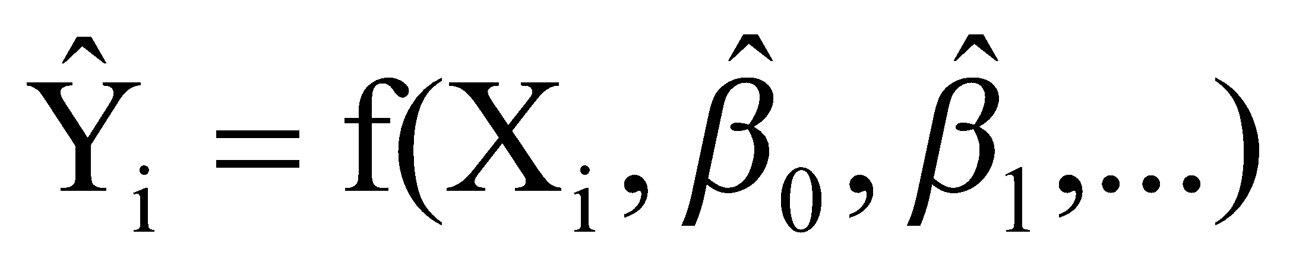
Regression - Non-linear data
Solution 1: Transformation
Solution 2: Non-linear Regression

Slide 25
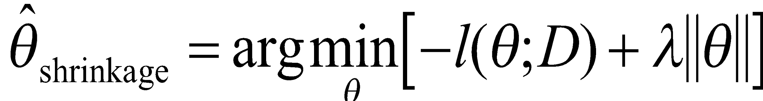
Regularization
Maximum-likelihood estimates are not always the best
Alternative: we "regularize" the likelihood objective (also known as penalized likelihood, shrinkage, smoothing, etc.), by adding to it a penalty term:
where ||θ|| might be the L1 or L2 norm.
The choice of norm has an effect
using the L2 norm pulls directly towards the origin,
while using the L1 norm pulls towards the coordinate axes, i.e it tries to set some of the coordinates to 0.
This second approach can be useful in a feature-selection setting.

Slide 26
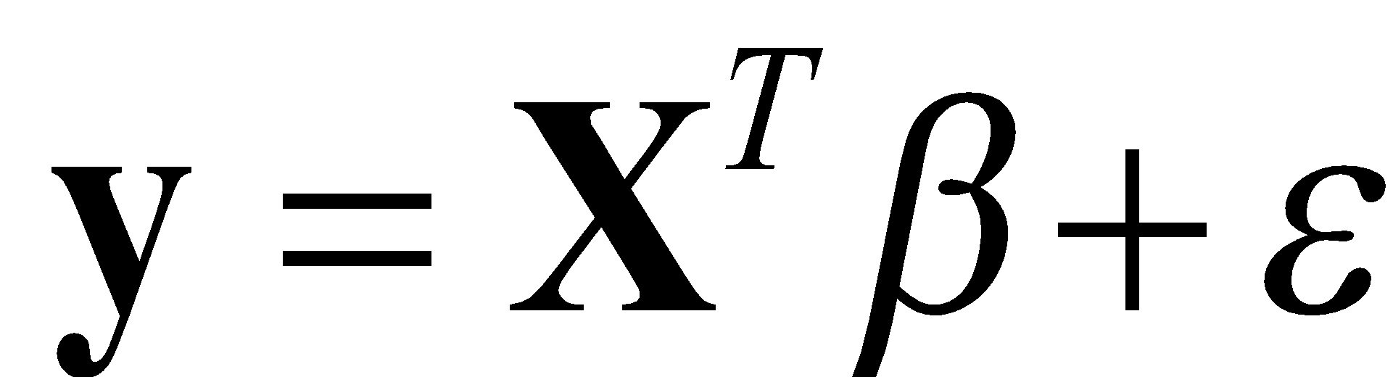
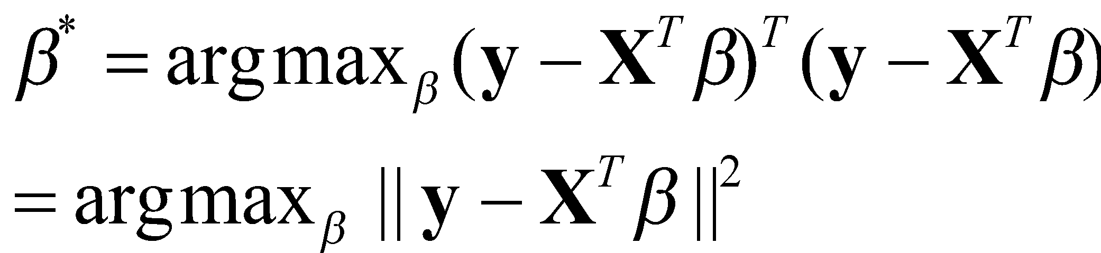
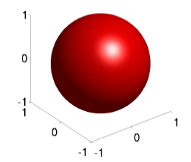
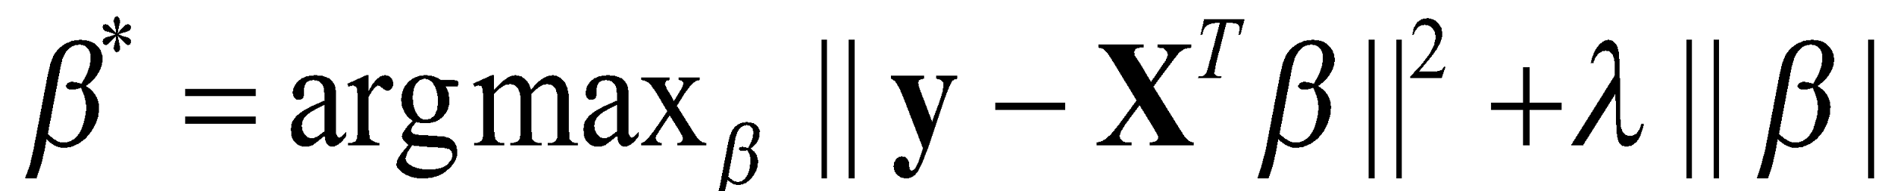
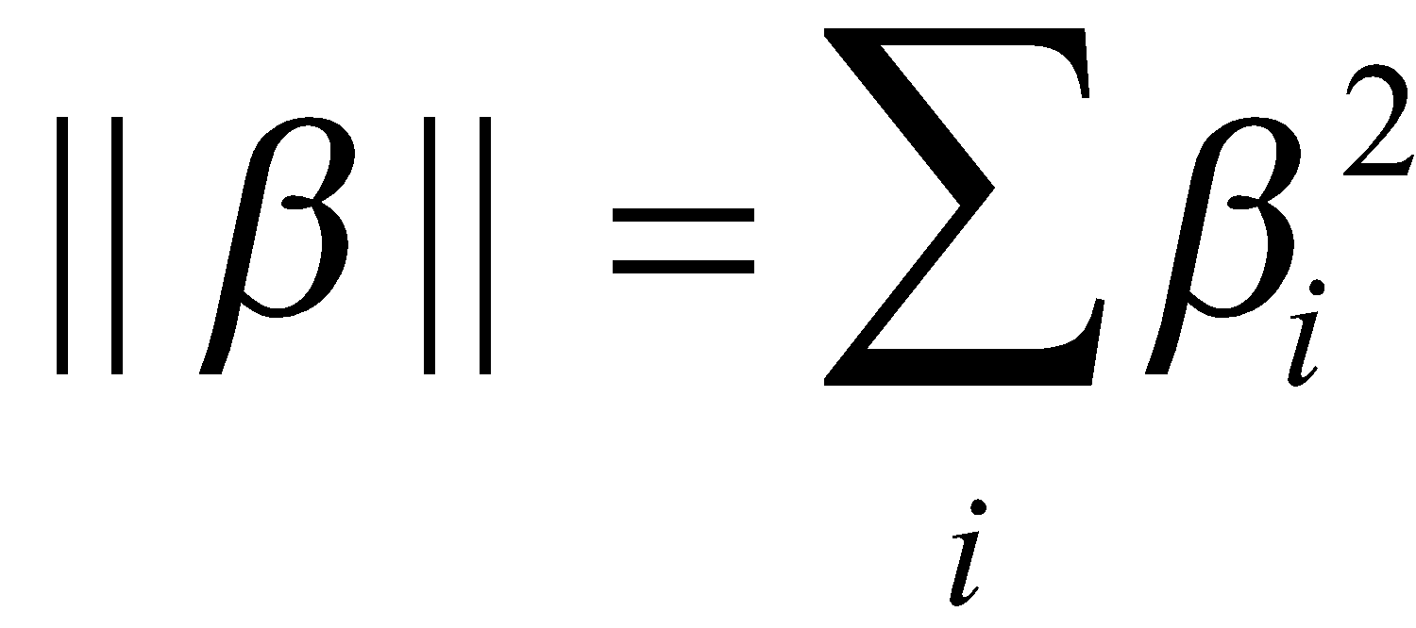
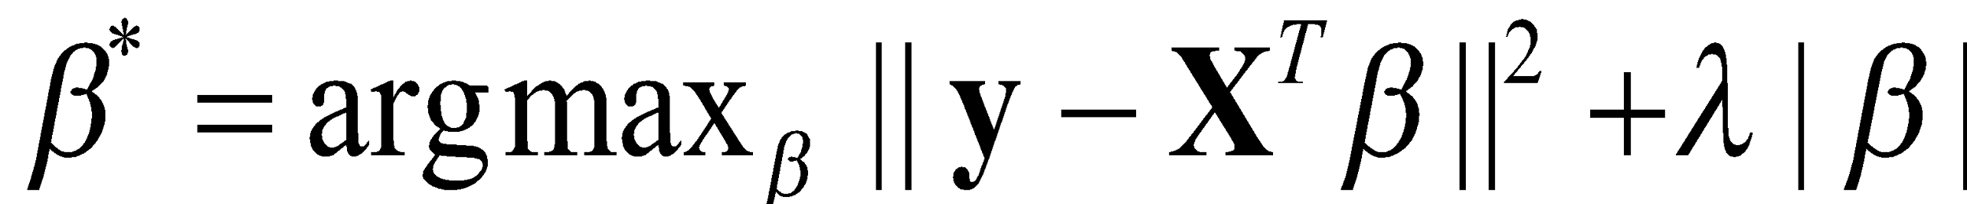
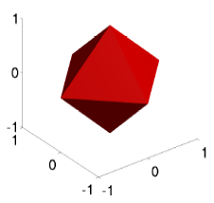
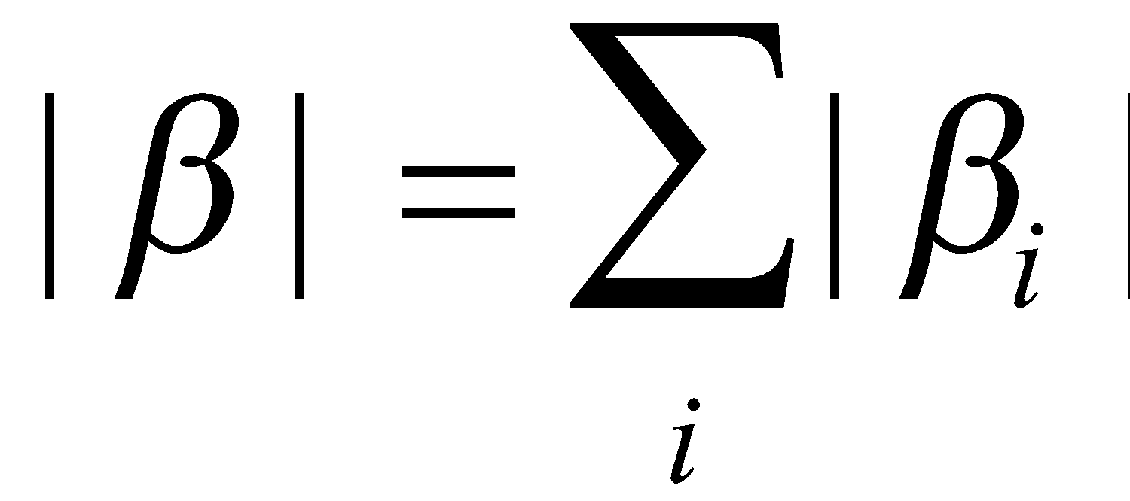
Regularized Regression
Recall linear regression:
Regularized LR:
L2-regularized LR:
where
L1-regularized LR:
where
Performs a model selection directly

Slide 27
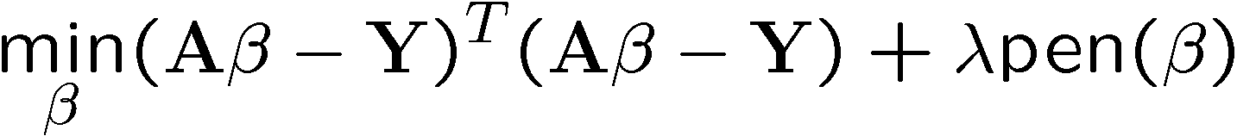
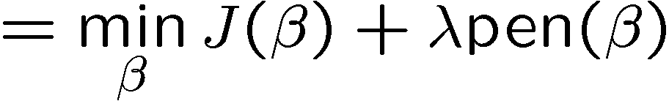


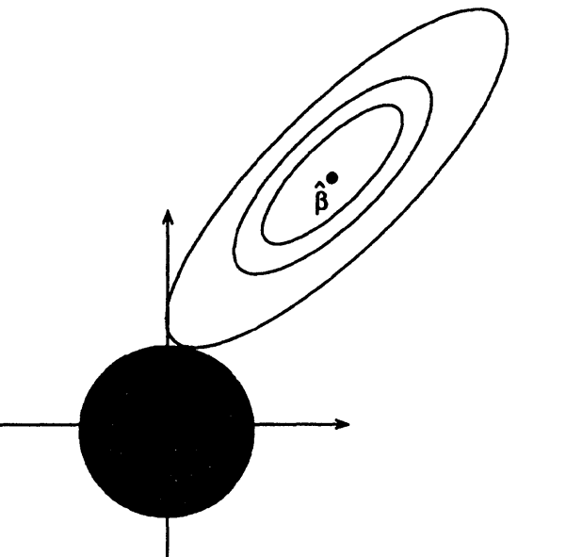
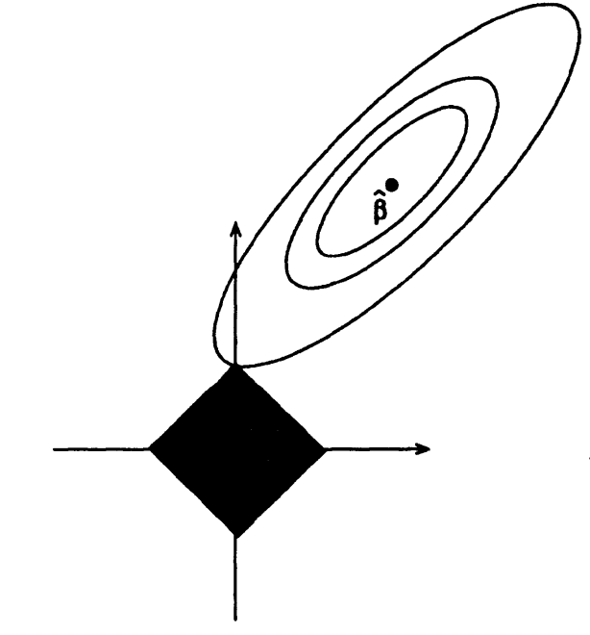
Ridge Regression vs Lasso
X
X
Ridge Regression: Lasso:
HOT!
βs with constant J(β)
(level sets of J(β))
βs with
constant
l2 norm
β2
βs with
constant
l1 norm
β1

