Slide 1

CS523 BDT Final Project

Slide 2
Real-Time Twitter Analysis
3. Wina Tesfamariam Merhazion - 610591
Professor: Mrudula Mukadam
Students:
1. Van Nhat Khong - 611039
2. Muhammad Luqman - 611023

Slide 3
Outline
Flume & Kafka
Spark Streaming
Data Visualization
Demo
Q & A
Spark SQL
Goal to achieve
Project Architecture and Data Pipeline

Slide 4
Goal to achieve Using Twitter Api
Real-time streaming data from Twitter
We filter Tweets written in English only DATA CLEANING IS PAINFUL BUT WORTH
To categorize tweets as positive, neutral, or negative, and figure out how the users are reacting to a topic NATURAL LANGUAGE ANALYSIS
Find top 10 most used hashtags, the most active users, and most mentioned users.
Display the data in a visual way by using charts for more understanding.

Slide 5
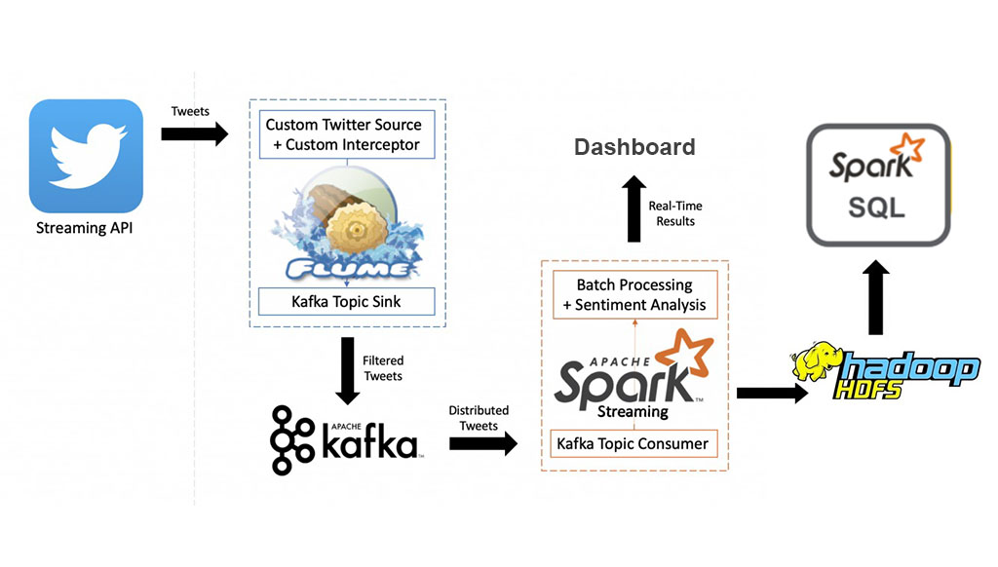
Project architecture and Data Pipeline

Slide 6
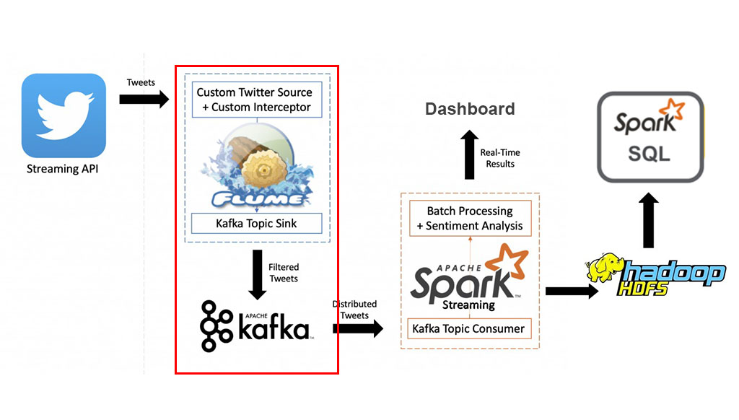
Flume & Kafka

Slide 7
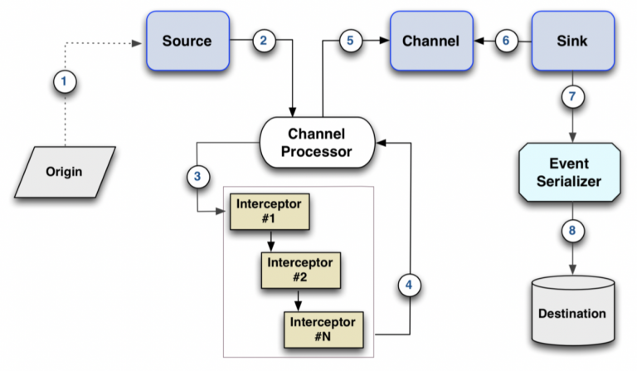
Architecture of flume & Kafka

Slide 8
Flume & Kafka Cont...
Origin: Our origin is Twitter API.
Source: We need a source to consume Twitter Stream events.
Channel: In this case over channel is memory.
Sink / Destination: Kafka, because it will distribute the data collected among the cluster into topics.

Slide 9
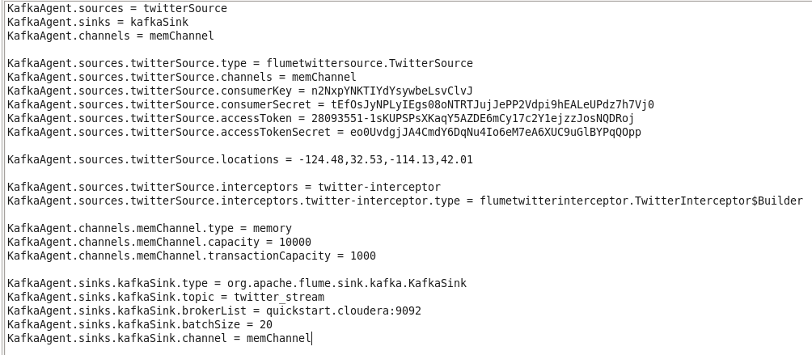
Flume & Kafka conf file

Slide 10
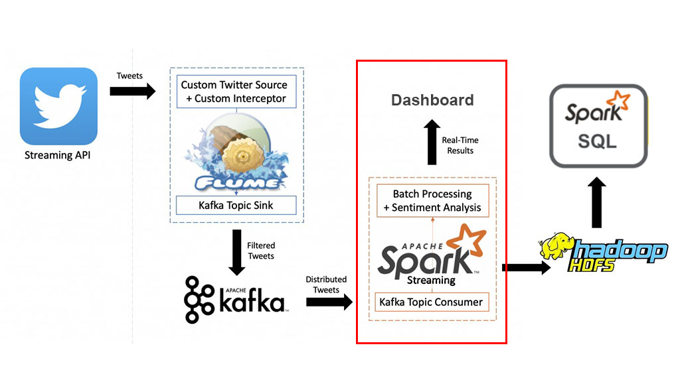
Spark Streaming

Slide 11
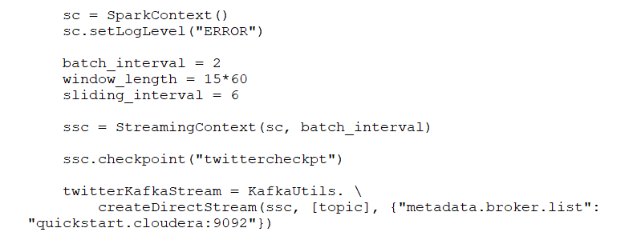
Spark Streaming cont...
Start reading from the Kafka Topic (“tweet_stream”) where we are placing the tweets with Flume:

Slide 12
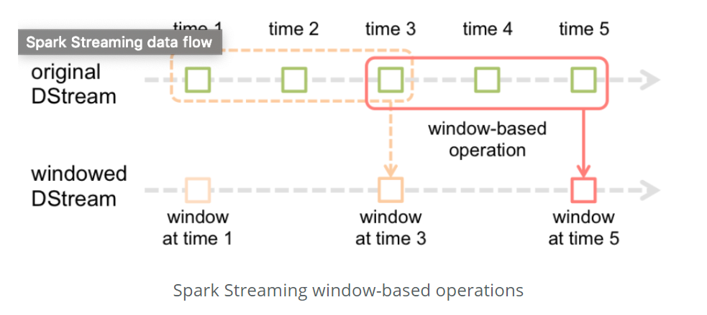

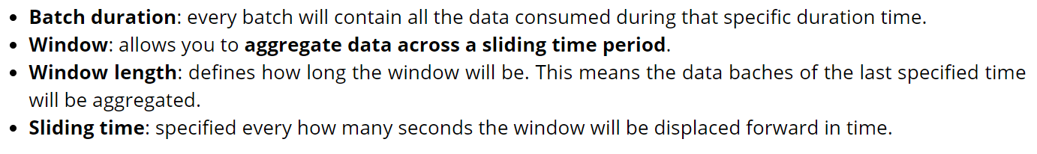
Spark Streaming cont...
analyze data collected across batches

Slide 13
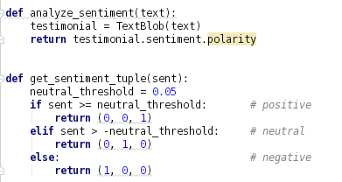
Spark Streaming cont....
Tweet sentiment – Feeling?

Slide 14
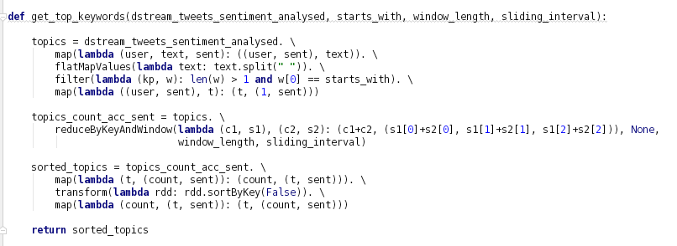
Spark Streaming cont....
Top 10 Hashtags and Top 10 Mentioned Users

Slide 15
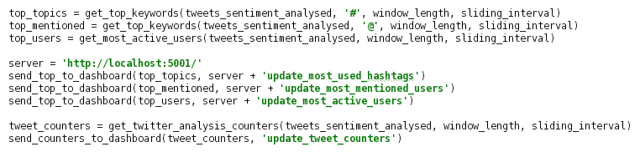
Spark Streaming cont...
Spark Streaming sending data to Dashboard for Visualization

Slide 16
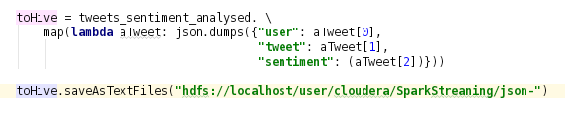
Spark Streaming cont...
Spark Streaming send data to HDFS......

Slide 17

Data Visualization
Flask is an open-source web micro-framework that allows us to create and run webpages quite quickly using Python as the main programming language. We opted by this one on top of the others because is easy, straightforward, and uses Python, which makes it perfect for real-time visualizations.

Slide 18
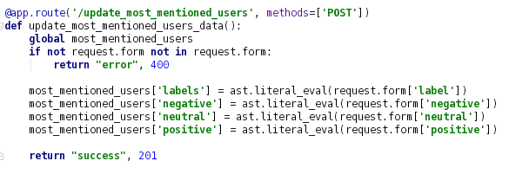
Data Visualization cont...
Receiving data from Spark Streaming to the Dashboard

Slide 19
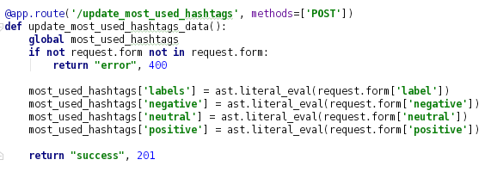
Data Visualization cont...

Slide 20

Spark SQL cont...

Slide 21
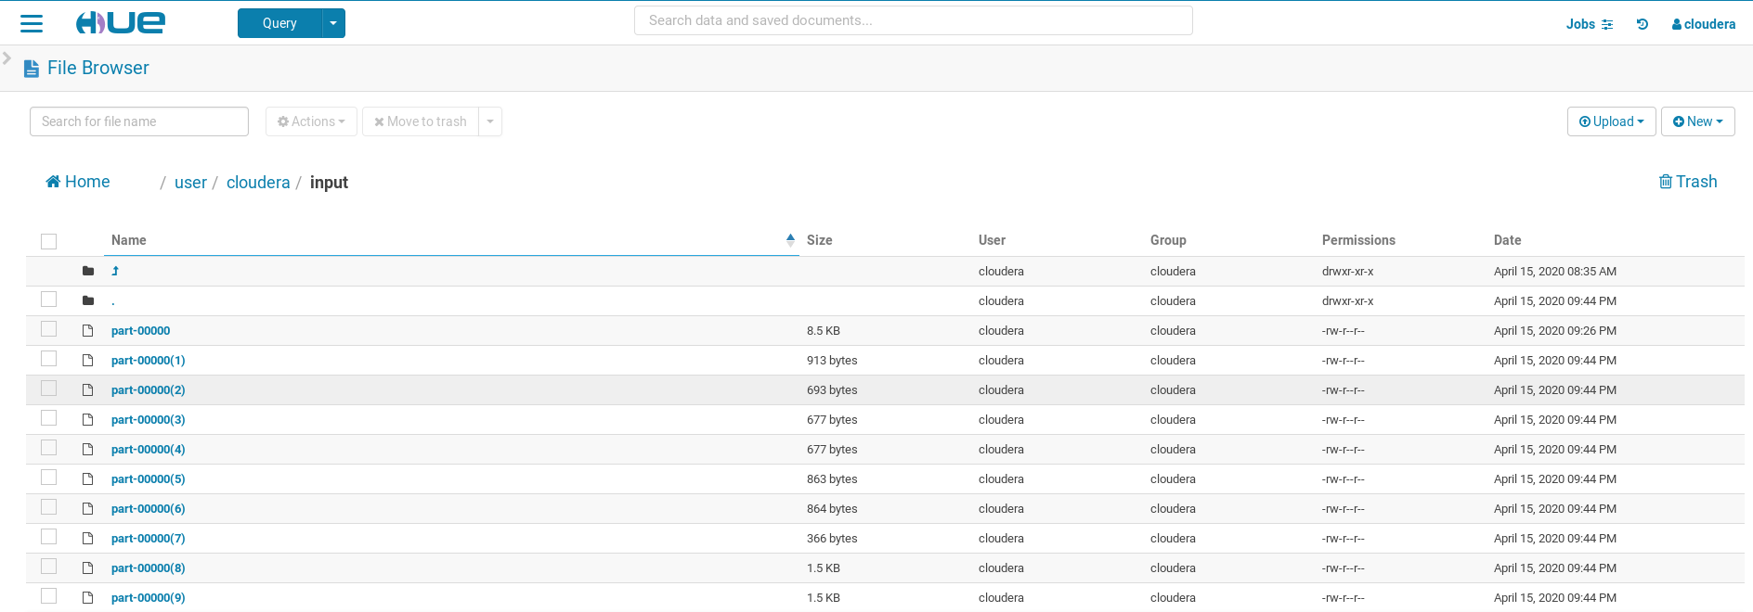
Spark SQL

Slide 22
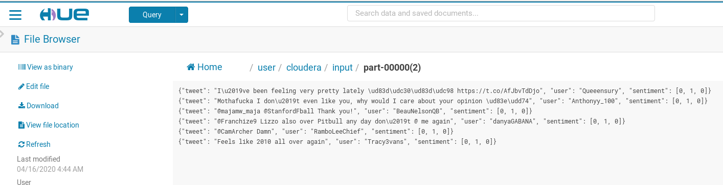
Spark SQL cont...

Slide 23
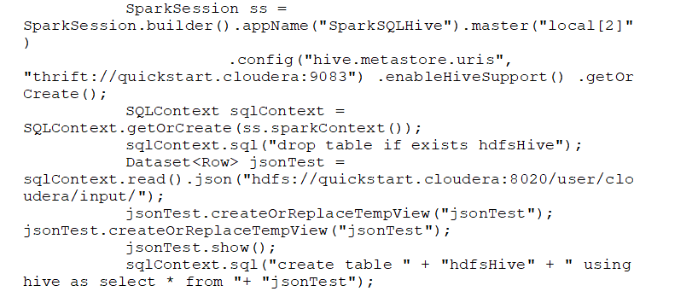
Spark SQL cont...

Slide 24
How to run whole project!
Run the Flume Agent
Run the Dashboard
Run the Spark Streaming job

Slide 25





Demo

Slide 26
Q & A

Slide 27

Thanks

