Slide 1

CS472 – Web application programming Final project
PROFESSOR: Obinna Kalu
Team 1: Taurus

Slide 2
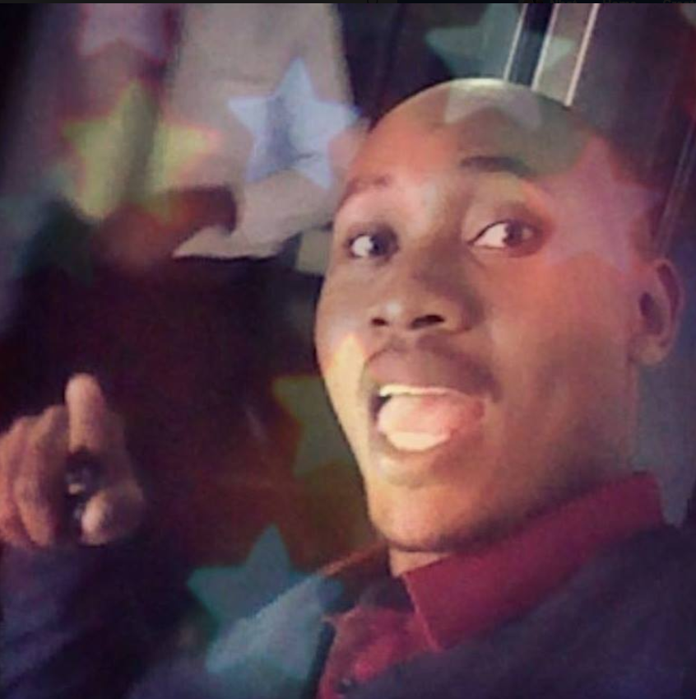
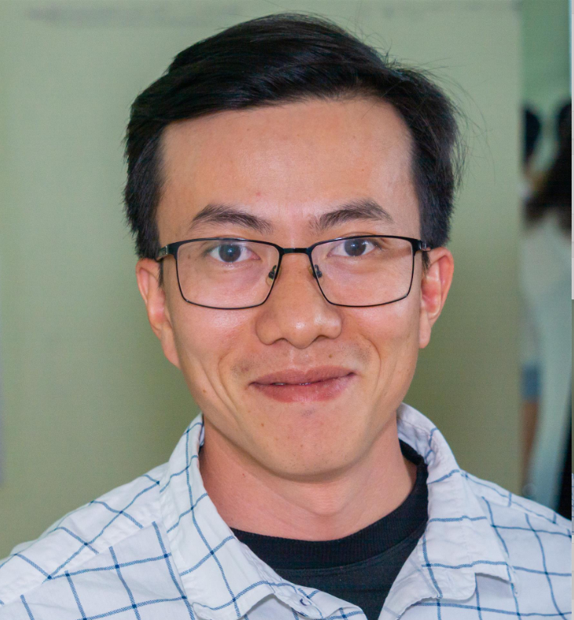
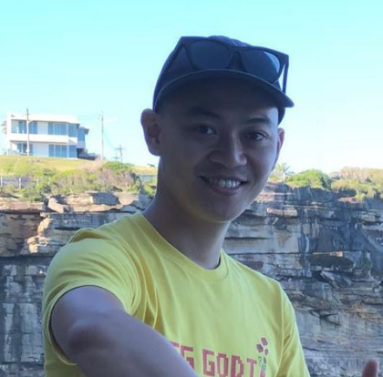
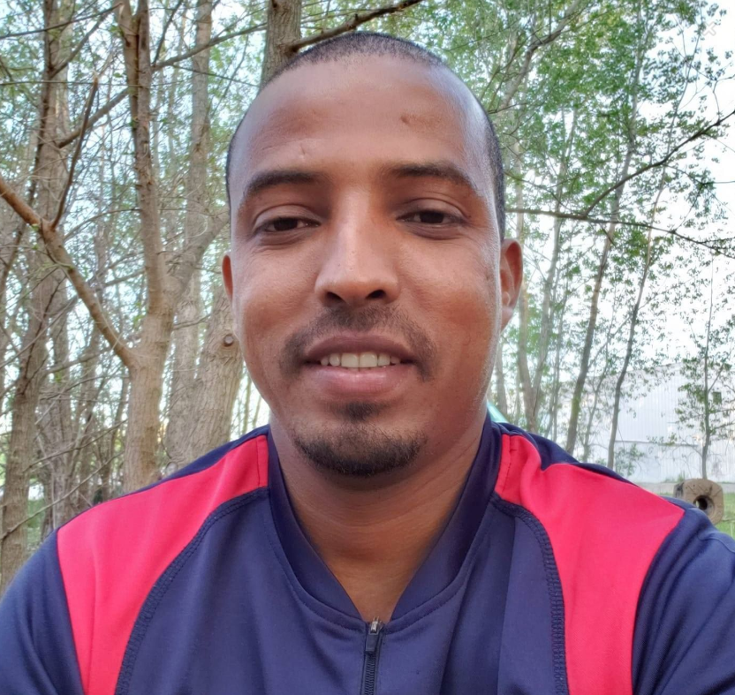
OUR TEAM
ELLY
TU
GEMI
HAFTOM

Slide 3
SLIDE DIVER
PROJECT DESCRIPTION
BUSINESS FLOWs
TECHNOLOGIES & FRAMEWORKs
KEY FEATURES & DEMO
FURTHER DEVELOPMENT

Slide 4
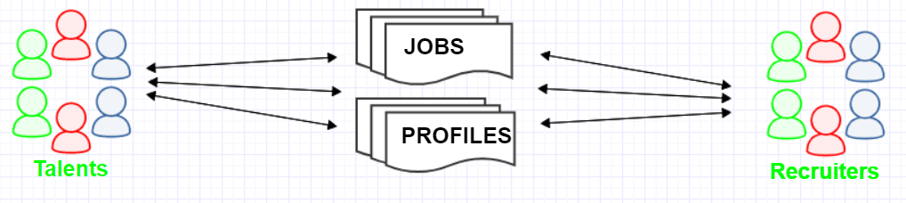
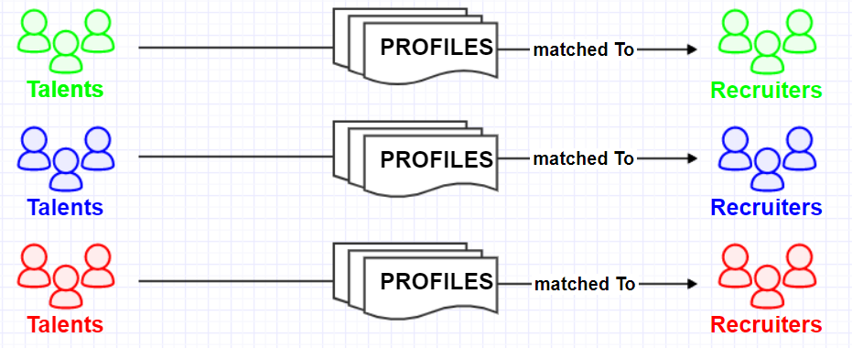
PROJECT DESCIPTION
PROBLEM IDENTIFICATION
Messy job websites
SOLUTION
Job matching
Career planning
Networking

Slide 5
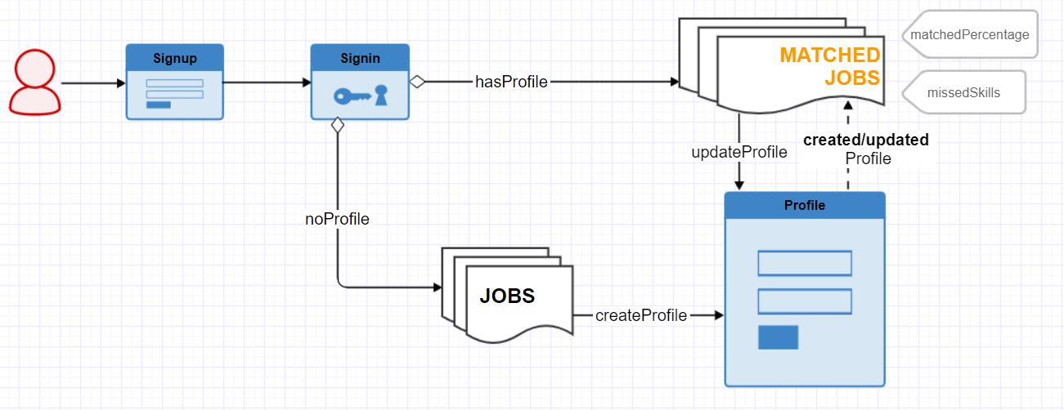
BUSINESS FLOWS

Slide 6
TECHNOLOGIES / FRAMEWORKs
FRONT-ENT | BACK-END | DATABASE
ReactJS | Spring Boot MVC | MySQL
Fetch (HttpRequest) | Hibernate

Slide 7
KEY FEATURES / DEMO
Sign up new account
Sign in
Show jobs and job details
Add / update profile
Show / filter jobs by matched percentage

Slide 8
FURTHER DEVELOPMENT
Provide Roadmap for developing missed skills
Connect candidates who has similar Roadmaps
Provide Recruiters statistics/reports about potential candidates

Slide 9
QUESTIONS
How many hours we spent on this project ?
Which part is the most challenging ?
How did we plan for the project ?
And what else ?

