Slide 1
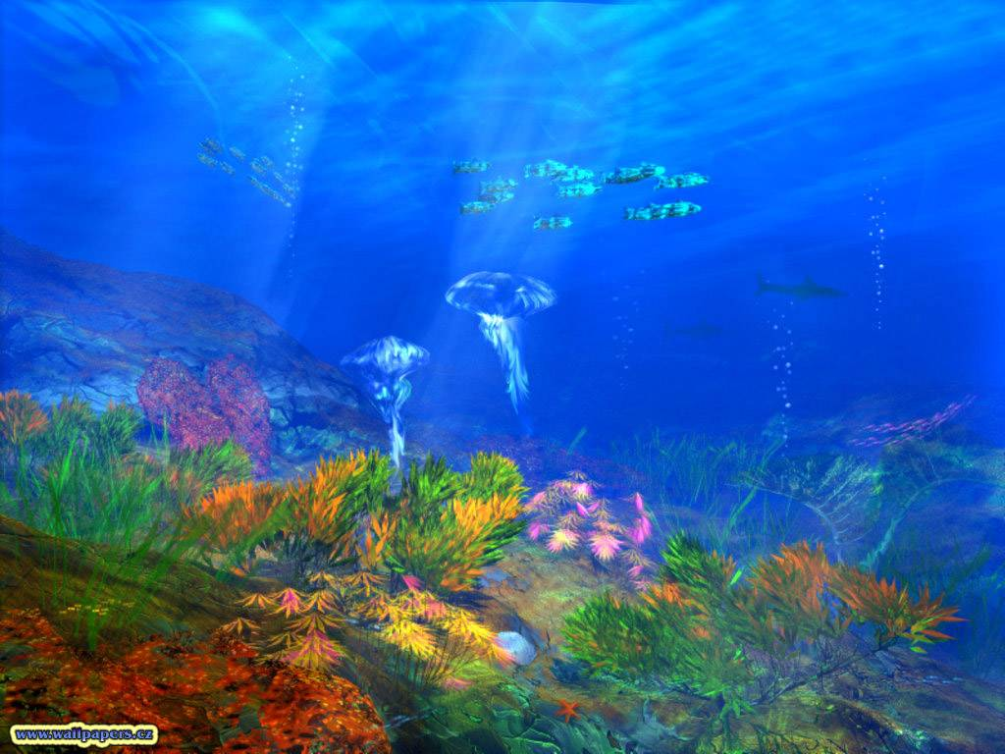
Welcome to our class

Slide 2



Tuesday, October 29th , 2009
PHONG NAM SECONDARY SCHOOL
ENGLISH 9
Unit 4: LEARNING A FOREIGN LANGUAGE
LESSON 5: READ

Slide 3

















Warm up :
Shark attack
F
O
R
E
I
G
N
L
A
N
G
U
A
G
E

Slide 4

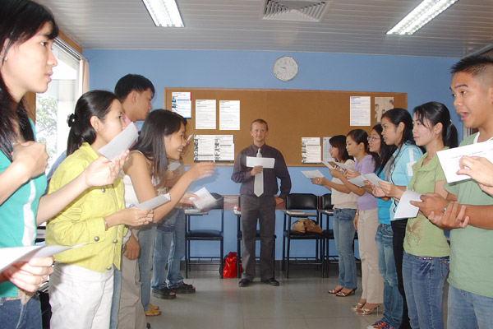


1/ New words
1/ New words
a language level:
beginner (n):
intermediate (adj):
advanced (adj):
well-qualified (adj):
a council:
TRỠNH độ NGỤN NGữ
sơ cấp
trung cấp
cao cấp
trỡnh độ cao
hội đồng

Slide 5


Rub out and remember:
1
2
council
beginner
3
advanced
4
intermediate
well - qualified
language level
5
6

Slide 6
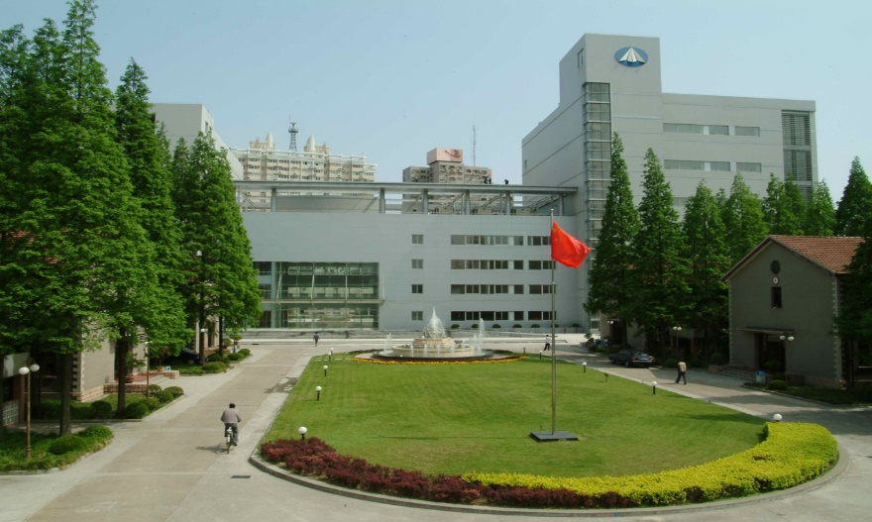
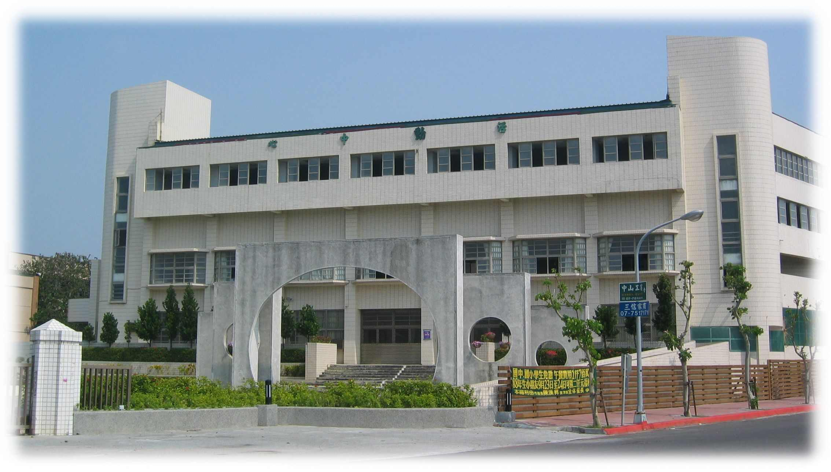
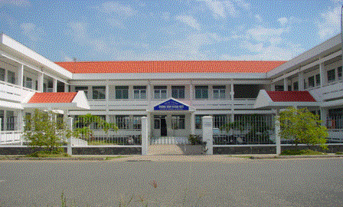
Language schools
FOREIGN LANGUAGE COUNCIL
ACADEMY OF LANGUAGE
NEW ENGLISH INSTITUTE

Slide 7







Note down information about the English classes from the advertisements
2/
80
79
76
78
77
75
74
73
72
71
70
69
68
67
66
65
64
63
62
61
60
59
58
57
56
55
54
53
52
51
50
49
48
47
46
45
44
43
42
41
40
39
38
37
36
35
34
33
32
31
30
29
28
27
26
25
24
23
22
21
20
19
18
17
16
15
14
13
12
11
10
9
8
7
6
5
4
3
2
1
0
School | Class time (morning/ afternoon, evening) | Language Level (beginner/ intermediate/ advanced…) | Time to start
Academy of language
Foreign Language Council
New English Institude
morning, afternoon, evening
first week of November
advanced
morning and evening
beginner/
intermediate
3rd November
afternoon, evening,
weekend
beginner
(today)

Slide 8



I’m looking for an English class.
early evening
intermediate level
starting late October/ early November
Answer the questions:
1. What class is Mr. Lam looking for?
You look at the advertisements and help Mr. Lam choosing a suitable school. Give reasons for your choice.
Mr Lam should choose the Foreign Language Council.
He is looking for an English class.
2. What time does he want to study?
He wants to study in early evening.
Because the class time, time to start and language level are suitable with him.
3. What level is he?
He is at intermediate level.
Mr. Lam
4. When does he want to start the course?
He wants to start in late October or early November.

Slide 9



3/
Choose the best answers:
1. Three schools have classes in the ___________
a. morning
b. afternoon
c. evening
d. weekend
2. Academy of language has ___________ teachers.
a. American
b. young
c. old
d. well- qualified
3. Mr. Lam can start the course in ___________
a. late Oct
b. early Nov
c. middle Oct
d. a &b correct
4. Mr. Lam’s level is ____________
a. beginner
b. intermediate
c. advanced
d. b &c correct
5. Come and see us at the New English Institute _________
a. today
b. tomorrow
c. one day
d. some day

Slide 10

Homework:
  Learn new words by heart.
  Copy the table into the notebook.
  Prepare “write” for the next period.
English 9

Slide 11
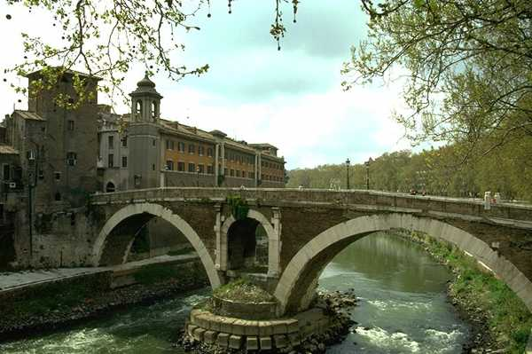


Thanks for your attendence
Good bye & see you again

