Slide 1
P2 Project: 4-bit RISC CPU Datapath
(3-Stage Pipeline)
Custom Upgrades: N/V Flags, Early JMP, SHL Instruction
Student Name: Pham Xuan Nhat Minh
Roll Number: HE200288
Vivado Version: 2026.1
Notes:
Good morning, respected panel and everyone. My name is Pham Xuan Nhat Minh. Today, I am proud to present my Project 2: A Custom 4-bit RISC CPU Datapath, engineered with a 3-Stage Pipeline and advanced architectural upgrades.

Slide 2
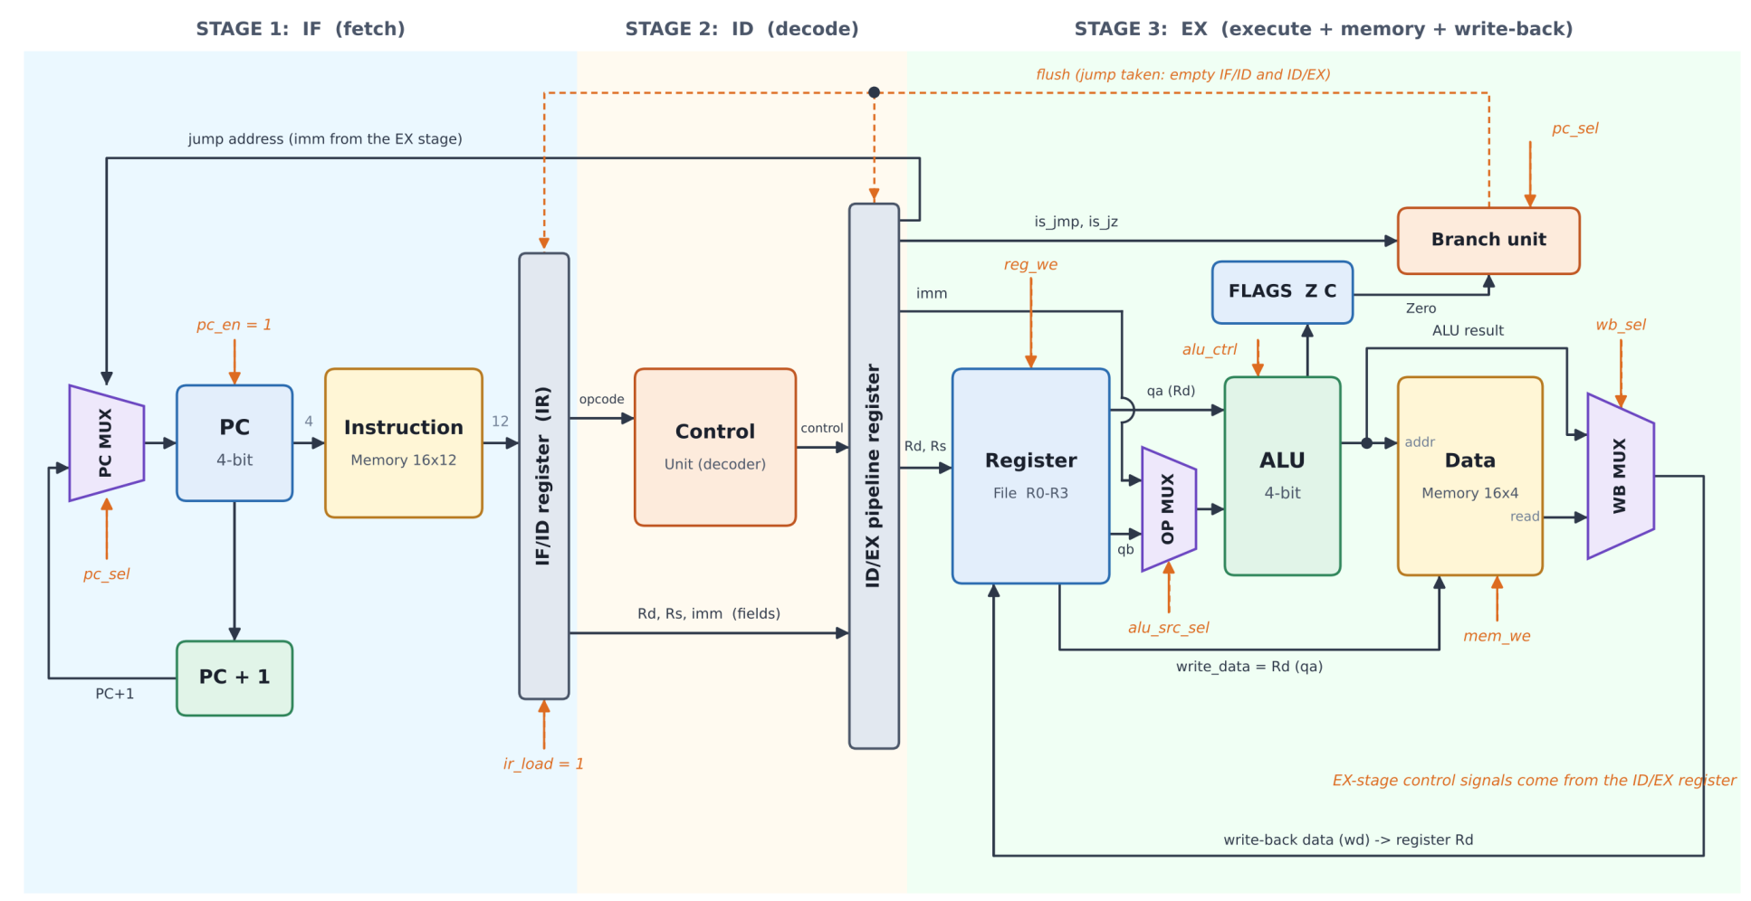
Project Overview & Design Architecture
Modular Architecture:
Integrates 10 independent Verilog modules.
Design Paradigm:
3-Stage Pipeline architecture (IF - ID - EX).
Datapath Features:
12-bit Instruction Set, Harvard memory model, 4 general-purpose registers.
Notes:
The foundation of this CPU is a 12-bit ISA operating on a Harvard memory model. Separating memories allows simultaneous fetch and access. The Datapath integrates 4 registers and a multi-function ALU, orchestrated by a Hardwired Control Unit.

Slide 3
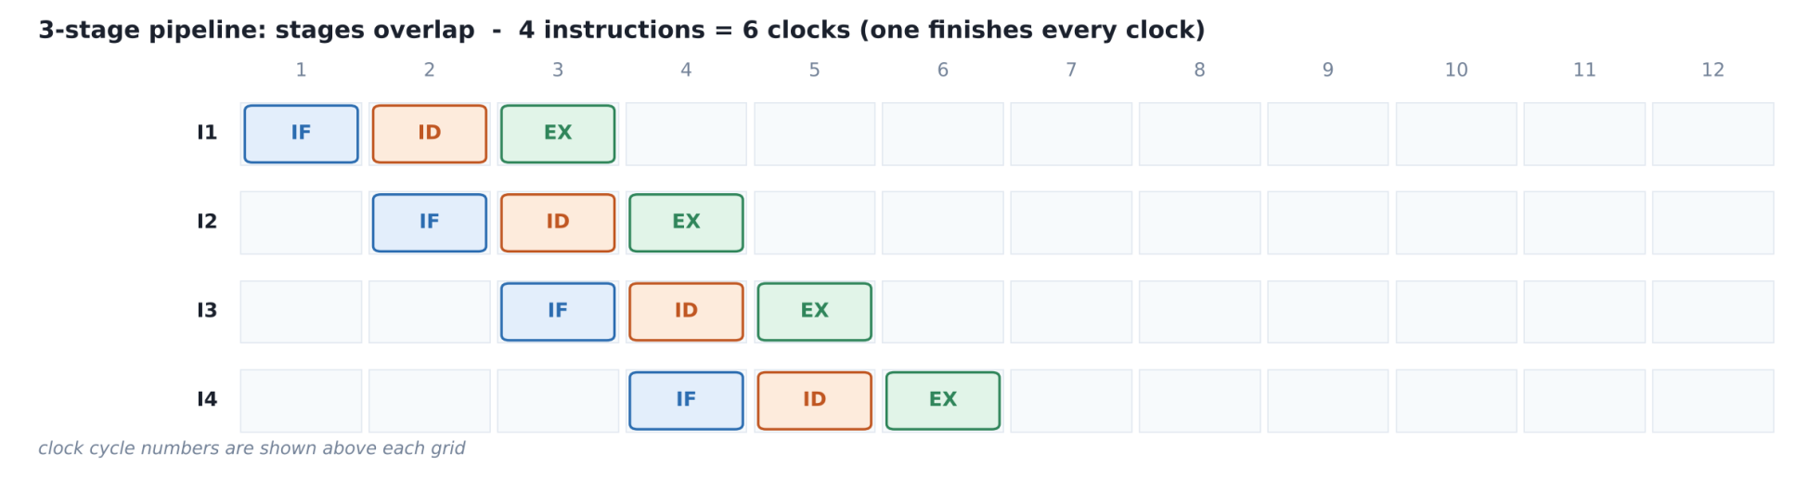
"Execution Paradigm: 3-Stage Pipeline Timing
Modular Architecture:
Integrates 10 independent Verilog modules.
Design Paradigm:
3-Stage Pipeline architecture (IF - ID - EX).
Datapath Features:
12-bit Instruction Set, Harvard memory model, 4 general-purpose registers.
Notes:
The foundation of this CPU is a 12-bit ISA operating on a Harvard memory model. Separating memories allows simultaneous fetch and access. The Datapath integrates 4 registers and a multi-function ALU, orchestrated by a Hardwired Control Unit.

Slide 4
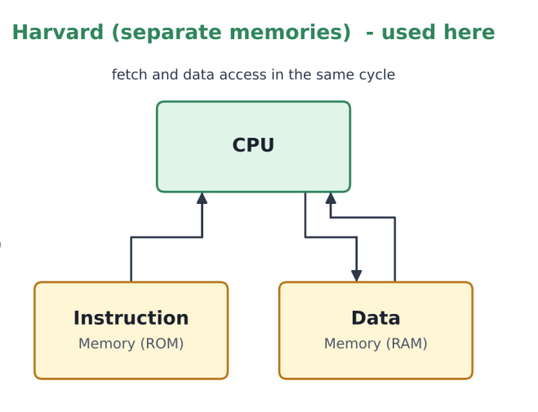
Memory Architecture: Harvard Model
Modular Architecture:
Integrates 10 independent Verilog modules.
Design Paradigm:
3-Stage Pipeline architecture (IF - ID - EX).
Datapath Features:
12-bit Instruction Set, Harvard memory model, 4 general-purpose registers.
Notes:
The foundation of this CPU is a 12-bit ISA operating on a Harvard memory model. Separating memories allows simultaneous fetch and access. The Datapath integrates 4 registers and a multi-function ALU, orchestrated by a Hardwired Control Unit.

Slide 5
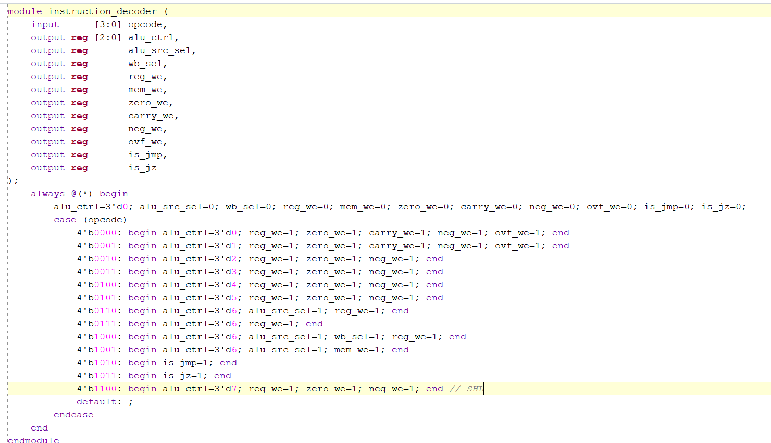
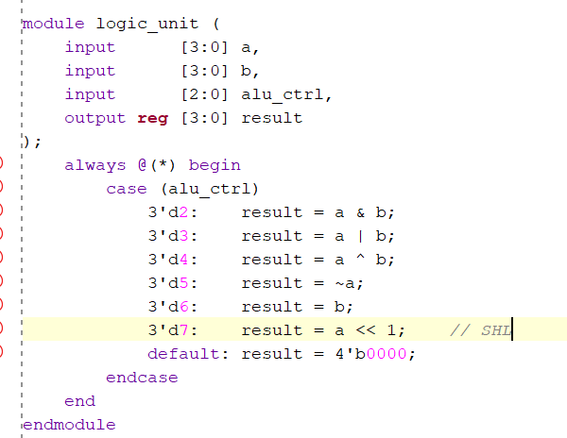
Architecture Highlight: Custom Upgrades
Advanced Flag Detection:
Upgraded ALU with Negative (N) and Overflow (V) flags for signed arithmetic.
Hardware Optimization:
Relocated JMP logic to Decode (ID) stage, reducing branch penalty to 1 cycle.
Datapath Control:
Implemented Logical Shift Left (SHL) instruction using opcode 1100.
Notes:
While the baseline required a standard pipeline, I engineered three upgrades. I added N/V flags for signed arithmetic, relocated Unconditional Jump logic to the ID stage to reduce penalty to 1 cycle, and utilized opcode 1100 for a hardware Shift Left instruction.

Slide 6
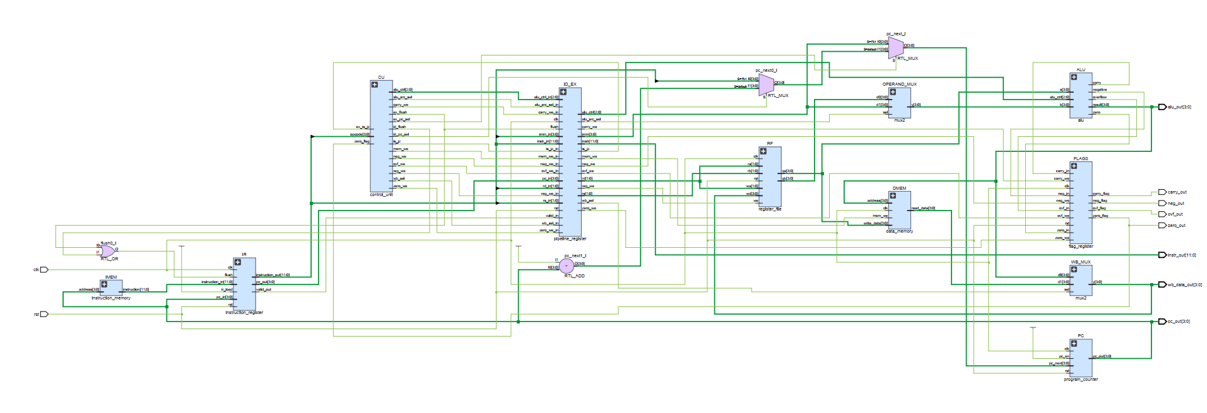
RTL Analysis: Elaborated Schematic
Mapping Code to Hardware:
Vivado synthesizes the Verilog code into physical CPU components.
Pipeline Isolation Proof:
Schematic displays IF/ID and ID/EX registers acting as signal boundaries.
Notes:
Moving to the RTL level, this schematic reveals how Vivado interprets the code. You can clearly see the pipeline registers isolating signals across the Fetch, Decode, and Execute stages.

Slide 7
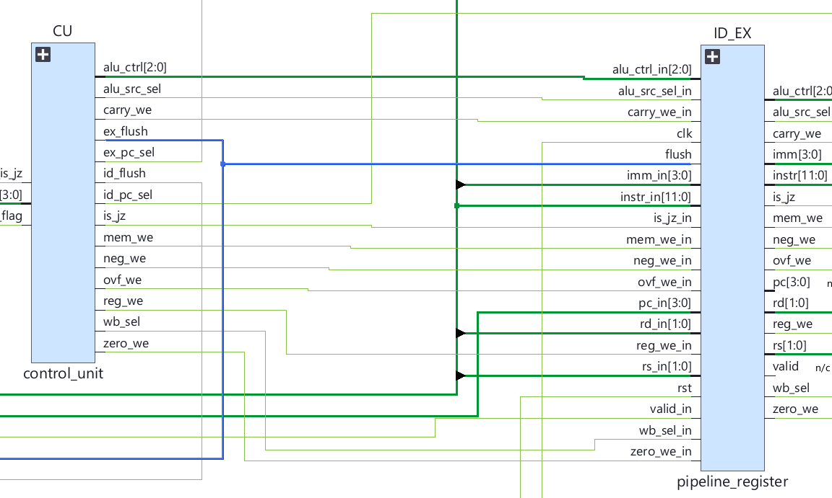
Pipeline Execution & Hazard Handling
Data Hazard Resolution:
Combinational read ports in the Execute (EX) stage provide instantly updated data.
Control Hazard Resolution:
Automated flush signal clears pipeline registers upon branch execution (JMP/JZ).
Notes:
To resolve Data Hazards, the register file employs combinational read ports directly in the Execute stage. For Control Hazards, an automated flush signal clears pipeline registers upon branch execution, maintaining data integrity.

Slide 8
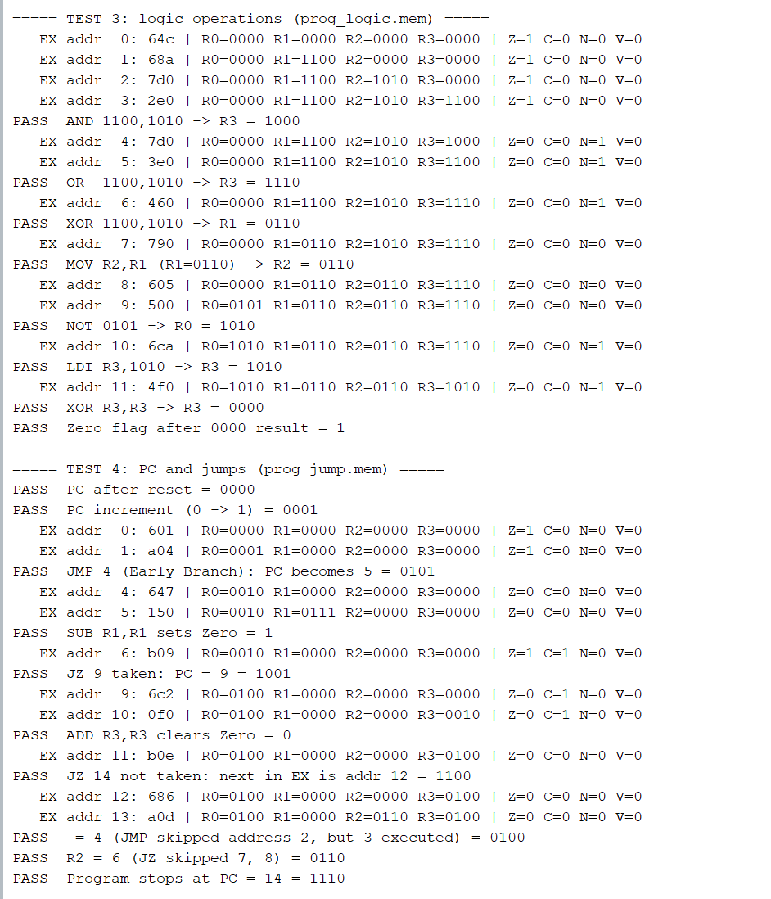
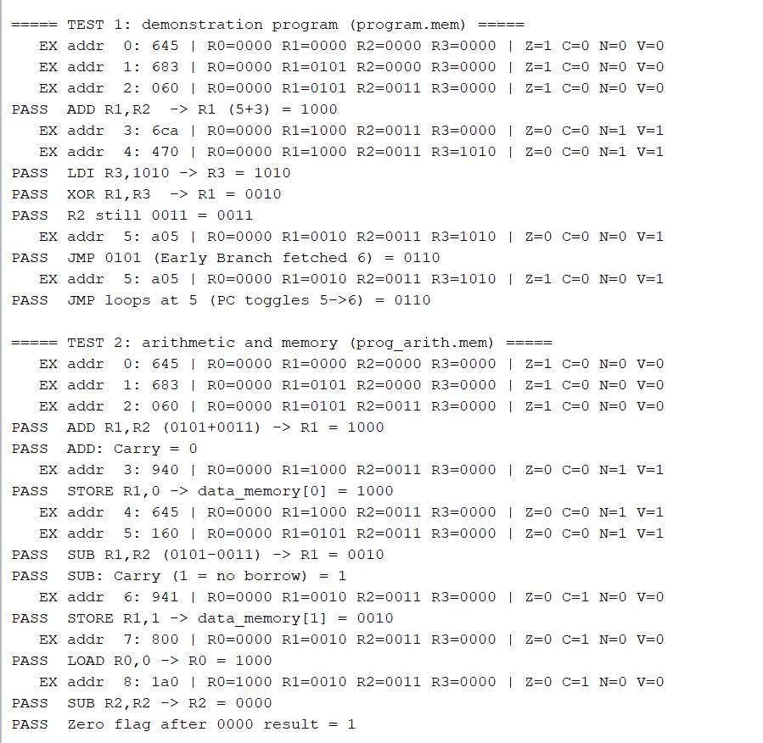
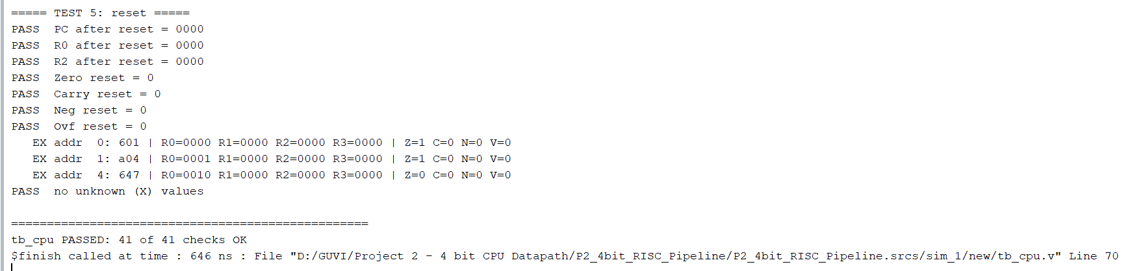
Automated Verification & Testbench
Self-Checking Mechanism:
Automated top-level testbench sweeping 4 independent machine code programs.
Test Coverage:
41 rigorous functional checks (Arithmetic, Memory, Early Branch, Reset).
Verification Output:
Tcl Console outputs '41 of 41 checks OK'.
Notes:
To guarantee reliability, I built a self-checking testbench suite. The system autonomously executes 4 different machine code programs, performing 41 stringent checks. As shown in the console, the CPU perfectly handles data paths and pipeline flushes, achieving a 100% pass rate.

Slide 9
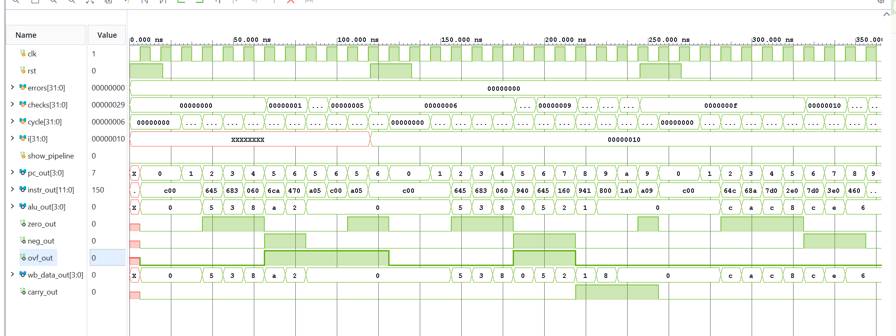
Waveform & Timing Analysis
Pipeline Execution:
Simulation waveform tracks concurrent instruction flow across clock cycles.
Step Verification:
Matches simulation data against theory, proving accuracy of N/V flags and JMP flush.
Notes:
This waveform provides a cycle-by-cycle view of the pipeline in action. It verifies the overlapping execution of instructions and confirms that the Overflow and Negative flags, along with the Early Branch flush, function perfectly.

Slide 10
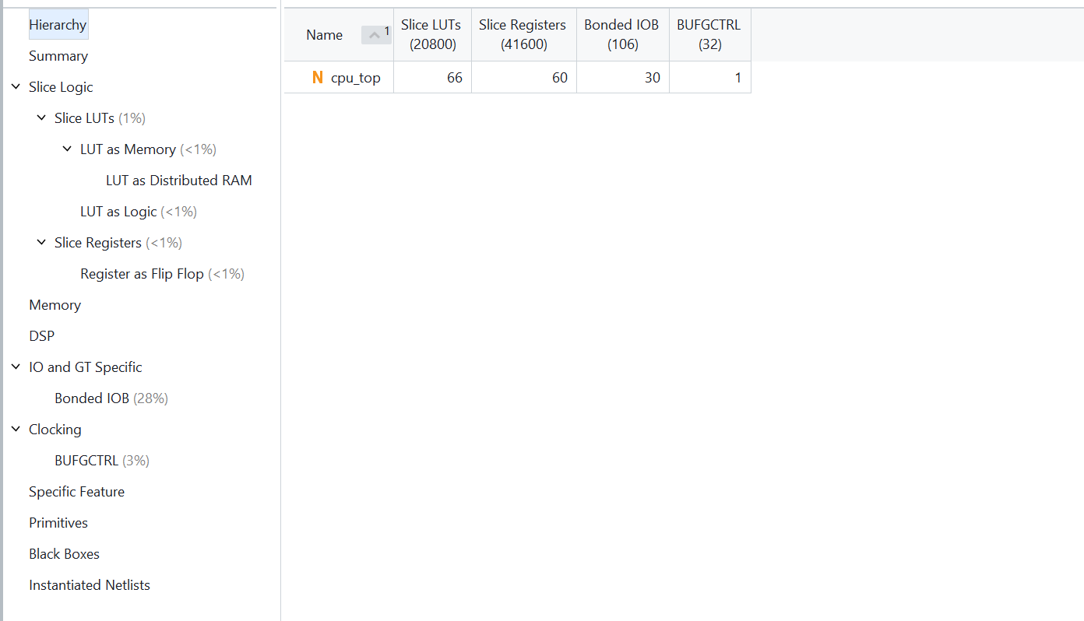
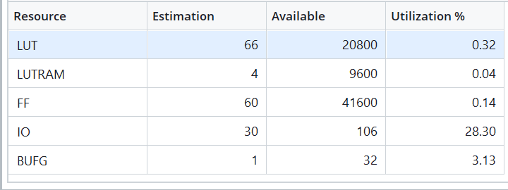
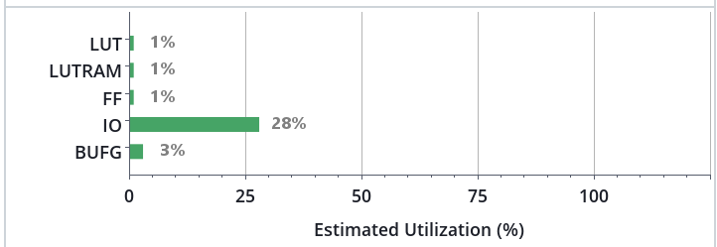
Synthesis: Hardware Utilization
High Efficiency:
The 3-Stage Pipeline architecture optimizes the surface area footprint.
Resource Count:
Low utilization of Slice LUTs and Slice Registers on Artix-7.
Notes:
Following synthesis, the hardware utilization report demonstrates high efficiency. The footprint is minimal, utilizing very few Slice LUTs and Registers on the FPGA.

Slide 11
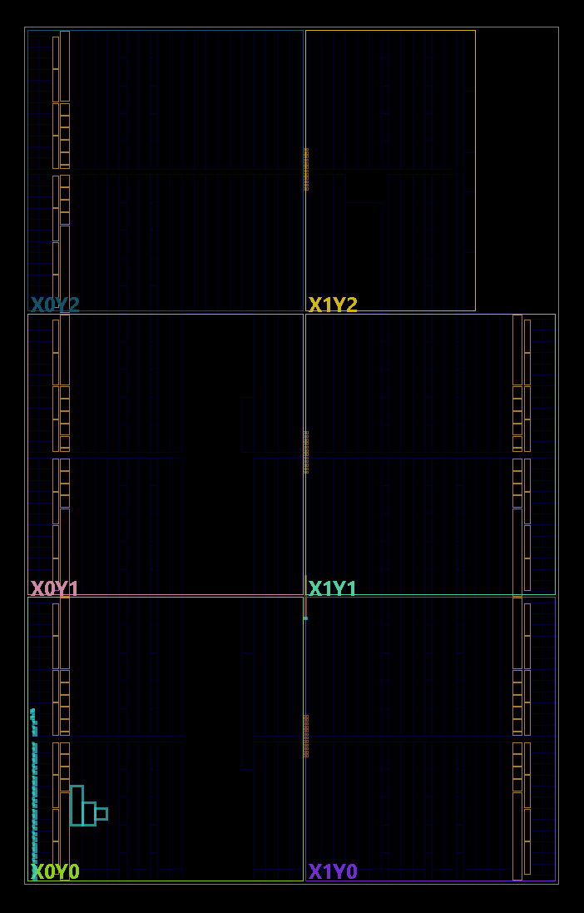
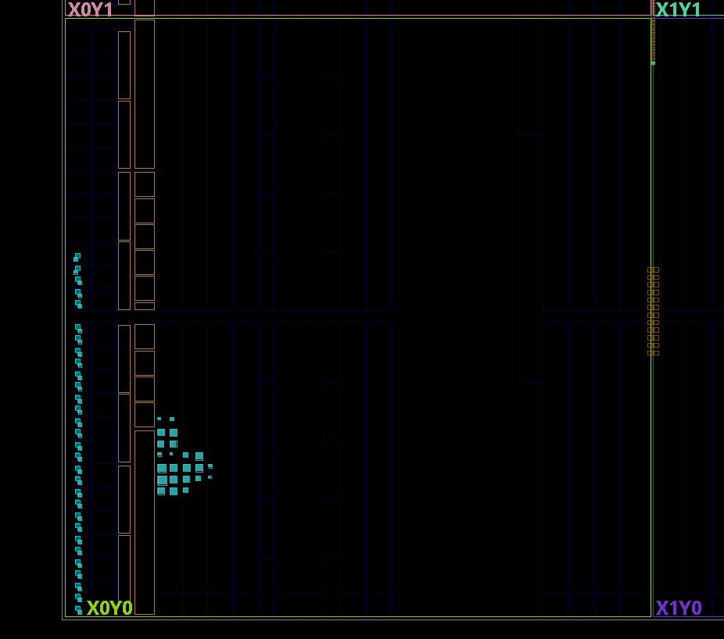
Implementation: Physical Device View
Physical Mapping:
Logic gates placed and routed successfully on Artix-7 silicon.
Location:
CPU core modules compactly clustered to minimize signal delay.
Notes:
The Implementation view confirms successful placement and routing. The core modules are compactly clustered on the grid, ensuring optimal signal propagation.

Slide 12
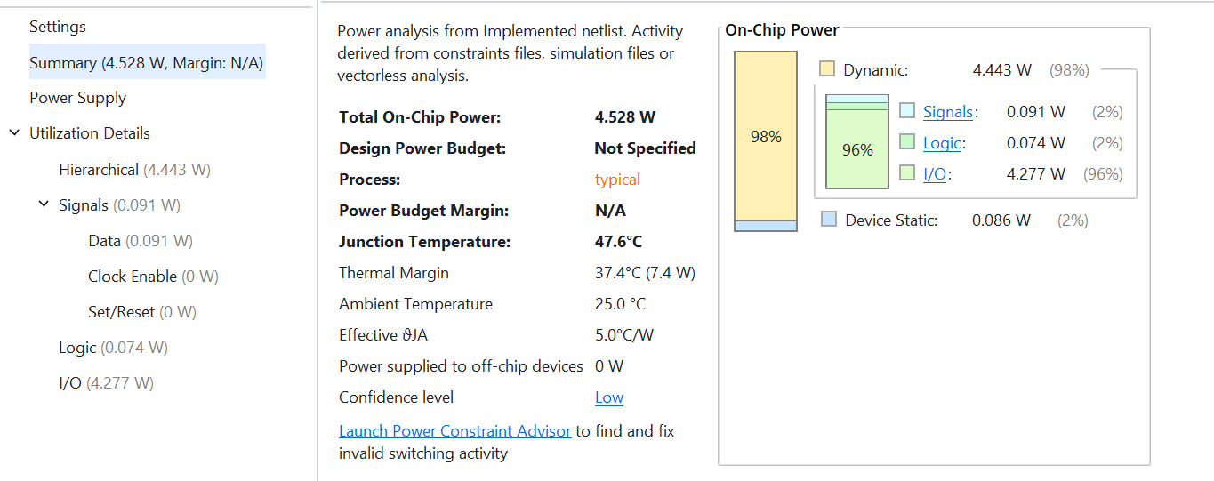
Implementation: Power Report
Low Power Consumption:
Total On-Chip Power maintained at a stable level.
Thermal Efficiency:
Junction Temperature remains safely within operating limits.
Notes:
The power report indicates a highly efficient design. Total on-chip power consumption is low, and the junction temperature remains well within safe margins.

Slide 13
Conclusion
Flow Completion:
Navigated the full FPGA flow: RTL Design -> Simulation -> Synthesis -> Implementation.
Deliverables:
The upgraded 4-bit RISC Pipeline CPU project is fully verified and ready for deployment.
Notes:
In conclusion, this project goes beyond a functional pipeline. By optimizing branch penalties and expanding the arithmetic logic, I have demonstrated a robust, customized RTL design. Thank you for your attention. I am now open to your questions.

