Slide 1
P3 Project: 8-bit RISC Processor Core (5-Stage Pipeline)
Custom Upgrades: Early ID-Stage JMP, 4-Bit Status Flags (Z, C, N, V) & Full Hazard Unit
Student Name: Pham Xuan Nhat Minh
Roll Number: HE200288
Vivado Version: 2026.1

Slide 2
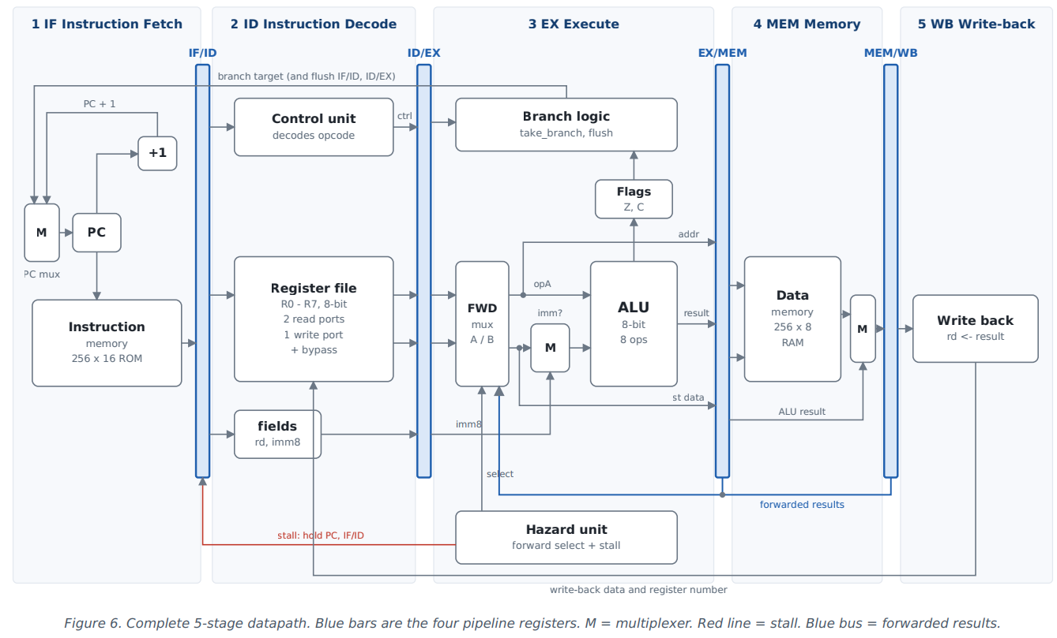
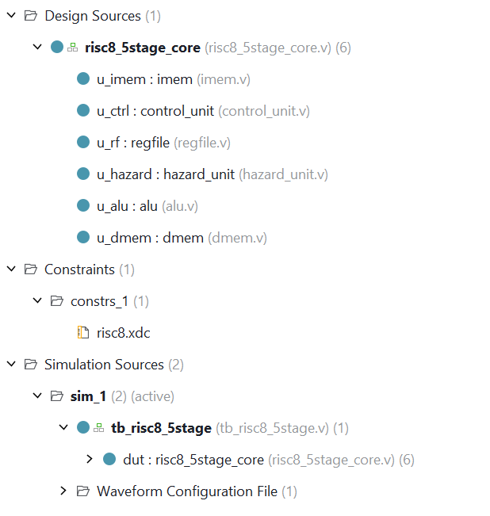
Project Overview & 5-Stage Datapath Architecture
Modular Architecture: Top module 'risc8_5stage_core' instantiates 6 independent leaf modules (imem, control_unit, regfile, hazard_unit, alu, dmem).
5-Stage Pipeline: IF (Fetch) -> ID (Decode) -> EX (Execute) -> MEM (Memory) -> WB (Write-Back).
Core Specs: 16-bit fixed ISA (16 instructions), 8-bit data width, 8 general-purpose registers (R0-R7), Harvard architecture.

Slide 3
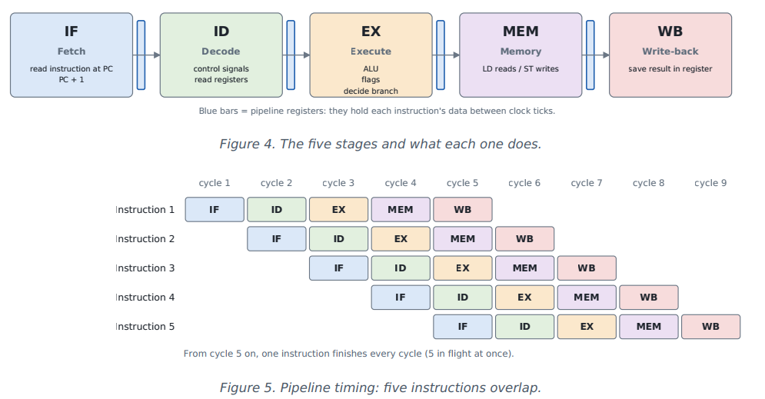
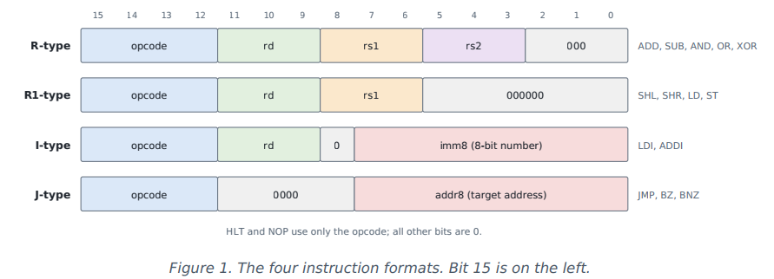
Execution Paradigm & ISA Encoding
Pipeline Overlap: Up to 5 instructions in flight simultaneously; ideal throughput of 1 instruction per cycle.
4 Instruction Formats: R-type (ALU 3-reg), R1-type (Shift, LD/ST), I-type (LDI, ADDI), and J-type (JMP, BZ, BNZ).

Slide 4
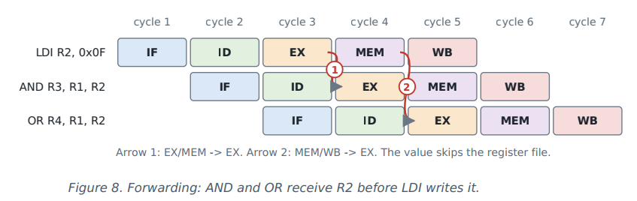
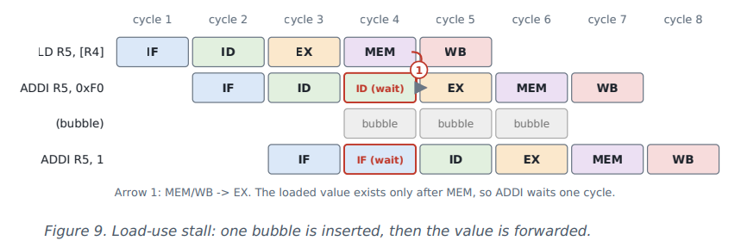
Hardware Hazard Resolution (Forwarding, Bypass & Stall)
Data Forwarding (0-Cycle Penalty): Routes results from EX/MEM and MEM/WB directly back to EX inputs, gated by uses_a / uses_b.
Write-Through Register Bypass: Solves distance-3 RAW hazards inside regfile.v within the same clock cycle.
Load-Use Hazard (1-Cycle Stall): Freezes PC and IF/ID while injecting a bubble into ID/EX when LD is immediately followed by a dependent instruction.

Slide 5
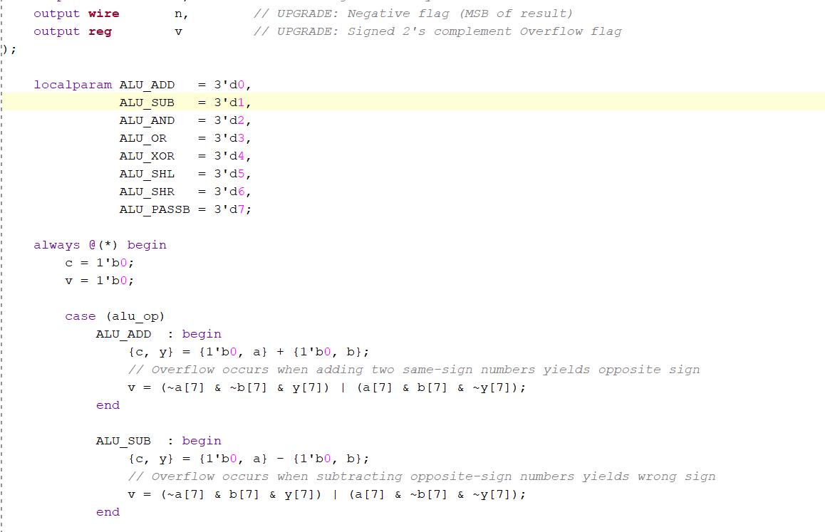
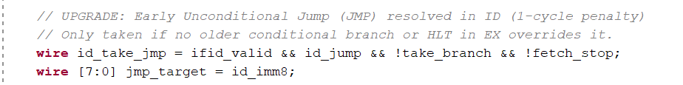
Architecture Highlight: Custom Hardware Upgrades
Upgrade 1 - Early Unconditional Jump (JMP in ID Stage): Relocated JMP resolution from EX to ID (id_take_jmp), cutting branch penalty from 2 cycles down to 1 cycle and reducing total execution time to 50 cycles (CPI: 1.47).
Upgrade 2 - 4-Bit Signed Arithmetic Flags (Z, C, N, V): Expanded ALU to compute Negative (N) and 2's complement Overflow (V) flags.
Upgrade 3 - Built-in Synthesis ROM: Embedded machine code in imem.v with KEEP_HIERARCHY and DONT_TOUCH attributes.

Slide 6
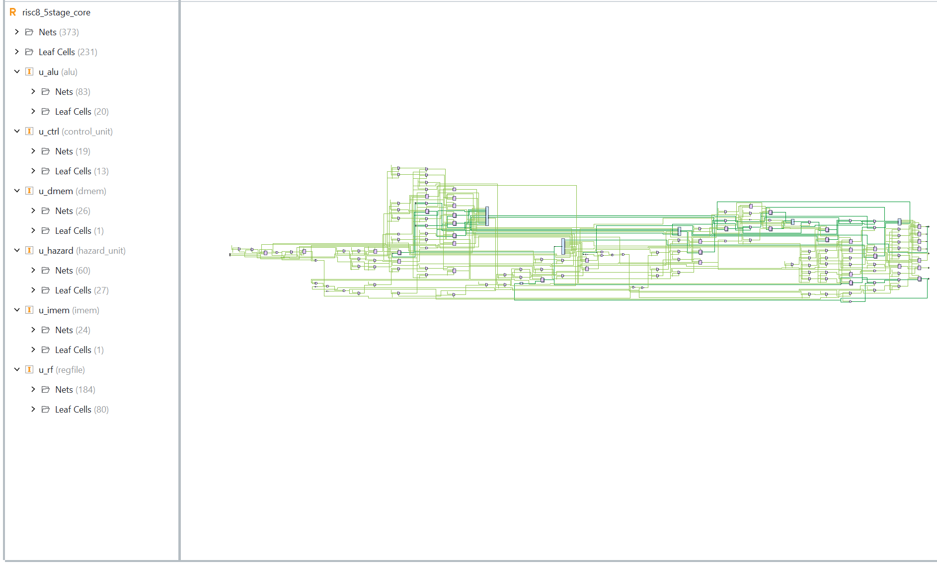
RTL Analysis: Full Elaborated Schematic
RTL Hardware Mapping: Complete 5-stage processor core elaborated in Vivado 2026.1.
Modular Boundaries: Clear separation between u_imem, u_ctrl, u_rf, u_hazard, u_alu, u_dmem, and pipeline registers.

Slide 7
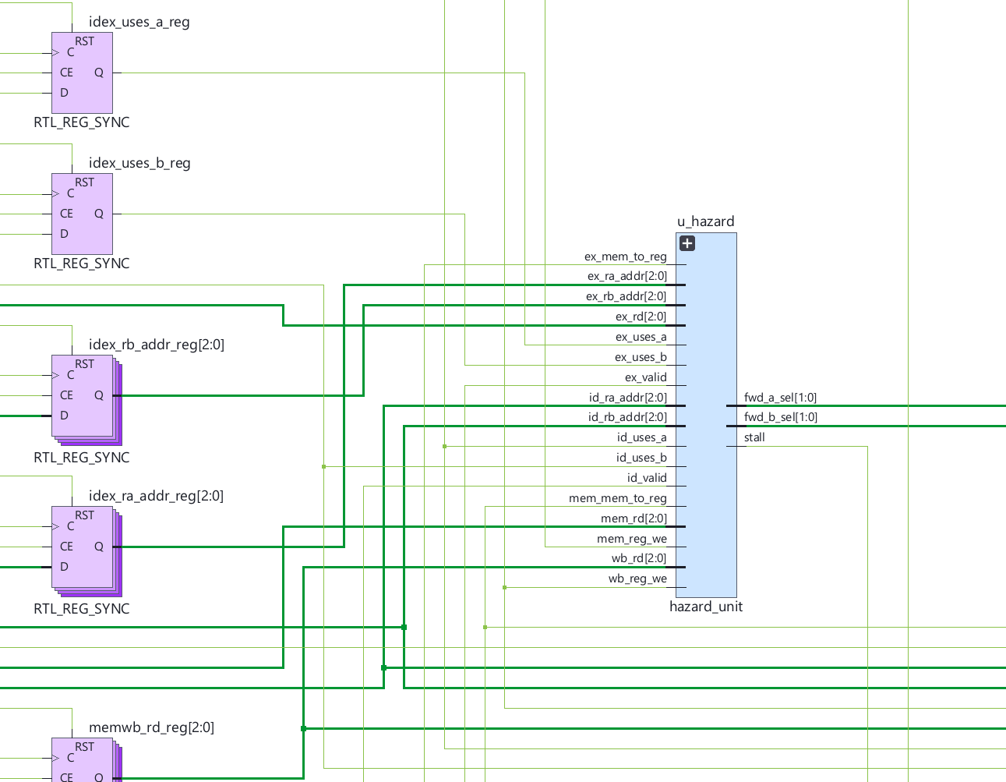
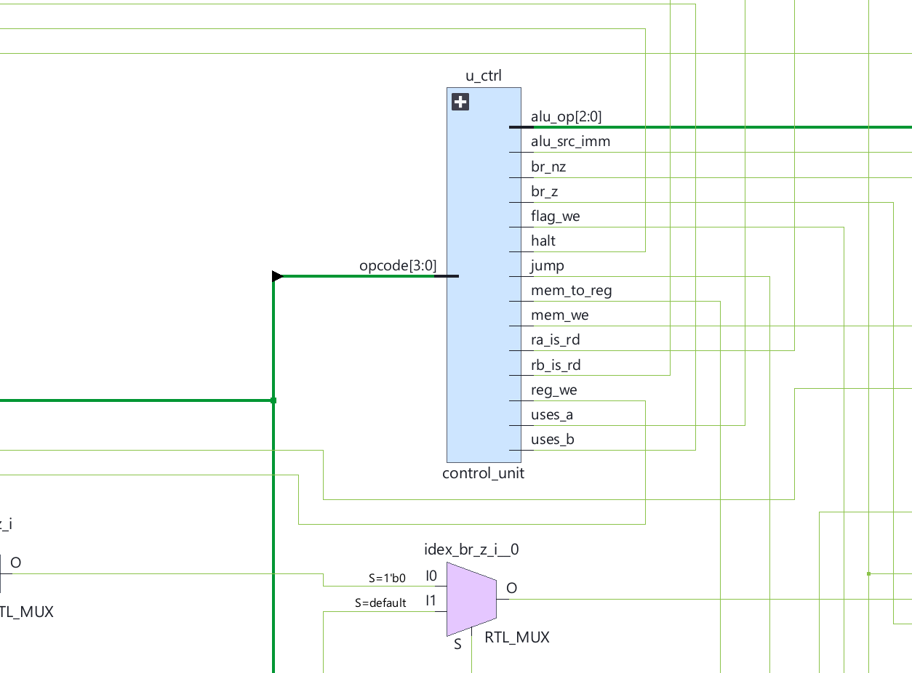
RTL Analysis: Hazard Unit & Early Jump Routing (Zoomed)
Forwarding & Stall Generation: Combinational paths from u_hazard driving fwd_a_sel, fwd_b_sel, and stall.
Dual Flush Control: take_branch (EX stage) and id_take_jmp (ID stage) controlling pipeline flush logic.

Slide 8
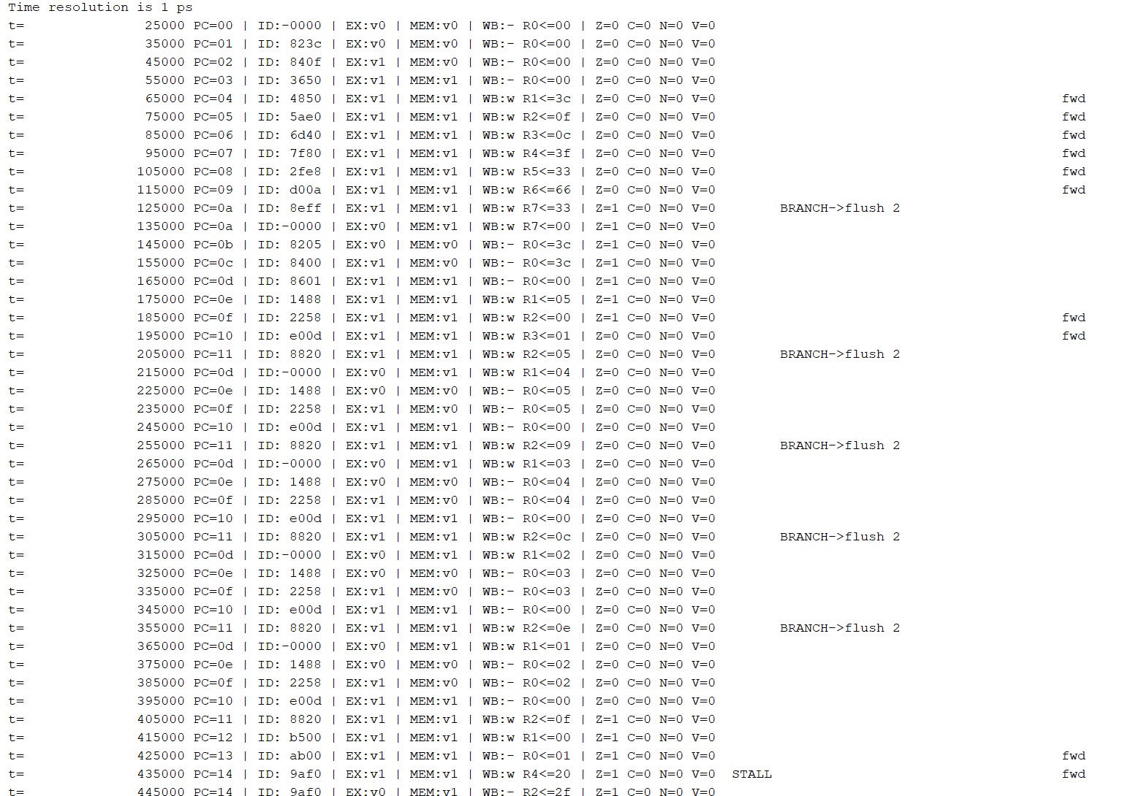
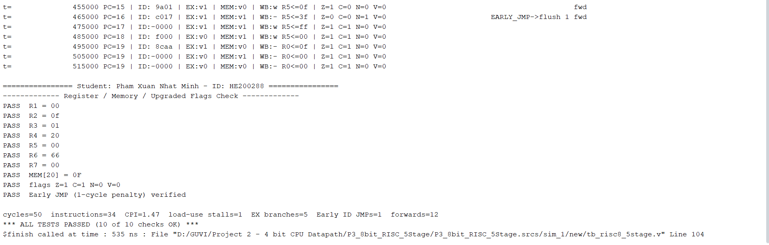
Automated Verification & Self-Checking Testbench
Cycle-Accurate Pipeline Trace: Monitors all 5 stages, flags, stalls, flushes, and forwards every clock edge.
10 Automated Self-Checks: Validates R1-R7, MEM[0x20] = 0x0F, 4-bit flags (1100), and Early JMP execution.
Performance Improvement: Completed 34 instructions in 50 cycles (CPI = 1.47, down from baseline 1.50).

Slide 9
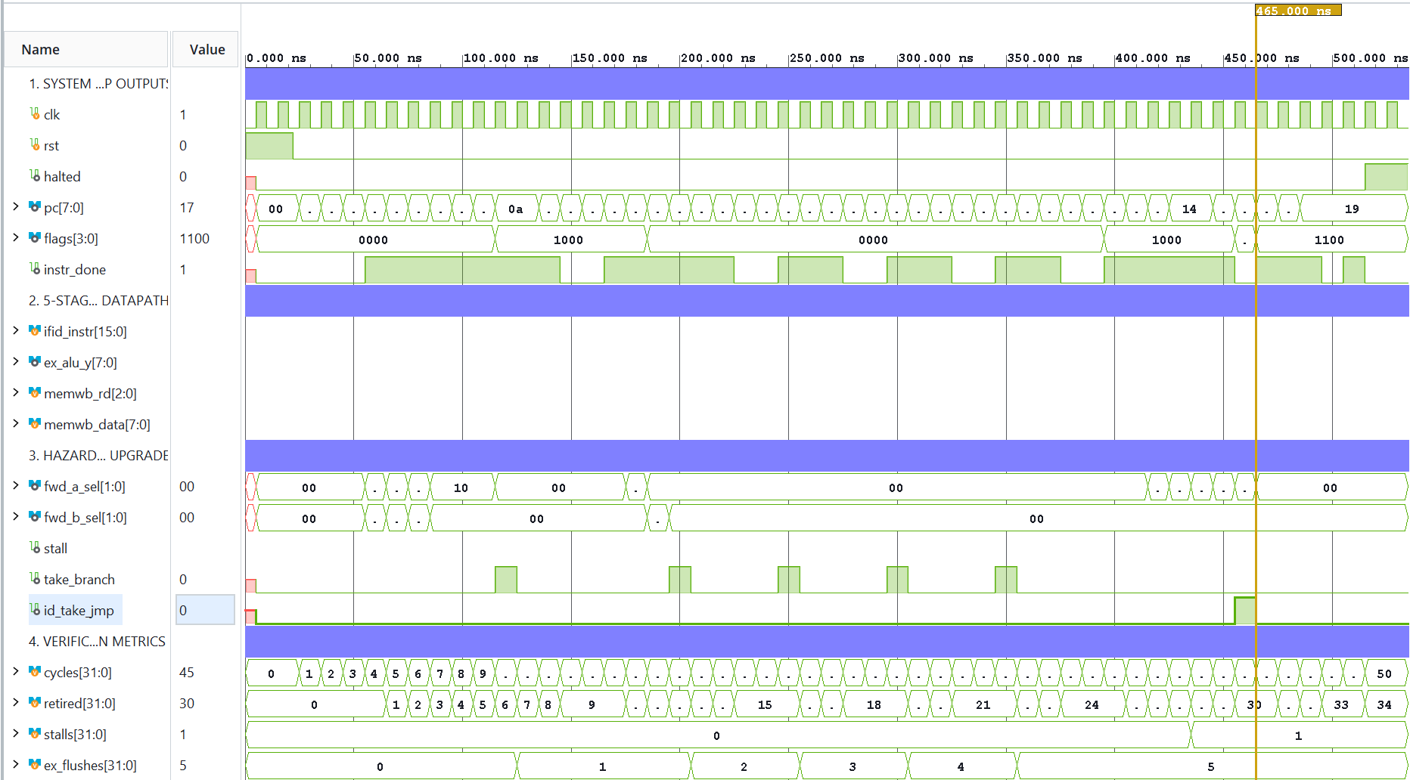
Waveform & Pipeline Timing Analysis
Concurrent Execution: Tracks pc, ifid_instr, ex_alu_y, and write-back bus across 50 clock cycles.
Hardware Event Capture: Visual proof of fwd_a/b_sel switching, stall assertion at 435 ns, and id_take_jmp pulse at 465 ns.

Slide 10
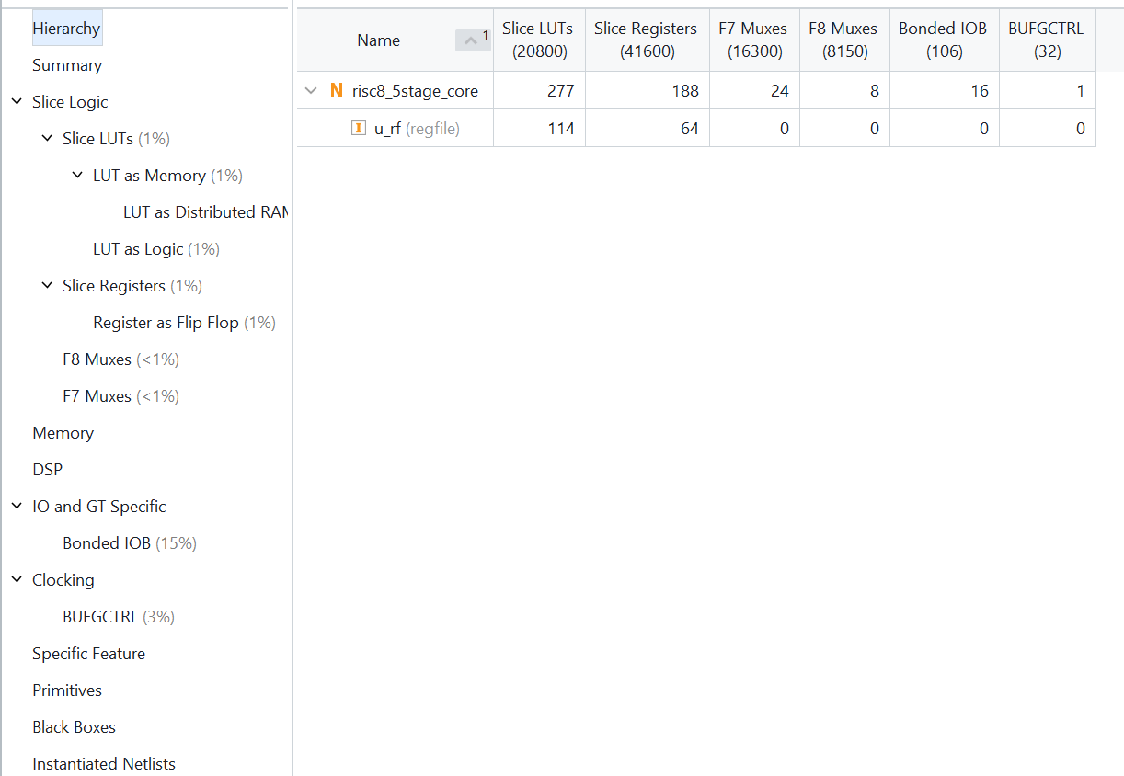
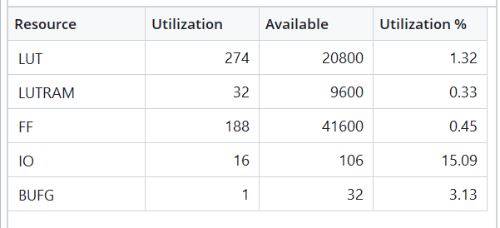
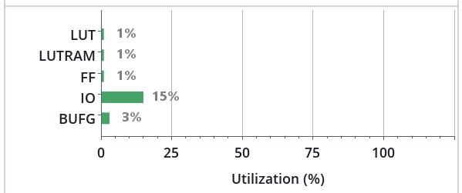
Synthesis & Post-Implementation Hardware Utilization
Logic Resources: 274 Slice LUTs (1.32%) for 8-bit ALU, Hazard/Forwarding muxes, Control Unit, and instruction ROM.
Memory & Sequential: 32 LUTRAMs (0.33%) for 256x8-bit RAM, and 188 Flip-Flops (0.45%) for registers and pipeline stages.
Interfaces: 16 Bonded IOBs (15.09%) and 1 BUFG global clock buffer.

Slide 11
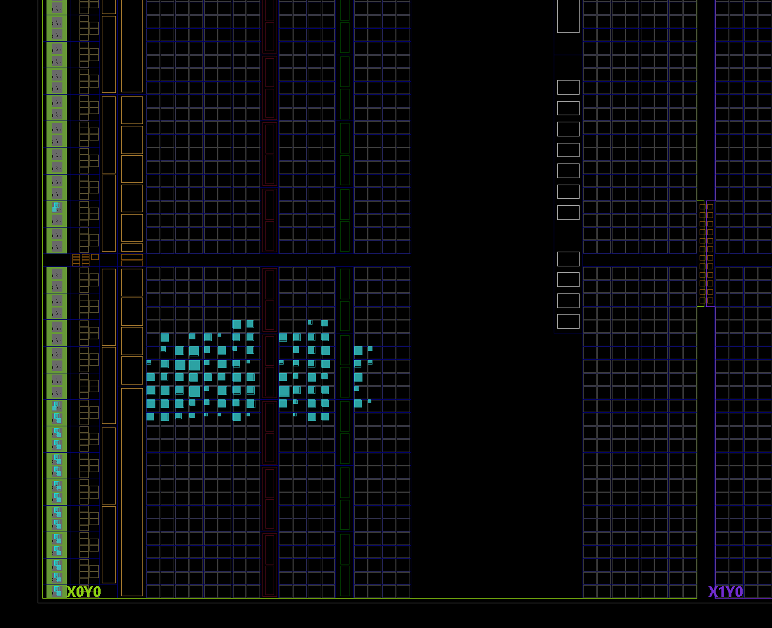
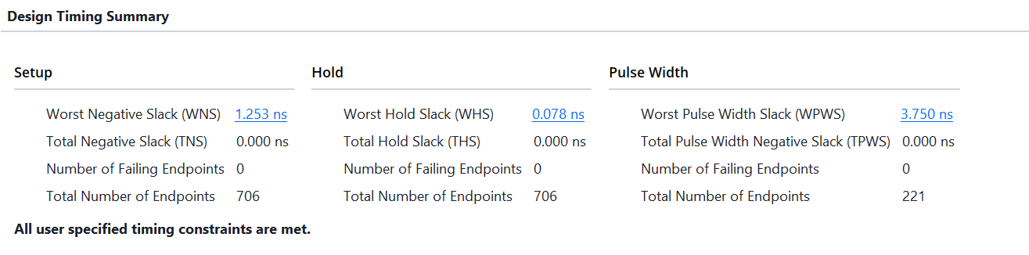
Implementation: Physical Device View & Timing Summary
Silicon Placement: Tightly clustered in the X0Y0 clock region on Artix-7, minimizing routing congestion.
100 MHz Timing Closure: Achieved Worst Negative Slack (WNS) = +1.253 ns, TNS = 0.000 ns, and 0 Failing Endpoints (Fmax approx 114.3 MHz).

Slide 12
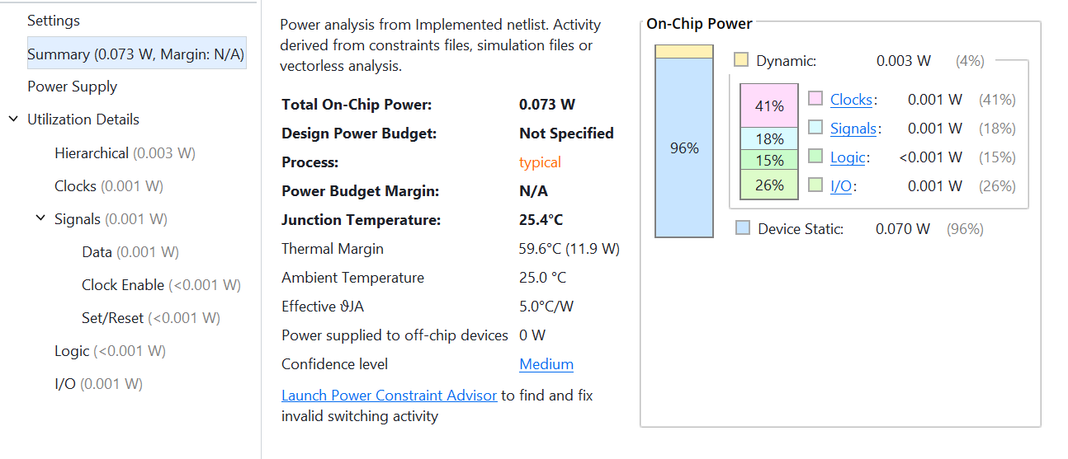
Implementation: Power Analysis Report
Ultra-Low Power Profile: 0.073 W (73 mW) Total On-Chip Power at 100 MHz.
Breakdown: 0.070 W Device Static (96%) and only 0.003 W (3 mW) Dynamic Power.
Thermal Stability: Junction temperature at a cool 25.4 degree Celsius with a 59.6 C thermal margin.

Slide 13
Conclusion
Full ASIC/FPGA Flow Mastery: Specification -> 5-Stage RTL Design -> Self-Checking Verification -> 100 MHz Timing Closure -> Physical Implementation.
Key Achievements: Zero hazard bugs, CPI reduced to 1.47 via Early Jump, full signed flag support (Z, C, N, V), and +1.253 ns WNS on Artix-7.

