Slide 1

Unit 10
Relational Database and SQLite

Slide 2
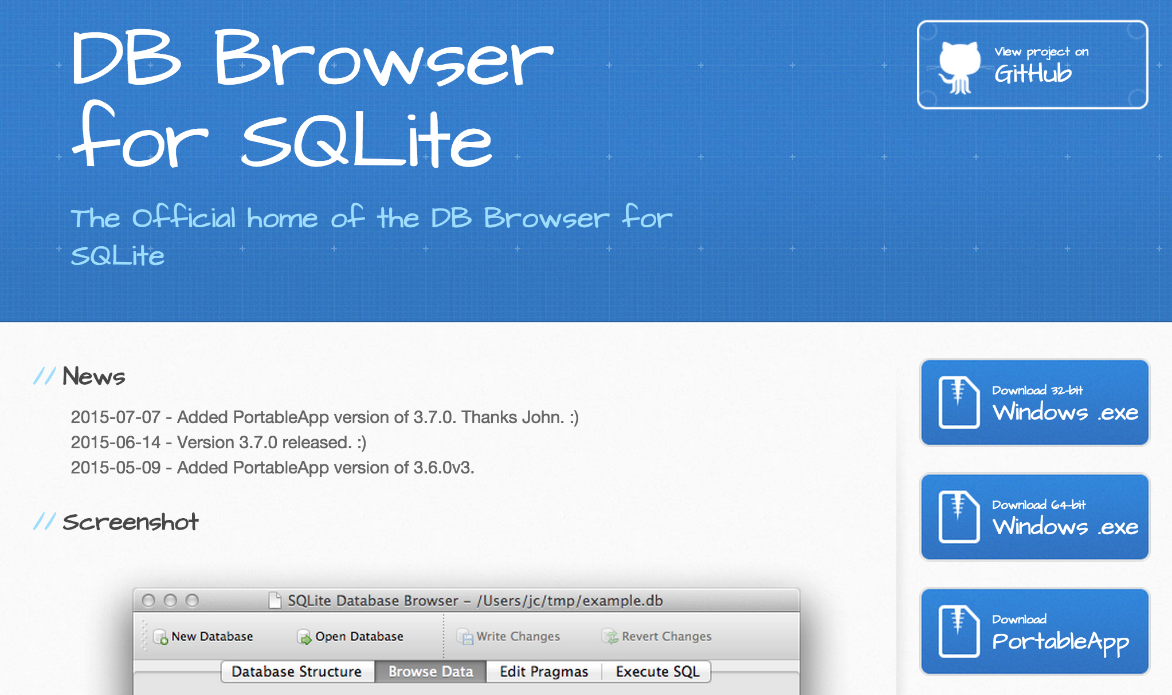
SQLite Browser
http://sqlitebrowser.org/

Slide 3
Relational Databases
Relational databases model data by storing rows and columns in tables. The power of the relational database lies in its ability to efficiently retrieve data from those tables and in particular where there are multiple tables and the relationships between those tables involved in the query.
http://en.wikipedia.org/wiki/Relational_database

Slide 4
Terminology
Database - contains many tables
Relation (or table) - contains tuples and attributes
Tuple (or row) - a set of fields that generally represents an “object” like a person or a music track
Attribute (also column or field) - one of possibly many elements of data corresponding to the object represented by the row

Slide 5
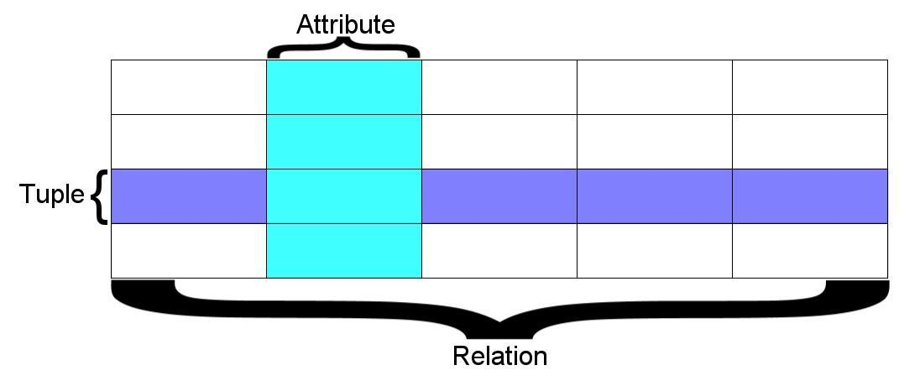
A relation is defined as a set of tuples that have the same attributes. A tuple usually represents an object and information about that object. Objects are typically physical objects or concepts. A relation is usually described as a table, which is organized into rows and columns. All the data referenced by an attribute are in the same domain and conform to the same constraints. (Wikipedia)

Slide 6
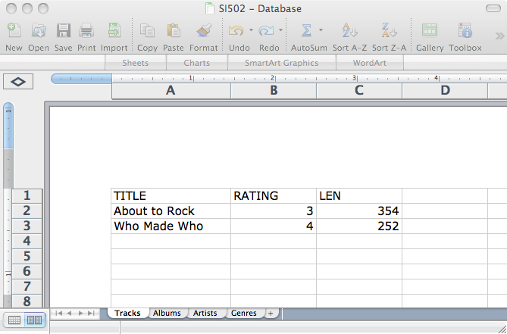
Columns / Attributes
Rows /
Tuples
Tables / Relations

Slide 7
SQL
Structured Query Language is the language we use to issue commands to the database
- Create data (a.k.a Insert)
- Retrieve data
- Update data
- Delete data
http://en.wikipedia.org/wiki/SQL

Slide 8

Input
Files
Python
Programs
Database
File
SQL
R
SQL
Output
Files
Excel
SQLite
Browser
You
D3.js

Slide 9
Application
Software
Database
Data Server
End
User
SQL
SQL
Developer
Database
Tools
DBA

Slide 10
SQL: Insert
Câu lệnh INSERT Chèn 1 dòng vào bảng
INSERT INTO HocVien (HoTen, DienThoai)
VALUES (‘Nhất Nghệ', '028393 22735')

Slide 11
SQL: Delete
Xóa các dòng dựa vào điều kiện chọn
DELETE FROM HocVien WHERE DienThoai=‘0909123456'

Slide 12
SQL: Update
Cập nhật một/một vài cột theo điều kiện
UPDATE HocVien SET HoTen=‘Hồng Anh’
WHERE MaHV=3

Slide 13
Retrieving Records: Select
The select statement retrieves a group of records - you can either retrieve all the records or a subset of the records with a WHERE clause
SELECT * FROM HocVien
SELECT * FROM HocVien
WHERE DienThoai=‘0909123456'

Slide 14
Sắp xếp với ORDER BY
Sử dụng ORDER BY ở câu lệnh SELECT để lấy kết quả có sắp xếp tăng hay giảm dần theo điều kiện nào đó.
SELECT * FROM HocVien ORDER BY HoTen
SELECT * FROM HocVien ORDER BY DienThoai DESC

Slide 15
Xem thêm
https://www.sqlitetutorial.net/

Slide 16
Python vs SQLite
Chèn thư viện:
import sqlite3
Mở database để thao tác:
MyDB=sqlite3.connect(‘NhatNgheDB.db’)

Slide 17
Sqlite library imported – ok
Connection to database – ok
3. Next, we need to create a cursor object (this will allow us to work with and manipulate our database)
import sqlite3
MyDB = sqlite3.connect(‘N:\\NhatNgheDb.db’)
c=MyDB.cursor()
Now we can create our first table of data!

Slide 18
We use DDL (Data Definition Language) to create a table in SQlite.
#create a table of students
c.execute('''
CREATE TABLE Student
(
StudentID text,
Firstname text,
Surname text,
DOB date,
FormGroup text
)
''')

Slide 19
The standard DDL for creating a table in SQLite is:
#create a table example
c.execute('''CREATE TABLE NameOfTable
(Field Data type,
Field Data type,
Field Data type)
''')

Slide 20
Now, to insert data into our new table called Student
#insert data into our table
c.execute(''‘INSERT INTO Student
VALUES (‘001’,’Hien’,’Luong’,’1/1/1981’,’11W’)
‘’’)
Make sure you are inserting data in the right order and with an appropriate data type.

Slide 21
Now you need to save changes using the COMMIT() function and close using the close() function
#insert data into our table
c.execute(''‘INSERT INTO Student
VALUES (‘001’,’Hien’,’Luong’,’1/1/1981’,’11W’)’’’)
#Save changes using the commit() function
MyDB.commit()
#Close the database connection
MyDB.close()

