Slide 1

| Welcome to Java Gold! |

Slide 2
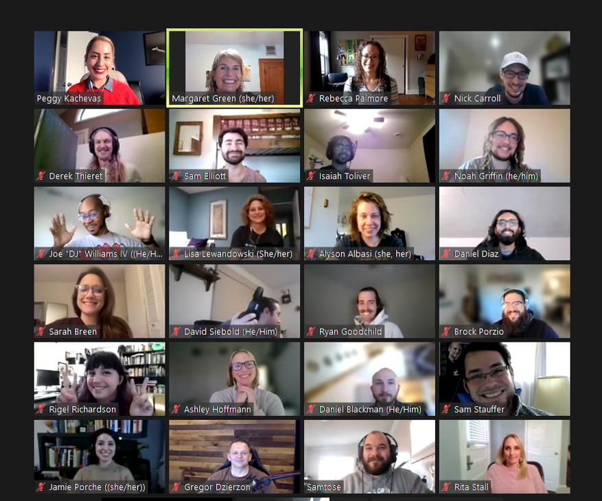

|During Lecture
Video on
Display name set to First and Last name
Have a Question?
Interrupt and ask
Ask in Chat
Message the instructor/Academic Fellow not lecturing

Slide 3
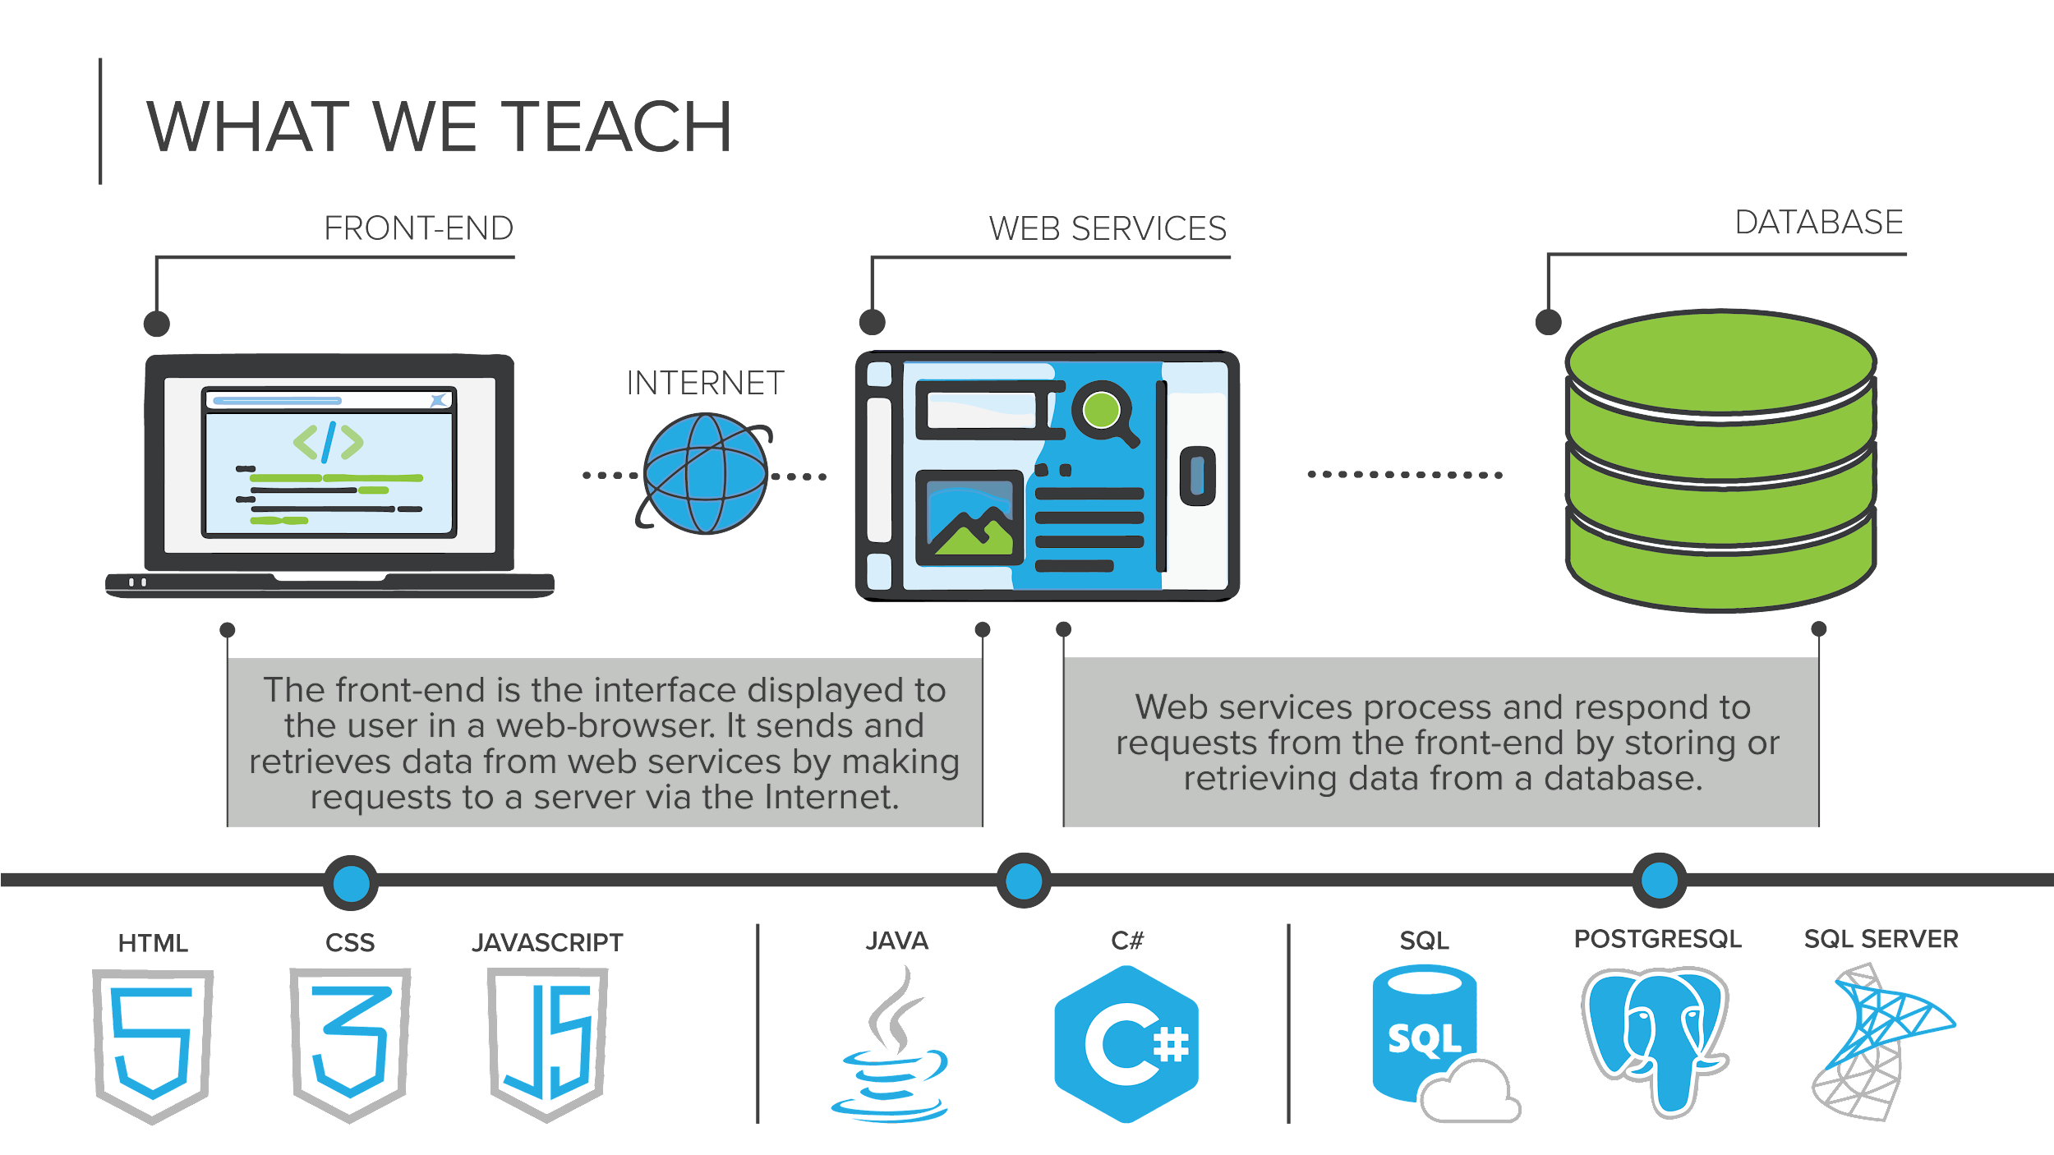

Slide 4







|Program Overview
WEEKS 1-4
WEEKS 5-8
WEEKS 9-12
programming fundamentals
databases and APIs
front-end programming
Learn object-oriented programming to compose larger programs together in Java
Work with development tools like Eclipse, and Git
Store and retrieve data using the Postgres relational databases
Consume and share data from our applications over the Internet using APIs
Develop web application interfaces using HTML, CSS, and JavaScript
Learn how create web components using the Vue.JS JavaScript framework

Slide 5
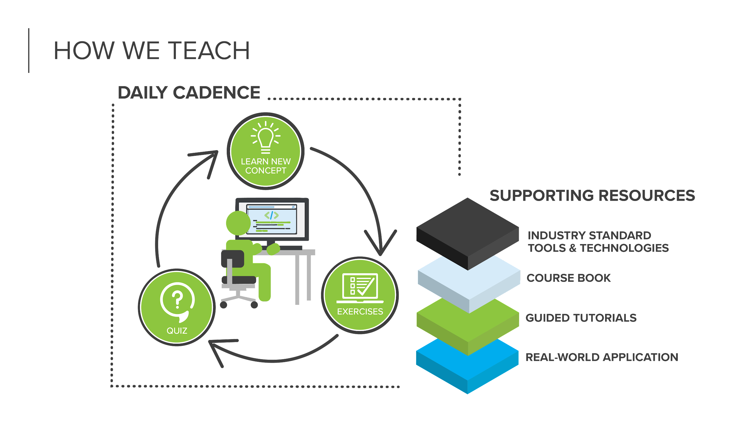

Slide 6

|Daily Workflow
Before each lecture
Complete the Reading and Tutorial in Bootcamp OS
Complete the Quiz
Lecture
Starts at 9 am
Ends when we complete that day’s objectives
After Lecture
Exercises
Pathway

Slide 7
| Expectations
Treat this like a job
Communicate if you are going to miss a deadline
Communicate if you are going to be late, absent, or need to leave the lecture early
Availability
Must be available 9-4 CST
Additional time on evenings and weekends may be required to complete the work
Keep up-to-date with scores and feedback in Bootcamp OS

Slide 8
3.0 100%-90%
2.0 89% - 50%
Grading
1.0 49% - 25%
0.0 24% - 0%

Slide 9
| Exercises and Scores
Required to complete the program
Must end each module with a minimum of a average score of 2
If you end a module below a 2 average then you will automatically be put on academic probation. If you fail to complete the terms of the academic probation or end a second module below a 2 average, you will be withdrawn from the program.

Slide 10
| DUE DATES
EXERCISES GIVEN... | ARE DUE...
Monday | Wednesday 9 AM
Tuesday | Thursday 9 AM
Wednesday | Friday 9 AM
Thursday | Monday 9 AM
Friday | Tuesday 9 AM

Slide 11
| Academic Integrity
It is OK to collaborate with others, but always turn in your own code and make sure you understand it.
Your code will be reviewed, and if we suspect that you have turned in code written by others, we reserve the right to have you explain the code to us. If you can not you will be required to redo the exercise and it will be treated as late.

Slide 12
| What to do when you are stuck
Reading and Tutorials in Bootcamp OS
Study group - it is OK to collaborate, but you must understand the final code.
All other classes are learning the same material.
Slack - post in the nlr-13-homework-help class channel (also remember to use that halp assistance)
Online resources
Ask an Instructor for help

Slide 13
| Effectively asking for help on Slack
Saying “I can’t make this work, how do I fix it?” doesn’t give enough information to solve your problem.
Provide Details:
Description of the problem
What is happening
How is it working differently than you expected
Error message
Test case results

