Slide 1
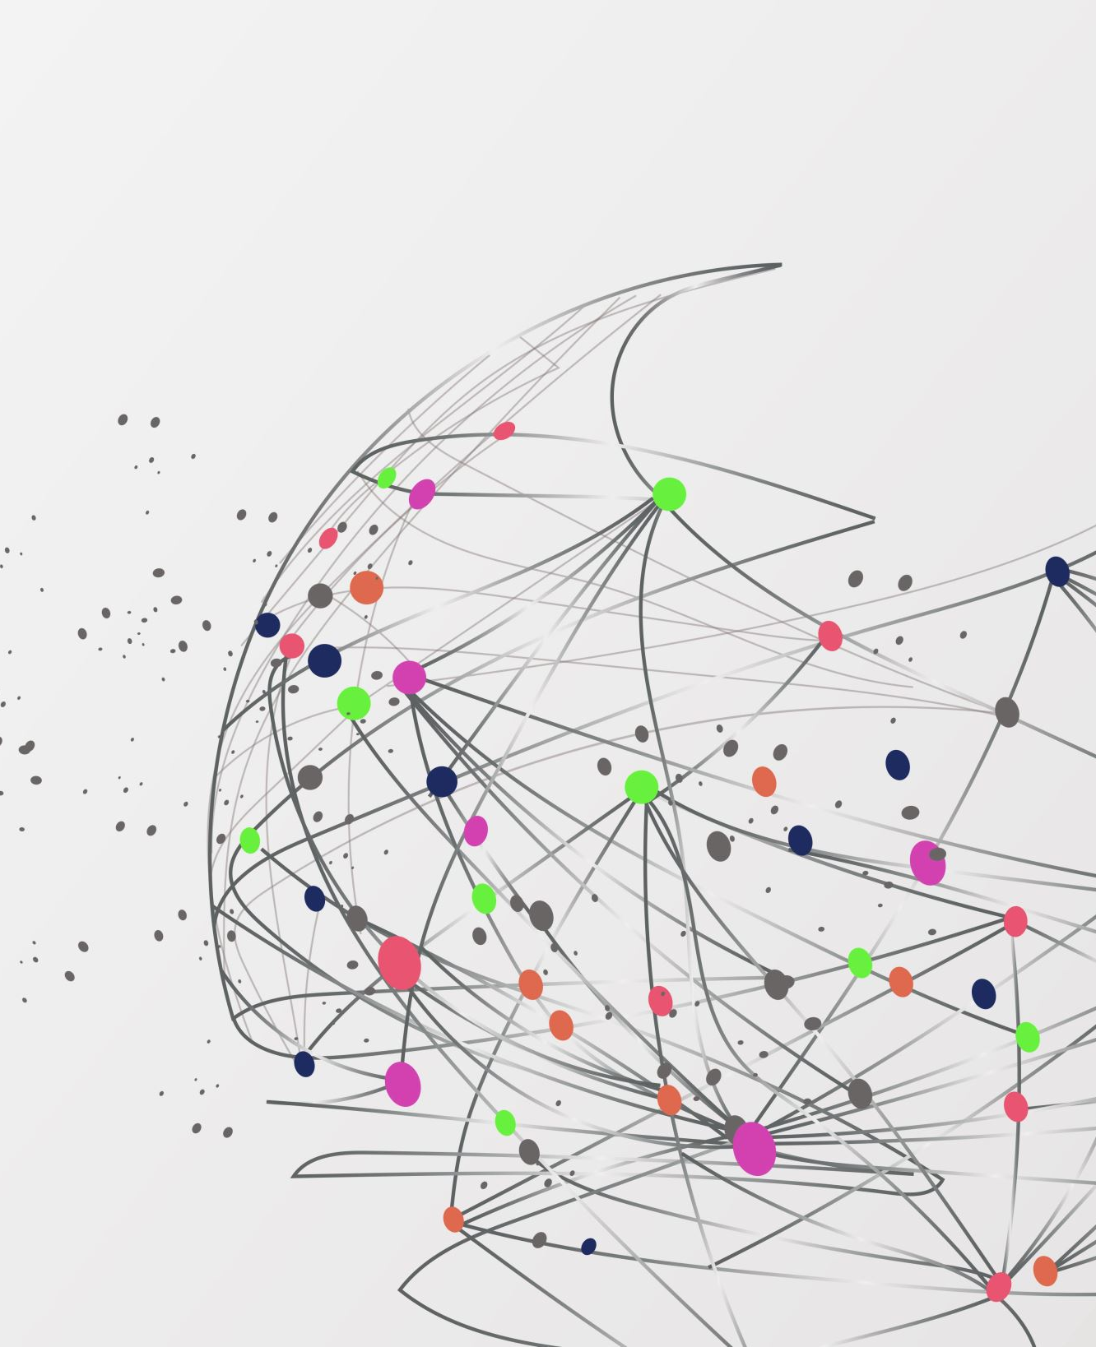
High performance machine Learning for Cervical cancer
Thuan Nhan

Slide 2
Cervical Cancer
Type of cancer in the cervix (part of the uterus)
Caused by human papillomavirus (HPV)
Risk factors: early sex, multiple partners, smoking, weak immune system, family history
Symptoms: abnormal bleeding, pelvic pain, pain during sex, unusual discharge
Detected through Pap test and HPV testing (Slow and expensive)
Prevention: HPV vaccine, regular screening
Highly preventable and treatable with early detection and care

Slide 3
GOAL
- Combine both PCA/LDA and parallelization for faster and more efficient training time.

Slide 4
Machine learning for cervical cancer prediction
Multiple papers explore machine learning for cervical cancer prediction.
Most tend to focus on increasing accuracy
Various models used, including Decision Tree, Logistic Regression, Random Forest, and XG-Boost.
High accuracies achieved, ranging from 96.8% to 99.71%.
Some papers focus on feature importance and explainability using SHAP.
Few papers address scalability of machine learning algorithms.
Genetic algorithm used to reduce features while maintaining accuracy.

Slide 5
Machine Learning Performance Metric
Accuracy, Precision, Recall
Usual oversight: training time and efficiency

Slide 6
Solution:
Instance rich data set: Spark (Row rich)
Feature rich data set: LDA, PCA
Combine both PCA/LDA and Spark

Slide 7

Map Reduce
MapReduce: programming framework introduce by google to handle large datasets, cluster processing
Workflow: input divided, independent processing, result combination
Procedures: map (preprocessing), reduce (aggregation)
Hadoop MapReduce: popular implementation
Scalable, fault-tolerant
Used for batch processing, offline data jobs

Slide 8
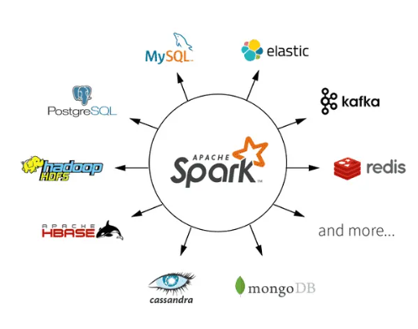
Spark and Spark ML
Spark:
Apache Spark: introduced in 2014 at UC Berkeley
Goal: addresses limitations of other Big Data frameworks
Spark expands on MapReduce, adds features and optimizations
In-memory caching boosts performance compared to disk-based MapReduce
Supports integration with other languages and platforms
Higher-level API and expressive programming models in Spark lower the barrier of entry compared to MapReduce

Slide 9

Spark and Spark ML
SparkML
SparkML: scalable and distributed machine learning library within Spark
Enables parallelized machine learning on large datasets
Lowers barrier of entry for distributed machine learning with high-level API
Includes popular machine learning algorithm implementations for efficient model deployment

Slide 10
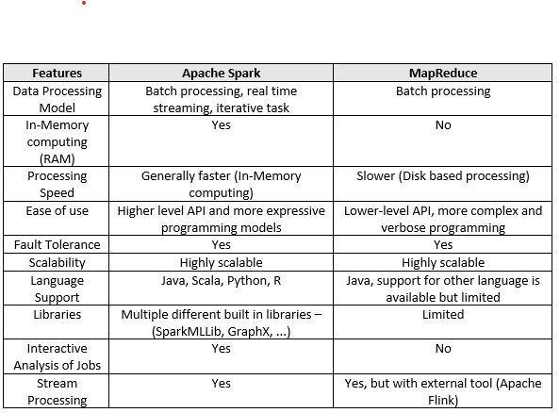
Spark vs MapReduce

Slide 11

Why Spark and SparkML
Spark and Spark ML perform better for bigger dataset compared to traditional model library such as SkLearn
Good integration with Google Cloud
Easy scalability: modifying the numbers of workers is 1 line of code

Slide 12
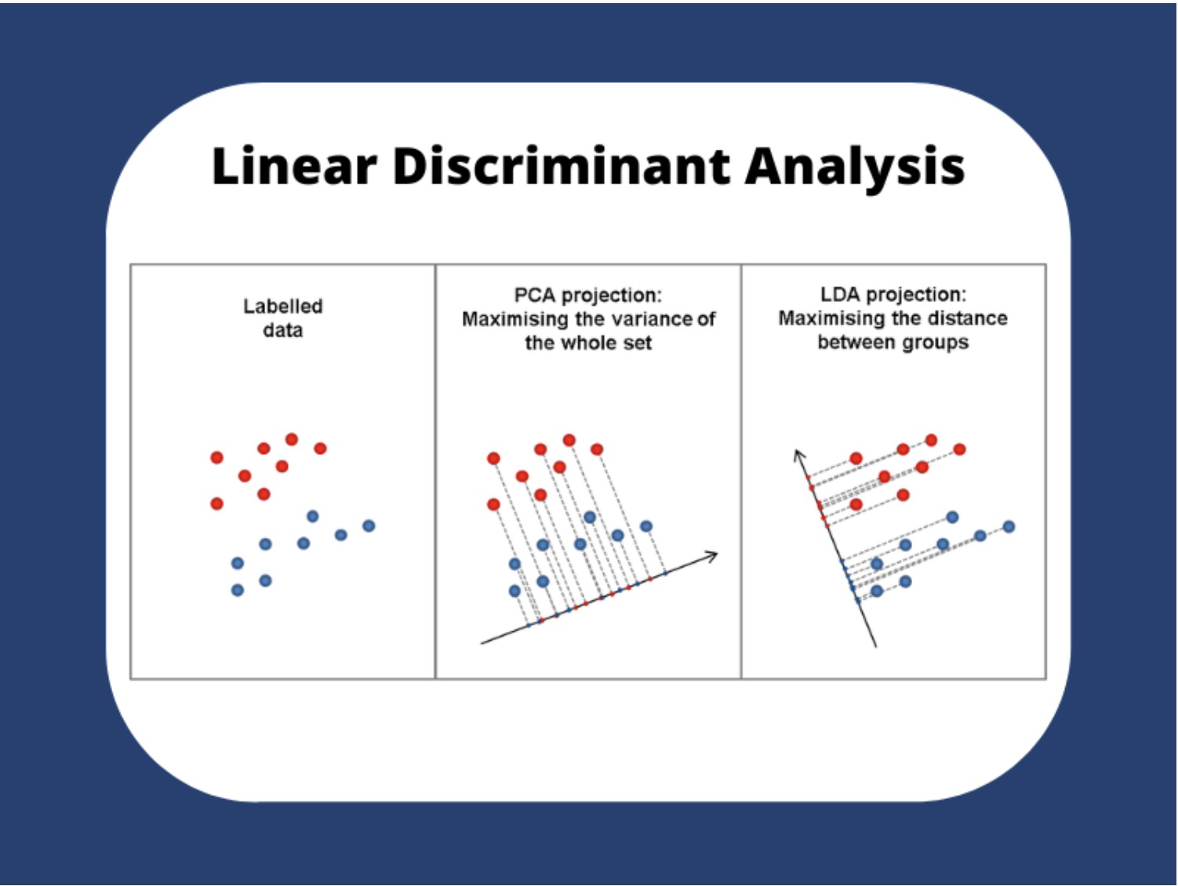
PCA and LDA
- PCA: Finding the component that maximize data variance
- LDA: Finding axes that maximize the separation between multiple class
- PCA: unsupervised learning
- LDA: supervised learning

Slide 13
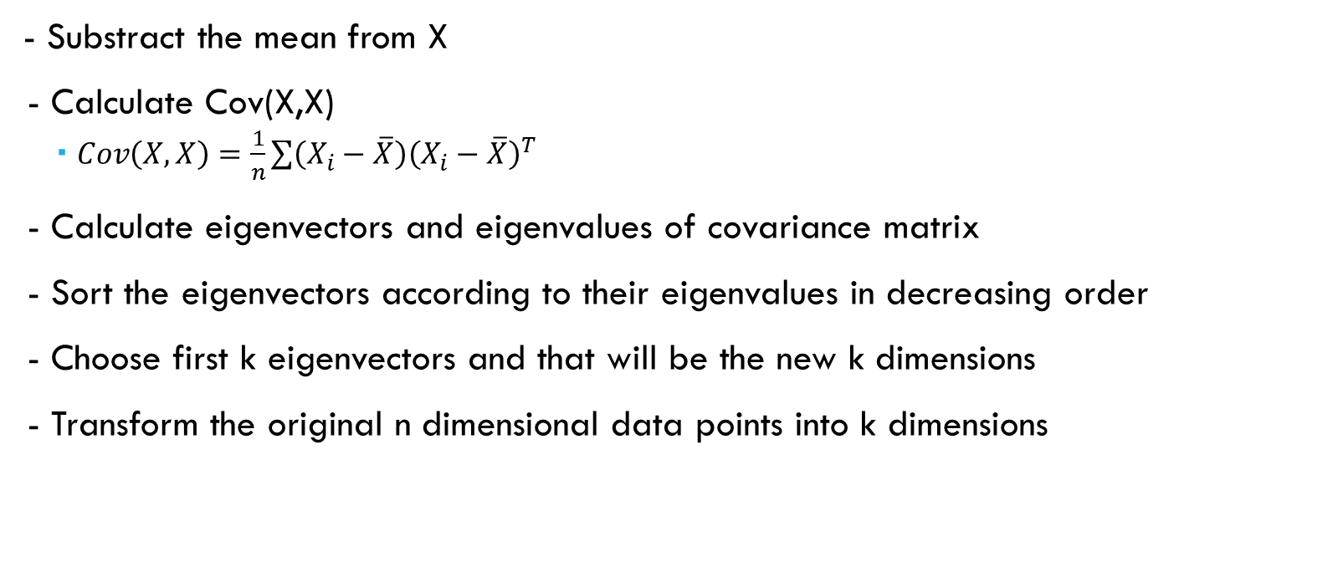
PCA:
- Substract the mean from X
- Calculate Cov(X,X)
$Cov\left(X,X\right)=\frac{1}{n}\sum{\left(X_{i}−\overline{X}\right){\left(X_{i}−\overline{X}\right)}^{T}}$
- Calculate eigenvectors and eigenvalues of covariance matrix
- Sort the eigenvectors according to their eigenvalues in decreasing order
- Choose first k eigenvectors and that will be the new k dimensions
- Transform the original n dimensional data points into k dimensions

Slide 14
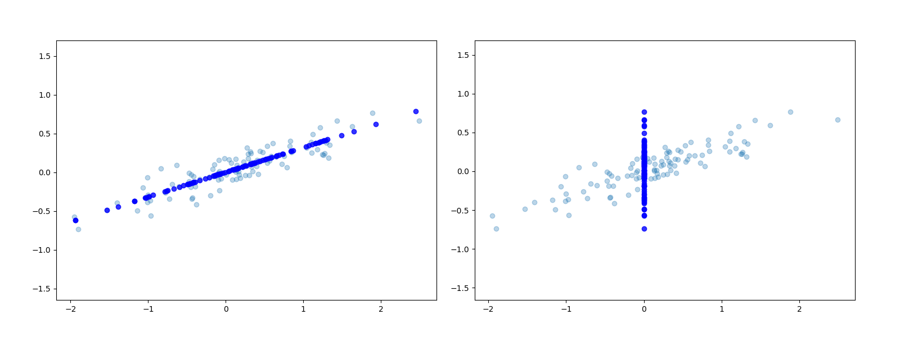
PCA: Good vs bad projection

Slide 15
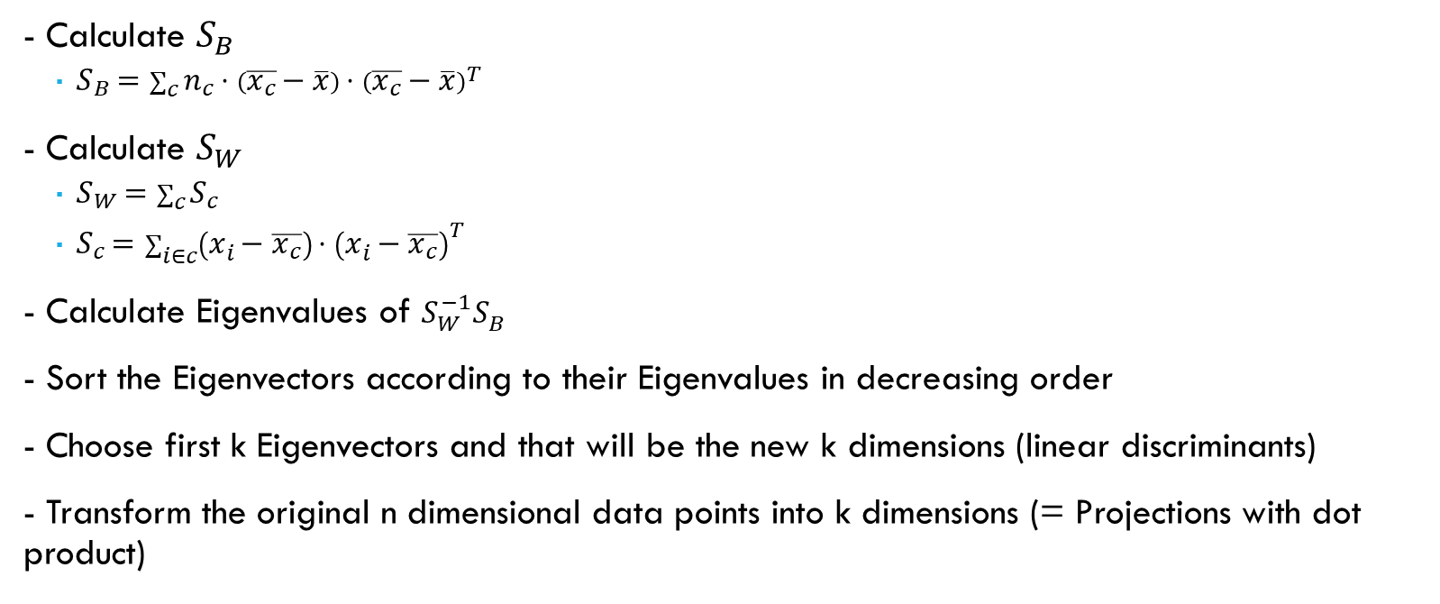
LDA
- Calculate $S_{B}$
$S_{B}=\sum_{c}{n_{c}⋅\left(\overline{x_{c}}−\overline{x}\right)⋅{\left(\overline{x_{c}}−\overline{x}\right)}^{T}}$
- Calculate $S_{W}$
$S_{W}=\sum_{c}{S_{c}}$
$S_{c}=\sum_{i∈c}{\left(x_{i}−\overline{x_{c}}\right)⋅{\left(x_{i}−\overline{x_{c}}\right)}^{T}}$
- Calculate Eigenvalues of $S_{W}^{−1}S_{B}$
- Sort the Eigenvectors according to their Eigenvalues in decreasing order
- Choose first k Eigenvectors and that will be the new k dimensions (linear discriminants)
- Transform the original n dimensional data points into k dimensions (= Projections with dot product)

Slide 16
DataSet
- SIPaKMeD (From Kaggle)
- Images for Pap Smear procedure
- Around 7gb

Slide 17
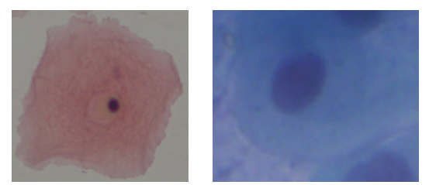
Labels
Normal cells
Superficial Intermediate
Parabasal Cells

Slide 18
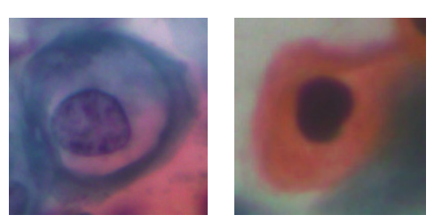
Labels
Abnormal cells
Koilocytotic cells
Dyskeratotic cells

Slide 19
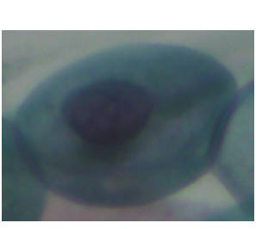
Labels
Benign cells
Metaplastic cells

Slide 20
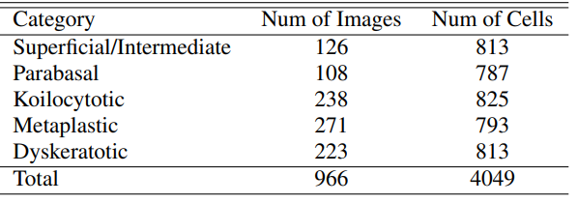
Distribution of Dataset

Slide 21
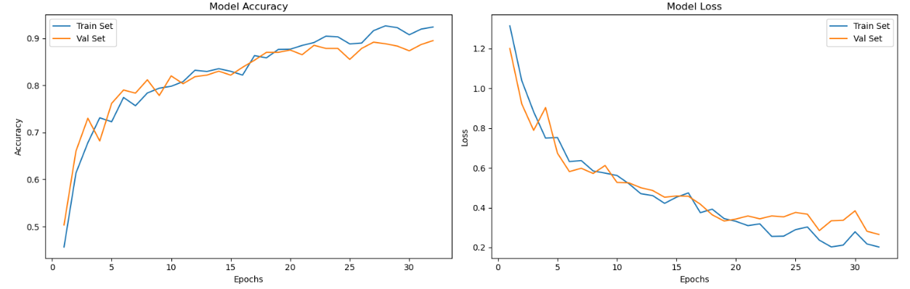
Result for CNN

Slide 22
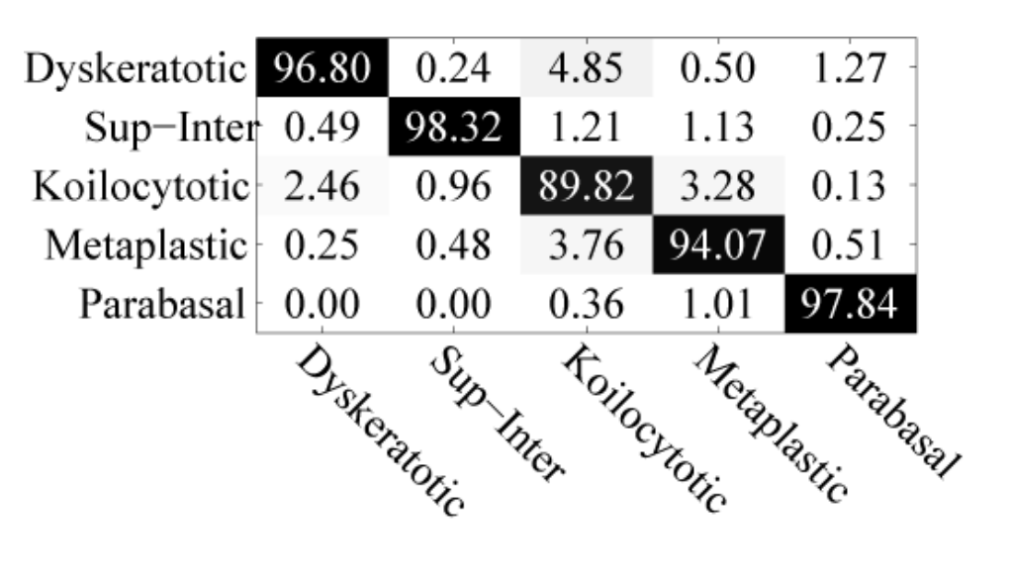
Result for CNN

