Slide 1
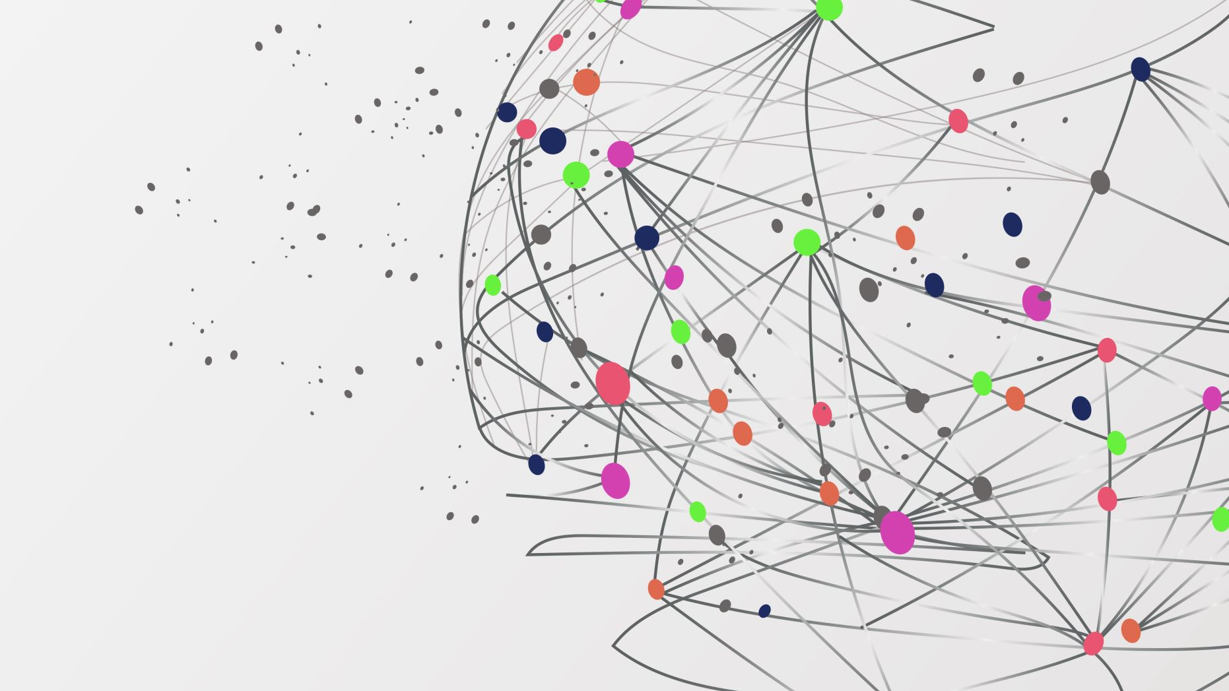
Scalable Multimodal machine learning for cervical cancer detection
Thuan Nhan

Slide 2
Cervical Cancer
Type of cancer in the cervix (part of the uterus)
Caused by human papillomavirus (HPV)
Risk factors: early sex, multiple partners, smoking, weak immune system, family history
Symptoms: abnormal bleeding, pelvic pain, pain during sex, unusual discharge
Detected through Pap test and HPV testing (Slow and expensive)
Prevention: HPV vaccine, regular screening
Highly preventable and treatable with early detection and care

Slide 3
GOAL
- Combine both PCA and parallelization for faster and more efficient training time.

Slide 4
Machine learning for cervical cancer prediction
Multiple papers explore machine learning for cervical cancer prediction.
Most tend to focus on increasing accuracy
Various models used, including Decision Tree, Logistic Regression, Random Forest, and XG-Boost.
High accuracies achieved, ranging from 96.8% to 99.71%.
Some papers focus on feature importance and explainability using SHAP.
Few papers address scalability of machine learning algorithms.
Genetic algorithm used to reduce features while maintaining accuracy.

Slide 5
Machine Learning Performance Metric
Accuracy, Precision, Recall
Usual oversight: training time and efficiency

Slide 6
Solution:
Instance rich data set: Spark (Row rich)
Feature rich data set: LDA, PCA
Combine both PCA/LDA and Spark

Slide 7
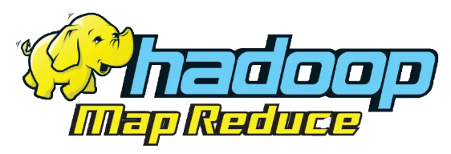
Map Reduce
MapReduce: programming framework introduce by google to handle large datasets, cluster processing
Workflow: input divided, independent processing, result combination
Procedures: map (preprocessing), reduce (aggregation)
Hadoop MapReduce: popular implementation
Scalable, fault-tolerant
Used for batch processing, offline data jobs

Slide 8
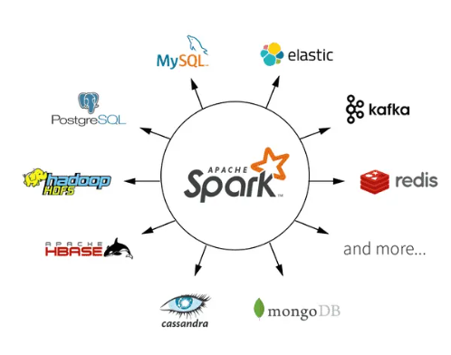
Spark and Spark ML
Spark:
Apache Spark: introduced in 2014 at UC Berkeley
Goal: addresses limitations of other Big Data frameworks
Spark expands on MapReduce, adds features and optimizations
In-memory caching boosts performance compared to disk-based MapReduce
Supports integration with other languages and platforms
Higher-level API and expressive programming models in Spark lower the barrier of entry compared to MapReduce

Slide 9

Spark and Spark ML
SparkML
SparkML: scalable and distributed machine learning library within Spark
Enables parallelized machine learning on large datasets
Lowers barrier of entry for distributed machine learning with high-level API
Includes popular machine learning algorithm implementations for efficient model deployment

Slide 10
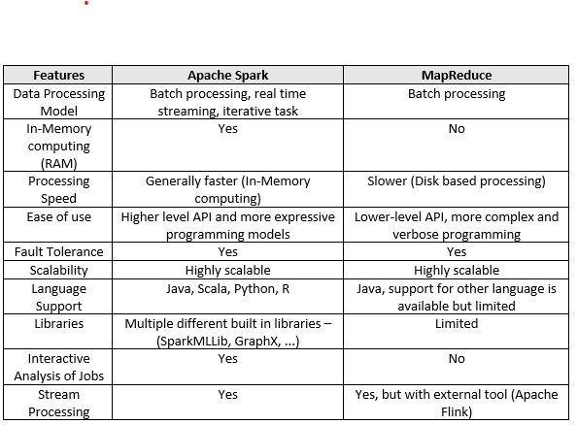
Spark vs MapReduce

Slide 11
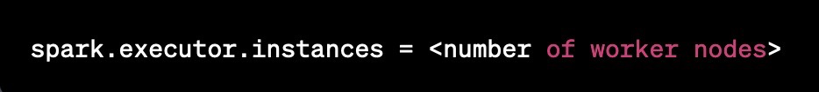
Why Spark and SparkML
Spark and Spark ML perform better for bigger dataset compared to traditional model library such as SkLearn
Good integration with Google Cloud
Easy scalability: modifying the numbers of workers is 1 line of code

Slide 12
DataSet – 2 different types
SipakMed:
7gb
Images
Cervical Cancer Risk Classification
CSV files

Slide 13

SipakMed
Can be found on Kaggle
Introduced in 2018
Standardized pap smear images

Slide 14
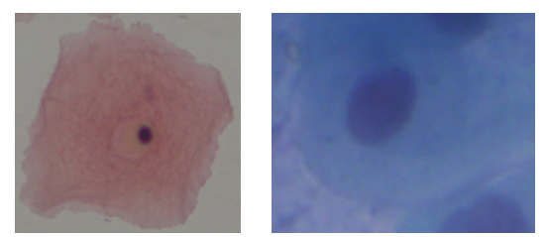
Labels
Normal cells
Superficial Intermediate
Parabasal Cells

Slide 15
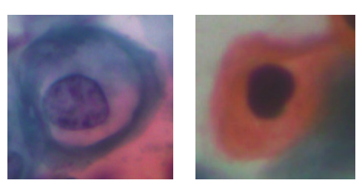
Labels
Abnormal cells
Koilocytotic cells
Dyskeratotic cells

Slide 16
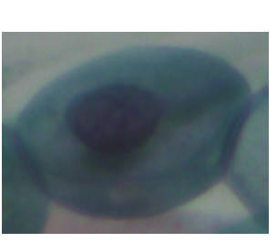
Labels
Benign cells
Metaplastic cells

Slide 17
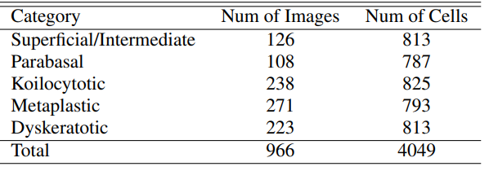
Distribution of SipakMed

Slide 18
Cervical Cancer Risk Classification (CCRC)
- Found on Kaggle
- 858 rows and 36 features
- Biopsy as target class

Slide 19
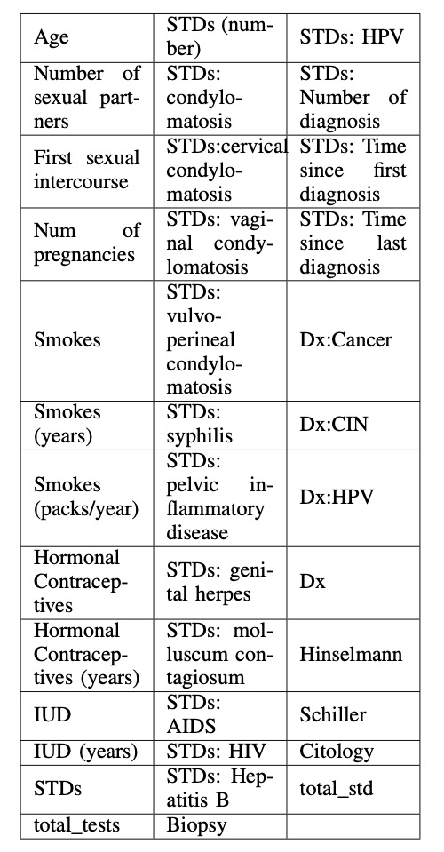

Slide 20
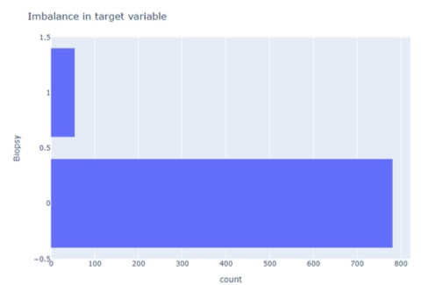
PreProcessing
Cervical Cancer Risk Classification:
Nan are replace with column median, remove duplicate
835 rows
Class imbalance (781 to 54) -> Adasyn

Slide 21

Preprocessing
Sipakmed:
- Image compression (77x77)
- Keep RGB format as grayscale leads to 20% accuracy loss
- Transform to Dataframe to feed to machine learning models

Slide 22
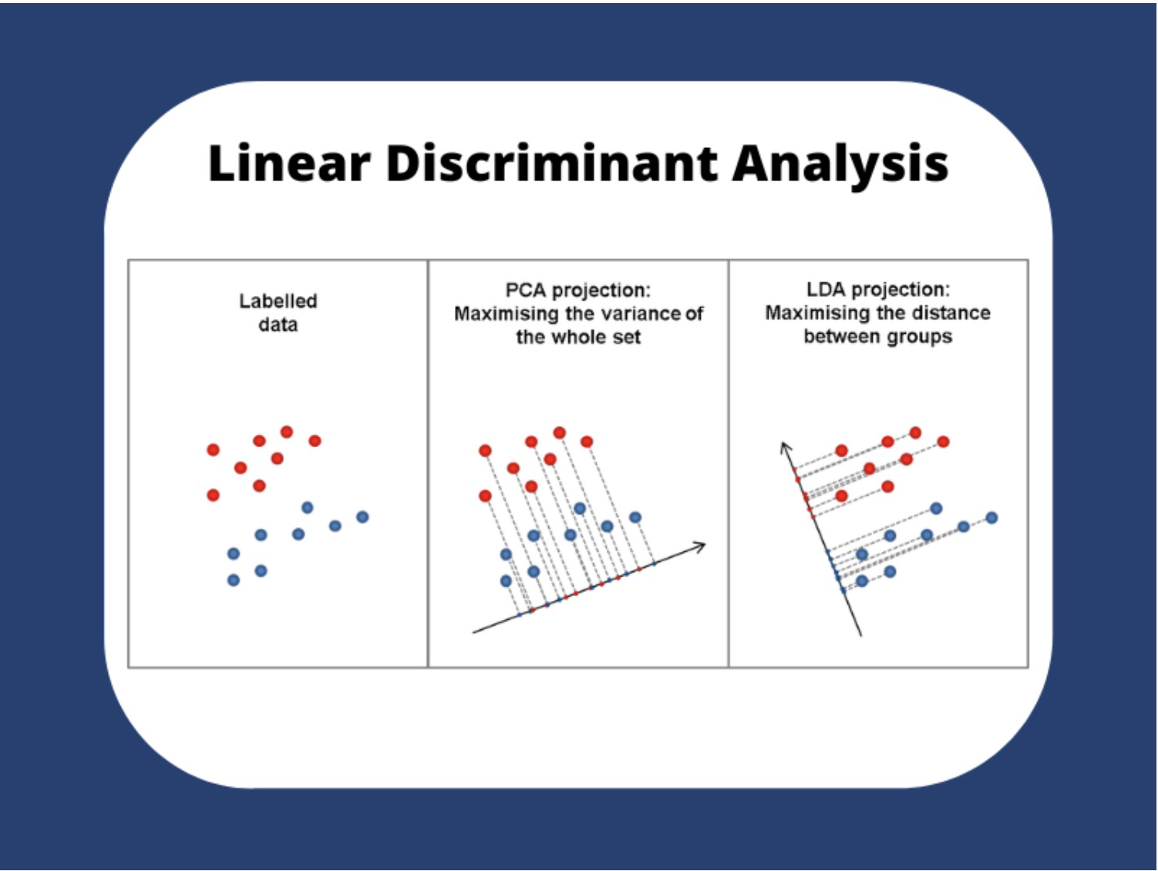
PCA
- PCA: Finding the component that maximize data variance
- PCA: unsupervised learning

Slide 23
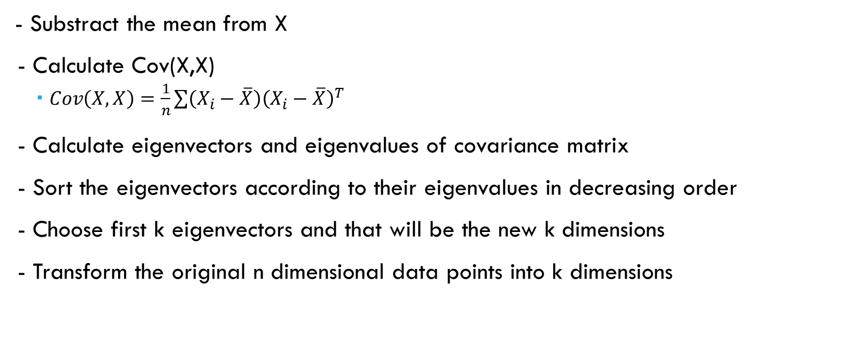
PCA:
- Substract the mean from X
- Calculate Cov(X,X)
$Cov\left(X,X\right)=\frac{1}{n}\sum{\left(X_{i}−\overline{X}\right){\left(X_{i}−\overline{X}\right)}^{T}}$
- Calculate eigenvectors and eigenvalues of covariance matrix
- Sort the eigenvectors according to their eigenvalues in decreasing order
- Choose first k eigenvectors and that will be the new k dimensions
- Transform the original n dimensional data points into k dimensions

Slide 24
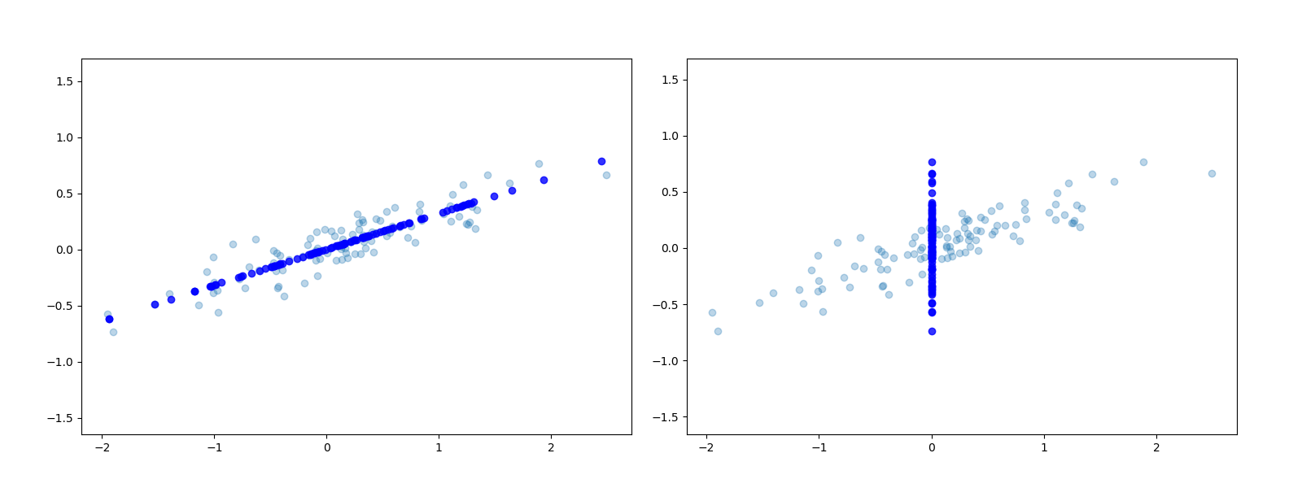
PCA: Good vs bad projection

Slide 25
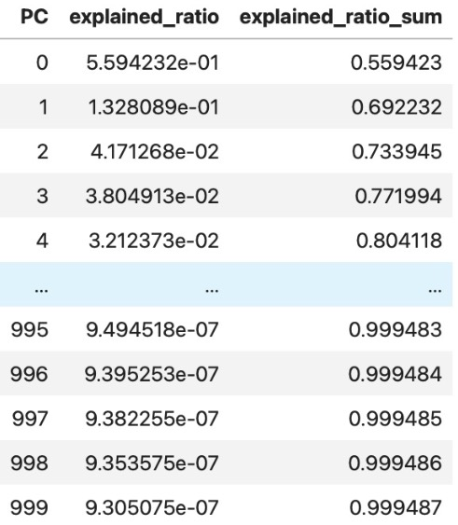
PCA
- Transform Pap Smear Images df to lower dimension
After compression 4049x17787
Select 1000 features to explain 99% variance

Slide 26
Machine Learning models
- Logistic Regression
- Decision Tree
- Random forest
- Gradient boosted
- Support vector machine
- Naives Bayes
- Factorization machine
- Convolutional neural network

Slide 27
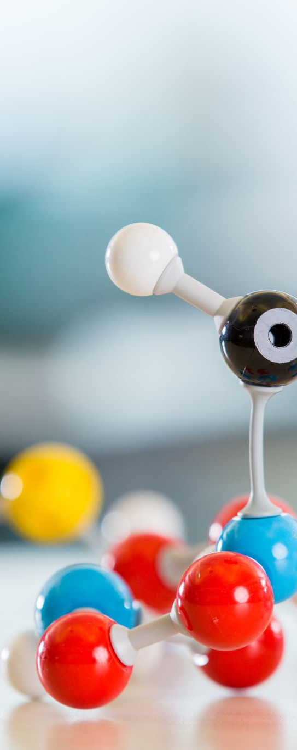
Machine Learning models
- All machine learning models are called from SkLearn and SparkML library
- CNN code is based on CBIR-NewCode-CNN Model on Kaggle
"https://www.kaggle.com/code/sjha999/cbir-newcode-cnn-model"

Slide 28
Methodology
Spark's Viability as an Alternative Platform:
Establish Spark as an alternative to traditional machine learning frameworks like SKLearn or CNN.
Preprocessed data shuffled and split 70-30 for training-testing.
Train machine learning algorithms using Spark's default implementation.
Repeat the process ten times and average outcomes.
Evaluate performance metrics (accuracy, precision, F1 score, recall).
Compare results with SKLearn (CSV) and CNN (images).

Slide 29
Methodology
Comparing Spark's Scalability:
Assess scalability with Cervical Cancer Risk Classification dataset.
Record training time for each algorithm in Spark.
Identify algorithm with longest training time.
Implement chosen algorithm in SKLearn and Spark.
Apply algorithm to CSV file, iteratively duplicating file size.
Focus on training time as the evaluation metric.

Slide 30
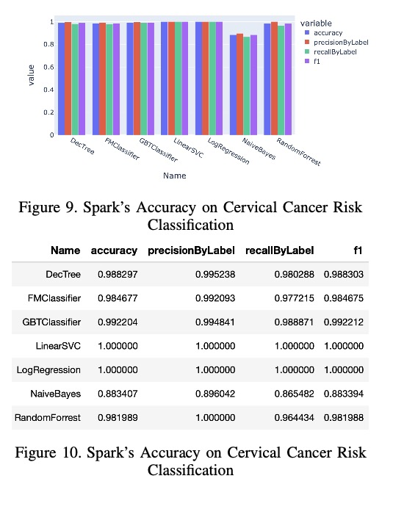
Result – Cervical Cancer Risk Classifcation
Figures 9 and 10 showcase robust performance of Spark algorithms.
Most algorithms exhibit over 98% accuracy, except Naive Bayes.
Naive Bayes achieves 88% accuracy with consistent precision, recall, and F1 scores.

Slide 31
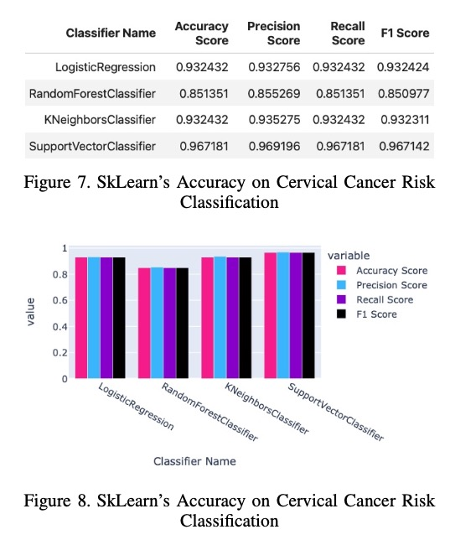
Result – Cervical Cancer Risk Classifcation
Figures 7 and 8 depict accuracy results using SkLearn.
SkLearn's accuracy slightly lower than Spark's, still commendable.
Support Vector Classifier achieves over 96% accuracy, while Random Forest around 85%.

Slide 32
Result – Cervical Cancer Risk Classification
Spark's accuracy comparable to SkLearn's.
Majority of Spark algorithms perform exceptionally, raising concerns of potential overfitting.
Need for thorough exploration of preprocessing and ADASYN impact on reliability and generalizability

Slide 33
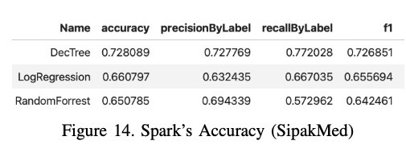
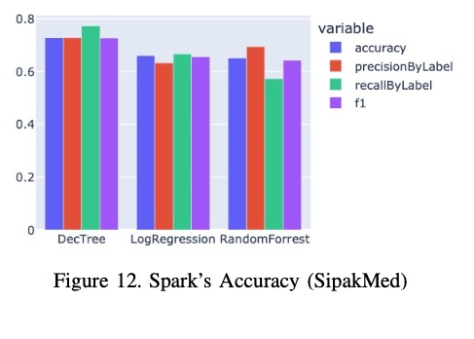
Result - SipakMed
Results overall suboptimal, no model exceeds 80% for any metric.
Decision Tree performs best, achieving over 72% for all metrics.
Random Forest least effective, recall at 57%, other metrics above 65%.

Slide 34
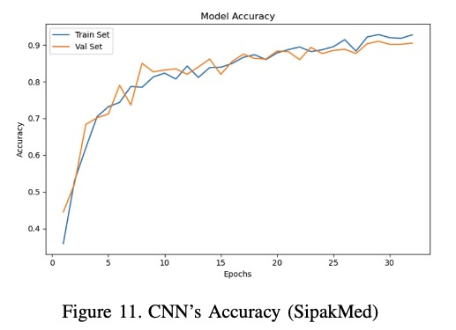
Result - SiPAKMED
CNN's superiority over Spark implementation.
CNN outperforms Spark algorithms by epoch 10.
By 32nd epoch, CNN reaches 92.75% accuracy on the same image dataset.

Slide 35
Result - SIPAKMED
Results indicate Spark's limitations for image classification.
Spark's implementation not as suitable as CNN.
CNN consistently excels in image classification tasks, aligning with expectation.

Slide 36
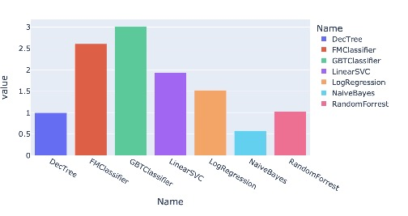
Result - Scalability
- GBT takes the highest training time -> chosen for scalability testing

Slide 37
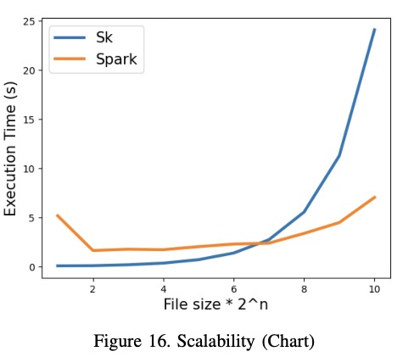
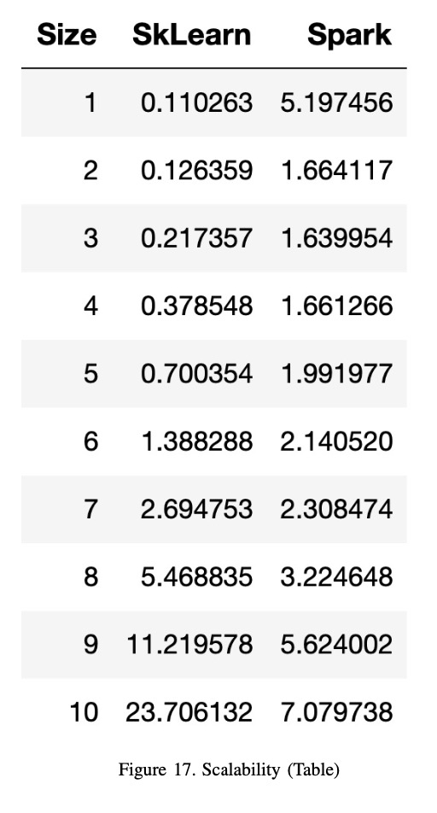
Result - Scalability
SkLearn's time doubles each iteration due to no parallelization.
Spark exhibits setup time but gains performance advantage.
SkLearn maintains steady, faster times from second to fourth iteration.
Spark's substantial improvement from seventh iteration.
SkLearn's early advantage minimal, Spark's lead grows.
By tenth iteration, Spark outperforms SkLearn by 16 seconds.

Slide 38
Spark’s scalability
Spark excels with larger datasets and parallel processing.
Consistent, efficient performance as data size increases.
Spark solidified as go-to for scalable text-based ML tasks.

Slide 39
Challenges and Considerations with Spark
Popularity and Algorithm Availability:
Spark has less widespread adoption compared to SkLearn.
SparkML library offers diverse algorithms but may lack some.
SkLearn ecosystem might have more readily accessible algorithms.
Learning Curve and Complexity:
Custom algorithms in Spark can be more complex than in SkLearn.
Requires understanding of concepts like MapReduce and RDDs.
Steeper learning curve demands more time and effort.

Slide 40
Challenges and Considerations with Spark
Performance Variations:
Spark shows disparities across different hardware setups.
M1 chip outperforms Windows i7-12700 setup significantly.
Example: Windows takes 50s, M1 chip takes 5.3s for the same task.
Challenges in Image Classification:
Personal experience highlights challenges in image classification.
Memory limitations encountered during image compression and PCA.
Upgrading to higher RAM system improved but didn't fully solve issues.
Task complexity led to use of SkLearn for PCA.

Slide 41
Methodological weakness and future works
Cervical Risk Classification Dataset:
Multiple target variables (Hinselmann, Schiller, Citology, Biopsy).
Challenge: Absence of definitive target class for cancer status.
Use of Biopsy as target variable may inflate accuracy due to inclusion of other test results.
Future solutions: Dataset with designated cancer status column or excluding other test results.

Slide 42
Methodological weakness and future works
Sipakmed Dataset and Methodological Challenges:
Methodological challenge comparing SparkML accuracy with traditional CNN.
Future research: Apply same traditional ML algorithm to both Spark and Sklearn.
GPU Acceleration and Image Classification:
Methodology lacks GPU acceleration for image classification.
Spark offers GPU support via Rapids, but complex implementation.
Future research: Investigate CNN with GPU acceleration for optimal image classification performance.

Slide 43
Anknowledgement
Dr. Khem Poudel
Machine Learning Research Group

Slide 44

Thank you

