Slide 1
SparkML: A Scalable Platform for Machine Learning in Cervical Cancer Research
Thuan Nhan

Slide 2
Cerivcal Cancer
A type of cancer that occur in cervix
4th most common cancer in women (WHO – 2020)
90% new case and deaths occurs in low and mid income country
Usually cause by HPV

Slide 3
Cervical Cancer – Slide Addtion

Slide 4
Cervical Cancer – Slide Addtion

Slide 5
Why machine learning
Quick deployment in the real world
Low barrier of entry for users
Lessen the burden of individuals and healthcare system
Improve cervical cancer prediction
Allows for analysis of multiple resources
Identify trends in data that is not apparent to human eyes

Slide 6

Map Reduce
MapReduce: programming framework introduce by google to handle large datasets, cluster processing
Workflow: input divided, independent processing, result combination
Procedures: map (preprocessing), reduce (aggregation)
Hadoop MapReduce: popular implementation
Scalable, fault-tolerant
Used for batch processing, offline data jobs

Slide 7
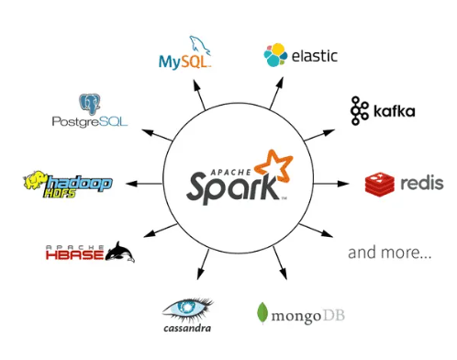
What is Spark and Spark ML
Spark:
Apache Spark: introduced in 2014 at UC Berkeley
Goal: addresses limitations of other Big Data frameworks
Spark expands on MapReduce, adds features and optimizations
In-memory caching boosts performance compared to disk-based MapReduce
Supports integration with other languages and platforms
Higher-level API and expressive programming models in Spark lower the barrier of entry compared to MapReduce

Slide 8

What is Spark and Spark ML
SparkML
SparkML: scalable and distributed machine learning library within Spark
Enables parallelized machine learning on large datasets
Lowers barrier of entry for distributed machine learning with high-level API
Includes popular machine learning algorithm implementations for efficient model deployment

Slide 9
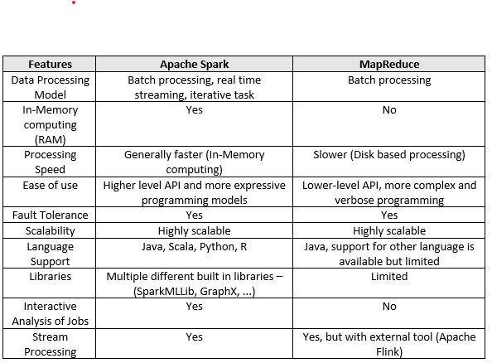
Spark vs MapReduce

Slide 10
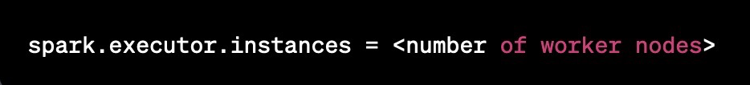
Why Spark and SparkML
Spark and Spark ML perform better for bigger dataset compared to traditional model library such as SkLearn
Good integration with Google Cloud
Easy scalability: modifying the numbers of workers is 1 line of code

Slide 11
Machine learning models chosen
Logistic Regression
Decision Tree Classifier
Random Forest Classifier
Gradient Boosted Classifier
Linear Support Vector Machine
Naives Bayes
Factorization Machine Classifier

Slide 12
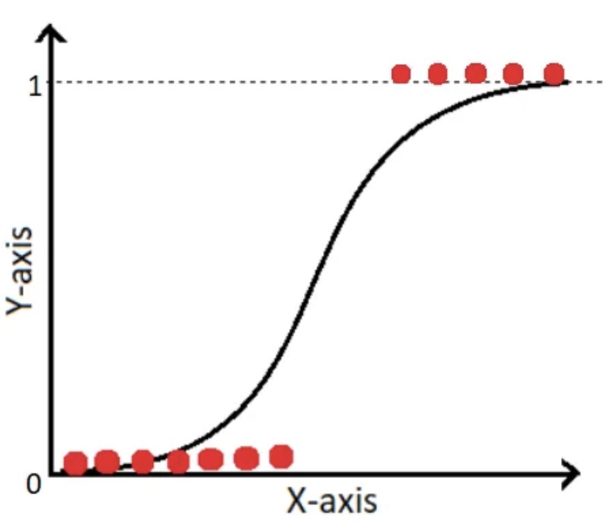
Logistic Regression
Using the logistic function to predict the fitment curve

Slide 13
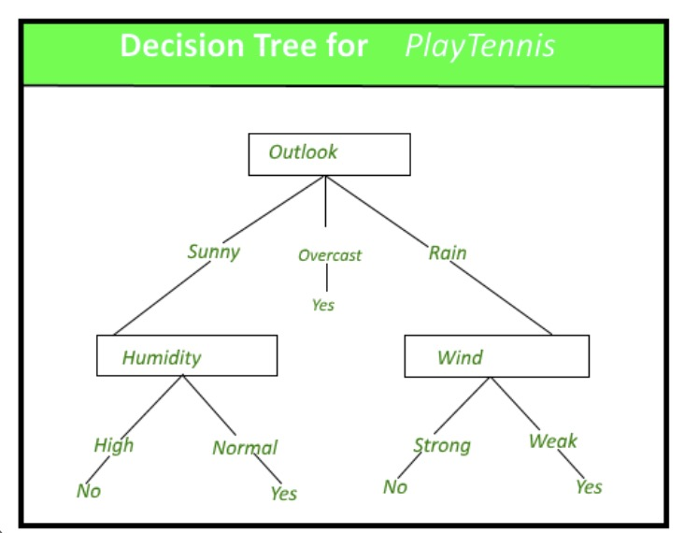
Decision tree
Use tree model to make decision
Split data to different subsets where each branch of the tree is a different rule set

Slide 14
Random Forest
Use multiple decision tree to improve the accuracy
Randomly select subset of data to train each decision tree.
Combine each tree prediction to make final decision

Slide 15
Gradient Boosted Classifier
Use multiple decision tree to improve classification performance
Trees are builds in sequence, each tree improve upon previous tree.

Slide 16
Linear Support Vector Machine
Find the hyper plane that set the data into different classes
Maximize margin between classes
Tune the weight of input variables to make prediction

Slide 17
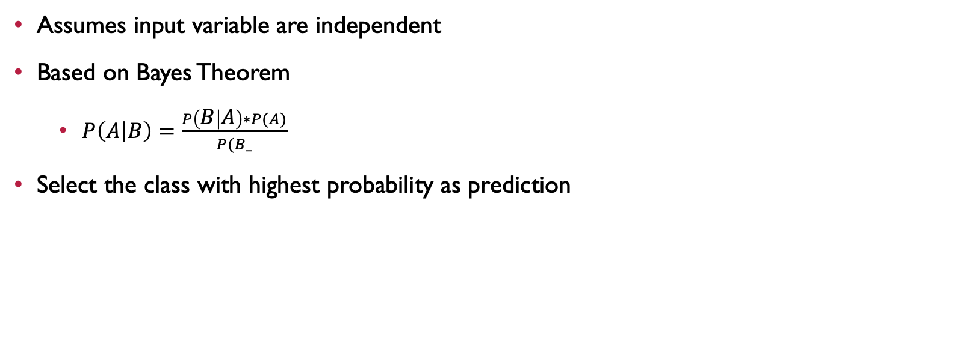
Naives Bayes
Assumes input variable are independent
Based on Bayes Theorem
$P\left(A | B\right)=\frac{P\left(B | A\right)∗P(A)}{P(B_}$
Select the class with highest probability as prediction

Slide 18
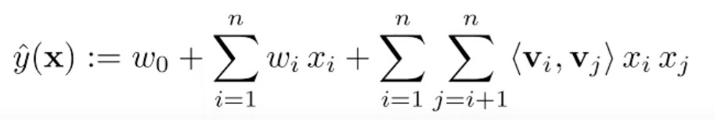
Factorization Machine Classifier
Used factorized representation and learn the weights of the variables to make prediction
Extension of linear regression model

Slide 19



LDA

Slide 20
Data Exploration
35 columns with Biopsy as the target column

Slide 21
SparkML and Spark
Application of Spark and SparkML
Performance metric
Accuracy (Done a lot before)
Scalability (Big data – similar parallel project)
Code Portability (GOOGLE –CLOUD –compared code modification …. – how easy to scale)

Slide 22
2 week goal
Looking at how to test code portability in a scientific manner
Run this thing on GCLoud
Spark Pipeline - SLides
Focus on algorithm, mathematical details – May be try to look at LDA.
Spark Statistic Parameter

