Slide 1

Reading Report
Thuan Nhan

Slide 2
Overview:
Health Recommender Systems: A State-of-the-Art Review
Health Recommender Systems Development, Usage, and Evaluation from 2010 to 2022: A Scoping Review
Implementation

Slide 3
Overview of documents

Slide 4
[1]. Health Recommender Systems: A State-of-the-art Review
A Search from articles published from January 2006 to August 2018
Find the trends and create a good summary in recommendation system for the health domain

Slide 5
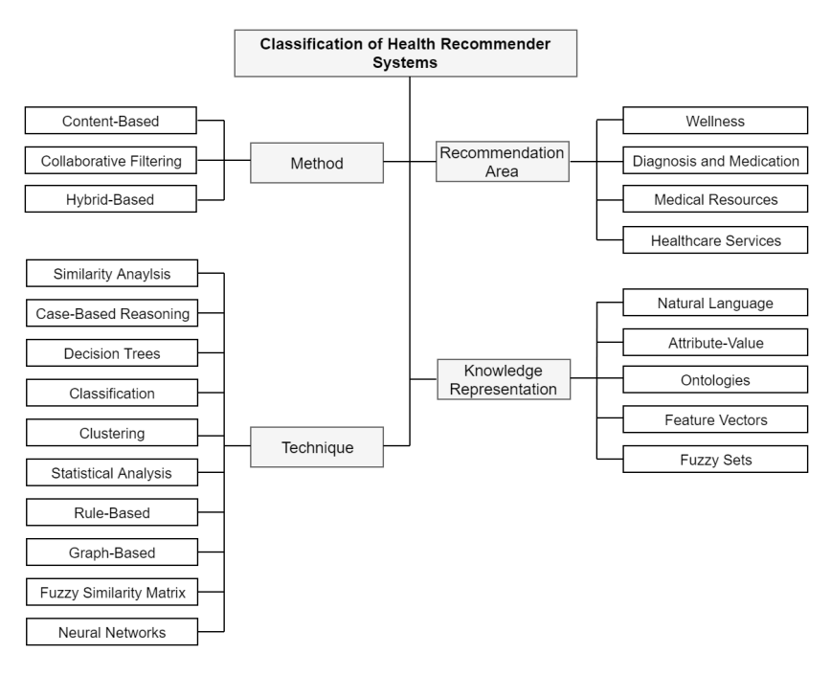
[1]. Health Recommender Systems: A State-of-the-art Review
Method: Approach that the system used to perform item retrieval (How database is build)
Techniques: how relationship between each item are found
Recommendation area: what is being recommended: medication, services, wellness,…
Knowledge Representation: method used to represent and store the data

Slide 6
[1]. Health Recommender Systems: A State-of-the-art Review
450 documents are selected for detail review
249 are classified using framework aboved

Slide 7
[1]. Health Recommender Systems: A State-of-the-art Review
14% used collaborative filtering
(Stark et al. [11] used CF to build a system capable of recommending drugs against migraine. For this implementation, users were grouped according to a similarity measure and the prescription recommendation was provided to the target user based on the drugs that worked for related users.)
31% used hybrid approach
(. Li and Cheng [12] built a system to recommend nutritional menus (combos) and made use of both CB and CF to appease some of the issues these approaches might present when using them separately, such as cold start and data sparsity )
55% used content-based approach
( Ex: in the work conducted by Bianchini et al. [10] a recommender system for healthy food was developed, the system retrieves recipes based on comparisons among characteristics of the users and the recipes themselves.)as
- Methodology

Slide 8
[1]. Health Systems Recommender : A State-of-the-art Review
Decision Tree / Rule Based 14%
Medical decisions are based on the evaluation of multiple conditions. If patient U presents the symptom A and also symptom B, then he might be suffering from the disease Z; (Not good idea to implement
Case-based reasoning and clustering were also used frequently by researchers
24% use some form of similarities measurement
(Cosine Similarity, Pearson Correlation, Euclidean Distance, Hamming distance)
- Techniques

Slide 9
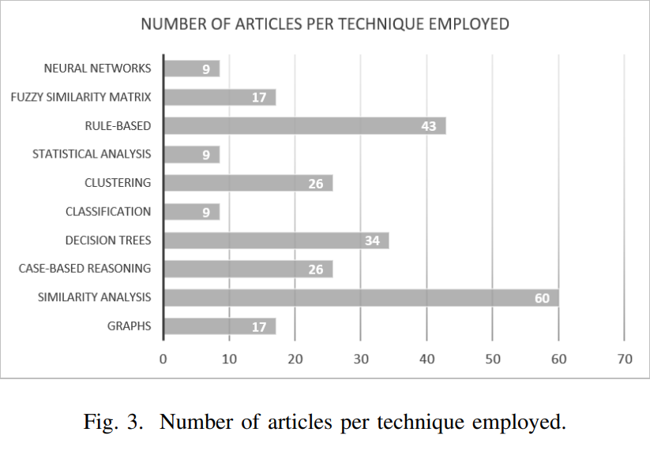
[1]. Health Systems Recommender : A State-of-the-art Review
- Techniques

Slide 10
[1]. Health Systems Recommender : A State-of-the-art Review
21% Focus on diagnosis and
Really tricky in terms of implementation and only being test for condition
10% Try to provide medication recommendation
14% Tried to recommend health care service (Finding appropriate doctor and medical services)
3% Tried health and wellness resources (articles, videos, books) recommendation.
(One example is the proposal of Rivero-Rodriguez et al. [22] whose implementation suggests YouTube videos enhanced with additional information coming from Medline Plus3 according to the users’ needs) – Might be Promising
52% are wellness recommendation:
Recommendation to improve user health like diet, exercise routines
- Recommendation Areas

Slide 11
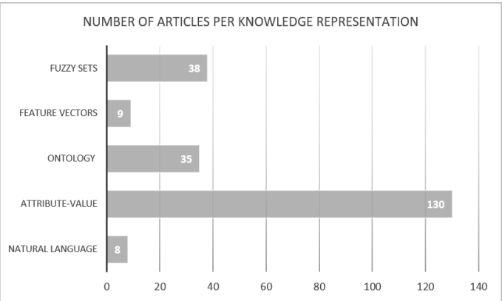
[1]. Health Systems Recommender : A State-of-the-art Review
88% of article point out the way in which data is being handled
- Knowledge Represenation: how the knowledge base, data input is stored and handle

Slide 12
[1]. Health Systems Recommender : A State-of-the-art Review
Fuzzy sets: (17%)
Ultilize fuzzy logics
Mainly used for medical condition diagnosis
Features Vectors (4%):
Allows for assigning weights to some parameters.
Ontologies (16%):
Hierarchy of concepts in a domain
Attribute value pairs (55%)
Usually used in wellnesss recommendation
Natural Language Represenation of knowledge (4%)
(articles, answer to question and videos)
- Knowledge Represenation: how the knowledge base, data input is stored and handle

Slide 13
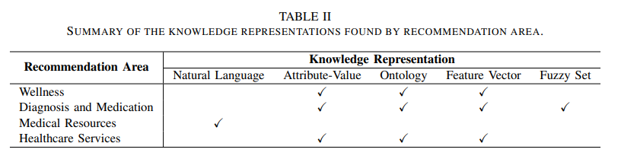
[1]. Health Systems Recommender : A State-of-the-art Review

Slide 14
[2] Health Recommender Systems Development, Usage, and Evaluation from 2010 to 2022: A Scoping Review
63 documents was included for data extraction and analysis

Slide 15
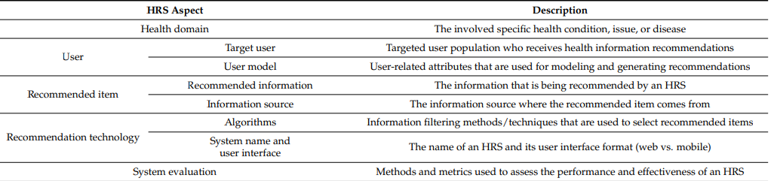
[2] Health Recommender Systems Development, Usage, and Evaluation from 2010 to 2022: A Scoping Review

Slide 16
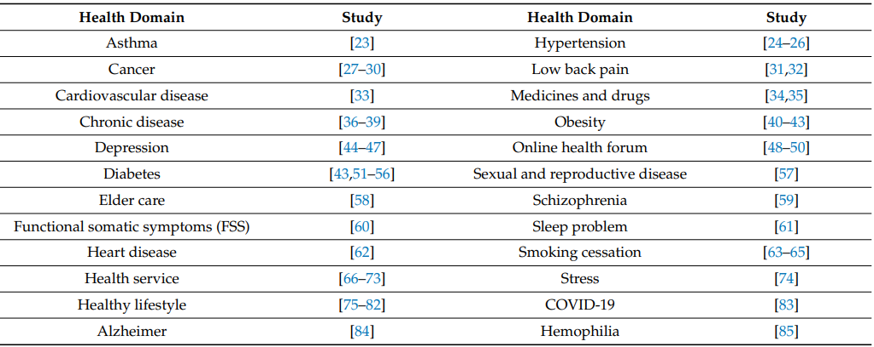
[2] Health Recommender Systems Development, Usage, and Evaluation from 2010 to 2022: A Scoping Review
Health Domain:

Slide 17
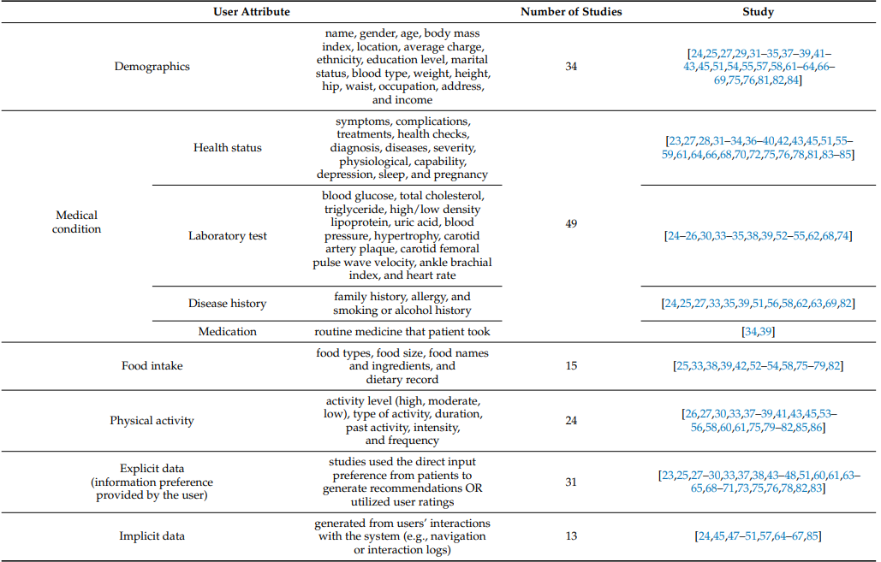
[2] Health Recommender Systems Development, Usage, and Evaluation from 2010 to 2022: A Scoping Review
Attributes of user’s model

Slide 18
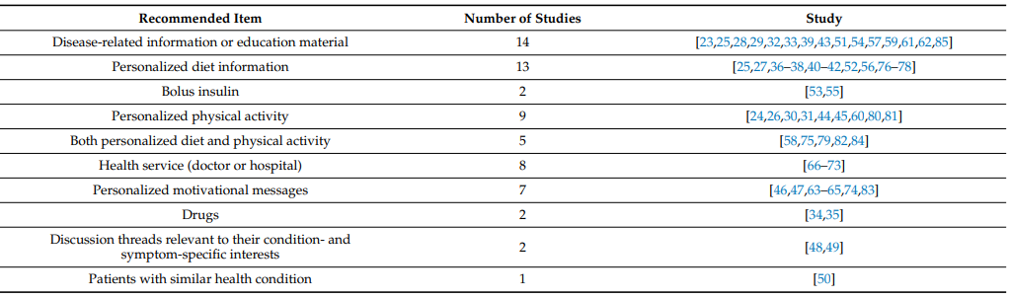
[2] Health Recommender Systems Development, Usage, and Evaluation from 2010 to 2022: A Scoping Review
Recommended information:

Slide 19
[2] Health Recommender Systems Development, Usage, and Evaluation from 2010 to 2022: A Scoping Review
Information sources:
Credible and authoritative website, guidelines and books
Domain experts of the researcher
Similar patient profile
Government database: USDA composition guideline for example
Other sources: for example
Online health community
Online registered doctors,…

Slide 20
[2] Health Recommender Systems Development, Usage, and Evaluation from 2010 to 2022: A Scoping Review
System evaluation methods:
Not involving other users:
Ask for evaluation from experts
Compared recommendation with expert recomendation
Evaluations involving users:
Survey
Measure the performance of different groups

Slide 21
[2] Health Recommender Systems Development, Usage, and Evaluation from 2010 to 2022: A Scoping Review
Performance of personalization:
Performance criteria (e.g., recall, mean reciprocal rank, normalized discounted cumulative gain, precision, mean absolute error, receiver operating characteristics, and F1)
User centered usability criteria: perceived usefulness, satisfaction level
Health related outcome (behavioral changes)

Slide 22
Implementations documents

Slide 23
[3] Prediction of Health Problems and Recommendation System Using Machine Learning and IoT
The paper propose a more modern diagnostic procedures which use a GUI based prediction system. This GUI use 7 different machines learning models to make prediction.
NodeMCU and ThinkSpeak (small IOT devices) can be used to monitor heart rate and temperature. These information can later be send to the doctor

Slide 24
[3] Prediction of Health Problems and Recommendation System Using Machine Learning and IoT
Symptoms is the user input
Other parameters such as height, weight, and glucose level are also used but these can be handle by IoT devices
All 7 machine learning algorithm is used to predict the disease by voting for the common output
Included ML algorithm:
Decision Tree
Random Forest
Naïve Bayes
K Nearest Neighbor
Suport Vector Machine
Multinominal Logistic Regression
Multilayer perceptron

Slide 25
[3] Prediction of Health Problems and Recommendation System Using Machine Learning and IoT
Dataset:
Create a word table that have the most common disease (Narrowed down to 29)
After data mining disease would be converted to a excel sheet of 0 and 1 for each symptoms
8 – 10 rows for each diseas

Slide 26
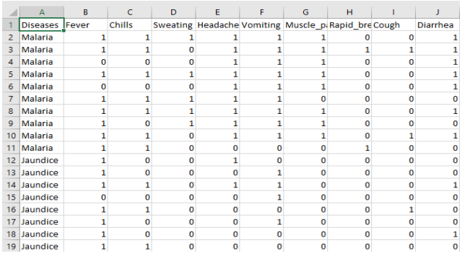
[3] Prediction of Health Problems and Recommendation System Using Machine Learning and IoT

Slide 27
[3] Prediction of Health Problems and Recommendation System Using Machine Learning and IoT
Results:
Cross validation is used to evaluated the model performance. Overall, average accuracy is high

Slide 28
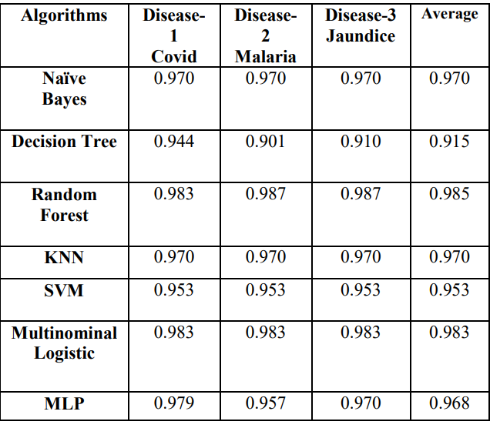
[3] Prediction of Health Problems and Recommendation System Using Machine Learning and IoT

Slide 29
[4]Health Recommender System for Cervical Cancer Prognosis in Women
A feature selection method based on Multi Objective Genetic Algorithm
Recommend some prediction models for Cervical Cancer with high degree of accuracy
Cervial Cancer Risk classification dataset for implementation and accuracy

Slide 30
[4]Health Recommender System for Cervical Cancer Prognosis in Women
Dataset:
SMOTE oversampling has been used to balanced the dataset
Cervical Cancer Risk Classification dataset
32 attributes
859 samples
Cervical Cancer Risk Classification | Kaggle

Slide 31
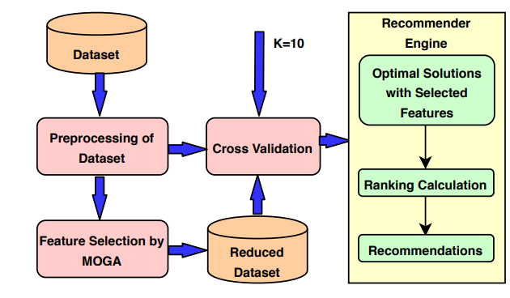
[4]Health Recommender System for Cervical Cancer Prognosis in Women
Method Used:
Multi-Objective Genetic Algorithm (MOGA) and KNN is used for feature selection

Slide 32

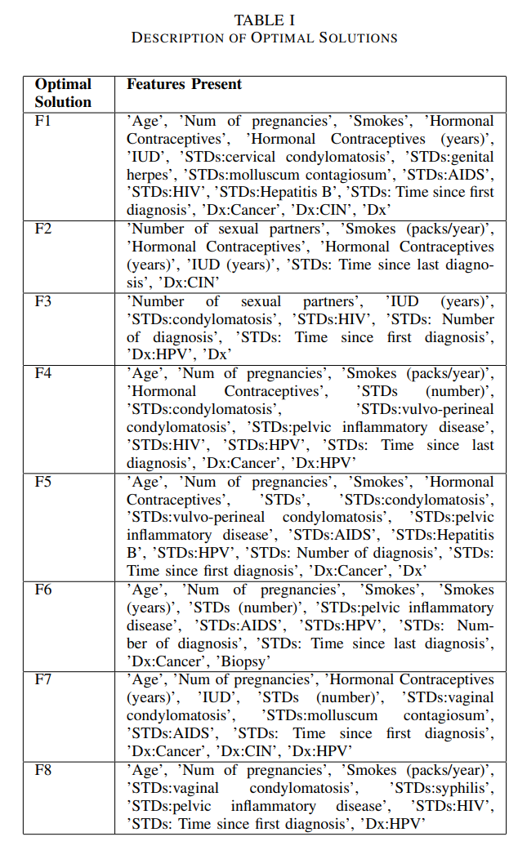
[4]Health Recommender System for Cervical Cancer Prognosis in Women
Moga is used to find optimal parameters that affects the result for cervical cancer
-> Return 8 set of 16 elements features
7 machine learning models are then used for classification:
Logistic Regression
Support Vector Classifier
Decision Tree
KNN
Gausian Naïve Bayes
XGBoost
Gradient Boosting Machine

Slide 33
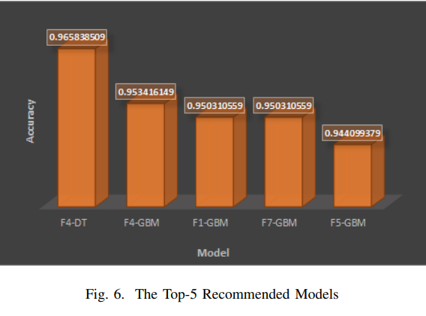
[4]Health Recommender System for Cervical Cancer Prognosis in Women
Result of 5 best models:

Slide 34
[4]Health Recommender System for Cervical Cancer Prognosis in Women
Benefits gained from using MOGA:
A narrower feature selection -> Easier to train machine learning models
Ability to highlight what features affects Cervical Cancer Prognosis most. This is important as it would let the user know so they can keep track of that particular attribute

Slide 35
[5] EvoRecSys: Evolutionary framework for health and well-being recommender systems
Issues with most other models:
Majority focus on a single aspect of health (exercise, food intake,…)
Lack of flexibility to recommend tailored item. Recommendation in health and well being should be configurable
Paper is introduction a recommendation frameworks that ultized evolutionary algorithms as the main recommendation engine
-> Modeling the problem of recommendation as multi-objective optimization problem
EvoRecSys enables the generation of dynamic recomendations

Slide 36
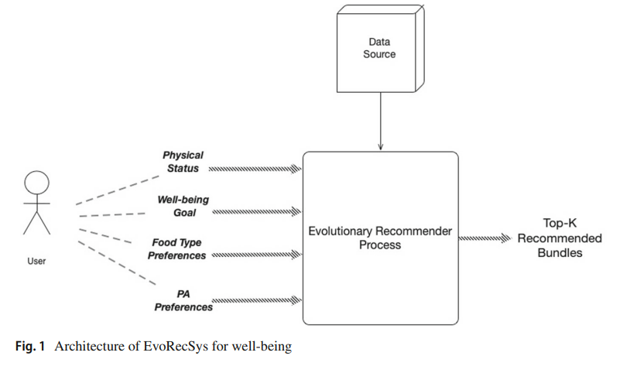
[5] EvoRecSys: Evolutionary framework for health and well-being recommender systems

Slide 37
[5] EvoRecSys: Evolutionary framework for health and well-being recommender systems
Input:
i) Physical status and exercising habits. Data related to age, gender and body measurements of the user, as well as their frequency of exercising.
(ii) Food category preferences. How much the user likes certain ingredients, predetermined types of food, etc. In order to do this, a numerical scale can be used, for example the 5-point Likert scale.
(iii) Preferences on types of physical activity. Information that describes how much the user likes certain types of PA. As in the previous element, it can be implemented focusing on predetermined set of physical activities.
(iv) Well-being goal. A goal chosen by the user from a set of predefined goals focused on a specific well-being aspect to be improved. The goals can be set for handling either general circumstances (losing weight, maintaining weight, etc.) or specific ones (control chronic diseases),

Slide 38
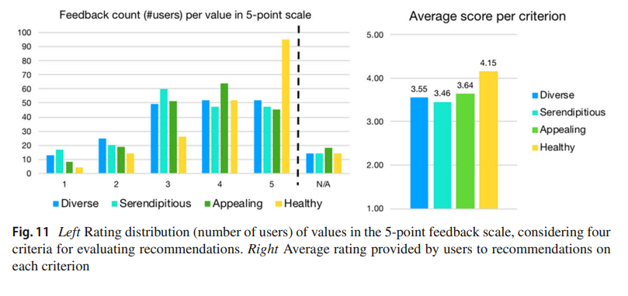
[5] EvoRecSys: Evolutionary framework for health and well-being recommender systems
The model is used as a survey on 200 people and result is return based on user review

Slide 39
[6] Using coevolution and substitution of the fittest for health and well-being recommender system
Combine substitution of the fittest(SF) to improve EvoRecSys
SF is domain independent and requires no calibaration -> No parameter tuning
SF combined with EvoRecSys is able to maintain a trade-off between engagement and performance. The recommendation is also generally are more diverse
Really Dense paper – More reading on evolutionary algorithm

Slide 40
Works Cited
Pincay, J. (. 1. )., et al. “Health Recommender Systems: A State-of-the-Art Review.” 2019 6th International Conference on EDemocracy and EGovernment, ICEDEG 2019, Apr. 2019, pp. 47-55–55. EBSCOhost, https://doi-org.ezproxy.mtsu.edu/10.1109/ICEDEG.2019.8734362.
Cai, Y. (.1,2 )., et al. “Health Recommender Systems Development, Usage, and Evaluation from 2010 to 2022: A Scoping Review.” International Journal of Environmental Research and Public Health, vol. 19, no. 22, Nov. 2022. EBSCOhost, https://doi-org.ezproxy.mtsu.edu/10.3390/ijerph192215115.
J P, Sanjay, et al. “Prediction of Health Problems and Recommendation System Using Machine Learning and IoT.” 2021 Innovations in Power and Advanced Computing Technologies (i-PACT), Innovations in Power and Advanced Computing Technologies (i-PACT), 2021, Nov. 2021, pp. 1–8. EBSCOhost, https://doi-org.ezproxy.mtsu.edu/10.1109/i-PACT52855.2021.9696622.

Slide 41
Works Cited
Kuanr, Madhusree, et al. “Health Recommender System for Cervical Cancer Prognosis in Women.” 2021 6th International Conference on Inventive Computation Technologies (ICICT), Inventive Computation Technologies (ICICT), 2021 6th International Conference On, Jan. 2021, pp. 673–79. EBSCOhost, https://doi-org.ezproxy.mtsu.edu/10.1109/ICICT50816.2021.9358540.
Alcaraz-Herrera, Hugo, et al. “EvoRecSys: Evolutionary Framework for Health and Well-Being Recommender Systems.” User Modeling & User-Adapted Interaction, vol. 32, no. 5, Nov. 2022, pp. 883–921. EBSCOhost, https://doi-org.ezproxy.mtsu.edu/10.1007/s11257-021-09318-3.
Alcaraz-Herrera, Hugo, and John Cartlidge. Using Coevolution and Substitution of the Fittest for Health and Well-Being Recommender Systems. 2022. EBSCOhost, search.ebscohost.com/login.aspx?direct=true&db=edsarx&AN=edsarx.2211.00414&site=eds-live&scope=site.

