Slide 1
Testing for React App
Team REX

Slide 2
React App Testing
Code Coverage
Implementation

Slide 3
React App Testing
When we talk about testing, we're talking about the process of automating the process of setting up and measuring our assumptions against assertions of functionality about our application.
When we talk about front-end testing in React, we’ll discuss three different software testing paradigms: unit testing, functional testing, and integration testing.

Slide 4
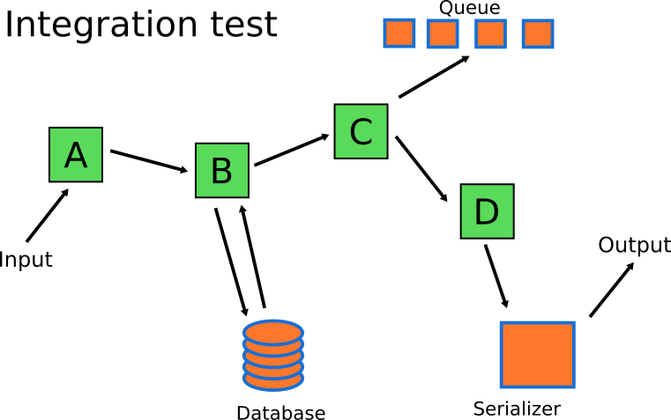

Slide 5
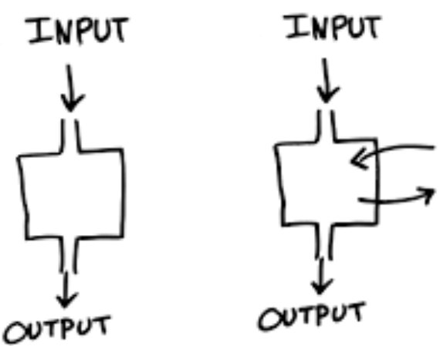
Unit tests
Unit testing simply verifies that individual units of code (mostly functions) work as expected.
Performing unit tests is designed to be simple, generally the tests are written in the form of functions that will determine whether a returned value equals the value you were expecting when you wrote the function
Pure Functions: reducers, helpers…
function plus(a, b) { return a + b;
}

Slide 6
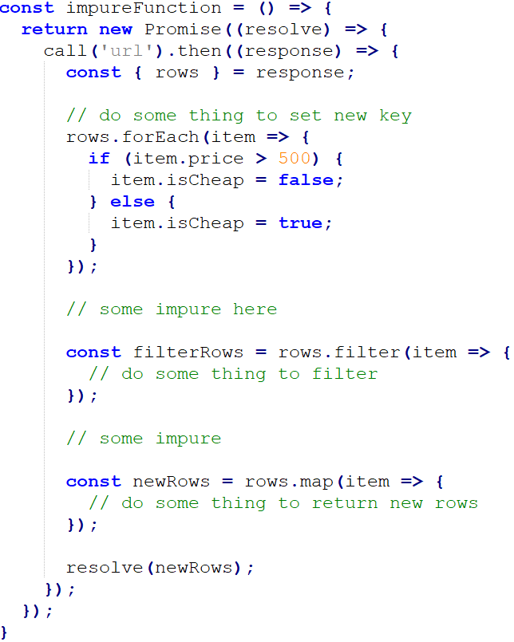
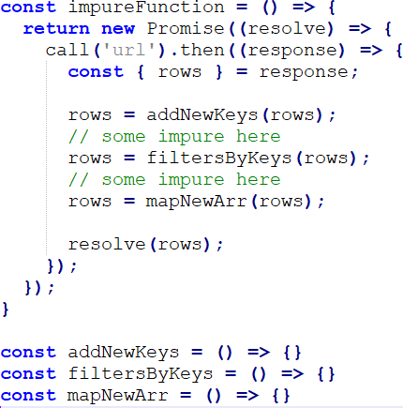

Slide 7
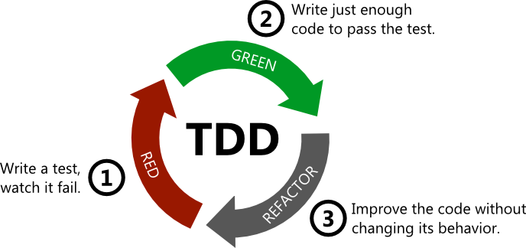
Test Driven Development (TDD)
The tests are a part of the spec definition, and therefore requires that they are written first, with code only written to "solve" these tests.

Slide 8



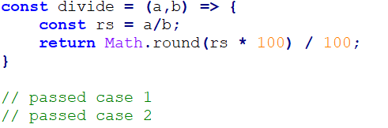
Divide function

Slide 9

Functional testing
With functional testing, we're focused on testing the behavior of our component. For instance, if we have a navigation bar with a user login/logout button, we can test our expectations that:
Given a logged in user, the navbar renders a button with the text Logout
Given no logged in user, the navbar renders a button with the text Login
Click login will send data username/password to server
…

Slide 10
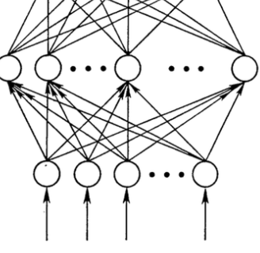
Why?
They should be done as often as possible. When you are performing tests as part of the development process, your code is automatically going to be designed better than if you just wrote the functions and then moved on.
The most obvious benefit is knowing down the road that when a change is made, no other individual units of code were affected by it if they all pass the tests.

Slide 11
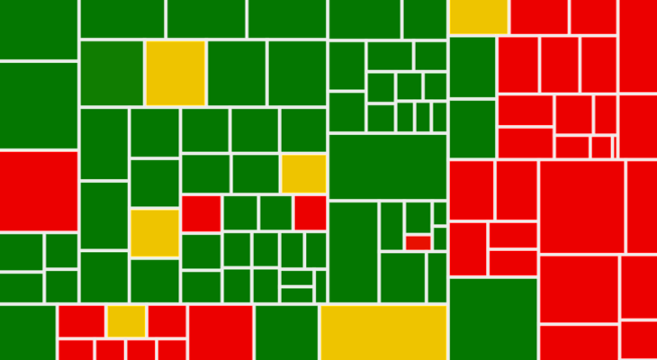
Code Coverage
In computer science, test coverage is a measure used to describe the degree to which the source code of a program is executed when a particular test suite runs.
A program with high test coverage, measured as a percentage, has had more of its source code executed during testing, which suggests it has a lower chance of containing undetected software bugs compared to a program with low test coverage.

Slide 12
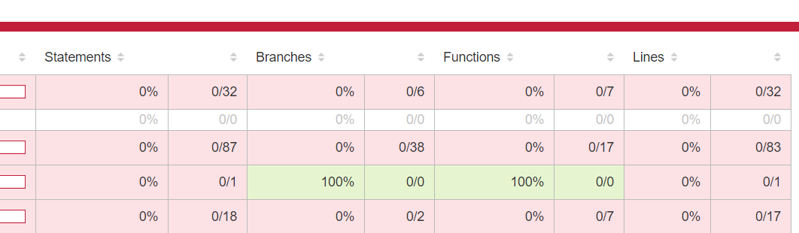
Coverage criteria
There are a number of coverage criteria, the main ones being:
Function coverage
Statement coverage
Line coverage
Branch coverage

Slide 13
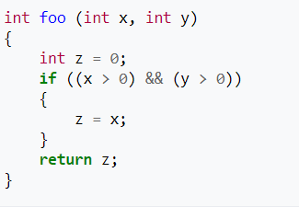
Function coverage
Has each function in the program been called?
foo()

Slide 14
Statement coverage
Has each statement in the program been executed?
foo(1,1)

Slide 15
Lines coverage
Has each lines in the program been executed?
foo(1,1)

Slide 16
var x= 10; console.log(x);
1 line but 2 statements

Slide 17
Branch coverage
Has each branch of each control structure (such as in if and case statements) been executed?
foo(1,1)
foo(0,0)

Slide 18
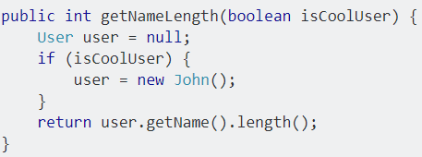
Branch coverage
getNameLength(true)
getNameLength()

Slide 19
Implementation
Jest
Enzyme

Slide 20
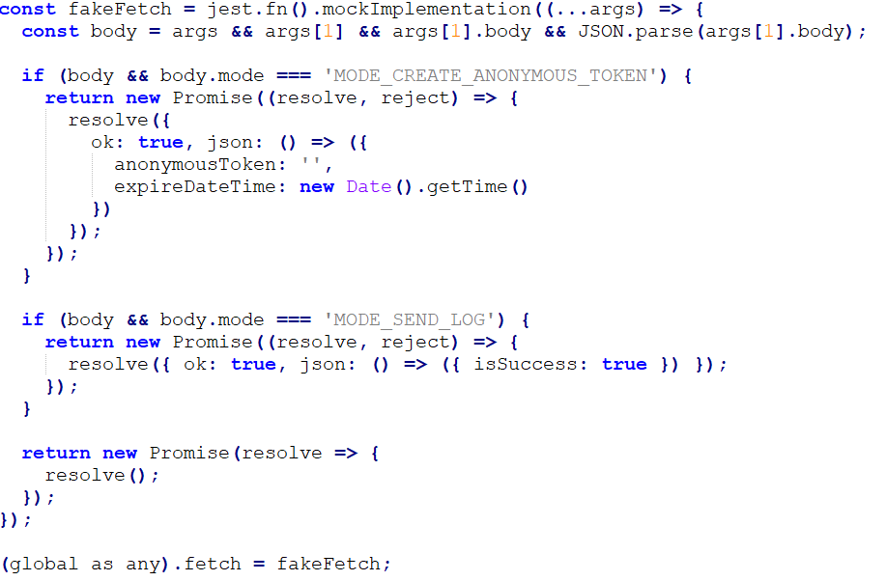
Mock API request

Slide 21
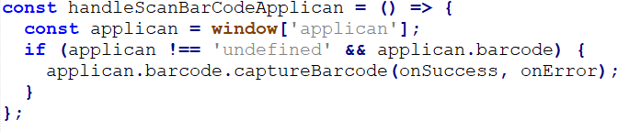
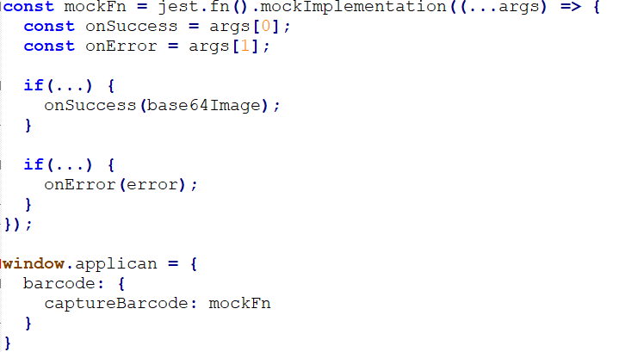
Mock function

Slide 22

Simulate DOM actions with enzyme

Slide 23
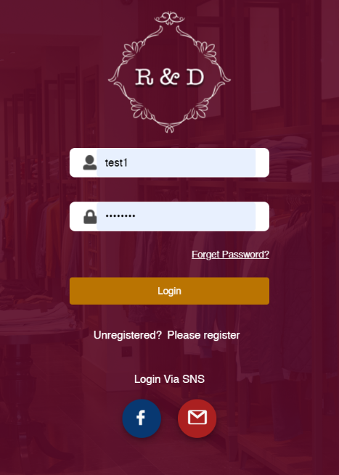

Slide 24
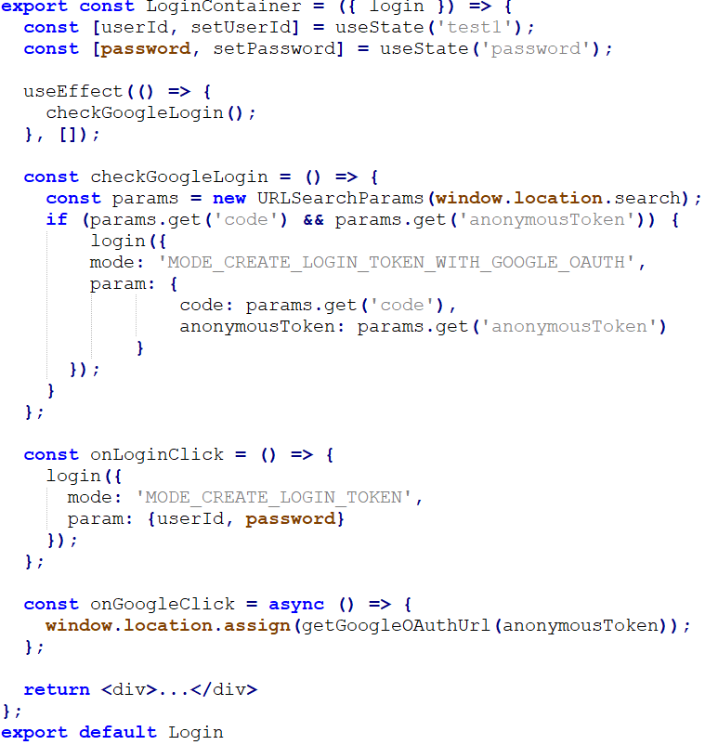

Slide 25
Render Component
Check Snapshot
Input username/password and click Login button, then track what data is sent
Click Google Login button, then track URL
Check after redirected from Google, check what data is sent

Slide 26
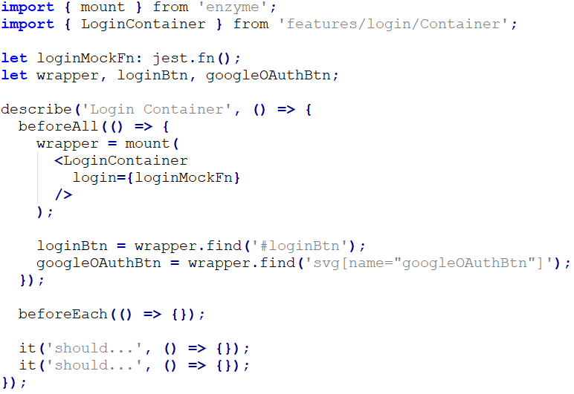
Render Component

Slide 27

Check Snapshot

Slide 28
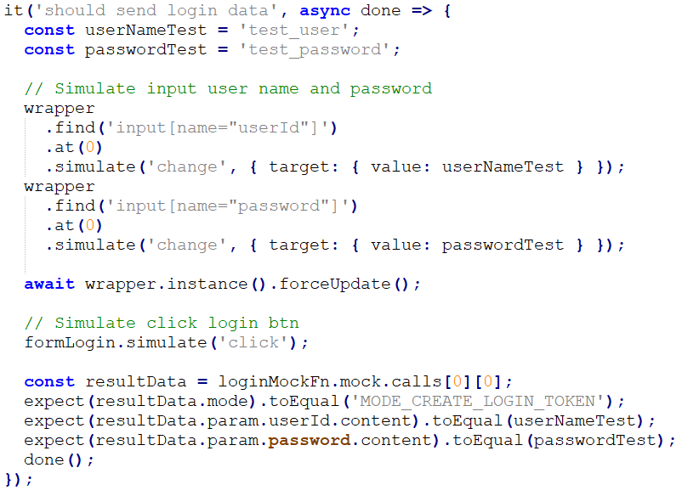
Input username/password and click Login button, then track what data is sent

Slide 29
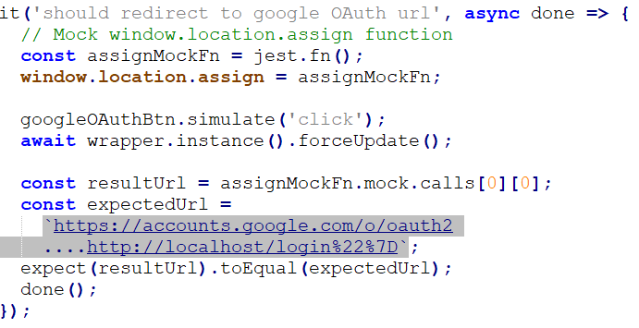
Click Google Login button, then track URL

Slide 30
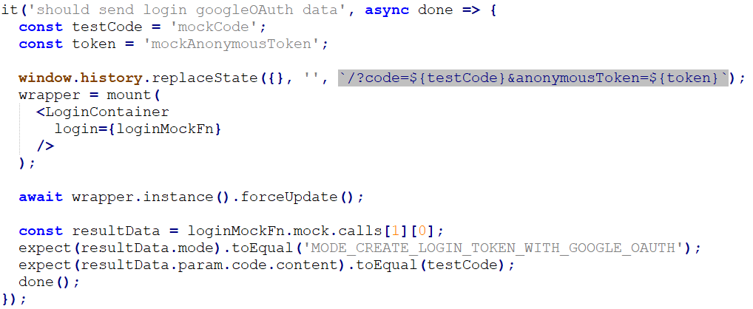
Check after redirected from Google, check what data is sent

Slide 32
THANK YOU

