Slide 1
Managing variability in software systems
Niklas Hauber
Johannes Kepler Universität
Linz, Austria
niklas.hauber@solentia.at
Jonas Reichhardt
Johannes Kepler Universität
Linz, Austria
j.reichhardt@tig.at

Slide 2
Origin of variability
Variation in function
Variation in data
Variation in technology
Variation in environment

Slide 3
Variability modeling
Feature model
Decision model

Slide 4
Feature model
mandatory
optional
alternative
cross-tree constraints

Slide 5
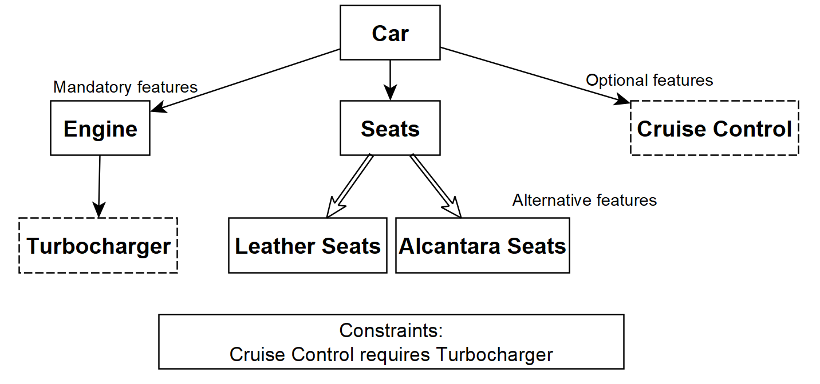

Slide 6
Decision model
feature = decision
commonalities of systems cannot be modeled
hierarchy is a secondary aspect
more intuitive for software devs.

Slide 7
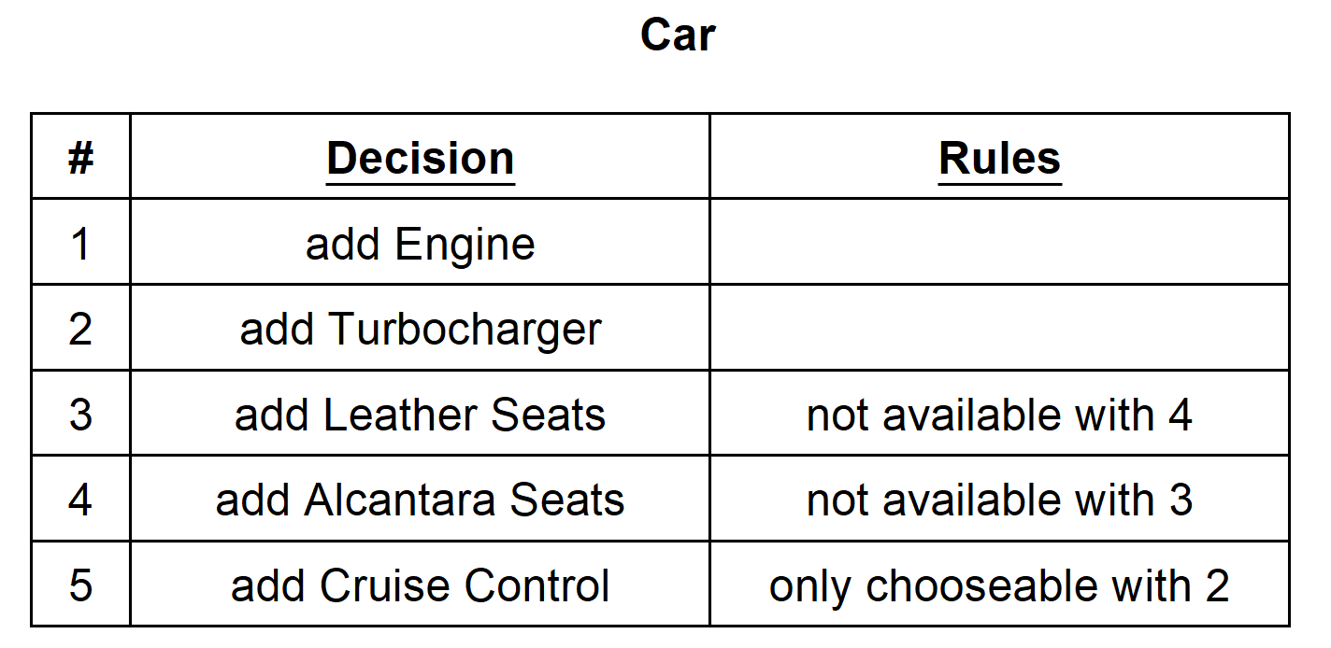

Slide 8
Variability patterns
Binding times
  Product architecture derivation
  Compilation
  Linking
  Startup
  Adaptation to runtime environment
Patterns
  Variant entity
  Optional entity
  Multiple coexisting entities

Slide 9
Related work
2000-2008: constant rise in published papers per year
2008-2010: stabilized at 20-30 papers per year

Slide 10
Challenges
Guaranteed correctness and consistency
Performance overheads
Runtime upgradability
Lack of support for security needs
Poor user-friendliness

Slide 11
Questions & Discussion

