Slide 1

Real-time Weather Data Analysis and Forecasting System in Vietnam
Big Data Storage and Processing– IT4043E
Group 10

Slide 2
Table of contents
Problem Definition
Architecture and Design
Implementation Details
Lesson learned

Slide 3
I. Problem Definition
Vietnam’s increasing climate variability and the limitations of traditional forecasting methods highlight the need for a real-time, scalable system that integrates high-frequency data to deliver accurate, localized weather predictions.
The problem is quintessential for “Big Data”:
Volume
Historical weather data can reach hundreds of thousands of rows, requiring fast read and write operations.
Velocity
Weather data arrives in real time and must be ingested and processed within seconds to be useful.
Variety
Data comes from multiple sources and formats (JSON and CSV) and must be unified into a single structure.
Veracity
Sensor noise and inconsistent fields require real-time data cleaning and validation
Value
Accurate real-time weather forecasting delivers significant socio-economic benefits for Vietnam.

Slide 4
I. Problem Definition
Scope
Geographical Coverage: Analysis of weather data across 34 cities in Vietnam
Data Sources: Open-source weather data collected via APIs from OpenWeatherAPI and Open-Meteo
Temporal Focus: Short-term forecasting using 24-hour input data to predict next-hour temperature (historical data stored on S3 for future extension)
Output: An interactive dashboard displaying weather analytics and next-hour temperature predictions
Limitations
Hardware Constraints: High-resolution weather modeling requires substantial CPU/GPU resources and costly cloud infrastructure
Data Availability: Limited or missing sensor coverage in some regions affects data completeness
Forecast Uncertainty: Atmospheric systems are inherently chaotic, limiting prediction accuracy over longer time horizons

Slide 5
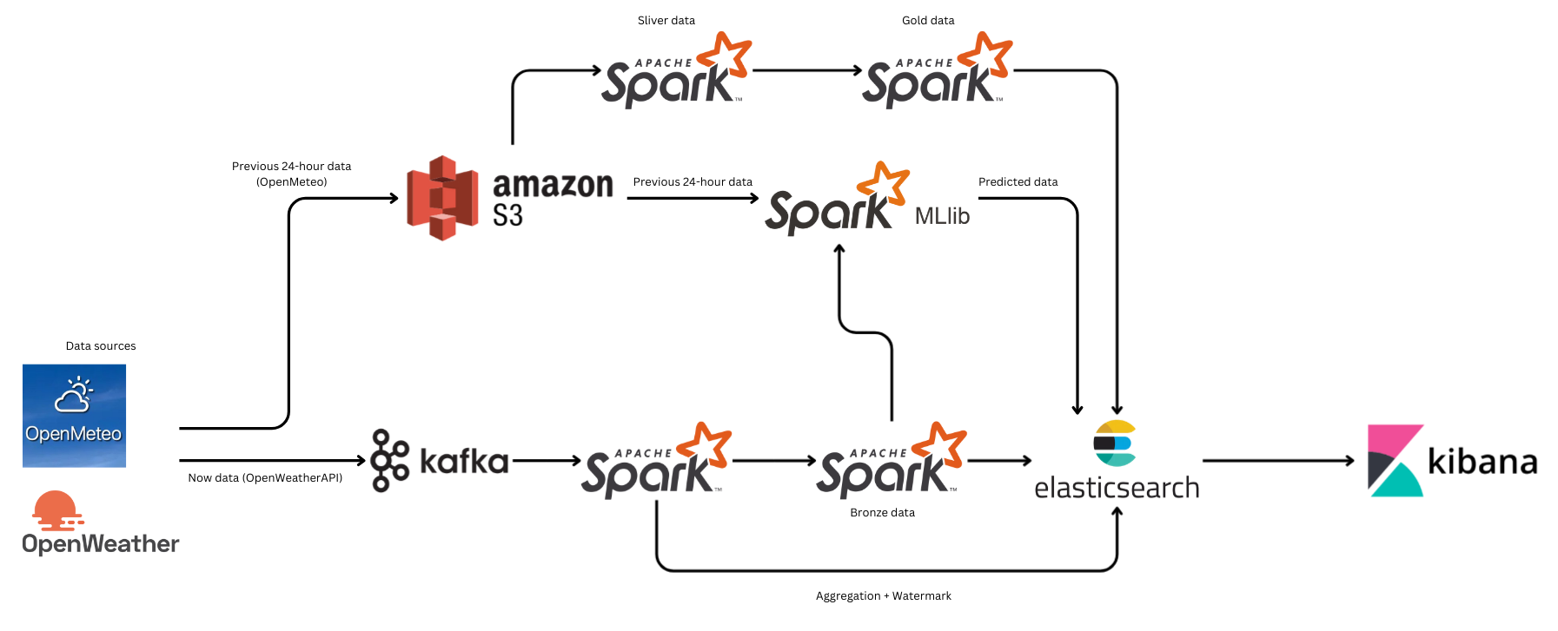
II. Architecture and Design
Lambda Architecture covering Ingestion, Processing, Storage, Visualization

Slide 6
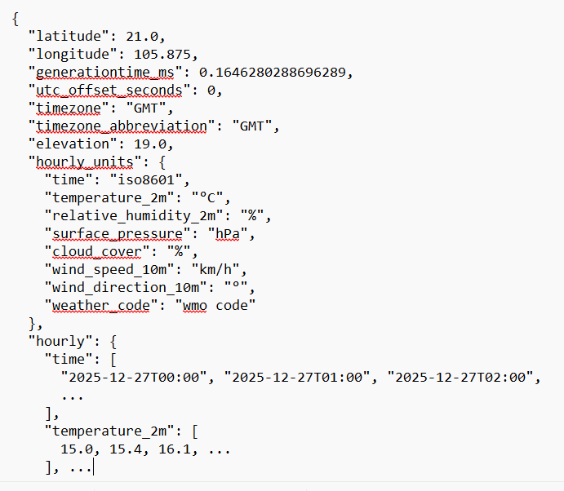
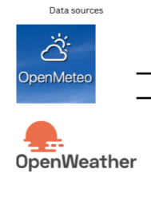
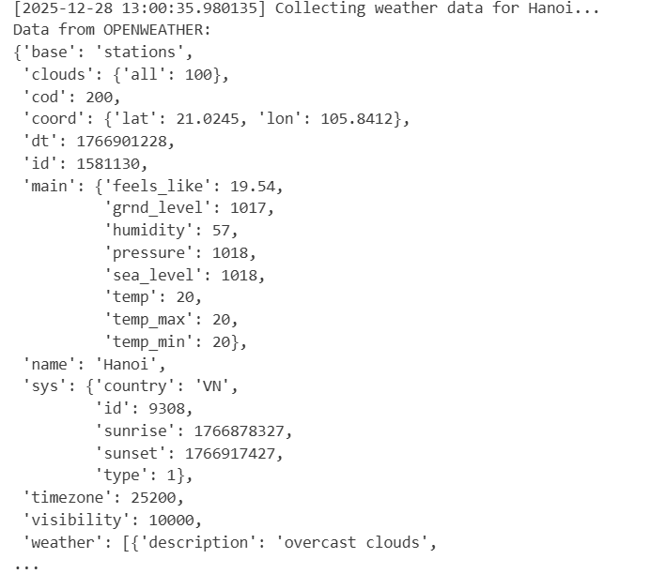
II. Architecture and Design
Data Ingestion Layer
OpenMeteo: Historical weather data
OpenWeather Current weather data

Slide 7
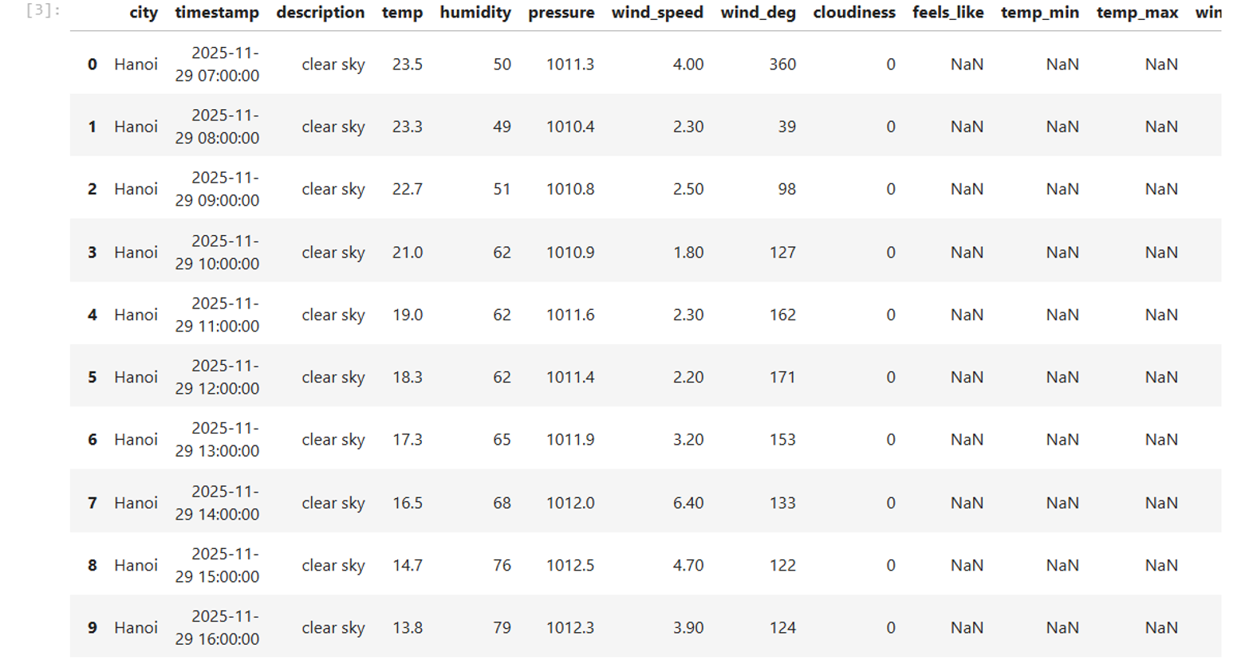
II. Architecture and Design
Data Ingestion Layer
Approach Tried
Removed unnecessary columns to reduce data size
Kept only features needed for ML training and real-time weather display
Final Solution
Dropped unused columns to significantly speed up ML processing
Key Takeaways
Different APIs have inconsistent data structures and require preprocessing
Flattening JSON simplifies data for efficient processing
Reducing data dimensions improves performance in real-time pipelines

Slide 8
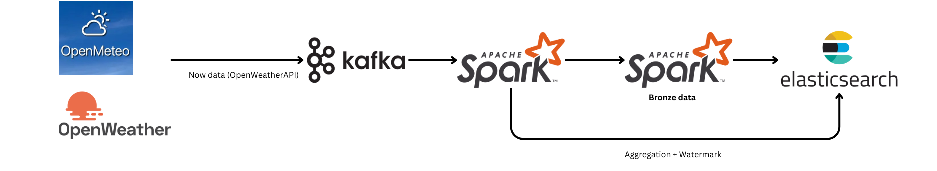
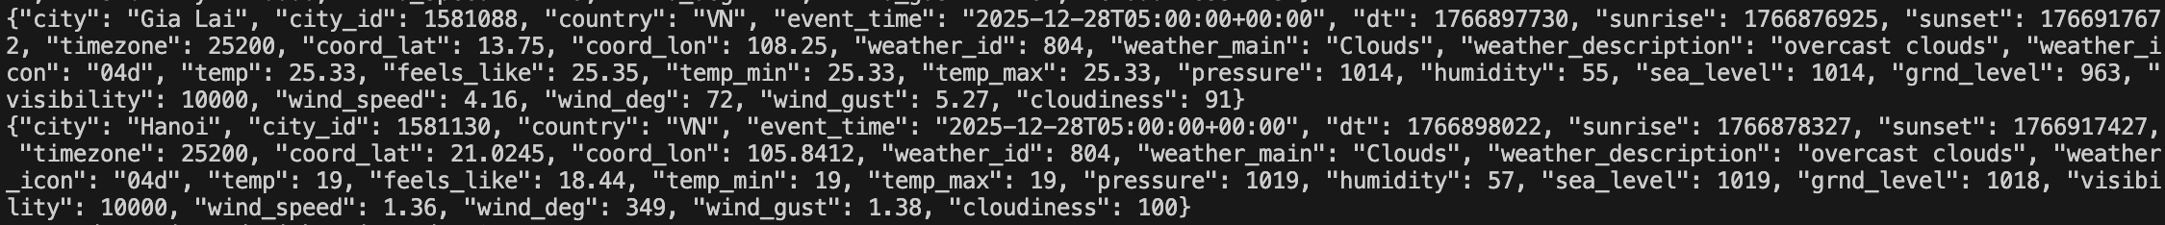
II. Architecture and Design
Stream Processing
Apache Kafka
Kafka handles stream data. In this case, stream data is the current weather data from OpenWeather API.

Slide 9
II. Architecture and Design
Stream Processing
Apache Spark (Stream Spark + Bronze)
Real-time weather data ingested from OpenWeather API via Kafka
Spark Structured Streaming processes event-time data continuously
Raw events stored in Bronze (Parquet) for durability
Windowed aggregation + watermark handle late data
Aggregated results upsurged to Elasticsearch for real-time analytics

Slide 10
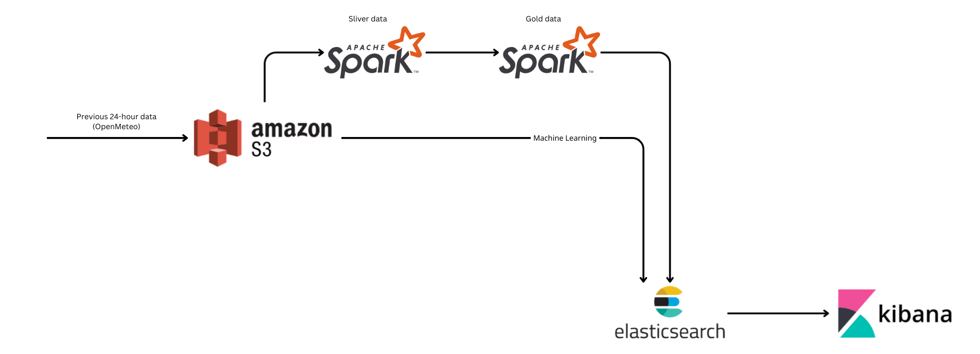
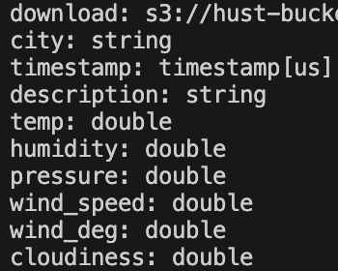
II. Architecture and Design
Batch Processing
Amazon S3
Amazon S3 serves as a storage for historical data
Historical weather data stored in Amazon S3
Spark batch jobs process 24-hour data windows
CronJob runs every 45 minutes to add datasets
Processed data written to Silver layer and ML-ready tables

Slide 11



II. Architecture and Design
Batch Processing
Time-Series Data Storage Evaluation
Large-scale time-series weather data requires efficient and scalable storage.
Multiple storage formats were evaluated for ingestion and analytics performance
Row-based storage format.
Excellent for fast ingestion and schema evolution.
Inefficient for analytics since entire rows must be read even when querying a single column.
Columnar format optimized for Hive.
Highest compression ratio among tested formats.
Less compatible with Python and broader data science workflows outside Hadoop.
Columnar format designed for analytical workloads and nested data.
Well-suited for transformed datasets in Silver and Gold layers.
Strong ecosystem support across Spark and Python tools.

Slide 12
II. Architecture and Design
Batch Processing
Parquet chosen as the primary storage format
Best balance of performance, usability, and ecosystem compatibility.
Easier to work with than Avro and ORC for analytics and ML pipelines.

Slide 13
II. Architecture and Design
Batch Processing
Silver data
Read historical data stored in Amazon S3
Spark batch job runs hourly (CronJob)
Cleans, deduplicates, and add average tempurature in 24 hours
Outputs Silver data for Gold data

Slide 14
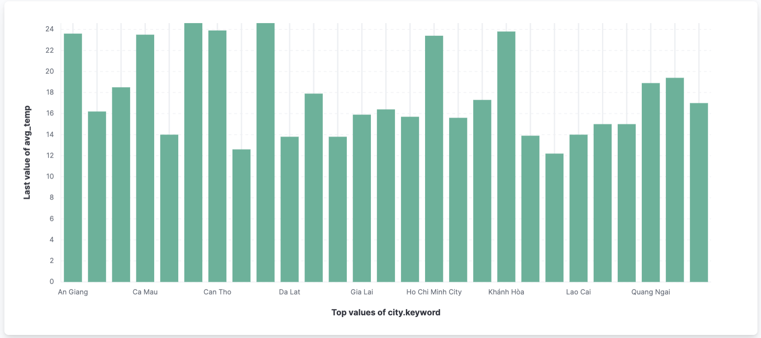
II. Architecture and Design
Batch Processing
Gold data
Spark batch job runs every 1h10m (CronJob)
Aggregates Silver data → hourly city-level metrics
Computes alerts & derived features
Writes Gold data to Elasticsearch for dashboards

Slide 15
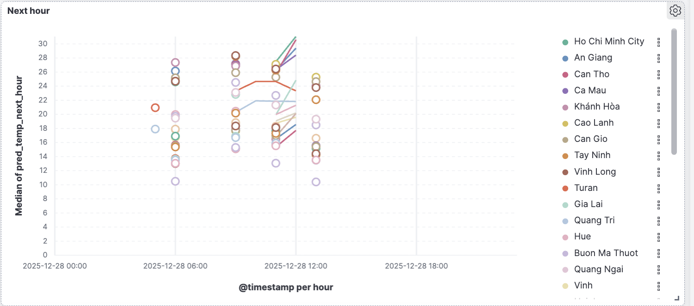
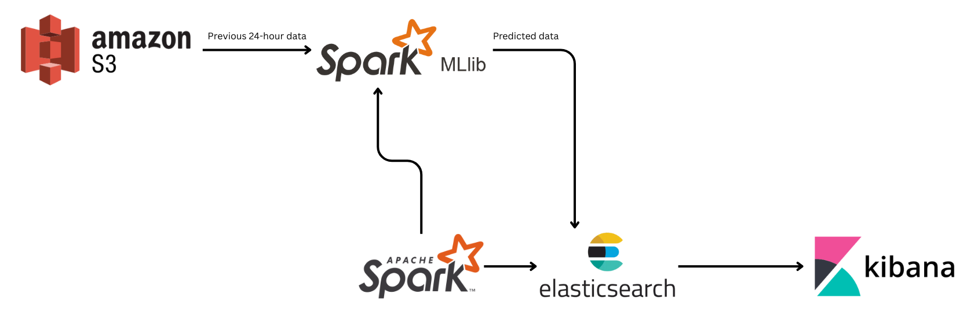
II. Architecture and Design
Machine Learning model Implementation
Spark MLlib
Hourly batch inference with Spark MLlib
Uses last 24h S3 + recent Bronze data
Predicts next-hour temperature per city
Stores predictions in Elasticsearch for visualization

Slide 16
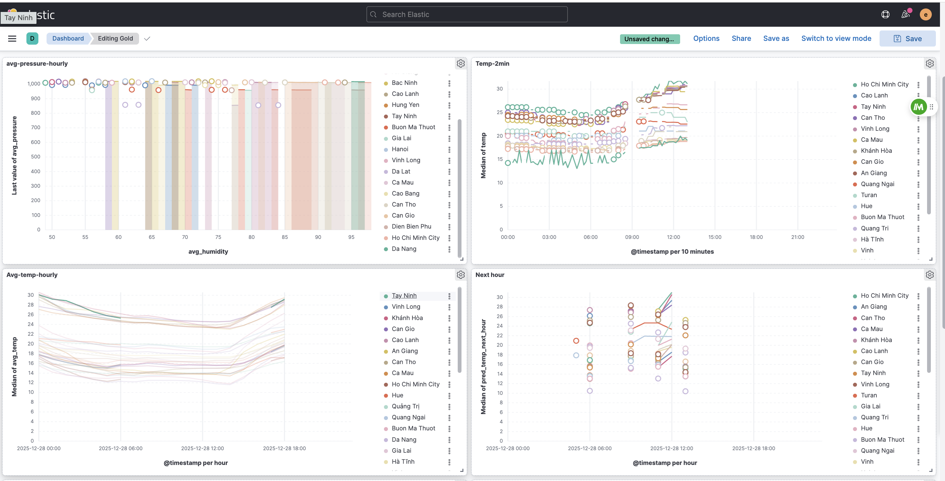
II. Architecture and Design
Visualization
Kibana
Monitoring & analytics
Gold + ML outputs
Interactive dashboards

Slide 17
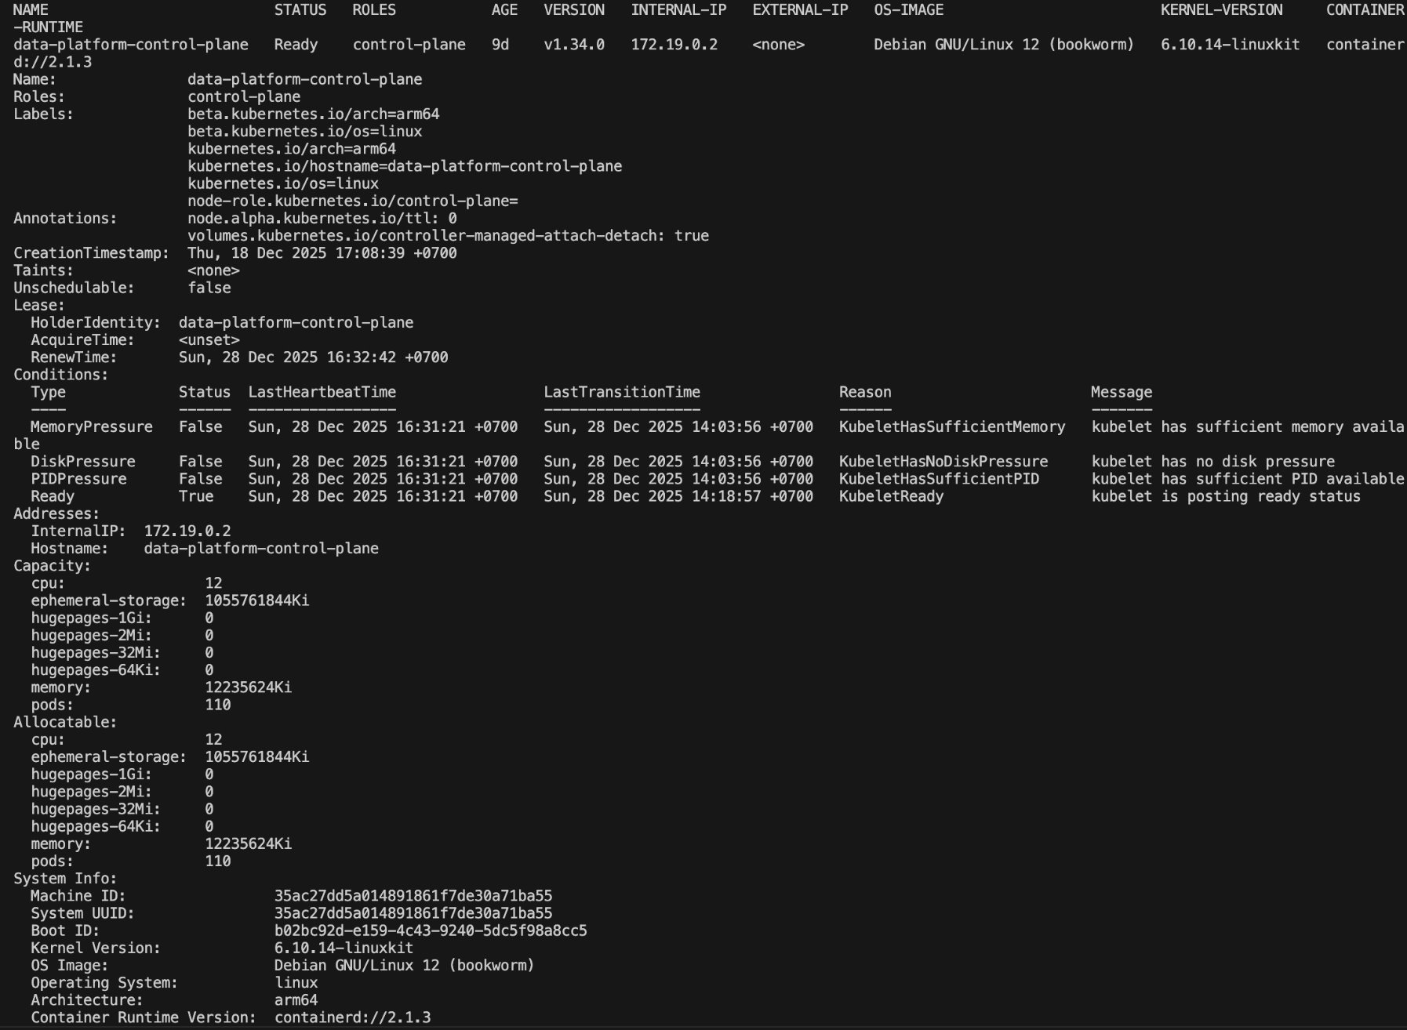

II. Architecture and Design
Deployment
Kubernetes
Kubernetes provides a unified orchestration layer to run streaming, batch, and ML workloads on the same infrastructure.
It handles resource scheduling and isolation, allowing Spark, Kafka, and Elasticsearch to coexist without hard coupling.
Kubernetes enables fault recovery and restart of long-running services such as Kafka brokers and Spark streaming jobs.
It simplifies deployment and lifecycle management through declarative manifests and operators (Strimzi, Spark Operator, Elastic Operator).

Slide 18
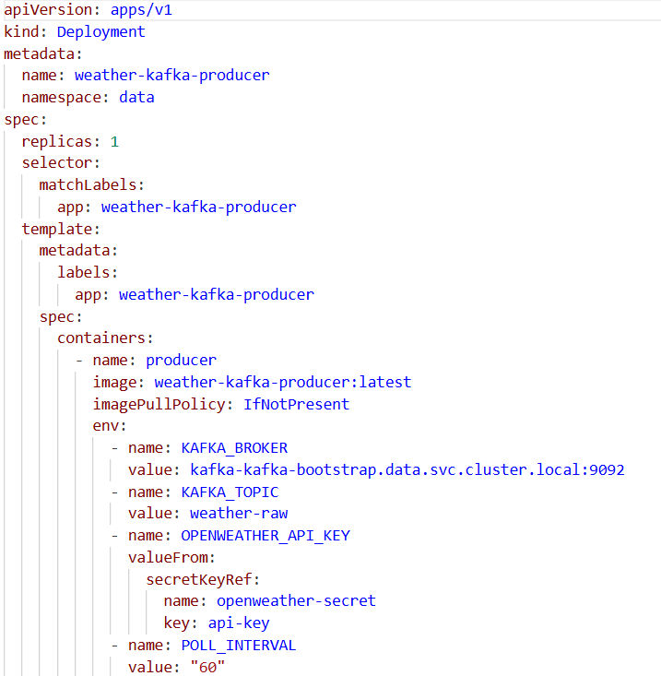
III. Implementation Details
Kafka Producer (Data sources readers): Weather-producer.yaml (for kafka)
Lifecycle
Deployment creates Pod
Pod starts Python script
Script:
Fetches weather
Produces messages to Kafka
If script crashes:
Pod restarts
Producer reconnects automatically

Slide 19
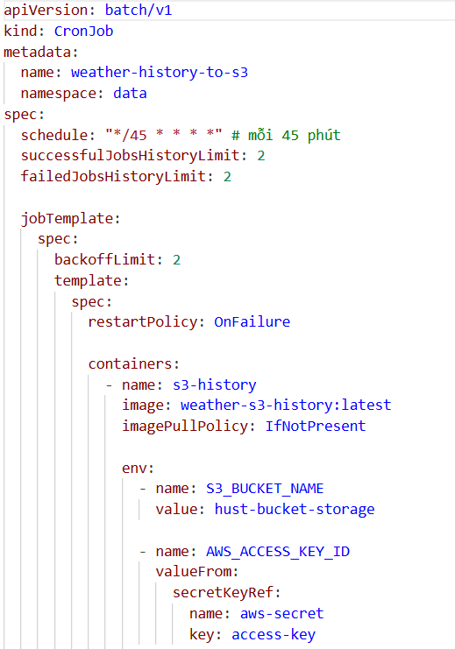
III. Implementation Details
S3

Slide 20
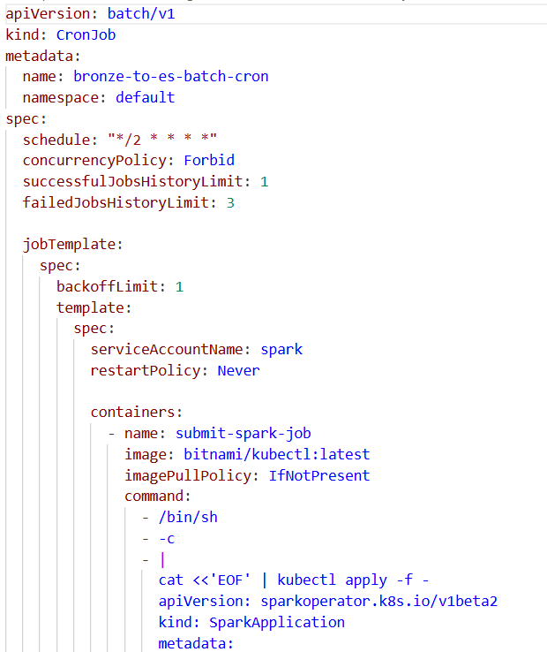
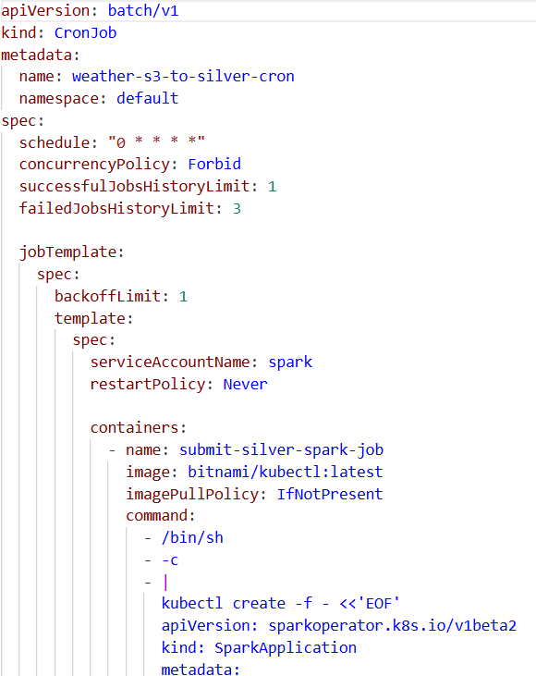
III. Implementation Details
Bronze
Silver.yaml

Slide 21
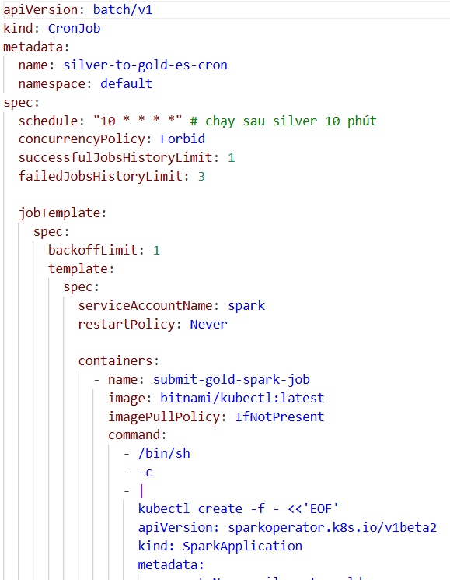
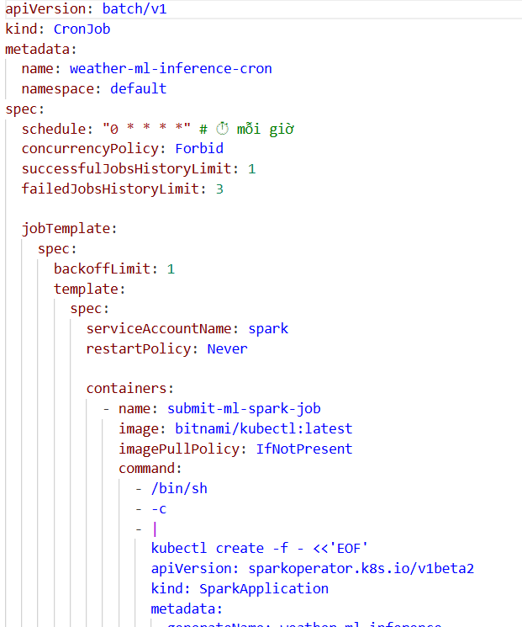
III. Implementation Details
Gold
Machine Learning Implementation

Slide 22
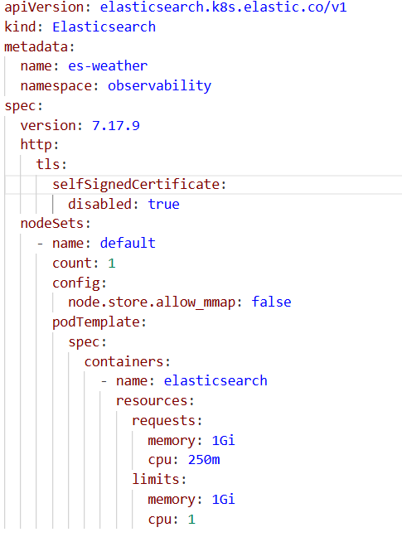
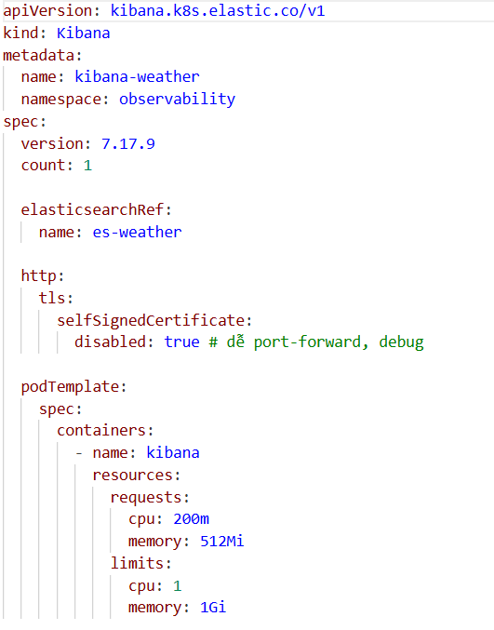
III. Implementation Details
Elasticsearch
Kibana

Slide 23
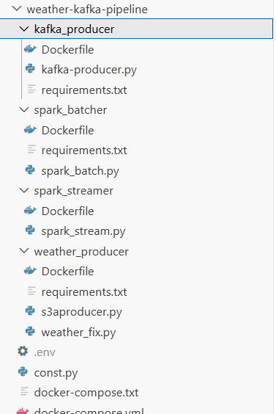
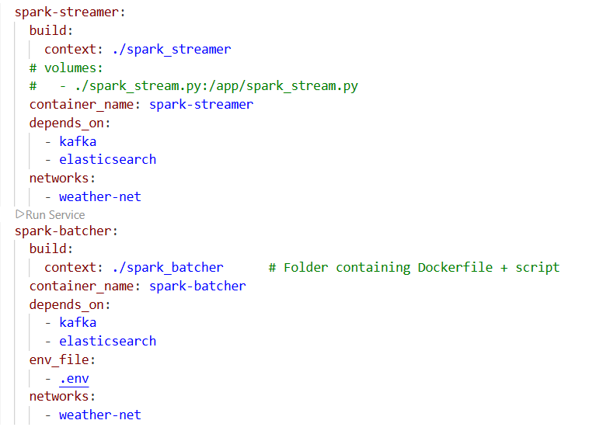
III. Implementation Details
Deployment strategy
We first deploy on docker using many Dockerfiles, with a docker-compose.yml file to run everything

Slide 24
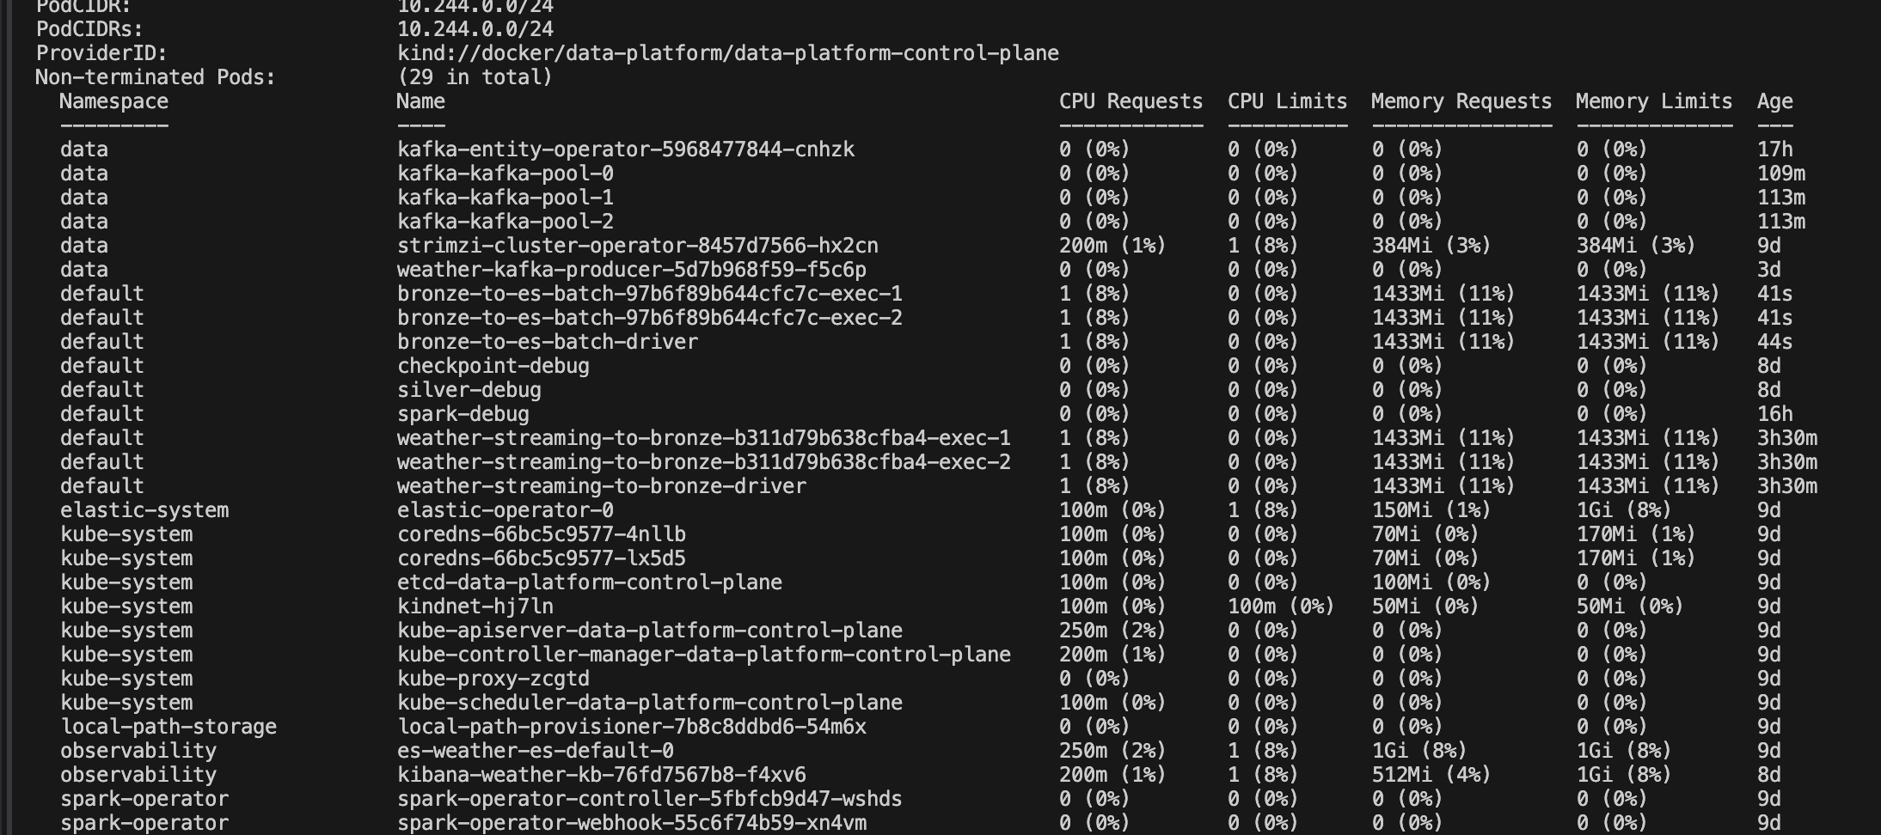
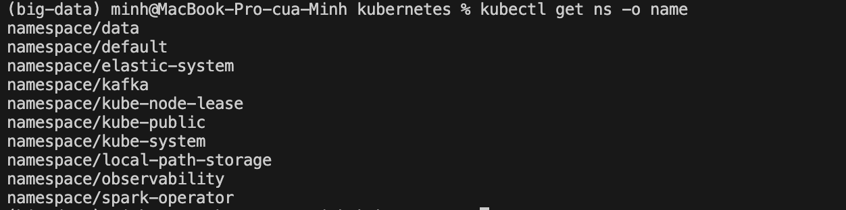
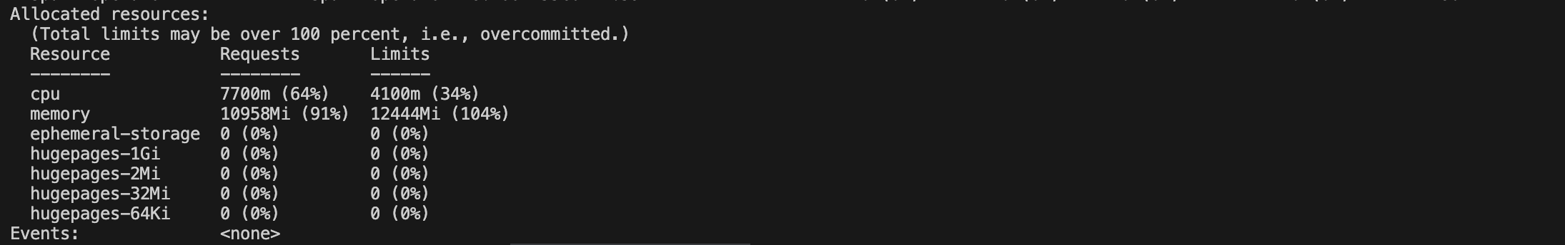
III. Implementation Details
Deployment​ strategy
Kubernetes​
Deployed on a single-node Kubernetes cluster, where one node acts as both control plane and worker.
Uses containerd as the container runtime with CPU and memory sized for data processing workloads.
Employs PersistentVolumeClaims (PVCs) for Spark checkpoints and intermediate data storage.
Organizes services into separate namespaces to ensure logical isolation and easier management.

Slide 25
IV. Lesson learned
System Integration
Enable data flow from Kafka to Spark and from Spark to Elasticsearch.
Kafka and Spark run on Kubernetes, requiring proper service configuration for communication.
Approaches Tried
Docker Compose Configuration
Used docker-compose.yml to connect Kafka, Spark, and Elasticsearch.
Effective for local development and testing.
Kubernetes YAML Configuration
Used .yaml manifests to define services, deployments, and networking.
Kubernetes-native approach for inter-service communication.
Final Solution: Kubernetes YAML files selected
Required for Kubernetes-based deployment.
Provides full control over networking, scaling, and service discovery.

Slide 26
IV. Lesson learned
Performance Optimization
Problem: Frequent loading of S3 data for each ML inference.
Approach:
Cache historical data in Spark DataFrames.
Load only the previous 24 hours at the start of each hour.
Final Solution: Use cached data instead of reloading from S3.
Monitoring & Debugging
Problem: Need system logs and visibility for monitoring.
Approaches
Kubernetes CLI commands (kubectl describe, logs).
Grafana-based monitoring.
Final Solution
Kubernetes-native commands used.
Grafana rejected due to high resource overhead.

Slide 27

IV. Lesson learned
Scaling
Problem: Improve Spark processing performance.
Approach:
Increased Spark executors from 1 to 2.
Enabled parallel processing of data partitions.
Final Solution: Two Spark executors used in production.
Data Quality & Testing
Problem: Prevent broken pipelines before pushing code to GitHub.
Approaches
Local unit testing of individual components.
Manual testing of data flow.
Docker used to simulate production services.
Final Solution: Combine local testing with container-based integration testing.

Slide 28
IV. Lesson learned
Data Quality & Testing
Problem
Prevent broken pipelines before pushing code to GitHub.
Approaches
Local unit testing of individual components.
Manual testing of data flow.
Docker used to simulate production services.
Final Solution
Combine local testing with container-based integration testing.
Key Takeaways
Early testing reduces deployment errors.
Component isolation simplifies debugging.

Slide 29
V. Conclusion
In conclusion, we have …
This project successfully builds an end-to-end real-time weather data pipeline for Vietnam using modern Big Data technologies.
The system integrates Kafka, Spark (streaming & batch), Elasticsearch, and Kubernetes to process, store, and analyze high-velocity weather data.
A Lambda Architecture is applied to support both real-time analytics and historical batch processing.
The pipeline demonstrates scalability, fault tolerance, and modular deployment suitable for real-world data engineering systems.
Future works
Extend forecasting models with advanced ML/DL approaches (e.g., LSTM, Transformer-based time-series models).
Expand data sources to include additional meteorological APIs and sensor networks.
Deploy the system on a multi-node Kubernetes cluster to evaluate scalability and high availability.
Optimize resource usage and monitoring with lightweight observability solutions.

