Slide 1
AgentCon Workshop
(LangChain, Semantic Kernel or Semantic Kernel .NET)
Udaiappa Ramachandran (Udai)
CTO|CSO @ Akumina Inc., | Microsoft MVP (AI)
Web: https://udai.io
LinkedIn: https://linkedin.com/in/udair
Meetup: https://meetup.com/nashuaug
https://meetup.com/devboston

Slide 2
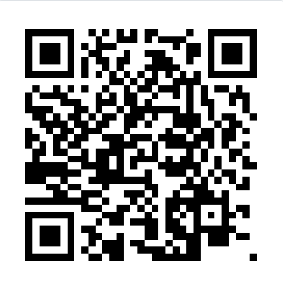
Start Here
Repo: https://github.com/nhcloud/agentcon-workshop
Goal:
Run interactive notebook
run a multi-agent backend on :8000 + React UI on :3001
Choose one backend track: LangChain (Py), Semantic Kernel (Py), or Semantic Kernel (.NET)
Clone: git clone https://github.com/nhcloud/agentcon-workshop
Start: https://github.com/nhcloud/agentcon-workshop/blob/main/docs/START.md

Slide 3
Pick Your Track
Backend: http://localhost:8000
Python (LangChain) – cd Backend/python/langchain
Python (Semantic Kernel) – cd Backend/python/sk
.NET (Semantic Kernel) – cd Backend/dotnet/sk
Frontend: http://localhost:3001
Node – cd Frontend
Start from START.MD

Slide 4
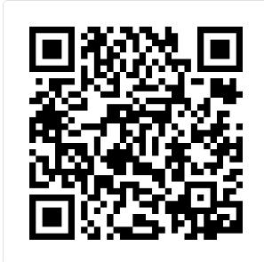
Pre-Configured Workshop VMs
Need a machine? Ask for a VM
Login boston / AgentCon2025
Preinstalled (Ready to Run): VS Code, Node, Python, .NET 9, Git, repo clone in (c:/workshop)
RDP into VM → navigate to c:/workshop → Open agentcon-workshop folder in VS Code
Run Jupyter and the Application
If you want to run the VM without creating azure services, then download the .env (save as .env) copy to your backend folder ( refer START.MD)

Slide 5
Ask for a VM
DNS: agentcon*.eastus.cloudapp.azure.com
mstsc /v:agentcon*.eastus.cloudapp.azure.com
Login (workshop only):
User: boston
PWD: AgentCon2025

Slide 6
Success Criteria
Create Azure Services docs/AI_SERVICES.MD
There are three pre-configured Agents
Generic Agent – Any questions can be asked
People Agent -- Ask about people (sample documents from docs/sample-data/employees)
Knowledge Agent – Ask about company policies (sample documents loaded from docs/sample-data/policies)
PYNB for at least one agent
Run Backend Application for at least one agent
Run Frontend
You can ask the agent a question from the UI and see a grounded answer
Pick Single Agent at a time then ask questions then Switch to Group chat to understand all agents' collaborations
You can switch tracks without changing the frontend
Sample Prompt: docs/PROMPT.MD

Slide 7
Thank you for your time and trust! AgentCon Boston

