Slide 1
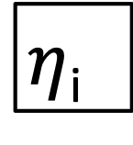
x_{1i}
wx₁
wy₁
y_{1i}
wx₂
x_{2i}
$η$_{i}
wy₃
y_{2i}
wx₃
x_{3i}

Slide 2
x_{1i}
y_{1i}
x_{2i}
$η$_{i}
y_{2i}
x_{3i}

