Slide 1
CSC 1302/DSCI 1302
Lab 5

Slide 2
Task 1
Given a list of 10,000 words in alphabetical order (words.txt), and an incomplete Python program in the next slide. The program first reads the words into a Python list. Then, it repetitively asks users to enter a word (target) and searches for it within the 'words' list using binary search. Complete the program as follows:
Implement the iterative binary search method to search for the target word within the words list and print the result in the following format from inside the method-
Target = {target} , Found at index = {index}, Number of iterations = {iterations}
Notes:
- You will need to keep track of how many iterations/steps it takes to find the result (iterations).
- If a word is not found within the list, the function should return -1.
- You will need to put your python script (.py) and the provided ‘words.txt’ in the same folder
Reference: (words.txt)
https://www.mit.edu/~ecprice/wordlist.10000

Slide 3
Example code
file = open('words.txt', 'r') words = file.read().splitlines() print('Number of words read:', len(words)) def binary_search(arr, target): #TODO: Implement the iterative binary search method and print the result as described on the previous slide
target = input('Enter search key: ').lower() while target != 'exit': binary_search(words, target) target = input('Enter search key: ‘).lower()

Slide 4
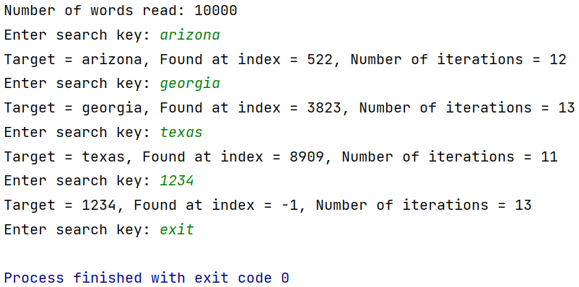
Sample output

Slide 5
Task 2
Write another method named linear_search() that uses the linear search strategy to find the ‘target’ and
prints the number of iterations it took to find the ‘target’. Then fill in the following table:
Target / Search Key | Num. of iterations – linear search | Num. of iterations – binary search
arizona
georgia
texas
1234
Submit the resulting table as a word document.

Slide 6
Submission Instructions
Submit the following in iCollege:
Source code file for the binary search (YOUR_FULL_NAME_Lab5_Task1.py)
Source code file for the linear search (YOUR_FULL_NAME_Lab5_Task2.py)
Comparison table (.docx)
Due date/time: Same Day within the lab period (strongly recommended)
Late submission (10% late submission penalty) :
Same Day - after the lab period but before 11:59PM
Demonstrate your solution to the Lab Instructor and be prepared to answer
1-2 questions on your solution.

