Slide 1
中國剩餘定理在信息科學之應用
張真誠
逢甲大學 講座教授
中正大學 榮譽教授
清華大學 合聘教授

Slide 2
1. Chinese Remainder Theorem (中國剩餘定理)
2. Ordered Minimal Perfect Hashing Functions (OMPHF)
3. Data Field Protection
4. Access Control
5. Conclusions

Slide 3
Chinese Remainder Theorem (中國剩餘定理)
韓信點兵問題：「今有物不知其數，三三數之剩二，五五數之剩三，七七數之剩二，問物幾何？」～(孫武 孫子算經)
亦即 求正整數C，使得
C ≡ 2 (mod 3)
C ≡ 3 (mod 5)
C ≡ 2 (mod 7)
兩個疑問？
(1) C是否存在？
(2) 如何求C？

Slide 4

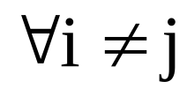
回答(1)：中國剩餘定理
Let r₁,r₂,…,r_{n} be integers.
an integer C. st.
C ≡ r₁ (mod m₁)
C ≡ r₂ (mod m₂)
.
.
.
C ≡ r_{n} (mod m_{n})
If (m_{i}, m_{j})=1,

Slide 5
EX：令m₁=3,m₂=5,m₃=7,且令
r₁=2,r₂=3,r₃=2,
C=23, s.t.
C mod m₁ = 23 mod 3 = 2,
C mod m₂ = 23 mod 5 = 3,
C mod m₃ = 23 mod 7 = 2.

Slide 6
回答(2)：
「三人同行七十稀
五樹梅花廿一枝
七子團圓正半月
除百零五便得知。」
～(程大位 算法統宗(1593))

Slide 7
亦即
70×2+21×3+15×2
=140+63+30
=233
233÷105= 餘23

Slide 8
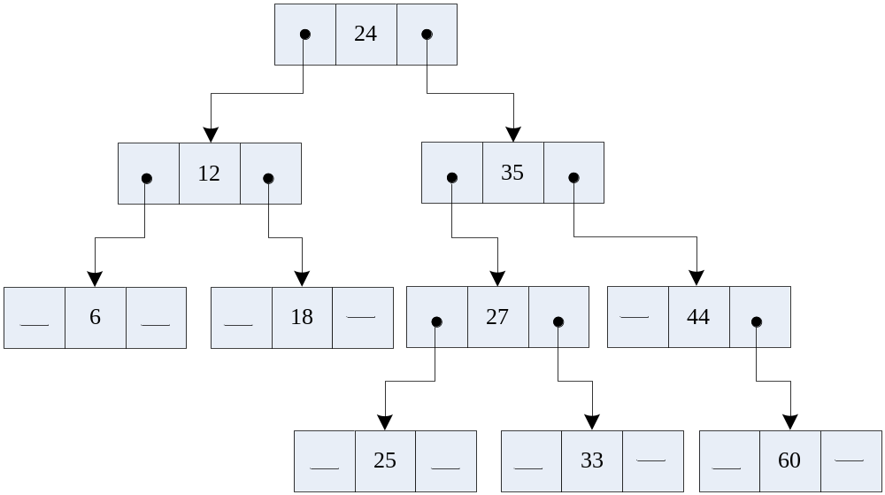
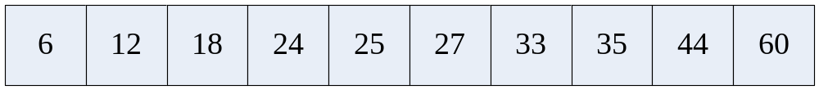
Ordered Minimal Perfect Hashing Functions
Non-linear Organization
  Ex: binary tree
  Linear Organization

Slide 9
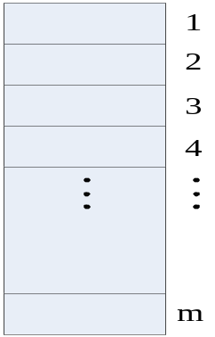
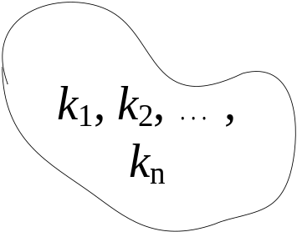


hashing
key to address transformation
  problem: collision
  particular cases
    (1) one-to-one mapping and
    | key space | ≤ | address space |
h
Perfect hashing

Slide 10

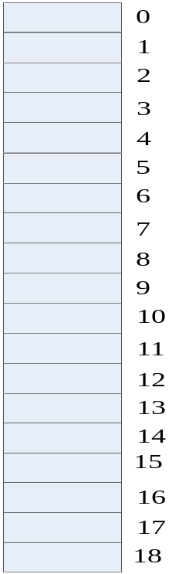
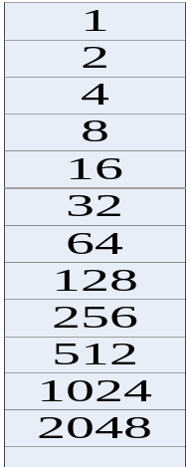
Hashing
(2)one-to-one mapping and
| key space | = | address space|
Minimal perfect hashing
Ex: key set={2⁰, 2¹, …, 2¹⁷}
h(k) = k mod 19 is a perfect hashing

Slide 11
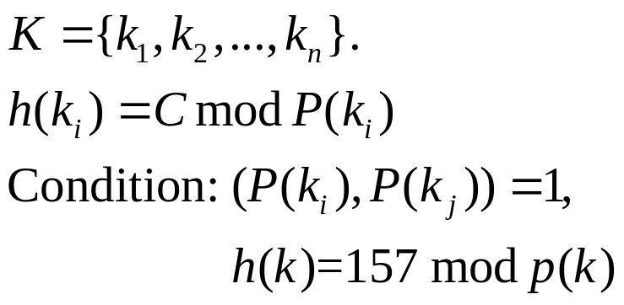
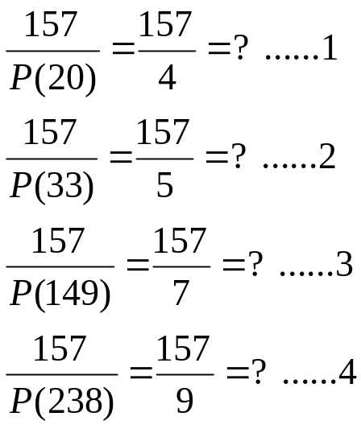
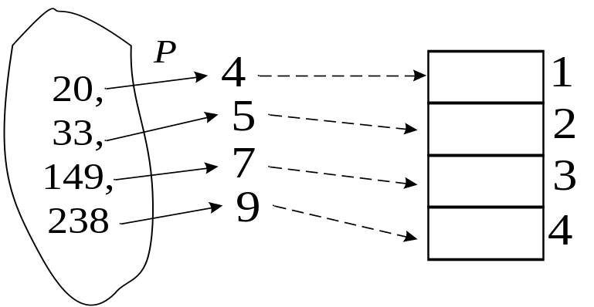
Minimal Perfect Hashing
since

Slide 12
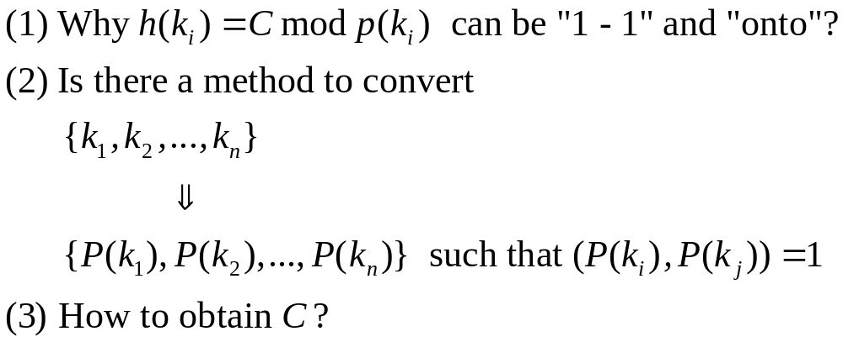
Minimal Perfect Hashing (Cont.)
Some questions

Slide 13
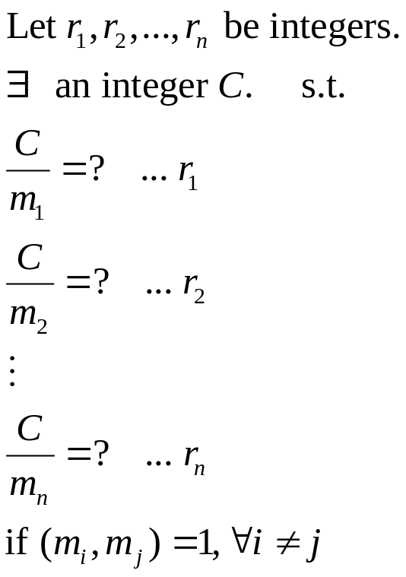
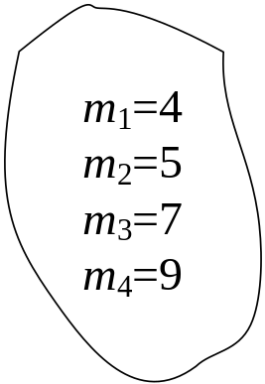
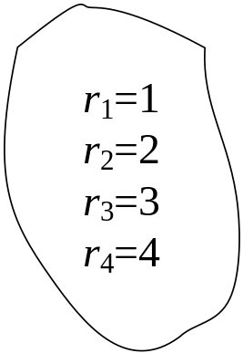
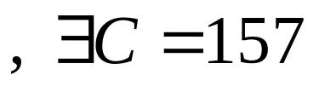
Minimal Perfect Hashing (Cont.)
Ans(1): Chinese Remainder Theorem

Slide 14
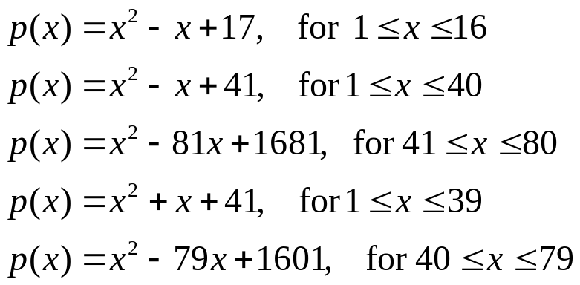
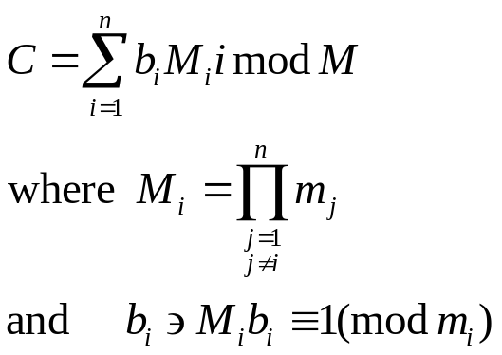
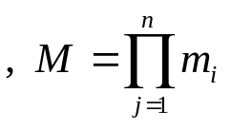
Minimal Perfect Hashing (Cont.)
Ans(2): Use Prime Number Functions
Ans(3):

Slide 15
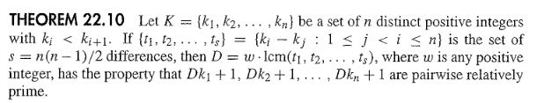

Slide 16
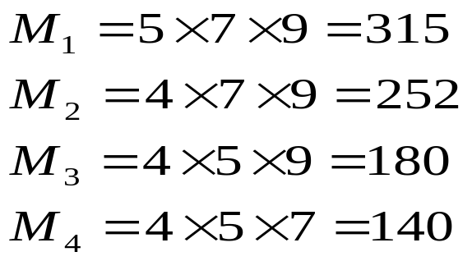
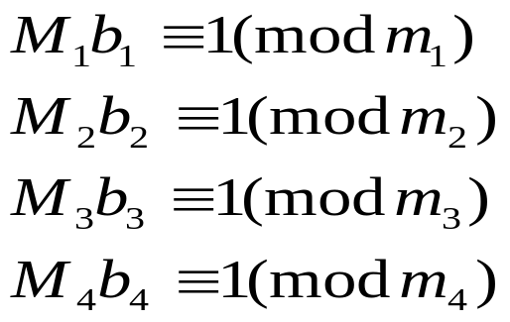
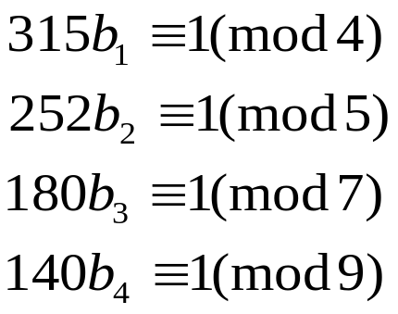
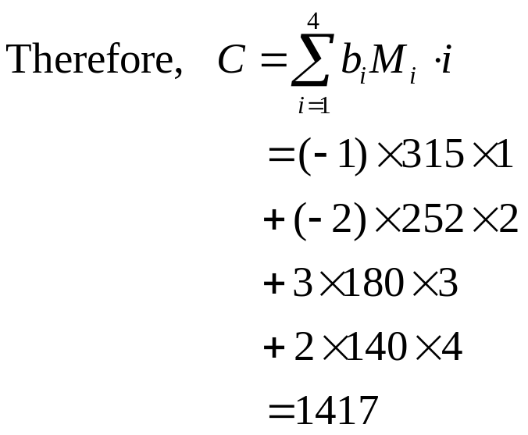
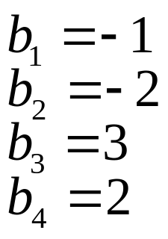
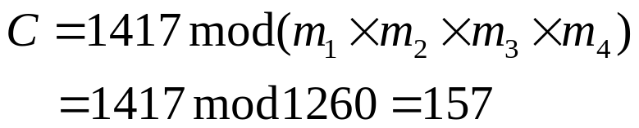
Minimal Perfect Hashing (Cont.)
Ex: m₁=4, m₂=5, m₃=7, m₄=9
C'
b_{i} M_{i} i

Slide 17
Applications-12 months English identifiers
JANUARY
FEBRUARY
MARCH
APRIL
MAY
JUNE
JULY
AUGUST
SEPTEMBER
OCTOBER
NOVEMBER
DECEMBER

Slide 18
Applications-12 months English identifiers (Cont.)
Extract (The 2nd char., The 3rd char.)
(A, N)
(E, B)
(A, R)
(P, R)
(A, Y)
(U, N)
(U, L)
(U, G)
(E, P)
(C, T)
(O, V)
(E, C)

Slide 19
Applications-12 months English identifiers (Cont.)
Group | Location | Extraction pair | Original key
1 | 1 2 3 | (A, N) (A, R) (A, Y) | JANUARY MARCH MAY
2 | 4 | (C, T) | OCTOBOR
3 | 5 6 7 | (E, B) (E, C) (E, P) | FEBRUARY DECEMBER SEPTEMBER
4 | 8 | (O, V) | NOVEMBER
5 | 9 | (P, R) | APRIL
6 | 10 11 12 | (U, G) (U, L) (U, N) | AUGUST JULY JUNE

Slide 20
Applications-12 months English identifiers (Cont.)
x | d(x) | c(x) | p(x)
A B C D E F G H I J K L M | 0 3 4 | 161896 1 427 | 2 3 5 7 11 13 17 19 23 29 31 37 41
x | d(x) | c(x) | p(x)
N O P Q R S T U V W X Y Z | 7 8 9 | 1 1 12989 | 43 47 53 59 61 67 71 73 79 83 89 97 101
H(P, R) = d(P) + (c(P) mod p(R))
= 8 + (1 mod 61)
= 8 +1
= 9

Slide 21
36 Pascal Reserved Words
ARRAY, AND, BEGIN, CASE,
CONST, DOWNTO, DO, DIV, END,
ELSE, FUNCTION, FILE, FOR, GOTO,
IF, IN, LABEL, MOD, NIL, NOT,
OTHERWISE, OF, OR, PROCEDURE,
PROGRAM, PACKED, REPEAT, RECORD,
SET, TYPE, THEN, TO, UNTIL, VAR,
WITH, WHILE

Slide 22
AA, AD, BI, CE, CS, DN
DO, DV, ED, EE, FC, FE
GO, IF, IN, LE, MD, NL
NT, OE, OF, OR, PC, PG
PK, RE, RO, ST, TE, TN
TO, UI, VR, WH, WL

Slide 23
x | d(x) | c(x) | p(x)
A B C D E F G H I J K L M | 0 2 3 5 8 10 13 14 16 17 | 9 1 672 50010 57 3236 1 131 1 1 | 2 3 5 7 11 13 17 19 23 29 31 37 41
x | d(x) | c(x) | p(x)
N O P Q R S T U V W X Y Z | 18 20 23 26 28 29 32 33 34 | 1777 3785 726 331 1 15654 1 1 39 | 43 47 53 59 61 67 71 73 79 83 89 97 101
H(W, L) = d(W) + (c(W) mod p(L))
= 34 + (39 mod 37)
= 34 + 2
= 36

Slide 24
Data Field Protection
α₁
α₂
…
α_{j}
…
α_{m}
Record R
＊e₁
＊e₂
＊e_{j}
＊e_{m}
∑ mod D
Record R’s Ciphertext
C
C mod d_{j}
The Occurrence of the j-th field

Slide 25
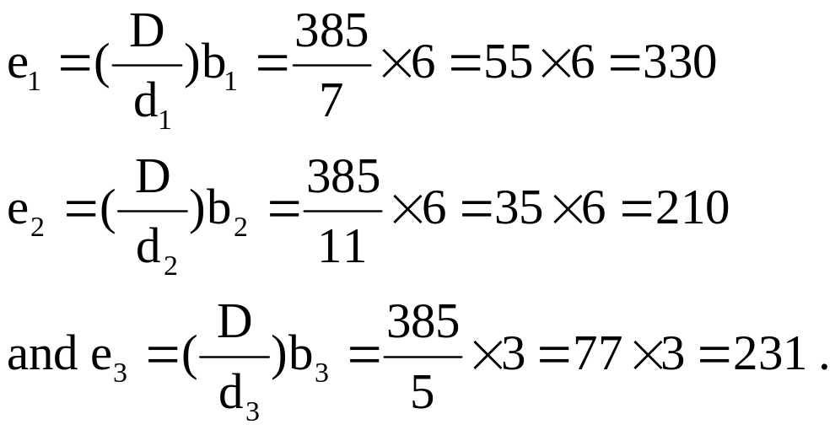
Data Field Protection (Cont.)
Example:
Let R = (4, 10, 2) be a record. Take d₁=7, d₂=11 and d₃=5 to be R’s three deciphering keys. Then D=d₁×d₂×d₃=7×11×5=385.
The following are encryption keys

Slide 26
Data Field Protection (Cont.)
Because α₁=4, α₂=10 and α₃=2, we have C = (e₁α₁+e₂α₂+e₃α₃) mod D. Thus R’s ciphertext is
C = (330×4+210×10+231×2) mod 385=32 .
Then we have
α₁= C mod d₁= 32 mod 7 =4,
α₂= C mod d₂= 32 mod 11 =10,
and α₃= C mod d₃= 32 mod 5 =2.

Slide 27
Data Field Protection (Cont.)
When α₂ is changed from 10 to 8, R’s ciphertext becomes
C = (C－e₂(C mod d₂) + e₂×8) mod D
= (32 －210×10 + 210×8) mod 385
= －388 mod 385
= 382.

Slide 28
Access Control
M₁
M₂
M₃
M₄
R
W
E
Own
R
W
P1
R
W
E
Own
R
E
P2
Access Matrix

Slide 29
Access Control (Cont.)
File
User
Database
Program
File System
Table

Slide 30
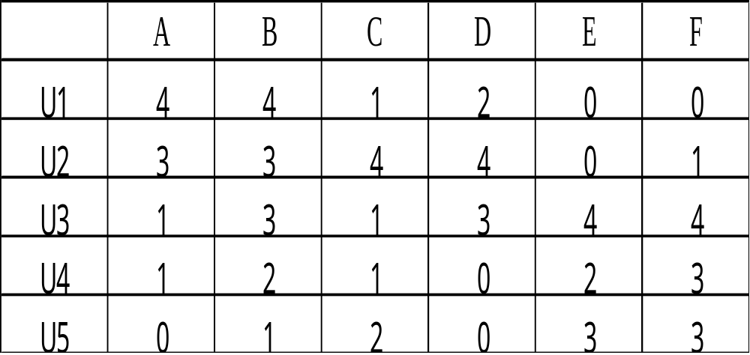
Access Control (Cont.)
File
0 : No access
1 : Execute
2 : Read
3 : Write
4 : Own
User

Slide 31
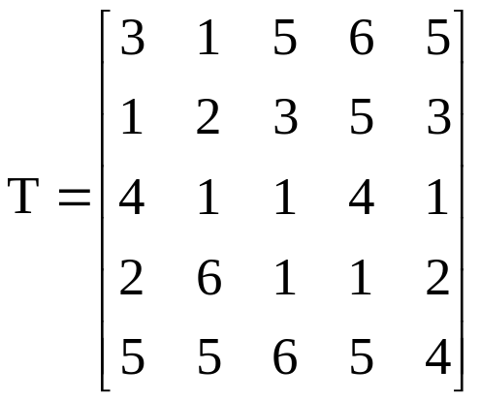
Key_Lock Pair
A. Wu and Hwang [1984]
a_{ij}=K_{i}*L_{j}
(1) * ：inner product of Galois Field GF(p)
(2) p>a_{ij} and p is a prime number
Step1:Find a 5*5 Non_Singular Matrix

Slide 32
Key_Lock Pair (Cont.)
Step 2:
K₁=(3, 1, 5, 6, 5)
K₂=(1, 2, 3, 5, 3)
K₃=(4, 1, 1, 4, 1)
K₄=(2, 6, 1, 1, 2)
K₅=(5, 5, 6, 5, 4)
Step 3:
L₁=(X₁, X₂, X₃, X₄, X₅).
K_{i}*L₁=a_{i1}, i= 1, 2, …, 5.

Slide 33
Key_Lock Pair (Cont.)
4=3X₁+X₂+5X₃+6X₄+5X₅
3=X₁+2X₂+3X₃+5X₄+3X₅
1=4X₁+X₂+X₃+4X₄+X₅
1=2X₁+6X₂+X₃+X₄+2X₅
0=5X₁+5X₂+6X₃+6X₄+4X₅
⇓
L₁=(1, 3, 0, 1, 4)
⇓

Slide 34
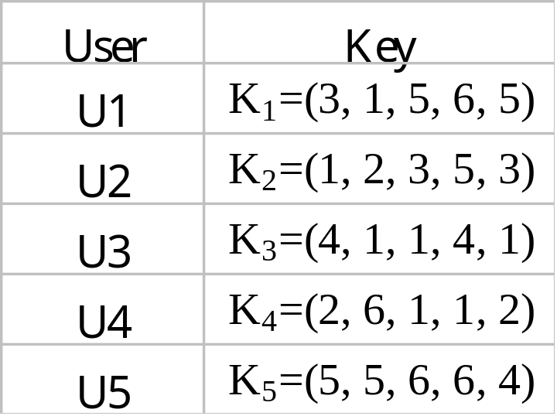
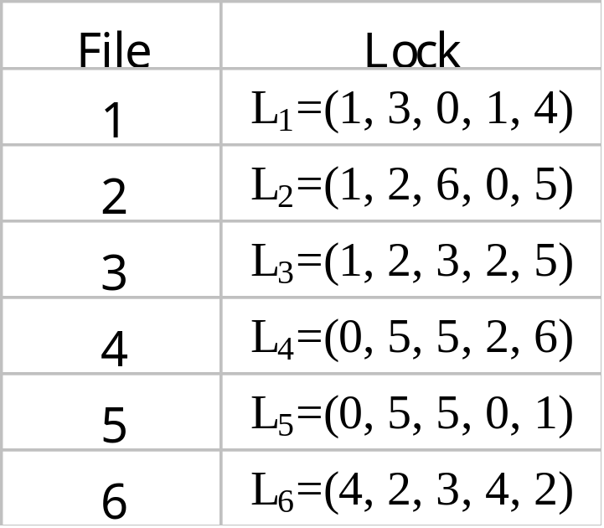
Key_Lock Pair (Cont.)

Slide 35

Key_Lock Pair (Cont.)
Example:
K₄*L₁=(2, 6, 1, 1, 2)*(1, 3, 0, 1, 4)
=2+18+0+1+8 = 29
29 mod 7 = 1#
Disadvantage:
(1) Space: O(m²+mn) > O(mn)
(2) Time: 1. m multiplications
2. m-1 additions
3. 1 divisions
※ m users and n files.

Slide 36
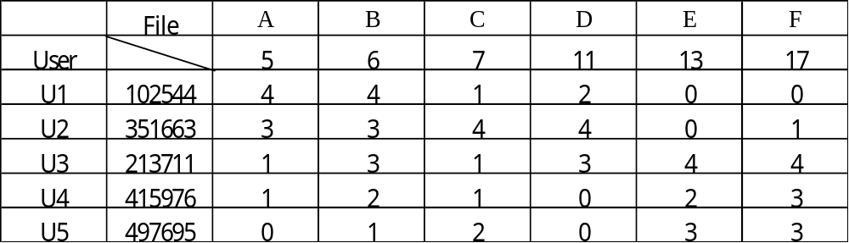
Key_Lock Pair (Cont.)
B. Chang [1985]
a_{ij}=K_{i} mod L_{j}
Lock
Key
Example:
a₄₅=K₄ mod L₅
_{=415976 mod 13}
₌₂

Slide 37



Key_Lock Pair (Cont.)
Questions??
(1) Why a_{ij} = K_{i} mod L_{j} ?
(2) How to find K_{i}’s 與 L_{j}’s ?
Answer (1)
Chinese Remainder Theorem
Let r₁ , r₂ , …, r_{n} be integers ,
∃ an integer K s.t.
… r₁
… r₂

… r_{n}
If (L_{i}, L_{j}) = 1, ∀ i≠j.

Slide 38
Key_Lock Pair (Cont.)
Ex:
∃ K=102544
L₁=5
4
L₂=6
4
L₃=7
1
L₄=11
2
L₅=13
0
L₆=17
0
Answer(2):
Lock: L₁, L₂,…,L_{n}, coprimes

Slide 39
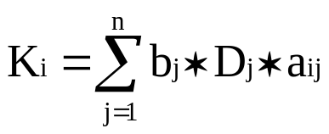
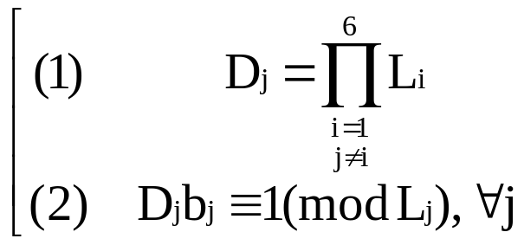
Key_Lock Pair (Cont.)
Key
Example
L₁=5, L₂=6, L₃=7, L₄=11, L₅=13, L₆=17
D₁=L₂L₃L₄L₅L₆=6*7*11*13*17=102102
D₂=L₁L₃L₄L₅L₆=5*7*11*13*17=85085
D₃=L₁L₂L₄L₅L₆=5*6*11*13*17=72930
D₄=L₁L₂L₃L₅L₆=5*6*7*13*17=46410
D₅=L₁L₂L₃L₄L₆=5*6*7*11*17=39270
D₆=L₁L₂L₃L₄L₅=5*6*7*11*13=30030

Slide 40

Key_Lock Pair (Cont.)
∵ D_{j}b_{j} ≡ 1 ( mod L_{j})
∴ b₁ = 3, b₂ = -1, b₃ = -12,
b₄ = 1, b₅ = 4, b₆ = 15.
K₁= b_{j}D_{j}a_{1j} = 3 * 102102 * 4
+ (-1) * 85085 * 4
+ (-12) * 72930 * 1
+ 1 * 46410 * 2
+ 4 * 39270 * 0
+ 15 * 30030 * 0
= 102544
● If Mb ≡ 1 ( mod m), where (M,m)=1, is there any efficient way to find b?
Mx+my=1 (e.g. 8x+3y=1), find (x,y)=?
● How to deal with large K_{i} ?

Slide 41
Conclusions
Design a perfect hashing function to allow insertion and deletion of keys
How to speed up the calculation of C?
Multi-key hashing
How to deal with large K_{i} problem?
Apply Data Field Protection to Secure Broadcasting
More applications?

