Slide 1
Introduction to Clustering
Clustering
- What is Clustering
- Types of Clustering Algorithms
- Partitional and Hierarchical
What is Clustering?
  Finding a structure in a collection of unlabeled data.
Types Of Clustering Algorithms
  Partitional
    Divides data into non-overlapping subsets (clusters)
    No cluster-internal structure
  Hierarchical
    Clusters are organized as trees
    Each node is consider a cluster

Slide 2
K-means
K-means
- Overview
- Implementation
- Time and Space Complexity
Overview
  Partitional Algorithm (K user defined partitions)
Simple Implementation
  Initialize Centroids(); // some heuristic or random
  While(!stopState){ // some heuristic
  Compute data point membership(); // based on distance from Centroid
  Recompute Centroids position(); // Center of Cluster
  } // end loop
Time Complexity
  O(n*k)
Space Complexity
  O(n*k)

Slide 3
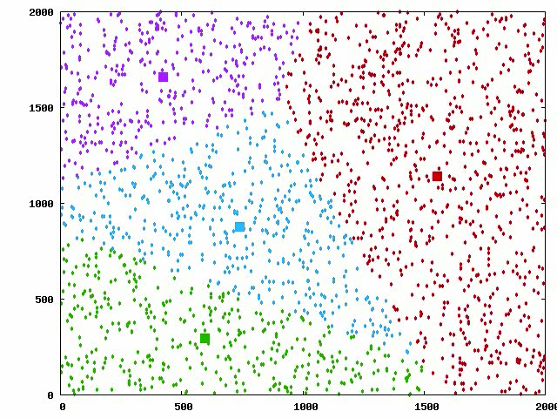
Sample Run

Slide 4
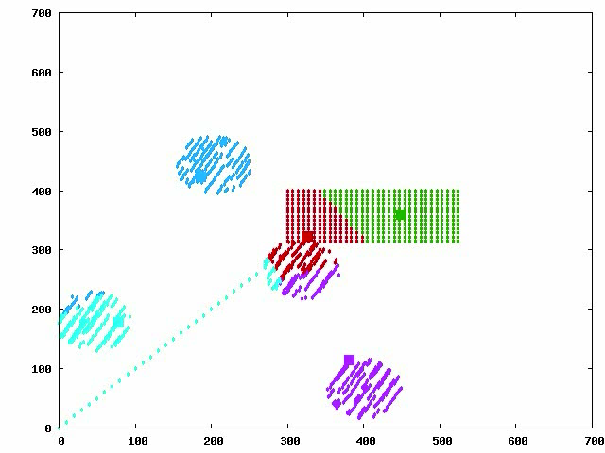
K-means
Clustering
- Properties
- Pros
- Cons
Properties
  There are always K clusters
  There is always at least one item in each cluster
  The cluster are non-hierarchical and they do not overlap
Pros
  Easy to Implement
  Speed (if K is small)
  Produces tighter clusters than hierarchical clustering, especially if the clusters are globular
Cons
  Different initial partitions affect outcome
  Difficult to determined what K should be
  Does not work well with “non-globular” clusters
  Different values of K affect final clusters
Figure: Natural Clustering output with k-means
Source: http://www.improvedoutcomes.com/docs/WebSiteDocs/Clustering/K-Means_Clustering_Overview.htm

Slide 5
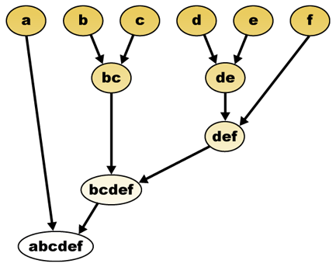
Hierarchical Methods
Agglomerative vs. Divisive.
- Single-Link, Complete-Link, Average-Link
Hierarchical Methods
Hierarchical Methods
Opposed to the partitional algorithms which work by partitioning data into clusters, Hierarchical algorithms produce a dendogram (tree-diagram) representing a hierarchy of clusters to produce a super cluster.
Agglomerative vs. Divisive
The hierarchical algorithms work by either breaking down or building up these clusters. The characteristic of breaking down, or building up clusters determines whether the hierarchical algorithm is agglomerative or divisive.
Single-Link, Complete-Link, & Average-Link
Single Link – Minimum distance between all points in a cluster.
Complete Link - Maximum distance between all points in a cluster.
Average Link – Average distance between all points in a cluster.
(Jain)
Figure: Illustration of Agglomerative
Hierarchical Algorithm. (Wikipedia)
Alex Prunka, Nathan Heminger ,and Chris Andrade
Clustering Analysis: K-means, Hierarchical, R-Trees

Slide 6
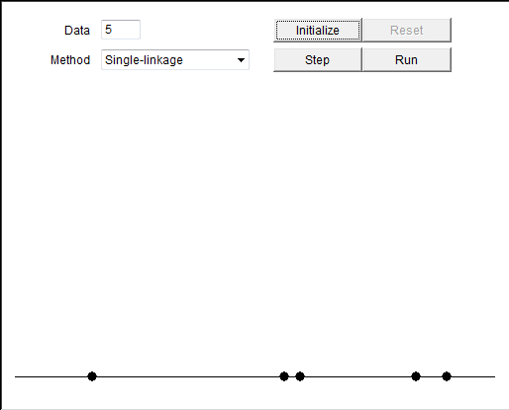
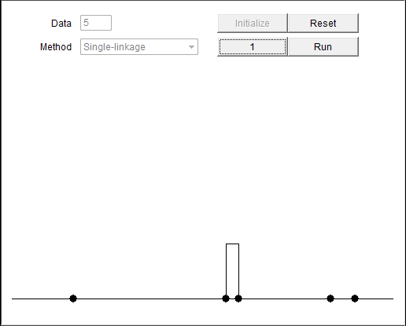
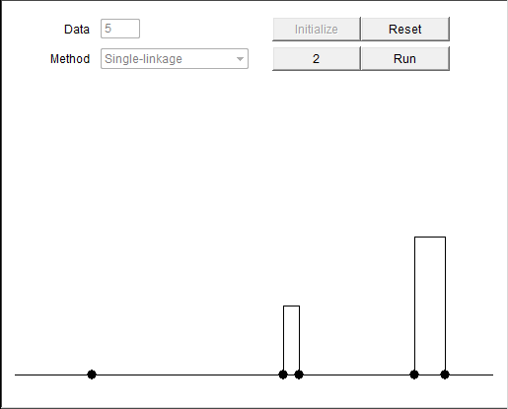
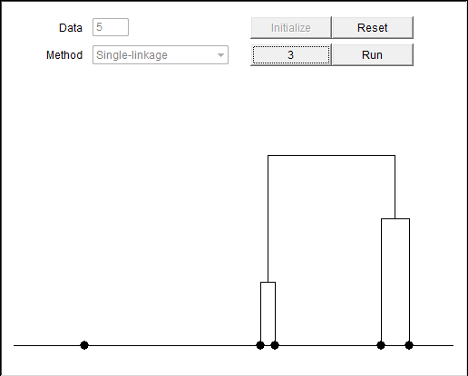
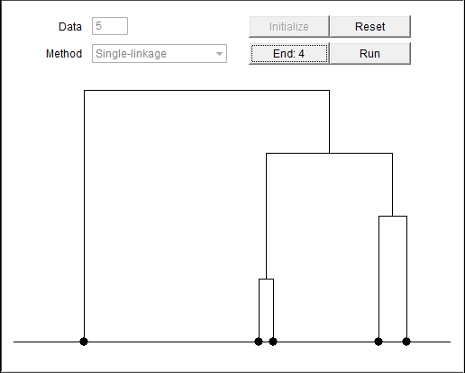
Hierarchical Algorithm Illustration
Hierarchical Methods
Pseudocode and Illustration
Psuedocode
1. Begin by placing each individual element into its own cluster.
2. Compute the distance between all clusters, Based on Link Type.
3. Group the two most similar clusters together.
4. Continue until only 1 cluster remains.
(Jain)
Figure: Illustration of Hierarchical Agglomerative Single-Link Algorithm
http://home.dei.polimi.it/matteucc/Clustering/tutorial_html/links.html

Slide 7
Hierarchical Method Results : Clustering Output
Hierarchical Methods
Dendograms
Dendogram
The dendogram is the fundamental representation of the hierarchical clustering method.
Advantages of the Dendogram
The hierarchical method unlike the k-means method generates a hierarchy of clusterings from 1 to n, where n is the number of elements to cluster.
Able to view the logic behind clusterings leading to larger clusters.
No need to guess which value of K for number of clusters is appropriate.
(Jain)
Figure: Illustration of Agglomerative
Hierarchical Algorithm. (Wikipedia)

Slide 8
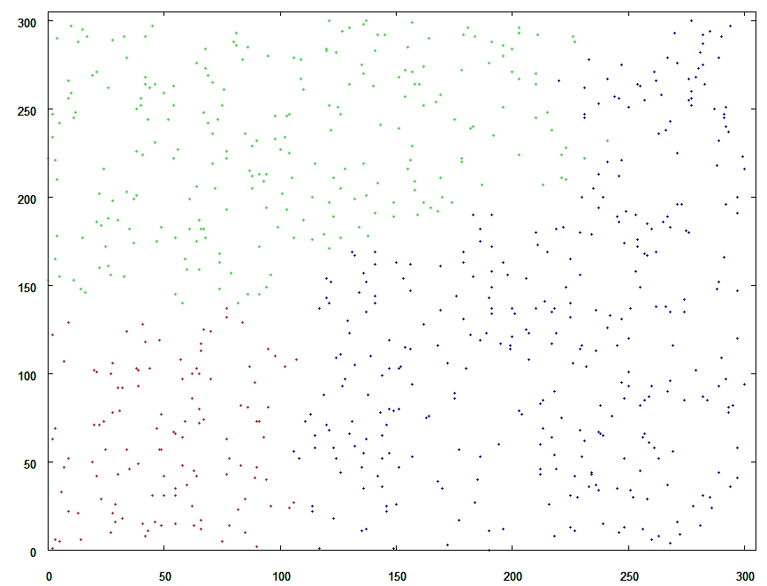
Hierarchical Clustering : Clustering Output
Hierarchical M641yrfethods
Simple Uniform Data for Sanity check
- Time and Space Complexity
Simple Uniform Random Data Input
The data is randomly distributed evenly throughout the graph. No apparent clustering exists.
Time-Complexity & Space Complexity
Should be O(n²) but implementation difficulties increased to O(n³). This is because the table containing distances between points had to be re-computed.
Space Complexity is O(n²) the dominant factor is the matrix containing pairwise distances between points.
(Jain), (A Tutorial on Clustering Algorithms)
Figure: Simpe Uniform Data Input, Hierarchical Agglomerative Average-Link Clustering.

Slide 9
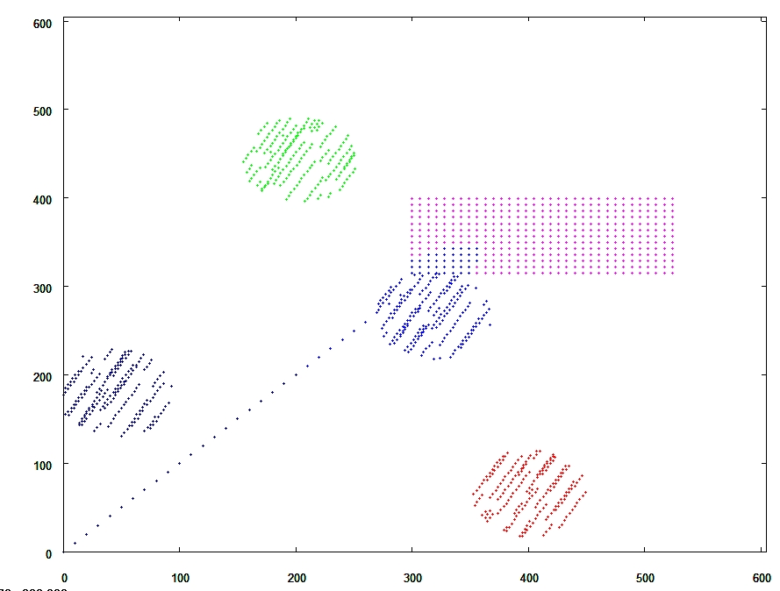
Hierarchical Clustering : Natural Clustering Output
Clustering Output performance
Real challenges arise when trying to extract natural clusters that exist in data.
Human Analysis
Able to recognize patterns such as shapes in data.
Hierarchical Clustering
It appears that the Hierarchical clustering algorithm provides output that is fairly consistent with human expectations. However, on the intersection of the points where the circle and rectangle intersect it can be seen that the clusters appear to bleed slightly into one another.
Figure: Simpe Uniform Data Input, Hierarchical Agglomerative Average-Link Clustering.

Slide 10
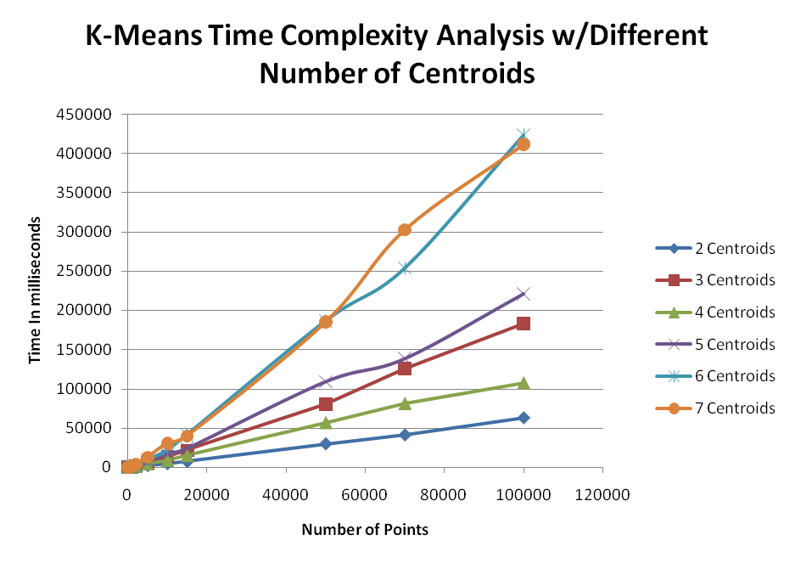
Results

Slide 11
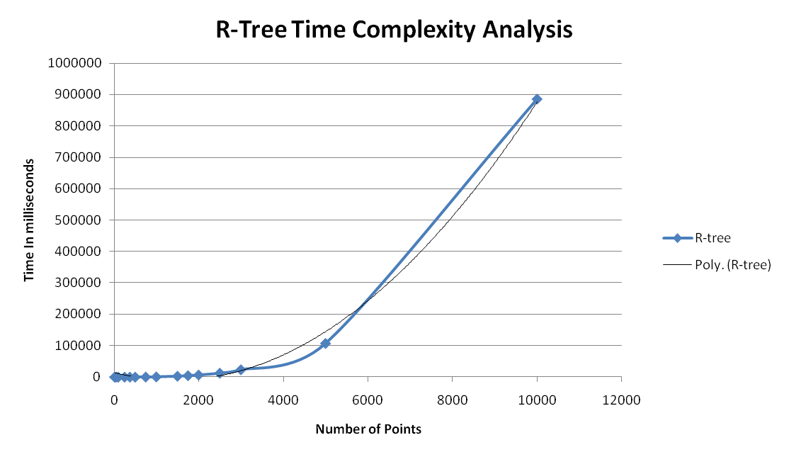
Results

Slide 12
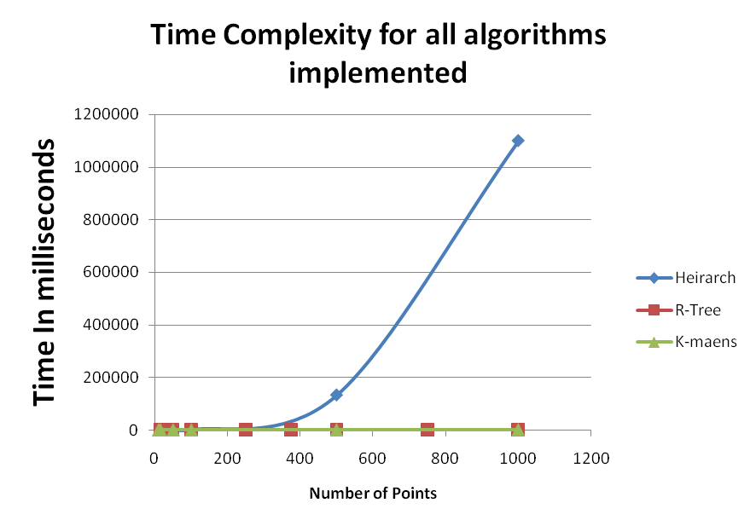
Results

Slide 13
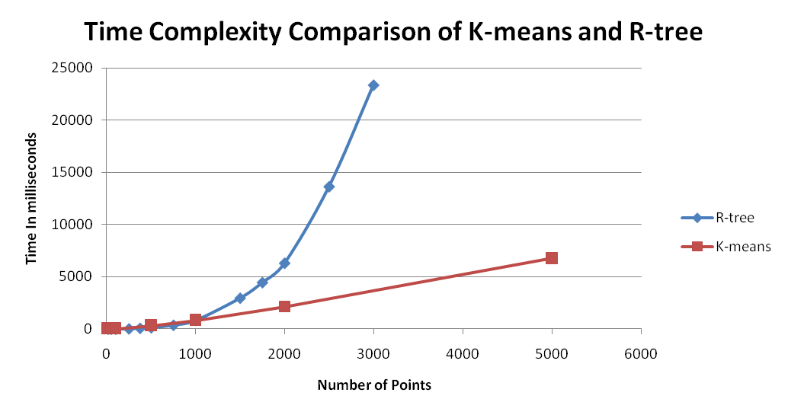
Results

Slide 14
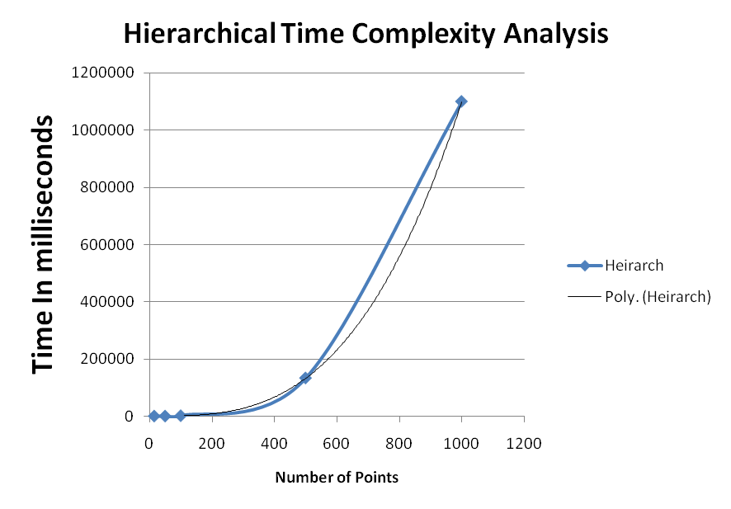
Results

Slide 15
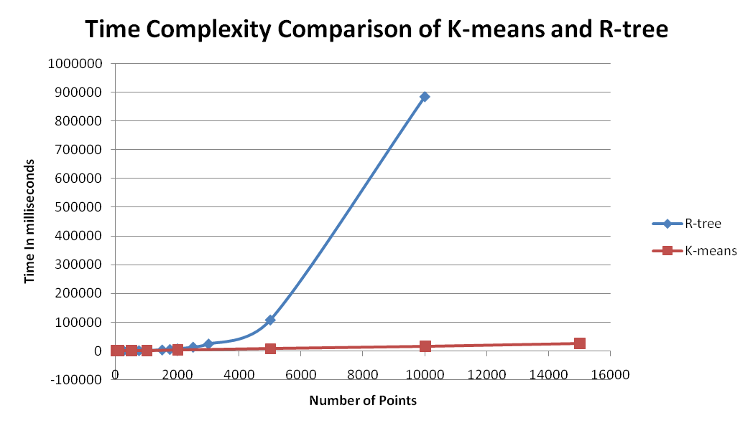
Results

Slide 16
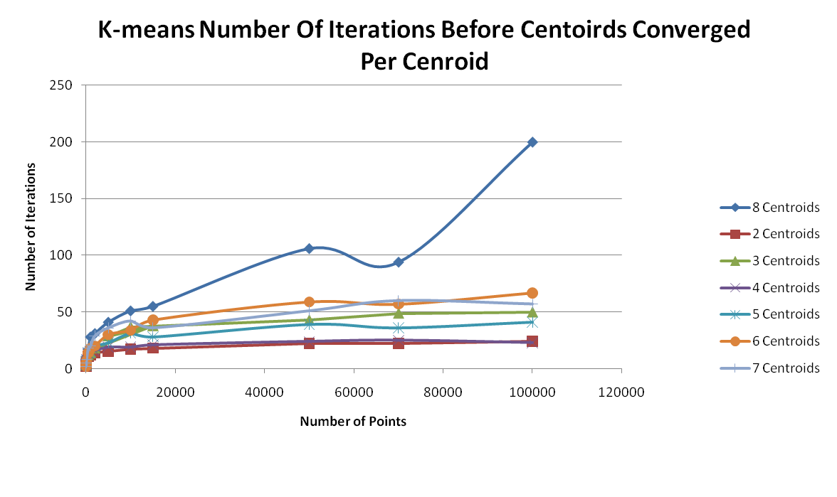
Results

Slide 17
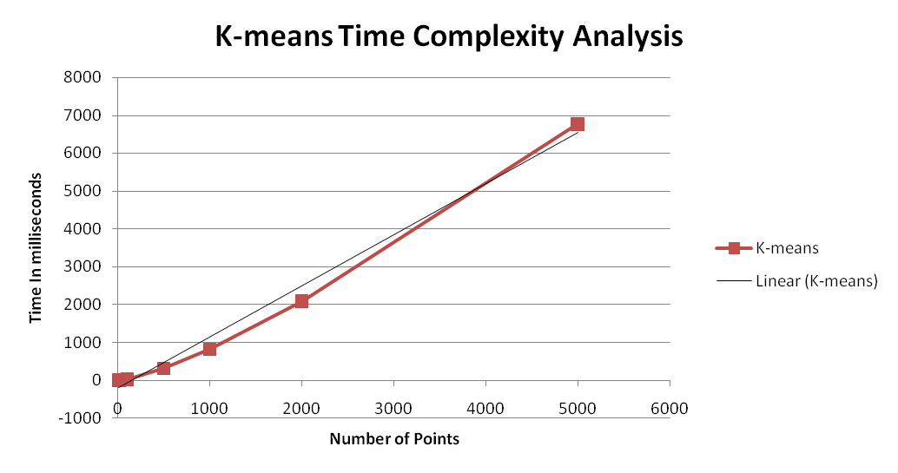
Results

Slide 18
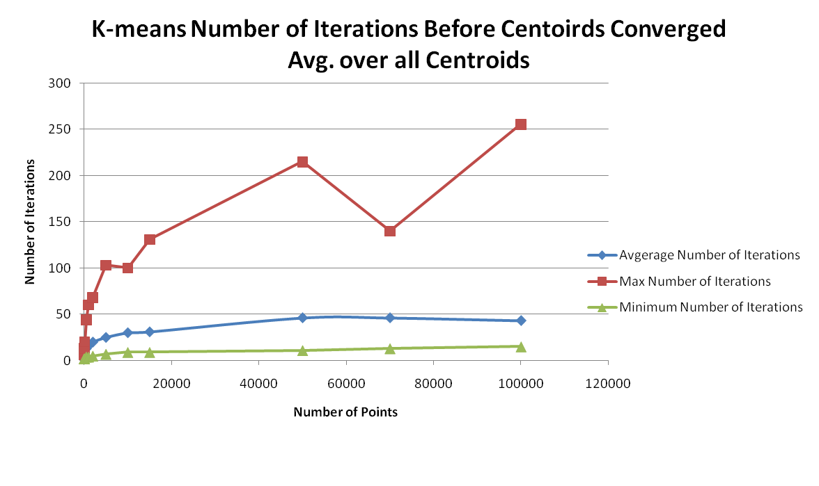
Results

Slide 19
Works Cited
Jain, A.K, Murty, M.N, Flynn, P.J. "Data Clustering: A review". ACM Computing Surveys, Vol 31,
No 3. Sept 1999. 30 Oct. 2008. <http://mutex.gmu.edu:2338/ft_gateway.cfm?id=331504&
type=pdf&coll=portal&dl=ACM&CFID=11772714&CFTOKEN=25758562>
"Data Clustering." Wikipedia: The Free Encyclopedia. 12 Nov 2008. 18 Nov
2008. <http://en.wikipedia.org/wiki/Data_clustering>
"k-means algorithm." Wikipedia: The Free Encyclopedia. 12 Nov 2008. 18 Nov
2008. http://en.wikipedia.org/wiki/K-means
"R-tree." Wikipedia: The Free Encyclopedia. 12 Nov 2008. 18 Nov
2008. http://en.wikipedia.org/wiki/R-tree
“A Tutorial on Clustering Algorithms”. 12 Nov 2008. http://home.dei.polimi.it/matteucc/Clustering/tutorial_html/index.html
Monz, Christof. “Machine Learning for Data Mining Week 6: Clustering”. 11 Dec 2008. http://www.dcs.qmul.ac.uk/~christof/html/courses/ml4dm/week06-clustering-4pp.pdf

