Slide 1
TP2 – Automaton
the Nit
Finite State Machine
Library
a simple library to make manipulations over automata

Slide 2
Using the FSM library
I . Automaton creation
Valid alphabet definition
States definition
II. Automaton execution (2 modes)
« Synchronous », input : sequence of symbols
« Asynchronous », input : symbol
III. Case study

Slide 3
Define alphabet
#define alphabet – list of symbols allowed
var alphabet = new Alphabet[ResourceLocator]
alphabet.add(symbolA) #symbol must be a ResourceLocator
alphabet.add(symbolB)
#builder – assist automaton (on this alphabet) creation
var automaton_bldr = new Fsm_Builder[ResourceLocator](alphabet)

Slide 4
Construct automaton
#create initial state – e.g. Index page
automaton_bldr.get_state_builder(state_index).
          set_initial(true).
          on_enter(new PageEnter_Index).
          on_exit(new PageExit_Index).
          set_transition(urlProduct, state_product).
          set_transition(urlCart, state_cart).
          commit
#other states declarations
var automaton = automaton_bldr.build

Slide 5
Execute automaton
« synchronously »
#Input sequence definition – only ResourceLocator
var sequence : new List[ResourceLocator]
sequence.add(symbolY) #symbol must be a ResourceLocator
sequence.add(symbolZ)
automaton.start
automaton.accept_word(sequence)

Slide 6
Combine automata 1/2
Union : C = A ∪ B
→Lc = LA + LB
→ensemble des mots mot de LA et des mots de LB
Exemple:
var fsa_sum = new CompositeAutomaton(left : AbstractAutomaton[Object], right : AbstractAutomaton[Object], new FsmOperation.union)
automaton.start
automaton.accept_word(hybrid_sequence)

Slide 7
Combine automata 2/2
Concaténation : C = A ∙ B
→Lc = LA x LB
→ensemble des mots qui sont la concaténation d'un mot de LA et d'un mot de LB
Exemple:
var fsa_product = new CompositeAutomaton(left : AbstractAutomaton[Object], right : AbstractAutomaton[Object], new FsmOperation.concat)
automaton.start
automaton.accept_word(hybrid_sequence)

Slide 8
Export automaton
Dot
Exemple:
fsa_shop.export("automaton_shop", "blue")
fsa_buy.export("automaton_buy", "red")
fsa_sum.export("automaton_sum", "purple")
fsa_product.export("automaton_product", "orange")

Slide 9
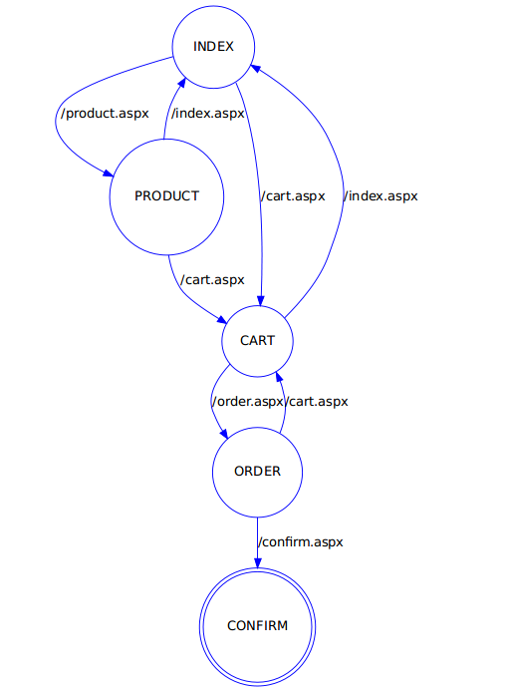
Etude de cas
Amazon©

Slide 10
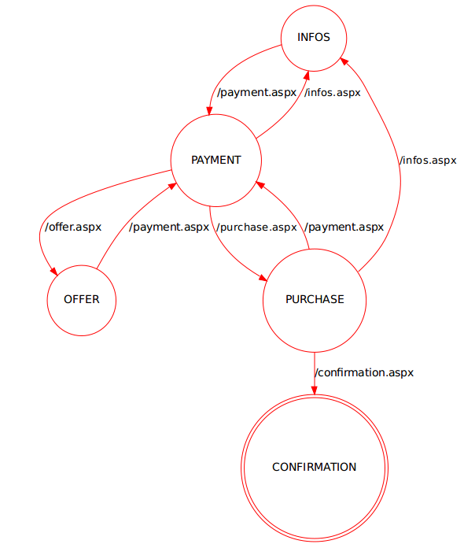
Etude de cas
PayPal©

Slide 11
Etude de cas
Mr.Dupont
Simple processus
    1. Shopping on Amazon©
    2. Payment with PayPal©
    Operation → concatenation
More complex processus
    1. Shopping on AliBaba© , Amazon© or something else
    Operation → union
    2. Payment with PayPal© or MasterCard©
    Combinaison : concatenation

