Slide 1




Slide 2
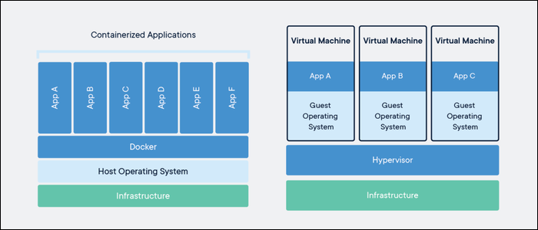
Why do we need Docker
Single immutable Image.
The image contains the application dependencies.
Your application is now code only. No UI for setting up the application or installing it.
Slim and trimmed! - .NET Core image size is typical between 50 and 250MB
Easy maintainable

Slide 3
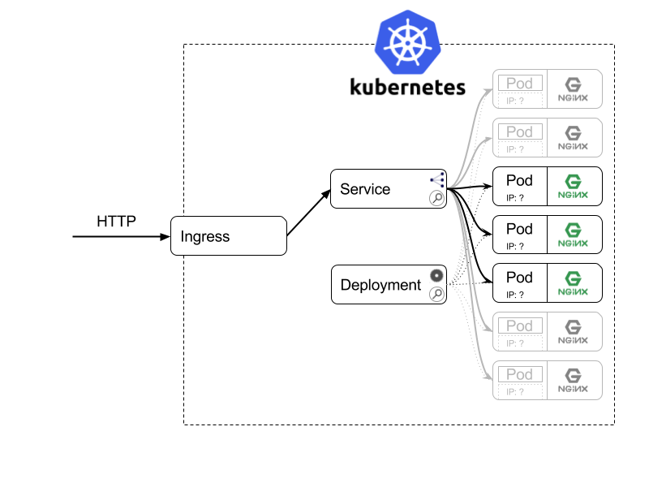
Why do we need Kubernetes
Your own Automated Ops engineer to do micromanagement.
  Health Checks
  Automated restarts
  Reschedule if a server dies
  Route traffic to correct container
Kubernetes is becoming the defacto standard and works across most on premise and cloud providers.
And besides this.. A LOT MORE
  Certificate management
  Advanced network security policies
  Enforced deployment policies
  Security policies
  Application isolation
  Rolling upgrades
  High available
  Access and resource management
  Custom operators to support databases, blob storage and even Hyperconverged storage solutions

Slide 4
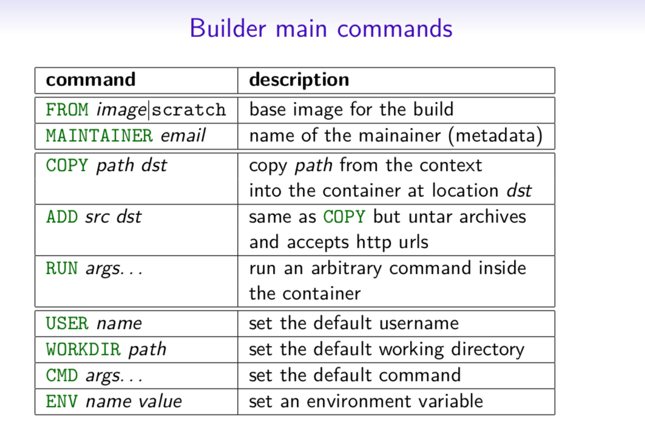
Hello world

Slide 5
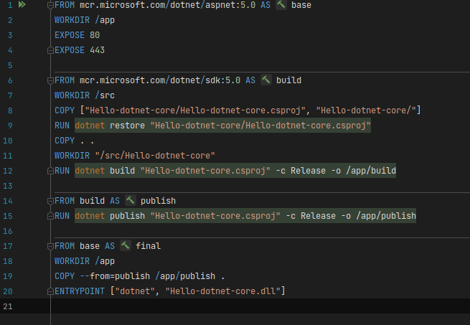
Create a real Dockerfile

Slide 6
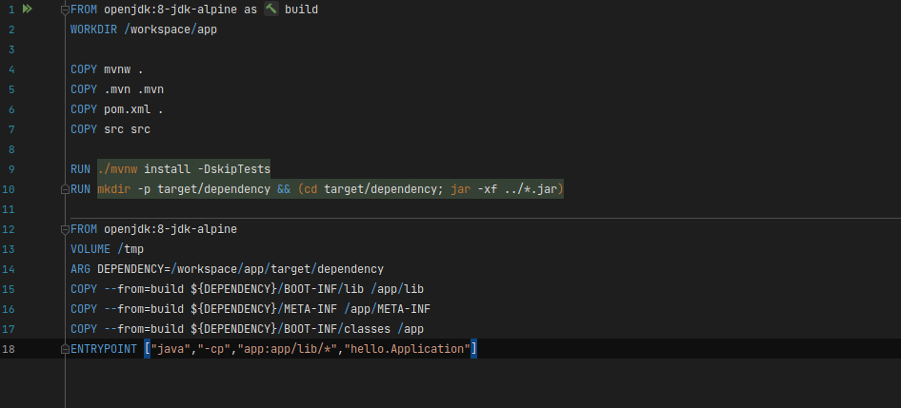
Spring boot?

Slide 7
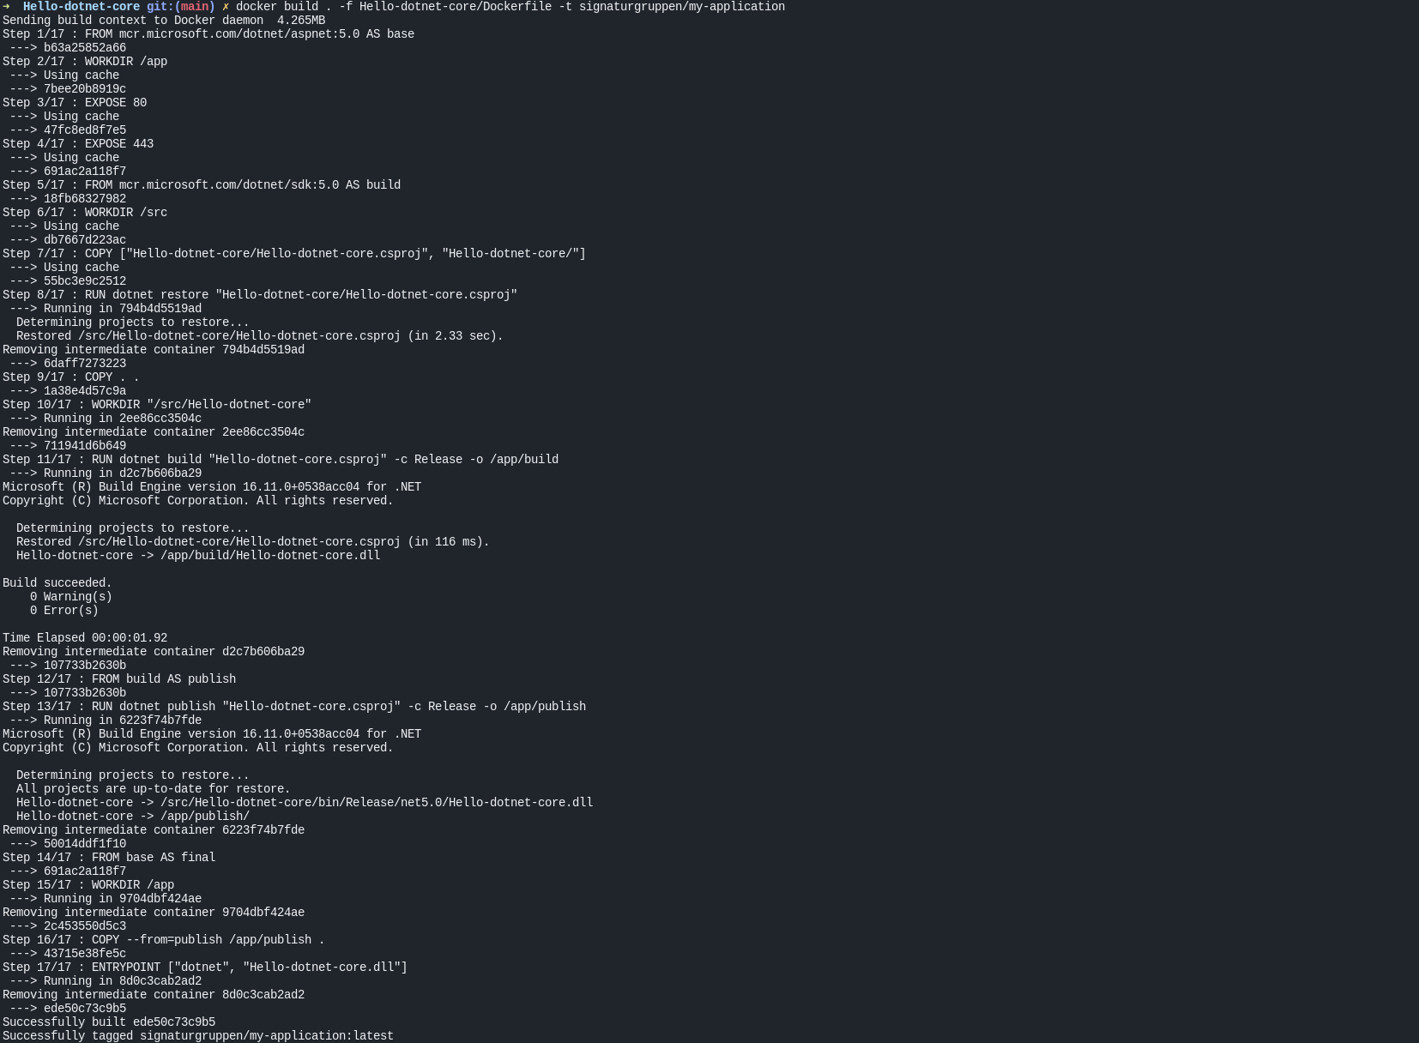
Create the image
Docker build .
  -f dockerfile.my-app
  -t signaturgruppen/ my-application

