Slide 1
Data Scientist Professional Practical Exam Representation
Recipe Site Traffic

Slide 2
Business Goals
Tasty Bytes has established for over two years and is a search engine platform for food recipes.
Creating more attractive recipes will bring more subscribers for the business.
The product team wants to
Determine which recipes will be popular with 80% accuracy.
Reduce the probability of showing less popular recipes.

Slide 3
Model Development
K Nearest Neighbors
Logistic Regression
Decision Tree
Random Forest
Support Vector Machine
XGBoost
MODELS
METRIC
Accuracy Score

Slide 4
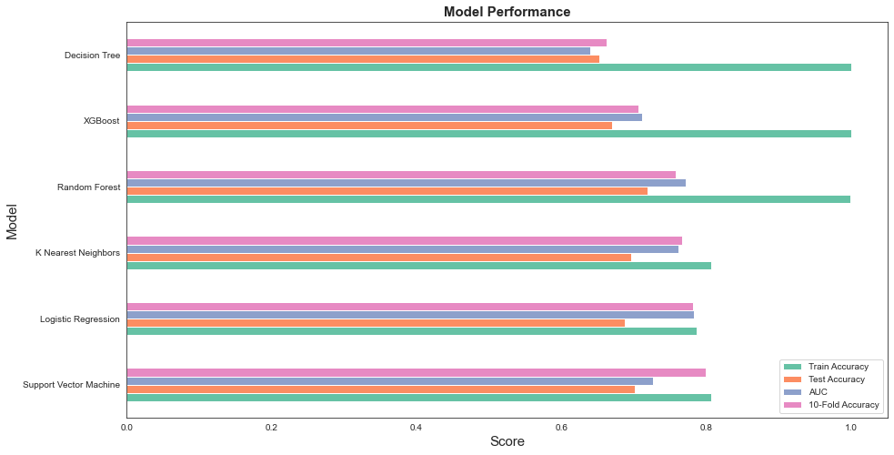
Model Performance
Based on AUC and Average Accuracy score using 10-fold cross-validation, Logistic Regression, K Nearest Neighbors, and Support Vector Machine have better performance.
Though, these models are a little overfitting.

Slide 5
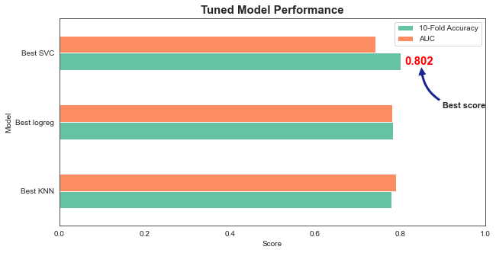
Hyperparameter Tuning
Use GridSearchCV and RandomizedSearchCV to tune hyperparameters from each model.
Support Vector Machine provides the highest accuracy score (80%).

Slide 6
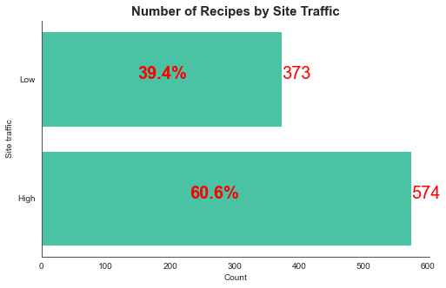
AUC vs Accuracy
SVC has higher Accuracy but lower AUC.
However, the target variable data is pretty balanced (60% vs 40%), so Accuracy score is a better metric.
Accuracy

Slide 7
Recommendations
First, collect more data since the original data is kind of small.
More importantly, collect data more correctly because there are many inappropriate values in the dataset.
Collect more features such as price, time to make a recipe, and other nutrients like fat.
Besides building learning models, conduct A/B test to check if some other features have an impact on the site traffic.

Slide 8
Thank you for watching

