Slide 1

IMPORTANCE OF LIFE PLANS AND MATERNALS CARE FRAMEWORK
>>>>>>>>>>>>
TEAM POPULATION GROWTH ANALYST

Slide 2

Topics and Highlights
Sustainable Development Goals
Introduction
Problem Statement
Objectives
Purpose
Source of Dataset

Slide 3




<<<<
Sustainable Development Goals
Goal 1: Proportion of the population below the international poverty line
Goal 2: To end hunger, achieve food security and improve nutrition and promote sustainable agriculture
Goal 3: Maternal mortality ration, adolescent birth rate per 1000 women in that age group
Goal 4: Proportion of children at the end of primary school achieving at least a minimum proficiency level in reading

Slide 4
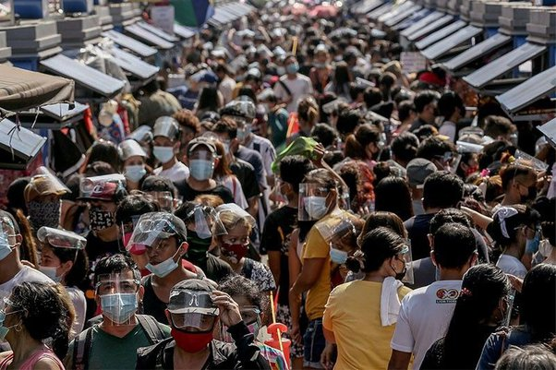
INTRODUCTION
The Philippines, a country of more than 70 million people and with a relatively high population growth rate, faces significant problems of poverty, unemployment and underemployment and particularly of environmental degradation.
_____________________________________
_________________________________________
LIFE PLANS AND MATERNAL CARE FRAMEWORK

Slide 5
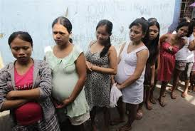
PROBLEM STATEMENT
The biggest problem discussed in this study is the continuous increase in the number of population in the Philippines. Reasons why this happens, or who is often the victim of such a situation. Whether Filipinos are still able to maintain their safety even though they are pregnant despite the severity caused by the pandemic. The study focused on some specific areas.

Slide 6
OBJECTIVES >>>>>
Registered Live Births in the Philippines(2021)
Objective 1
In 2020, a total of 1,528,684 live births were registered, which is equivalent to a crude birth rate (CBR) of 14.1 or 14 births per thousand population. The number of registered live births showed a generally decreasing trend. A decrease of -14.6 percent in the registered live births was noted in the past eight years, from 1,790,367 in 2012 to 1,528,684 in 2020. The highest decline rate was noted in 2020 (-8.7%) compared to the total registered live births of 1,673,923 in 2019.
Objective 2
Summary
Efficacy of RH LAW (2018)
Objective 1
Objective 2
Summary

Slide 7
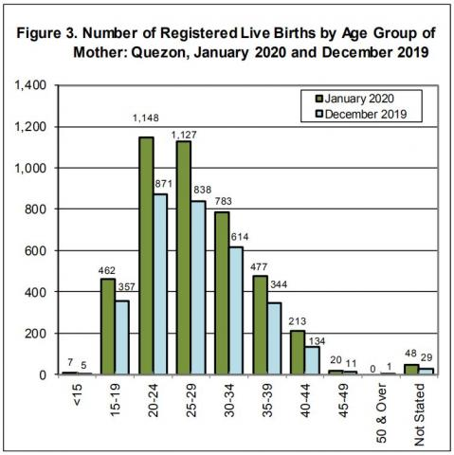
Registered Live Births in the Philippines(2021)
Objective 1
Objective 2
Summary
Efficacy of RH LAW (2018)
Objective 1
Objective 2
Summary
>>>>>

Slide 8
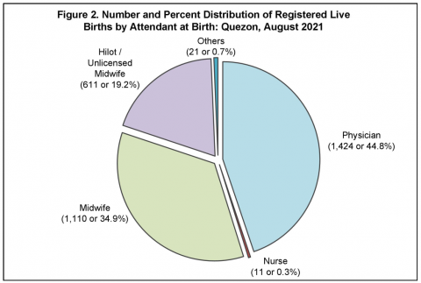
Registered Live Births in the Philippines(2021)
Objective 1
Objective 2
Summary
Efficacy of RH LAW (2018)
Objective 1
Objective 2
Summary
>>>>>

Slide 9
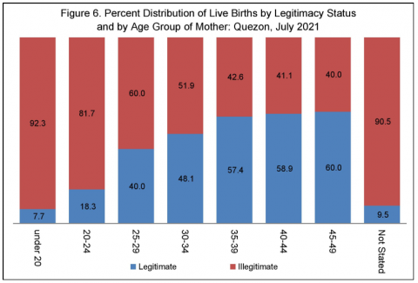
Registered Live Births in the Philippines(2021)
Objective 1
Objective 2
Summary
Efficacy of RH LAW (2018)
Objective 1
Objective 2
Summary

Slide 10
Registered Live Births in the Philippines(2021)
Data on births presented in this release were obtained from the timely and late registered births at the Office of the City/Municipal Civil Registrars all throughout the country and submitted to the Office of the Civil Registrar General through the Philippine Statistics Authority (PSA) -Provincial Statistical Offices (PSOs). Information presented includes registered births that occurred from January to December 2020 (cut-off date is as of 16 July 2021 on the submission of encoded data files to the PSA-Central Office from PSOs). Figures presented herein are not adjusted for under registration. Births of Filipinos abroad which were reported to the Philippine Foreign Service Posts are presented in a separate report.
Objective 1
Objective 2
Summary
Efficacy of RH LAW (2018)
Objective 1
Objective 2
Summary
>>>>>

Slide 11
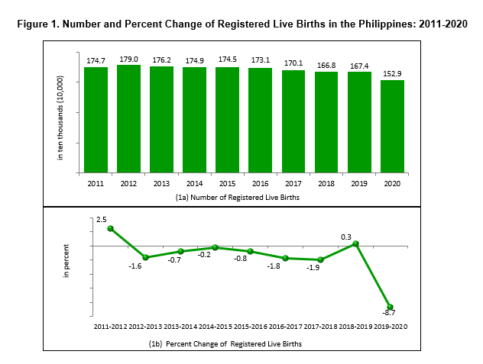
Registered Live Births in the Philippines(2021)
Objective 1
Objective 2
Summary
Efficacy of RH LAW (2018)
Objective 1
Objective 2
Summary
>>>>>

Slide 12
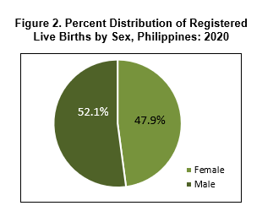
Registered Live Births in the Philippines(2021)
Objective 1
Objective 2
Summary
Efficacy of RH LAW (2018)
Objective 1
Objective 2
Summary
>>>>>

Slide 13
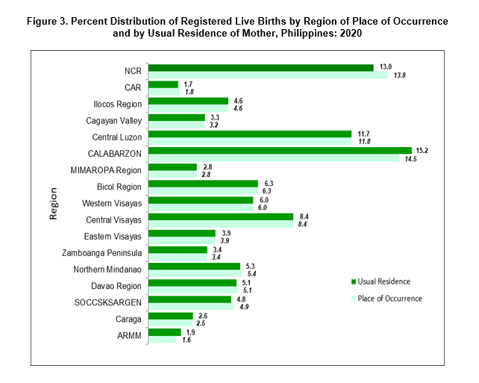
Registered Live Births in the Philippines(2021)
Objective 1
Objective 2
Summary
Efficacy of RH LAW (2018)
Objective 1
Objective 2
Summary
>>>>>

Slide 14
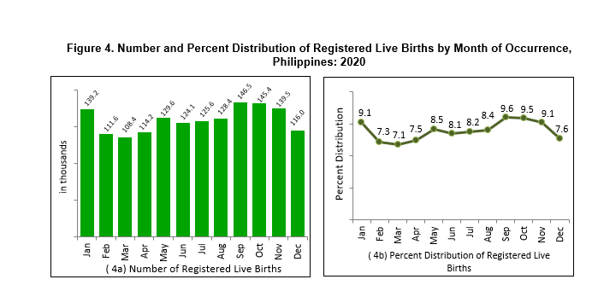
Registered Live Births in the Philippines(2021)
Objective 1
Objective 2
Summary
Efficacy of RH LAW (2018)
Objective 1
Objective 2
Summary
>>>>>

Slide 15
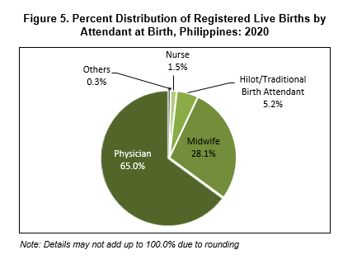
Registered Live Births in the Philippines(2021)
Objective 1
Objective 2
Summary
Efficacy of RH LAW (2018)
Objective 1
Objective 2
Summary
>>>>>

Slide 16
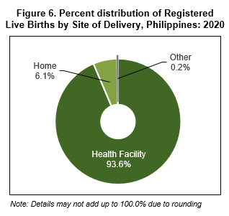
Registered Live Births in the Philippines(2021)
Objective 1
Objective 2
Summary
Efficacy of RH LAW (2018)
Objective 1
Objective 2
Summary
>>>>>

Slide 17
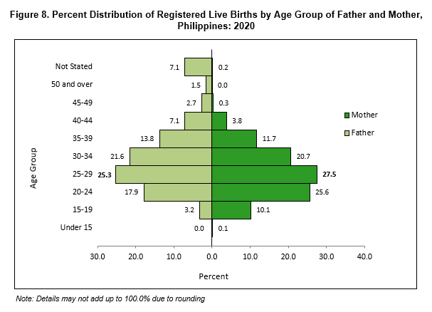
Registered Live Births in the Philippines(2021)
Objective 1
Objective 2
Summary
Efficacy of RH LAW (2018)
Objective 1
Objective 2
Summary
>>>>>

Slide 18
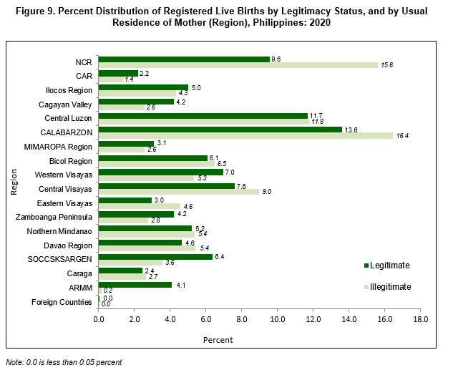
Registered Live Births in the Philippines(2021)
Objective 1
Objective 2
Summary
Efficacy of RH LAW (2018)
Objective 1
Objective 2
Summary
>>>>>

Slide 19
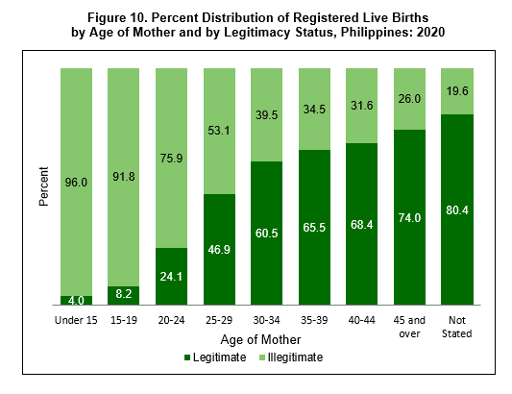
Registered Live Births in the Philippines(2021)
Objective 1
Objective 2
Summary
Efficacy of RH LAW (2018)
Objective 1
Objective 2
Summary
>>>>>

Slide 20
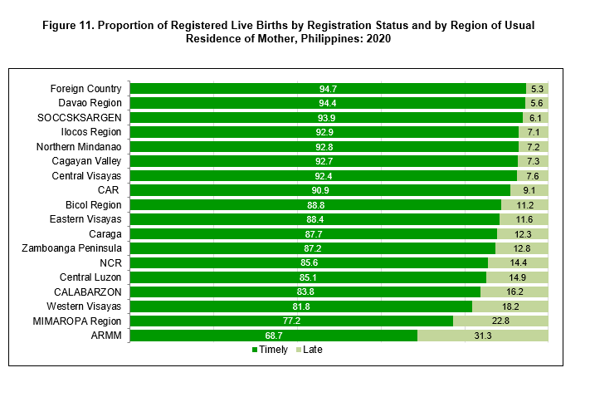
Registered Live Births in the Philippines(2021)
Objective 1
Objective 2
Summary
Efficacy of RH LAW (2018)
Objective 1
Objective 2
Summary

Slide 21
Registered Live Births in the Philippines(2021)
According to the graphs stated in each of these objectives, each result shows the data gathered regarding each of the studies obtained by the researchers or by the government agency itself focused on the information stated here. It is clear that with each change of the year, the population here in the Philippines also continues to increase. Having a general record will greatly help every reader to understand one of the reasons why our dear Philippines is having or experiencing poverty that produces results that our society does not expect.
Objective 1
Objective 2
Summary
Efficacy of RH LAW (2018)
Objective 1
Objective 2
Summary

Slide 22
Registered Live Births in the Philippines(2021)
The exhilarating news is that the increase in our population growth rate (PGR) in 2021 is the lowest in 75 years at 0.3 percent since the 1945-1946 period. The increase is minimal at 324,000 new Filipinos, or 2 million less than what was earlier projected based on a 1.63 percent PGR.
Objective 1
Objective 2
Summary
Efficacy of RH LAW (2018)
Objective 1
Objective 2
Summary
>>>>>

Slide 23
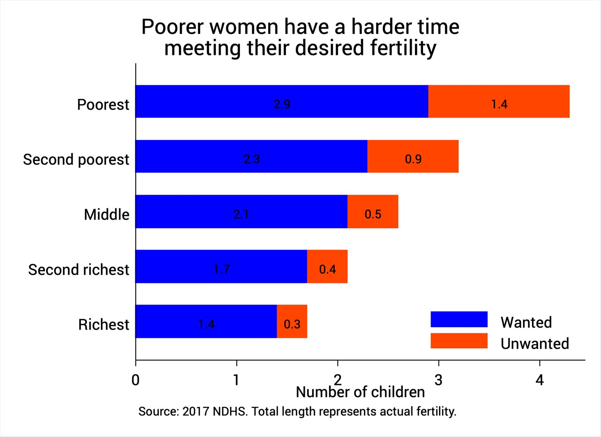
Registered Live Births in the Philippines(2021)
Objective 1
Objective 2
Summary
Efficacy of RH LAW (2018)
Objective 1
Objective 2
Summary
>>>>>

Slide 24
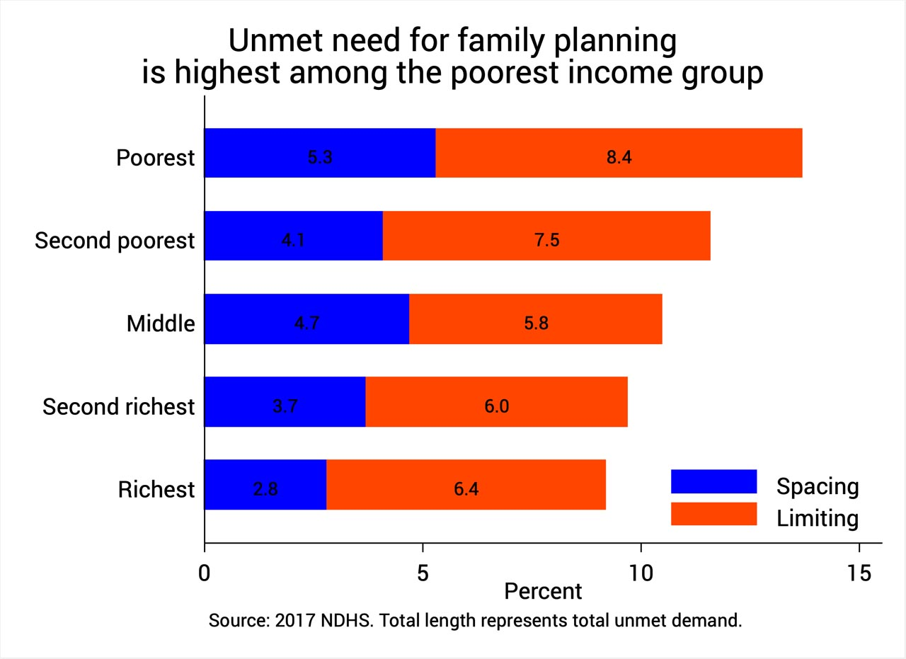
Registered Live Births in the Philippines(2021)
Objective 1
Objective 2
Summary
Efficacy of RH LAW (2018)
Objective 1
Objective 2
Summary

Slide 25
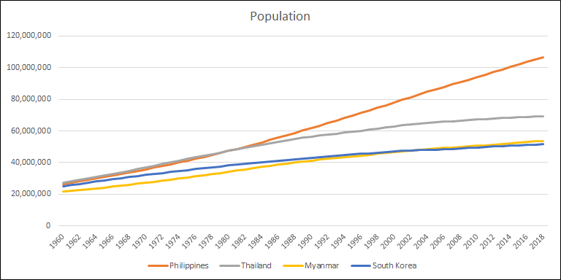
Registered Live Births in the Philippines(2021)
Objective 1
Objective 2
Summary
Efficacy of RH LAW (2018)
Objective 1
Objective 2
Summary
>>>>>

Slide 26
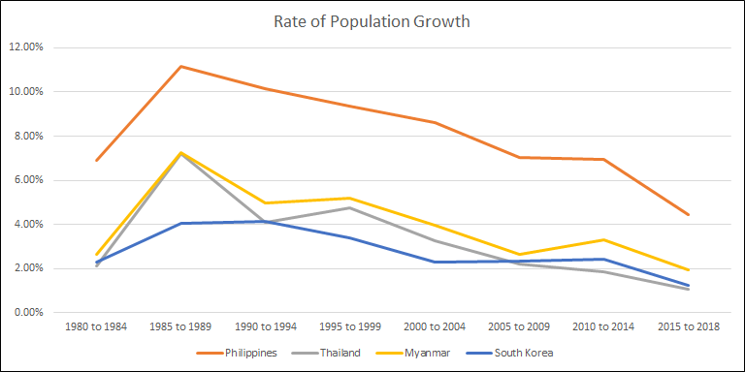
Registered Live Births in the Philippines(2021)
Objective 1
Objective 2
Summary
Efficacy of RH LAW (2018)
Objective 1
Objective 2
Summary
>>>>>

Slide 27
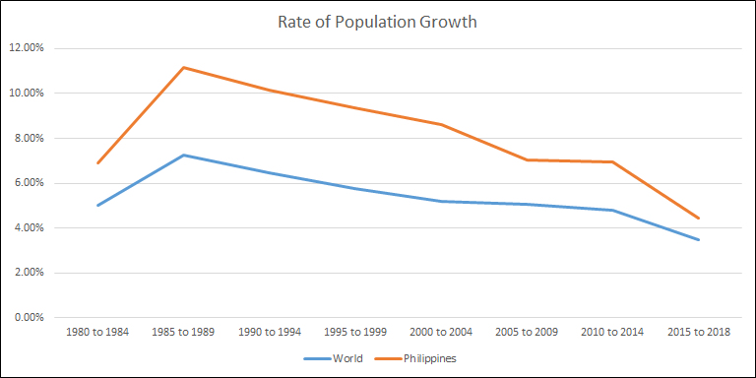
Registered Live Births in the Philippines(2021)
Objective 1
Objective 2
Summary
Efficacy of RH LAW (2018)
Objective 1
Objective 2
Summary
>>>>>

Slide 28
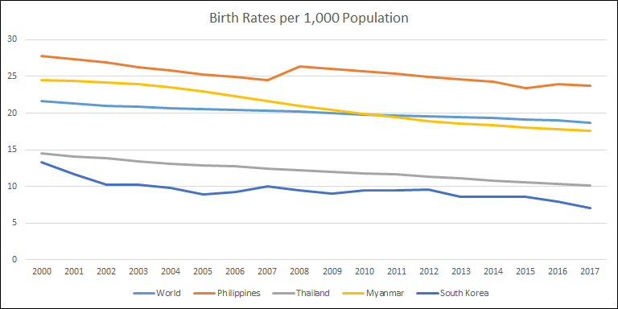
Registered Live Births in the Philippines(2021)
Objective 1
Objective 2
Summary
Efficacy of RH LAW (2018)
Objective 1
Objective 2
Summary
>>>>>

Slide 29
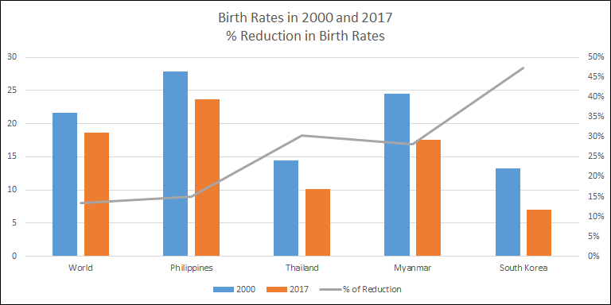
Registered Live Births in the Philippines(2021)
Objective 1
Objective 2
Summary
Efficacy of RH LAW (2018)
Objective 1
Objective 2
Summary

Slide 30
Registered Live Births in the Philippines(2021)
According to the graphs stated in these objectives. it also clearly shows the results of studies about the continued growth of our population. Perhaps these graphs also show the difference between the results gathered in the Philippines and the results gathered in other countries. At present, this shows that the proposed law in the Philippines, which focuses on controlling the increase of the Filipino people in our country, really has an effect.
Objective 1
Objective 2
Summary
Efficacy of RH LAW (2018)
Objective 1
Objective 2
Summary

Slide 31
Purpose
>>>>>
The purpose of this study is to get the full details of the continuous increase of our population in our beloved Philippines. It also focuses on providing each result gathered in selected articles that provide factual information on this issue. Every person or citizen in our country should know every piece of information contained in these articles, so that they can be open to every possible result of the continuous increase in population here in the Philippines. Having enough information on each of these issues will help the Philippines to come up with a way and idea to reduce the poverty that the Filipino people continue to go through.
>>>>>

Slide 32
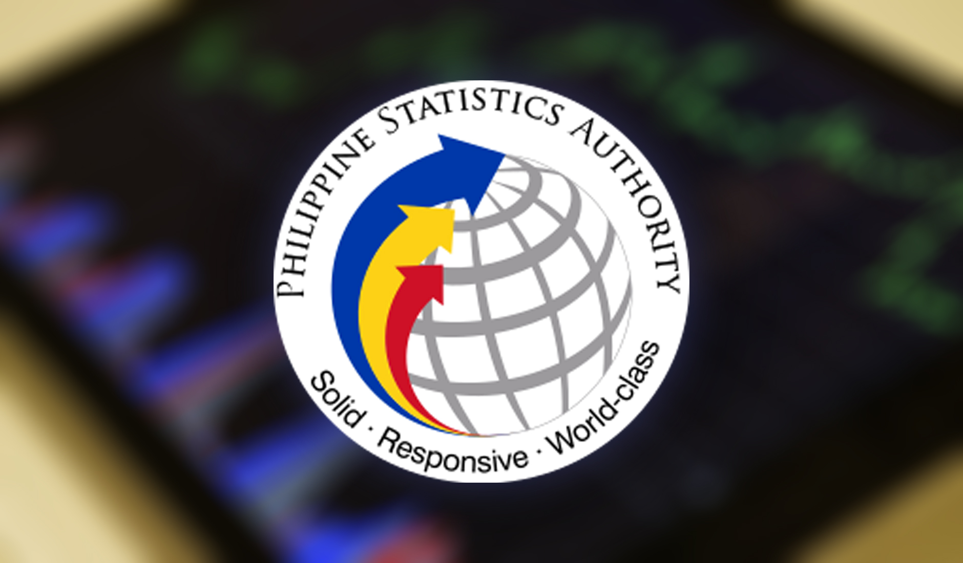

Source of dataset
It is a government agency dedicated to counting or analyzing the number of Filipinos who are registered or not. The role of this agency is important because of this, The people will be able to better understand every question of the people about the legal basis of the Filipino people in our society. _____________________________________
This is a legal law in our beloved philippines that aims to help control the ever -increasing population in our beloved philippines. _____________________________________

Slide 33


