Slide 1
SE325.K21 – Chuyên đề J2EE
Giving Spring Some Rest
(Spring in Action 3rd Edition)
Vương Thịnh Đạt – 17530343
Đinh Hoàng Nhi – 17520853
Đinh Hoàng Luôn – 17520727

Slide 2
Giving Spring Some Rest
A. Getting Rest
Fundamental & How Spring Support Rest
B. Writing Resource-oriented Controllers
Restless - Restful Controllers & Rest verbs
C. Representing Resources
Negotiating resource representation
HTTP message converters
D. Writing Rest Clients
Rest templates operations
GET – PUT – DELETE – POST resources
Exchanging resources
E. Submitting RESTful forms
Rendering hidden method fields in JSP
Unmasking the real requests

Slide 3
A. Getting Rest
Fundamental & How Spring Support Rest

Slide 4
A. Getting Rest
REST: Representational State Transfer
Representational: REST resources can be represented in virtually any form, including XML, JavaScript Object Notation (JSON), or even HTML — whatever form best suits the consumer of those resources.
State: When working with REST, we’re more concerned with the state of a resource than with the actions we can take against resources
Transfer: REST involves transferring resource data, in some representational form, from one application to another
REST is about transferring the state of resources
from a server to a client

Slide 5
A. Getting Rest
How Spring supports development of REST resources
Controllers can handle requests for all HTTP methods, including the four primary REST methods: GET, PUT, DELETE, and POST.
The new @PathVariable annotation enables controllers to handle requests for parameterized URLs.
The JSP tag from Spring’s form-binding JSP tag library, along with the new HiddenHttpMethodFilter.
Resources can be represented in a variety of ways using Spring’s view and view resolvers, including new view implementations for rendering model data as XML, JSON, Atom, and RSS.

Slide 6
B. Writing Resource - Oriented Controllers
Restless – Restful Controllers & Rest verbs

Slide 7
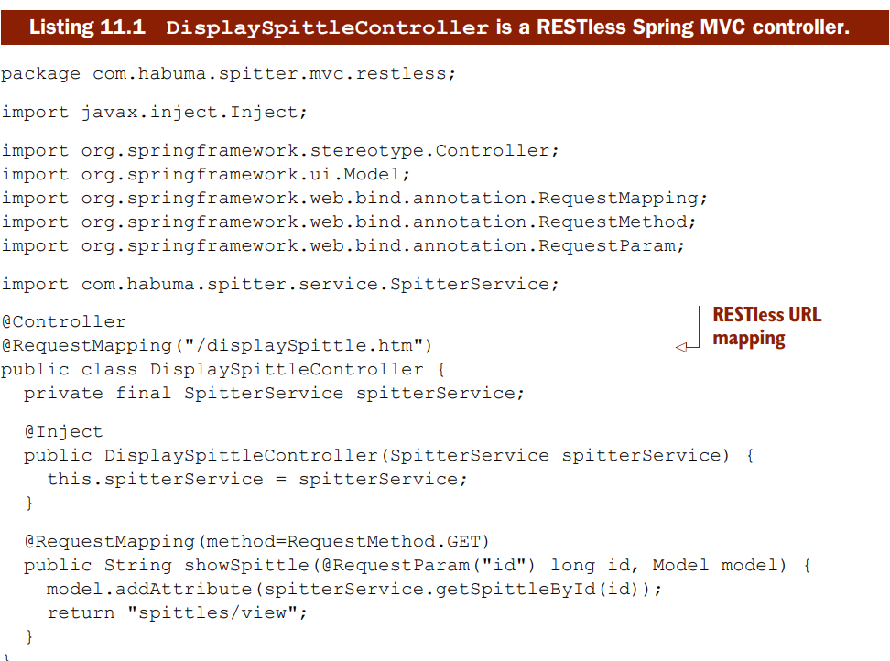
B. Writing Resource-oriented Controllers
Notes:
@RequestMapping annotation at the class level. It says that this controller will handle requests for /displaySpittle.htm. That seems to imply that this controller is focused on the specific use case of displaying spittles (which is corroborated by the name of the class). What’s more, the extension implies that it’s only capable of displaying that list in HTML form.
Nothing is terribly wrong with how DisplaySpittleController is written. But it isn’t a RESTful controller. It’s action-oriented and focused on a specific use case: displaying a Spittle object’s details in HTML form. Even the controller’s class name agrees.

Slide 8
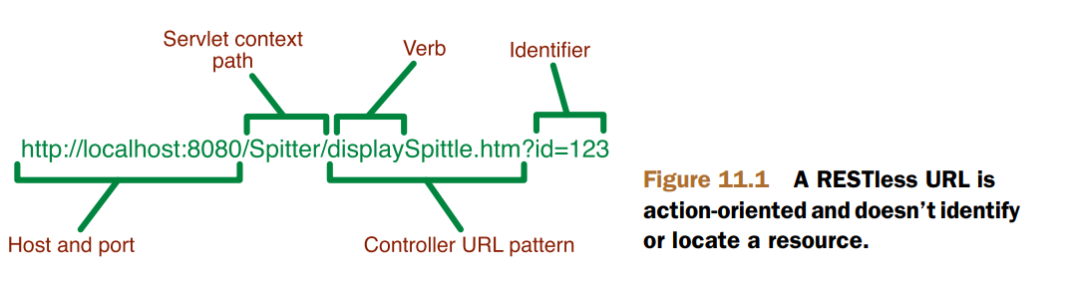
B. Writing Resource-oriented Controllers
RESTless & RESTful URL
Many RESTless URLs don’t locate or identify anything — they make demands. Rather than identify a thing, they insist that some action be taken.

Slide 9
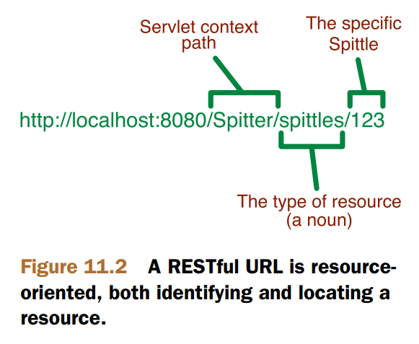
B. Writing Resource-oriented Controllers
RESTless & RESTful URL
RESTful URLs fully acknowledge that HTTP is all about resources. What it does will be depended on the HTTP methods.

Slide 10
B. Writing resource-oriented controllers
RESTful URL observation
http://localhost:8080 identifies a domain and port. Although our application won’t associate a resource with this URL.
http://localhost:8080/Spitter identifies the application’s servlet context. This URL is more specific in that it has identified an application running on the server.
http://localhost:8080/Spitter/spittles identifies a resource that represents a list of Spittle objects within the Spitter application.
http://localhost:8080/Spitter/spittles/123 is the most precise URL, identifying a specific Spittle resource.

Slide 11
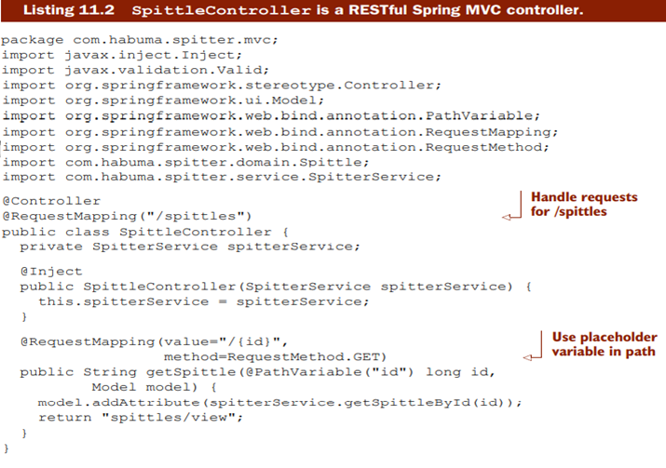
B. Writing resource-oriented controllers

Slide 12
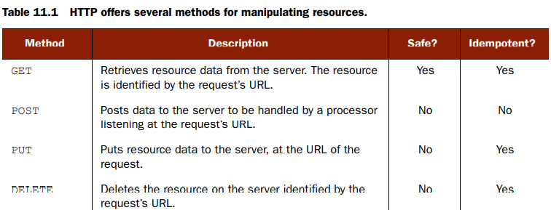
B. Writing resource-oriented controllers
REST verbs
REST is about the transfer of resource state. Therefore, we really only need a handful of verbs to be able to act upon those resources — verbs to transfer the state of a resource.

Slide 13
C. Representing Resources
Negotiating resource representation
HTTP message converters

Slide 14
C. Representing resources
Controllers usually don’t concern themselves with how resources will be represented. Controllers will deal with resources in terms of the Java objects that define them. But it’s not until after the controller has finished its works that the resource will be transformed into a form that best suits the client.
Spring provides two ways to transform a resource’s Java representation into the representation that will be shipped to the client:
Negotiated view-based rendering
- HTTP message converters

Slide 15
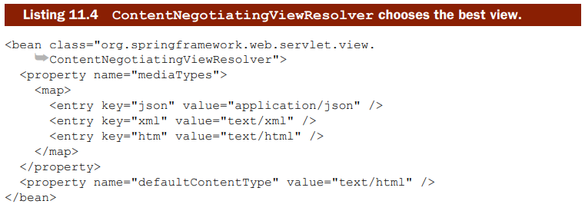
C. Representing resources
Negotiatied view base rendering
Spring’s ContentNegotiatingViewResolver is a special view resolver that takes the content type that the client wants into consideration.

Slide 16
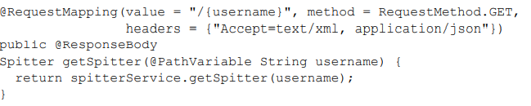
C. Representing resources
HTTP message converters
For example, suppose the client has indicated via the request’s Accept header that it can accept application/json. Assuming that the Jackson JSON library is in the application’s classpath, the object returned from the handler method will be given to the MappingJacksonHttpMessageConverter for conversion into a JSON representation to be returned to the client.

Slide 17
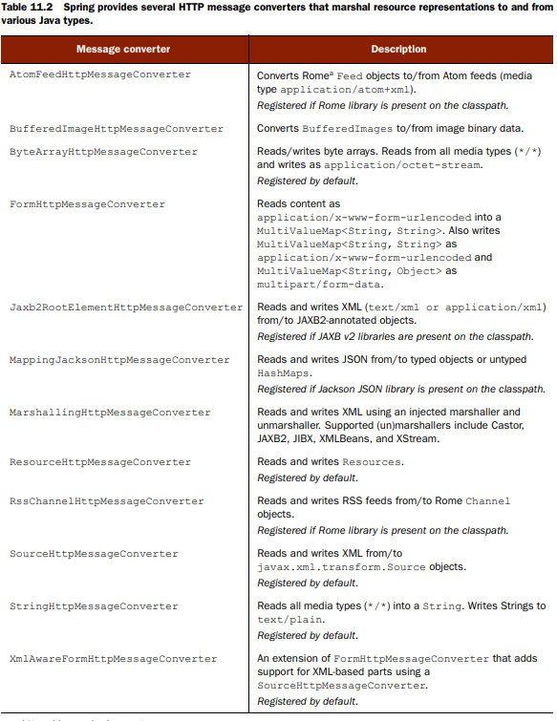

Slide 18
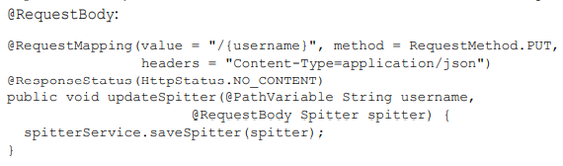
C. Representing resources
Receiving resources from request body
The request’s Content-Type header must be set to application/json
The Jackson JSON library must be available on the application’s classpath.
Notes:
When the request arrives, Spring MVC will see that the updateSpitter() is able to handle the request. But the message arrives as an XML document, and this method asks for a Spitter object. In this case, the MappingJacksonHttpMessageConverter may be chosen to convert the JSON message into a Spitter object. For that to work, the following criteria must be met:
The request’s Content-Type header must be set to application/json
The Jackson JSON library must be available on the application’s classpath.

Slide 19
D. Writing Rest Clients
Rest templates operations
GET – PUT – DELETE – POST resources
Exchanging resources

Slide 20
D. Writing Rest Clients
RestTemplate’s operations
Method | Description
delete() | Performs an HTTP DELETE on a resource at a specified URL.
exchange() | Executes a specified HTTP method against the URL, returning a ResponseEntity containing an object mapped from the response body.
execute() | Executes a specified HTTP method against the URL, returning an object mapped from the response body.
getForEntity() | Sends an HTTP GET request, returning a ResponseEntity containing the response body as mapped to an object.
getForObject() | GETs a resource, returning the response body as mapped to an object.

Slide 21
D. Writing Rest Clients
RestTemplate’s operations
Method | Description
headForHeaders() | Sends an HTTP HEAD request, returning the HTTP headers for the specified resource URL.
optionsForAllow() | Sends an HTTP OPTIONS request, returning the Allow header for the specified URL.
postForEntity() | POSTs data, returning a ResponseEntity that contains an object mapped from the response body.
postForLocation() | POSTs data, returning the URL of the new resource.
postForObject() | POSTs data, returning the response body as mapped to an object.
put() | PUTs a resource to the specified URL.

Slide 22
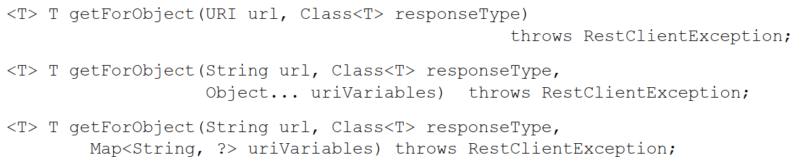
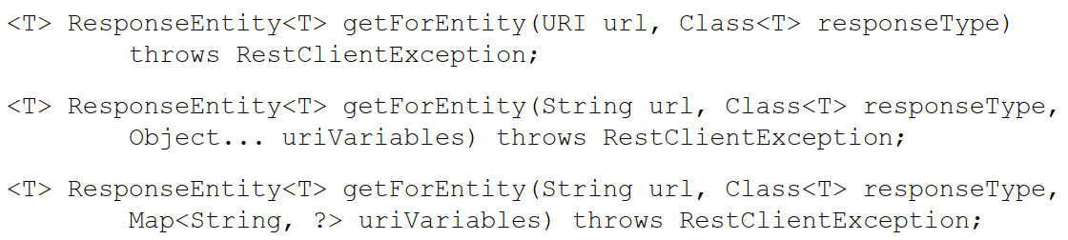
D. Writing Rest Clients
GETting resources - Defination
getForObject: Returns an object of the type requested
getForEntity: Returns that object along with
extra information about the response.

Slide 23
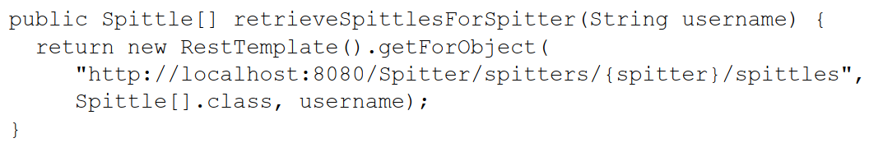
D. Writing Rest Clients
GETting resources – retrieve resources
Cannot put username parameter into a new map and replace username variable by the map!!!

Slide 24
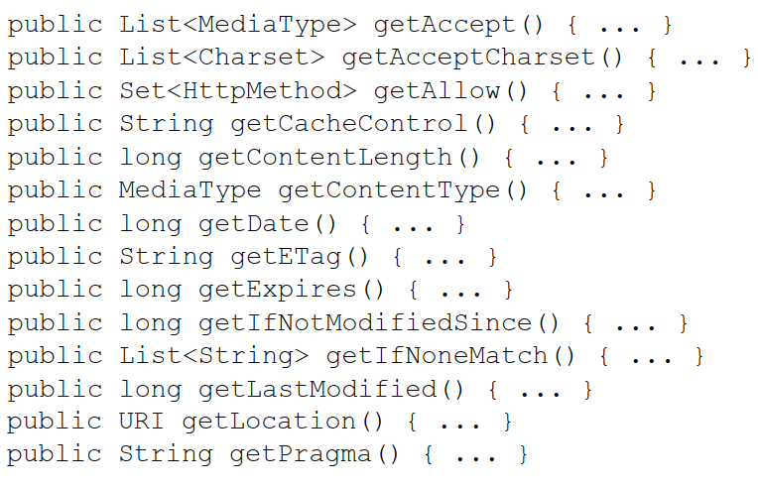
D. Writing Rest Clients
GETting resources – Extracting response metadata (getForEntity)
Headers

Slide 25
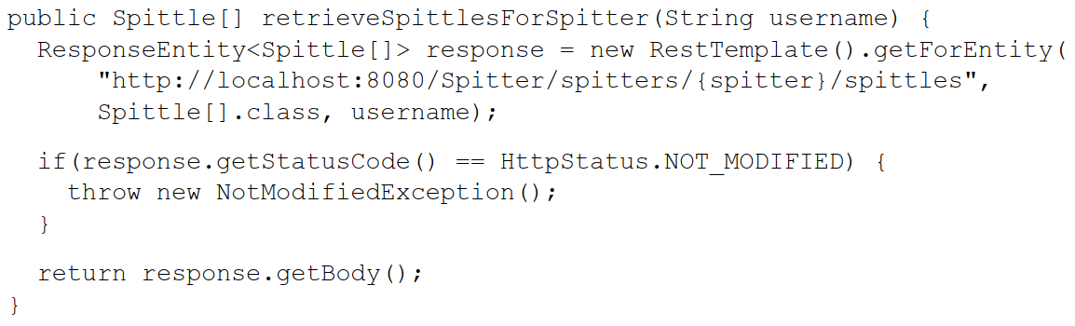
D. Writing Rest Clients
GETting resources – Extracting response metadata (getForEntity)
Response status

Slide 26
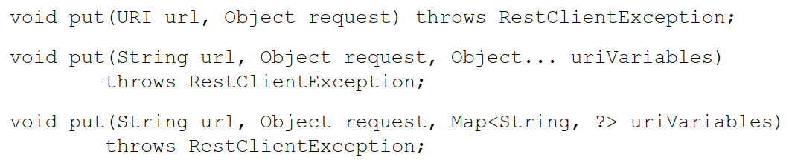
D. Writing Rest Clients
PUTting resources - Defination

Slide 27
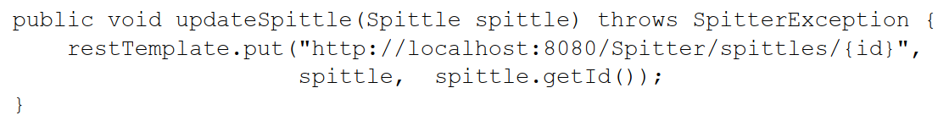
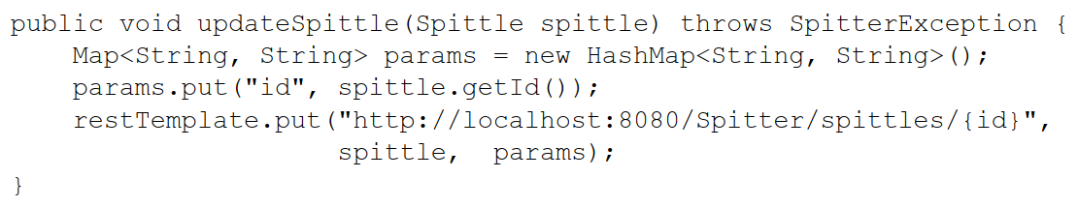
D. Writing Rest Clients
PUTting resources – How to use
Cannot put username parameter into a new map and replace username variable by the map!!!

Slide 28
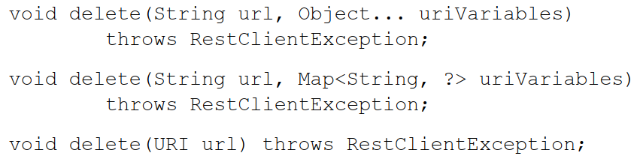
D. Writing Rest Clients
DELETE-ing resources - Defination

Slide 29
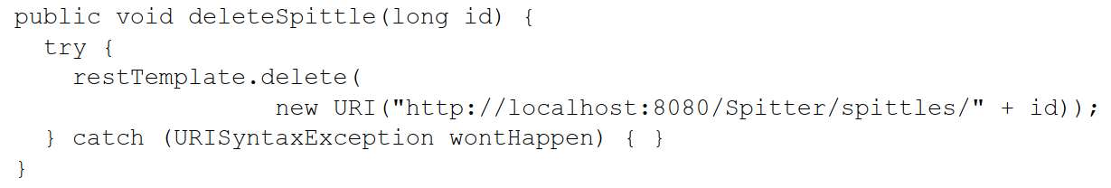
D. Writing Rest Clients
DELETE-ing resources – How to use
Cannot put username parameter into a new map and replace username variable by the map!!!

Slide 30
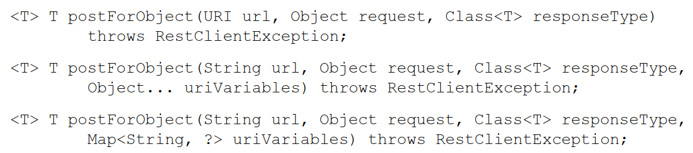
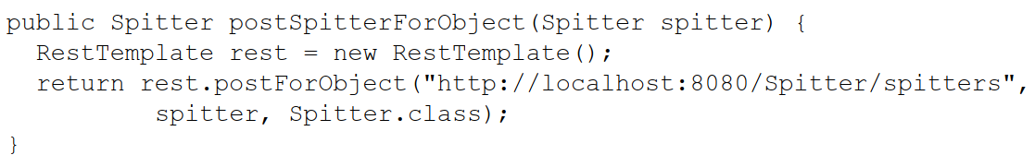
D. Writing Rest Clients
POSTing resource data – Defination & How to use (postForObject)
Defination
How to use

Slide 31
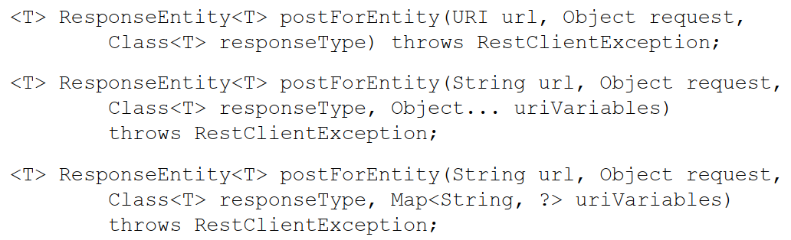
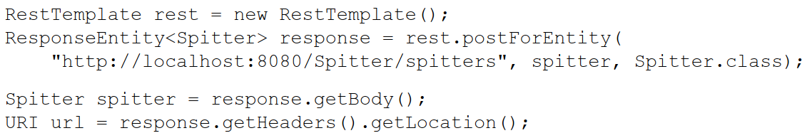
D. Writing Rest Clients
POSTing resource data – Defination & How to use (postForEntity)
Defination
How to use

Slide 32
D. Writing Rest Clients
POSTing resource data – Defination & How to use (postForEntity)
Defination
How to use

Slide 33
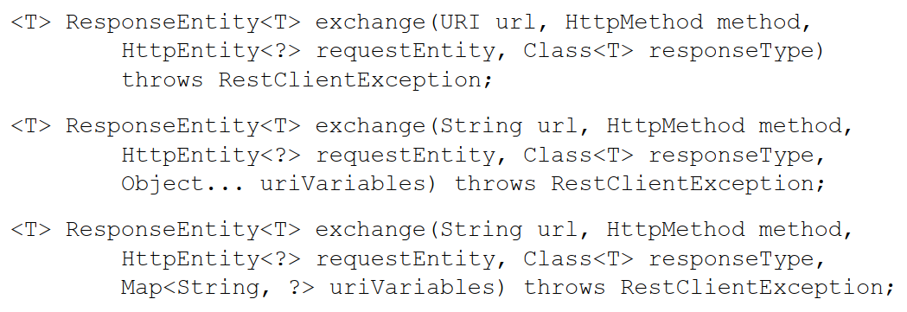
D. Writing Rest Clients
Exchanging resources – Defination

Slide 34
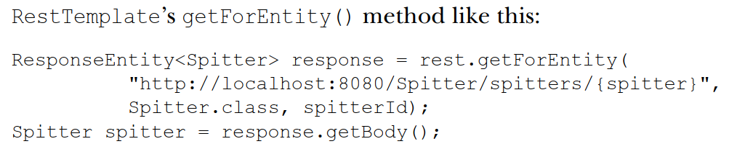
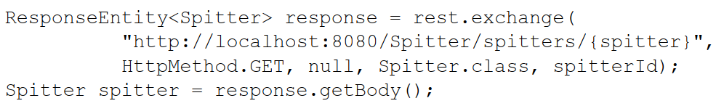
D. Writing Rest Clients
Exchanging resources – How to use
Get
Exchange

Slide 35
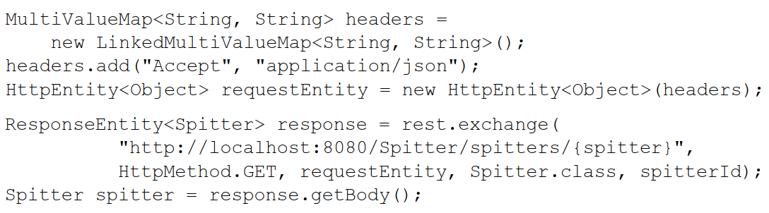
D. Writing Rest Clients
Exchanging resources – Difference with other methods
The request will be sent with specific Accept in above

Slide 36
E. Submitting RESTful forms
Rendering hidden method fields in JSP
Unmasking the real request

Slide 37
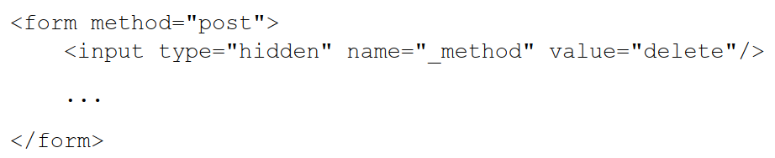
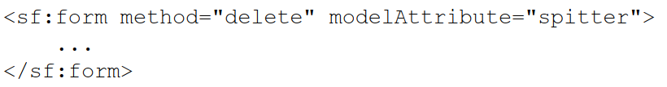
E. Submitting RESTful forms
Rendering hidden method fields in JSP

Slide 38
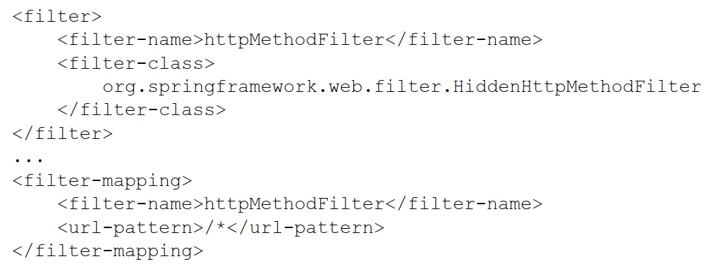
E. Submitting RESTful forms
Unmasking the real request

Slide 39
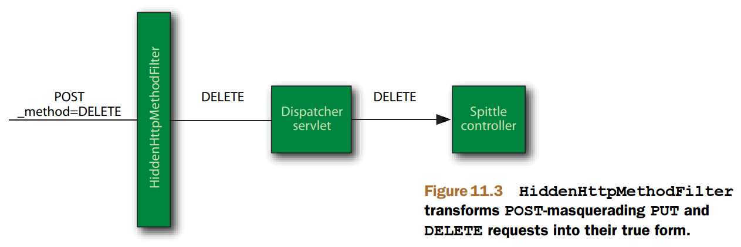
E. Submitting RESTful forms
Unmasking the real request

Slide 40
F. Demo
Restful Controllers
Restful Forms
New annotations in Spring 5.x.x

