Slide 1
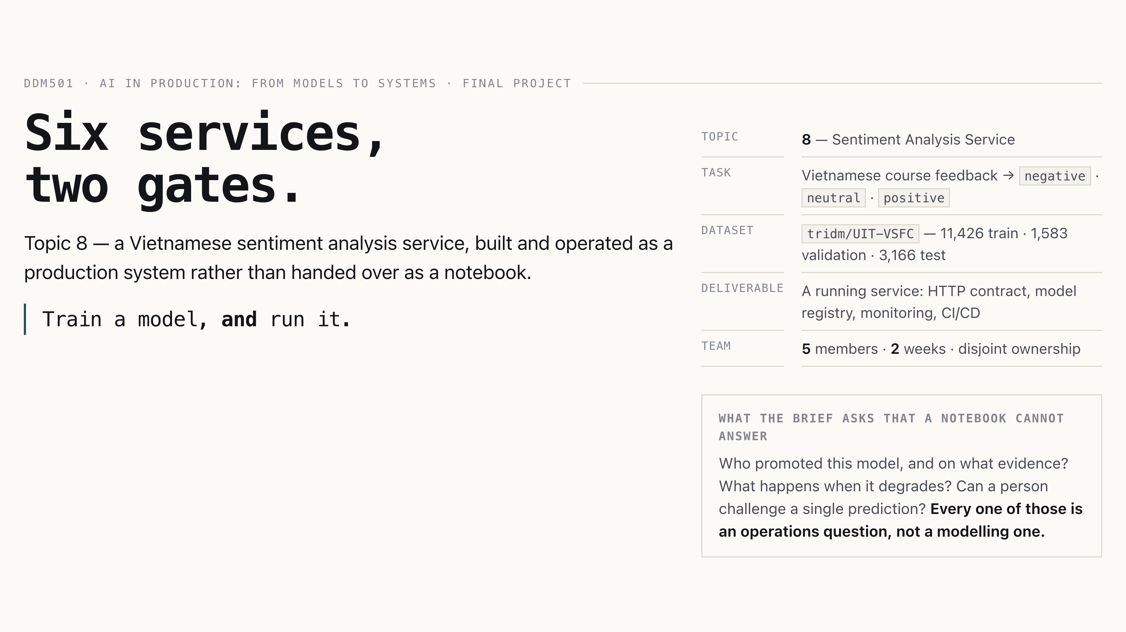
Six services,
two gates.
DDM501 · AI in Production: From Models to Systems · Final project
Six services,
two gates.
Topic 8 — a Vietnamese sentiment analysis service, built and operated as a
production system rather than handed over as a notebook.
Train a model, and run it.
topic
8 — Sentiment Analysis Service
task
Vietnamese course feedback → negative · neutral · positive
dataset
tridm/UIT-VSFC — 11,426 train · 1,583 validation · 3,166 test
deliverable
A running service: HTTP contract, model registry, monitoring, CI/CD
team
5 members · 2 weeks · disjoint ownership
what the brief asks that a notebook cannot answer
Who promoted this model, and on what evidence? What happens when it degrades?
Can a person challenge a single prediction? Every one of those is an
operations question, not a modelling one.
Notes:
[Intro] Nhiên · 1 min
0:55. Open here. Name the topic and the one framing that carries the
whole deck: the deliverable is a service, so the interesting work is what stops a bad model
from reaching a user. Do not mention metrics yet.

Slide 2
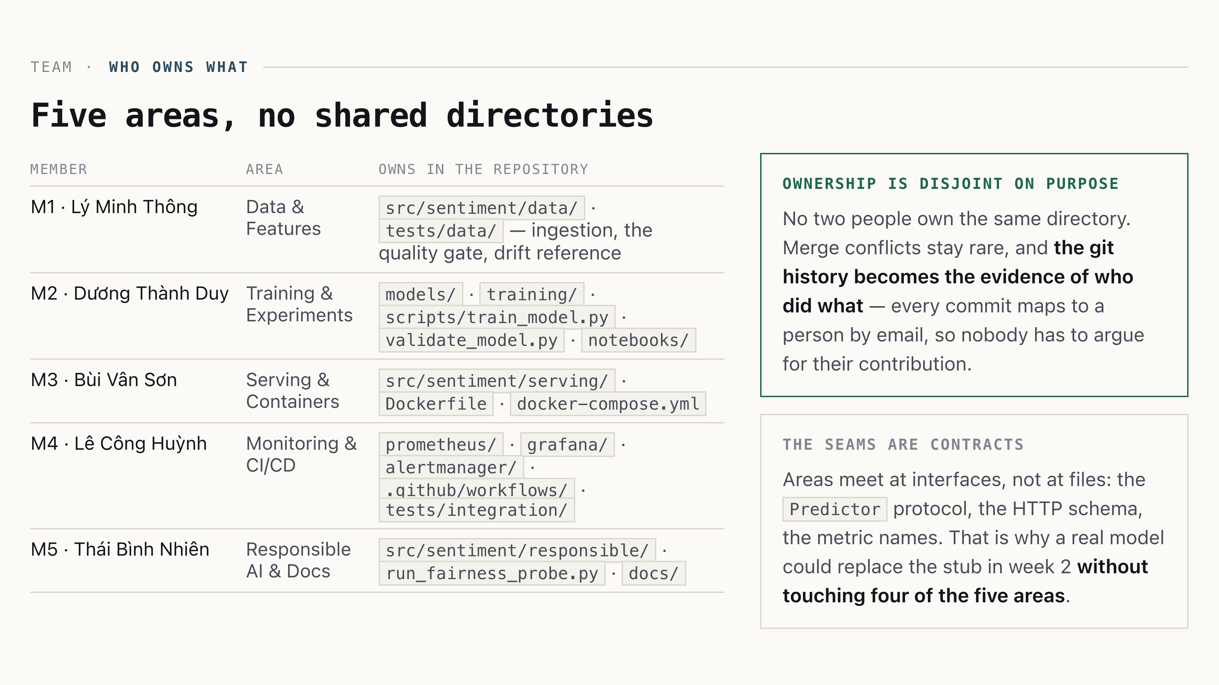
Five areas, no shared directories
Team · who owns what
Five areas, no shared directories
Member · Area · Owns in the repository
M1 · Lý Minh Thông · Data & Features · src/sentiment/data/ · tests/data/ — ingestion, the quality gate, drift reference
M2 · Dương Thành Duy · Training & Experiments · models/ · training/ · scripts/train_model.py · validate_model.py · notebooks/
M3 · Bùi Vân Sơn · Serving & Containers · src/sentiment/serving/ · Dockerfile · docker-compose.yml
M4 · Lê Công Huỳnh · Monitoring & CI/CD · prometheus/ · grafana/ · alertmanager/ · .github/workflows/ · tests/integration/
M5 · Thái Bình Nhiên · Responsible AI & Docs · src/sentiment/responsible/ · run_fairness_probe.py · docs/
ownership is disjoint on purpose
No two people own the same directory. Merge conflicts stay rare, and
the git history becomes the evidence of who did what — every commit
maps to a person by email, so nobody has to argue for their contribution.
the seams are contracts
Areas meet at interfaces, not at files: the Predictor protocol, the HTTP
schema, the metric names. That is why a real model could replace the stub in week 2
without touching four of the five areas.
Notes:
[Intro] Nhiên · 0.75 min
0:40. Ten seconds per person, no more — say the area and one thing they
own. The point of the slide is the two cards: ownership is verifiable, and the seams are
contracts. That is what made parallel work possible on a two-week deadline.

Slide 3
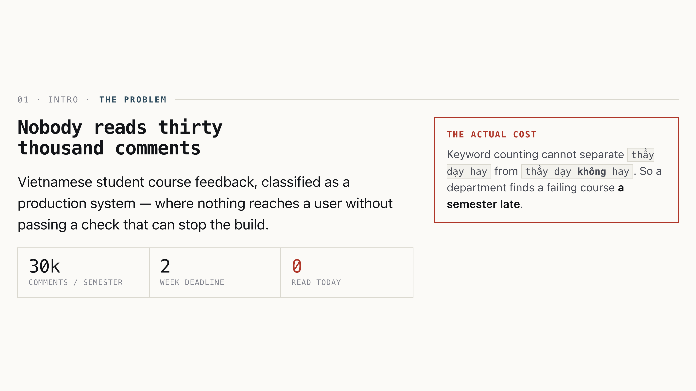
Nobody reads thirty thousand comments
01 · Intro · the problem
Nobody reads thirty thousand comments
Vietnamese student course feedback, classified as a production system — where nothing reaches a user without passing a check that can stop the build.
30kcomments / semester
2week deadline
0read today
the actual cost
Keyword counting cannot separate thầy dạy hay from thầy dạy không hay. So a department finds a failing course a semester late.
Notes:
[Intro] Nhiên · 0.75 min
0:45. Land the problem and the title's promise — "two gates" is the spine of the whole deck. No models yet.

Slide 4
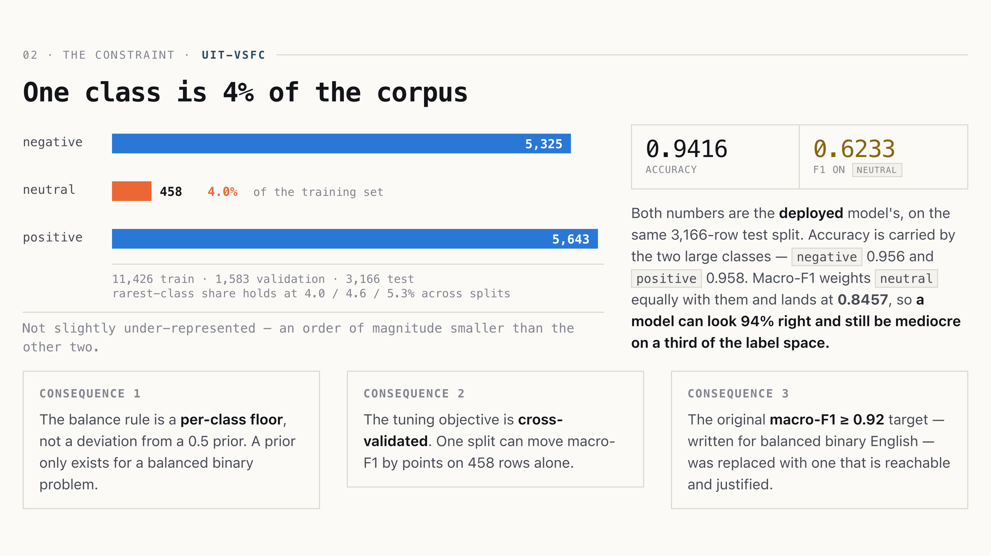
One class is 4% of the corpus
02 · The constraint · UIT-VSFC
One class is 4% of the corpus
Not slightly under-represented — an order of magnitude smaller than the other two.
0.9416accuracy
0.6233F1 on neutral
Both numbers are the deployed model's, on the same 3,166-row test split. Accuracy is carried by the two large classes — negative 0.956 and positive 0.958. Macro-F1 weights neutral equally with them and lands at 0.8457, so a model can look 94% right and still be mediocre on a third of the label space.
consequence 1
The balance rule is a per-class floor, not a deviation from a 0.5 prior. A prior only exists for a balanced binary problem.
consequence 2
The tuning objective is cross-validated. One split can move macro-F1 by points on 458 rows alone.
consequence 3
The original macro-F1 ≥ 0.92 target — written for balanced binary English — was replaced with one that is reachable and justified.
Notes:
[Intro] Thông · 1 min
1:00. The most important data slide. If they remember one number from your section, it is 4%. The three cards are the payoff — say “three decisions trace back to this”.

Slide 5
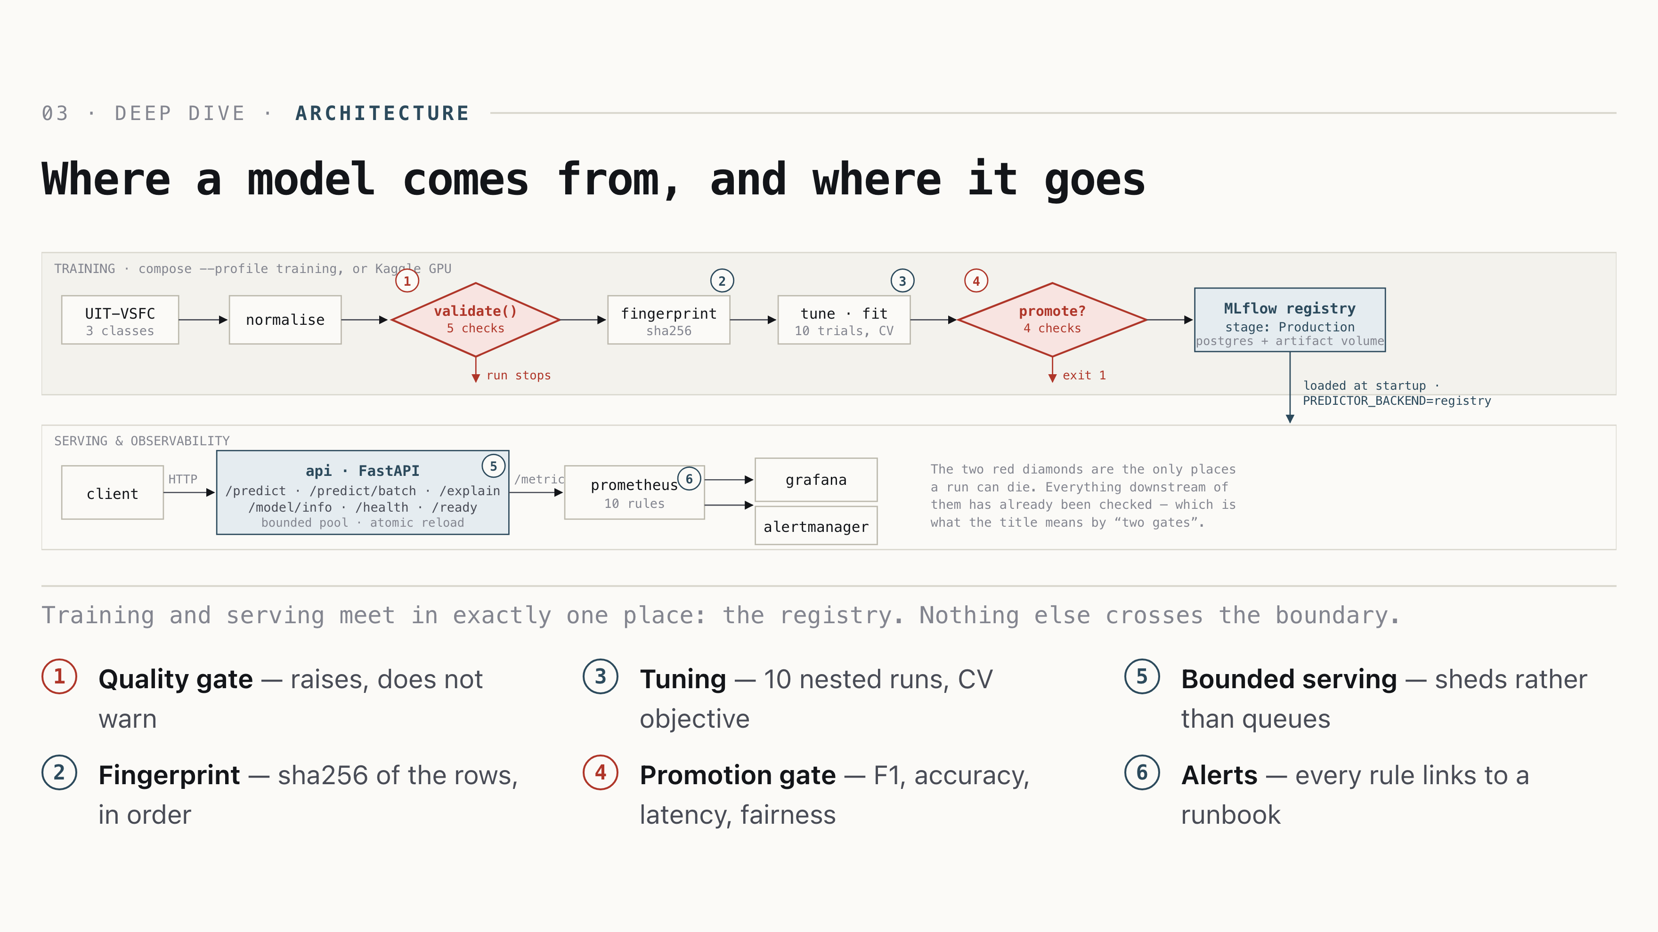
Where a model comes from, and where it goes
03 · Deep dive · architecture
Where a model comes from, and where it goes
Training and serving meet in exactly one place: the registry. Nothing else crosses the boundary.
1Quality gate — raises, does not warn
2Fingerprint — sha256 of the rows, in order
3Tuning — 10 nested runs, CV objective
4Promotion gate — F1, accuracy, latency, fairness
5Bounded serving — sheds rather than queues
6Alerts — every rule links to a runbook
Notes:
[Architecture] Sơn · 1 min
1:15. Walk the numbers 1→6, one sentence each. Do not describe boxes that carry no argument. The claim is: the registry is the only seam.

Slide 6
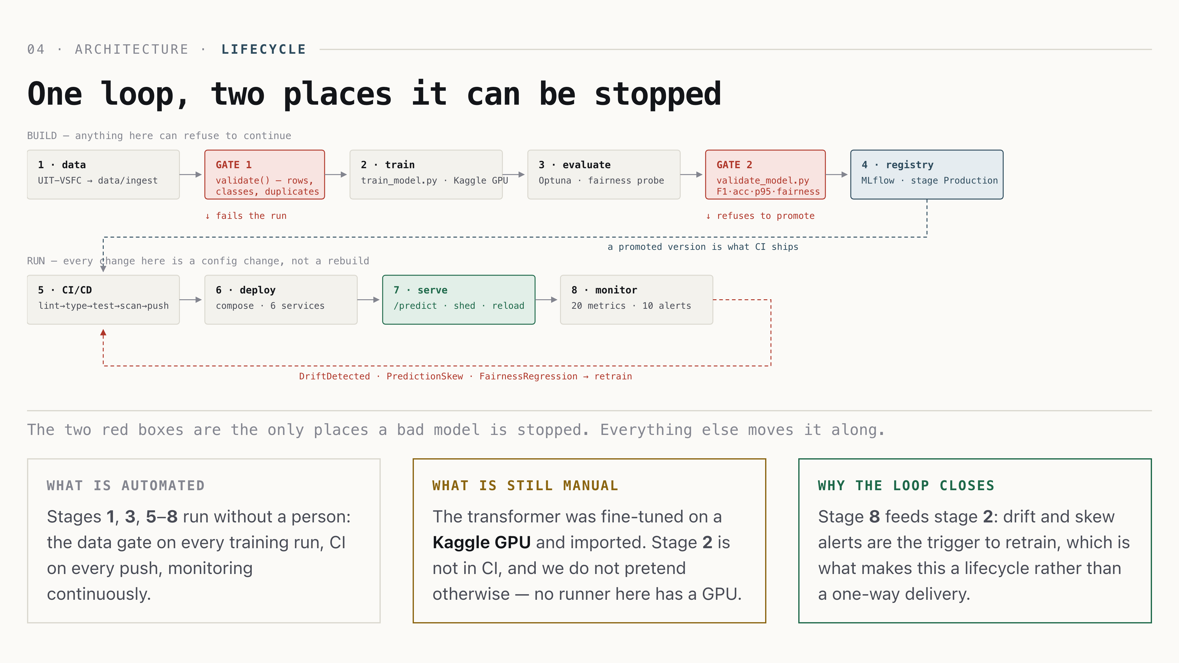
One loop, two places it can be stopped
04 · Architecture · lifecycle
One loop, two places it can be stopped
The two red boxes are the only places a bad model is stopped. Everything else moves it along.
what is automated
Stages 1, 3, 5–8 run without a person: the data gate on every training run, CI on every push, monitoring continuously.
what is still manual
The transformer was fine-tuned on a Kaggle GPU and imported. Stage 2 is not in CI, and we do not pretend otherwise — no runner here has a GPU.
why the loop closes
Stage 8 feeds stage 2: drift and skew alerts are the trigger to retrain, which is what makes this a lifecycle rather than a one-way delivery.
Notes:
[Architecture] Duy · 1 min
0:55. The one slide that shows the whole project at once. Trace it with a finger: left to right on the top row, then the bottom row, then the red arrow back. Land two sentences — the red boxes are the only brakes, and stage 2 is honestly still manual.

Slide 7
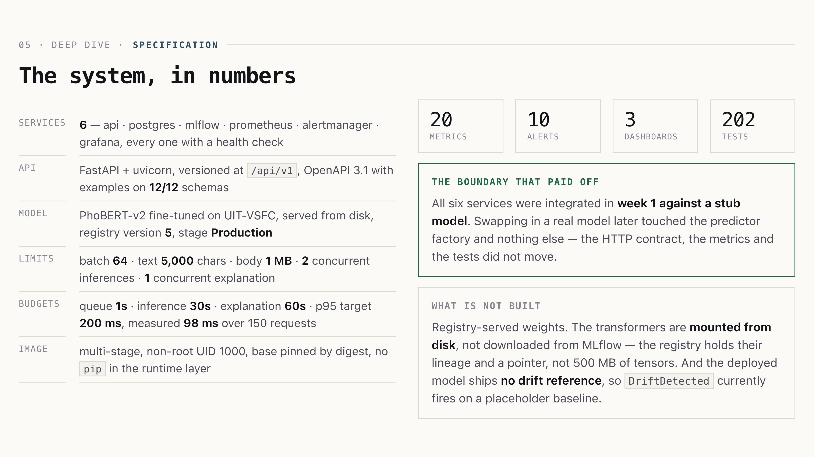
The system, in numbers
05 · Deep dive · specification
The system, in numbers
services
6 — api · postgres · mlflow · prometheus · alertmanager · grafana, every one with a health check
api
FastAPI + uvicorn, versioned at /api/v1, OpenAPI 3.1 with examples on 12/12 schemas
model
PhoBERT-v2 fine-tuned on UIT-VSFC, served from disk, registry version 5, stage Production
limits
batch 64 · text 5,000 chars · body 1 MB · 2 concurrent inferences · 1 concurrent explanation
budgets
queue 1s · inference 30s · explanation 60s · p95 target 200 ms, measured 98 ms over 150 requests
image
multi-stage, non-root UID 1000, base pinned by digest, no pip in the runtime layer
20metrics
10alerts
3dashboards
202tests
the boundary that paid off
All six services were integrated in week 1 against a stub model. Swapping in a real model later touched the predictor factory and nothing else — the HTTP contract, the metrics and the tests did not move.
what is not built
Registry-served weights. The transformers are mounted from disk, not downloaded from MLflow — the registry holds their lineage and a pointer, not 500 MB of tensors. And the deployed model ships no drift reference, so DriftDetected currently fires on a placeholder baseline.
Notes:
[Architecture] Sơn · 0.5 min
0:30. A reference slide — do not read it. Point at the two cards. Panels like knowing the numbers exist and are stated without being asked.

Slide 8
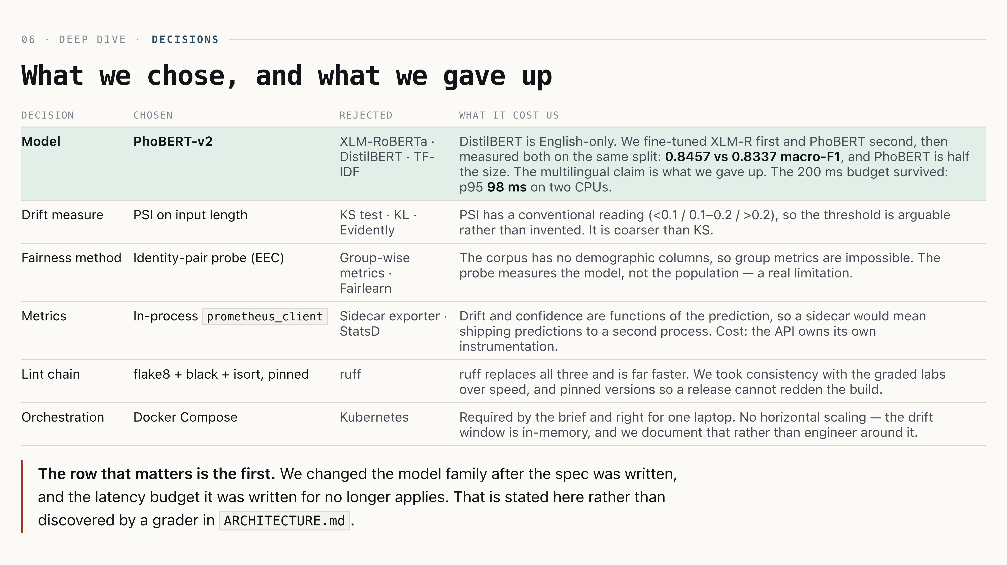
What we chose, and what we gave up
06 · Deep dive · decisions
What we chose, and what we gave up
Decision · Chosen · Rejected · What it cost us
Model · PhoBERT-v2 · XLM-RoBERTa · DistilBERT · TF-IDF · DistilBERT is English-only. We fine-tuned XLM-R first and PhoBERT second, then measured both on the same split: 0.8457 vs 0.8337 macro-F1, and PhoBERT is half the size. The multilingual claim is what we gave up. The 200 ms budget survived: p95 98 ms on two CPUs.
Drift measure · PSI on input length · KS test · KL · Evidently · PSI has a conventional reading (<0.1 / 0.1–0.2 / >0.2), so the threshold is arguable rather than invented. It is coarser than KS.
Fairness method · Identity-pair probe (EEC) · Group-wise metrics · Fairlearn · The corpus has no demographic columns, so group metrics are impossible. The probe measures the model, not the population — a real limitation.
Metrics · In-process prometheus_client · Sidecar exporter · StatsD · Drift and confidence are functions of the prediction, so a sidecar would mean shipping predictions to a second process. Cost: the API owns its own instrumentation.
Lint chain · flake8 + black + isort, pinned · ruff · ruff replaces all three and is far faster. We took consistency with the graded labs over speed, and pinned versions so a release cannot redden the build.
Orchestration · Docker Compose · Kubernetes · Required by the brief and right for one laptop. No horizontal scaling — the drift window is in-memory, and we document that rather than engineer around it.
The row that matters is the first. We changed the model family after the spec was written, and the latency budget it was written for no longer applies. That is stated here rather than discovered by a grader in ARCHITECTURE.md.
Notes:
[Architecture] Sơn · 0.5 min
0:45. Do not read the table. Pick the model row and the ruff row — one shows a risk we accepted, one shows a speed we declined. Both prove the decision was made rather than defaulted.

Slide 9
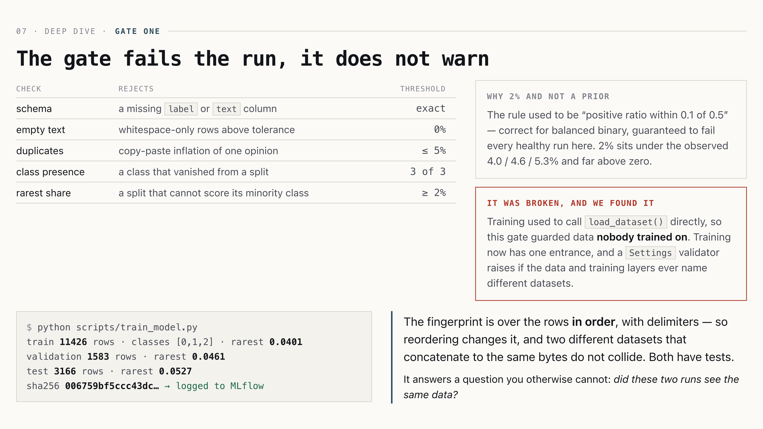
The gate fails the run, it does not warn
07 · Deep dive · gate one
The gate fails the run, it does not warn
Check · Rejects · Threshold
schema · a missing label or text column · exact
empty text · whitespace-only rows above tolerance · 0%
duplicates · copy-paste inflation of one opinion · ≤ 5%
class presence · a class that vanished from a split · 3 of 3
rarest share · a split that cannot score its minority class · ≥ 2%
why 2% and not a prior
The rule used to be “positive ratio within 0.1 of 0.5” — correct for balanced binary, guaranteed to fail every healthy run here. 2% sits under the observed 4.0 / 4.6 / 5.3% and far above zero.
it was broken, and we found it
Training used to call load_dataset() directly, so this gate guarded data nobody trained on. Training now has one entrance, and a Settings validator raises if the data and training layers ever name different datasets.
$ python scripts/train_model.py
train 11426 rows · classes [0,1,2] · rarest 0.0401
validation 1583 rows · rarest 0.0461
test 3166 rows · rarest 0.0527
sha256 006759bf5ccc43dc… → logged to MLflow
The fingerprint is over the rows in order, with delimiters — so reordering changes it, and two different datasets that concatenate to the same bytes do not collide. Both have tests.
It answers a question you otherwise cannot: did these two runs see the same data?
Notes:
[Application] Thông · 0.5 min
1:00. “Fails the run” is the phrase, not “validates”. If asked why not DVC: the dataset is immutable on the hub — we needed provenance, not remote storage.

Slide 10
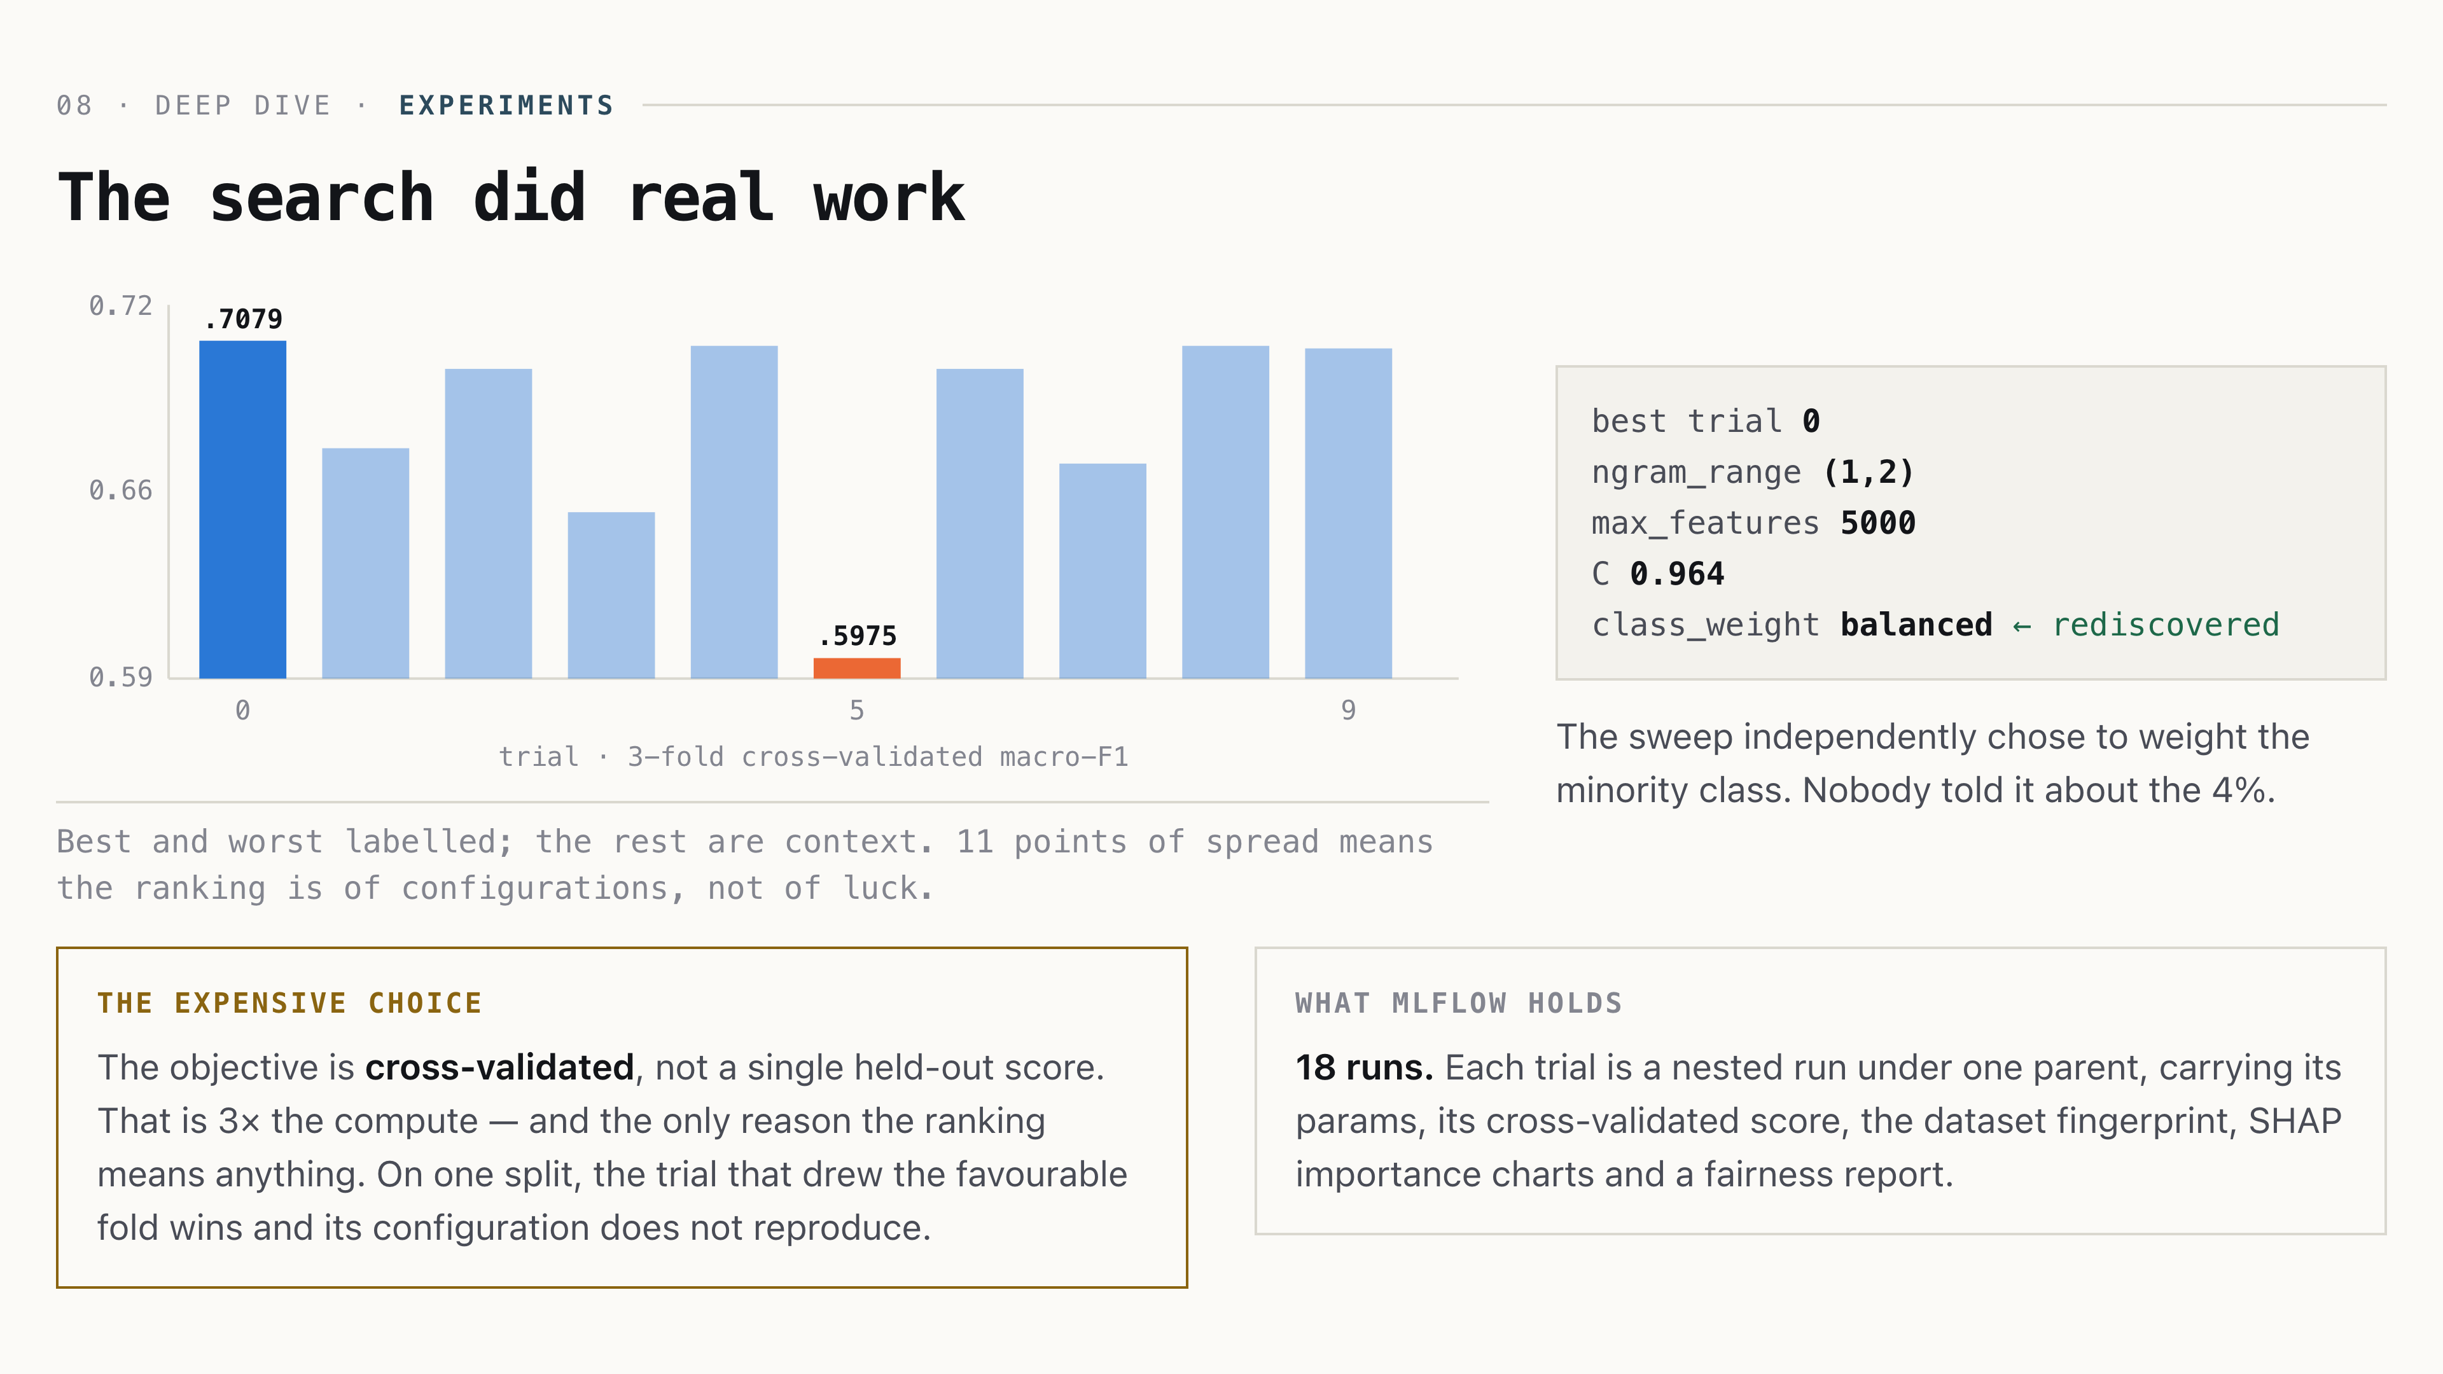
The search did real work
08 · Deep dive · experiments
The search did real work
Best and worst labelled; the rest are context. 11 points of spread means the ranking is of configurations, not of luck.
best trial 0
ngram_range (1,2)
max_features 5000
C 0.964
class_weight balanced ← rediscovered
The sweep independently chose to weight the minority class. Nobody told it about the 4%.
the expensive choice
The objective is cross-validated, not a single held-out score. That is 3× the compute — and the only reason the ranking means anything. On one split, the trial that drew the favourable fold wins and its configuration does not reproduce.
what MLflow holds
18 runs. Each trial is a nested run under one parent, carrying its params, its cross-validated score, the dataset fingerprint, SHAP importance charts and a fairness report.
Notes:
[Application] Duy · 0.5 min
1:00. If asked about the transformer: implemented, contract-tested by the slow suite, not promoted. Say it before they ask — slide 4 already flagged it.

Slide 11
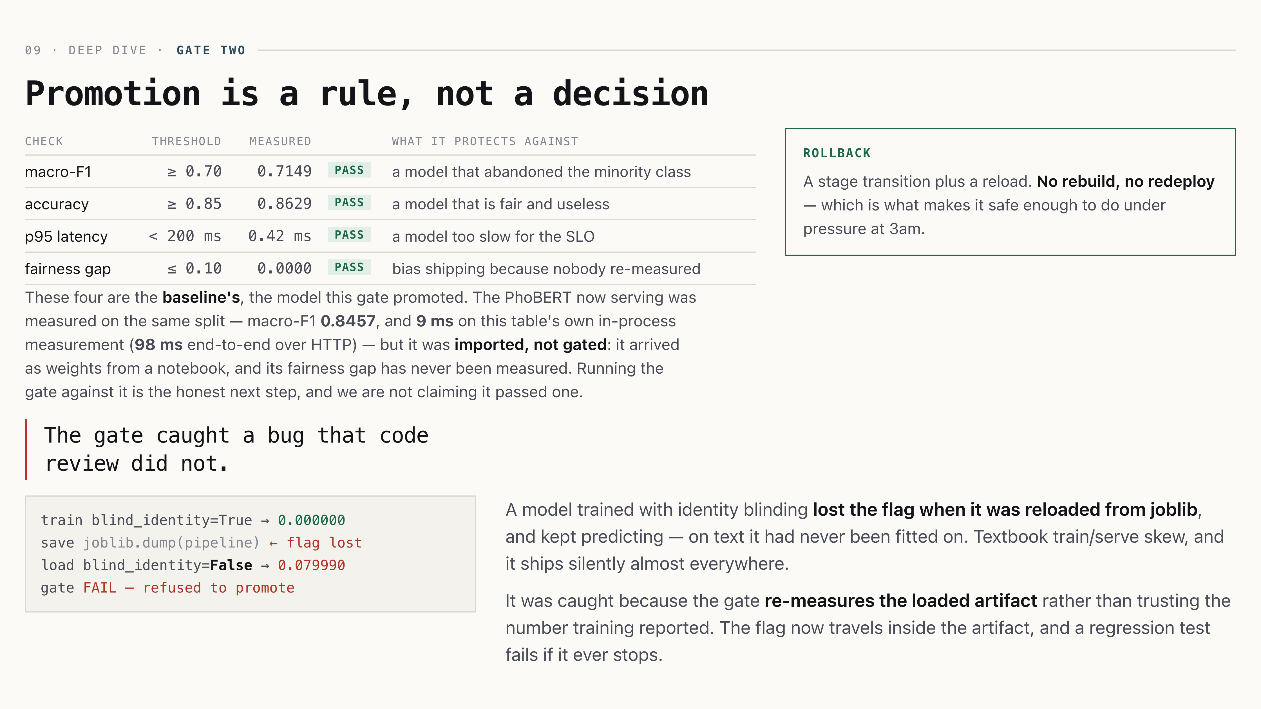
Promotion is a rule, not a decision
09 · Deep dive · gate two
Promotion is a rule, not a decision
Check · Threshold · Measured · · What it protects against
macro-F1 · ≥ 0.70 · 0.7149 · pass · a model that abandoned the minority class
accuracy · ≥ 0.85 · 0.8629 · pass · a model that is fair and useless
p95 latency · < 200 ms · 0.42 ms · pass · a model too slow for the SLO
fairness gap · ≤ 0.10 · 0.0000 · pass · bias shipping because nobody re-measured
These four are the baseline's, the model this gate promoted. The PhoBERT now serving was measured on the same split — macro-F1 0.8457, and 9 ms on this table's own in-process measurement (98 ms end-to-end over HTTP) — but it was imported, not gated: it arrived as weights from a notebook, and its fairness gap has never been measured. Running the gate against it is the honest next step, and we are not claiming it passed one.
rollback
A stage transition plus a reload. No rebuild, no redeploy — which is what makes it safe enough to do under pressure at 3am.
The gate caught a bug that code review did not.
train blind_identity=True → 0.000000
save joblib.dump(pipeline) ← flag lost
load blind_identity=False → 0.079990
gate FAIL — refused to promote
A model trained with identity blinding lost the flag when it was reloaded from joblib, and kept predicting — on text it had never been fitted on. Textbook train/serve skew, and it ships silently almost everywhere.
It was caught because the gate re-measures the loaded artifact rather than trusting the number training reported. The flag now travels inside the artifact, and a regression test fails if it ever stops.
Notes:
[Application] Duy · 1 min
1:15. The best story in the deck — tell it slowly. The transferable point: measure the thing you will deploy, not the thing you trained.

Slide 12
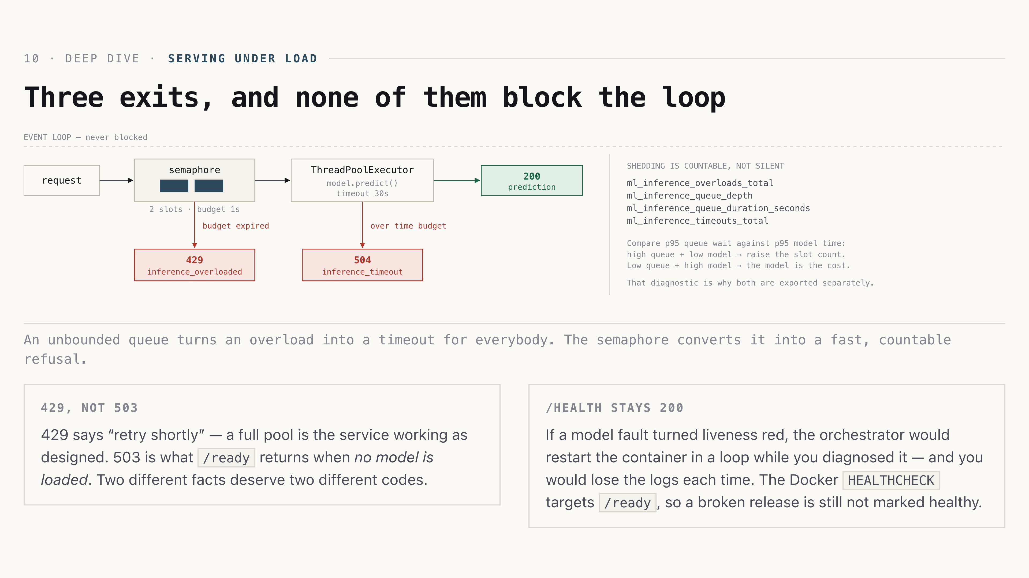
Three exits, and none of them block the loop
10 · Deep dive · serving under load
Three exits, and none of them block the loop
An unbounded queue turns an overload into a timeout for everybody. The semaphore converts it into a fast, countable refusal.
429, not 503
429 says “retry shortly” — a full pool is the service working as designed. 503 is what /ready returns when no model is loaded. Two different facts deserve two different codes.
/health stays 200
If a model fault turned liveness red, the orchestrator would restart the container in a loop while you diagnosed it — and you would lose the logs each time. The Docker HEALTHCHECK targets /ready, so a broken release is still not marked healthy.
Notes:
[Application] Sơn · 1 min
1:15. The densest slide — walk left to right, then down. Expect “why not autoscale”: single-replica CPU is the stated target and the drift window is in-memory.

Slide 13
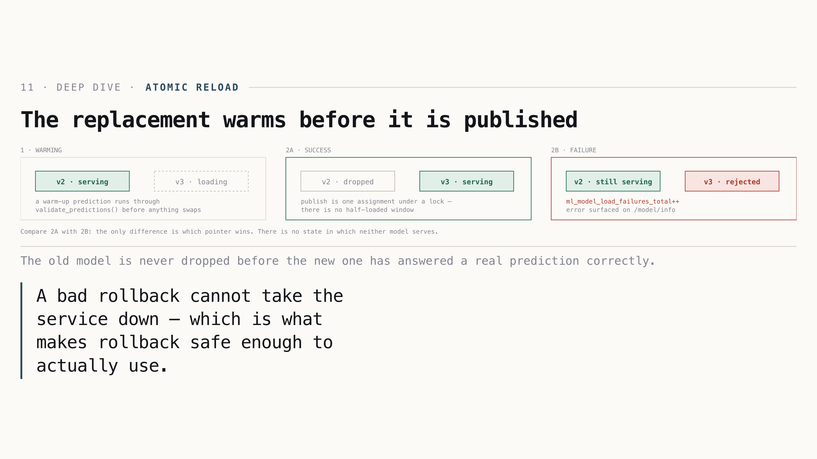
The replacement warms before it is published
11 · Deep dive · atomic reload
The replacement warms before it is published
The old model is never dropped before the new one has answered a real prediction correctly.
A bad rollback cannot take the service down — which is what makes rollback safe enough to actually use.
Notes:
[Application] Sơn · 0.5 min
0:45. Point at 2B. This answers “what happens at 3am when the promoted model is broken”, which is the question behind every rollback story.

Slide 14
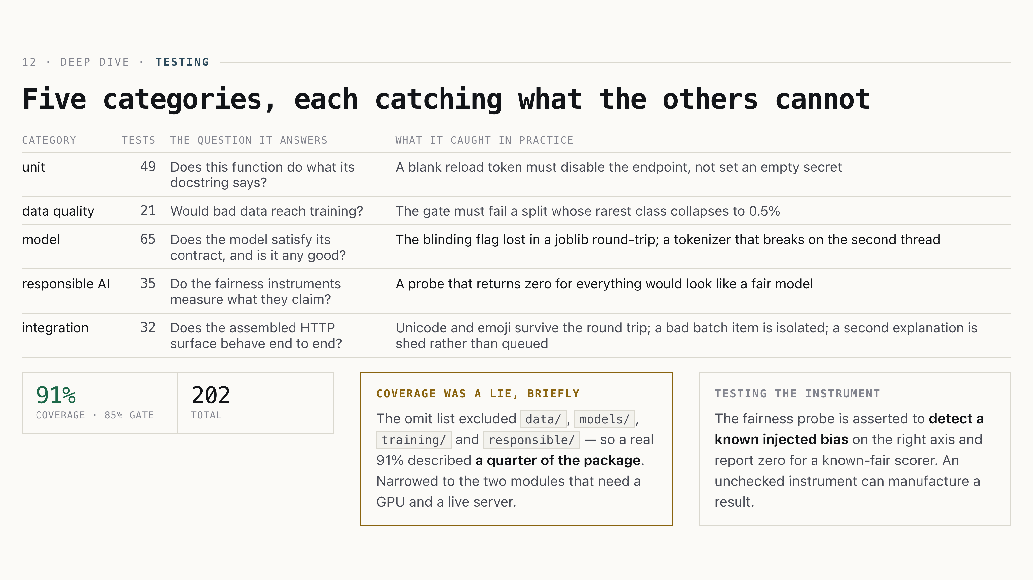
Five categories, each catching what the others cannot
12 · Deep dive · testing
Five categories, each catching what the others cannot
Category · Tests · The question it answers · What it caught in practice
unit · 49 · Does this function do what its docstring says? · A blank reload token must disable the endpoint, not set an empty secret
data quality · 21 · Would bad data reach training? · The gate must fail a split whose rarest class collapses to 0.5%
model · 65 · Does the model satisfy its contract, and is it any good? · The blinding flag lost in a joblib round-trip; a tokenizer that breaks on the second thread
responsible AI · 35 · Do the fairness instruments measure what they claim? · A probe that returns zero for everything would look like a fair model
integration · 32 · Does the assembled HTTP surface behave end to end? · Unicode and emoji survive the round trip; a bad batch item is isolated; a second explanation is shed rather than queued
91%coverage · 85% gate
202total
coverage was a lie, briefly
The omit list excluded data/, models/, training/ and responsible/ — so a real 91% described a quarter of the package. Narrowed to the two modules that need a GPU and a live server.
testing the instrument
The fairness probe is asserted to detect a known injected bias on the right axis and report zero for a known-fair scorer. An unchecked instrument can manufacture a result.
Notes:
[Application] Huỳnh · 0.5 min
0:45. The fourth column is the slide. Anyone can count tests; naming what each category actually caught is what shows the suite is load-bearing.

Slide 15
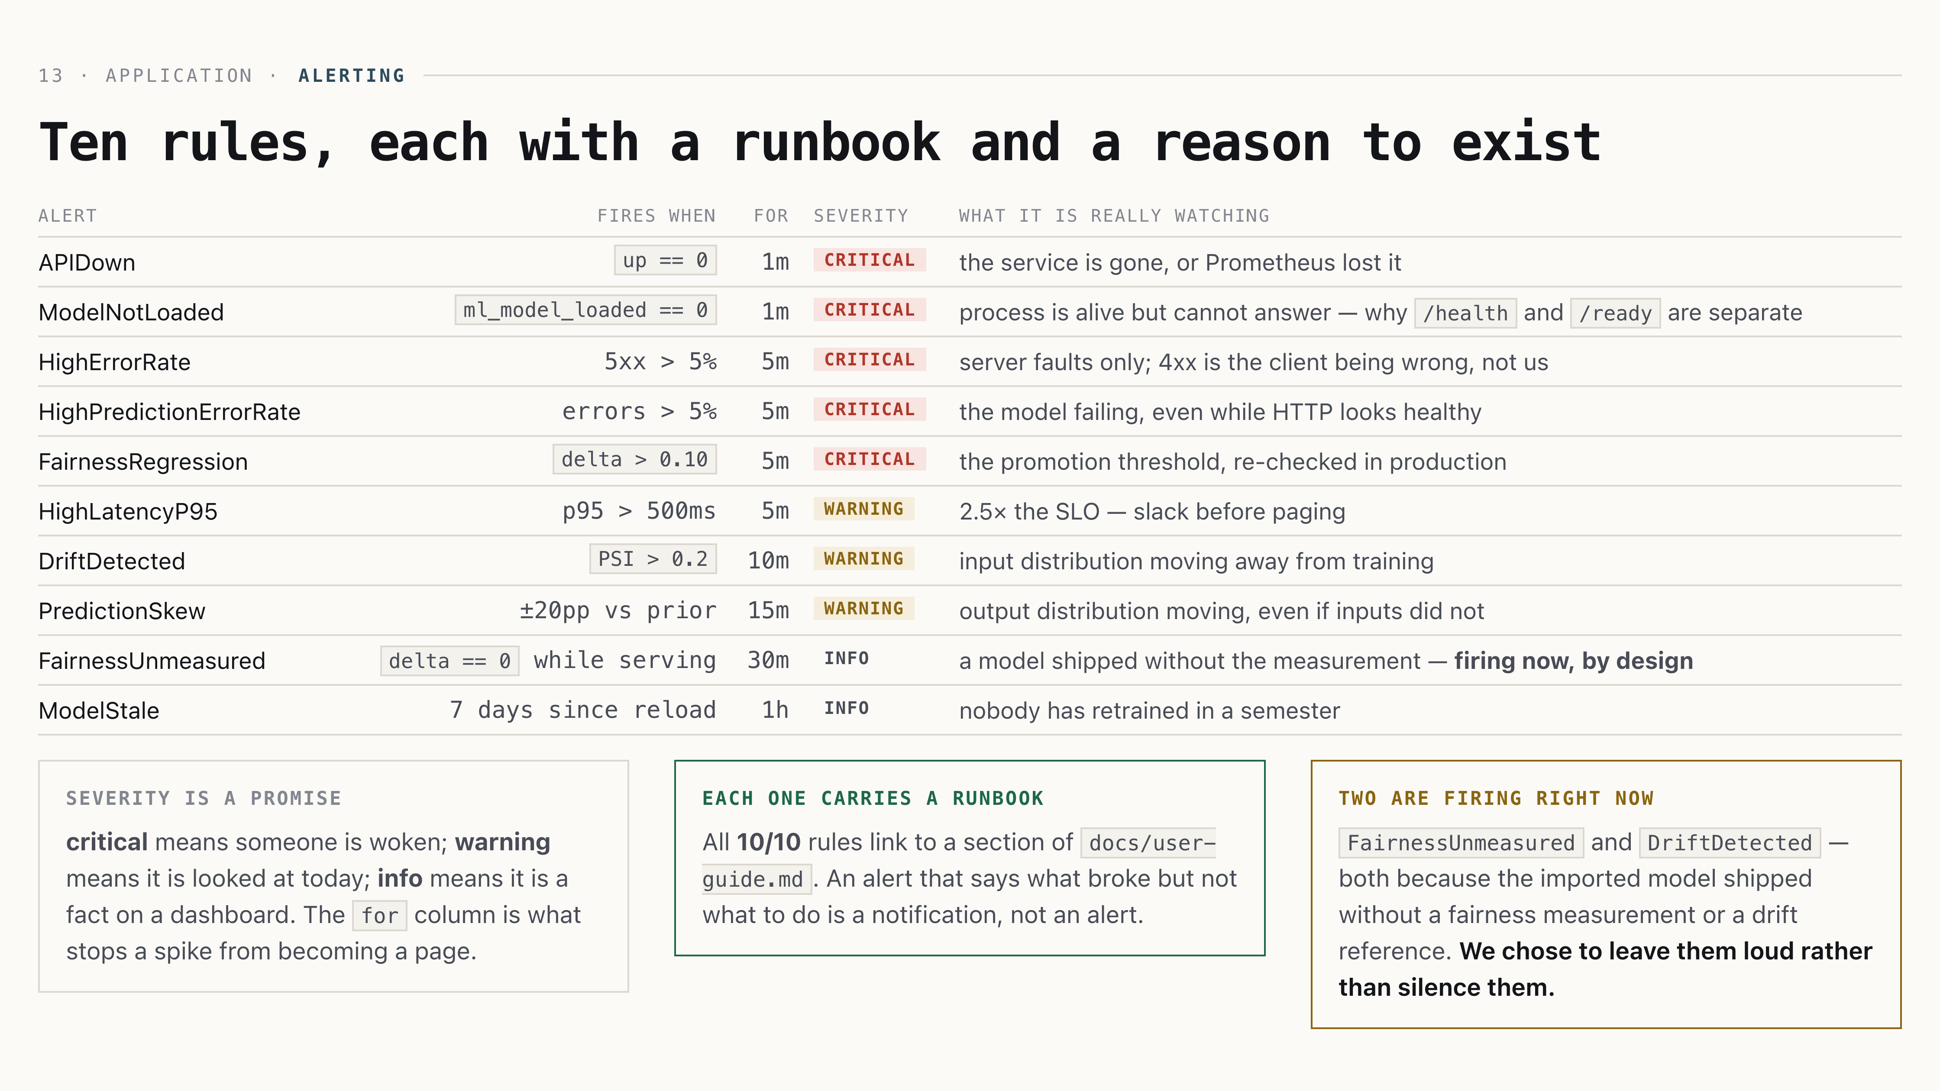
Ten rules, each with a runbook and a reason to exist
13 · Application · alerting
Ten rules, each with a runbook and a reason to exist
Alert · Fires when · for · Severity · What it is really watching
APIDown · up == 0 · 1m · critical · the service is gone, or Prometheus lost it
ModelNotLoaded · ml_model_loaded == 0 · 1m · critical · process is alive but cannot answer — why /health and /ready are separate
HighErrorRate · 5xx > 5% · 5m · critical · server faults only; 4xx is the client being wrong, not us
HighPredictionErrorRate · errors > 5% · 5m · critical · the model failing, even while HTTP looks healthy
FairnessRegression · delta > 0.10 · 5m · critical · the promotion threshold, re-checked in production
HighLatencyP95 · p95 > 500ms · 5m · warning · 2.5× the SLO — slack before paging
DriftDetected · PSI > 0.2 · 10m · warning · input distribution moving away from training
PredictionSkew · ±20pp vs prior · 15m · warning · output distribution moving, even if inputs did not
FairnessUnmeasured · delta == 0 while serving · 30m · info · a model shipped without the measurement — firing now, by design
ModelStale · 7 days since reload · 1h · info · nobody has retrained in a semester
severity is a promise
critical means someone is woken; warning means it is looked at today; info means it is a fact on a dashboard. The for column is what stops a spike from becoming a page.
each one carries a runbook
All 10/10 rules link to a section of docs/user-guide.md. An alert that says what broke but not what to do is a notification, not an alert.
two are firing right now
FairnessUnmeasured and DriftDetected — both because the imported model shipped without a fairness measurement or a drift reference. We chose to leave them loud rather than silence them.
Notes:
[Application] Huỳnh · 0.75 min
0:40. Do not read the table. Point at the three severity bands, then say the last card out loud — the alerts that are firing are firing for a reason we can name, and we did not silence them to make the demo look clean.

Slide 16
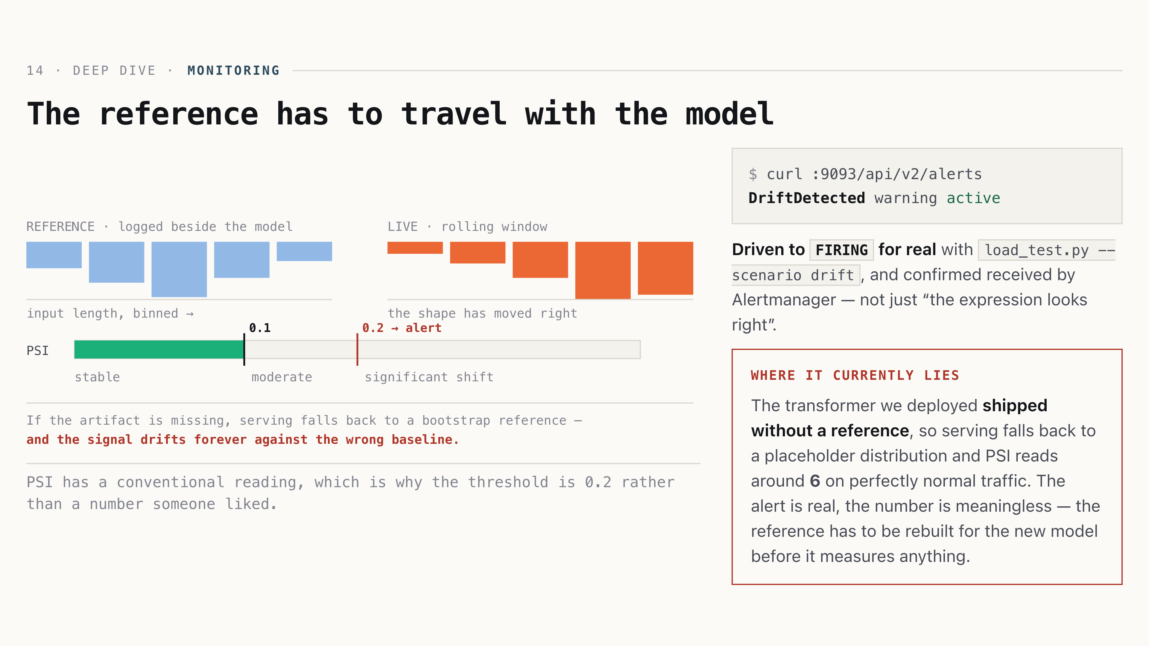
The reference has to travel with the model
14 · Deep dive · monitoring
The reference has to travel with the model
PSI has a conventional reading, which is why the threshold is 0.2 rather than a number someone liked.
$ curl :9093/api/v2/alerts
DriftDetected warning active
Driven to FIRING for real with load_test.py --scenario drift, and confirmed received by Alertmanager — not just “the expression looks right”.
where it currently lies
The transformer we deployed shipped without a reference, so serving falls back to a placeholder distribution and PSI reads around 6 on perfectly normal traffic. The alert is real, the number is meaningless — the reference has to be rebuilt for the new model before it measures anything.
Notes:
[Application] Huỳnh · 0.75 min
1:00. Volunteering the unverified alert buys credibility for the nine that are verified. Do not let it be discovered in Q&A instead.

Slide 17
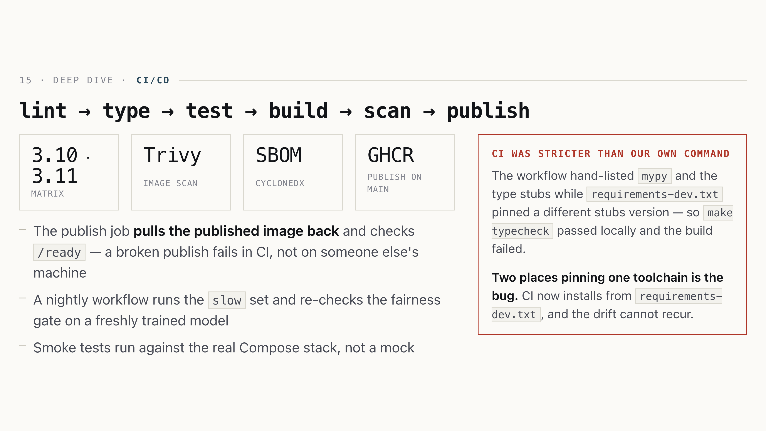
lint → type → test → build → scan → publish
15 · Deep dive · ci/cd
lint → type → test → build → scan → publish
3.10 · 3.11matrix
Trivyimage scan
SBOMcyclonedx
GHCRpublish on main
The publish job pulls the published image back and checks /ready — a broken publish fails in CI, not on someone else's machine
A nightly workflow runs the slow set and re-checks the fairness gate on a freshly trained model
Smoke tests run against the real Compose stack, not a mock
ci was stricter than our own command
The workflow hand-listed mypy and the type stubs while requirements-dev.txt pinned a different stubs version — so make typecheck passed locally and the build failed.
Two places pinning one toolchain is the bug. CI now installs from requirements-dev.txt, and the drift cannot recur.
Notes:
[Application] Huỳnh · 0.5 min
0:45. The right-hand card is the point: we treat the toolchain as part of the system, not as somebody's laptop setup.

Slide 18
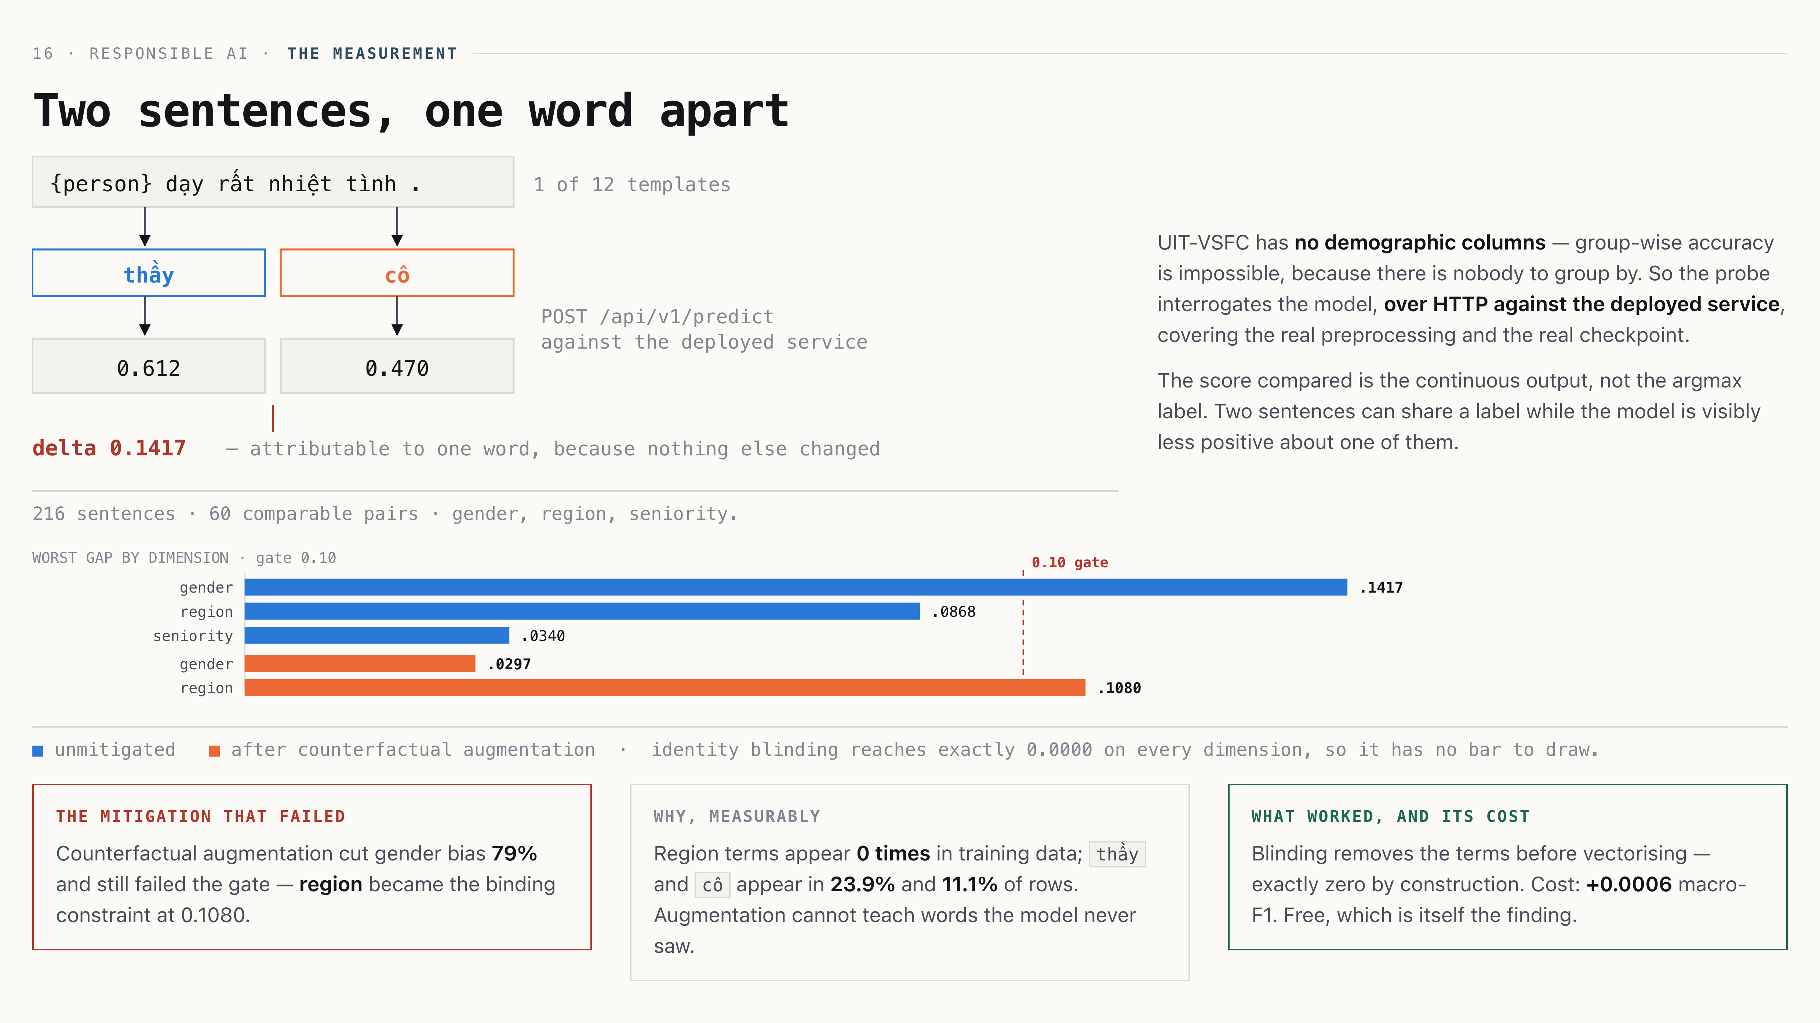
Two sentences, one word apart
16 · Responsible AI · the measurement
Two sentences, one word apart
216 sentences · 60 comparable pairs · gender, region, seniority.
UIT-VSFC has no demographic columns — group-wise accuracy is impossible, because there is nobody to group by. So the probe interrogates the model, over HTTP against the deployed service, covering the real preprocessing and the real checkpoint.
The score compared is the continuous output, not the argmax label. Two sentences can share a label while the model is visibly less positive about one of them.
■ unmitigated ■ after counterfactual augmentation · identity blinding reaches exactly 0.0000 on every dimension, so it has no bar to draw.
the mitigation that failed
Counterfactual augmentation cut gender bias 79% and still failed the gate — region became the binding constraint at 0.1080.
why, measurably
Region terms appear 0 times in training data; thầy and cô appear in 23.9% and 11.1% of rows. Augmentation cannot teach words the model never saw.
what worked, and its cost
Blinding removes the terms before vectorising — exactly zero by construction. Cost: +0.0006 macro-F1. Free, which is itself the finding.
Notes:
[Responsible AI] Nhiên · 1.25 min
1:45 — the highest-value slide. Do not rush. Then the admission: our first measurement said 0.63, because the probe used capitalised Thầy against an entirely lowercase corpus. It was measuring casing, not bias.

Slide 19
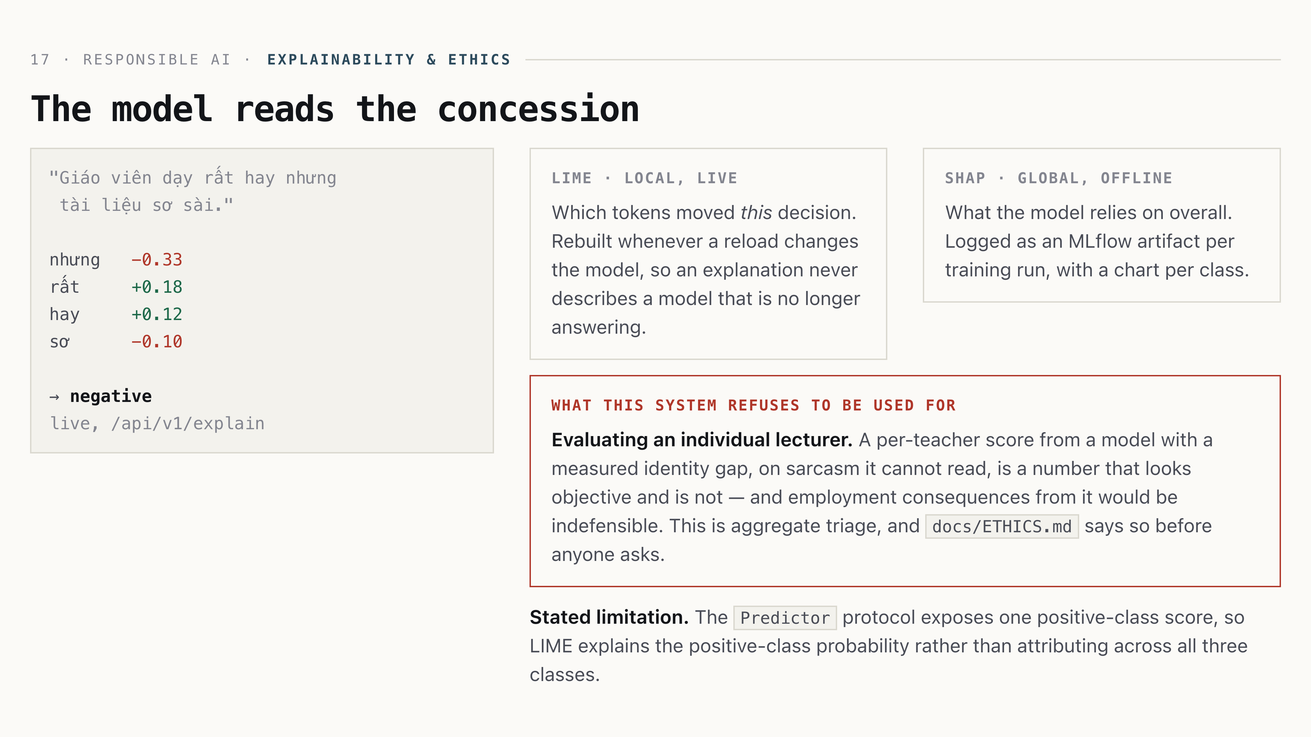
The model reads the concession
17 · Responsible AI · explainability & ethics
The model reads the concession
"Giáo viên dạy rất hay nhưng
tài liệu sơ sài."
nhưng −0.33
rất +0.18
hay +0.12
sơ −0.10
→ negative
live, /api/v1/explain
LIME · local, live
Which tokens moved this decision. Rebuilt whenever a reload changes the model, so an explanation never describes a model that is no longer answering.
SHAP · global, offline
What the model relies on overall. Logged as an MLflow artifact per training run, with a chart per class.
what this system refuses to be used for
Evaluating an individual lecturer. A per-teacher score from a model with a measured identity gap, on sarcasm it cannot read, is a number that looks objective and is not — and employment consequences from it would be indefensible. This is aggregate triage, and docs/ETHICS.md says so before anyone asks.
Stated limitation. The Predictor protocol exposes one positive-class score, so LIME explains the positive-class probability rather than attributing across all three classes.
Notes:
[Responsible AI] Nhiên · 0.75 min
0:45. The refusal is the part that scores. Anyone can add SHAP; naming the use you decline is what “thoughtful ethics” means.

Slide 20
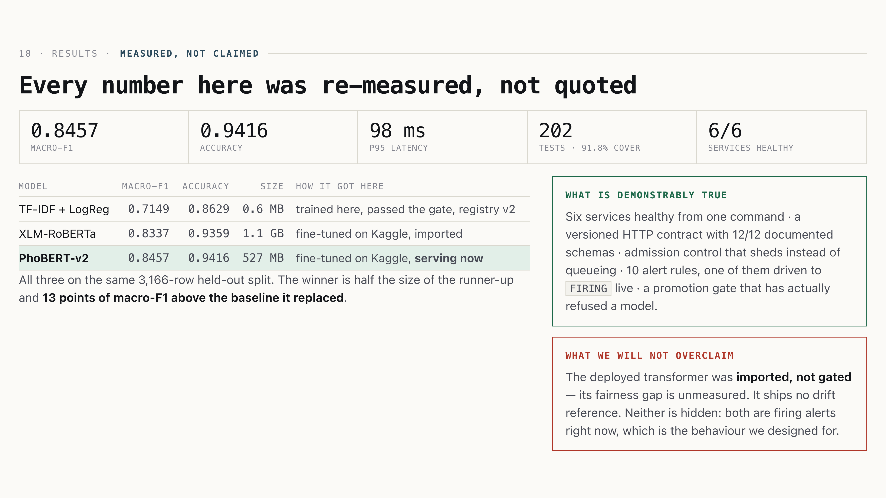
Every number here was re-measured, not quoted
18 · Results · measured, not claimed
Every number here was re-measured, not quoted
0.8457macro-F1
0.9416accuracy
98 msp95 latency
202tests · 91.8% cover
6/6services healthy
Model · macro-F1 · accuracy · size · How it got here
TF-IDF + LogReg · 0.7149 · 0.8629 · 0.6 MB · trained here, passed the gate, registry v2
XLM-RoBERTa · 0.8337 · 0.9359 · 1.1 GB · fine-tuned on Kaggle, imported
PhoBERT-v2 · 0.8457 · 0.9416 · 527 MB · fine-tuned on Kaggle, serving now
All three on the same 3,166-row held-out split. The winner is half the size of
the runner-up and 13 points of macro-F1 above the baseline it replaced.
what is demonstrably true
Six services healthy from one command · a versioned HTTP contract with 12/12 documented
schemas · admission control that sheds instead of queueing · 10 alert rules, one of them
driven to FIRING live · a promotion gate that has actually refused a model.
what we will not overclaim
The deployed transformer was imported, not gated — its fairness gap is
unmeasured. It ships no drift reference. Neither is hidden: both are firing alerts right
now, which is the behaviour we designed for.
Notes:
[Results] cả nhóm · 0.75 min
0:55. The payoff slide. Lead with the table — three models, same split,
one sentence each. Then the two cards, in order: what is true, then what we refuse to overclaim.
Saying the second half yourself is what makes the first half believable.

Slide 21
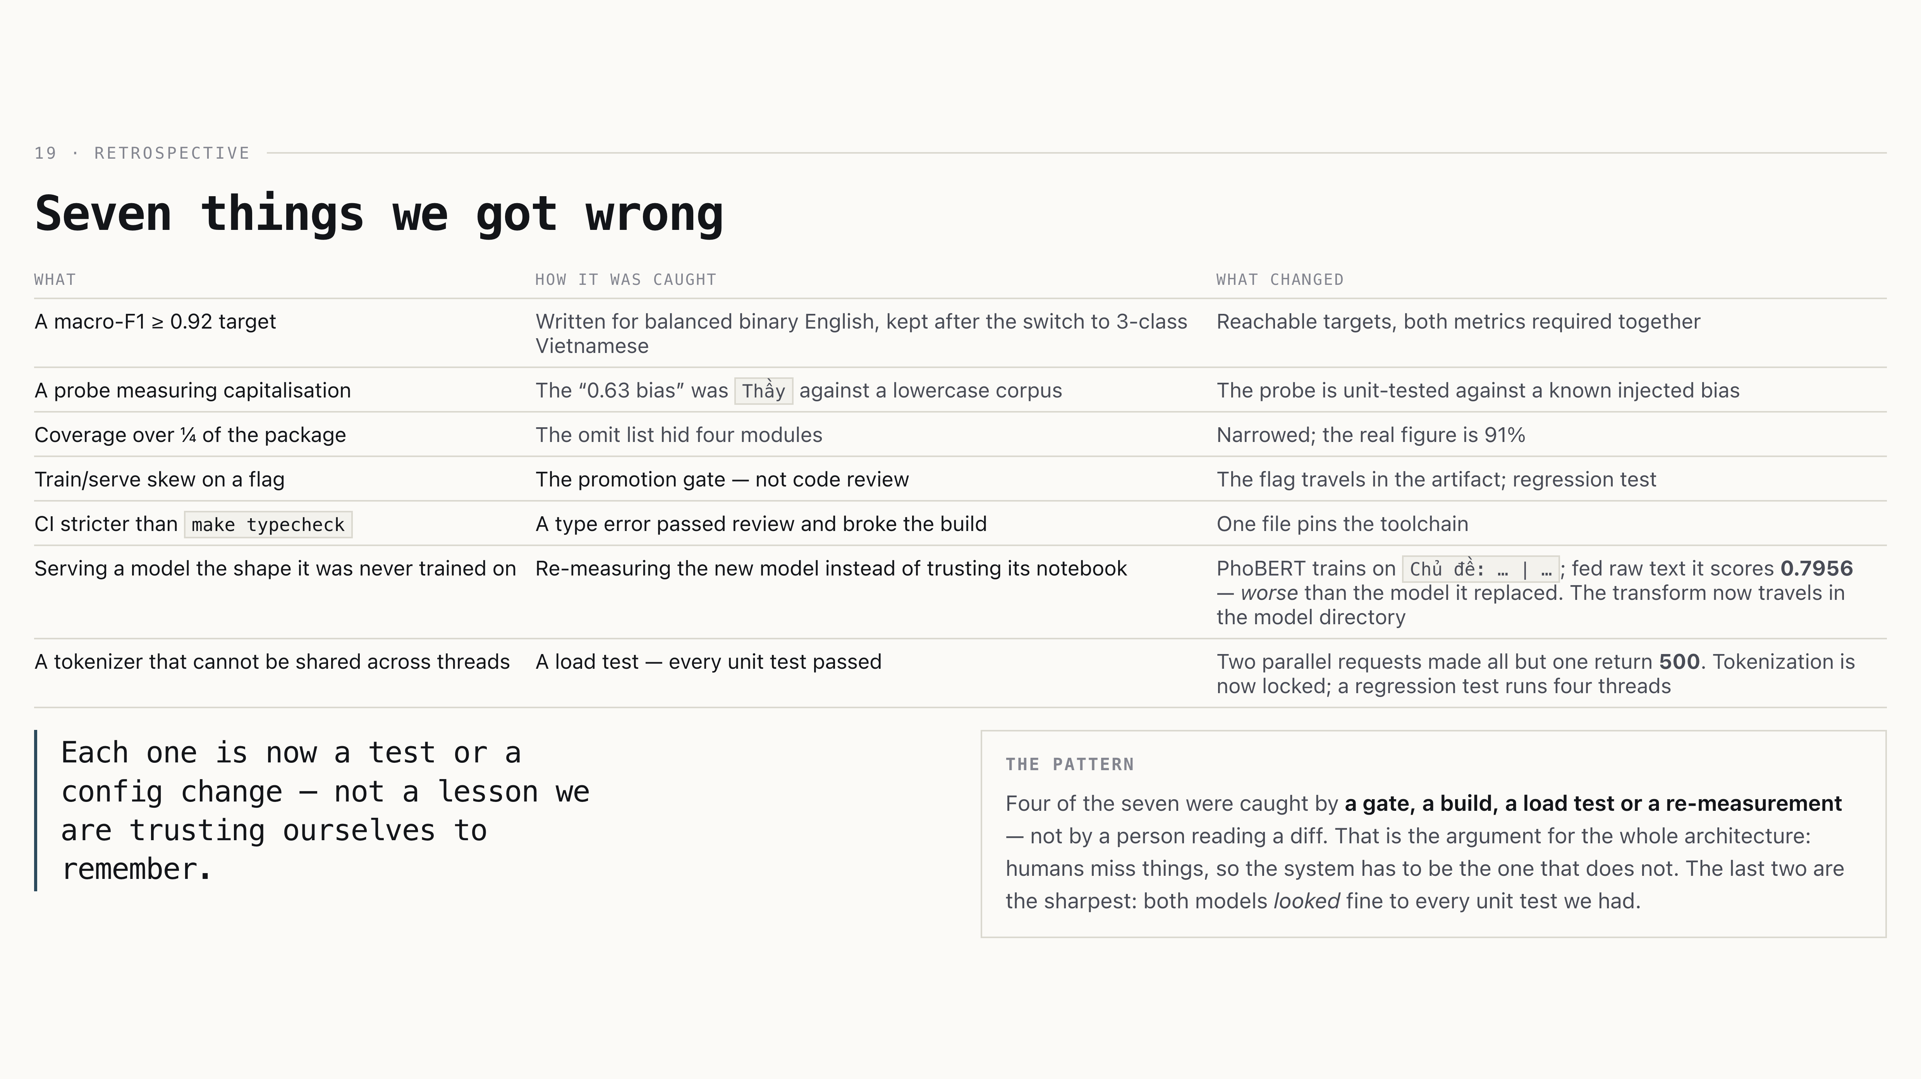
Seven things we got wrong
19 · Retrospective
Seven things we got wrong
What · How it was caught · What changed
A macro-F1 ≥ 0.92 target · Written for balanced binary English, kept after the switch to 3-class Vietnamese · Reachable targets, both metrics required together
A probe measuring capitalisation · The “0.63 bias” was Thầy against a lowercase corpus · The probe is unit-tested against a known injected bias
Coverage over ¼ of the package · The omit list hid four modules · Narrowed; the real figure is 91%
Train/serve skew on a flag · The promotion gate — not code review · The flag travels in the artifact; regression test
CI stricter than make typecheck · A type error passed review and broke the build · One file pins the toolchain
Serving a model the shape it was never trained on · Re-measuring the new model instead of trusting its notebook · PhoBERT trains on Chủ đề: … | …; fed raw text it scores 0.7956 — worse than the model it replaced. The transform now travels in the model directory
A tokenizer that cannot be shared across threads · A load test — every unit test passed · Two parallel requests made all but one return 500. Tokenization is now locked; a regression test runs four threads
Each one is now a test or a config change — not a lesson we are trusting ourselves to remember.
the pattern
Four of the seven were caught by a gate, a build, a load test or a re-measurement — not by a person reading a diff. That is the argument for the whole architecture: humans miss things, so the system has to be the one that does not. The last two are the sharpest: both models looked fine to every unit test we had.
Notes:
[Results] cả nhóm · 0.75 min
0:45. Do not skip. It pre-empts half the hostile questions, and “caught by the gate, not by review” is the sentence that proves the design works. The last two rows are the strongest — a 500-under-load bug and a silent accuracy loss, both invisible to unit tests.

Slide 22
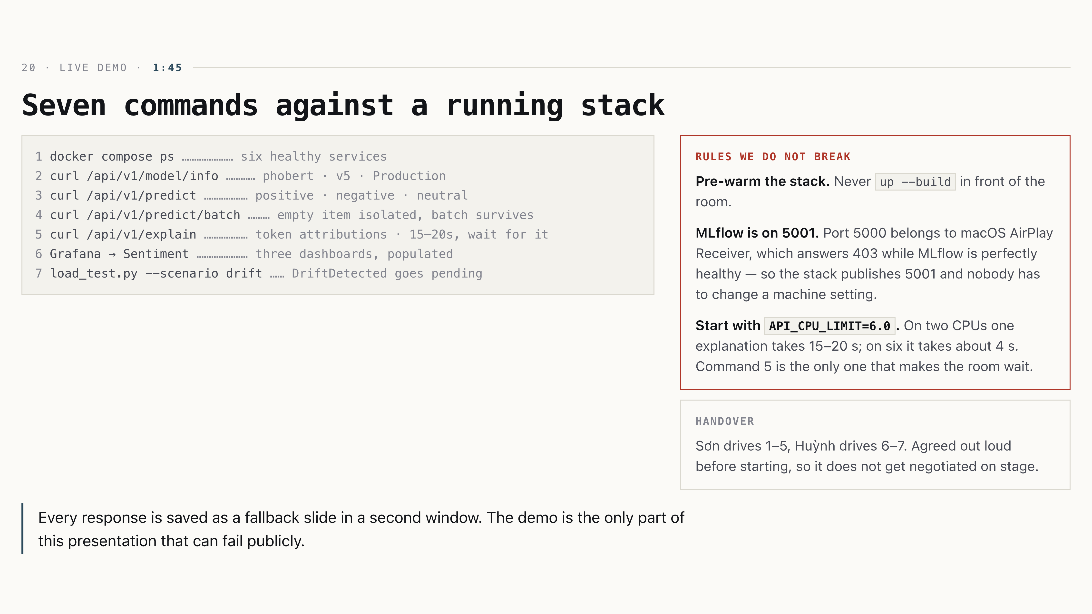
Seven commands against a running stack
20 · Live demo · 1:45
Seven commands against a running stack
1 docker compose ps ………………… six healthy services
2 curl /api/v1/model/info ………… phobert · v5 · Production
3 curl /api/v1/predict ……………… positive · negative · neutral
4 curl /api/v1/predict/batch ……… empty item isolated, batch survives
5 curl /api/v1/explain ……………… token attributions · 15–20s, wait for it
6 Grafana → Sentiment ………………… three dashboards, populated
7 load_test.py --scenario drift …… DriftDetected goes pending
rules we do not break
Pre-warm the stack. Never up --build in front of the room.
MLflow is on 5001. Port 5000 belongs to macOS AirPlay Receiver, which answers 403 while MLflow is perfectly healthy — so the stack publishes 5001 and nobody has to change a machine setting.
Start with API_CPU_LIMIT=6.0. On two CPUs one explanation takes 15–20 s; on six it takes about 4 s. Command 5 is the only one that makes the room wait.
handover
Sơn drives 1–5, Huỳnh drives 6–7. Agreed out loud before starting, so it does not get negotiated on stage.
Every response is saved as a fallback slide in a second window. The demo is the only part of this presentation that can fail publicly.
Notes:
[Demo] Sơn + Huỳnh · 1.5 min
1:45. Rehearse until boring. If the stack misbehaves, switch to fallbacks without commentary — narrating a failure costs more time than the failure does.

Slide 23
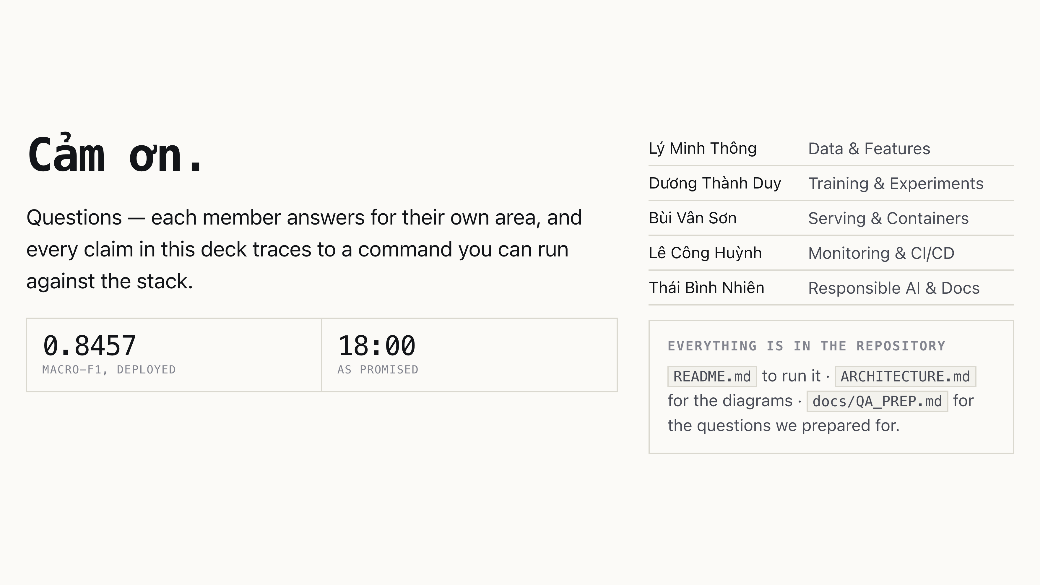
Cảm ơn.
Cảm ơn.
Questions — each member answers for their own area, and every claim in this
deck traces to a command you can run against the stack.
0.8457macro-F1, deployed
18:00as promised
Lý Minh Thông · Data & Features
Dương Thành Duy · Training & Experiments
Bùi Vân Sơn · Serving & Containers
Lê Công Huỳnh · Monitoring & CI/CD
Thái Bình Nhiên · Responsible AI & Docs
everything is in the repository
README.md to run it · ARCHITECTURE.md for the diagrams
docs/QA_PREP.md for the questions we prepared for.
Notes:
[Close] cả nhóm · 0.5 min
0:30. Hand to Q&A. Do not summarise again — the results slide already
did that. Whoever owns the area takes the question; nobody answers for someone else.

