Slide 1
Manuscript 4

Slide 2
Aims
Compare fAD-like (Q96_K97del) zebrafish and 5XFAD mouse brains at different ages
Gene set enrichment analysis
Cluster human sAD and fAD samples and look for patient subsets that could be more comparable to fAD-like zebrafish
Originally planned to use matrix factorisation + projection approach to summarise similarities and differences between species
AES-PCA
Techniques to compare gene expression across species.

Slide 3
Datasets
Q96_K97del dataset (same as in IRE paper)
5XFAD dataset 1 (6 months and 11 months; 5XFAD and WT; 5 samples in each condition)
5XFAD dataset 2 (3, 6, and 12 months; 5XFAD and WT; 2-3 samples in each condition) – also analysed in IRE paper
Mayo Clinic study (sAD dataset also analysed in IRE paper)
Antonell et al. study (fAD microarray dataset; 7 eofAD, 7 eofAD due to PSEN1 mutation, 7 controls)

Slide 4
AES-PCA
Adaptive Elastic-Net Sparse PCA
Used for gene set analysis but the method is different to conventional enrichment analysis methods (e.g. GSEA, fry)
AES-PCA is similar to using PCA, but results in 1-2 sparse PCs for each gene set per sample.
PCs are estimated from a coherent subset of genes selected via the elastic-net penalty, which shrinks the estimates for many genes to zero
This makes it very suitable for gene set analysis.
Different conditions can be separated according to their PC1 value for a gene set.
Sample-specific gene set activity estimates
Notes:
https://www.biorxiv.org/content/10.1101/615435v1.full.pdf
file:///Users/nhihin/Downloads/chen2011.pdf

Slide 5
Example
- Show Antonell and Mayo histograms

Slide 6
Heatmaps of fAD and sAD samples
fAD samples show a clear pattern while sAD samples are very heterogenous
sAD samples can be clustered. Some controls resemble AD and vice versa.

Slide 7
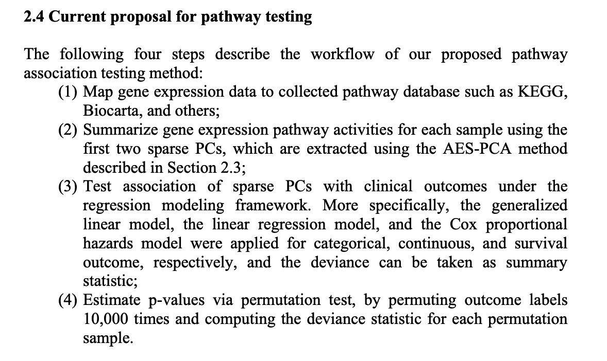
Chen 2011

