Slide 1
Code Snippets
(commented)

Slide 2
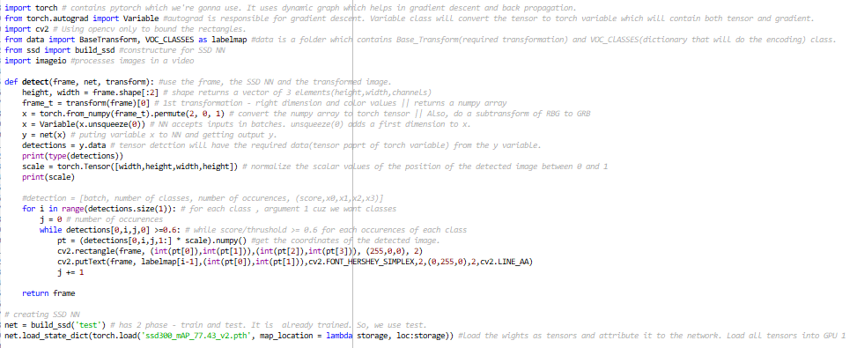

Slide 3
