Slide 1
Discrete Mathematics and Its Applications
Kenneth H. Rosen Trees
1

Slide 2
Tree
Definition 1. A tree is a connected undirected graph with no simple circuits.
Theorem 1. An undirected graph is a tree if and only if there is a unique simple path between any two of its vertices.
2

Slide 3






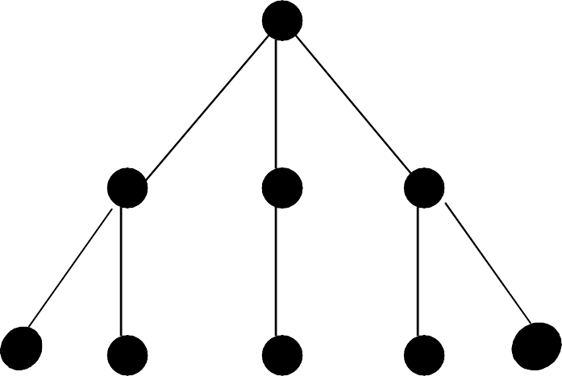
Which graphs are trees?
a)
b)
c)
3

Slide 4

Specify a vertex as root
Then, direct each edge away from the root.
ROOT
c)
4

Slide 5

Specify a root.
Then, direct each edge away from the root.
ROOT
a)
5

Slide 6

Specify a root.
Then, direct each edge away from the root.
ROOT
a)
6

Slide 7
Specify a root.
Then, direct each edge away from the root.
ROOT
a)
A directed graph called a rooted tree results.
7

Slide 8
What if a different root is chosen?
Then, direct each edge away from the root.
ROOT
a)
8

Slide 9
What if a different root is chosen?
Then, direct each edge away from the root.
ROOT
a)
9

Slide 10
What if a different root is chosen?
Then, direct each edge away from the root.
ROOT
a)
10

Slide 11
What if a different root is chosen?
Then, direct each edge away from the root.
ROOT
a)
A different rooted tree results.
11

Slide 12
Jake’s Pizza Shop Tree
Owner Jake
Manager Brad
Chef Carol
Waitress Joyce
Waiter Chris
Cook Max
Helper Len
12

Slide 13
A Tree Has a Root
TREE ROOT
Owner Jake
Manager Brad
Chef Carol
Waitress Joyce
Waiter Chris
Cook Max
Helper Len
13

Slide 14
Level
The level of vertex v in a rooted tree is the length of the unique path from the root to v.

Slide 15
A Tree Has Levels
Owner Jake
LEVEL 0
Manager Brad
Chef Carol
Waitress Joyce
Waiter Chris
Cook Max
Helper Len
15

Slide 16
Level One
Owner Jake
LEVEL 1
Manager Brad
Chef Carol
Waitress Joyce
Waiter Chris
Cook Max
Helper Len
16

Slide 17
Level Two
Owner Jake
Manager Brad
Chef Carol
LEVEL 2
Waitress Joyce
Waiter Chris
Cook Max
Helper Len
17

Slide 18
What is the level of Ted?
Lou
Hal
Max
Ed
Ken
Sue
Joe
Ted

Slide 19
Height
The height of a rooted tree is the maximum of the levels of its vertices.

Slide 20
What is the height?
Lou
Hal
Max
Ed
Ken
Sue
Joe
Ted

Slide 21
Parent
The parent of a non-root vertex is the unique vertex u with a directed edge from u to v.

Slide 22
What is the parent of Ed?
Lou
Hal
Max
Ed
Ken
Sue
Joe
Ted

Slide 23
Sibling nodes have same parent
Owner Jake
SIBLINGS
Manager Brad
Chef Carol
Waitress Joyce
Waiter Chris
Cook Max
Helper Len
23

Slide 24
Sibling nodes have same parent
Owner Jake
Manager Brad
Chef Carol
Waitress Joyce
Waiter Chris
Cook Max
Helper Len
SIBLINGS
24

Slide 25
Internal vertices
Vertices that have children are called internal vertices.

Slide 26
How many internal vertices?
Owner Jake
Manager Brad
Chef Carol
Waitress Joyce
Waiter Chris
Cook Max
Helper Len

Slide 27
Leaf
A vertex is called a leaf if it has no children.

Slide 28
Leaf nodes have no children
Owner Jake
Manager Brad
Chef Carol
Waitress Joyce
Waiter Chris
Cook Max
Helper Len
LEAF NODES
28

Slide 29
How many leaves?
Lou
Hal
Max
Ed
Ken
Sue
Joe
Ted

Slide 30
Ancestors
The ancestors of a non-root vertex are all the vertices in the path from root to this vertex.

Slide 31
How many ancestors of Ken?
Lou
Hal
Max
Ed
Ken
Sue
Joe
Ted

Slide 32
Descendants
The descendants of vertex v are all the vertices that have v as an ancestor.

Slide 33
How many descendants of Hal?
Lou
Hal
Max
Ed
Ken
Sue
Joe
Ted

Slide 34
Subtree
The subtree at vertex v is the subgraph of the tree consisting of vertex v and its descendants and all edges incident to those descendants.

Slide 35
A Subtree
ROOT
Owner Jake
Manager Brad
Chef Carol
Waitress Joyce
Waiter Chris
Cook Max
Helper Len
LEFT SUBTREE OF ROOT
20

Slide 36
Another Subtree
ROOT
Owner Jake
Manager Brad
Chef Carol
Waitress Joyce
Waiter Chris
Cook Max
Helper Len
RIGHT SUBTREE OF ROOT

Slide 37
Binary Tree
Definition 2’. A rooted tree is called a binary tree if every internal vertex has no more than 2 children.
The tree is called a full binary tree if every internal vertex has exactly 2 children.

Slide 38
Ordered Binary Tree
Definition 2’’. An ordered rooted tree is a rooted tree where the children of each internal vertex are ordered.
In an ordered binary tree, the two possible children of a vertex are called the left child and the right child, if they exist.

Slide 39
An Ordered Binary Tree
Lou
Hal
Max
Ed
Ken
Sue
Joe
Ted

Slide 40
m-ary Tree
A rooted tree is called an m-ary tree if every internal vertex has no more than m children.
The tree is called a full m-ary tree if every internal vertex has exactly m children.

Slide 41
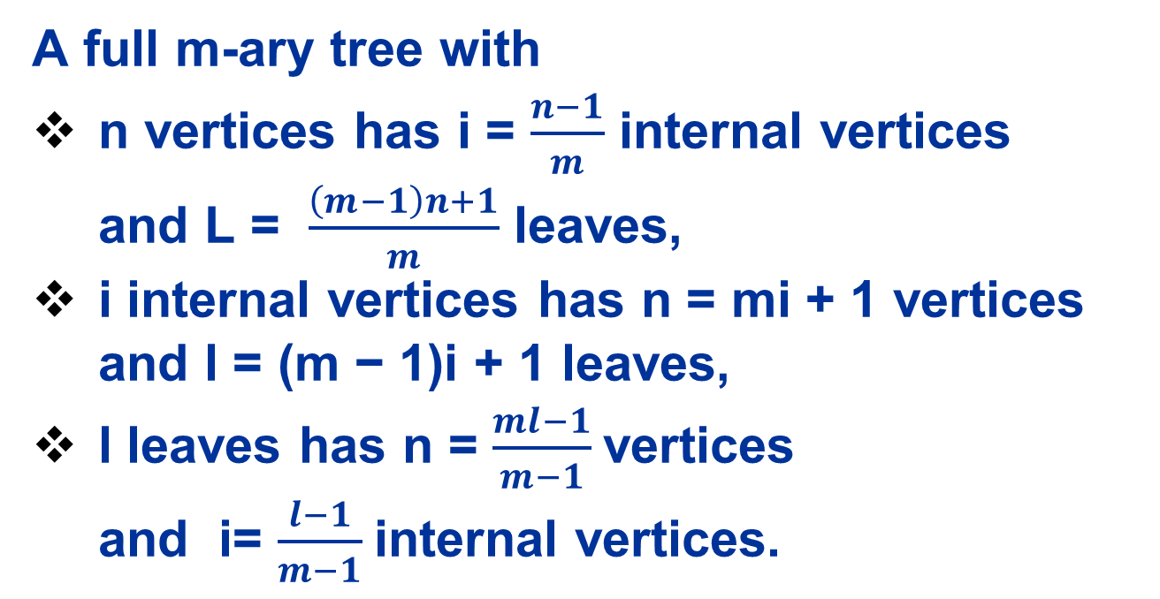
m-ary Tree
A full m-ary tree with
n vertices has i = $\frac{n−1}{m}$ internal vertices and L = $\frac{\left(m−1\right)n+1}{m}$ leaves,
i internal vertices has n = mi + 1 vertices and l = (m − 1)i + 1 leaves,
l leaves has n = $\frac{ml−1}{m−1}$vertices and i= $\frac{l−1}{m−1}$internal vertices.

Slide 42
Balanced
A rooted tree of height H is called balanced if all its leaves are at levels H or H-1.

Slide 43
Balanced
In most textbook:
A balanced binary tree, also referred to as a height-balanced binary tree, is defined as a binary tree in which the height of the left and right subtree of any node differ by not more than 1

Slide 44
Is this binary tree balanced?
Lou
Hal
Max
Ed
Ken
Sue
Joe
Ted

Slide 45
Tree Properties
Theorem 2. A tree with N vertices has N-1 edges.
Theorem 5. There are at most 2 ^{H} leaves in a binary tree of height H.
Corallary. If a binary tree with L leaves is full and balanced, then its height is
H = ⎡ log₂ L ⎤ .

Slide 46
Traversal Algorithms
A traversal algorithm is a procedure for systematically visiting every vertex of an ordered binary tree.
Tree traversals are defined recursively.
Three traversals are named: preorder, inorder, postorder.

Slide 47
PREORDER Traversal Algorithm
Let T be an ordered binary tree with root r.
If T has only r, then r is the preorder traversal.
Otherwise, suppose T₁, T₂ are the left and right subtrees at r. The preorder traversal begins by visiting r. Then traverses T₁ in preorder, then traverses T₂ in preorder.

Slide 48
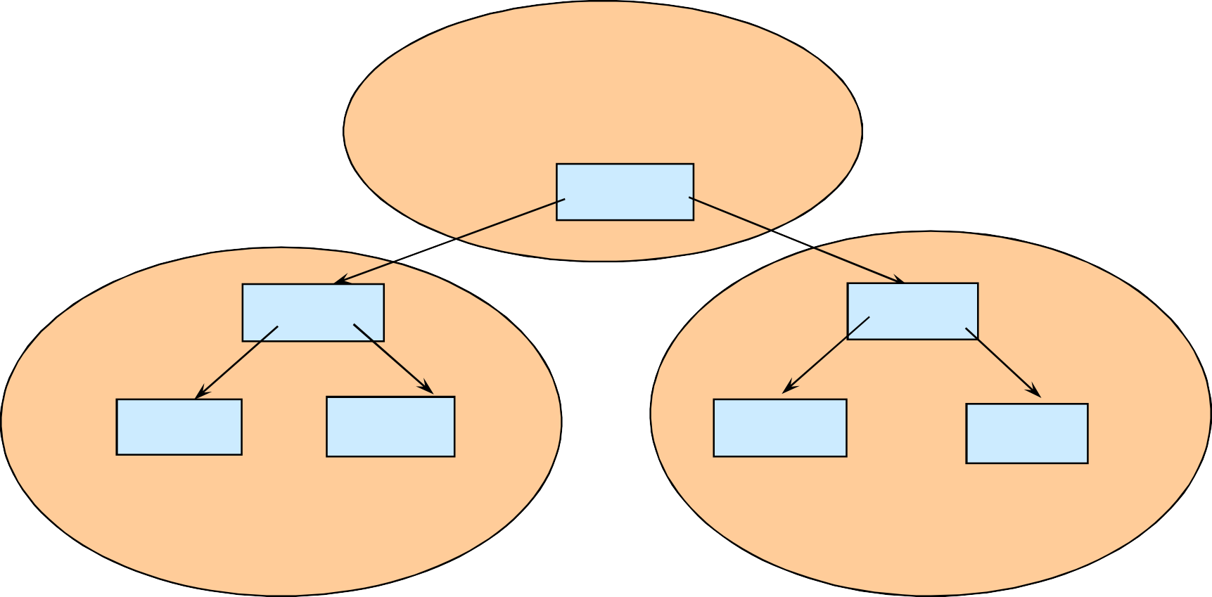
Preorder Traversal:
J E A H T M Y
Visit first.
ROOT
‘J’
‘E’
‘T’
‘A’
‘H’
‘M’
‘Y’
Visit left subtree second
Visit right subtree last

Slide 49
INORDER Traversal Algorithm
Let T be an ordered binary tree with root r.
If T has only r, then r is the inorder traversal.
Otherwise, suppose T₁, T₂ are the left and right subtrees at r. The inorder traversal begins by traversing T₁ in inorder. Then visits r, then traverses T₂ in inorder.

Slide 50
Inorder Traversal: A E H J M T Y
Visit second
ROOT ‘J’
‘E’
‘T’
‘A’
‘H’
‘M’
‘Y’
Visit left subtree first
Visit right subtree last

Slide 51
POSTORDER Traversal Algorithm
Let T be an ordered binary tree with root r.
If T has only r, then r is the postorder traversal. Otherwise, suppose T₁, T₂ are the left and right
subtrees at r. The postorder traversal begins by traversing T₁ in postorder. Then traverses T₂ in postorder, then ends by visiting r.

Slide 52
Postorder Traversal: A H E M Y T J
Visit last
ROOT ‘J’
‘E’
‘T’
‘A’
‘H’
‘M’
‘Y’
Visit left subtree first
Visit right subtree second

Slide 53
A Binary Expression Tree
ROOT
‘-’
‘8’
‘5’
INORDER TRAVERSAL :
8 – 5 has value 3
PREORDER TRAVERSAL:
- 8 5
POSTORDER TRAVERSAL: 8 5 -

Slide 54
Searching takes time . . .
So the goal in computer programs is to find any stored item efficiently when all stored items are ordered.
A Binary Search Tree can be used to store items in its vertices. It enables efficient searches.

Slide 55
A Binary Search Tree (BST) is . . .
A special kind of binary tree in which:
Each vertex contains a distinct key value,
The key values in the tree can be compared using “greater than” and “less than”, and
The key value of each vertex in the tree is
less than every key value in its right subtree, and greater than every key value in its left subtree.

Slide 56
Shape of a binary search tree . . .
Depends on its key values and their order of insertion. Insert the elements ‘J’ ‘E’ ‘F’ ‘T’ ‘A’ in that order. The first value to be inserted is put into the root.
‘J’

Slide 57
Inserting ‘E’ into the BST
Thereafter, each value to be inserted begins by comparing itself to the value in the root, moving left it is less, or moving right if it is greater. This continues at each level until it can be inserted as a
new leaf.
‘J’
‘E’

Slide 58
Inserting ‘F’ into the BST
Begin by comparing ‘F’ to the value in the root, moving left it is less, or moving right if it is greater. This continues until it can be inserted as a leaf.
‘J’
‘E’
‘F’

Slide 59
Inserting ‘T’ into the BST
Begin by comparing ‘T’ to the value in the root, moving left it is less, or moving right if it is greater. This continues until it can be inserted as a leaf.
‘J’
‘E’
‘T’
‘F’

Slide 60
Inserting ‘A’ into the BST
Begin by comparing ‘A’ to the value in the root, moving left it is less, or moving right if it is greater. This continues until it can be inserted as a leaf.
‘J’
‘E’
‘T’
‘A’
‘F’

Slide 61
What binary search tree . . .
is obtained by inserting the elements ‘A’ ‘E’
‘F’ ‘J’ ‘T’
in that order?
‘A’

Slide 62
Binary search tree . . .
obtained by inserting
the elements ‘A’ ‘E’ ‘F’ ‘J’ ‘T’
in that order.
‘A’
‘E’
‘F’
‘J’
‘T’

Slide 63
Another binary search tree
‘J’
‘E’
‘T’
‘A’
‘H’
‘M’
‘K’
‘P’
Add nodes containing these values in this order:
‘D’ ‘B’ ‘L’ ‘Q’ ‘S’ ‘V’ ‘Z’

Slide 64
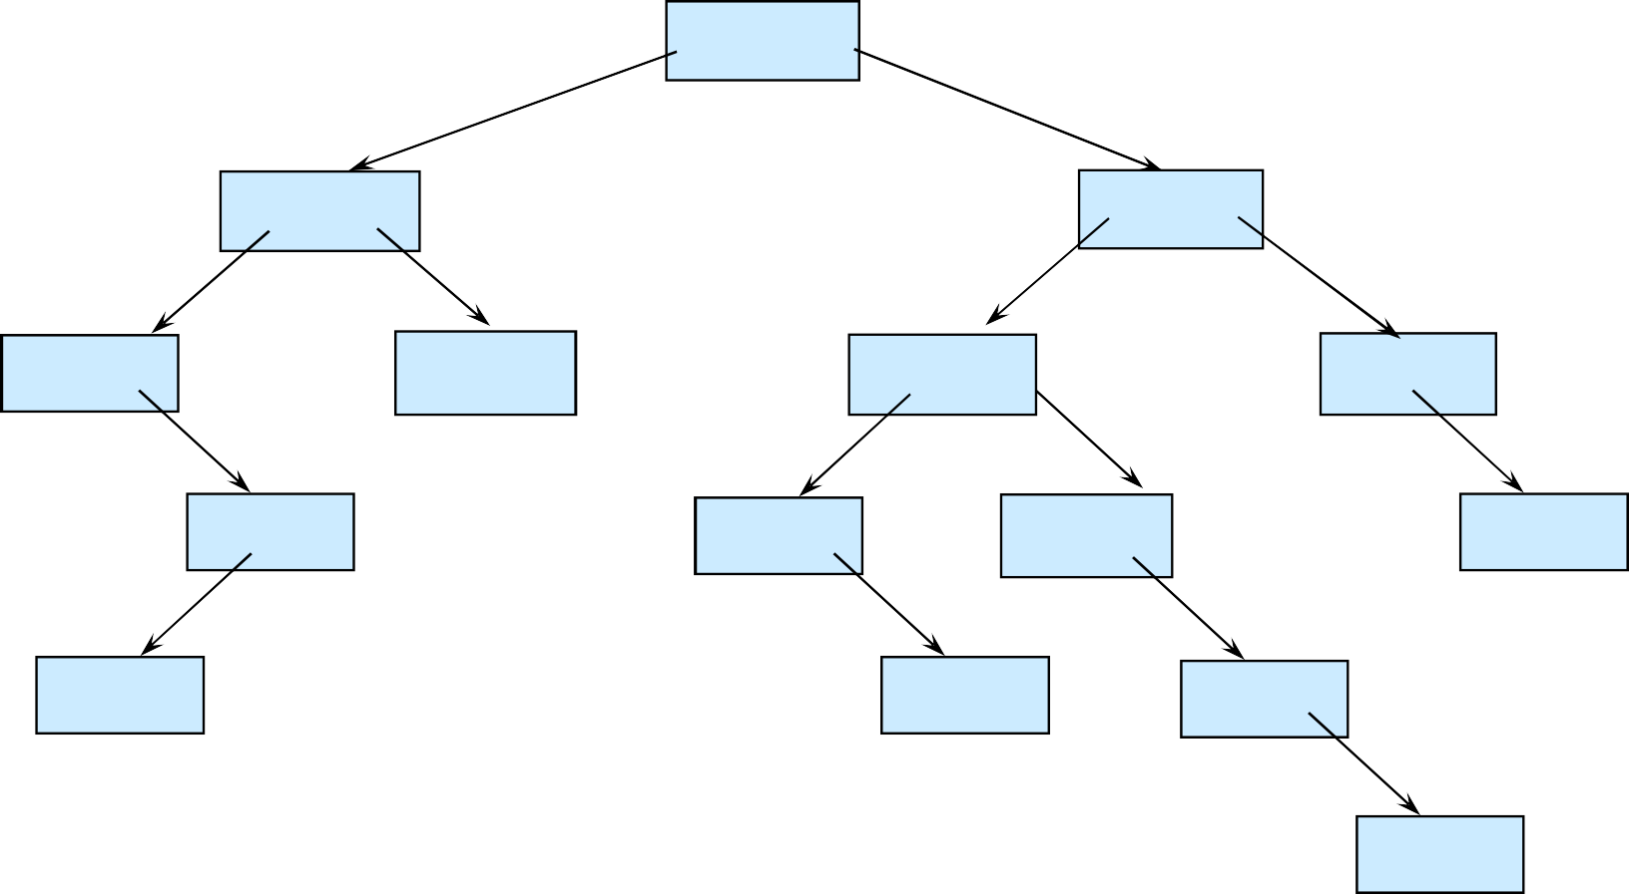
Is ‘F’ in the binary search tree?
‘J’
‘E’
‘T’
‘A’
‘H’
‘M’
‘V’
‘D’
‘K’
‘P’
‘Z’
‘B’
‘L’
‘Q’
‘S’

Slide 65
A Binary Expression Tree is . . .
A special kind of binary tree in which:
Each leaf node contains a single operand,
Each nonleaf node contains a single binary operator, and
The left and right subtrees of an operator node represent subexpressions that must be evaluated before applying the operator at the root of the subtree.

Slide 66
A Binary Expression Tree
‘*’
‘+’
‘3’
‘4’
‘2’
What value does it have?
( 4 + 2 ) * 3 = 18

Slide 67
A Binary Expression Tree
‘*’
‘+’
‘3’
‘4’
‘2’
What infix, prefix, postfix expressions does it represent?

Slide 68
A Binary Expression Tree
‘*’
‘+’
‘3’
‘4’
‘2’
Infix: Prefix: Postfix:
( ( 4 + 2 ) * 3 )
* + 4 2 3
4 2 + 3 *
evaluate from right evaluate from left

Slide 69
Levels Indicate Precedence
When a binary expression tree is used to represent an expression, the levels of the nodes in the tree indicate their relative precedence of evaluation.
Operations at higher levels of the tree are evaluated later than those below them.
The operation at the root is always the last operation performed.

Slide 70
Evaluate
this binary expression tree
‘*’
‘-’
‘/’
‘8’
‘5’
‘+’
‘3’
‘4’
‘2’
What infix, prefix, postfix expressions does it represent?

Slide 71
A binary expression tree
‘*’
‘-’
‘/’
‘8’
‘5’
‘+’
‘3’
‘4’
‘2’
Infix: Prefix:
( ( 8 - 5 ) * ( ( 4 + 2 ) / 3 ) )
* - 8 5 / + 4 2 3
Postfix:
8 5 -
4 2 + 3 / *
has operators in order used
71

Slide 72
A binary expression tree
‘*’
‘-’
‘/’
‘8’
‘5’
‘+’
‘3’
‘4’
‘2’
Infix: ( ( 8 - 5 ) * ( ( 4 + 2 ) / 3 ) )
Prefix: * - 8 5 / + 4 2 3 evaluate from right
Postfix: 8 5 - 4 2 + 3 / * evaluate from left

Slide 73
Constructing a Binary Expression Tree from Infix
Initialize Two Stacks
operands stack → Stores tree nodes representing numbers/variables.
operators stack → Stores operators (+, -, *, /, ^).
2. Read Tokens from the Infix Expression
If it's an operand (number/variable) →Create a tree node and push it onto the operands stack.
If it's an opening parenthesis ( →Push it onto the operators stack.
If it's a closing parenthesis ) →Pop operators from the operators stack and create nodes until an opening parenthesis ( is found. The sub-expression inside the parentheses is now built as a subtree.
If it's an operator (+, -, *, /, ^) →
While the operators stack is not empty and the top operator has greater or equal precedence:
Pop the top operator and construct a subtree using the top two nodes from the operands stack.
Push the new subtree back into operands.
Push the current operator into the operators stack.

Slide 74
Constructing a Binary Expression Tree from Infix
Example: ( ( 8 - 5 ) * ( ( 4 + 2 ) / 3 ) )

Slide 75
Constructing a Binary Expression Tree from Prefix
Use a Stack to build the Tree:
If it's an operand (number/variable): Create a new node and push it onto the stack.
If it's an operator (+, -, *, /):
Create a new node for the operator.
Pop the top two nodes from the stack (they are the right and left children).
Attach them as children of the operator node.
Push the new node back onto the stack.

Slide 76
Constructing a Binary Expression Tree from Infix (cont)
3. Process Remaining Operators
After reading all tokens, process all remaining operators in the operators stack:
Pop the top operator.
Pop two operands from the operands stack.
Create a new subtree and push it back to operands.
4. The Last Node in the Operands Stack is the Root of the Expression Tree
This node represents the fully constructed binary expression tree.

Slide 77
Infix, prefix, postfix conversion
Infix expressions are easily readable and solvable by humans whereas the computer cannot differentiate the operators and parenthesis easily so, it is better to convert the expression to postfix(or prefix) form before evaluation

Slide 78
Infix to Postfix
To convert infix expression to postfix expression, use the stack data structure.
Scan the infix expression from left to right. Whenever we get an operand, add it to the postfix expression and if we get an operator or parenthesis add it to the stack by maintaining their precedence.

Slide 79
Infix to Postfix
Scan Each Element of the Infix Expression
If it's an operand (number, variable) → Append it directly to the output.
If it's an opening parenthesis ( → Push it onto the stack.
If it's a closing parenthesis ) → Pop operators from the stack and append them to the output until ( is encountered.
If it's an operator (+ - * / ^):
Pop operators from the stack (if any) and append them to the output as long as they have higher or equal precedence.
Then, push the current operator onto the stack.
After scanning the entire expression, pop all remaining operators from the stack and append them to the output.

Slide 80
Infix to Postfix
Convert infix to postfix:
( ( 8 - 5 ) * ( ( 4 + 2 ) / 3 ) )
5 + 3 * 6 - 4

Slide 81
Infix to Postfix
( ( 8 - 5 ) * ( ( 4 + 2 ) / 3 ) )
Token | Stack (Operators) | Output (Postfix)
( | ( | -
( | (( | -
8 | (( | 8
- | ((- | 8
5 | ((- | 8 5
) | ( | 8 5 -
* | (* | 8 5 -
( | (*( | 8 5 -
( | (*(( | 8 5 -
4 | (*(( | 8 5 - 4
+ | (*((+ | 8 5 - 4
2 | (*((+ | 8 5 - 4 2
) | (*( | 8 5 - 4 2 +
/ | (*(/ | 8 5 - 4 2 +
3 | (*(/ | 8 5 - 4 2 + 3
) | (* | 8 5 - 4 2 + 3 /
) | - | 8 5 - 4 2 + 3 / *

Slide 82
Infix to Prefix
To convert an infix expression to a prefix expression, we can use the stack data structure.
Step 1: Reverse the infix expression. Note while reversing each ‘(‘ will become ‘)’ and each ‘)’ becomes ‘(‘.
Step 2: Convert the reversed infix expression to “nearly” postfix expression.
While converting to postfix expression, instead of using pop operation to pop operators with greater than or equal precedence, here we will only pop the operators from stack that have greater precedence.
Step 3: Reverse the postfix expression.
The stack is used to convert infix expression to postfix form.

Slide 83
Postfix to prefix
Read the Postfix expression from left to right
If the symbol is an operand, then push it onto the Stack
If the symbol is an operator, then pop two operands from the Stack
Create a string by concatenating the two operands and the operator before them.
string = operator + operand2 + operand1
And push the resultant string back to Stack
Repeat the above steps until end of Postfix expression.
Convert postfix to prefix:
AB+CD-*
ABC/-AK/L-*

Slide 84
Postfix to infix
Read the Postfix expression from left to right
If the symbol is an operand, then push it onto the Stack
If the symbol is an operator, then pop two operands from the Stack
Create a string by concatenating the two operands and the operator before them.
string = (operand2 + operator + operand1 )
And push the result string back to Stack
Repeat the above steps until end of Postfix expression.
Convert postfix to infix:
AB+CD-*
ABC/-AK/L-*
Convert postfix to infix:
AB+CD-*
ABC/-AK/L-*

Slide 85
Prefix to postfix
Read the Prefix expression in reverse order (from right to left)
If the symbol is an operand, then push it onto the Stack
If the symbol is an operator, then pop two operands from the Stack Create a string by concatenating the two operands and the operator after them. string = operand1 + operand2 + operator And push the resultant string back to Stack
Repeat the above steps until end of Prefix expression.
Convert prefix to postifx:
*+AB-CD
*-A/BC-/AKL

Slide 86
Prefix to infix
Read the Prefix expression in reverse order (from right to left)
If the symbol is an operand, then push it onto the Stack
If the symbol is an operator, then pop two operands from the Stack Create a string by concatenating the two operands and the operator between them. string = (operand1 + operator + operand2) And push the resultant string back to Stack
Repeat the above steps until the end of Prefix expression.
At the end stack will have only 1 string i.e resultant string
Convert prefix to infix:
*+AB-CD
*-A/BC-/AKL

Slide 87
Inorder Traversal: (A + H) / (M - Y)
Print second
ROOT
‘/’
‘+’
‘-’
‘A’
‘H’
‘M’
‘Y’
Print left subtree first
Print right subtree last
87

Slide 88
Preorder Traversal:
/ + A H - M Y
Print first
ROOT
‘/’
‘+’
‘-’
‘A’
‘H’
‘M’
‘Y’
Print left subtree second
Print right subtree last
70

Slide 89
Postorder Traversal: A H + M Y - /
Print last
ROOT
‘/’
‘+’
‘-’
‘A’
‘H’
‘M’
‘Y’
Print left subtree first
Print right subtree second
89

