Slide 1
Minimum Spanning Trees

Slide 2
Spanning Trees
Given (connected undirected) graph G(V,E),
a spanning tree T(V’,E’):
Is a subgraph of G; that is, V’ ⊆ V, E’ ⊆ E.
Include all of the vertices(V’ = V)
Forms a tree (no cycle);
So, E’ has |V| -1 edges

Slide 3
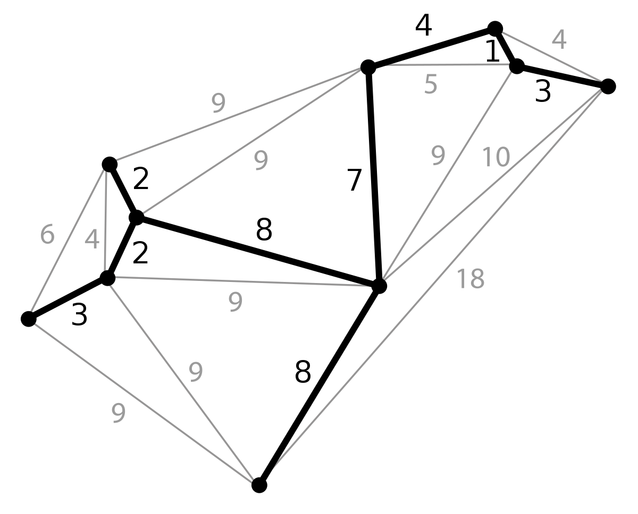
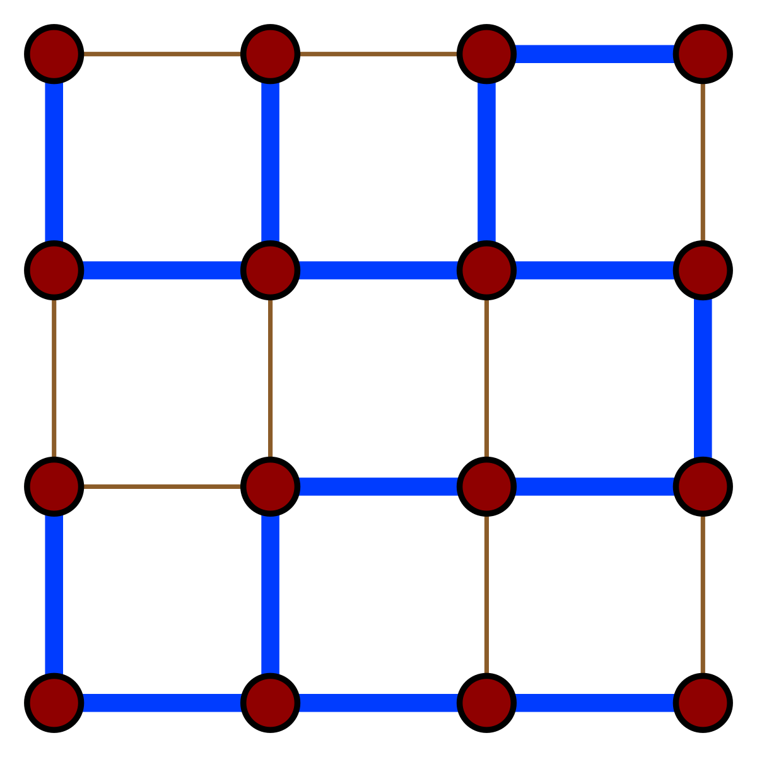
Spanning Trees - Example

Slide 4
Minimum Spanning Trees
Edges are weighted: find minimum cost spanning tree
Applications
Find cheapest way to wire your house
Find minimum cost to send a message on the Internet
Find the minimum length of cables to connect PCs

Slide 5
Strategy for Minimum Spanning Tree
For any spanning tree T, inserting an edge e_{new} not in T creates a cycle
But
Removing any edge e_{old} from the cycle gives back a spanning tree
If e_{new} has a lower cost than e_{old} we have progressed!

Slide 6
Strategy
Strategy for construction:
Add an edge of minimum cost that does not create a cycle (greedy algorithm)
Repeat |V| -1 times
Correct since if we could replace an edge with one of lower cost, the algorithm would have picked it up

Slide 7
Two Algorithms
Prim: (build tree incrementally)
Pick lower cost edge connected to known (incomplete) spanning tree that does not create a cycle and expand to include it in the tree
Kruskal: (build forest that will finish as a tree)
Pick lowest cost edge not yet in a tree that does not create a cycle. Then expand the set of included edges to include it. (It will be somewhere in the forest.)

Slide 8
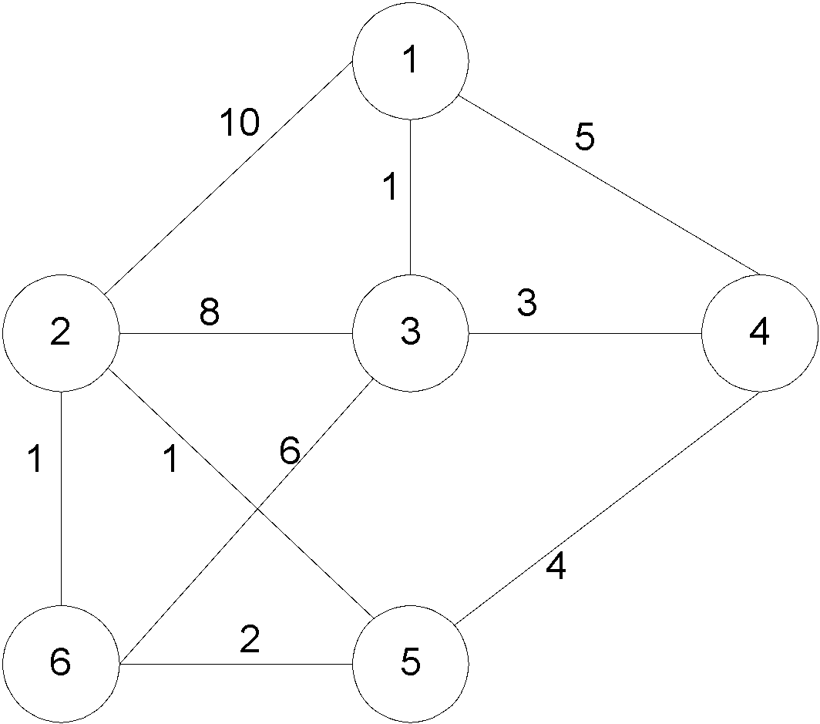
Prim’s algorithm
Starting from empty T, choose a vertex at random and initialize
V = {1), E’ ={}

Slide 9
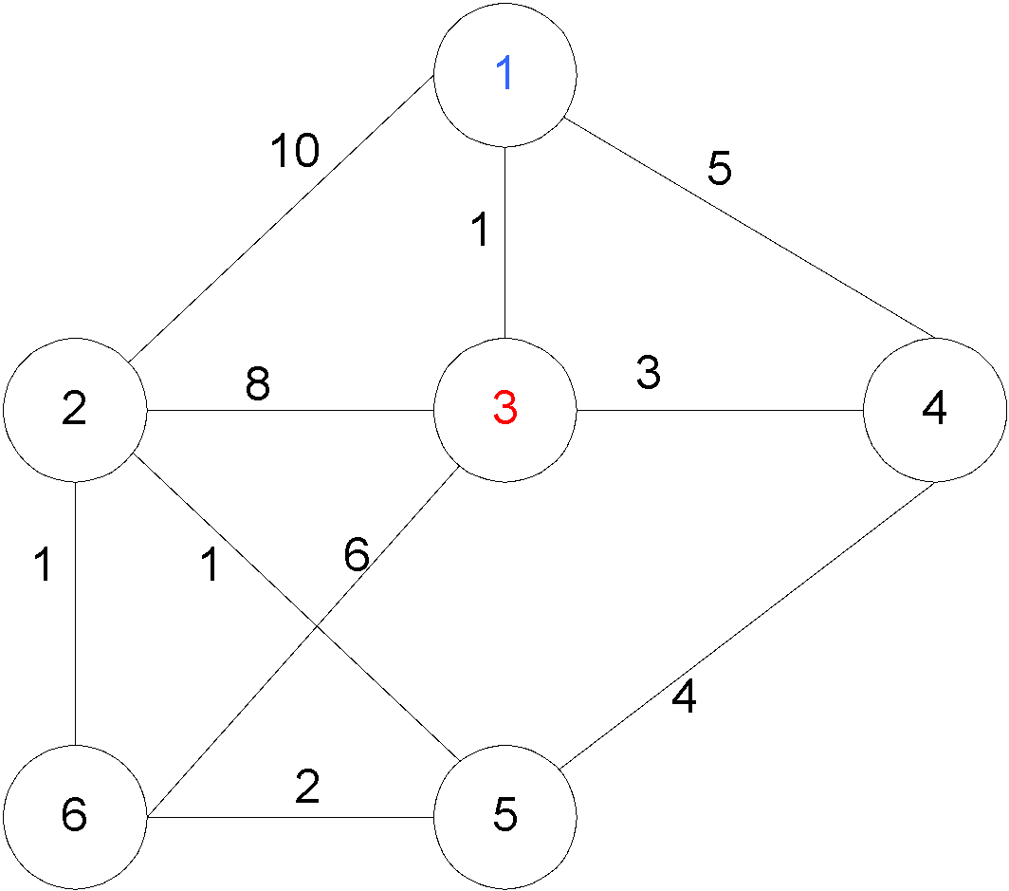
Prim’s algorithm
Choose the vertex u not in V such that edge weight from u to a vertex in V is minimal (greedy!)
V={1,3} E’= {(1,3) }

Slide 10
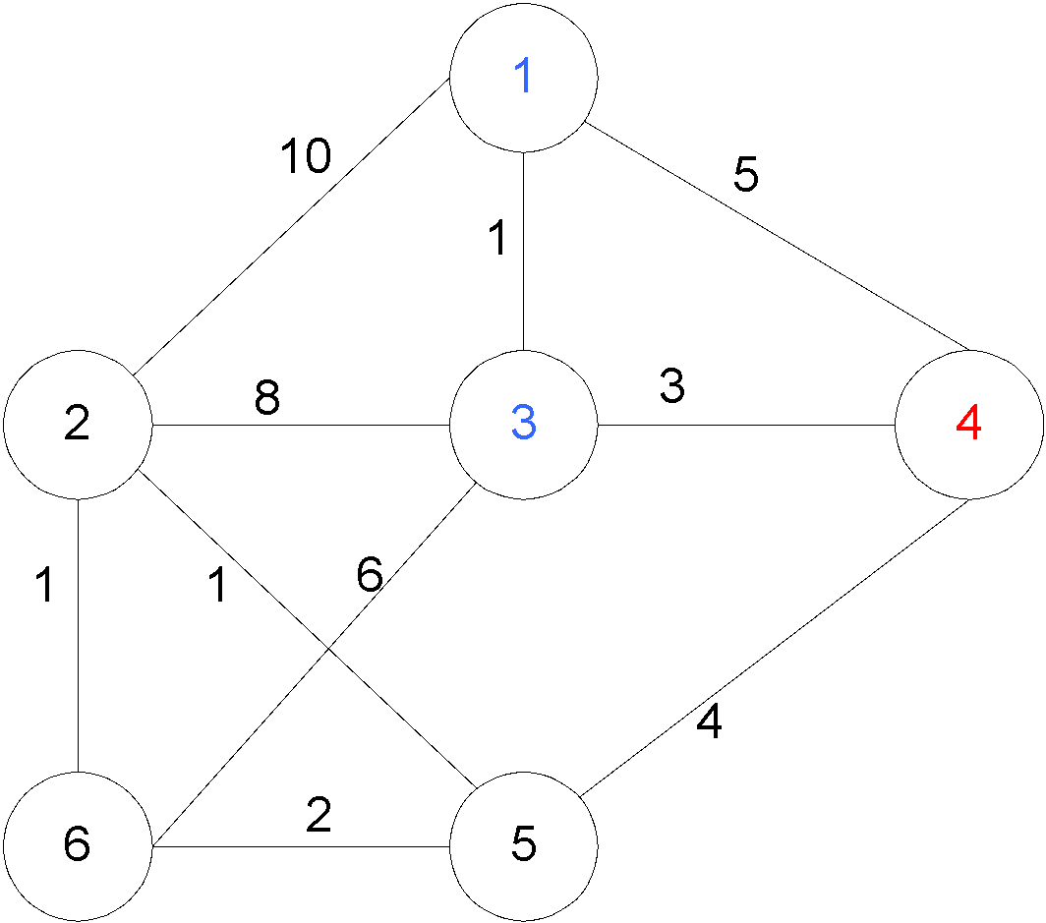
Prim’s algorithm
Repeat until all vertices have been chosen
Choose the vertex u not in V such that edge weight from v to a vertex in V is minimal (greedy!)
V= {1,3,4} E’= {(1,3),(3,4)}
V={1,3,4,5} E’={(1,3),(3,4),(4,5)}
….
V={1,3,4,5,2,6}
E’={(1,3),(3,4),(4,5),(5,2),(2,6)}

Slide 11
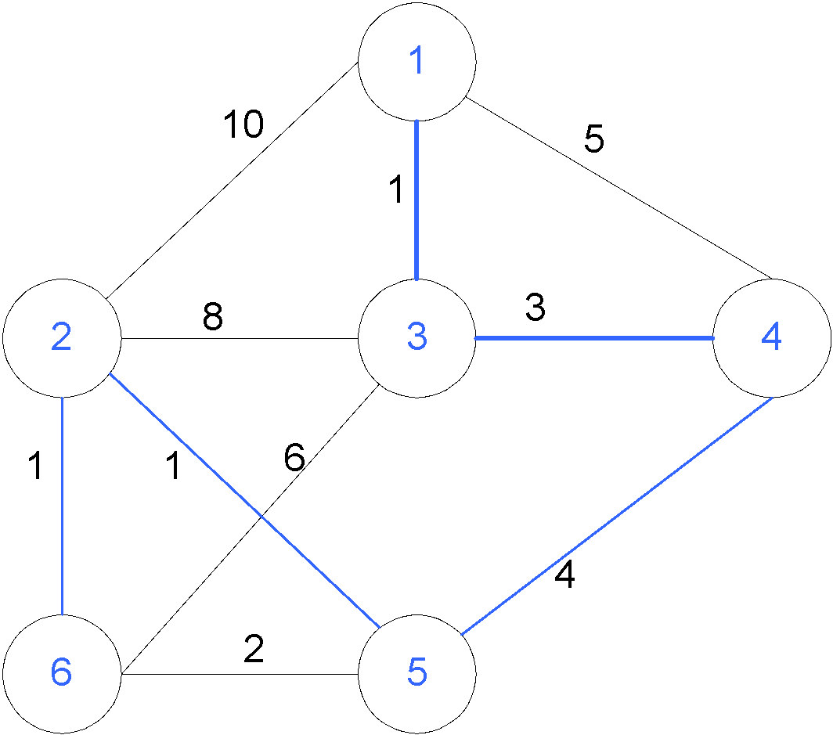
Prim’s algorithm
Repeat until all vertices have been chosen
V={1,3,4,5,2,6}
E’={(1,3),(3,4),(4,5),(5,2),(2,6)}
Final Cost: 1 + 3 + 4 + 1 + 1 = 10

Slide 12
Prim’s Algorithm Implementation
Assume adjacency list representation
Initialize connection cost of each node to “inf” and “unmark” them
Choose one node, say v and set cost[v] = 0 and prev[v] =0
While there are unmarked nodes
Select the unmarked node u with minimum cost; mark it
For each unmarked node w adjacent to u
if cost(u,w) < cost(w) then cost(w) := cost (u,w)
prev[w] = u

Slide 13
Prim’s algorithm Analysis
If the “Select the unmarked node u with minimum cost” is done with binary heap then O((n+m)logn)

Slide 14
Kruskal’s Algorithm
Select edges in order of increasing cost
Accept an edge to expand tree or forest only if it does not cause a cycle
Implementation using adjacency list, priority queues and disjoint sets

Slide 15
Kruskal’s Algorithm
Initialize a forest of trees, each tree being a single node
Build a priority queue of edges with priority being lowest cost
Repeat until |V| -1 edges have been accepted {
Deletemin edge from priority queue
If it forms a cycle then discard it
else accept the edge – It will join 2 existing trees yielding a larger tree and reducing the forest by one tree
}
The accepted edges form the minimum spanning tree

Slide 16
Detecting Cycles
If the edge to be added (u,v) is such that vertices u and v belong to the same tree, then by adding (u,v) you would form a cycle
Therefore to check, Find(u) and Find(v). If they are the same discard (u,v)
If they are different Union(Find(u),Find(v))

Slide 17
Properties of trees in K’s algorithm
Vertices in different trees are disjoint
True at initialization and Union won’t modify the fact for remaining trees
Trees form equivalent classes under the relation “is connected to”
u connected to u (reflexivity)
u connected to v implies v connected to u (symmetry)
u connected to v and v connected to w implies a path from u to w so u connected to w (transitivity)

Slide 18
K’s Algorithm Data Structures
Adjacency list for the graph
To perform the initialization of the data structures below
Disjoint Set ADT’s for the trees (recall Up tree implementation of Union-Find)
Binary heap for edges

Slide 19
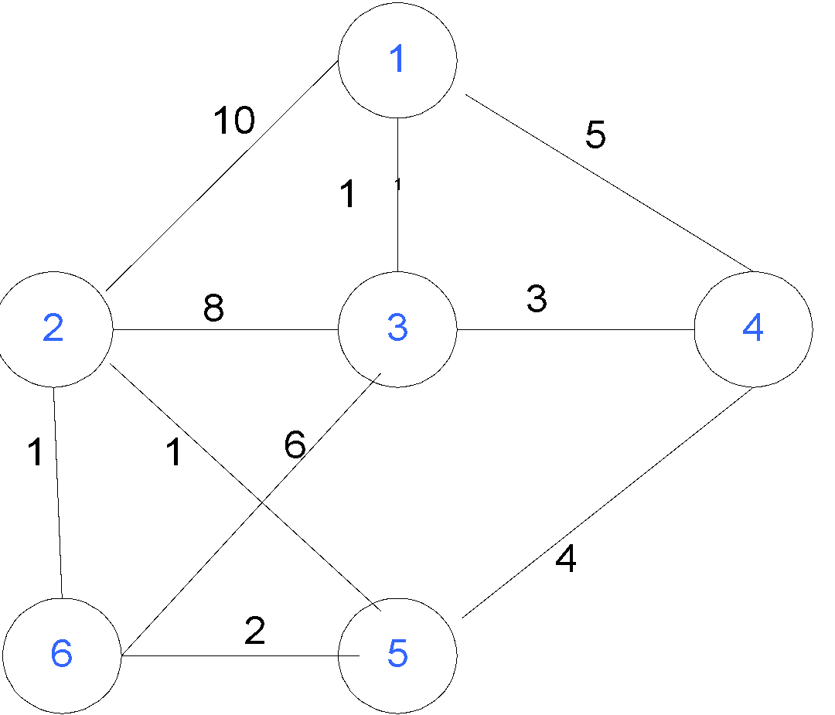
Example

Slide 20
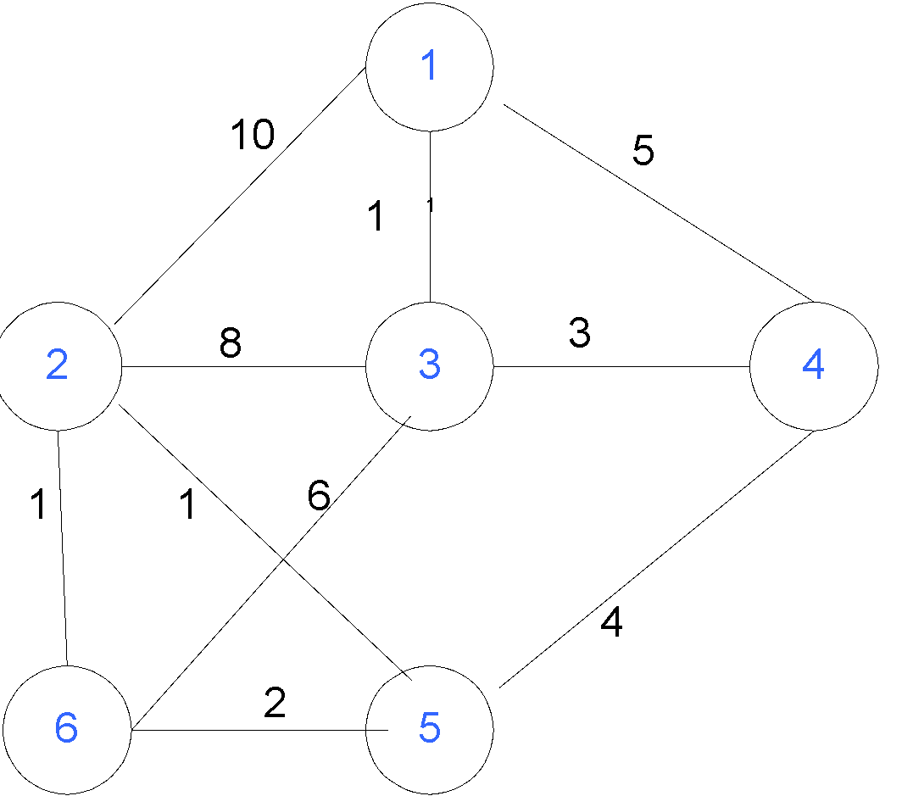

Slide 21
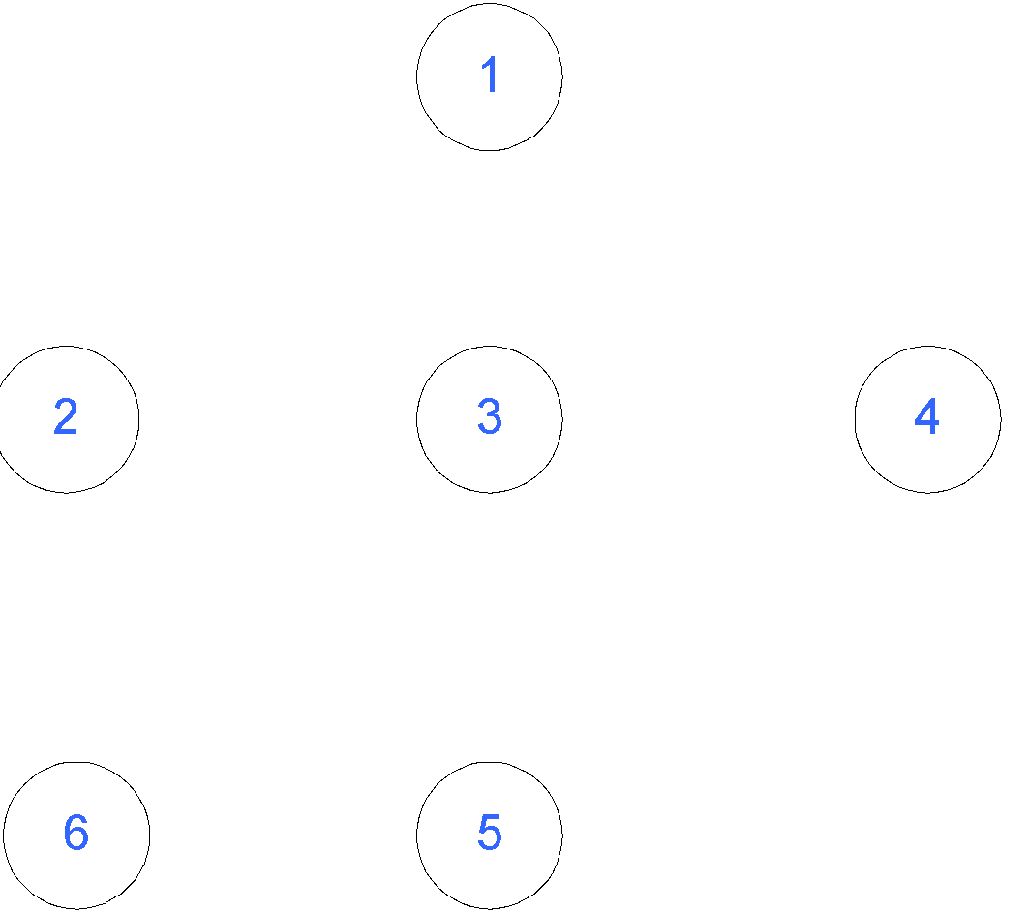
Initialization
Initially, Forest of 6 trees
F= {{1},{2},{3},{4},{5},{6}}
Edges in a heap (not shown)

Slide 22
Step 1
Select edge with lowest cost (2,5)
Find(2) = 2, Find (5) = 5
Union(2,5)
F= {{1},{2,5},{3},{4},{6}}
1 edge accepted
1

Slide 23
Step 2
Select edge with lowest cost (2,6)
Find(2) = 2, Find (6) = 6
Union(2,6)
F= {{1},{2,5,6},{3},{4}}
2 edges accepted
1
1

Slide 24
Step 3
Select edge with lowest cost (1,3)
Find(1) = 1, Find (3) = 3
Union(1,3)
F= {{1,3},{2,5,6},{4}}
3 edges accepted
1
1
1

Slide 25
Step 4
Select edge with lowest cost (5,6)
Find(5) = 2, Find (6) = 2
Do nothing
F= {{1,3},{2,5,6},{4}}
3 edges accepted
1
1
1

Slide 26
Step 5
Select edge with lowest cost (3,4)
Find(3) = 1, Find (4) = 4
Union(1,4)
F= {{1,3,4},{2,5,6}}
4 edges accepted
1
3
1
1

Slide 27
Step 6
Select edge with lowest cost (4,5)
Find(4) = 1, Find (5) = 2
Union(1,2)
F= {{1,3,4,2,5,6}}
5 edges accepted : end
Total cost = 10
Although there is a unique spanning tree in this example, this is not generally the case
1
3
1
4
1

Slide 28
Kruskal’s Algorithm Analysis
Initialize forest O(n)
Initialize heap O(m), m = |E|
Loop performed m times
In the loop one DeleteMin O(log m)
Two Find, each O(log n)
One Union (at most) O(1)
So worst case O(m log m) = O(m log n)

Slide 29
Time Complexity Summary
Recall that m = |E| = O(V²) = O(n² )
Prim’s runs in O((n+m) log n)
Kruskal runs in O(m log m) = O(m log n)
In practice, Kruskal has a tendency to run faster since graphs might not be dense and not all edges need to be looked at in the Deletemin operations

Slide 30
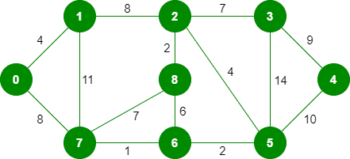
Exercise

Slide 31
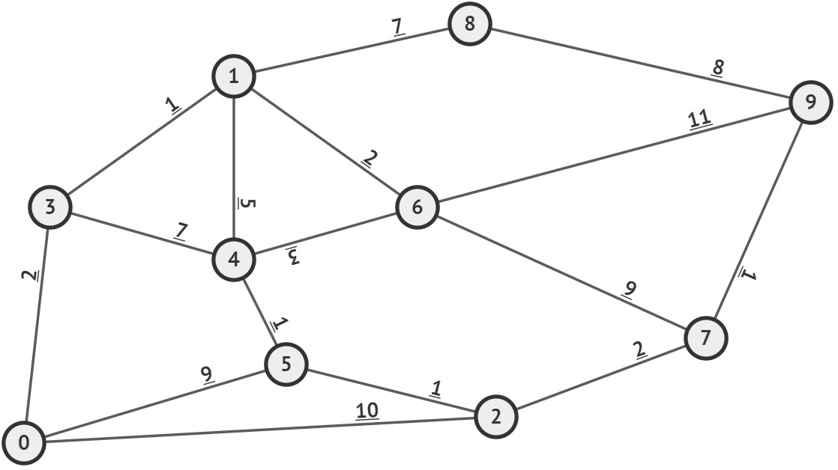
Exercise

Slide 32
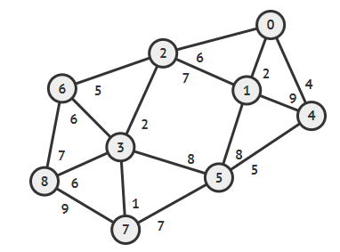
Exercise

Slide 33
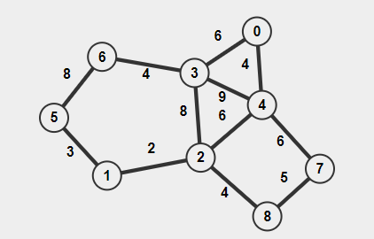

Slide 34
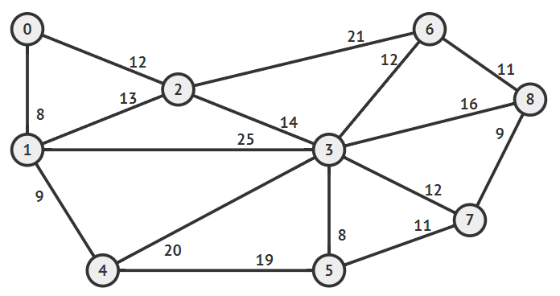

Slide 35
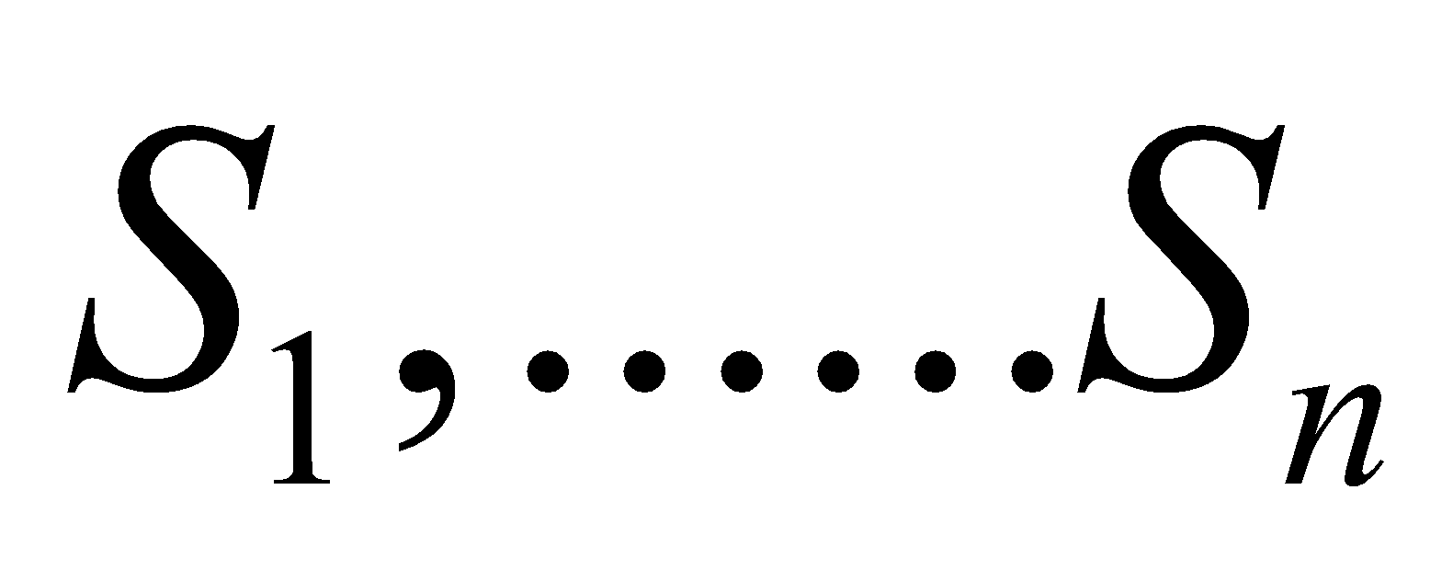
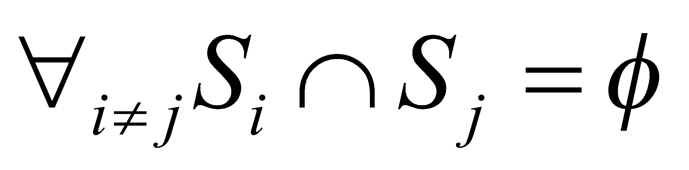
Disjoint Sets
Some applications require maintaining a collection of disjoint sets.
A Disjoint set S is a collection of sets
where
Two sets are called disjoint sets if they don’t have any element in common, the intersection of sets is a null set.

Slide 36
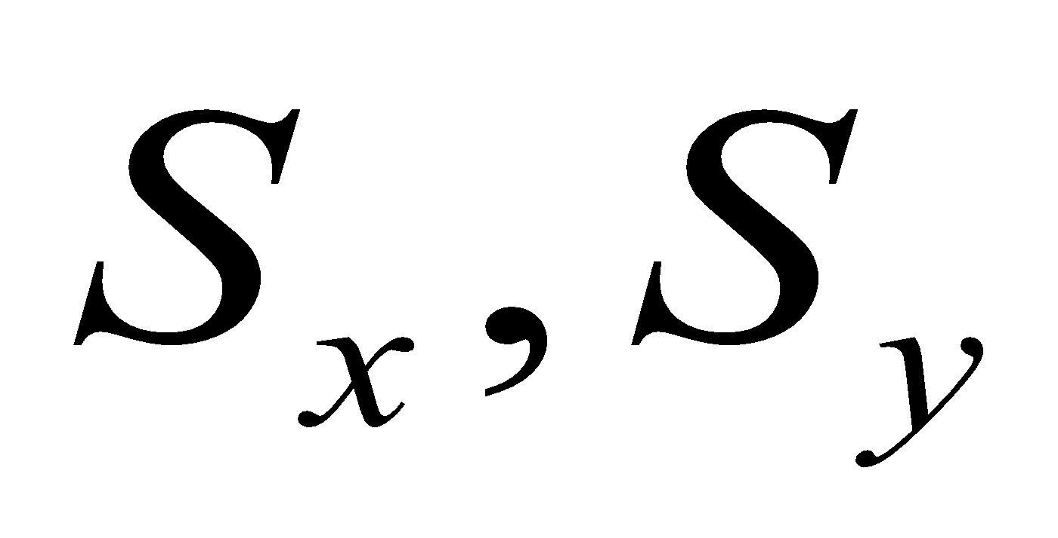
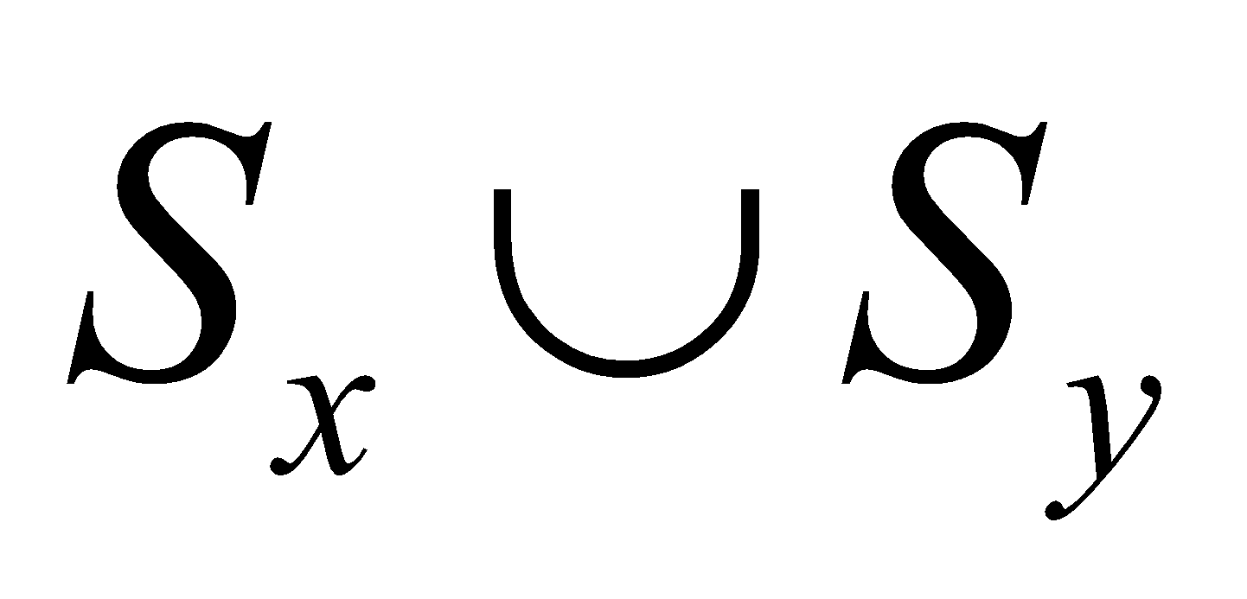
Disjoint Set Operations
Make-Set(x) – Creates a new set where x is it’s only element (and therefore it is the representative of the set). O(1) time.
Union(x,y) – Replaces by one of the elements of becomes the representative of the new set. O(log n) time.
Find(x) – Returns the representative of the set containing x O(log n) time

Slide 37
Disjoint-Set Forests
Maintain A collection of trees, each element points to it’s parent. The root of each tree is the representative of the set

Slide 38
Make Set
MAKE_SET(x)
p(x)=x
x

Slide 39
Find Set
FIND_SET(d)
if d != p[d]
return FIND_SET(p[d])
return d
c
a
b
f
d

Slide 40
Union
w
c
UNION(x,y)
link(findSet(x),
findSet(y))
link(x,y)
if x != y
then p(y)=x
x
a
b
f
y
d
z
c
w
a
b
f
x
y
d
z

Slide 41
Disjoint-Set Forests
Maintain A collection of trees, each element points to it’s parent. The root of each tree is the representative of the set
We use two strategies for improving running time
Union by Rank
Path Compression
c
a
b
f
d

Slide 42
Make Set
MAKE_SET(x)
p(x)=x
rank(x)=0
x

Slide 43
Find Set
FIND_SET(d)
if d != p[d]
p[d]= FIND_SET(p[d])
return p[d]
c
a
b
f
d

Slide 44
Union
w
c
UNION(x,y)
link(findSet(x),
findSet(y))
link(x,y)
if rank(x)>rank(y)
then p(y)=x
else
p(x)=y
if rank(x)=rank(y)
then rank(y)++
x
a
b
f
y
d
z
c
w
a
b
f
x
y
d
z

Slide 45
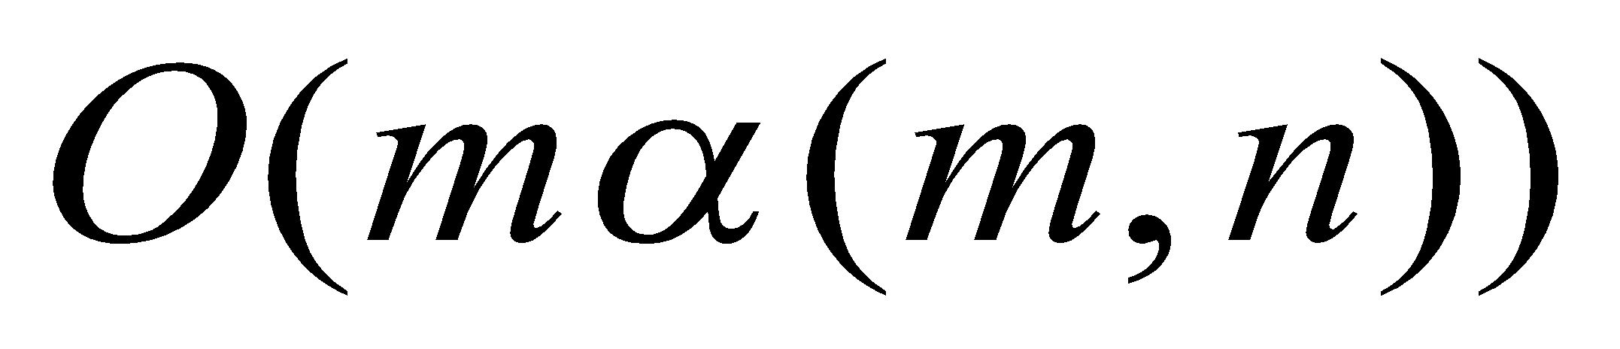
Analysis
In Union we attach a smaller tree to the larger tree, results in logarithmic depth.
Path compression can cause a very deep tree to become very shallow
Combining both ideas gives us (without proof) a sequence of m operations in

