Slide 1
Tree - Review

Slide 2
Definitions
Tree and rooted tree,
Sibling nodes, internal nodes, leaves, ancestors, descendants
Subtree
Level of a vertex
Height of a tree
Binary tree, balanced tree
Binary search tree
Inorder, preoder, postorder

Slide 3
Questions
Maximum number nodes/leaves in a binary tree of height H.
Prove that in a full binary tree the number of vertices is always odd
Prove that in a full binary tree, the number of leaves = the number of internal vertices + 1
List 3 ways to check if an undirected graph is a tree

Slide 4
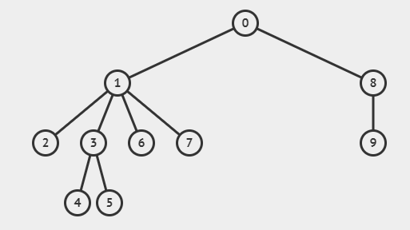
Exercise 1
Traverse the following tree using BFS and DFS from node 0
Determine the level of each nodes and the height of the tree if node 9 is the root.

Slide 5
Exercise 2
Draw the binary search tree if its nodes are inserted in the following order
13 1 19 5 15 17 9 20 4 7 6 8

Slide 6
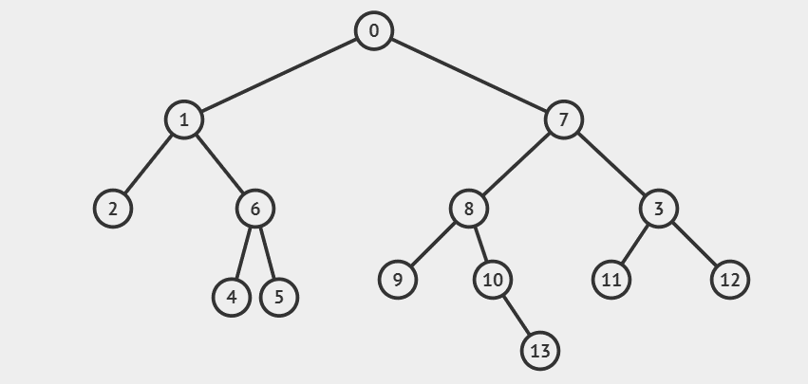
Exercise 3
Traverse the following binary tree and print node’s lables with pre-order, in-order, and post-order

Slide 7
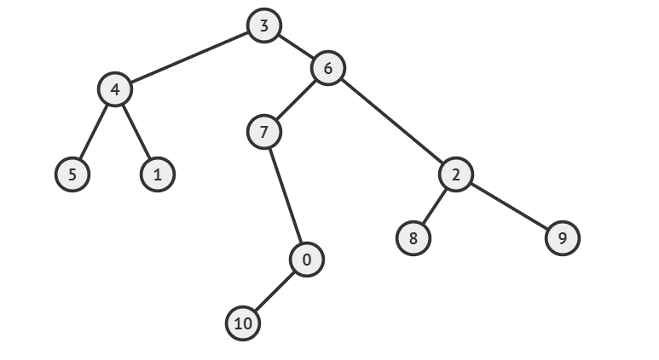
Exercise 4
Traverse the following binary tree and print node’s lables with pre-order, in-order, and post-order

Slide 8
Exercise 5
Given the pre-order and in-order traversals of a binary tree, construct the given tree and traverse the tree in post-order
Pre-order: 1 2 0 10 11 4 5 7 3 6 8 9
In-order:10 11 0 2 5 4 7 1 6 8 3 9

Slide 9
Exercise 6
Given the pre-order and in-order traversals of a binary tree, construct the given tree and traverse the tree in post-order
In-order: 7 8 9 1 5 0 3 11 6 10 4 2
Pre-order: 0 8 7 5 9 1 3 10 11 6 2 4

Slide 10
Exercise 7
Given the post-order and in-order traversals of a binary tree, construct the given tree and traverse the tree in preorder
PostOrder: 3 10 0 4 5 9 1 6 8 7 2
InOrder: 3 5 0 10 4 2 1 9 6 7 8

Slide 11
Exercise 8
Given the post-order and in-order traversals of a binary tree, construct the given tree and traverse the tree in preorder
PostOrder: 7 1 5 0 11 3 2 9 10 8 13 4 6
InOrder:1 7 5 6 3 0 11 4 9 2 13 8 10

Slide 12
Exercise 9
Given the pre-order a binary search tree, construct the given tree and traverse the tree in postorder
0 1 3 4 7 6 5 10 8 9 11

Slide 13
Exercise 10
Given the pre-order and in-order traversals of a binary tree, construct the given tree and traverse the tree in post-order
Pre-order: 4 3 9 8 6 5 2 1 7 0 13 14
In-order: 9 8 3 5 6 2 4 7 1 13 14 0

Slide 14
Exercise 11
Given the post-order a binary search tree, construct the given tree and traverse the tree in preorder
1 4 3 6 7 8 10 11 14 13 12 9 5 2

Slide 15
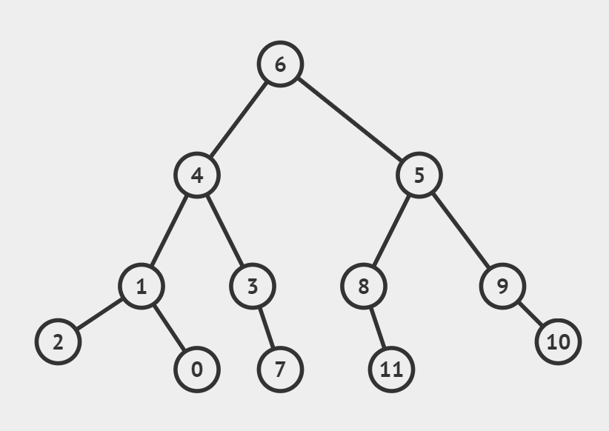
Exercise 12
Traverse the following binary tree and print node’s lables with pre-order, in-order, and post-order

Slide 16
Exercise 13
Given the post-order and in-order traversals of a binary tree, construct the given tree and traverse the tree in preorder
PostOrder: 1 2 12 5 0 3 7 11 9 10 8 6 4
InOrder:1 3 2 0 12 5 4 7 6 11 9 8 10

Slide 17
Exercise 14
Draw the binary search tree if its nodes are inserted in the following order
7 2 26 14 24 17 18 11 30 19 4 16 23 13 20 10 5 25 9
22 2 13 30 7 20 15 21 12 5 18 14 1 24 19

Slide 18
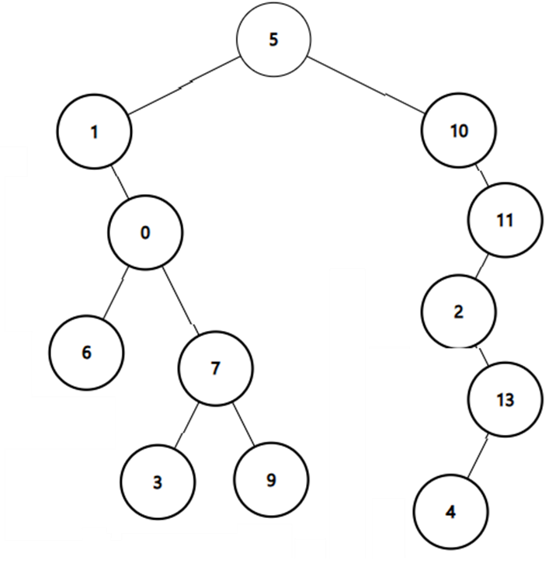
Exercise 15
Traverse the following binary tree and print node’s lables with pre-order, in-order, and post-order:

Slide 19
Exercise 16
Construct the binary tree from given Inorder and PostOrder traversals
In-order: 12 1 11 7 8 0 6 10 9 2 4 5 3
Post-order: 12 11 8 7 1 10 9 6 5 3 4 2 0

