Slide 1
Crop Prediction Using Machine Learning
Group ID :16
Guide :
Guide Name:
Prof. Rekha kotwal
By:
1.Pooja Giramkar
2.Vishal Chamwad
3.Manthan Takalkar
4.Nikita Hirve

Slide 2
Table of Contents
Abstract
Literature Survey
Introduction
Objectives
Proposed System
Dataset Details
Methodology/Models
Advantages
Disadvantages
Conclusion
Reference

Slide 3
Abstract
Agricultural industry plays a major role in the process of economic development as well as the Gross Domestic Product of India. The lack of scientific approaches to soil fertility has become a major challenge for the industry. Since most of the farmers are not familiar with the concepts of soil nutrients, they tend to start their cultivations by assuming myths and assumptions. The project aims at suggesting the best crop based on the soil fertility and also recommends a fertilizer plan to minimize the amount of fertilizers that are needed. The project developed a cross- platform web application to suggest the best crops according to available soil fertility. Further, a fertilizer plan will be suggested on the basis of the contents of NPK Nitrogen (N), Phosphorus (P) and Potassium (K) values to optimize fertilizer usage in order to increase profitability and avoid soil degradation.

Slide 4
Literature Survey
Sr. No. | Name of Researchers | Paper title | Methodology Adopted / Modules Used | Observations Noted
1 | Prof. Rakesh Shirsath | Agriculture decision support system using data mining | Subscription based system ANN Android application Personalized content | Android app with a login module. Previously planted crops known to system User feedback mechanism Maintenance of crop.
2 | Ji-chun Zhao, Jian-xin Guo | Big Data Analysis Technology Application in Agricultural Intelligence Decision System | Inference engine. Domain expertise Knowledge engineering Knowledge acquisition module Knowledge base for recommendation system | Large database of crops. Processed using Hadoop. Professional knowledge. Past experiences. Feature selection using HDFS. Future Scope: Using Hadoop with Artificial Neural Networks.
3 | Miftahul Jannat Mokarrama | RSF: A Recommendation System for Farmers | Location Detection. Data analysis and storage. Similar location detection. Recommendation generation module. | Physiographic, thermal, crop growing period, crop production rate Seasonal crop database Similar location detection Generating the set of crops

Slide 5
Literature Survey
Sr. No. | Name of Researchers | Paper title | Methodology Adopted / Modules Used | Observations Noted
4 | S.Pudumalar, E.Ramanujam | Crop Recommendation System for Precision Agriculture | Random tree CHAID KNN Naïve Bayes WEKA tool | Pre-processing of data Handling missing and out-of-range values Feature extraction Ensemble model to get higher accuracy Rule generation
5 | Yogesh Gandge, Sandhya, | A Study on Various Data Mining Techniques for Crop Yield Prediction | Attribute selection Multiple Linear Regression Decision Tree using ID3 SVM Neural Networks C4.5 K-means and KNN | Selection of agricultural field Selection of crop previously planted Input from user Preprocess Attribute Selection Classification algorithm on data Crop is recommended

Slide 6
Introduction
Farming is one of the major sectors that influences a country’s economic growth.
In country like India, majority of the population is dependent on agriculture for their livelihood. Many new technologies, such as Machine Learning and Deep Learning, are being implemented into agriculture so that it is easier for farmers to grow and maximize their yield.
In this project, we present a website in which the following applications are implemented; Crop recommendation and Fertilizer recommendation respectively.
In the crop recommendation application, the user can provide the soil data from their side and the application will predict which crop should the user grow.
For the fertilizer recommendation application, the user can input the soil data and the type of crop they are growing, and the application will predict what the soil lacks or has excess of and will recommend improvements.

Slide 7
Objectives
Agriculture is a business with risk and reliable crop yield prediction is vital for decisions related to agriculture risk management.
The vision of meeting world's food demands for the increasing population throughout the world is becoming more important in these recent years.
Eventually, helps in achieving ZERO hunger.
Predictions could be used by crop managers to minimize losses when unfavorable conditions may occur.

Slide 8
Proposed System
The aim of proposed system is to help farmers to cultivate crop for better yield. The crops selected in this work are based on important crops from selected location.
The selected crops are Rice, Jowar, Wheat, Soyabean, and Sunflower, Cotton, Sugarcane, Tobacco, Onion, Dry Chili etc.
There are 2 process in proposed work:
Crop Yield Prediction: Crop Yield Prediction can be done using crop yield data, nutrients and location data. These inputs are passed to Random Forest and Support Vector Machine algorithms. These algorithms will predict crop based on present inputs.
Fertilizer Recommendation: Fertilizer Recommendation can be done using fertilizer data, crop and location data. In this part suitable crops and required fertilizer for each crop is recommended.
Third Party applications are used to get Weather information, Temperature information as well as Humidity and rainfall.

Slide 9
Dataset Details
Dataset We are using is -
Crop Recommendation Dataset -
This dataset was build by augmenting datasets of rainfall, climate and
fertilizer data available for India.
Data fields
N - ratio of Nitrogen content in soil
P - ratio of Phosphorus content in soil
K - ratio of Potassium content in soil
temperature - temperature in degree Celsius
humidity - relative humidity in %
ph - ph value of the soil
rainfall - rainfall in mm

Slide 10
Methodology
We used different Methodology/ML Models and compared them:
Decision Tree
Gaussian Naive Bayes
Logistic Regression
Random Forest
XGBoost

Slide 11
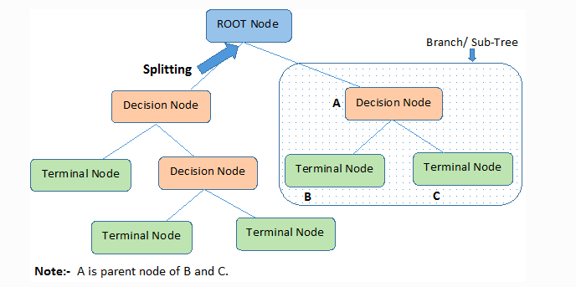
Decision Tree
Decision Tree algorithm belongs to the family of supervised learning algorithms. The goal of using a Decision Tree is to create a training model that can use to predict the class or value of the target variable by learning simple decision rules inferred from prior data(training data).
Accuracy is 90.0 %

Slide 12
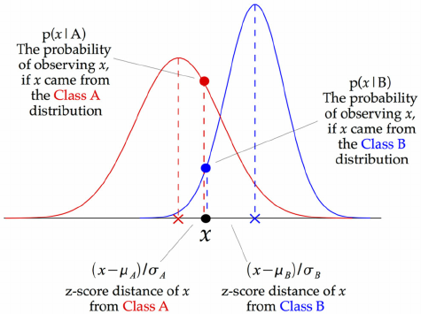
Gaussian Naive Bayes
Gaussian Naive Bayes is a variant of Naive Bayes that follows Gaussian normal distribution and supports continuous data.
Naive Bayes are a group of supervised machine learning classification algorithms based on the Bayes theorem.
Accuracy is 99.09 %

Slide 13
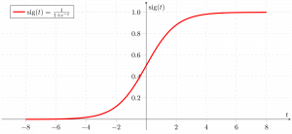
Logistic Regression
Logistic regression is basically a supervised classification algorithm. In a classification problem, the target variable(or output), y, can take only discrete values for given set of features(or inputs), X.
Accuracy is 95.22 %

Slide 14
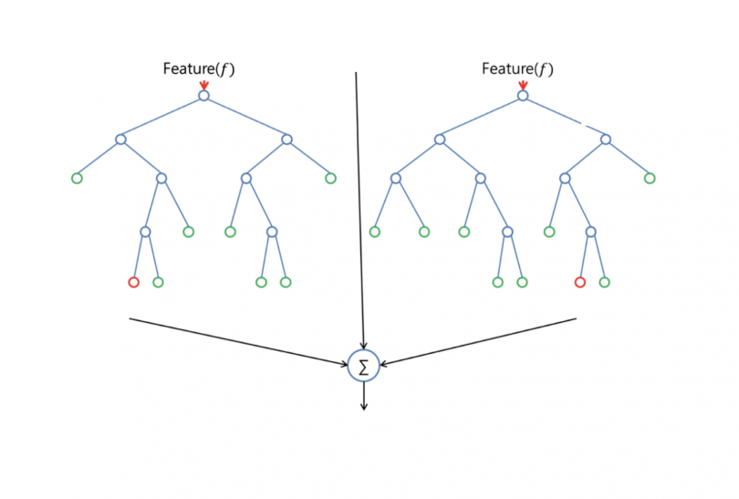
Random Forest
Random forest is a supervised learning algorithm. The "forest" it builds, is an ensemble of decision trees, usually trained with the “bagging” method. T
he general idea of the bagging method is that a combination of learning models increases the overall result.
Accuracy is 99.09 %

Slide 15
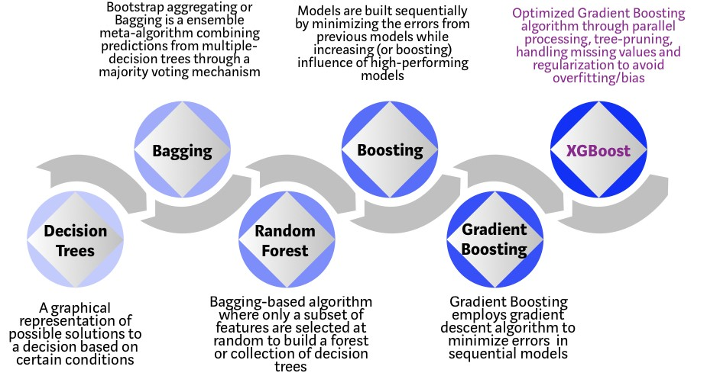
XGBoost
XGBoost is a decision-tree-based ensemble Machine Learning algorithm that uses a gradient boosting framework.
Accuracy is 99.31 %

Slide 16
Advantages
Achieving the maximum crop at minimum yield is the ultimate Aim of the project.
Early detection of problems and management of that problems can help the farmers for better crop yield.
For the better understanding of the crop yield, we need to study of the huge data with the help of machine learning algorithm so it will give the accurate yield for that crop and suggest the farmer for a better crop.

Slide 17
Disadvantages
The obtained result for the crop yield prediction using Decision tree gives less accuracy when compared to Gaussian naïve Bayes, Random Forest and XGBoost.
Previously yield is predicted on the bases of the farmers prior experience but now weather conditions may change drastically so they cannot guess the yield.

Slide 18
Conclusion
This project highlighted the limitations of current systems and their practical usage on yield prediction. Then walks through a viable yield prediction system to the farmers, a proposed system provides connectivity to farmers via a web application. The web application includes multiple features that users can leverage for the selection of a crop. The inbuilt predictor system helps the farmers to predict the yield of a given crop. The inbuilt recommender system allows a user exploration of the possible crops and their yield to take more educated decisions. For yield to accuracy, various machine learning algorithms such as Decision Tree, Gaussian Naive Bayes, Logistic Regression, Random Forest, XGBoost were implemented and tested on the given datasets. Results indicate that XGBoost gives best result.

Slide 19
References
[1] S. M. PANDE, P. K. RAMESH, A. ANMOL, B. R. AISHWARYA, K. ROHILLA and K. SHAURYA, "Crop Recommender System Using Machine Learning Approach," 2021
[2] S. Bhanumathi, M. Vineeth and N. Rohit, "Crop Yield Prediction and Efficient use of Fertilizers," 2020
[3] C. P. Wickramasinghe, P. L. N. Lakshitha, H. P. H. S. Hemapriya, A. Jayakody and P. G. N. S. Ranasinghe, "Smart Crop and Fertilizer Prediction System," 2019

