Slide 1

Understanding Stroke
Math 448 Project Nhi Vu

Slide 2
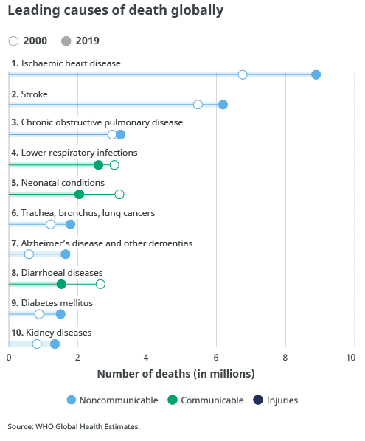
Introduction.
responsible for approximately 11% of total deaths,
the number of people who die due to stroke rises by more than 2 million to 8.9 million.
I wish during analyzing the dataset I can see risk factors, which are more likely to cause strokes.

Slide 3
Data
The data was a free available data set provided by Kaggle website and the last update is 01-26-2021 .
Sorce: https://www.kaggle.com/fedesoriano
5110 patients with 12 attributes (12 columns).
11 clinical features for predicting stroke events: patients’ demographic data and health records.
The response variable is Stroke (experience of stroke)

Slide 4
Data preparation.
Change to appropriate format.
The “bmi” column, variables supposed to be numeric values but its class is characters showing in the “summary table”.
Cleaning data.
Outlier data: only 1 patient categorize “Other” in gender column.
Missing data:
3.9% 30%
remove. Keep.
bmi | Smoking_stattus
201 N/A | 1544 “unkown”

Slide 5
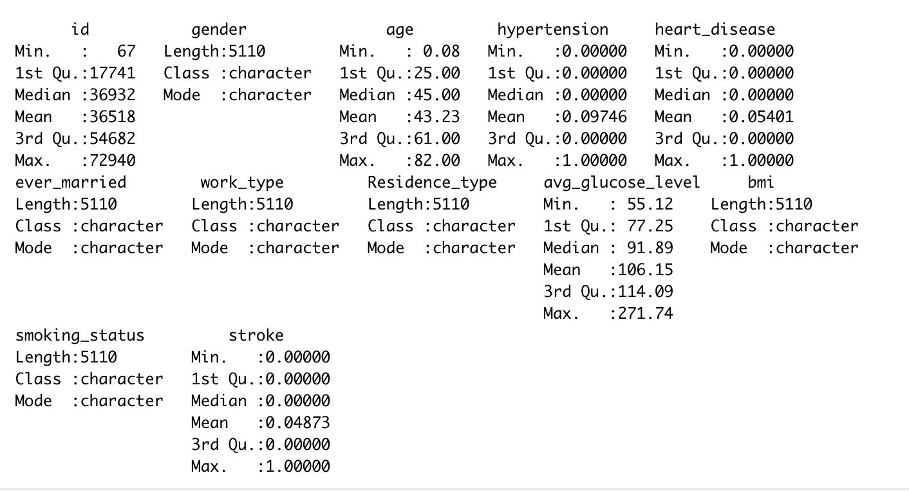
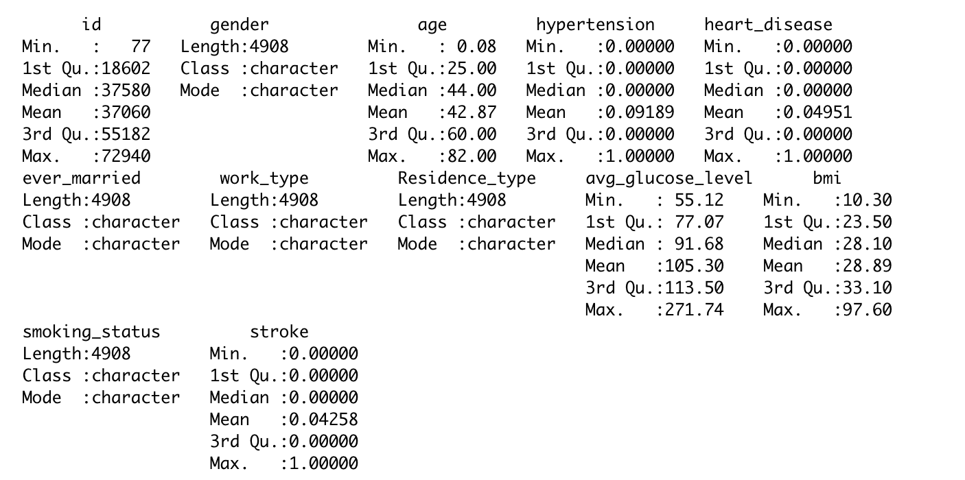
Before
After

Slide 6
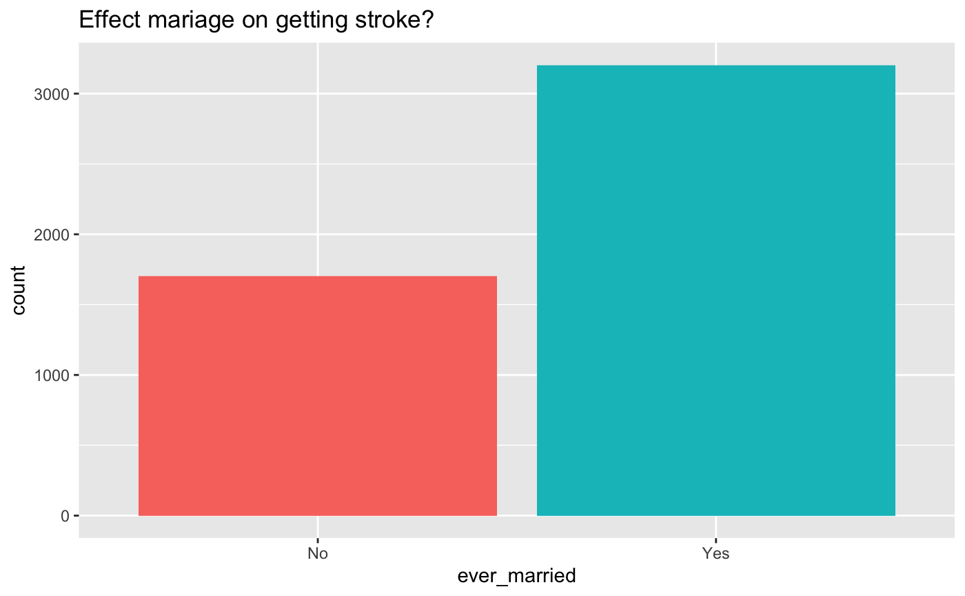
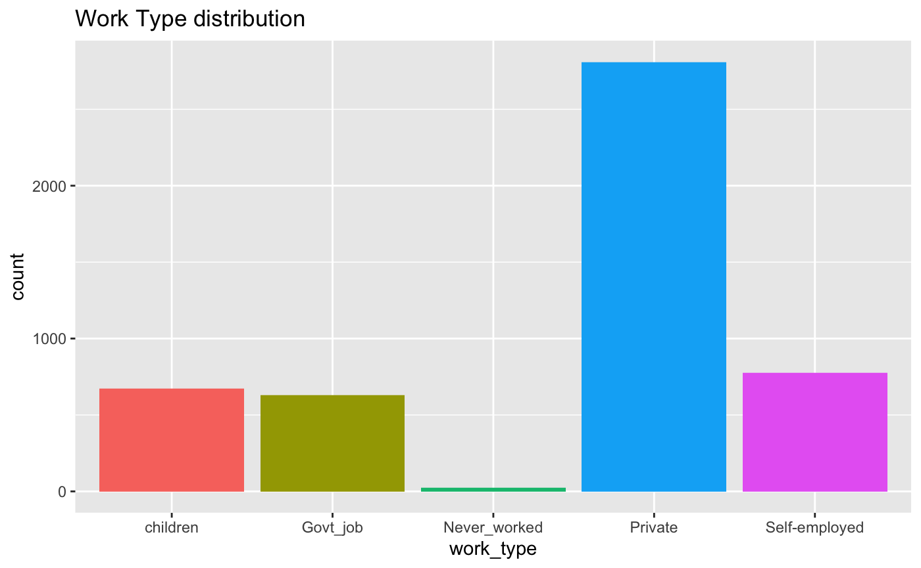
Visualization Categorical variables.
The risk of stroke in married people is higher than single people and people who are self-employed most likely to have strokes than others. These results lead us to another hypothesis that stroke relative to mental health ? because maybe these patients are suffering depression from work stress and conflicts in marriage

Slide 7
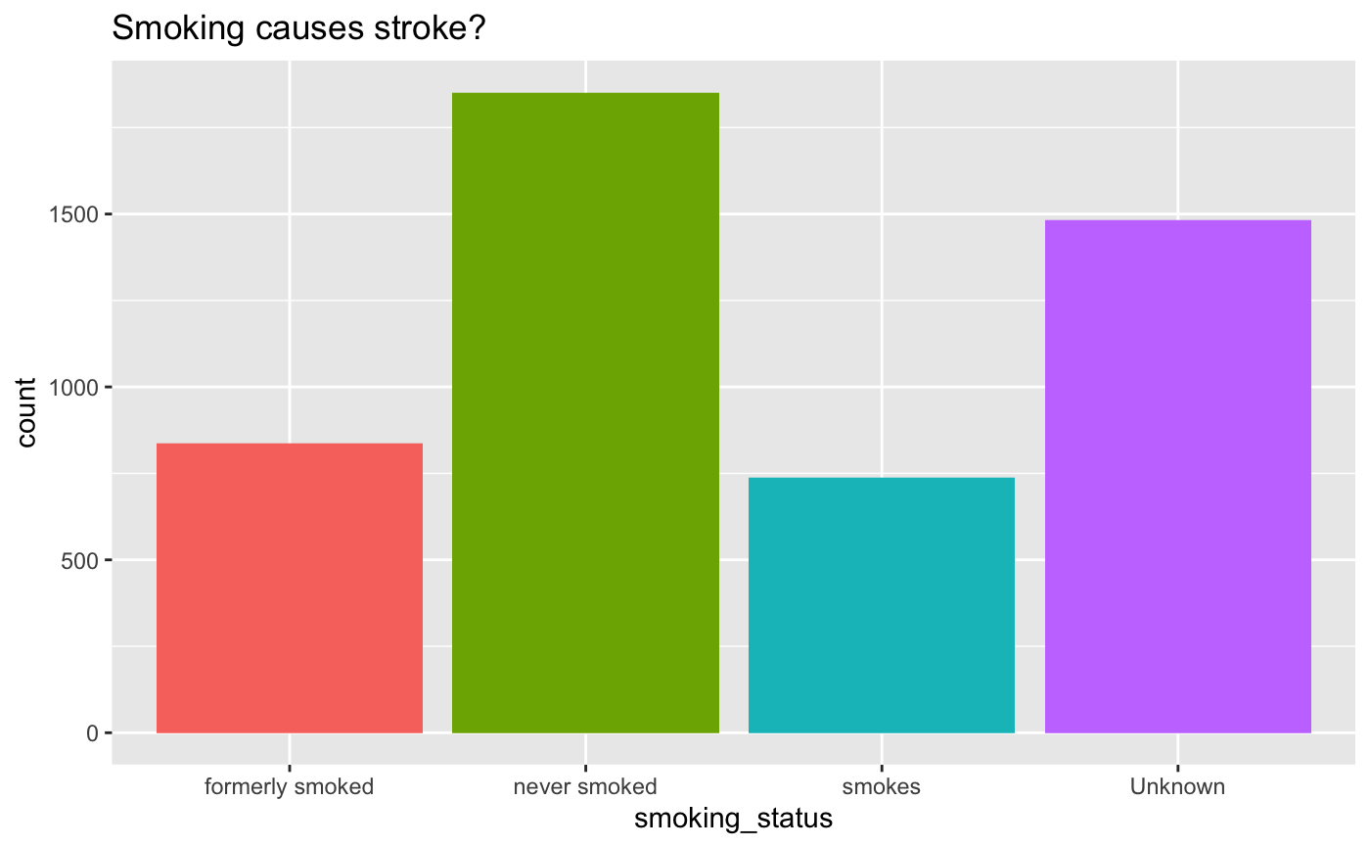
Visualization Categorical variables.
The number of patients who never smoke is a tallest columns. But the total of formerly smoke and smokes is reasonable enough to conclude that smoking raises the risk of stroke.
“Unknown” column is high which indicates that it takes a significant amount of data.

Slide 8
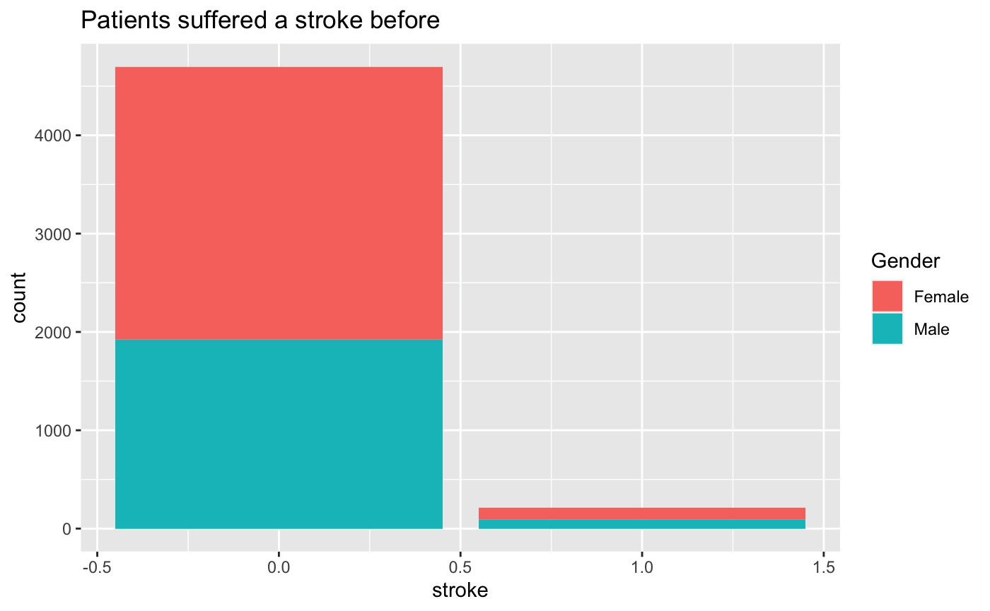
Visualization Categorical variables.
We can see the imbalance in the data distribution which is approximately 95% of patients not suffering strokes in the past. which implies any dump model should randomly predictions of stroke could reach accuracy of 95%. Therefore, in the building model, I pay more attention in the sensitivity, predict the true positive to evaluate the model.

Slide 9
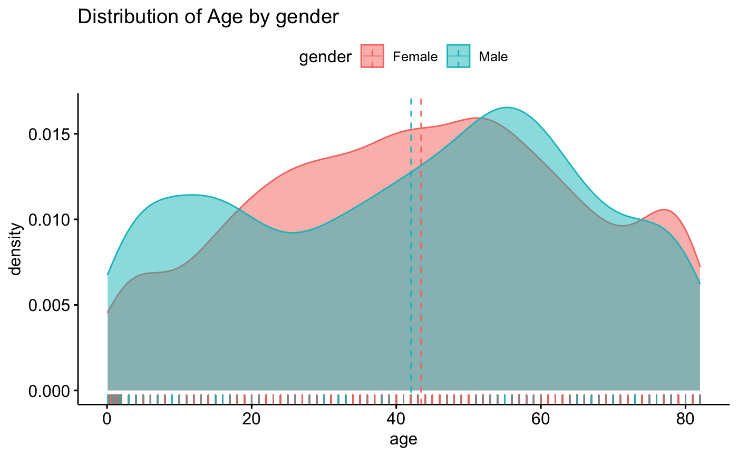
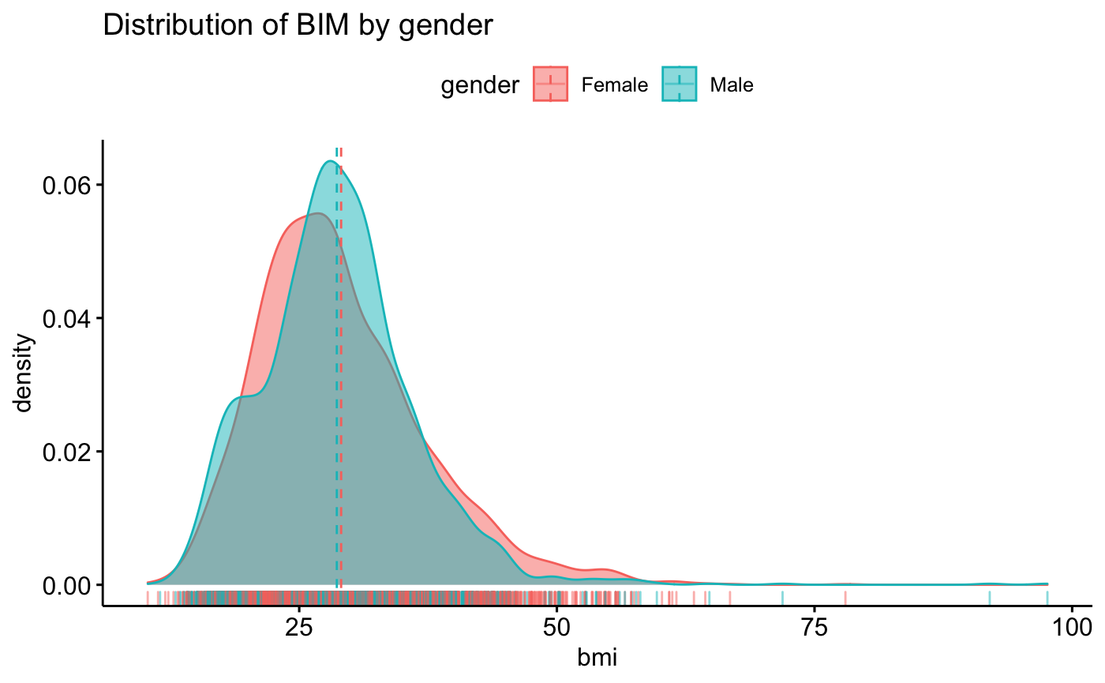
Visualization numerical variables.
Bmi and age both have normal distribution. While bmi is highly skewed toward to left side and average is around 30, Age is toward to a right side, and risk of stroke is high for elderly people and mid age adults for both gender, even though male has average’s age is younger than of female.

Slide 10
Modelling and Results
Slip data into traing set (70%) and test set (30%).
Method:
Logistic Regression.
Penalized logistic regression: Using Lasso method vs Ridge Regression.
Linear Discriminant Analysis (LDA)
Comparison:
ROC curve, threshold and Accurate, sensitive and specific rate.

Slide 11
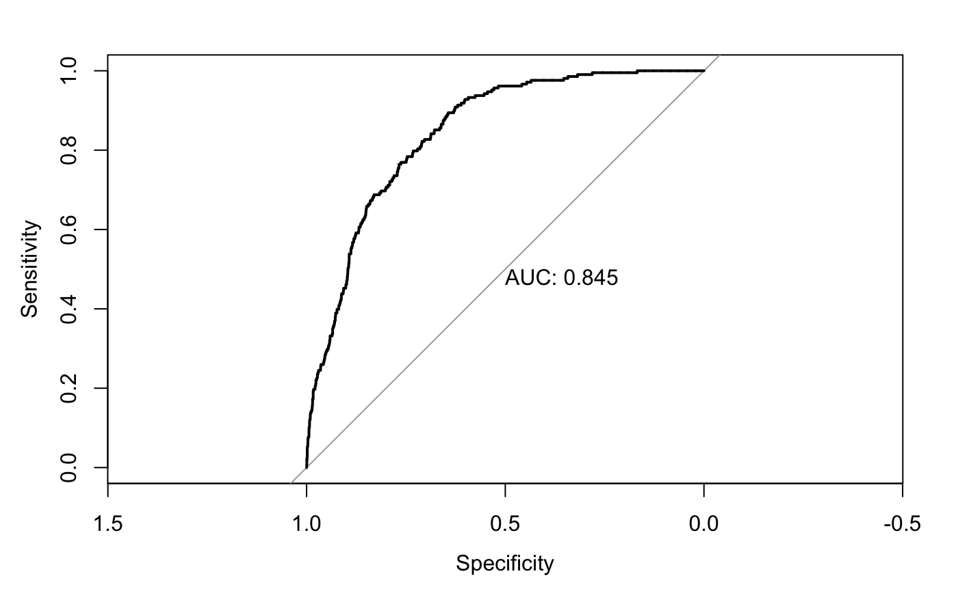
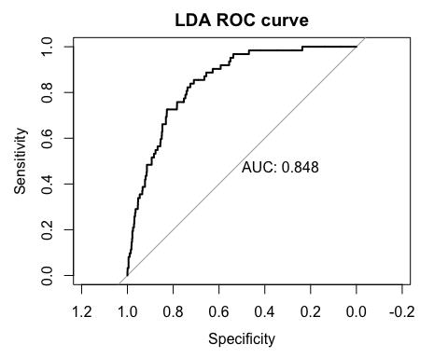
Logistic Regression vs Linear Discriminant Analysis (LDA)
The optimal threshold value where sensitivity + specify is maximum at 0.02933321 for Logistic Regression and 0.02524951 for LDA. The AUC of both methods is not significant different and both high enough which shows that the model performs well at distinguish between positive and negative classes.

Slide 12
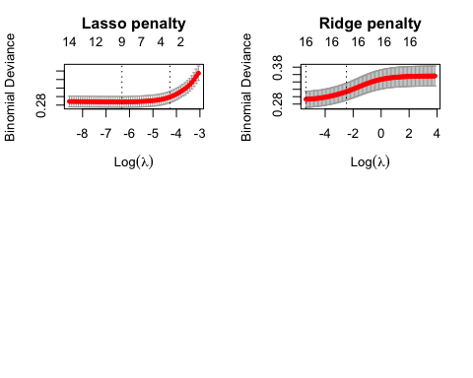
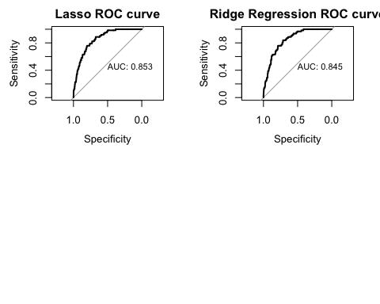
Lasso method vs Ridge Regression
Find the best lambda using cross-validation
The best lambda for lasso is 0.00179601
The best lambda for ridge is 0.00466068
The optimal threshold for lasso is 0.03277425
The optimal threshold for ridge is 0.03982708

Slide 13
Result and Comparison
Method | Accuracy | Sensitivity | Specificity | AUC
Logistic Regression (with best threshold) | 0.6838235 | 0.8709677 | 0.6757322 | 0.845
Logistic Regression (with a threshold =0.5) | 0.95922460 | 0.0161293 | 1.00000000
LDA (with a best threshold) | 0.7159091 | 0.8548387 | 0.7099024 | 0.848
LDA (a threshold =0.5) | 0.95454545 | 0.0806456 | 0.99232915
Lasso | 0.6838235 | 0.8870968 | 0.6750349 | 0.853
Ridge Regression | 0.7192513 | 0.8387097 | 0.7140865 | 0.845
Comment: To improve sensitivity, we need to change a threshold for predicted class. All methods have similar results, after use the optimal threshold, the sensitivity is improved and other rates are high enough. The method give the highest rate in sensitivity and AUC rate is Lasso but Logistic Regression is good too.

Slide 14

Thank you for listening !!

