Slide 1
TITLE SLIDE
PROJECT TITLE: “OrgMind Privacy-Preserving Depression Detection Using ML.”
TEAM MEMBERS:
Naveena .H
Naveena Sree
DEPARTMENT: Computer Science and Engineering GUIDE: Dr. Sangeetha K PROJECT COORDINATOR:
BATCH: C3
DOMAIN: Data Science , Machine Learning DATE: 29/10/25

Slide 2
BASE PAPER DETAILS
PAPER TITLE: “DDNet:A robust and reliable Hybrid ML model for Effective Detection of Depression Among University Students.“ AUTHORS: Nasirul Mumenin et al. JOURNAL/CONFERENCE: IEEE Xplore , 2025
Key Learning: Focused on detecting depression from survey data of university students. OUR CONTRIBUTION: We extend this research by focusing on detecting depression from survey data and facial emotion recognition(via image)model that adds extra layer for better accuracy.

Slide 3
PROBLEM STATEMENT
THE CHALLENGE: Rising stress and depression among students and employees often go undetected due to stigma and lack of proactive mental health monitoring. Data and Statistics:
WHO (2023): 280 million+ people suffer from depression globally.
NCRB (India, 2022): 13,000+ student suicides, many linked to stress.
- Only 10–12% of working Indians seek mental health support due to fear or stigma.
Mapped SDG Goals:
-SDG 3-Good Health and Well-being
-Target:Promote mental health , reduce chronic diseases.
-SDG 8-Decent Work and Economic Growth
-Target:Promote safe and healthy work environment .

Slide 4
Social relevance
SOCIETAL BENEFIT: This project helps reduce depression and stress by enabling early, private detection, improving well-being.
REAL-WORLD RELEVANCE:
Empowers individuals to manage their mental health without fear of being judged or exposed.
Reduces healthcare costs by catching issues before they become severe or require intervention.
Aligns with global health goals: Supports SDG 3 and SDG 8.
Contributes to a positive culture:Fosters happier , healthier and more productive communities.

Slide 5
PROPOSED SOLUTION
We propose ML based mental health monitoring system that analyzes users responses to mental health surveys , detects emotional states through facial expressions ( via images).
Survey Modal:
- Predicts depression/stress risk using responses from validated scales (e.g., PHQ-9, DASS-21).
- Deployed as a Streamlit app for easy, interactive use.
Aggregates scores for anonymized group reports.
Image Modal:
- Will estimate emotional states from webcam images.
- Model will classify basic emotions(happy , sad , neutral.etc)

Slide 6
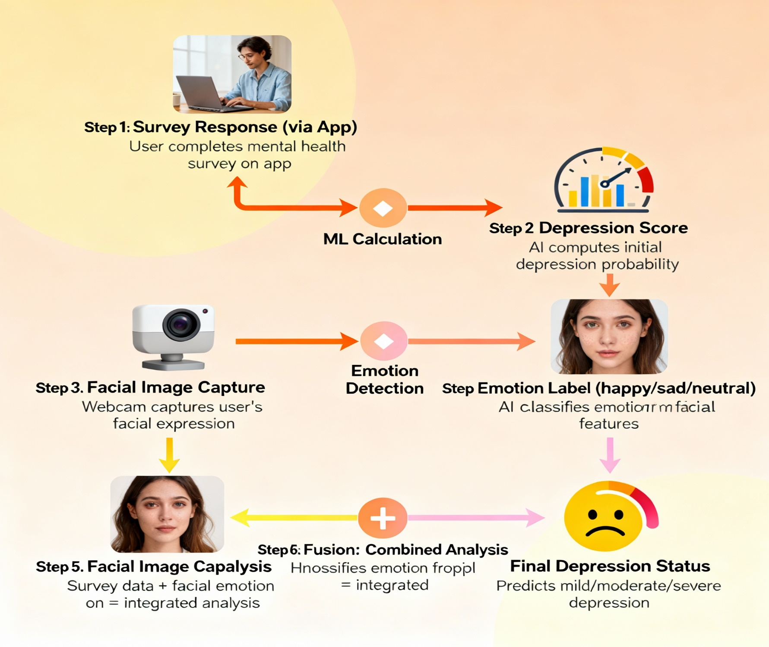
WORK FLOW

Slide 7
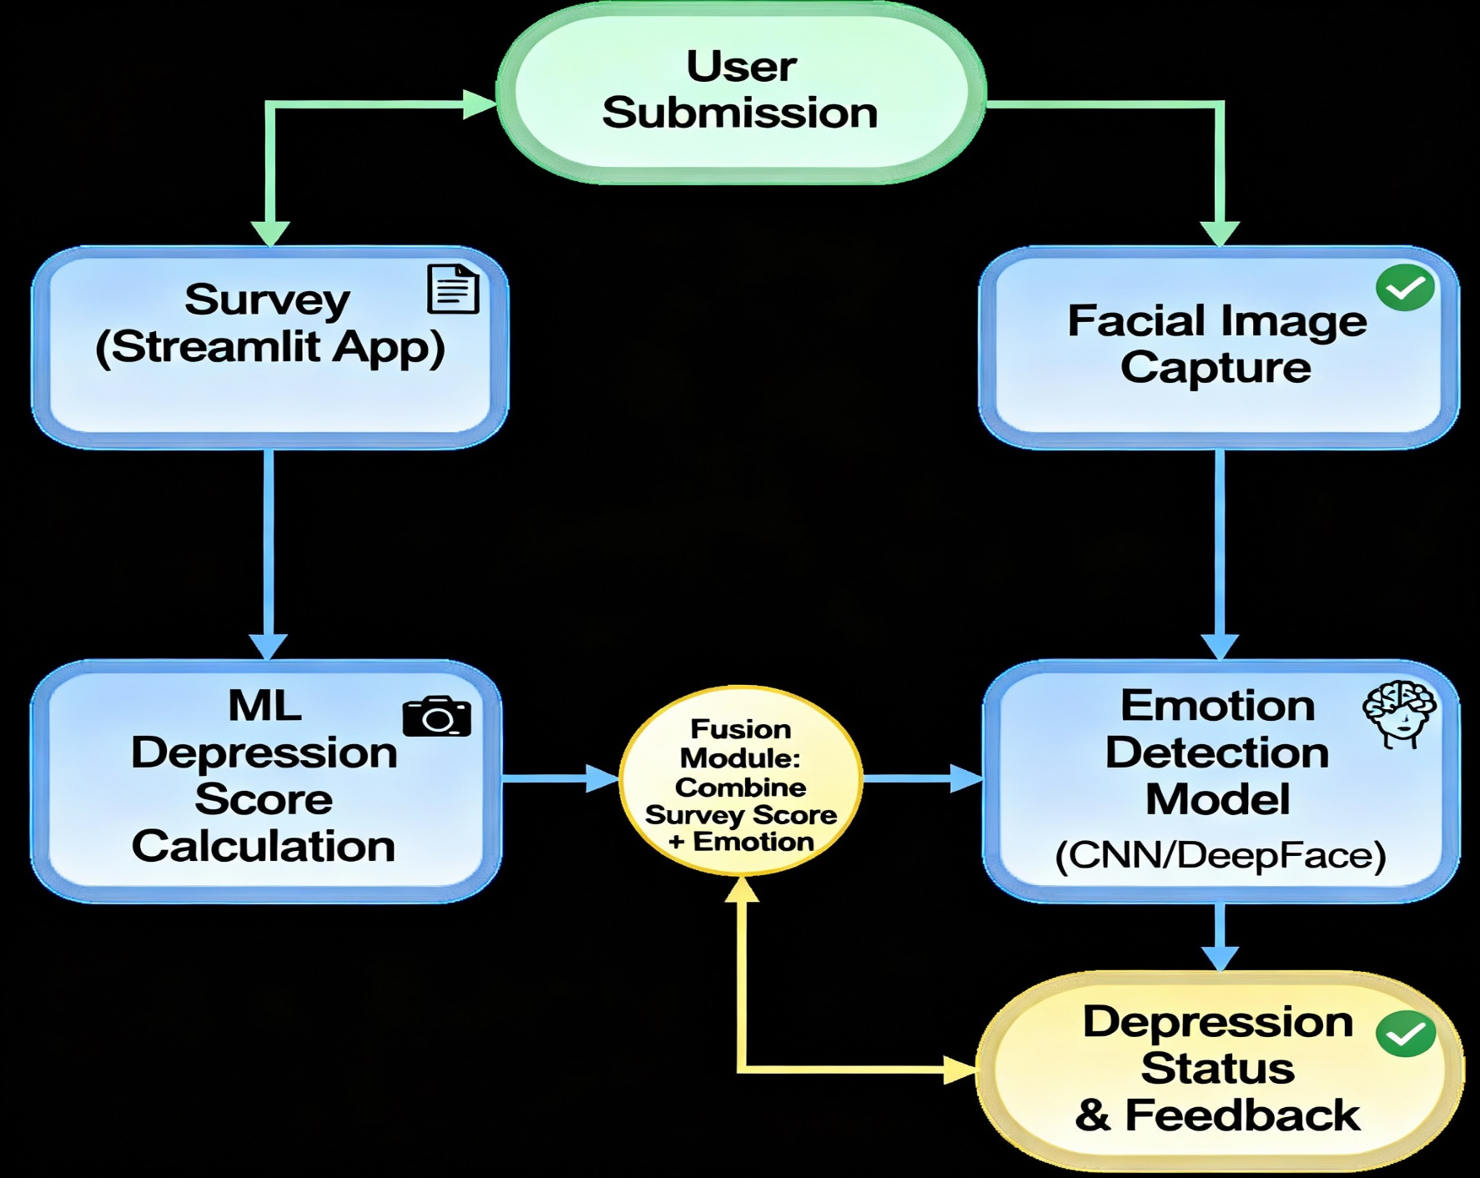
ARCHITECTURE DIAGRAM

Slide 8
Hardware/ software specification
HARDWARE:
Server/PC (8 GB RAM, i5+ CPU), Webcam (for image modal and reliable internet connection ( for Streamlit app deployment and usage ),Optional : GPU(NVIDIA , for faster machine learning prediction.
SOFTWARE:
Python, TensorFlow, Streamlit, DASS-21/PHQ-9,scikit-learn , Matplotlib , OpenCV , Github ,DeepFace/FER , Numpy and Pandas( data handling).
ID3 : Jupyter Notebook / VS Code
Operating System: Windows 10+

Slide 9
MODULE EXPLANATION
1. Survey Module:
- Presents users with validated questions about their mood, behavior, and symptoms (PHQ-9, DASS-21, etc.).
- Collects responses and automatically calculates a depression risk score using predefined rules or ML algorithms.
- Deploys on Streamlit for real-time, user-friendly access.
2. Image Module:
- Captures a facial image from the user (using webcam).
- Processes the image with deep learning (CNN/DeepFace/FER) to detect basic emotions like happy, sad, or neutral.
- Outputs the detected emotion as an additional indicator of mental state.

Slide 10
3.Fusion/Integration Module:
- Combines the depression score obtained from the survey and the emotion detected from the image.
- Ensures prediction is more robust than using either modal alone.
- Applies logical or ML-based rules to generate the final depression status (Likely Depressed / Not Depressed).
4.User Feedback Module:
- Presents the final score and status to the user in a clear, private, and informative manner.
- May offer personalized advice or recommend next steps based on the prediction

Slide 11
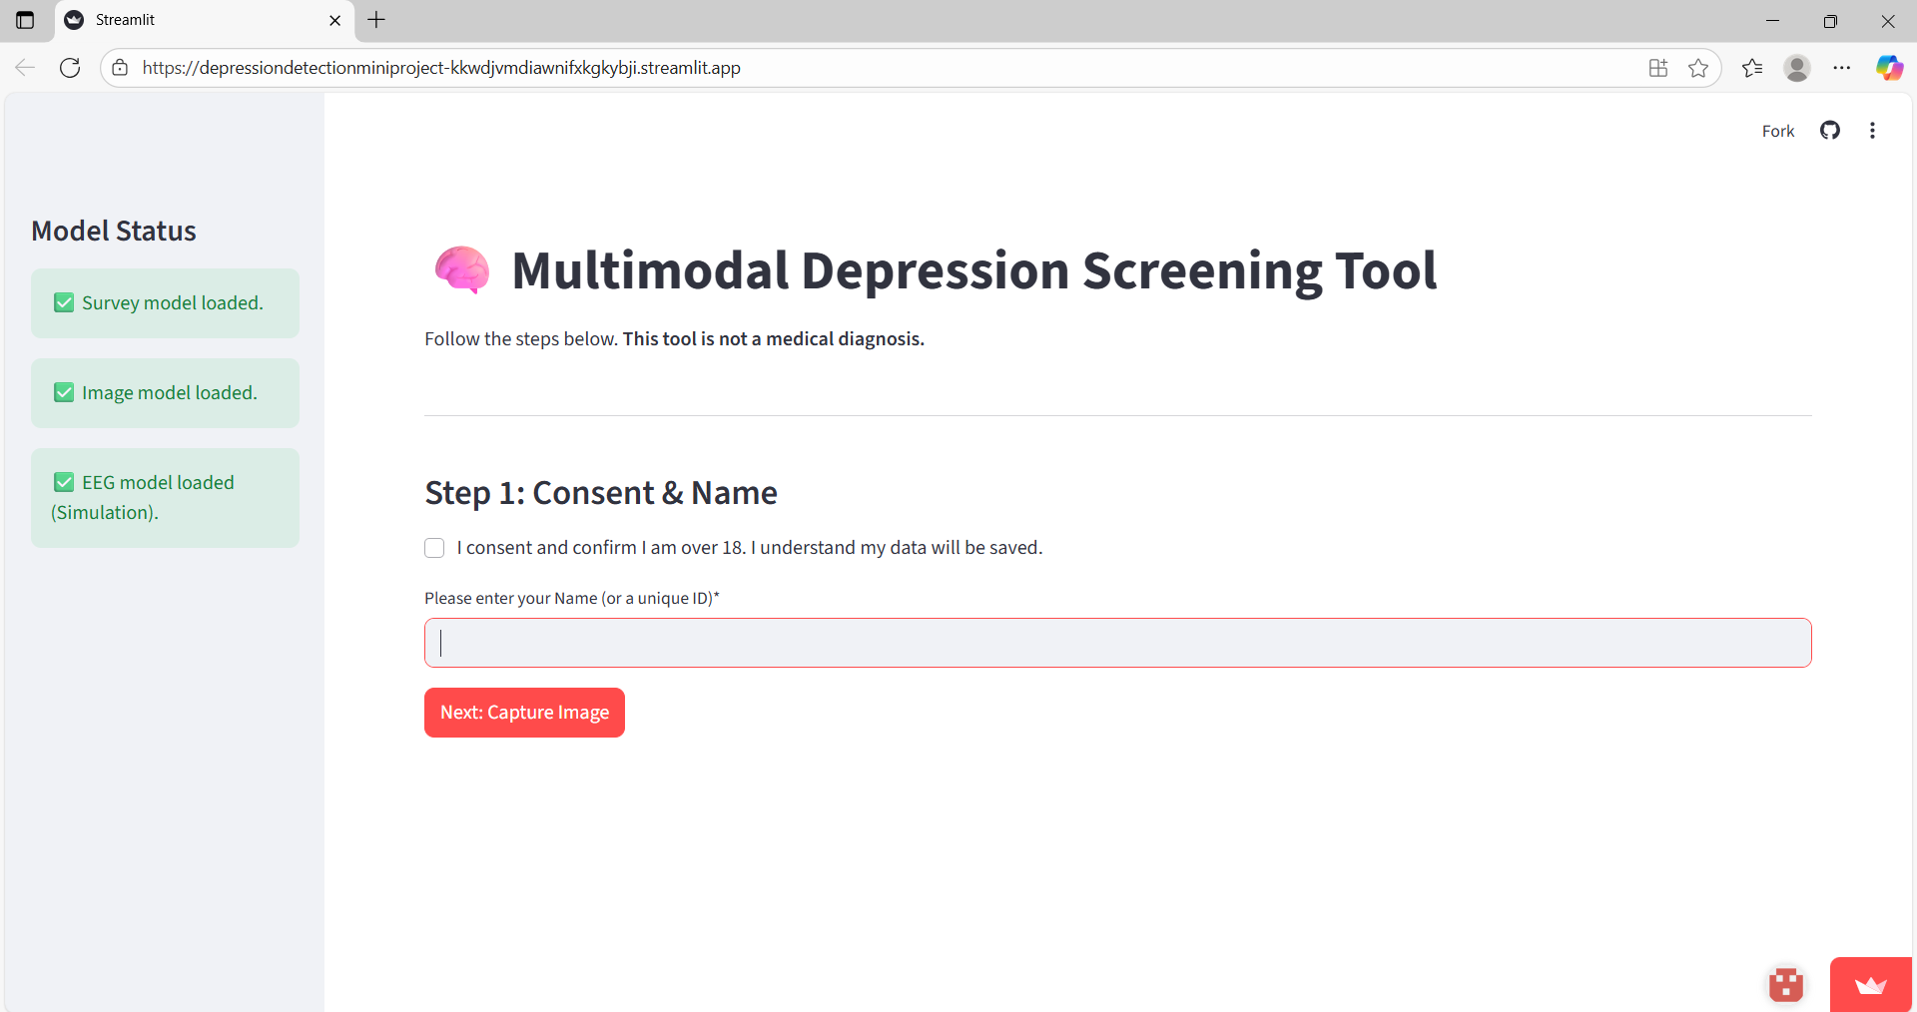
OUTPUT (DEMO SCREENSHOTS)
initial screening page

Slide 12
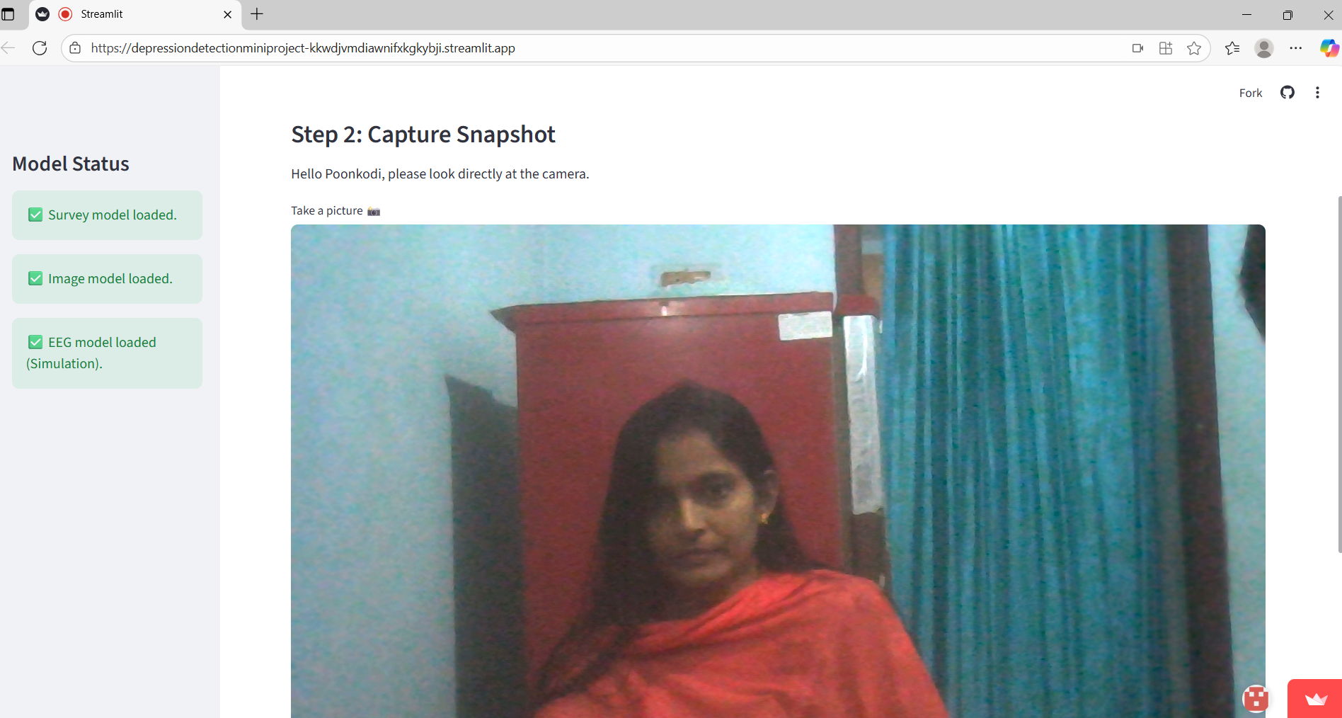
Image Capturing phase

Slide 13
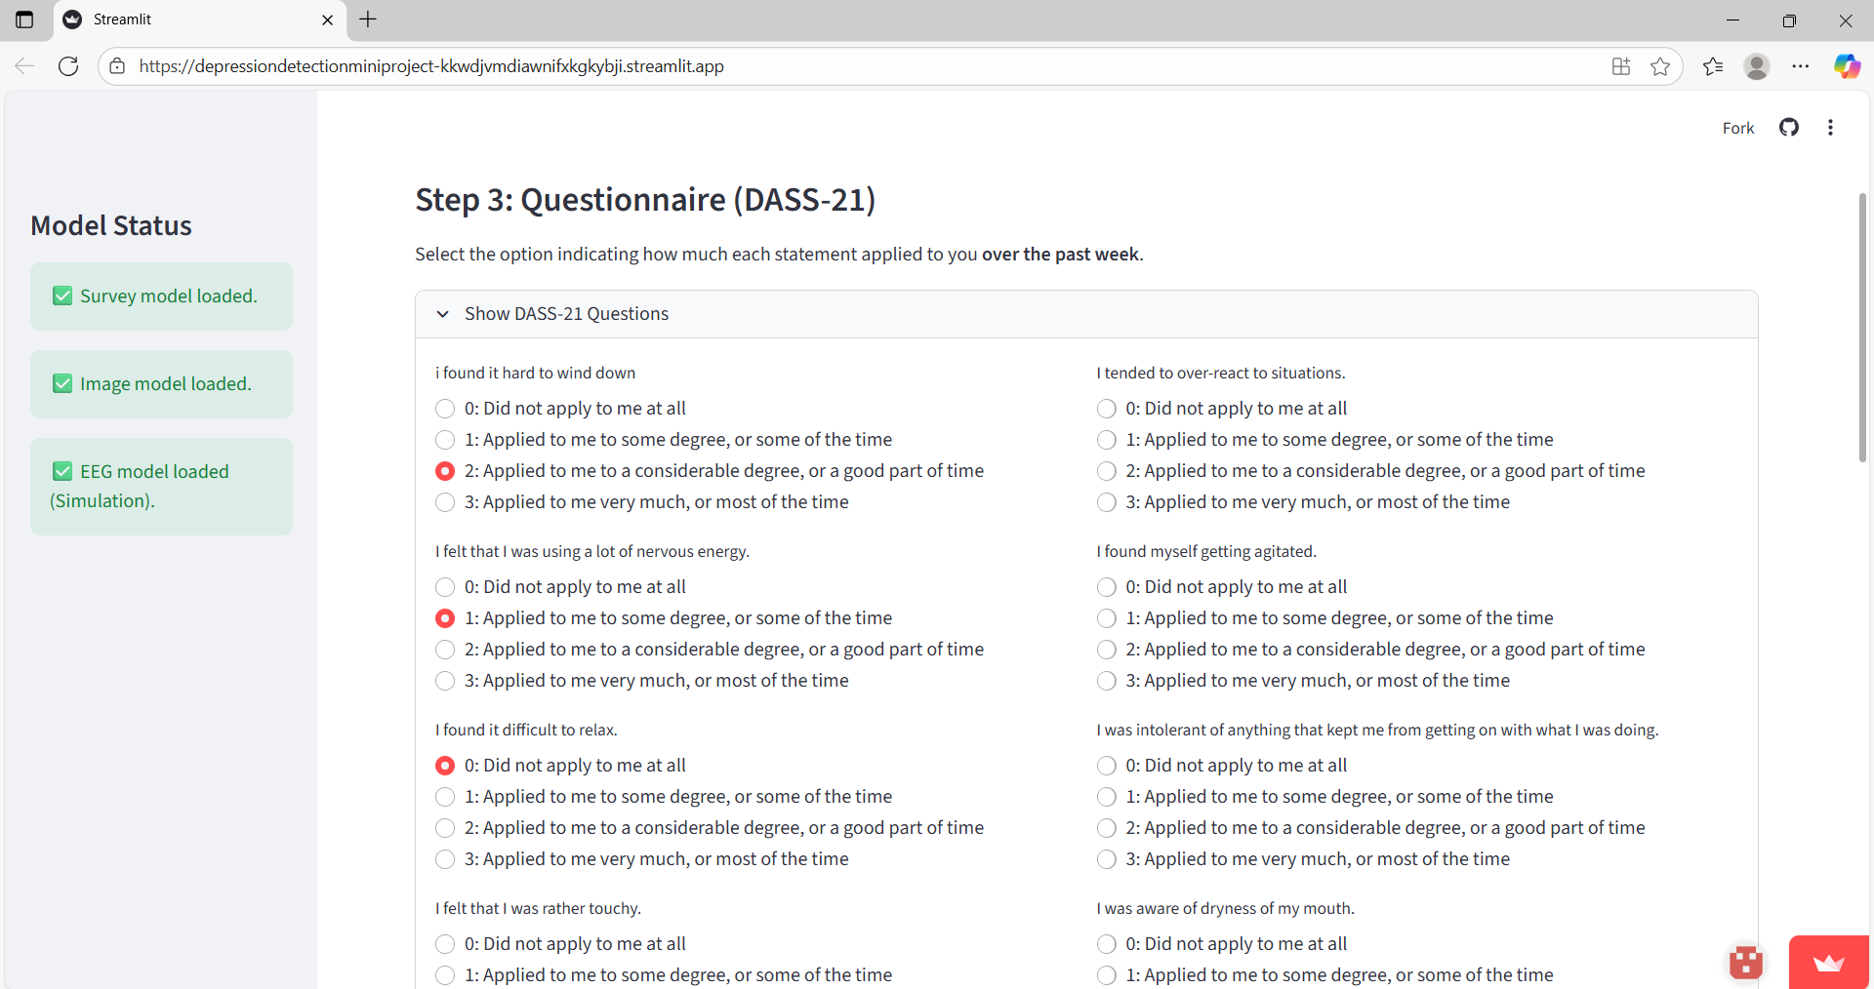
SURVEY ANSWERING

Slide 14
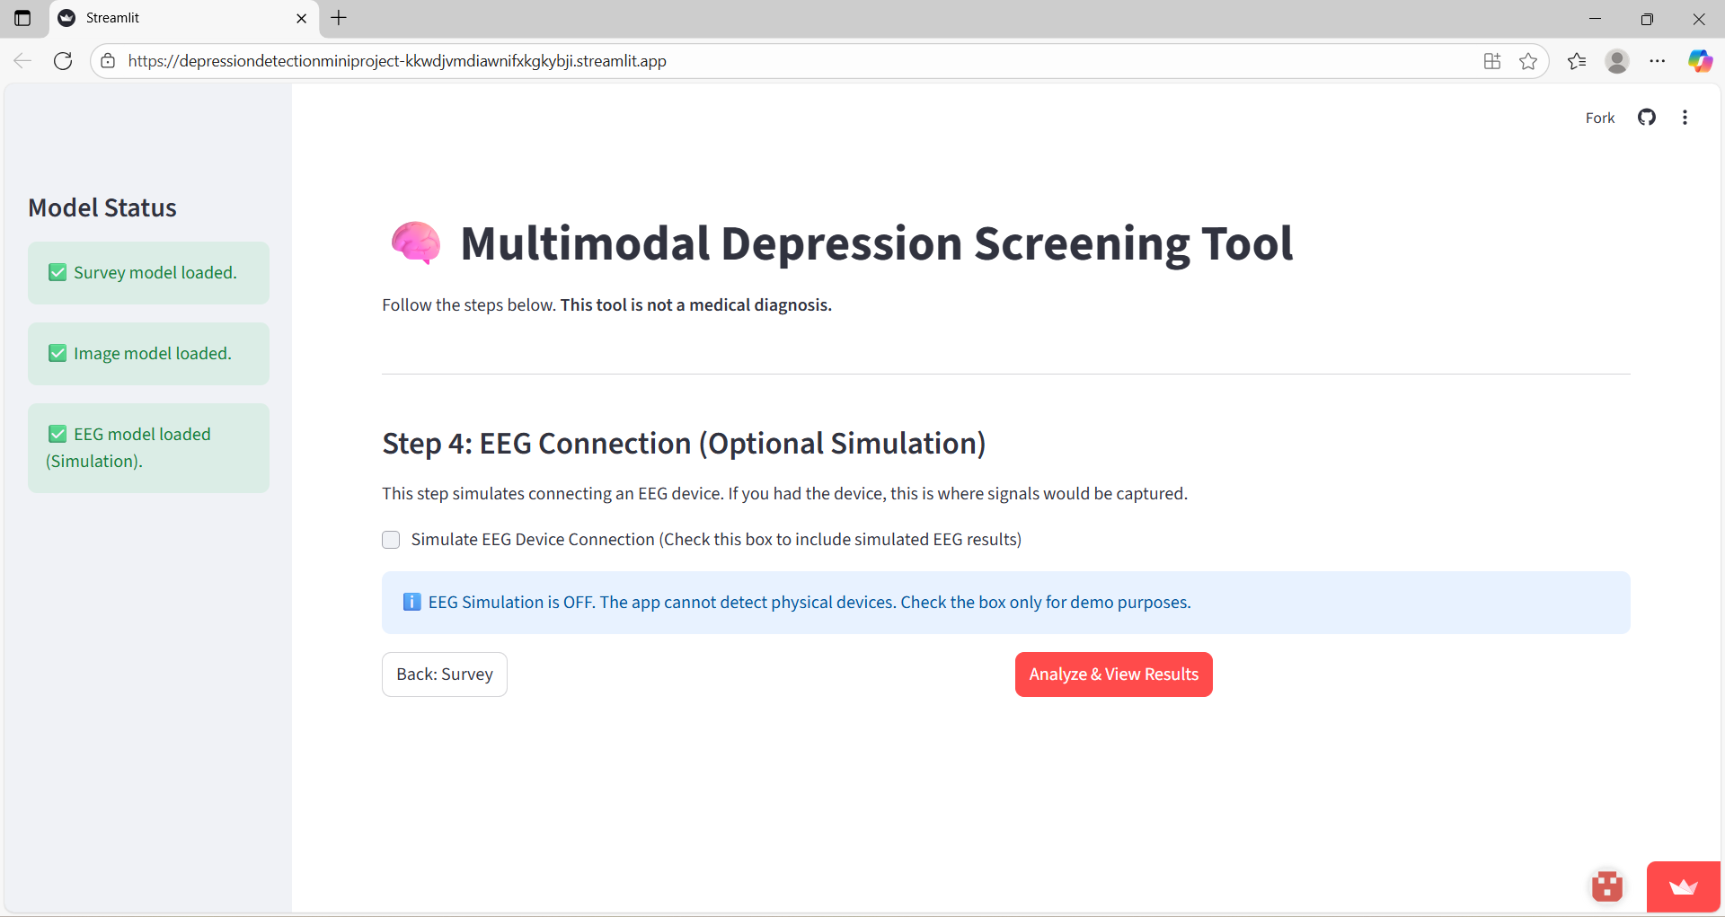
EEG ANALYSIS(FUTURE ENHAnCEment)

Slide 15
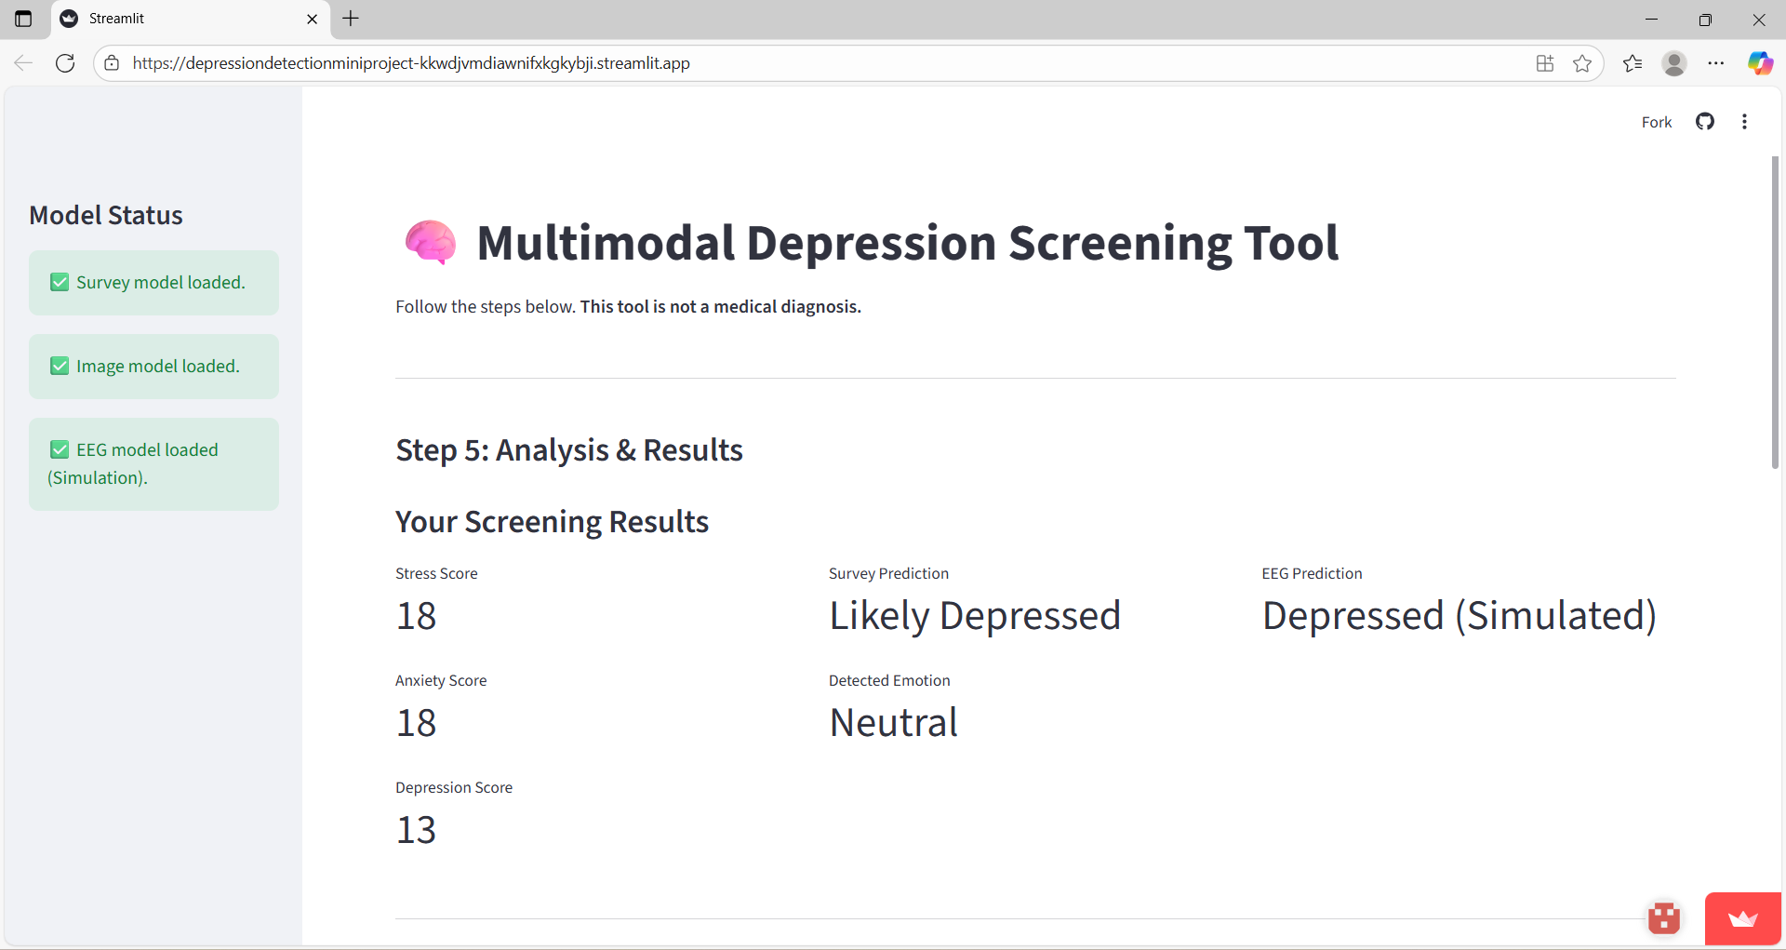
FINAL ANALYSIS

Slide 16
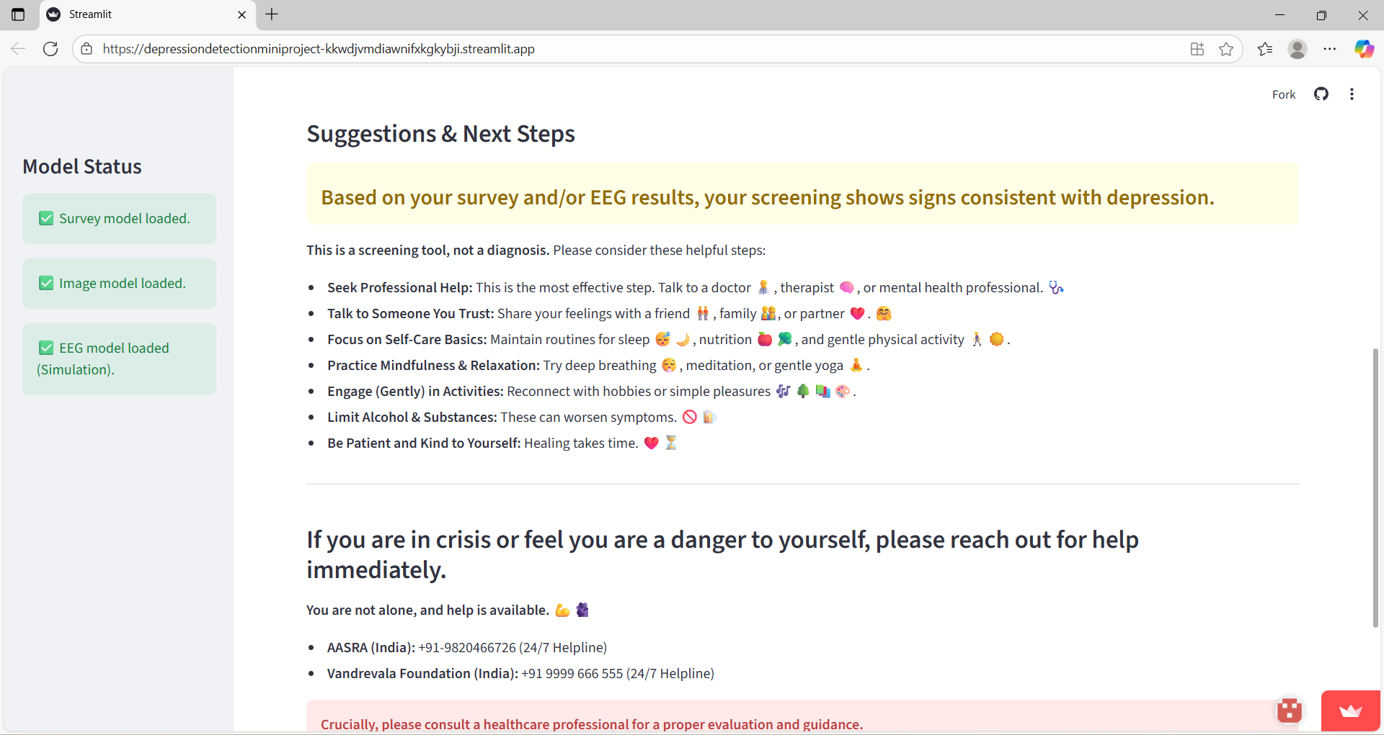
SUGGESTIONS BASED ON THE RESULT

Slide 17
FUTURE ENHANCEMENTS
Add Video and EEG Modal Integration: Combine real-time video emotion analysis and EEG brainwave data for more robust, multimodal depression prediction.
Mobile App Development: Create Android/iOS apps for easier self-assessment and regular check-ins, expanding reach beyond desktops.
Real-Time Monitoring: Enable continuous mental health tracking, sending timely alerts or suggestions when user risk increases.
Expand Emotion Detection: Improve image modal to recognize more nuanced emotions (e.g., anger, fear, surprise) with advanced deep learning models.

Slide 18
CONCLUSION
- Our project brings together survey and image analysis to predict depression quickly and securely, breaking stigma and helping users get early help. - With future upgrades like video, EEG, and mobile integration, this system can transform mental health support for everyone.
This solution lets people check their mental well-being easily and safely, encouraging them to seek help sooner.

Slide 19
THANK YOU

