Slide 1
Pedestrian Detection Using Various Deep Learning Models
17011832 Kim Namhun
AI project proposal

Slide 2
Contents
Goal
System environment
System architecture
Schedule
Reference

Slide 3
Goal
Detect the pedestrian by deep learning model
Dataset: KAIST Multispectral Pedestrian Detection Dataset
Model: Faster R-CNN, Yolo, SSD

Slide 4
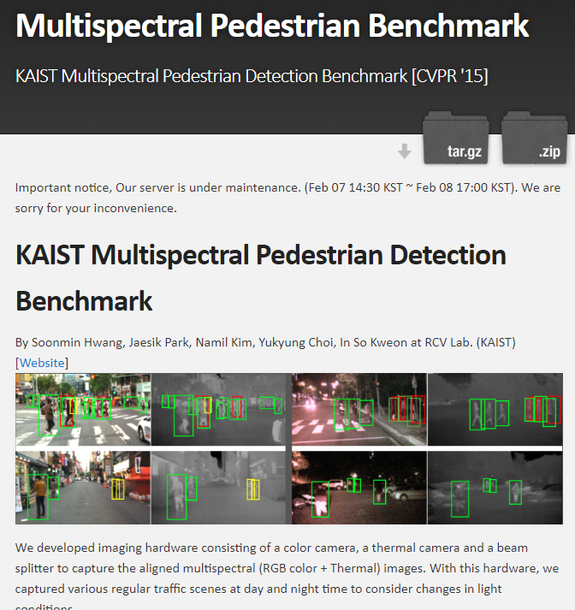
System Environment
DataSet
Color image : RGB
Thermal image: Long-wave infrared
Size : 640x480
95k color-thermal pairs
103k annotation bounding boxes
Regular traffic scenes
Daylight, night

Slide 5
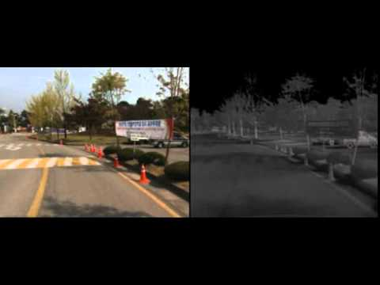
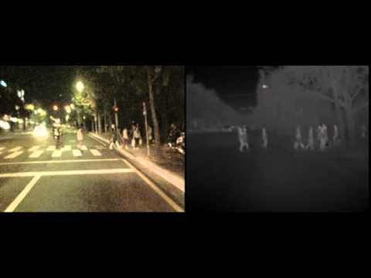
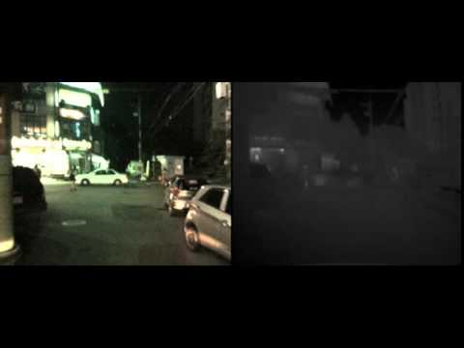
System Environment
DataSet example

Slide 6
System Environment
Devices
PC : Ryzen 2600 3.2GHz, DDR4 32G
DGX-1
8x Tesla GP100
170 TFLOPS / FP16
16GB
2x Intel Xeon E5-2698 v4 2.2GHz
DDR4 512GB

Slide 7
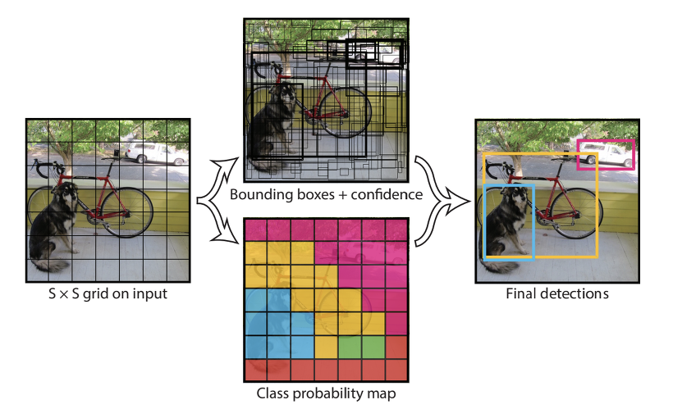
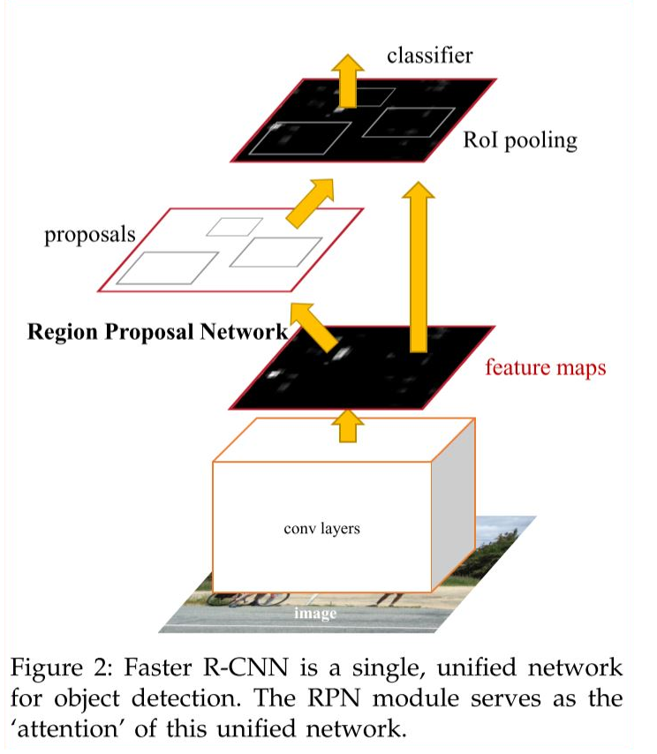
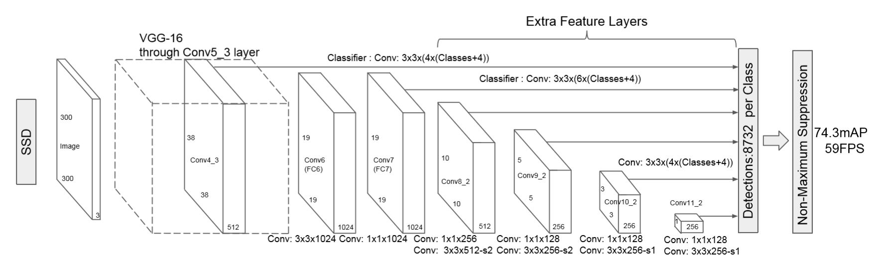
Deep learning model

Slide 8

Evaluation indicators
Miss rate
FPPI(False Positive Per Image)
mAP(mean Average Precision)
Precision-recall
IOU(Intersection Over Union)
Miss rate $∝$ FPPI

Slide 9


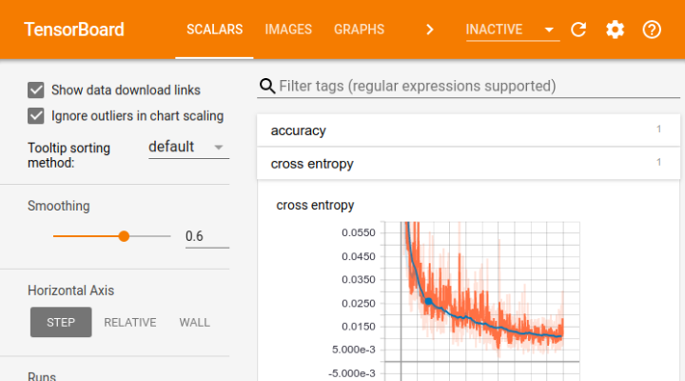




System Environment
Library
Pytorch
COCO
tesnorboard
Programming language
Python 3.x
IDE
Pycharm
vim
- Docker

Slide 10
Model selection
Survey
Test
Get mAP, IOU to compare
Select
Best fit model
Object detection models
Parameter tuning

Slide 11
System workflow
Input Image
Model
Detected Person with bounding box

Slide 12
Schedule
Works | Period
 | 11 |  |  |  |  | 12
 | 1 | 2 | 3 | 4 | 5 | 1 | 2
Study Deep learning models, libraries, datasets
Setting dev environment
Model compare by code experimentation
Adapt & test
Writing report

Slide 13
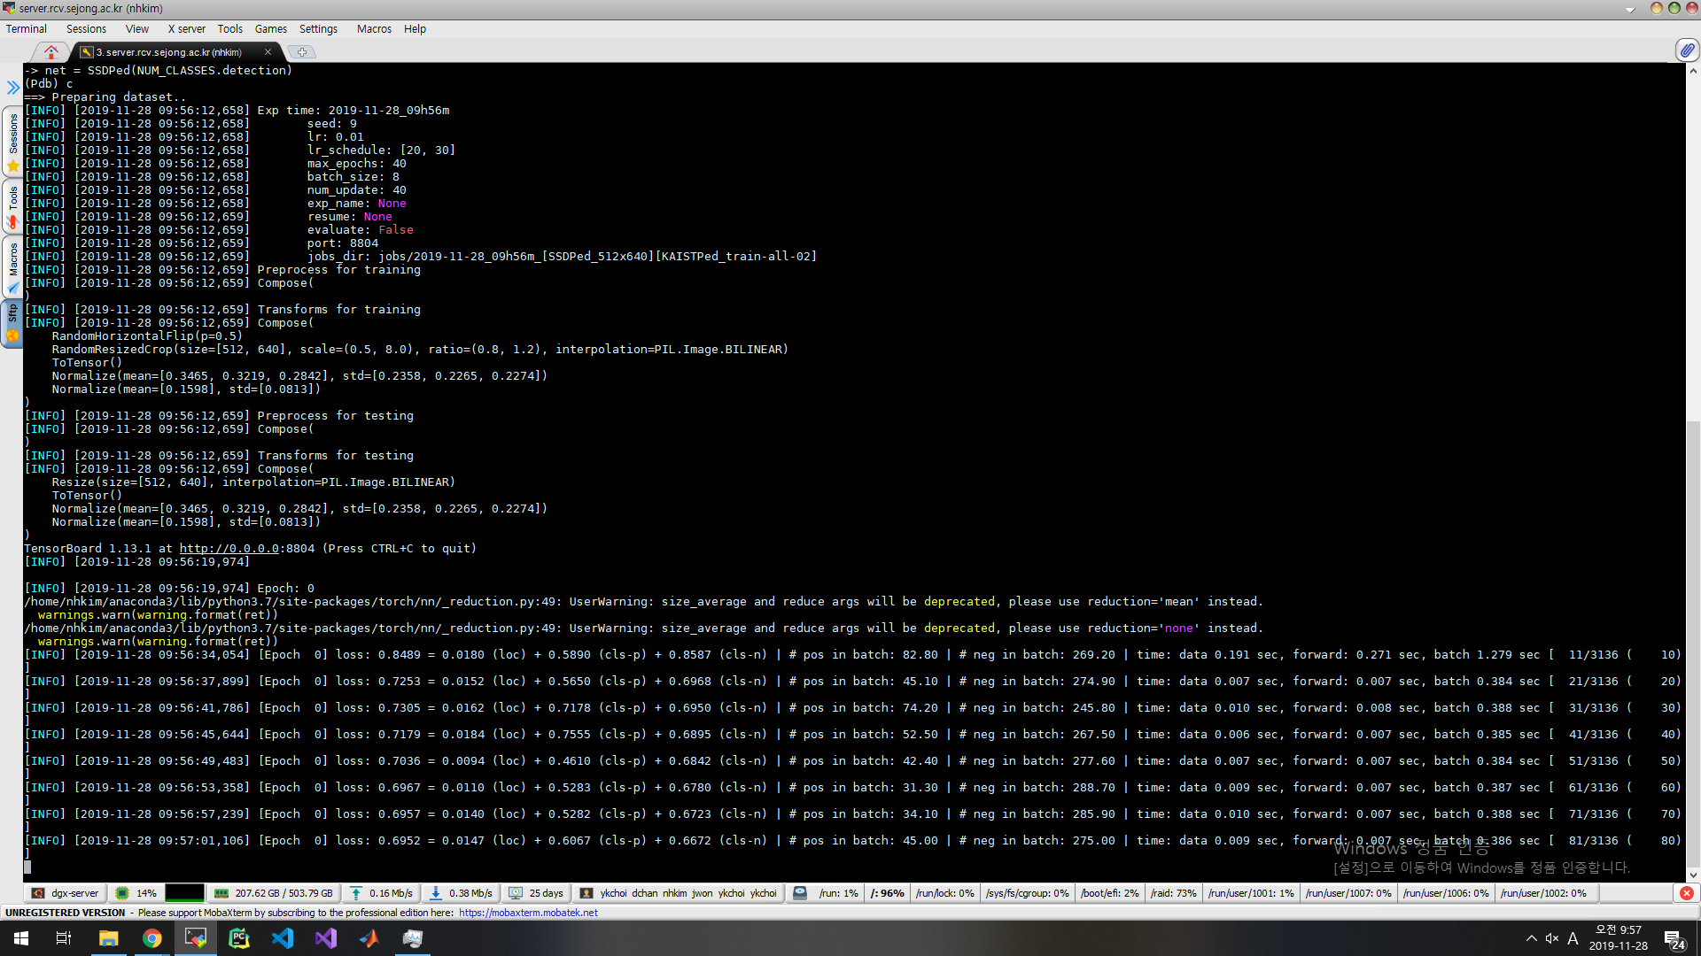
Results - SSD

Slide 14
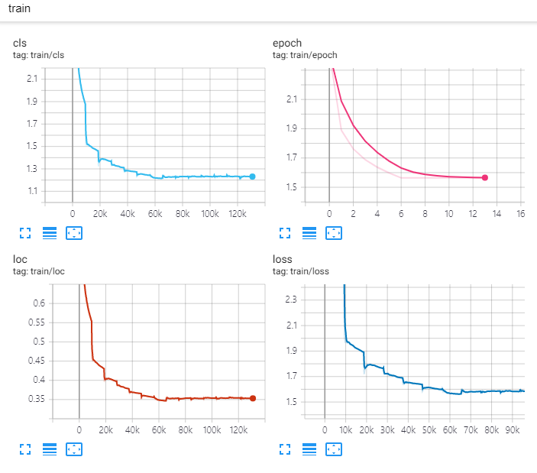
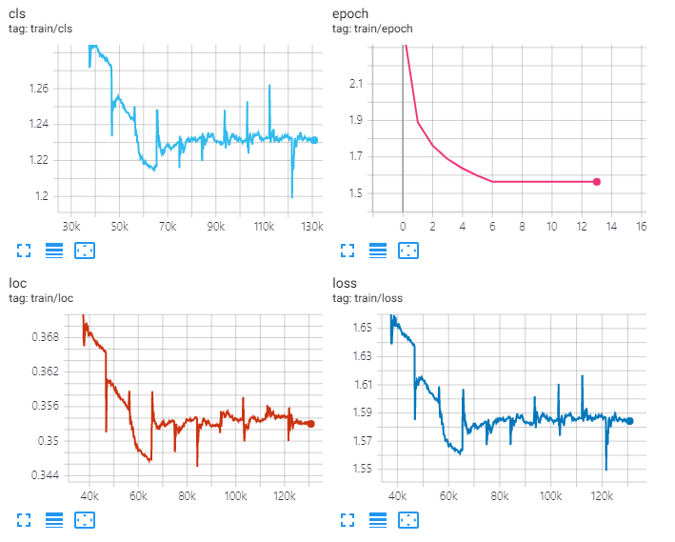
Results - SSD

Slide 15
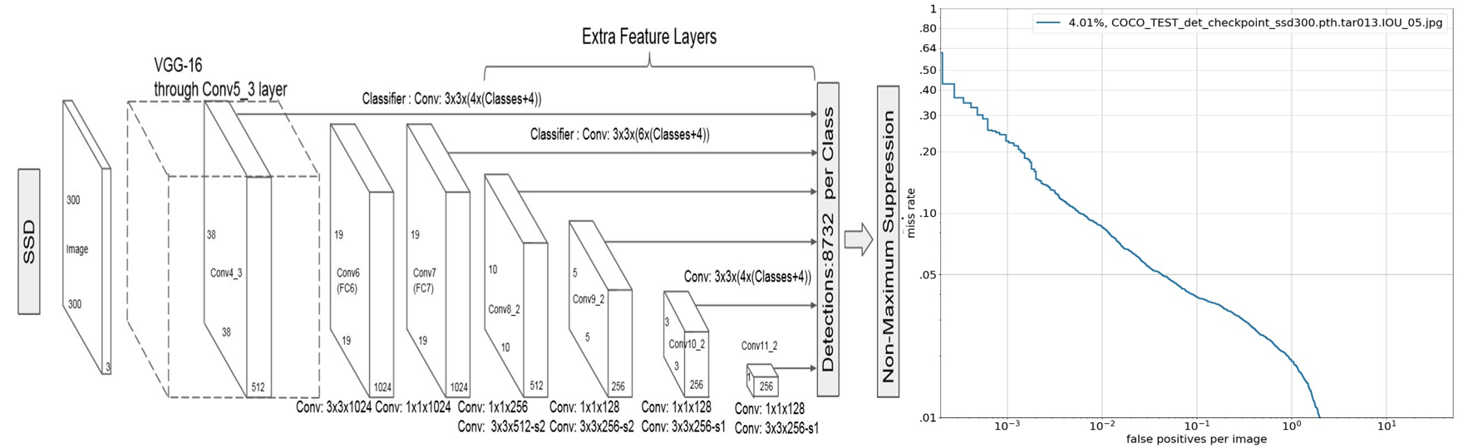
Results - SSD

Slide 16
Reference
[KAIST Multispectral Pedestrian Detection Benchmark] (https://soonminhwang.github.io/rgbt-ped-detection/)
[Faster R-CNN: Towards Real-Time Object Detection with Region Proposal Networks] (https://papers.nips.cc/paper/5638-faster-r-cnn-towards-real-time-object-detection-with-region-proposal-networks.pdf)
[You Only Look Once: Unified, Real-Time Object Detection] (https://pjreddie.com/media/files/papers/yolo.pdf)
[ECCV 2016, SSD: Single Shot MultiBox Detector] (http://arxiv.org/abs/1512.02325)

