Slide 1
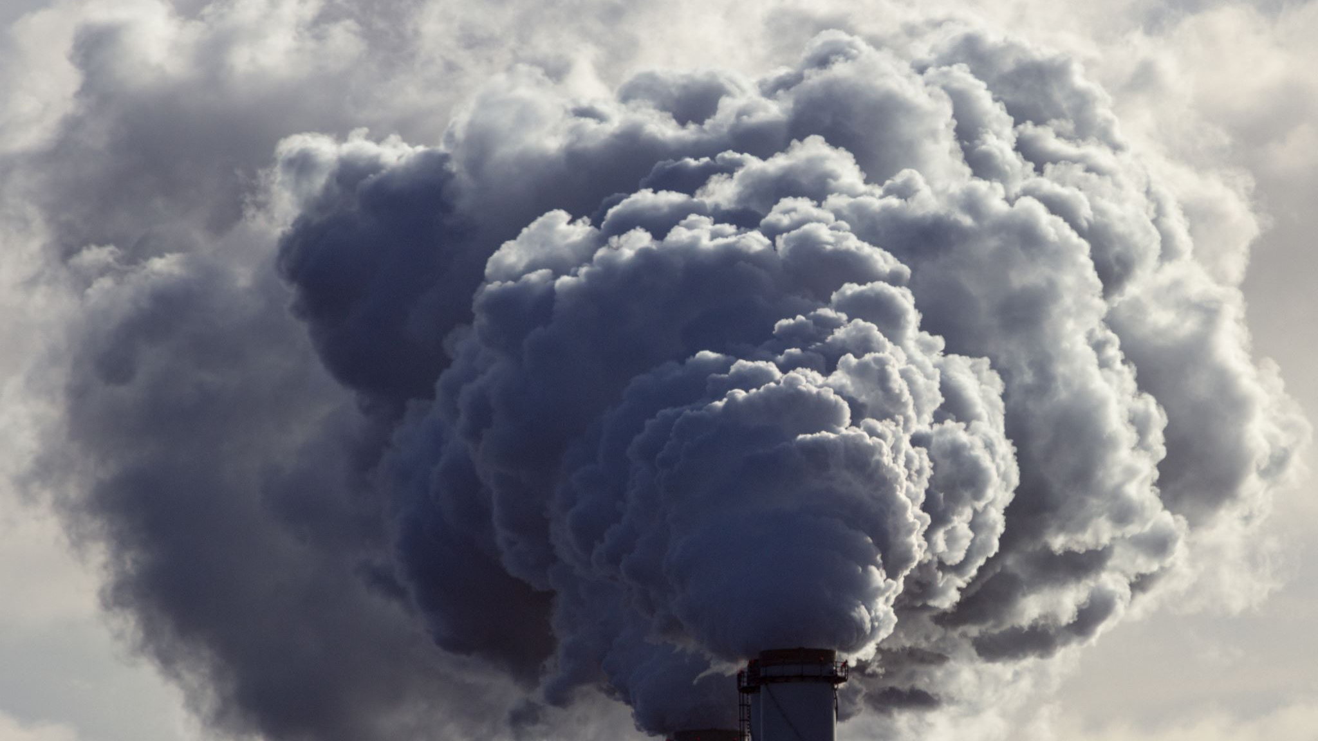
Electric Car Emissions
Group 4 Members: Zachary Evans, Yonas Michael, Nhan Le, and Megan Williams

Slide 2

Questions Asked
Is Electric Vehicles popular?
Has the introduction of electric cars brought on a decrease in emissions overall?
What impact does a switch to alternative fuel vehicles have on overall emissions from vehicles nationally?
How do electricity sources effect emissions from electric vehicles?

Slide 3
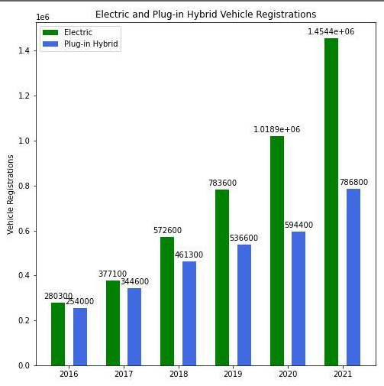
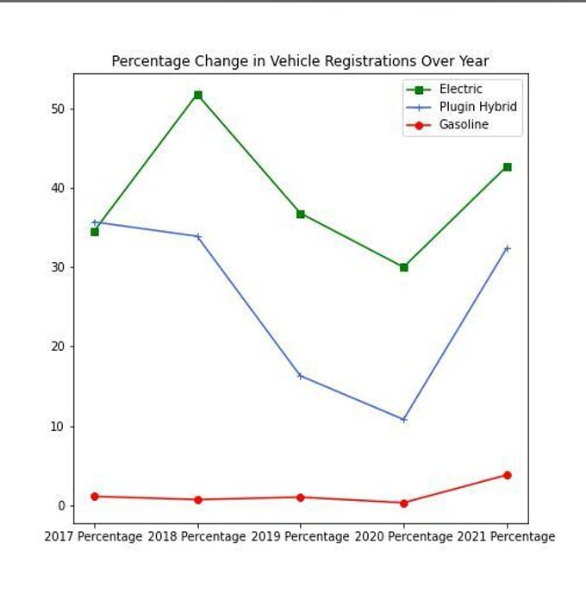
The Rise of the Electric Car
Over the past decade Electric Car technology has become more accessible and affordable
Notes:
The rise of the electric car and all its variations(EV,PHEV, HEV): the technology and the times have finally caught up to each other. The technology is manufactured and mass produced to where acquiring an electric vehicle isn't a back breaking purchase anymore; and can be even possibly stylish. The threat of global warming has made customers more environmentally conscience; leading to more lifestyle decisions towards an electric vehicle.

Slide 4
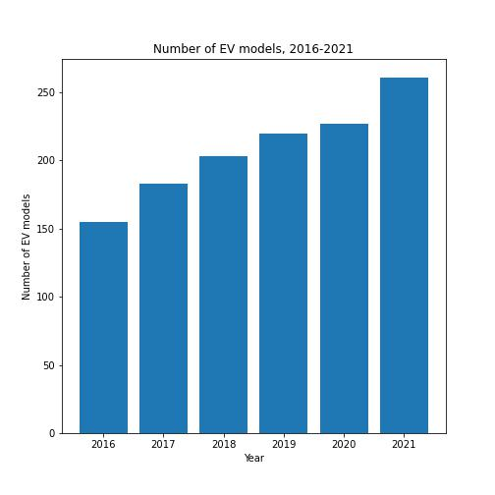
The Rise of the Electric Car
Notes:
Figure above shows the percent change of number EVs is a lot higher than regular cars; they’re growing at faster rate but regular gasoline vehicles still out number electric vehicles clearly

Slide 5
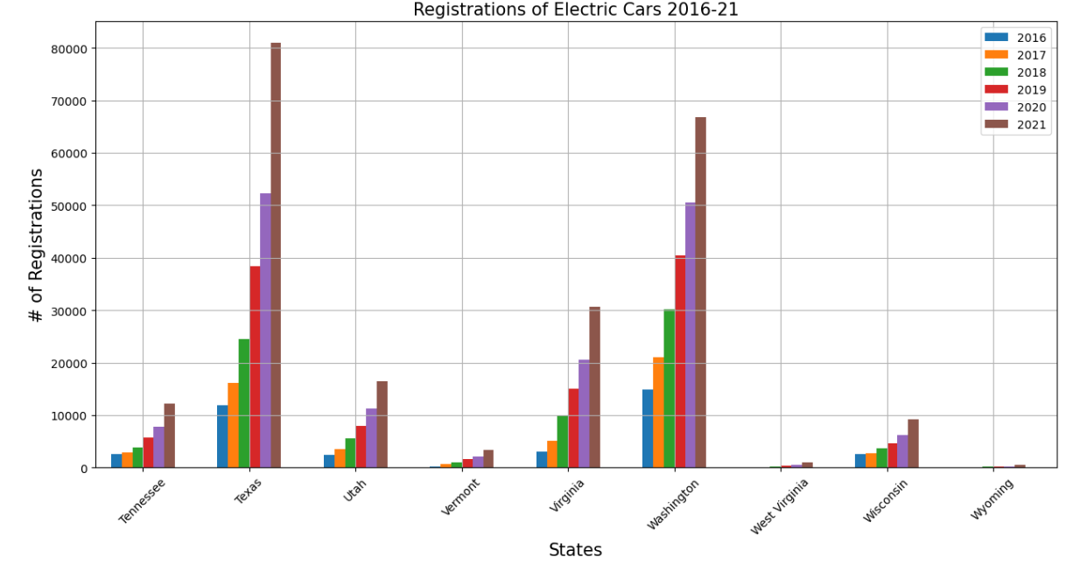
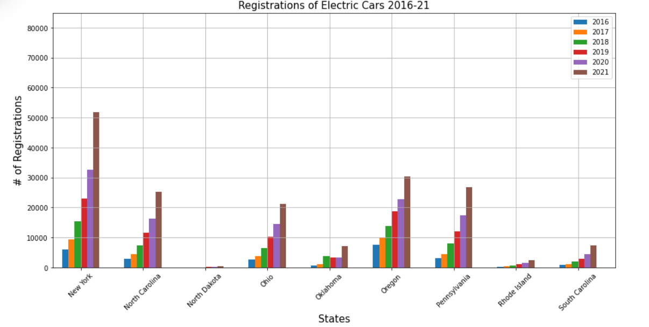
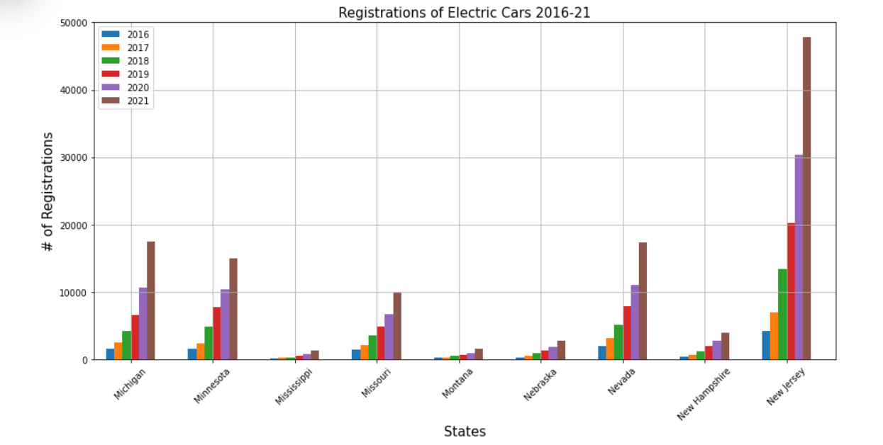
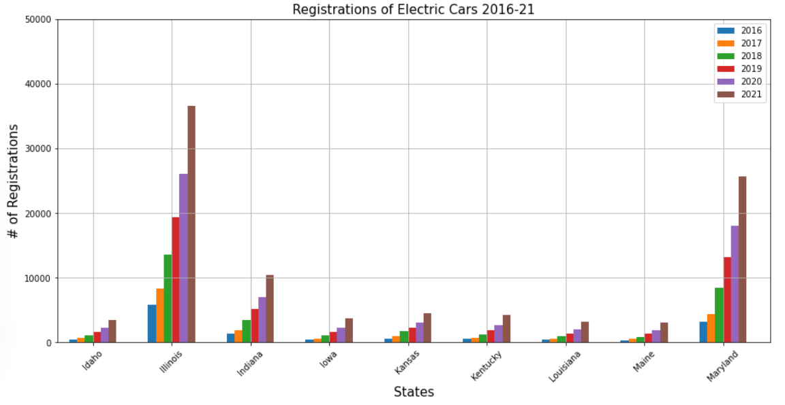
Have Electric Cars made a difference in overall emissions?
Notes:
Building on Le’s analysis Here on 36 states showing the trend of the Electric Vehicle, regardless of size of state EVs are growing

Slide 6
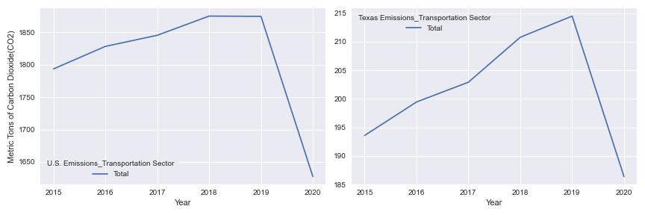
Have Electric Cars made a difference in overall emissions?
Notes:
The rise of EVs has brought a about less emissions to the transportation sector, the emissions don't start declining until 2019; possibly the number of EVs are now sufficient to make a difference in CO2 emissions. However, something to contest this claim can be the effects of the pandemic as well

Slide 7
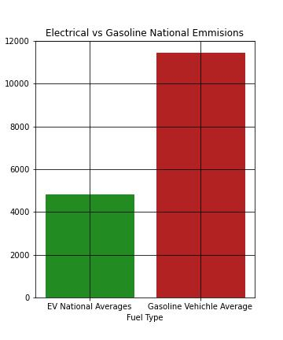
Carbon Dioxide Emissions (Annually)
Overall, the Electric Vehicle emissions is nearly half of gasoline vehicle emissions
Notes:
Overall the Electric Vehicle emissions is nearly half of it gasoline vehicle emissions

Slide 8
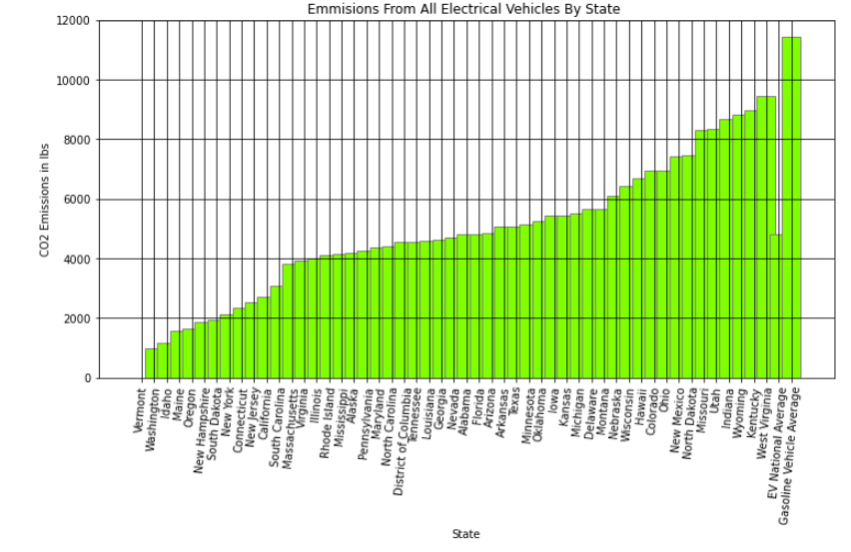
Carbon Dioxide Emissions

Slide 9

What is Well-to-Wheel (WTW) Analysis?
A well-to-wheel analysis looks at the vehicle environmental impacts AND the impacts of the process of extracting the fuel (oil, coal, etc.) used to power the vehicle's engine.
For EV, the well-to-wheel analysis includes
fuel used in power stations to recharge battery his analysis illuminates the advantage the EVs
Fuel may be derived from high emission sources (Coal and Natural Gas) or renewable resources
To answer our question thoroughly, we must take a closer look at electricity sources

Slide 10
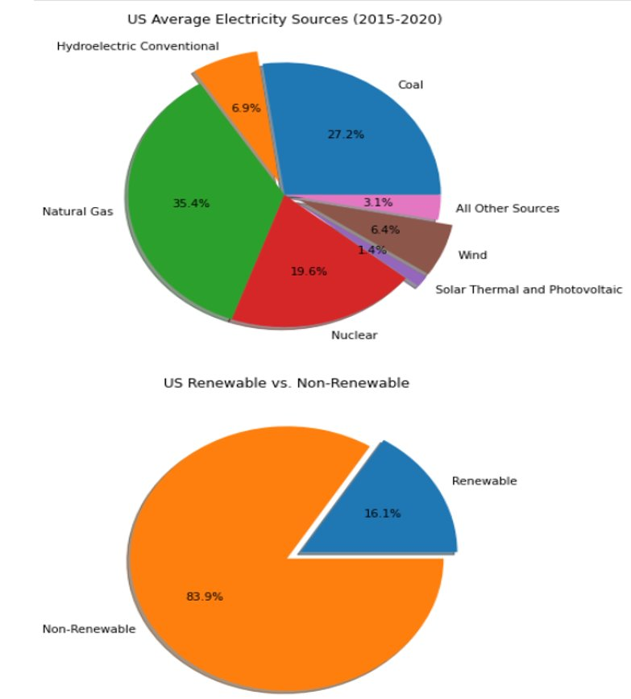
National Electricity Sources
Non-Renewable: Natural Gas, Coal, Nuclear, Other Sources
Renewable: Hydroelectric Conventional, Wind, Solar, Geothermal

Slide 11
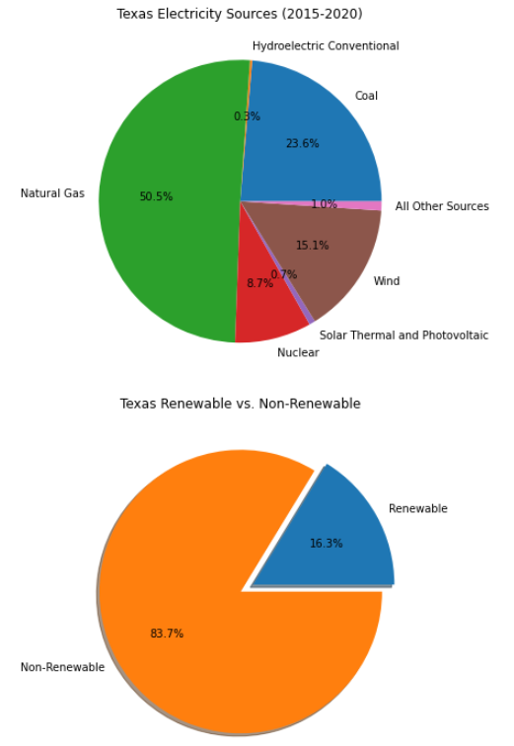
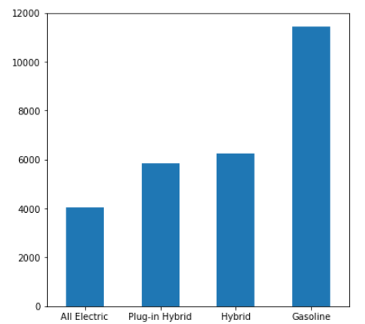
Texas: Electricity Source and WTW
Pounds of CO2 Equivalent

Slide 12
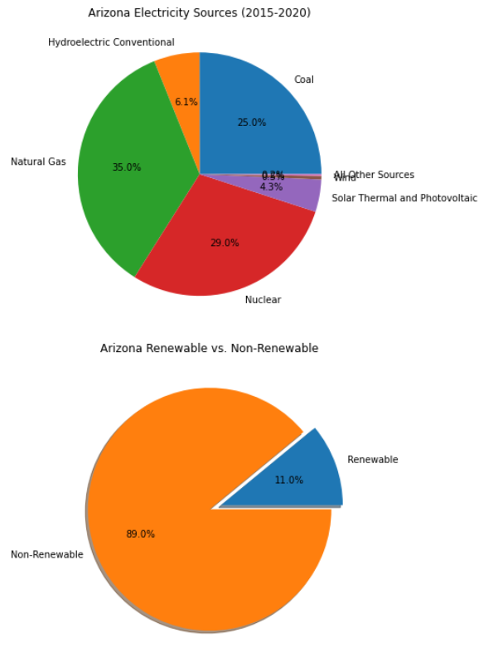
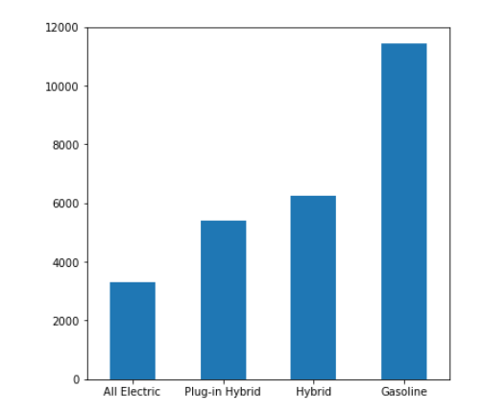
Arizona: Electricity Source and WTW
Pounds of CO2 Equivalent

Slide 13
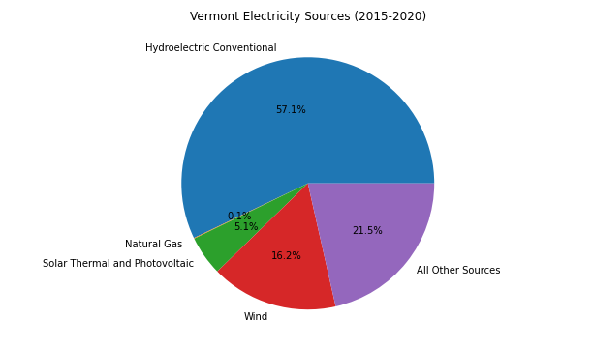
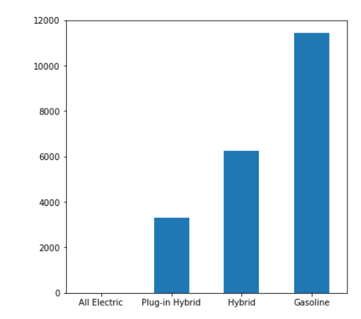
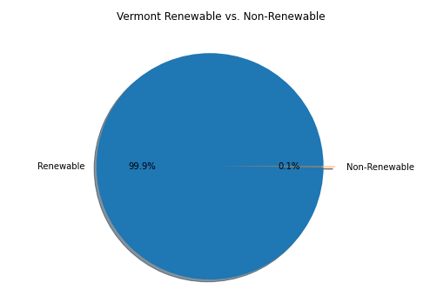
Vermont: Electricity Source and WTW
Pounds of CO2 Equivalent

Slide 14
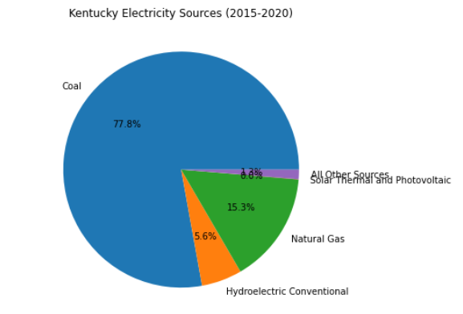
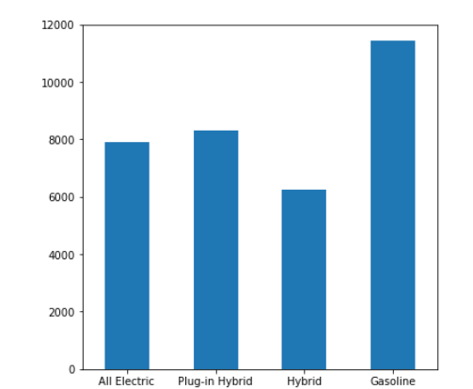
Kentucky: Electricity Source and WTW
Pounds of CO2 Equivalent

Slide 15
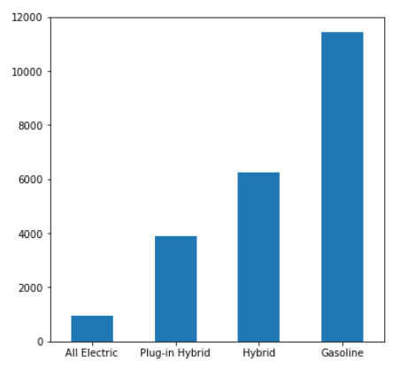
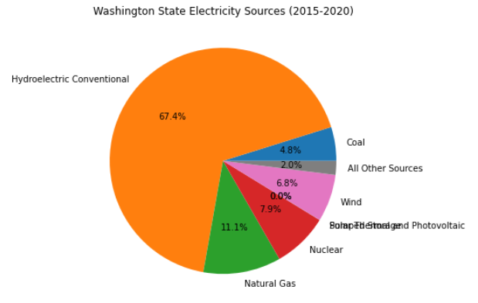
Washington: Electricity Source and WTW
Pounds of CO2 Equivalent

Slide 16
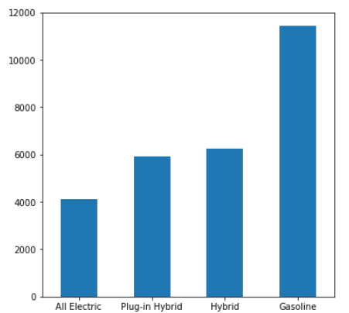
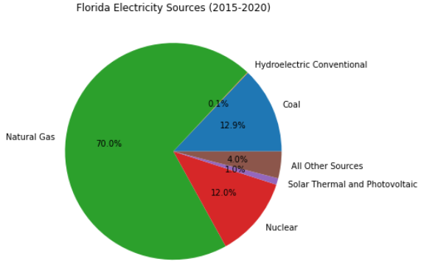
Florida: Electricity Source and WTW
Pounds of CO2 Equivalent

Slide 17
How We Got Our Data
We searched government agencies dealing with the environment for majority of our data
Links to our data:
Alternative Fuels Data Center: Vehicle Registration Counts by State (energy.gov)
Historical State Data (eia.gov)
State EV Registration Data – Atlas EV Hub
Alternative Fuels Data Center: Emissions from Electric Vehicles (energy.gov)

Slide 18
Limitations:
Limitations:
During the project, datasets on particular topics were scarce. Evidently, we did stray away from the initial proposal questions, due to insufficient datasets. Datasets on the production of electric car, from start to finish, and what emissions are involved in the production of the cars as well as the battery could not be found.

