Slide 1
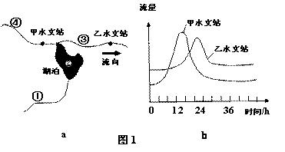
Thank you for using PHPPresentation!

